Slide 1



EV Range Predictor
AI-Powered Electric Vehicle Range Prediction

Slide 2

Learning Objectives
Understand factors influencing EV driving range
Learn ML workflow: EDA → Model Training → Evaluation
Build an accurate range prediction model
Integrate AI for insights and user interaction chatbot
Develop a Streamlit-based EV prediction web app
GOAL
Source :
www.freepik.com/

Slide 3









Tools and Technology used
Python – Core language for data analysis and ML
Pandas, NumPy – Data preprocessing and manipulation
Matplotlib, Seaborn – Data visualization
Scikit-learn – Machine learning model development
Joblib – Model saving and loading
Jupyter Notebook – EDA and experimentation
HuggingFace API + DeepSeek-V3.2 – AI assistant integration
Streamlit – Web application interface

Slide 4
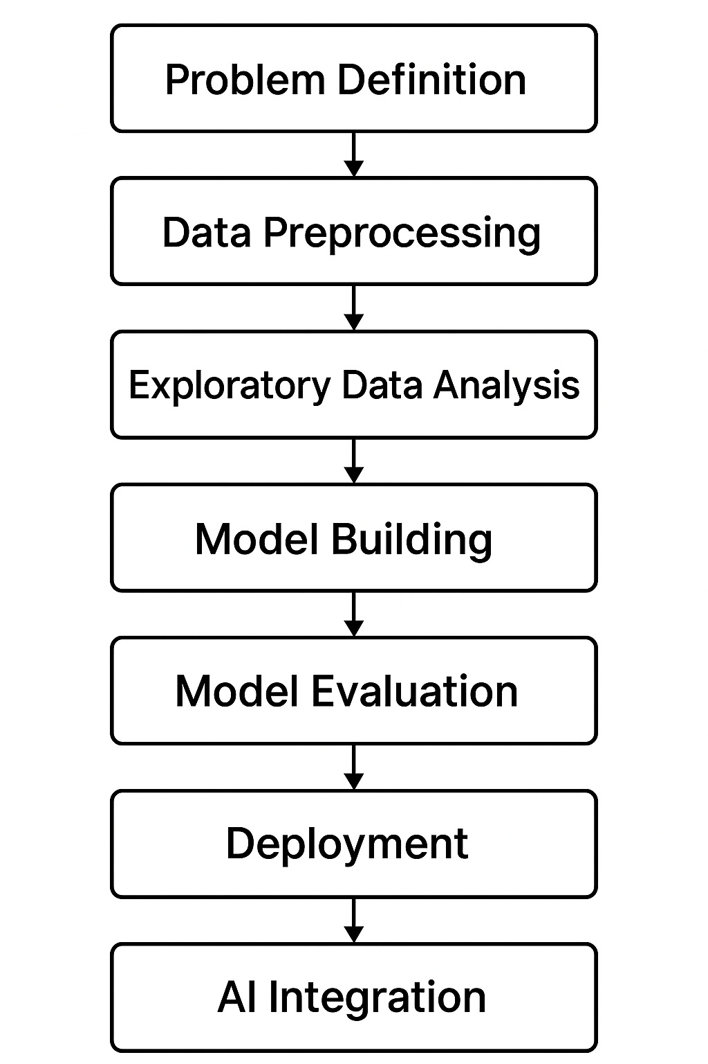
Methodology
Problem Definition – Predict EV driving range using specifications
Data Preprocessing – Cleaning, feature selection, and encoding
Exploratory Data Analysis – Understanding patterns and correlations
Model Building – Training Random Forest Regressor
Model Evaluation – MAE, RMSE, and R² performance assessment
Deployment – Streamlit-based interactive prediction app
AI Integration – Adding DeepSeek-powered insights and chat assistant

Slide 5

Problem Statement:
Electric vehicle buyers often face range anxiety due to uncertainty in real-world driving range.
EV range depends on multiple changing factors like temperature, terrain, battery health, and driving style.
Manufacturers provide a rated range, but actual performance varies significantly, making decision-making difficult.
There is a need for a data-driven, accurate, and user-friendly system that can predict EV driving range and offer intelligent insights.

Slide 6

Solution:
Performed complete data cleaning, preprocessing, and feature engineering
Developed a model for accurate EV range prediction
Integrated AI (DeepSeek-V3.2) to provide insights and recommendations
Added preset examples and clean UI for better user experience
Built a user-friendly Streamlit web app for real-time predictions
https://github.com/chandan-911/Electric-Vehicle

Slide 7
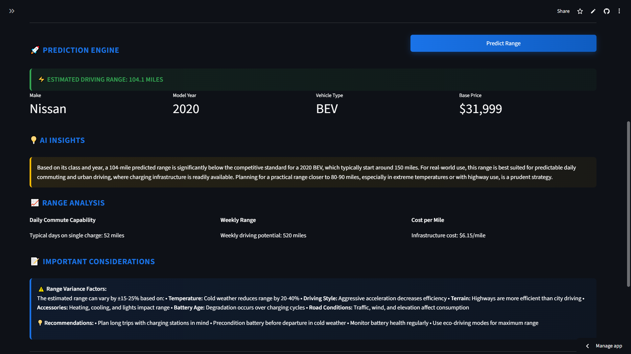
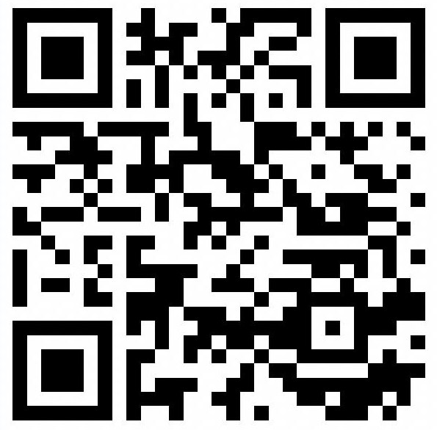
Screenshot of Output:
Try this:

Slide 8
Conclusion:
The project successfully predicts EV driving range with high accuracy
Combines ML and AI to enhance user understanding and decision-making
Provides an interactive, easy-to-use Streamlit application
Demonstrates the potential of AI-driven tools for better EV analysis
Can be extended with more features like using real-time data for better and real time prediction of range

Slide 9


