Slide 1
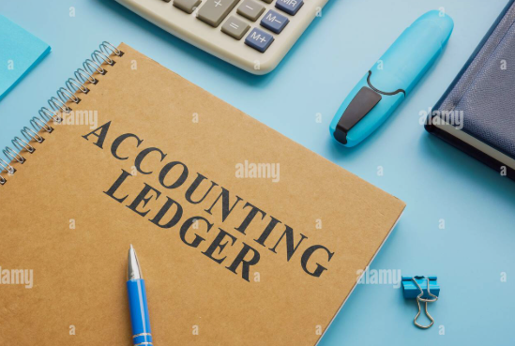
Chapter Five

Slide 2

At the end of this chapter, we will be able to
explain the idea and importance of ledger as a permanent book
classify the types of ledger
detect the differences between Journal & Ledger
identify the balances by preparing accounts through ‘T’ and ‘Moving balance’-format
analyze the significance of debit & credit balance of ledgers.

Slide 3
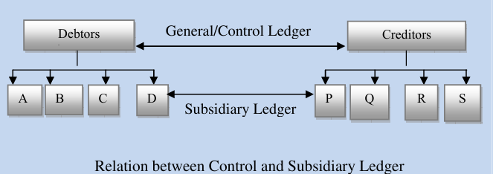
Ledger
After the recording of transactions primarily it’s necessary to transfer these to the concerned heads of account following the classification of accounts.
Ledger assembles the scattered purchase, sales and other income and expenses and helps in ascertaining total purchase, total sales and other total income & expenses.
To know about the balances of accounts and to testify their arithmetic accuracy along with having a primary about the total condition of the business are included in this chapter.

Slide 4
Concept of ledger
A Ledger is the principal book or record in accounting where all financial transactions are classified, summarized, and maintained.
If Items are displayed serially and classified properly it can be located and the amount can be obtained easily. After recording transactions in journal are entered into the ledger serially and classified manner permanently.
It is not possible from journal to know about the total result and financial condition of a business. In a ledger the same type of classes of accounts are recorded in different heads of accounts.

Slide 5

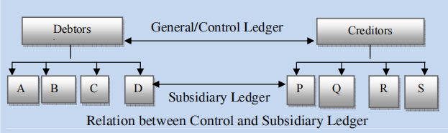
Types of Ledger

Slide 6
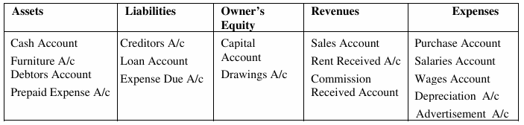
Features of ledger
Features:
Each account is given a title
Moving Balance Method and T format are used for keeping ledger
Balance of each accounts are identified individually
In preparing ledger journal acts as a helping book. Journal folio no. is mentoned at the time of recording to Ledger.
Balance of Ledgers help to verify the arithmetical accuracy of keeping accounts
Trial Balance is prepared with the balance of Ledgers.

Slide 7
Importance of ledger
Since transactions are properly arranged in a sequence to accounts, users can easily access their desired information from the ledger.
It’s possible to get idea about the total amount of assets, liabilities, income and expenses of a business from the ledger.
For the purpose of preparing trial balance, the balances of ledger are used and as such arithmetical accuracy is confirmed.
The necessity and importance of ledger is amplified by saying that ‘Ledger is the king of all books of accounts’.

Slide 8
Distinguish between Journal and ledger
Journal and ledger both belong to the steps of accounting cycle. Ledger by comparison is more important and useful than journal. Keeping journal is optional while compulsory for the case of ledger. Apart from the arithmetical accuracy of accounts the ledger reflects the financial results and condition of a business.
There are differences between the tables of a journal and a ledger. In a journal only the debit and credit side of transaction is identified where as in a ledger balance of each accounts are identified by comparing total debits and total credits.
For preparing the ledger properly and accurately journal acts as a supplementary book.
Journal is chronological (by date) whereas ledger is by account category.

Slide 9
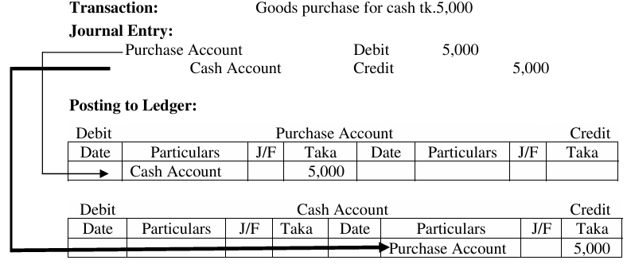
Posting in ledger
Looking at the posting, as purchase account is debited in journal, it is posted to the debit side of the purchase ledger, but in the particulars column the opposite credited head name i.e. Cash account is mentioned.
On the other hand, Cash accounts is credit so it has been posted to credit side of Cash ledger but the particulars column is represented in the name of debit side account i.e. Purchase account. With these it is identifiable that purchase account is debited by which account, while cash account is credited by which account.

Slide 10

Therefore, the debit side posting of an account in a ledger will be recorded in the name of its subsequent account into the particular column vice versa.
Balancing in ledger
Balancing of Accounts During the time of preparing a ledger, the first step is posting and the next step is balancing.
In general, terms the word balancing means what remains. For example: 5 kg of rice purchased and 3 kg of which have been consumed so the remaining is 2 kg.
Ascertaining the balance of an account is almost like this. The difference between the posted amount in debit and credit side of the accounts is known as balancing.

Slide 11
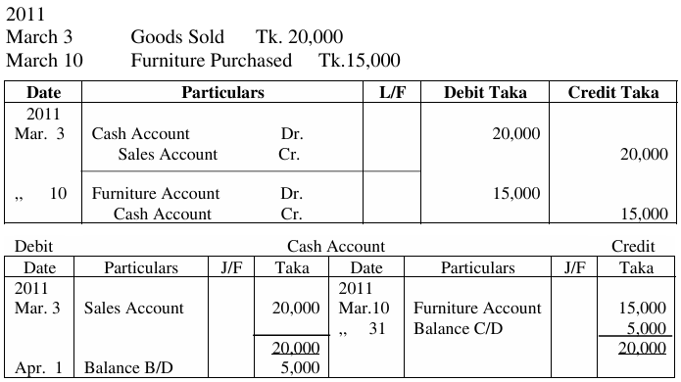
Balancing in ledger

Slide 12
Balancing in ledger
The debit and credit side summation must be equal. So, the amount which is higher must be recorded on either sides of the accounts, In the above account the debit side indicate the higher amount (20,000) and hence has been written on both debit and credit side.
Underneath the summation of each side the accounts must be closed by drawing two parallel lines.
Generally at the end of a specific time the difference between the debit and credit side is ascertained. The difference is then headed by balance C\D i.e. carried down and putting it in the lower side both side equaled. The above account is for the month March, so the difference is calculated at the end 31st March.
Balance c/d at the end of a particular period will be posted to the opposite side of the account mentioning Balance b/d i.e. brought down at the beginning of a next period.
The balance represents the higher amount it indicates. for example- the above cash account indicate debit balance, so on the 1st April Balance b/d is written on the debit side of Cash account and the ledger of April has been opened.

Slide 13
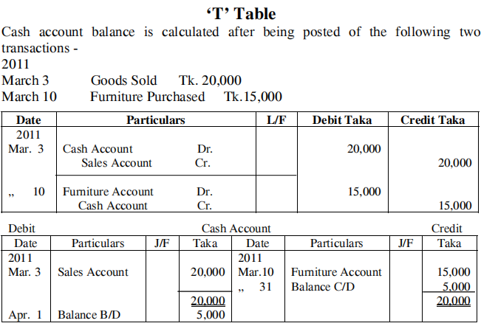

Slide 14
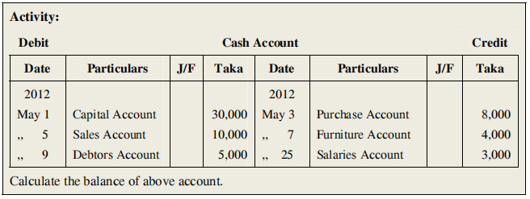
Exercise:

Slide 15
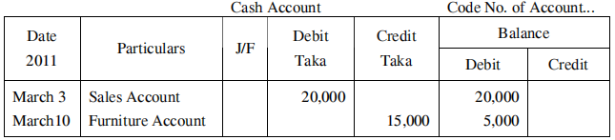
‘Moving Balance’ - Table
In moving balance method for ascertaining the balance no particular date is required. The balance is calculated just after each posting.
There are separate columns for showing the balance in the moving balance method.
Accounts Posting | Balance of Accounts
Debit Posting | Debit Balance +
Credit Posting | Debit Balance -
Credit Posting | Credit Balance +
Debit Posting | Credit Balance -

Slide 16
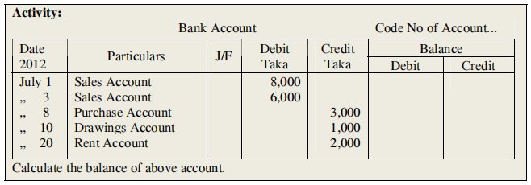
Exercise:

Slide 17
Classification of Accounts | Balance of Accounts
Assets | Debit Balance
Liabilities | Credit Balance
Equity | Credit Balance
Revenue | Credit Balance
Expense | Debit Balance
General/ Normal Balance of Accounts

Slide 18
Exercise: 1
Preparing of Ledger from General Journal on 1 February 2026 Mr. Shahin started a business with capital of Tk. 1, 00,000.His transactions for the month were
Feb. 2 Furniture purchase Tk.20, 000.
,, 3 Goods purchased on credit Tk. 30,000.
,, 5 Goods sold Tk. 25,000
,, 8 Purchase returns Tk. 2,000.
,, 12 Tk.10,000 paid to creditor.
,, 18 A bank account opened by depositing Tk. 15,000.
,, 22 Goods sold and received a cheque. Tk. 8,000
,, 25 Goods Purchased from Shafiq by cheque Tk. 6,000.
,, 28 Salaries paid to the employees Tk. 5,000.

Slide 19
Exercise: 2
Post the following Transactions into the ledger account and balance the accounts
of Rumana Akter.
2026
August 1 Sold goods on credit Tk.15,000.
,, 2 Loan has taken of Tk.30,000.
,, 6 Deposited in the Bank Tk.10,000.
,, 8 Purchased goods returned Tk.2,000.
,, 12 Cash Tk.6,000 received from debtor.
,, 15 Withdrawn cash from Bank for personal use Tk.1,000.
,, 20 Goods purchased by cheque Tk.4,000.
,, 25 goods sold Tk.12,000.
Divided into two groups, one follows ‘T’ and other ‘Moving Balance’ method.
Match the balances with one another.

Slide 20
Exercise: 3
Post the following Transactions into the ledger account and balance the accounts of Mr. Rakib.
On 1st July 2011 Mr. Rakib started a business with cash tk.30,000 and goods worth tk.15,000. Other transactions were ,
July 2 Sold goods for cash Tk.20,000.
,, 3 Furniture Purchase 5,000 Taka.
,, 5 Tk.3000 deposited into Bank.
,, 10 Goods purchased Tk.7,000.
,, 15 Withdraw Tk.1,000.
,, 20 Salaries Paid to the employees Tk. 2000.

Slide 21
Exercise: 4
On March 2026 the transactions of Selim and Co. were :
March 1 Started business with cash tk.50,000
March 3 Opened an account into bank by depositing tk.15,000
March 5 Goods purchased on credit tk.20,000
March 7 Furniture purchased tk.10,000
March 10 Goods sold tk.30,000
March 12 Paid to creditors by cheque tk.12,000.
a) Pass the journal entries for the transactions of March 5 and 12.
b) Prepare Cash account, Bank account, Purchase account, and Creditors account from the above transactions of Selim and Co.

Slide 22
Exercise: 5
On 1st June 2025 Abu Taleb Sarker started a business with a capital of
Tk.20,000. His transaction for the month were
June 1 Furniture purchased Tk.5,000
,, 3 Commission received Tk.1,000
,, 4 Goods purchased on credit Tk.8,000
,, 7 Goods sold to Azad for cash Tk.6,000
,, 9 Goods purchased Tk.4,000
,, 11 Cash paid to creditor Tk.3,000
,, 16 Advertisement expenses paid Tk.2,000
,, 26 Stationary purchased Tk.500.
,, 28 Goods sold Tk.7,000
a) Pass the journal entries for the transactions of March 4 and 11.
b) Prepare Cash account, Sales account, Purchase account, and Creditors account from the above transactions .

Slide 23
Exercise: 6
Mr. Shahid is a businessman. He has a nursery at Ashuliya of Savar. He produces different types of sapling of flowers, fruits, and medicated trees.
On July 2026 the following transactions occurred in his business :
July 05 Trees and seeds purchased from Rahim tk.25,000
July 10 Sold to Rashed & Co in cash tk.37,000
July 19 Trees returned tk.2,500
July 30 Salary paid to employee tk.4,500
July 31 Advertisement expense tk.1,500
a) Pass the journal entries for the transactions of July 05 and 10.
b) Determine the balance of cash account, purchase account, and purchase return account using ‘T’ ledger format.
c) Prepare Rahim account, sales account, salary account and advertisement account using ‘Moving Balance’ ledger format.

Slide 24
Thank You

