Slide 1
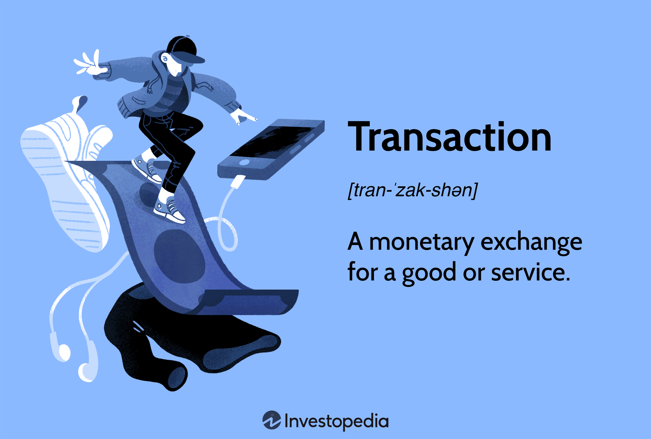
Chapter Two

Slide 2

Transaction
Many events occur in business. However, not all these events can be recorded in the book of accounts. Only the events that are measurable in terms of money or something
that brought changes financial position are to be treated as transactions. For example, suppose Mr. Simanto bought an almirah with 5000 taka, again got himself injured coming from the shop. Both these incidents are events. Only the first one is related to financial change and treated, as transaction but the later has no relation to the financial matter and such should not be recorded as transaction.

Slide 3
Transaction
Without the cash or credit, purchase or sales there can be other exchange of services that lead to transaction. For example, salary paid to Mrs. Mahbuba for her job or received 3000tk because of rent. This is also a transaction. Again, invisible events can also be a transaction. For example, assets used for a long time thus the value depreciation can also be a case of transaction.

Slide 4

Features of Transactions
Measurable in terms of money: One of the important features of a transaction is that it has to be measurable in terms of money or else it could not be treated as transaction.
For Example: For example, the death of manager of a firm is loss to the firm but is not measurable in terms of money. However, goods destroyed by fire worth 20,000 taka are a loss to the firm and will be treated as a transaction.
1
2
Changes of financial condition: If any event brings any financial changes of a firm, it will be treated as a transaction.
For Example: business has been increased by 5000 taka at the same time cash 5000 taka has also been decreased.
3
Dual entity: Every transaction must include two parties. That is one party will receive benefits while the other will ensure the same.
For example – salaries paid to the workers taka 5000. Here one party is the salary expense
account while the other one is cash account.
4
Impact over accounting equation: Each transaction leaves a direct impact over the accounting equation. The items of transactions are affected by accounting equation. “Asset= Liabilities+ owner’s Equity” this accounting equation.
5
Historical event: The financial matters that have taken place previously are known as historical transactions. Again, some events that may take in future are also known as transaction. If any future events change the financial position of the business, it will also be treated as transaction.
For example – reserve for bad debts, reserve for discount etc.
6
Complete and independent: Another important feature of transaction is that each transaction is completely separate and independent from the others.
For example – goods sold on credit taka 10,000 and the payment of which is received after 7 day. Here goods sold on credit are a transaction while 7 days later the payment received is a separate account.

Slide 5
Transaction
Literally, the meaning of the word transaction is to ‘give’ and ‘receive’ or give and take. In every transaction, there is one recipient of benefit while the other provides benefit. For example – Ratan gave Manik tk.1,000. With this, we see two parties. Ratan gave tk.1000 while Manik received the same.

Slide 6
Transaction
Again, invisible events can also be a transaction. For example, assets used for a long time thus the value depreciation can also be a case of transaction.
Exchange of money or money’s worth any event or service that reflects on the financial condition of a firm will be treated as transaction.

Slide 7

Identifying transaction:
Which events are transactions and which are not is explained by the following examples-
In the business of Mr. Sohail, the following events took place-
Mr. Sohail started business with tk.50,000.
He purchased goods with cash tk.15,000.
He has paid one of his creditors tk.10,000.
He has placed an order for purchasing goods worth tk.8,000.
Made an expense for advertisement worth tk.2,000.
Mr. Mamun has appointed as manager in business for a monthly salary tk.7,000.
Withdrawn from business for his personal use tk.3,000.
Tk.500 has stolen from his personal fund.
Agreed to purchase goods from Hashem Brother’s worth tk.10,000 per month.
Sold goods to Hanif on account tk.10,000.
Whether these events are transaction or not explained with reason-

Slide 8
Identifying transaction:
SI. No | Whether transaction or not | Explanation with reason
1. | Transaction | Since cash brought in as capital it has brought a financial change and includes two parties involved in it- one the capital of the owner and the other is the cash.
2. | Transaction | Value of product is measurable in terms of money. Purchase of goods is an expense to the business, while the payment has decreased the cash amount.
3. | Transaction | Payment to the creditor has decreased both the liability as well as the cash of the business, so financial condition has been affected.
4 | Not a Transaction | Placing order for the purchase of goods does not mean actual purchase. The buying and selling of the goods have not been taken place, so it is not a transaction.
5 | Transaction | The business has taken a benefit by placing advertisement and the value paid for it has brought a financial change.
6 | Not a Transaction | Giving appointment letter to any person has not brought any financial change to the business ad it does not include any cash flow either.
7 | Transaction | The owner has taken a benefit by withdrawing amount from the business, so the cash of the business has been affected.

Slide 9
Identifying transaction:
SI. No | Whether transaction or not | Explanation with reason
8. | Not a Transaction | Loss of personal savings is not related to the business; the loss belongs to the owner alone. So the cash of the business is not affected.
9. | Not a Transaction | Has been agreed to purchase but actual purchase has not been taken place and the payment of which is neither made. So no financial changes occur in the business.
10. | Transaction | By selling goods on credit to Hanif, the business has given him a benefit, which is an income to the business. It has brought a financial change.
Accounting Equation: In a particular time, the total asset of an organization should be equal to the sum of owner’s equity and external liabilities. The equation that represents this fundamental concept is known as accounting equation.
A
Assets
L
Liabilities
OE
Owner’s Equity

Slide 10
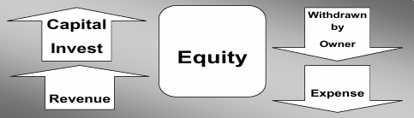
Equation Component:
Asset: Asset means the economic resources that belong to a business that is invested for making profit. For example, furniture, buildings, machineries of a business.
Liability: Liability means the financial rigidity that has to be paid up after a certain period of time. That is it is the claim of the third party over the total assets of the business.
Owner’s Equity: If the claim of the third party is deducted from the total assets of the business the rest will be known as owner’s equity. That is the claim of the owner over the entire assets of the business is known as owner’s equity. Four elements affect owner’s equity. These are:
1. Investment of owner
2. Income
3. Drawings
4. Expense

Slide 11
Extending Accounting Equation :
Extending Accounting Equation, we get -
Assets = Liabilities + Capital + Revenue - Expenses - Drawings
Means,
A = L + (C + R – E – D)
Where,
A=Assets
L=Liabilities
C=Capital
R=Revenue
E=Expenses
D=Drawings

Slide 12
Extending Accounting Equation :
The impact of transactions over accounting equation is shown in the chart-
Mr. Dipok started his legal practitioner business on January 1, 2026. The transactions of the first month were as follows:
Jan 1 Invested tk.50,000 in his business.
Jan 2 Paid the rent for the month of January tk.3000.
Jan 7 Machine purchase on credit worth tk.15,000.
Jan 10 Legal services given to the clients for cash tk.6,000.
Jan 15 Paid salary to the office staff tk.2,000.
Jan 20 Loan taken from the bank tk.20,000.
Jan 24 Legal services provided to the clients on credit tk.7,000.
Jan 29 Dues for machine purchase paid tk.10,000.
Shown the impact over accounting equation in tabular format.

Slide 13
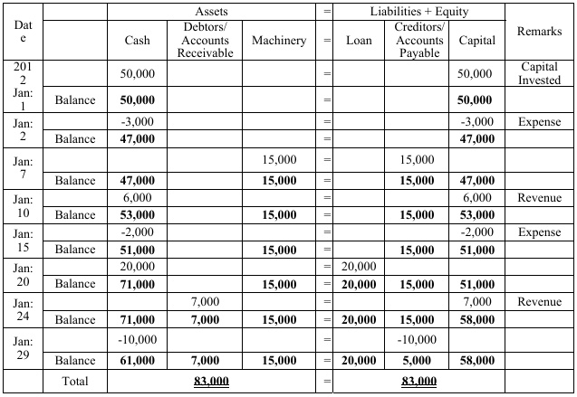
Identifying transaction:
Effects of transactions over the elements of Accounting Equation is Shown for January 2026 -

Slide 14
Identifying transaction:
Activity: Show the effect of the following transactions in Accounting Equation using the above table.
Question 1: Nargis Akter has started a tailoring business on March 1, 2026. Transactions of the first month mentioned below:
March 1 Invested in Business tk.20,000.
3 Shop rent for the month of March paid off tk.5000
9 Bought sewing machine by cash tk.15,000
14 Stitching wages realized tk. 2,000
17 Amount spent for publicity of the shop tk.1,000
22 Receivable from customer for stitching wages tk.1,500
25 Repair of sewing machine tk. 3000.
30 Bill of 22nd march realized tk.1,200.

Slide 15
Identifying transaction:
Question 2: Mr. Ashish Kumar Chokroborti is a businessman. Following transactions took place in his business in December 2025-
Dec. 1 Started business with tk.20,000
Dec. 3 Open an account in Janata Bank depositing tk.5,000
Dec. 5 Goods purchase on credit tk.5,000
Dec. 7 Goods sold in cash tk.15,000
Dec. 10 Loan taken from Bank for own purpose tk.10,000
Dec. 15 Furniture purchase in cash tk.3,000
Requirements:
a) Calculate the total amount of those events, which are not transaction.
b) Identify the transactions from events with explaining reason under equation method.
c) Show the effects of the transaction on accounting equation in tabular/statement format.

Slide 16
Identifying transaction:
Question 3: Mr. Shankar Chondro Saha is a businessman. Following transactions took place in his business in January 2026-
Jan. 2 A manager appointed with tk.5,000
Jan. 7 Sold goods on credit tk.20,000
Jan. 10 Stationary purchase in cash tk.500
Jan. 12 Mr. Shankar Chondro Saha pays his son’s school salary personally
Jan. 20 Received tk.5,000 from Sumona Traders
Jan. 25 Paid tk.700 for advertisement
Requirements:
a) Calculate the total amount of those events, which are not transaction.
b) Explain the reason of Mr. Shankar Chondro Saha’s transactions under equation method
c) Show the effects of Mr. Shankar Chondro Saha’s transactions on the elements of accounting equation.

Slide 17
Identifying transaction:
Question 4: Mr. Zakir started his legal practitioner business on 1st May 2011. The transactions
of the first month were as follows:
May 1 Invested tk.1,50,000 in his business.
May 4 Paid office rent for the month of May tk.12,000
May 8 Machine purchase for office on credit worth tk.25,000
May 12 Legal services provided to the clients for cash tk.8,000
May 16 Paid salary to the office staff tk.4,000
May 25 Loan taken from the bank tk.35,000.
May 27 Legal services provided to the clients on credit tk.10,000.
May 30 Dues for machine purchase paid off tk.15,000.
Requirements:
a) What is the unpaid amount of office machine?
b) Calculate the amount of Mr. Zakir’s equity at the end of the month.
c) Show the effects of May’s transactions on the elements of accounting equation.

