Slide 1
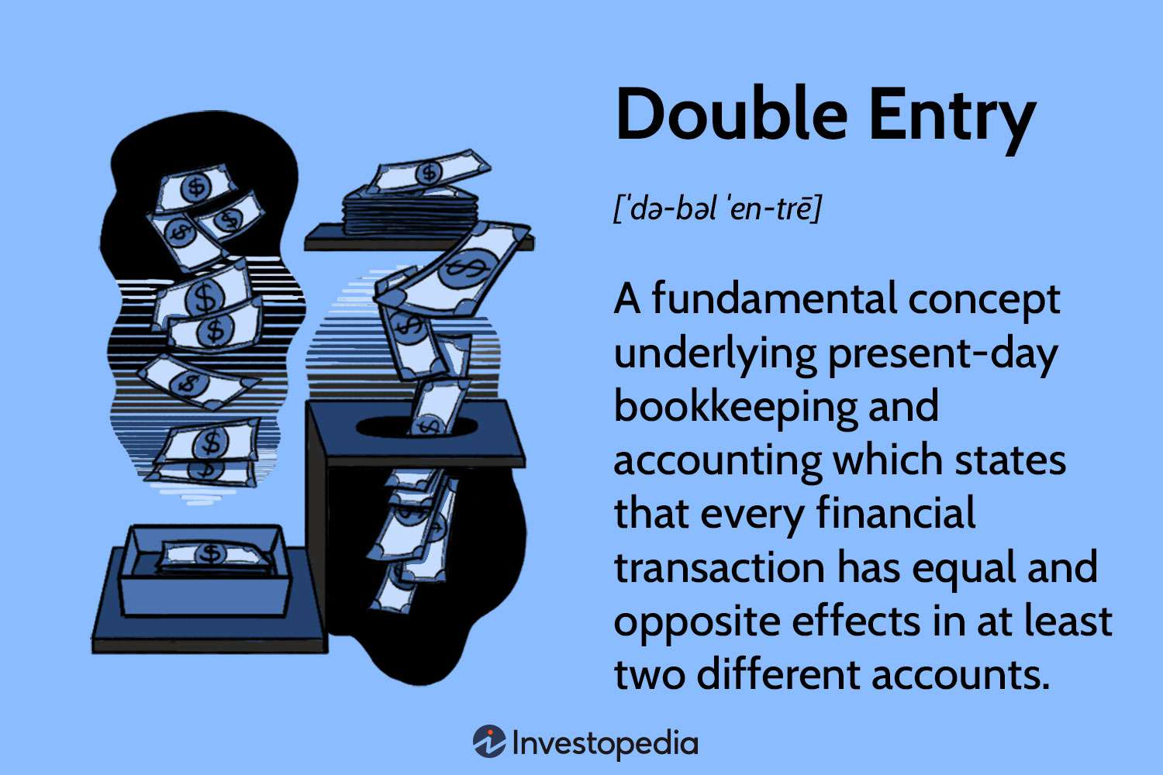
Chapter Three

Slide 2

Throughout the world, Double Entry System is established & known as dependable, scientific, and complete system for keeping accounts in the business. In double entry system each transaction that measured or measurable in terms of money is expressed in dual entity. There is no alternative method of Double Entry System to know the actual result and financial condition of business.
The concept has been explained with an example:
Salary paid to office staff tk.5,000.
For recording this transaction under double entry system, we need to identify the two parties involved in it. Two accounts involved in it are –
a) Salary Account
b) Cash Account
Since salary is an expense to the business, expense has been increase and so salary 5,000 taka will be debited. Again, cash goes out while salary is paid, so cash or asset will decrease and so cash account will be credited.
So, it is seen that the same amount have been used both for salary and cash account. This is the basic principle of Double Entry System.

Slide 3
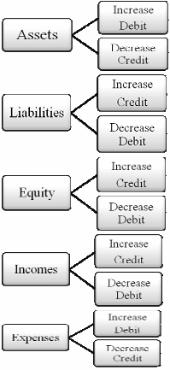
Procedure of Identifying Debit and Credit:
The main elements of accounting equation are asset, liability, and owner’s equity. The income of the business increases owner’s equity while the expense decreases the same.
Therefore, it can be said that, we see five types of accounts in business:
1. Asset
2. Liability
3. Owner’s equity
4. Income
5. Expense

Slide 4
Procedure of Identifying Debit and Credit:
Effects of Double Entry System in Transactions described below with examples:
1. Mr. Hasan has started business bringing in Tk. 50,000 as Capital.
2. Furniture bought for business Tk. 5,000.
3. Employees salary paid off Tk. 6,000
4. Goods Purchase Tk. 20,000
5. Tk. 25,000is deposited into Bank.
6. Goods sold Tk. 18,000
7. Cheque paid for advertisement Tk. 7,000
8. Commission received Tk. 3,000.
9. Interest received from bank Tk. 1,200.
10. Goods sold on credit Tk. 15,000.
11. Cheque paid for rent Tk. 6,000
12. Tk. 8,000 has withdrawn from bank for business.

Slide 5
Procedure of Identifying Debit and Credit:
Activity: Calculate the debit & credit of the following transactions identifying accounts in the book of M/S. Joya & Co. –
1. Mrs. Joya Mukharjee has made additional investment tk.20,000.
2. Computer purchase for office tk.25,000
3. Office rent paid in advance for three months tk.18,000
4. Sold to Rajon tk.25,000
5. Bank charged tk.1,500
6. Withdrawn from banktk.6,000
7. Goods purchased on credit tk.15,000
8. Wages paid tk.3,000
9. Purchase return tk.2,000
10. Deposited into bank tk.10,000

Slide 6
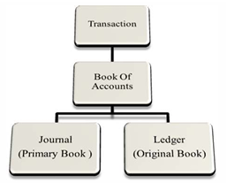
Accounts kept under double entry system:
The main accounts, which are kept under double entry system, are shown below:
Journal: After transaction occurs then it is identified and debit and credit is ascertained and men it is recorded in a book. This book is known as the primary book of account or Journal.
Ledger: The book where all the transactions of journal are included by transferring individually to related accounts with appropriate title is called Ledger.

Slide 7
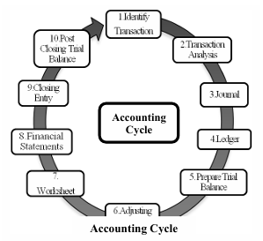
Accounting cycle:
According to ongoing concept, it is expected that the business will go on forever. The continuous cycle of keeping accounts is known as Accounting cycle.
1.Identifying Transactions: Analyzing each event, transactions are identified in the first stage of Accounting cycle.
2. Analyzing Transactions: In this stage, each transaction is
analyzed and accounts are identified. For example Machineries bought for Taka 5,000. Here two accounts are One Machinery Account and the other cash Account.
3. Journalizing: Analyzed accounts record into the primary Book of Accounts as Debit and credit chronologically and the journalizing is done.
4. Transfer to Ledger: In this stage, transactions recorded in journal are recorded into the separate heads of accounts.
5. Preparing Trial Balance: Trial balance is prepared to testify whether the transactions are recorded accurately to their concerned head of accounts and with the balances of debit and credit of ledger, a trial balance is prepared.

Slide 8
6. Adjusting Entries: To identify the actual financial condition of a business the receivable income, accrued expense, expenses paid in advance and unearned income these items of a particular accounting period are adjusted through adjusting entries.
7. Prepare Worksheet: For the objective of preparing the financial statement easier, an optional multi column statement is prepared. It is known as worksheet.
8. Preparation of Financial Statement: With the financial statement, the amount of profit-loss, assets, liability, and owner’s equity of a business is determined.
9. Closing Entry: The balance of the revenue income, revenue expense, and drawings of a business need to be closed at the end of the year. The income and expense of a business remain closed with the remaining asset, liability, and owner’s equity the next year starts.
10. Opening Journal: Income, Expense & Drawing
accounts are being closed by closing entry. Next accounting period starts with the remaining balance of Asset, Liability & Owner’s Equity accounts.

