Slide 1
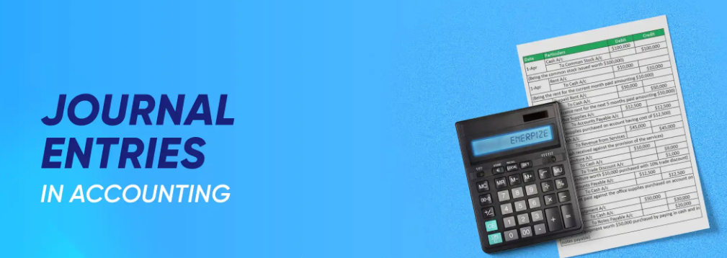
Chapter Four

Slide 2

At the end of this chapter, we will be able to
identify and importance of journal.
classify journal.
list the factors considered for general journal
provide general journal Entry.

Slide 3
After the identification of financial and non-financial events, it is necessary to
record the financial transactions in the books of accounts identifying Debit and Credit parties.
The detail of the transaction is recorded first in journal primarily. Analyzing the debit and credit side of a transaction it is written chronologically with explanation in a journal. Later on the journal is acted as the subsidiary book for the principal book Ledger. Therefore, the journal is called the primary book of accounts.
Keeping of journal is not compulsory but for the benefit of keeping records, it is
required to be kept. If transactions are kept in a journal, the chance of happening
omission of errors reduces significantly.

Slide 4
Importance of Journal
The book of accounts of an institution must be clear and faultless. The financial result and the financial position of business are calculated based on this account. For achieving these principal objectives of accounting, the role of journal is described-
Recording transactions: Many transactions take place in an organization. Transferring those immediately to the ledger may not be possible. The transactions if recorded in a journal then transferring those later on in a ledger become easier.
Knowing the total number and quantity of transactions: It is not possible from ledger to know how many transactions took place on a certain day, in a week or in a month. Since transactions are recorded chronologically in a journal, on a certain date, week or month the total number of transaction can be ascertained. It’s also possible to know the total amount of transactions in different times.
Application of Dual Entity: In double entry system transactions are recorded into concerned Debit & Credit accounts together. So, the application of dual entity can be confirmed from journal.
Explanation of Transaction: If any question arises from transaction, its explanation can be obtained from journal. Because after recording the transaction into the journal, its reasons and explanation are also provided.
Reduce error & faults: If Transactions are recorded in journal before recording to ledger, the faults and being omitted from ledger become less likely to occur.
Future Reference: In journal, transactions are arranged systematically in a chronological manner. In future, it can be used as a proof or evidence.
Helping aid to principal book: Since journal act as a subsidiary book to ledger, so preparation of ledger becomes easier, clear and faultless.

Slide 5
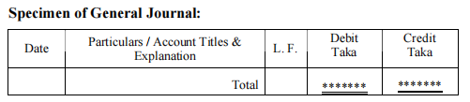
General Journal: Identifying debit and credit of transaction and recording in the journal proforma is called general journal. A transaction should always consist of a debit and credit is not applicable. Based on transactions there can be more than on debits or credits items. But it should be watched specially that the total amount of debit should equal to the total amount of credit.

Slide 6
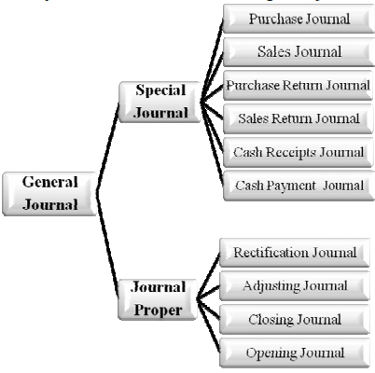
Classification of Journal:
For the benefits of accounts information users’ journal are classified under the following manner-
Special Journal
Almost all the transaction that takes place in a business
is recorded in a special journal.
Purchase Journal: All the credit goods purchases of a business are recorded in this journal.
Sales Journal: All the credit goods sales of a business are recorded in this journal.
Purchase Return Journal: Goods purchased on credit but returned are recorded in this journal.
Sales Return Journal: Goods sold on credit but returned are recorded in this journal.
Cash Receipt Journal: The transactions that include cash receipts (including goods sold for cash) are recorded in cash receipt journal.
Cash Payment journal: The transactions that include cash payments (including goods purchased) are recorded in cash payment journal.

Slide 7
Journal Proper: The transactions which are not record in Special Journal, those are include in Journal
Proper.
1. Rectifying Journal: If any mistake occurs on recording transactions, it cannot be made scrabble. The mistake is rectified by giving a journal entry. The entry which is given for the rectification of error is known as rectifying journal.
Example: Furniture purchase tk.10000, wrongly purchase account debited with tk.10,000.
Furniture Account Debit 10000
Purchase Account Credit 10000
(Wrongly purchase account was debited in place of furniture account, now rectified)
Adjusting Journal: Financial statements are prepared to determine the financial position of business. Unrecorded and unadjusted items (accrued and advance expense, unearned and receivable income, depreciation, reserve etc.) that are included at preparing the financial statements is known as adjusting entries.
Example: Prepaid Rent Account Debit
Rent Account Credit
(Prepaid rent adjusted with rent account)
3. Closing Journal: Revenue incomes and expenses of a particular year will not affect the next year’s accounts. So, during the preparation of financial statement revenue income and expenses should be closed. We have learnt in accounts chapter that the balances of income denote credit while the balances of expense denote debit balance. Beside, Drawings account is also closed by closing journal.
Example: Balance of Revenue income & expenditure accounts in 2025 of a business was Purchase 50,000; Sales 80,000; Salaries 10,000; Rent 5,000.

Slide 8
Closing Journal:
a. Sales Account Debit
Income Statement Credit
(Sales account balance closed by transferring to Income Statement)
b. Income Statement Debit
Purchase Account Credit
Salary Account Credit
Rent Account Credit
(Balance of Purchase Account, Salary Account and Rent Account closed by transferring to Income Statement)
4. Opening Journal: Business institution is a continuous process. Assets, liabilities and owner’s equity of the last year are brought to beginning of the next year, for which opening journal is made.
Example: On 31 December 2025, Cash Account tk.50,000, Furniture Account tk.30,000, Debtors Account tk.20,000, Creditors Account tk.15,000 and Capital Account tk.85,000
Cash Account Debit
Furniture Account Debit
Debtors Account Debit
Creditors Account Credit
Capital Account Credit
(Business begin in 2024 with Assets, Liabilities & Equity of 2025)

Slide 9
Factors to be considered for General Journal:
It is to be remembered that only identifying two parties is not thereby enough, besides the proper title of each heads of accounts is also important. If it is wrongly done, the real financial picture of the business will never be disclosed.
(a) No accounts will be opened under the name goods, materials, cheque etc.
Transaction Journal Entry
Goods sold Cash Account Debit
Sale Account Credit
Cheque issued for goods purchase
Purchase Account Debit
Bank Account Credit
(b) If name of the seller & buyer respectively for goods purchase & goods sale are mentioned, it will be considered as credit transaction. But besides name- cash, cheque, bank etc. words attached will not be considered as credit.
Transaction Journal Entry
Purchase from Hasan
Purchase Account Debit
Creditors(Hasan) Account Credit
Goods sold to Khaled for cash
Cash Account Debit
Sales Account Credit

Slide 10
Factors to be considered for General Journal:
(c) Goods bought & sold on credit is mentioned but name of seller & buyer is not mentioned than in Creditors account for purchase and Debtors account for sale will be recorded.
Transaction Journal Entry
Goods purchase on credit
Purchase Account Debit
Creditors Account Credit
Goods sold on account
Debtors Account Debit
Sales Account Credit
(d) For purchase return and sales return- consider that the purchase & sale had made earlier on credit.
Transaction Journal Entry
Returns inward
Sales Returns Account Debit
Debtors Account Credit
Purchased goods returned
Creditors Account Debit
Purchase Returns Account Credit
(e) Buying & selling assets the words new, old, purchase, sale etc. can not be used. Such as Furniture purchase account, Old furniture sales account, New office equipment account etc. named accounts can’t be opened.

Slide 11
Factors to be considered for General Journal:
Transaction Journal Entry
Purchase of new Furniture
Furniture Account Debit
Cash Account Credit
Sold of old Machine
Cash Account Debit
Machinery Account Credit
(f) There will be no accounted under the name of individual or institute for income & expenses generally. Though the income is accrued and expense is due.
Transaction Journal Entry
Salary paid to employee Jamil
Salary Account Debit
Cash Account Credit
Stationary purchased on credit from Moni Stationeries
Stationary Account Debit
Stationery Due Account Credit
(g) Amount of the goods decreases because of goods is used personally or for business, distributed freely for advertisement, stolen, destroyed etc., so for all these situation Purchase account will be credited.

Slide 12
Factors to be considered for General Journal:
Transaction Journal Entry
Goods withdrawn for personal use
Drawings Account Debit
Purchase Account Credit
Goods stolen from shop
Sundry Loss Account Debit
Purchase Account Credit
(h) Withdrawn from business means owner’s drawing. Withdrawn from bank is considered for business. If it is mentioned for owner, will be record in – Drawings account.
Transaction Journal Entry
Withdrawn from Business
Drawings Account Debit
Cash Account Credit
Withdrawn from Bank
Cash Account Debit
Bank Account Credit
(i) Goods, cash, any asset stoled or destroyed will be record in Sundry loss accounts.
Transaction Journal Entry
Money stolen from cash box
Sundry Loss Account Debit
Cash Account Credit

Slide 13
Factors to be considered for General Journal:
Transaction Journal Entry
Goods destroyed by fire
Sundry Loss / Loss on fire A/c Debit
Purchase Account Credit
(j) Bank account will be always affected by bank interest allowed or charged and charges of bank.
Transaction Journal Entry
Interest allowed by Bank
Bank Account Debit
Bank Interest Account Credit
Bank charged for expenses Bank
Charge Account Debit
Bank Account Credit
(k) If the value of the fixed assets decreases because of using or for any ther reason, “Accumulated Depreciation account –respective assets” -named account will be credit in place of being credit the respective assets account.
Transaction Journal Entry
Depreciation charged on furniture
Depreciation Account Dr.
Accumulated Depreciation (Furniture) A/c Cr.
(l) Cheque received from any source, Bank account will be debited. Because bearer or open cheque never is handed over to organization, Account Payee cheque is provided.

Slide 14
Factors to be considered for General Journal:
Transaction Journal Entry
Cheque received from Rajib for goods sold
Bank Account Debit
Debtors (Rajib) Account Credit
Cheque received from debtors, deposited into bank immediately
Bank Account Debit
Debtors Account Credit
(m) Any service gets from owner or provides to owner Capital account credit and Drawings account debit respectively.
Transaction Journal Entry
Salary of the employee paid by the owner personally
Salary Account Debit
Capital Account Credit
Owner’s shopping expense paid from Business
Drawings Account Debit
Cash Account Credit
(n) Discount allowed and received at settlement of receivable and payable respectively debtors to creditors account will be affected.
Transaction Journal Entry
Discount Received
Creditors Account Debit
Discount received Account Credit

Slide 15
Example-1
Mr. Nila Chowdhury is a businessman. During the month of March 2025, the following transactions took place.
March 1 Purchased goods Tk. 9000
,, 2 Purchased furniture Tk. 12,000
,, 3 Sold goods to Bahar for cash Tk. 15000.
,, 7 Deposited in the Bank Tk. 8000
,, 9 Purchased goods on credit Tk. 5000.
,, 12 Withdrawn by the owner for personal requirement Tk. 2000
,, 15 Sold goods Tk. 14000.
,, 18 Purchased stationary Tk. 1000
,, 30 Salaries paid to the employees Tk. 7000.
Requirements: Prepare a Journal of these Transactions.

Slide 16
Example-2
On 1st July 2025 Mr. Showkat started a business with cash of Tk. 50,000 and goods of Tk. 20,000 as capital. His transactions for the month were-
2025
July 2 Opened a bank account with Janata Bank by depositing Tk.20, 000.
,, 7 Purchased computer for business Tk.22, 000.
,, 9 Sold goods to Rumi and received cheque 10,000.
,, 10 Purchased goods from Babul Tk.15,000.
,, 12 Office rent paid in advance Tk. 4,000.
,, 15 Purchased goods returned to Babul Tk. 1,000.
,, 20 Advertisement expenses paid for business Tk. 3,000.
,, 23 Issued cheque to Babul Tk. 5,000.
,, 25 Mr. Showkat’s personal expenses paid from the business Tk. 2,000.
,, 30 Salary of Raihan is unpaid Tk.3,500
Requirements: Prepare Journal Entries of these transaction at july 31, 2025.

Slide 17
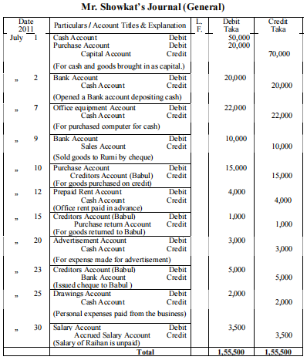

Slide 18
Example-3
Journal of Service Providing Organization :
On 1 March 2025 Mr. Pijush Kumar started a theatre business at Baily Road. He invested tk.5,00,000. Transactions on March of his business was
March 2 3 months’ rent of the theater paid in advance Tk. 90,000.
,, 4 publicity expense for the theater Tk. 15,000.
,, 6 Purchased chair and table for the theater Tk. 30,000.
,, 7 Cost of making & decorating stage tk.50,000
“ 12 Entertainment expense for artist & technician tk.2,000
,, 15 Sale of ticket for showing drama tk.80,000
,, 18 Honorarium paid to artist tk.25,000
,, 25 Electricity bill due Tk. 3,000.
,, 28 Salaries paid to the theater employees Tk. 12,000.
Requirements: Prepare Journal Entries of these transaction at March 31, 2025.

Slide 19
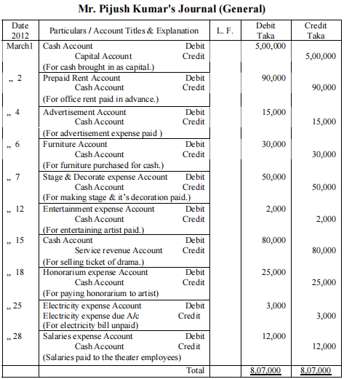

Slide 20
Example-4
Activity:
Shachin Kormoker is a businessman. During the month of April 2011 following transactions took place in his business.
April 1 Received a cheque from debtor and deposited it in the Bank then
,, 3 Took loan from Maruf Tk. 20000.
,, 5 Purchase Return Tk. 500.
,, 8 Sold old furniture Tk. 2000
,, 10 Bad debts writing off Tk. 1000
,, 12 Bank paid notes payable Tk. 3000.
,, 15 Purchased chair and table Tk. 7000.
,, 18 Interest on investment Tk. 1000
,, 20 Commission receivable Tk. 600.
,, 22 Withdrawn from Bank Tk. 4000
,, 25 Paid creditor by cheque Tk. 6500 and received discount Tk. 500.
,, 30 Charged depreciation of furniture Tk. 800
Record the above transactions in the General Journal Book.

Slide 21
Example-4
Activity:
Shachin Kormoker is a businessman. During the month of April 2011 following transactions took place in his business.
April 1 Received a cheque from debtor and deposited it in the Bank then
,, 3 Took loan from Maruf Tk. 20000.
,, 5 Purchase Return Tk. 500.
,, 8 Sold old furniture Tk. 2000
,, 10 Bad debts writing off Tk. 1000
,, 12 Bank paid notes payable Tk. 3000.
,, 15 Purchased chair and table Tk. 7000.
,, 18 Interest on investment Tk. 1000
,, 20 Commission receivable Tk. 600.
,, 22 Withdrawn from Bank Tk. 4000
,, 25 Paid creditor by cheque Tk. 6500 and received discount Tk. 500.
,, 30 Charged depreciation of furniture Tk. 800
Record the above transactions in the General Journal Book.

Slide 22
Thank You

