Slide 1
G PULLA REDDY ENGINEERING COLLEGE
GPREC College Portal
Project Presentation
A role-based ERP web portal for students, faculty, administration, parents,
alumni, non-teaching staff, and campus fest management
Static HTML/CSS/JS · Python backend · PostgreSQL

Slide 2
OVERVIEW
Agenda
▸ Introduction & Objectives
▸ System Architecture & Tech Stack
▸ Roles & Modules Overview
▸ Public Website
▸ Role-Based Login System
▸ Student Portal
▸ Faculty Portal
▸ Admin Console
▸ Department / Hostel / Exam Cell / Placement Dashboards
▸ College Fest & Event Management System
▸ Database Design
▸ Security & Access Control
▸ Notable Recent Enhancements
▸ Conclusion & Future Scope
GPREC College Portal
2

Slide 3
INTRODUCTION
What is the GPREC College Portal?
▸ A full role-based ERP-style web application for G Pulla Reddy Engineering College.
▸ Combines the public college website with a complete internal portal.
▸ Covers 10 distinct user roles: Student, Faculty, College/Department Admin, Hostel Warden, Exam Cell Officer, Placement Cell Officer, Parent, Alumni, Non-Teaching Staff, and public Event/Fest Visitors.
▸ Frontend: plain HTML, CSS, and JavaScript - no framework dependency.
▸ Backend: lightweight Python HTTP servers + PostgreSQL for all persistent data.
▸ Runs fully locally for development; deployable to production per PRODUCTION.md.
GPREC College Portal
3

Slide 4
OBJECTIVES
Project Objectives
▸ Digitize day-to-day academic and administrative workflows for every stakeholder.
▸ Give each role a purpose-built dashboard with exactly the data/actions relevant to them.
▸ Centralize student records, attendance, grades, fees, hostel, placements, and examinations.
▸ Give the college admin a single console for users, content, notices, and integrations.
▸ Support the annual College Fest end-to-end - publishing, volunteers, visitor registration, digital passes, gate check-in.
▸ Keep the stack dependency-light and easy to run, audit, and extend.
GPREC College Portal
4

Slide 5
ARCHITECTURE
System Architecture
Layer | Responsibility
Frontend | 116 static HTML pages, one shared script.js (~30k lines) and styles.css
static_server.py | Serves the static site - http://127.0.0.1:8080
portal_db_server.py | Postgres-backed API - http://127.0.0.1:8766 (auth, bootstrap, all reads/writes)
admin_config_server.py | admin-config.json + file uploads - http://127.0.0.1:8765
pdf_render_server.py | Optional Playwright HTML-to-PDF rendering - http://127.0.0.1:8767
PostgreSQL (gprec_erp) | 78 tables: students, faculty, admins, attendance, grades, fees, hostel, placements, exams, campus events, ...
GPREC College Portal
5

Slide 6
ARCHITECTURE
Technology Stack
Layer | Technology
Frontend | HTML5, CSS3, vanilla JavaScript (ES6+) - no build step or framework
Client libraries | qrcode-generator.js, html2canvas.min.js
Backend | Python 3 (built-in http.server based tools)
Database | PostgreSQL (schema: gprec_erp)
PDF rendering | Playwright (headless Chromium), optional
Payments | PayU payment gateway integration
Auth | Session tokens, salted/hashed passwords, math CAPTCHA, login throttling
GPREC College Portal
6

Slide 7
ROLES
Roles & Modules Overview
Role | Login Page | Dashboard
College Admin | admin-login.html | admin-dashboard.html
Department Admin | admin-login.html | department-dashboard.html
Hostel Warden | admin-login.html | hostel-dashboard.html
Exam Cell Officer | admin-login.html | exam-cell-dashboard.html
Placement Cell Officer | admin-login.html | placement-dashboard.html
Student | student-login.html | student-dashboard.html
Faculty | faculty-login.html | faculty-dashboard.html
Parent | parent-login.html | parent-dashboard.html
Alumni | alumni-login.html | alumni-dashboard.html
Non-Teaching Staff | non-teaching-login.html | non-teaching-dashboard.html
Event Visitor (public) | self-service | event-visitor-dashboard.html
GPREC College Portal
7

Slide 8
MODULE
Public Website
Homepage, About, Admissions, Campus Life, Fees, Contact & more

Slide 9
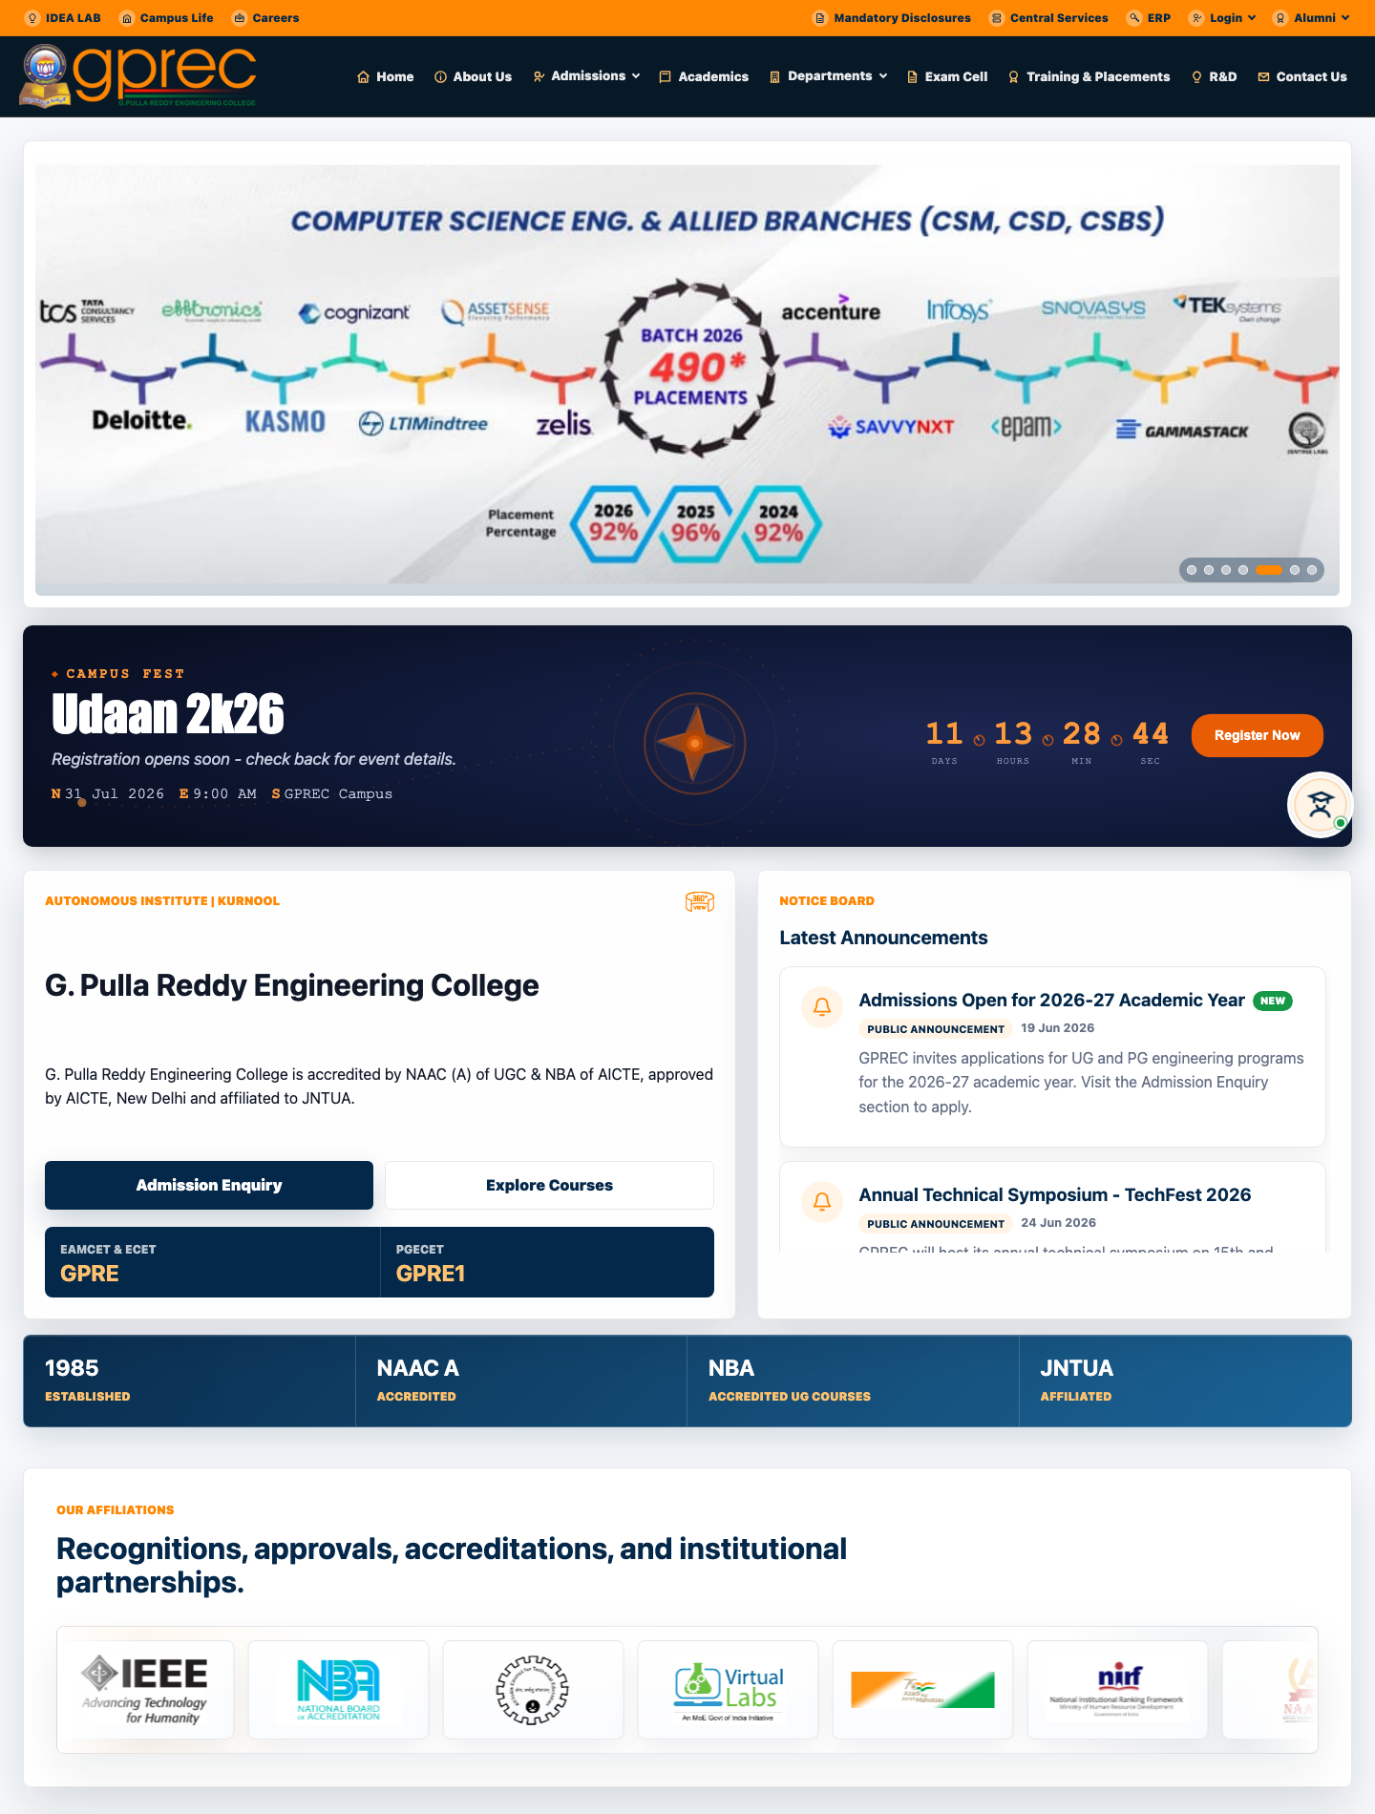
PUBLIC WEBSITE
Homepage
www.gprec.ac.in - public homepage
GPREC College Portal
9

Slide 10
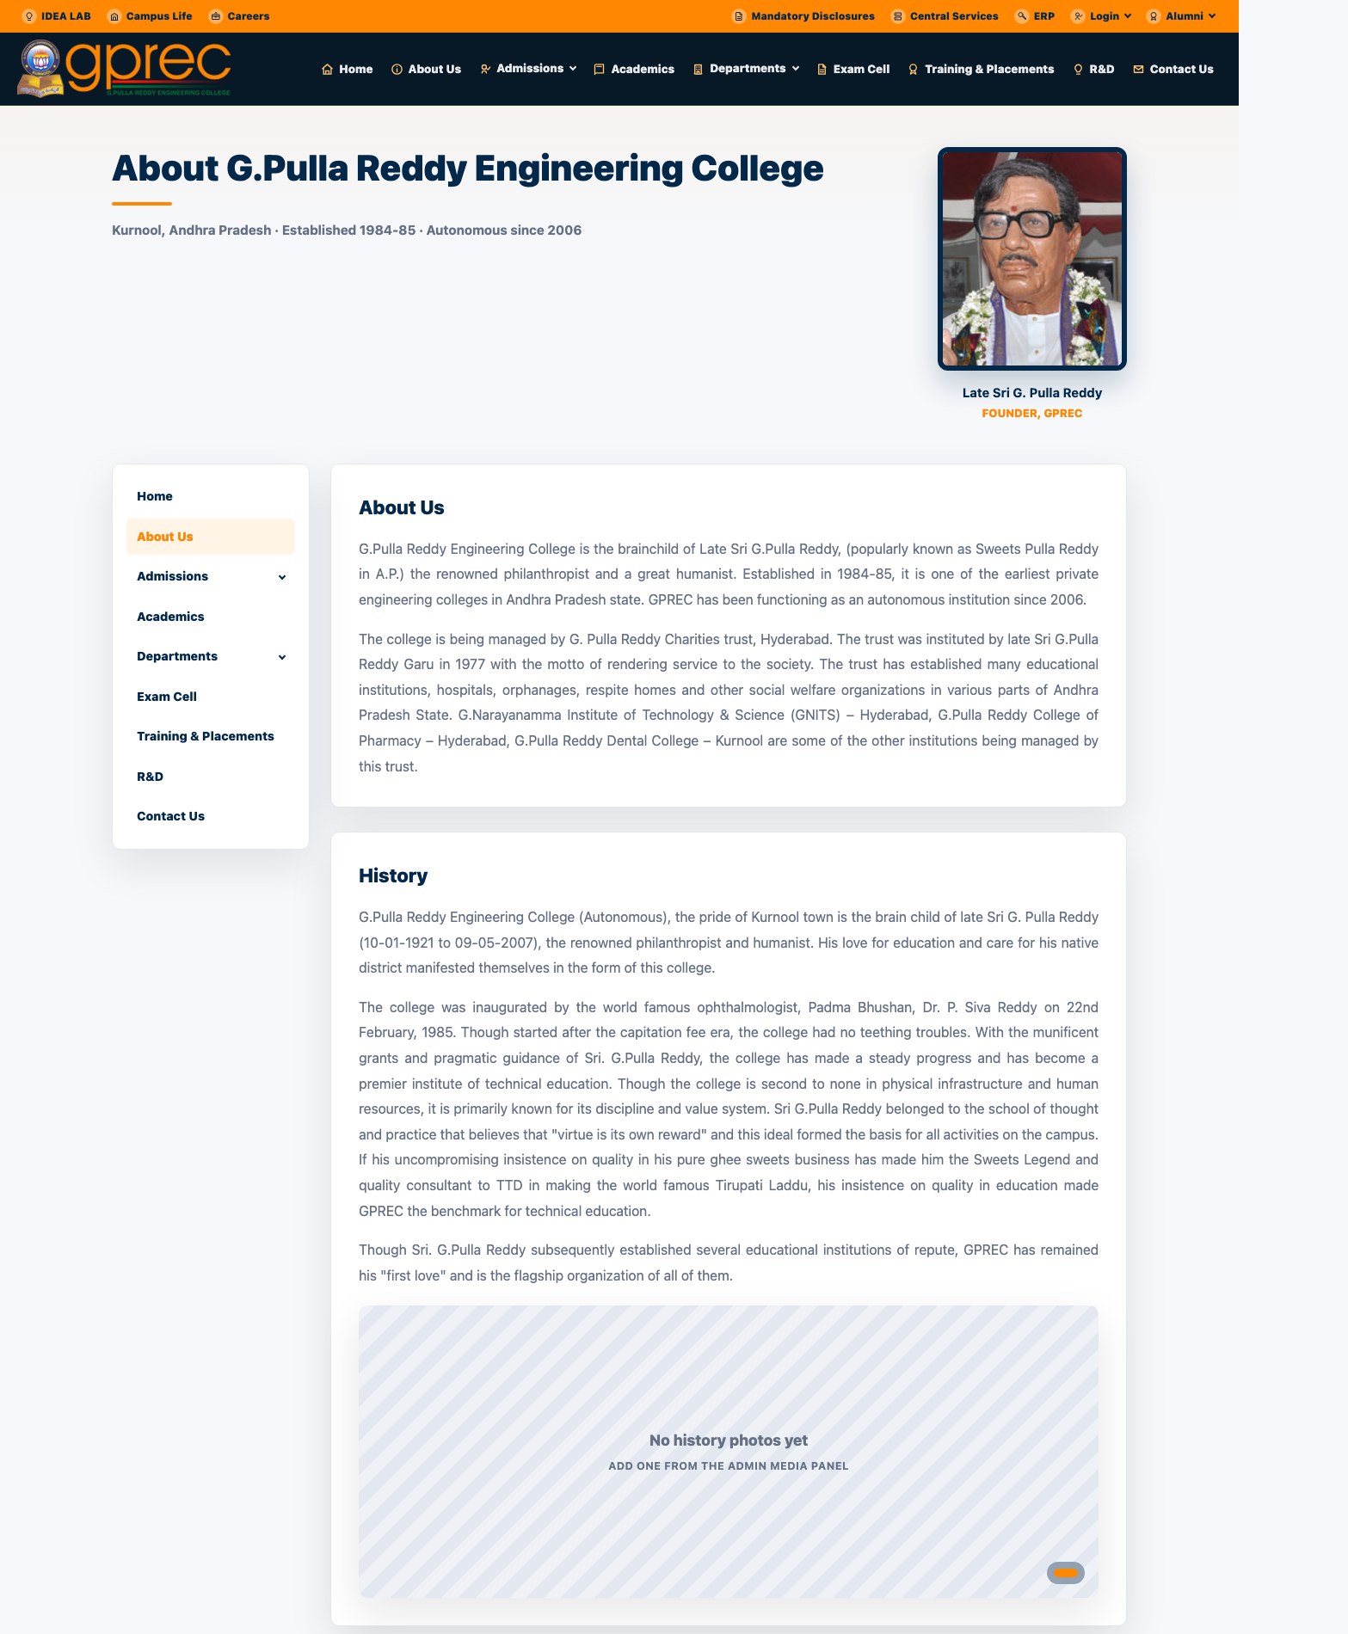
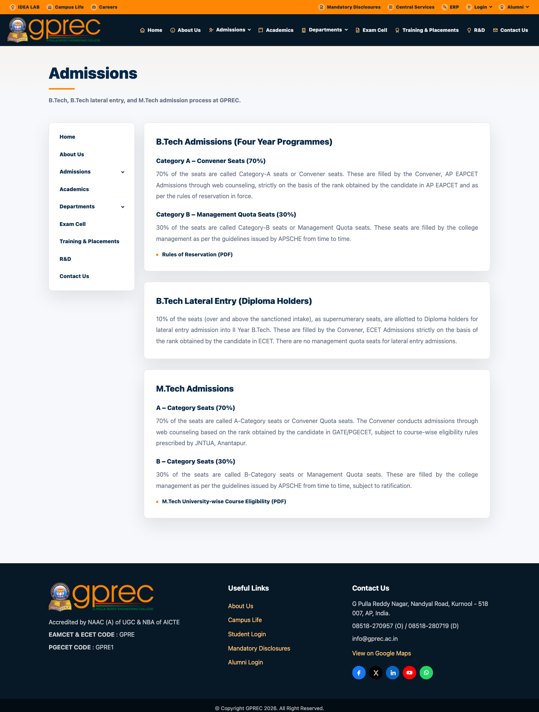
PUBLIC WEBSITE
About Us & Admissions
About Us
Admissions
GPREC College Portal
10

Slide 11
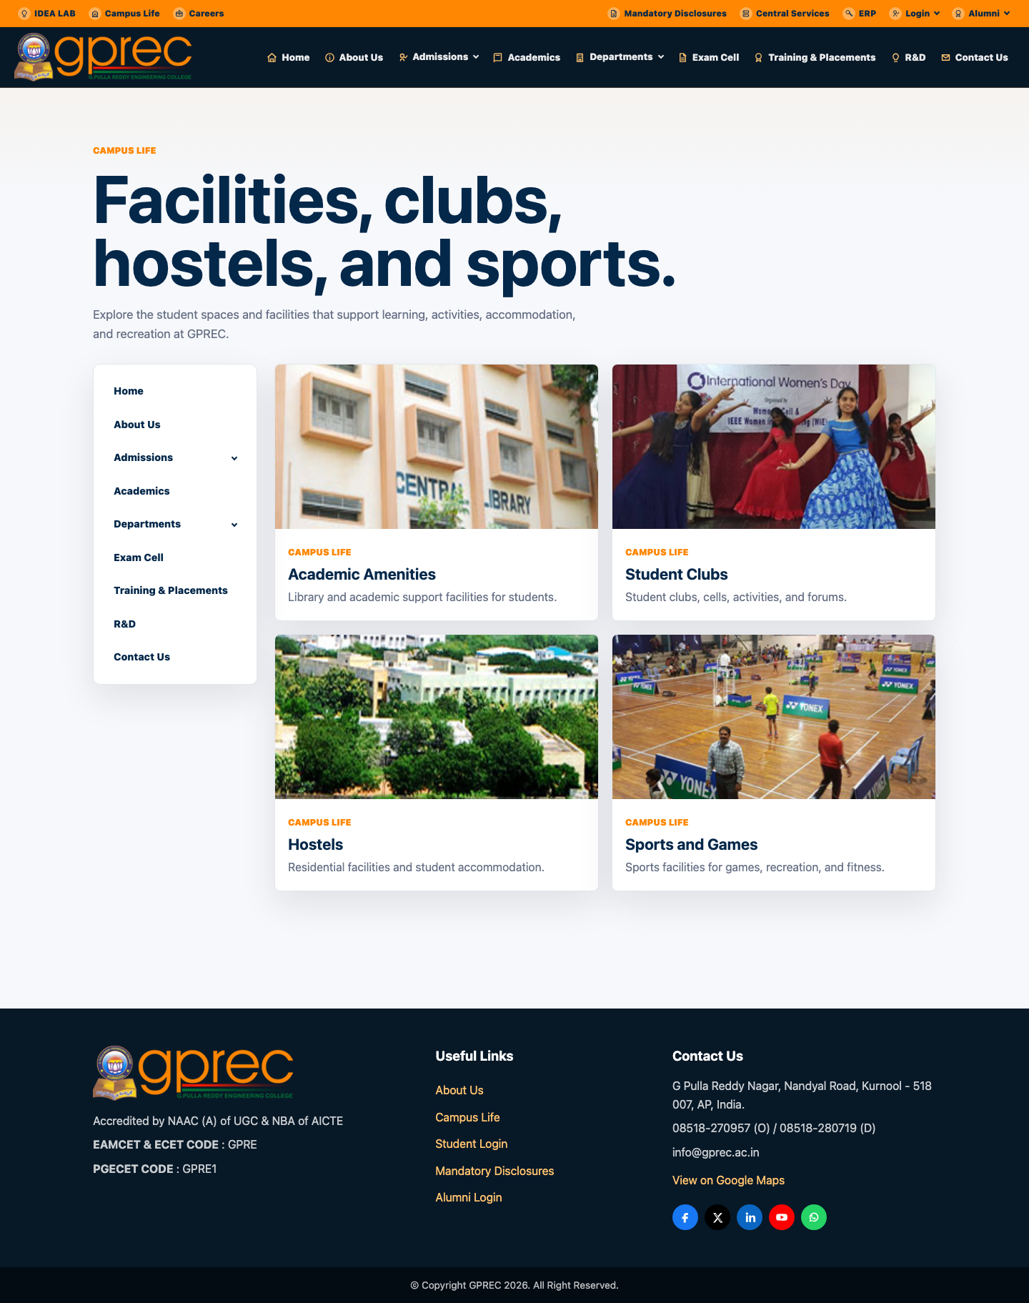
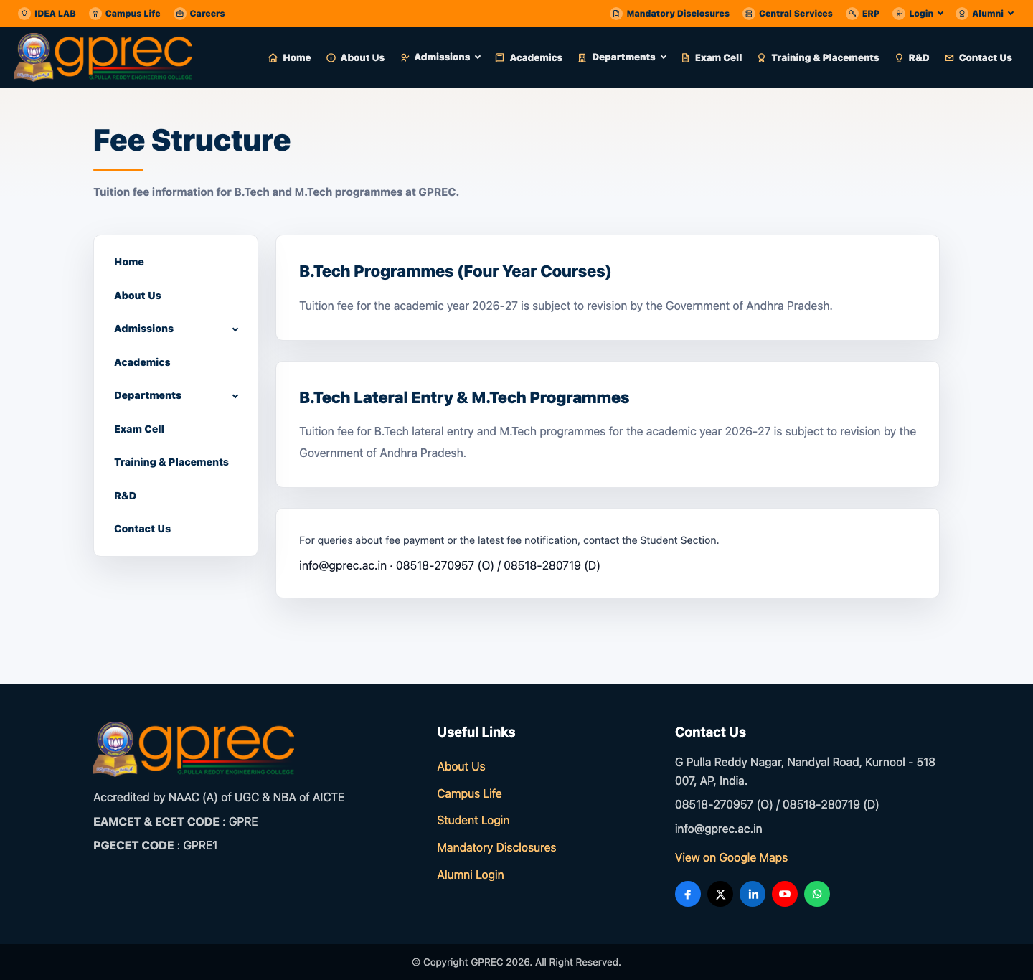
PUBLIC WEBSITE
Campus Life & Fee Structure
Campus Life
Fee Structure
GPREC College Portal
11

Slide 12
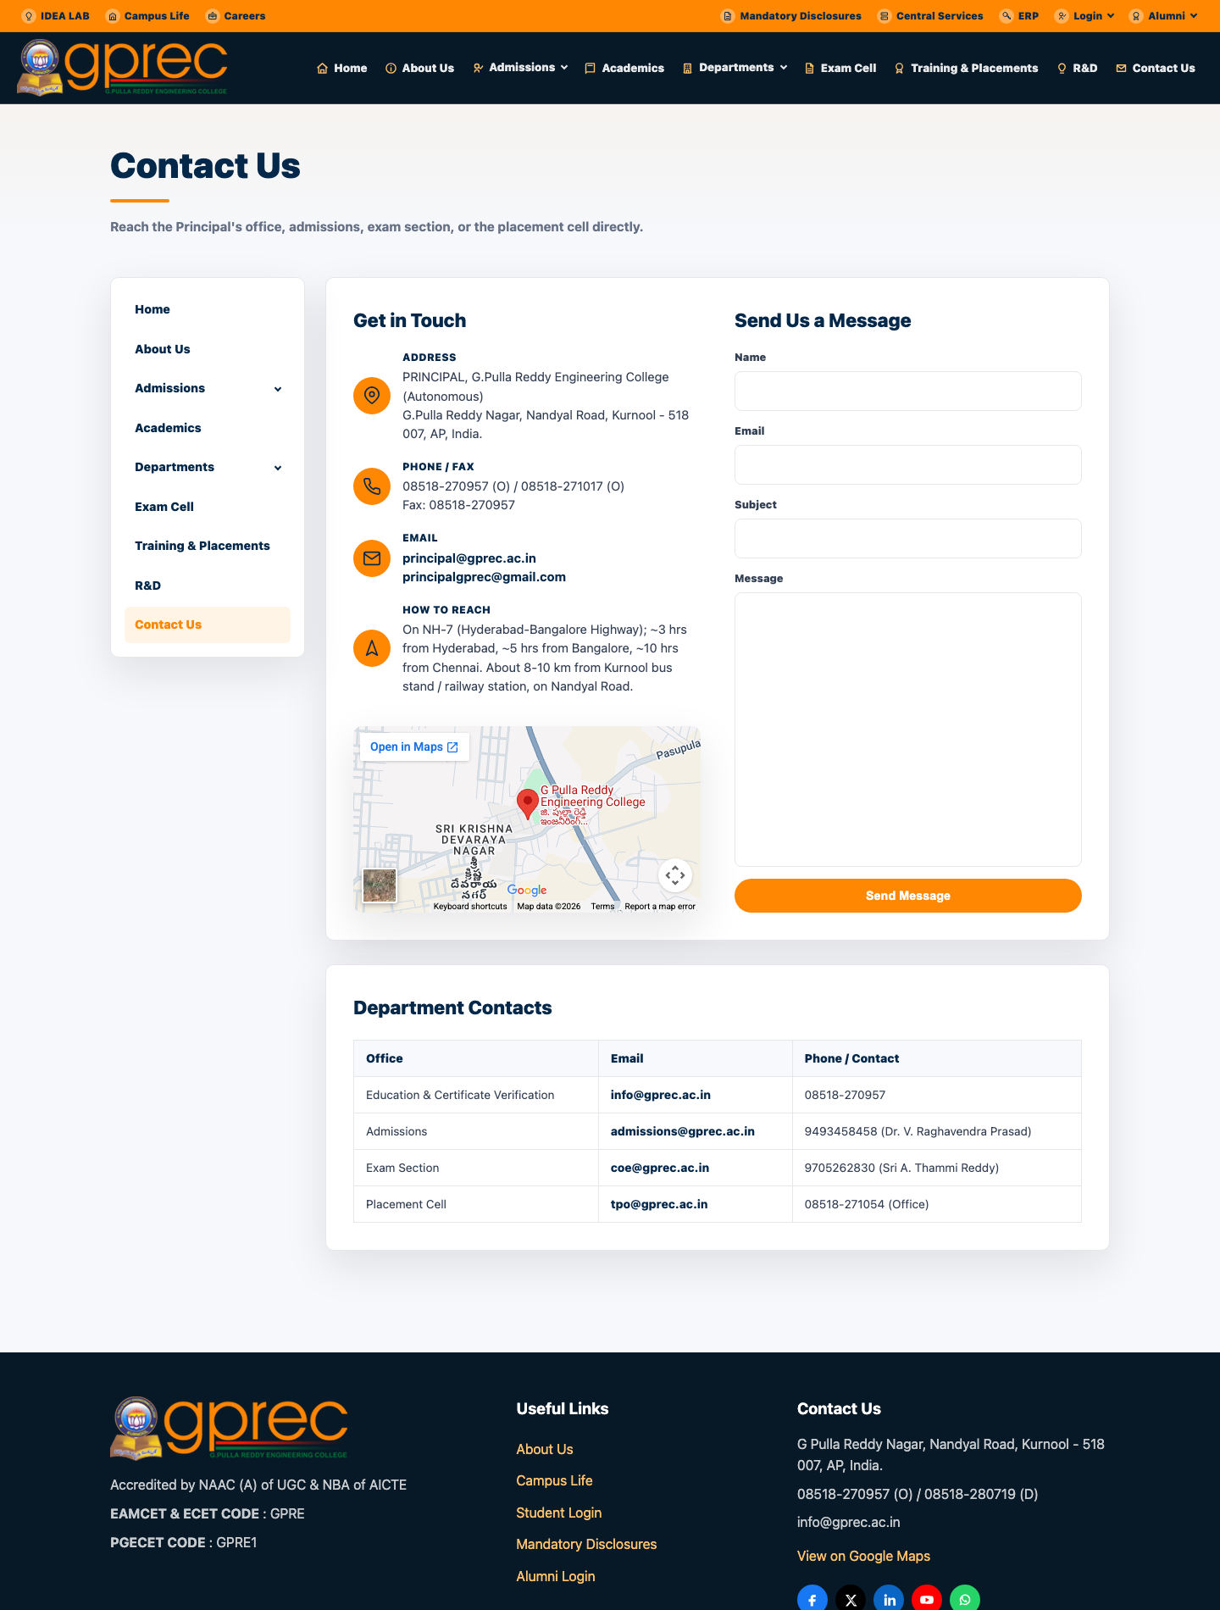
PUBLIC WEBSITE
Contact Us
Contact Us page
GPREC College Portal
12

Slide 13
MODULE
Role-Based Login System
Roll+DOB / email+password / OTP, all CAPTCHA-protected and rate-limited

Slide 14
LOGIN SYSTEM
How Authentication Works
▸ Every role signs in through its own dedicated login page.
▸ Students authenticate with roll number + date of birth, verified server-side.
▸ Staff/Admin roles authenticate with college email + password (salted & hashed).
▸ Parents use a mobile-number OTP flow - no password.
▸ Every form includes a self-hosted math CAPTCHA.
▸ Repeated failed attempts are rate-limited (throttled) server-side per identity.
▸ Session tokens + active role are kept in browser local storage, matched to the exact role at every API call.
GPREC College Portal
14

Slide 15
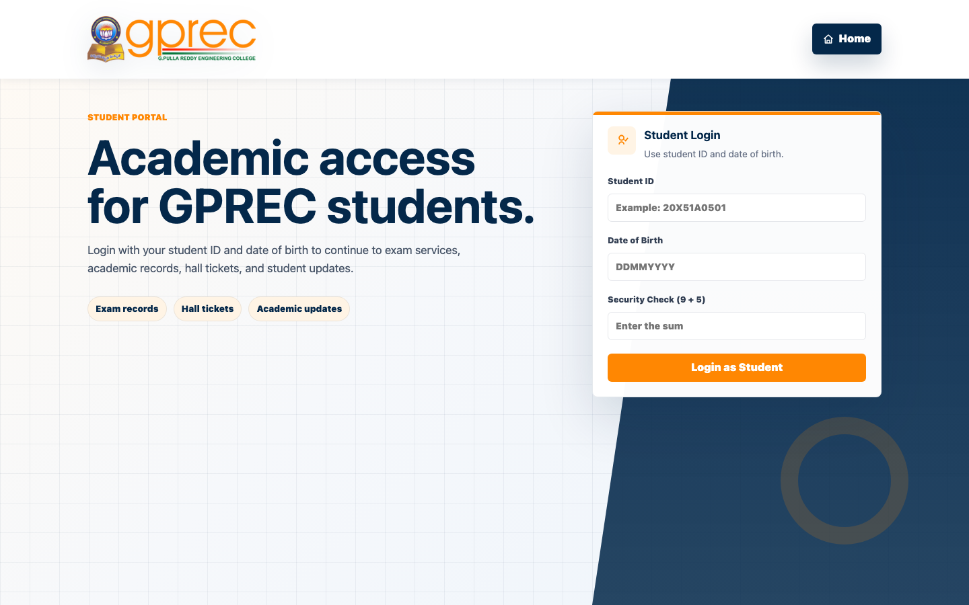
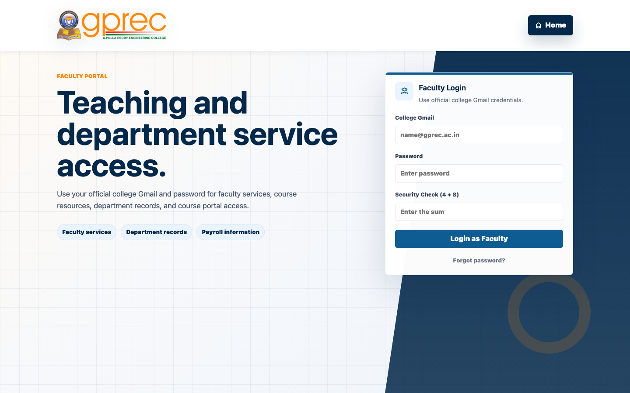
LOGIN SYSTEM
Student & Faculty Login
Student Login (Roll No. + DOB)
Faculty Login
GPREC College Portal
15

Slide 16
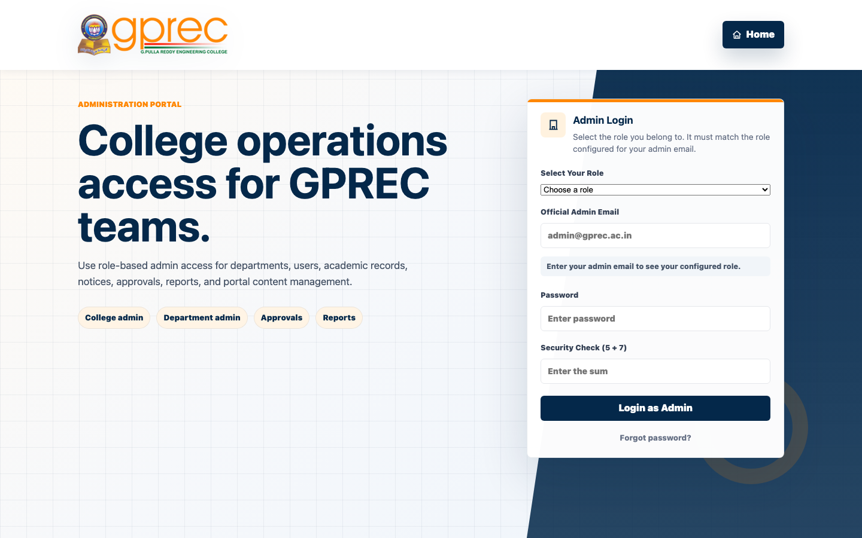
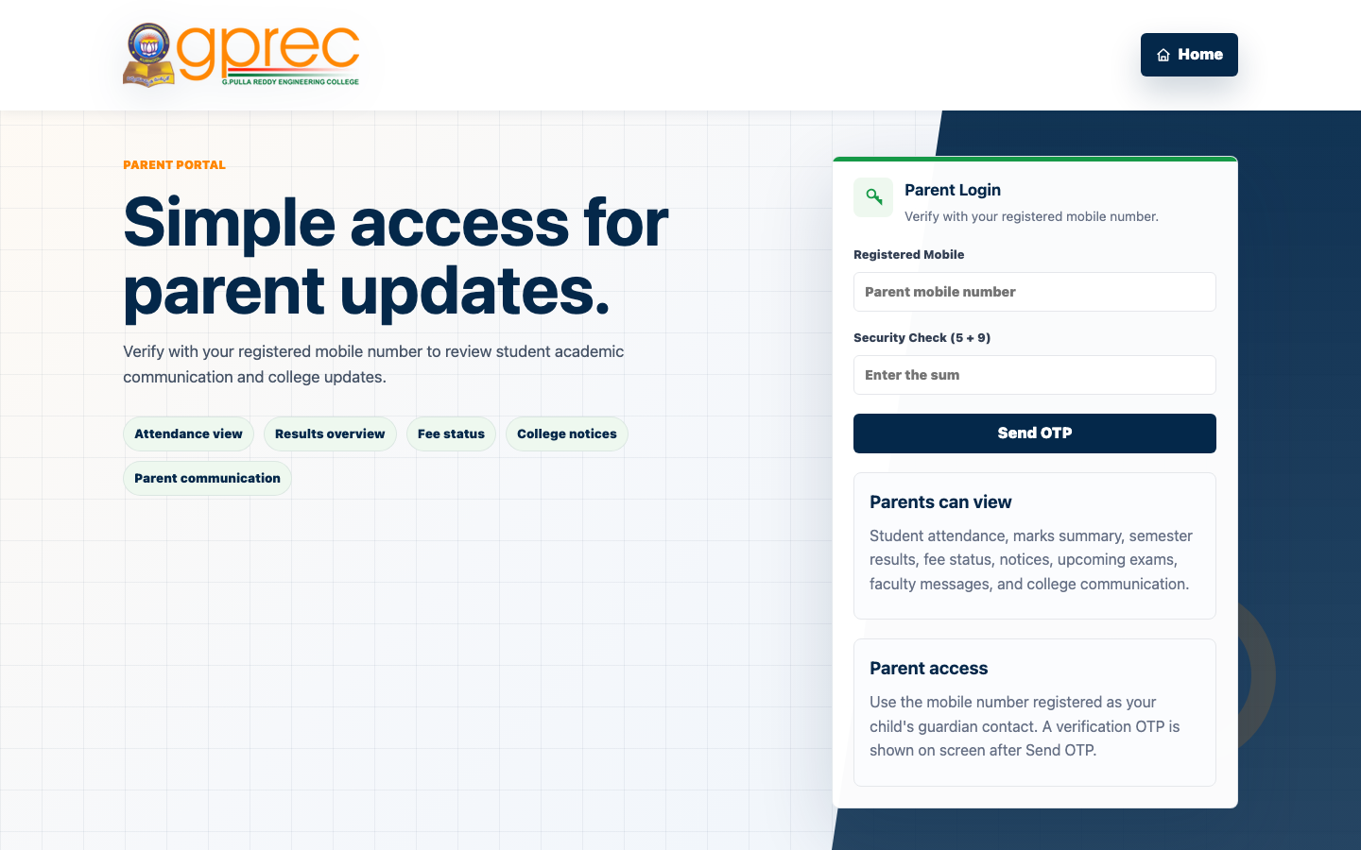
LOGIN SYSTEM
Admin & Parent Login
Admin Login (role-aware)
Parent Login (OTP)
GPREC College Portal
16

Slide 17
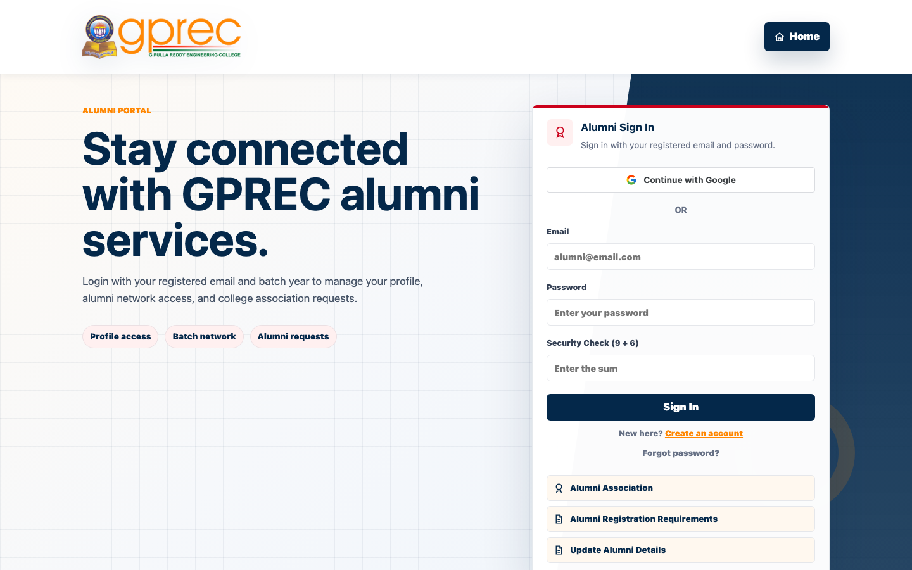
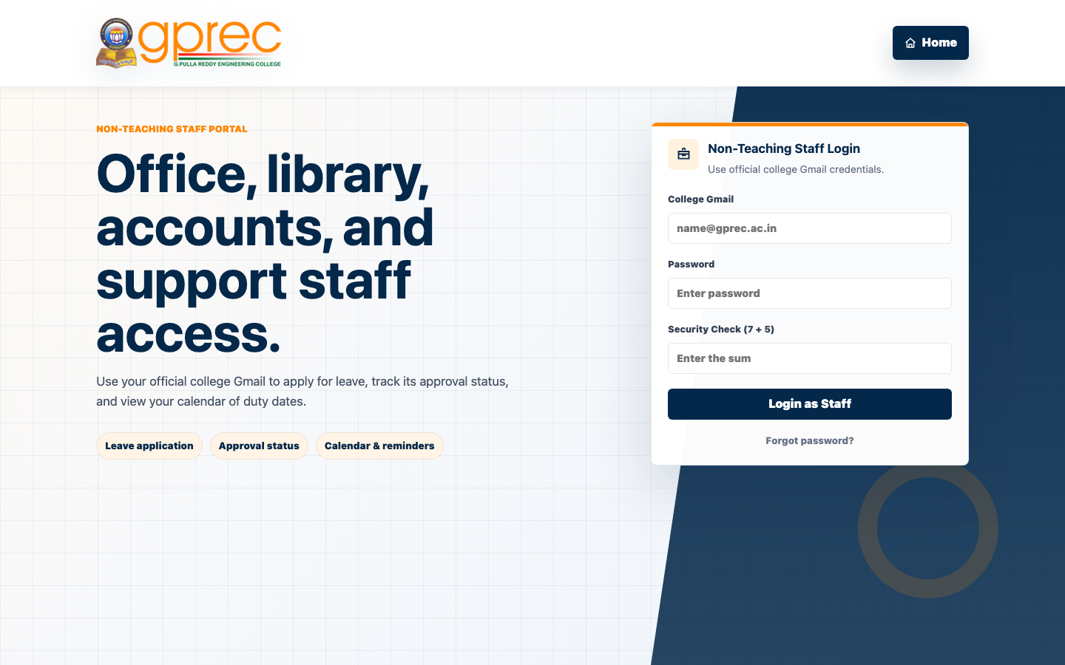
LOGIN SYSTEM
Alumni & Non-Teaching Staff Login
Alumni Login / Sign-up
Non-Teaching Staff Login
GPREC College Portal
17

Slide 18
MODULE
Student Portal
Academics, attendance, fees, hostel, events, and more

Slide 19
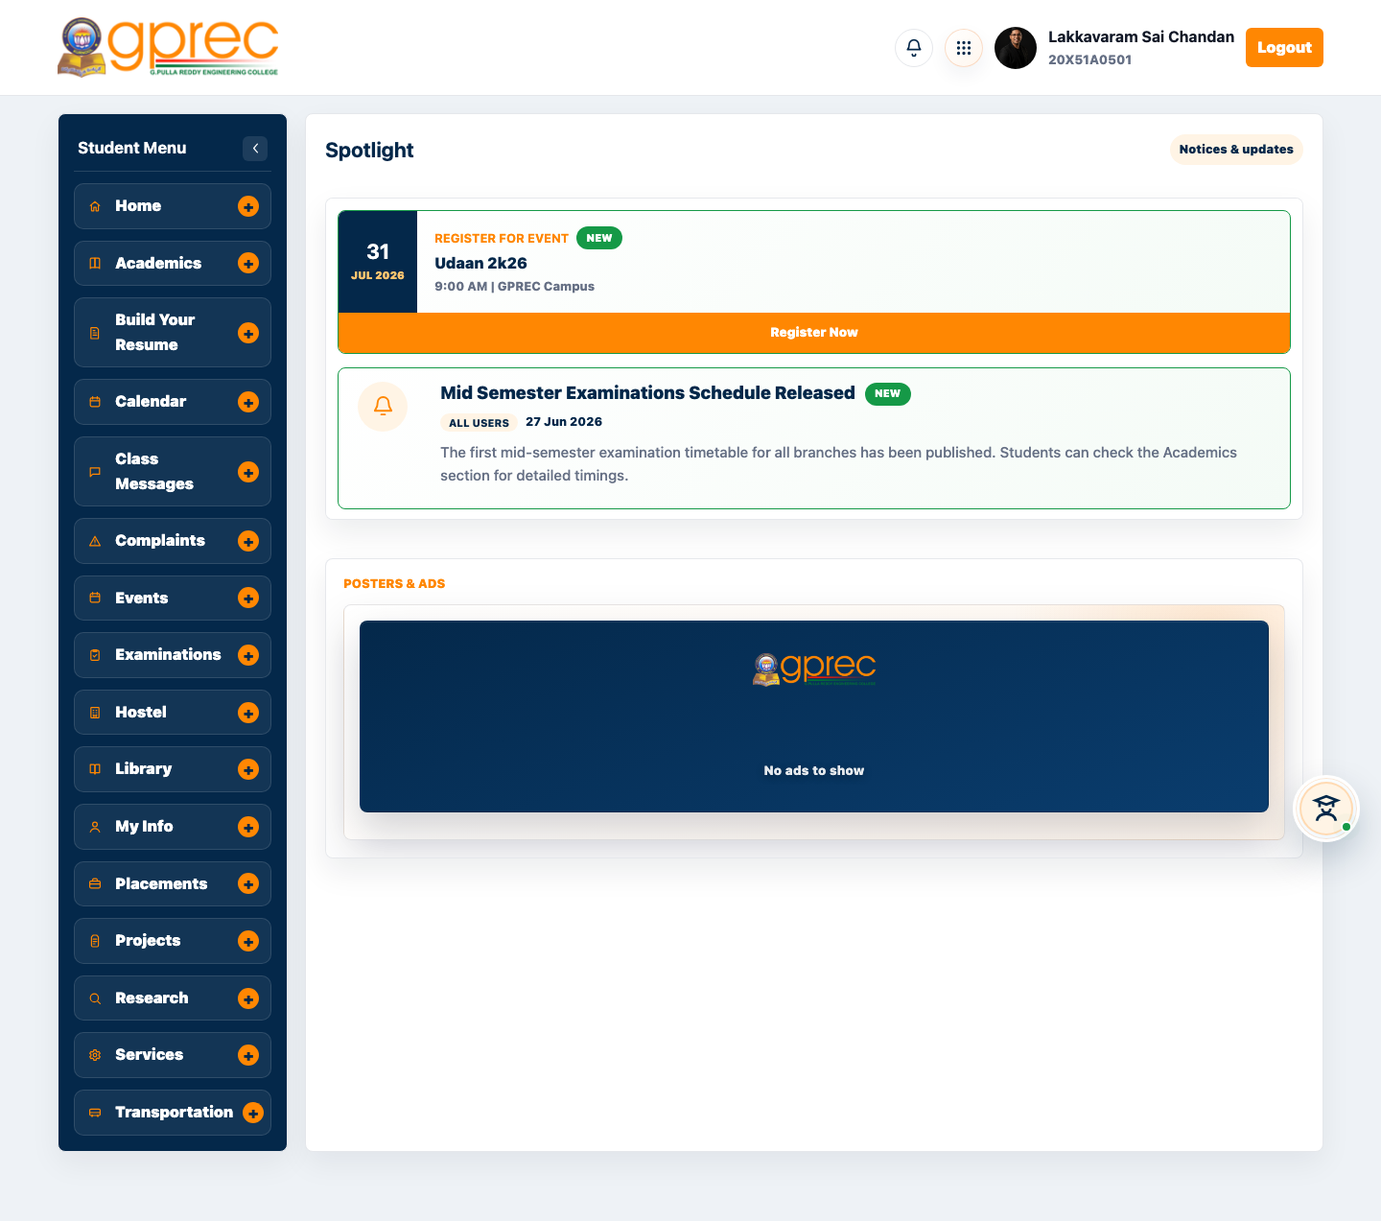
STUDENT PORTAL
Student Dashboard - Home
Collapsible sidebar covering every student-facing module
GPREC College Portal
19

Slide 20
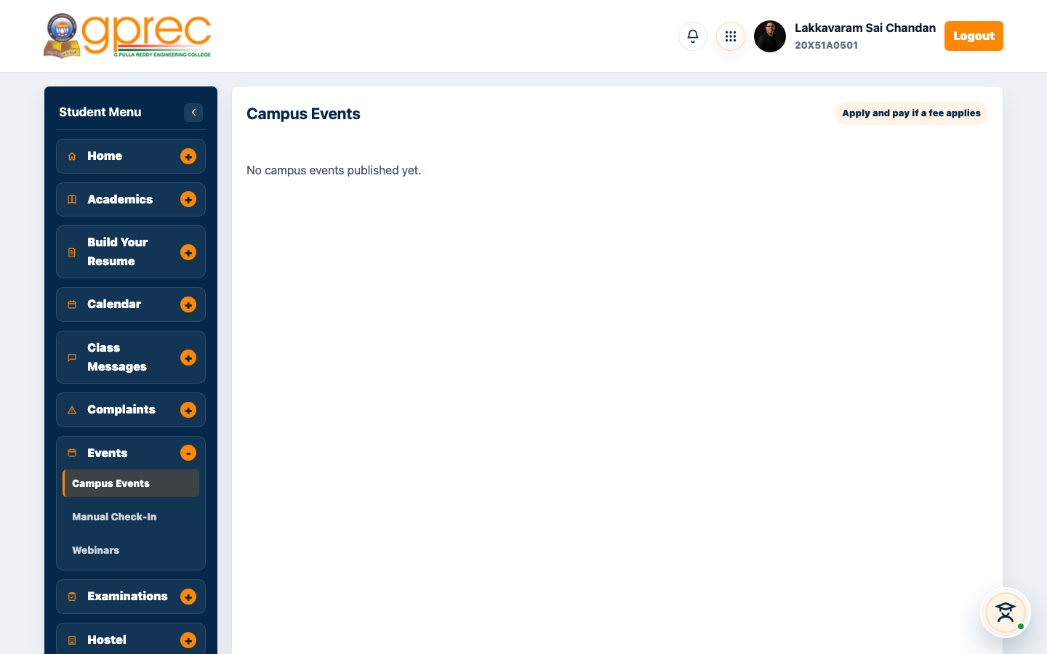
STUDENT PORTAL
Campus Events
Browse open events and register
GPREC College Portal
20

Slide 21
STUDENT PORTAL · NEW
Manual Check-In (New Feature)
▸ A student signed in as an event volunteer can check an attendee into a fest event.
▸ Works by GPREC roll number (students) or outside-visitor email (public guests).
▸ No QR camera scan required - a desktop-friendly fallback right in the dashboard nav.
▸ Reuses the existing /campus-event/manual-checkin backend endpoint - no backend changes.
GPREC College Portal
21

Slide 22
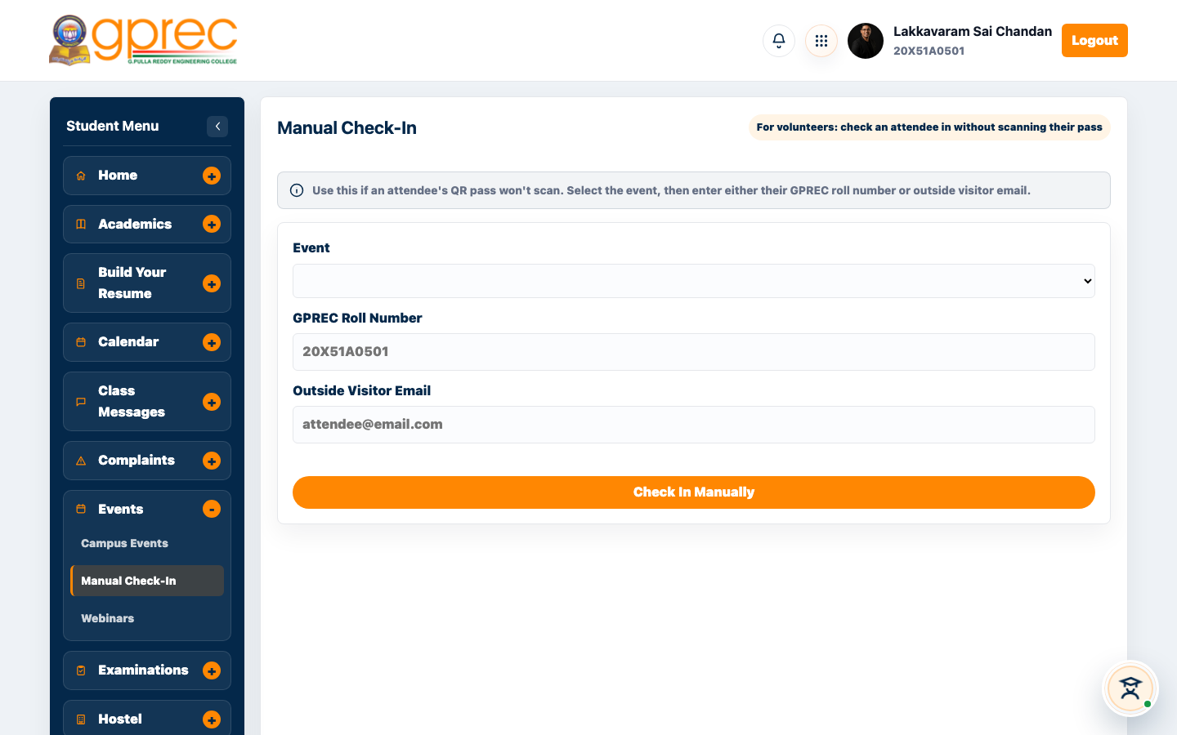
STUDENT PORTAL · NEW
Manual Check-In Panel
Select event, enter roll number or visitor email, check in
GPREC College Portal
22

Slide 23
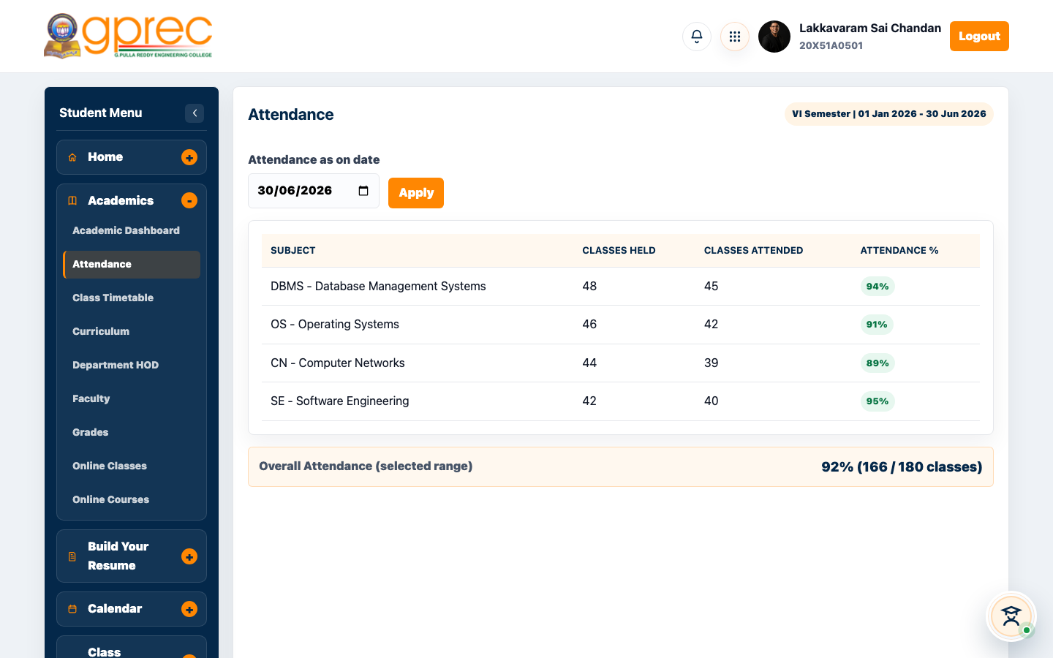
STUDENT PORTAL
Attendance
Subject-wise attendance tracking
GPREC College Portal
23

Slide 24
MODULE
Faculty Portal
Classes, assignments, attendance, leave, research & events

Slide 25
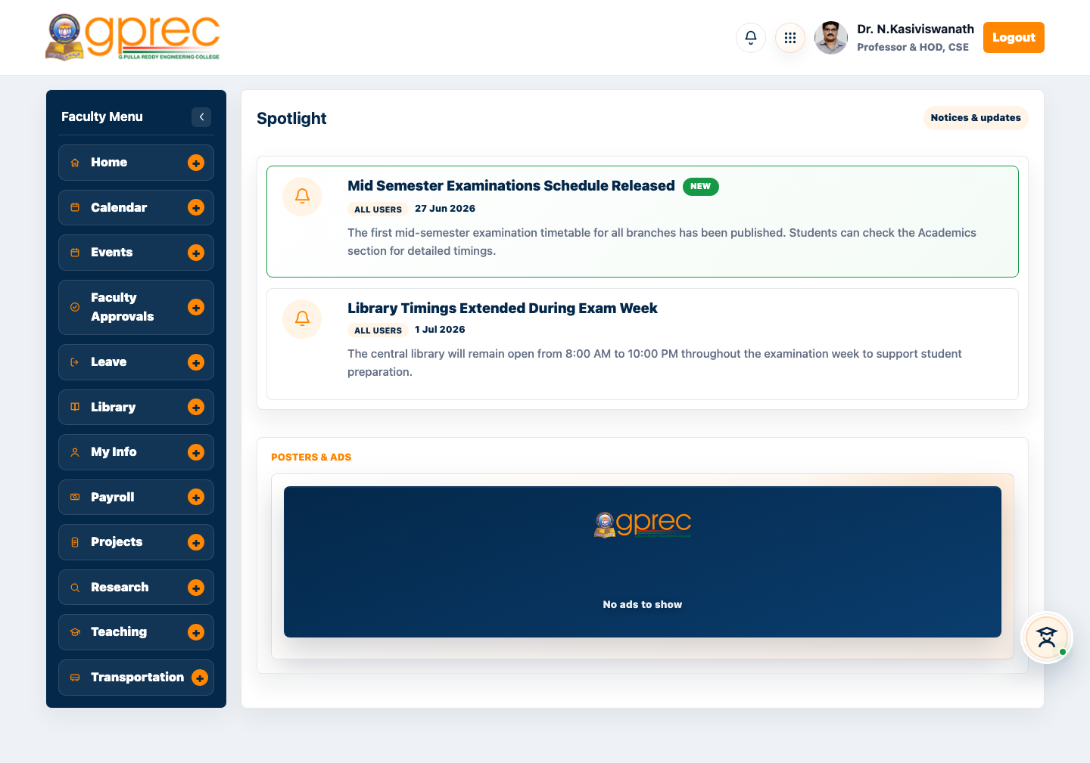
FACULTY PORTAL
Faculty Dashboard - Home
Classes, assignments, attendance, payroll, and more
GPREC College Portal
25

Slide 26
FACULTY PORTAL · NEW
Register for Event (New Feature)
▸ Faculty can now browse open campus/fest events and register themselves as an attendee.
▸ Separate from creating or managing an event - this is the attendee-side flow.
▸ Same registration + downloadable digital pass flow students already had.
▸ Identity resolved by login email (faculty have no roll number) via a shared getCampusEventRegistrant() helper.
GPREC College Portal
26

Slide 27
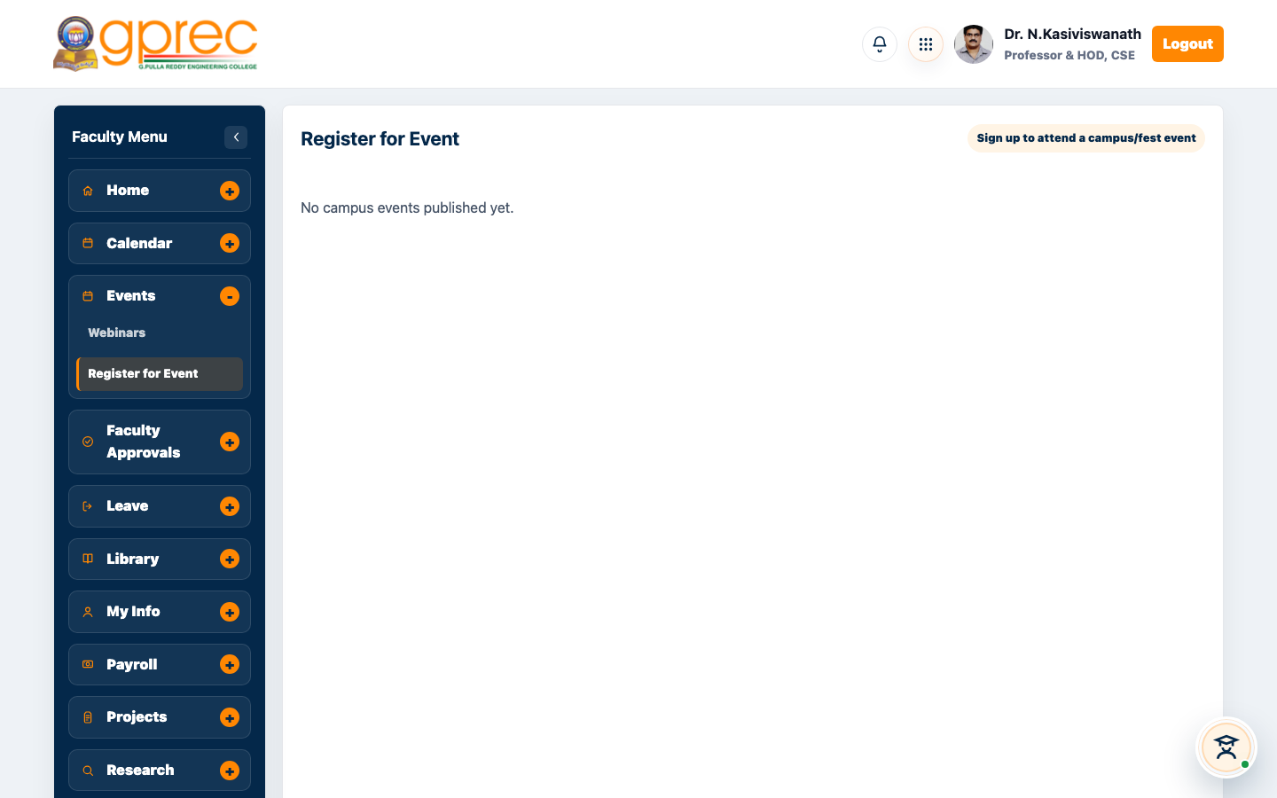
FACULTY PORTAL · NEW
Register for Event Panel
Browse events and register - faculty dashboard
GPREC College Portal
27

Slide 28
MODULE
Admin Console
The operational nerve centre of the portal

Slide 29
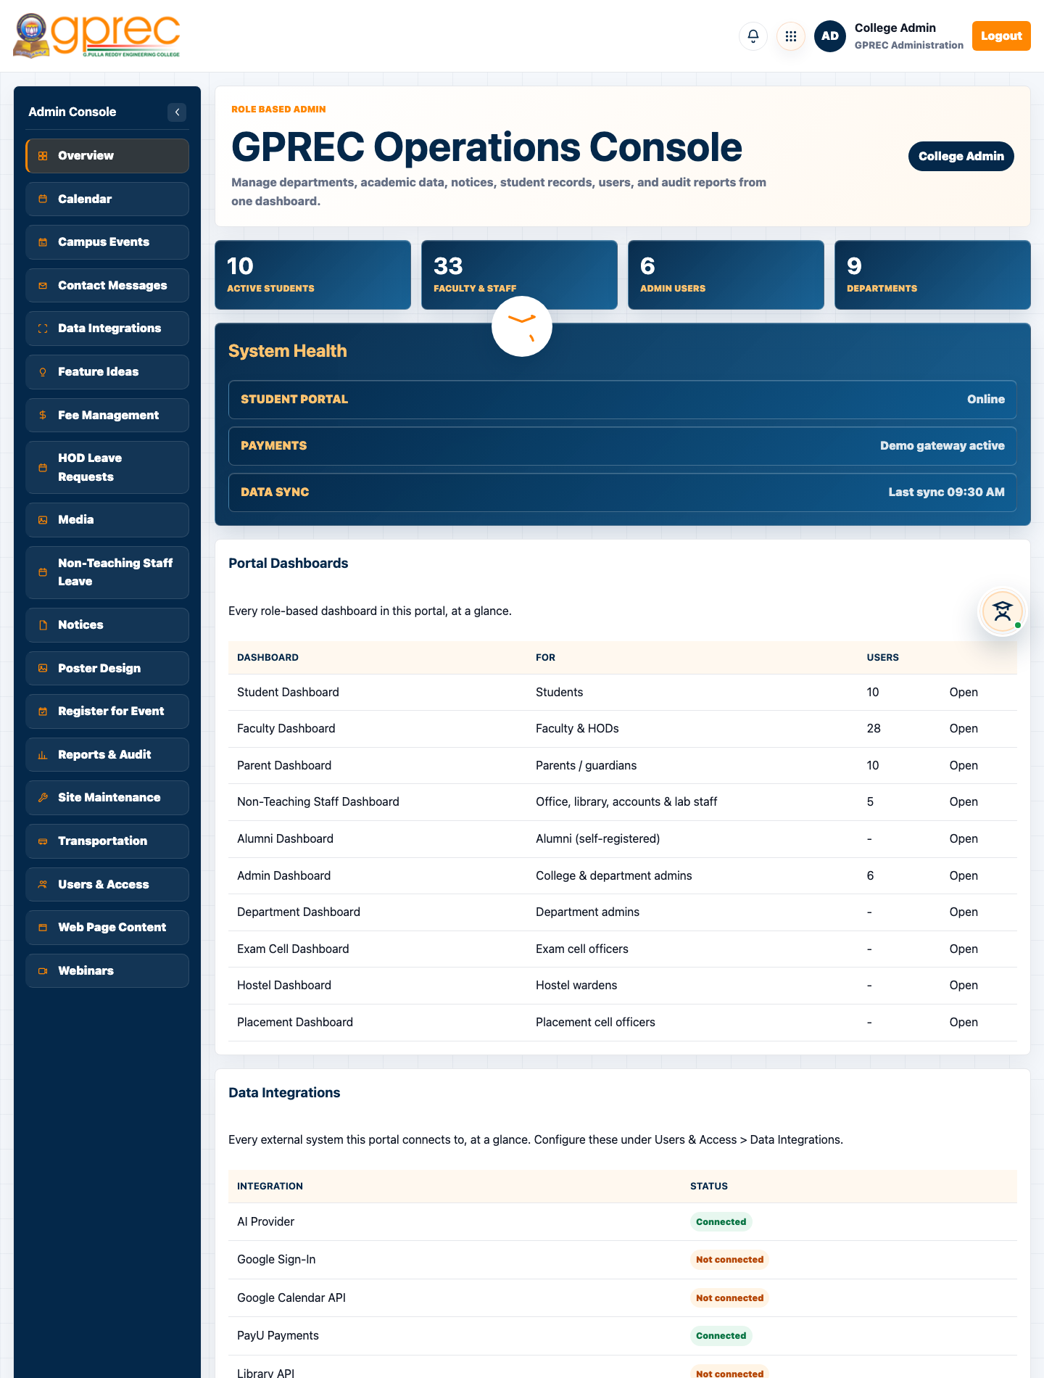
ADMIN CONSOLE
Admin Console - Overview
Portal-wide counts, system health, and every dashboard at a glance
GPREC College Portal
29

Slide 30
ADMIN CONSOLE
Admin Console Modules
Module | What it's for
Overview | Portal-wide counts, system health, dashboard directory
Calendar | Academic dates and reminders
Campus Events | Fest and activity listings for the public site
Data Integrations | Google, PayU, AI, library, DB, SMS/KYC settings
Fee Management | Student fee structures, dues, payment tracking
Register for Event (new) | Admin registers as an attendee for a campus/fest event
Reports & Audit | Report exports, admin audit trail, data retention policy
Site Maintenance | Take the site/dashboards offline with a warning banner
Users & Access | Admin directory - who has access, at what role
Web Page Content | Editable content blocks on the public website
GPREC College Portal
30

Slide 31
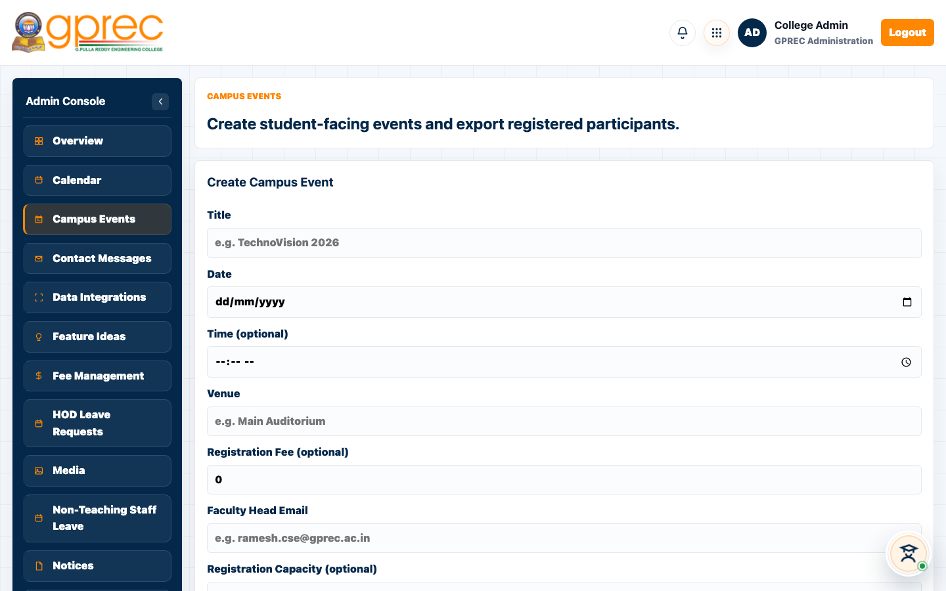
ADMIN CONSOLE
Campus Events
Publish events and export attendee check-ins
GPREC College Portal
31

Slide 32
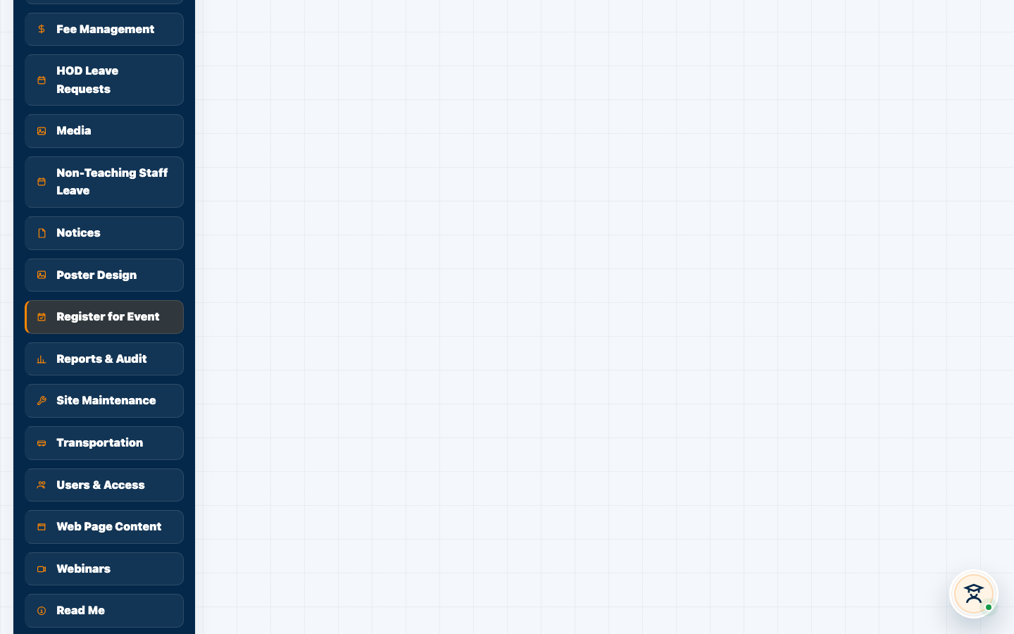
ADMIN CONSOLE · NEW
Register for Event Panel
Browse events and register - admin dashboard
GPREC College Portal
32

Slide 33
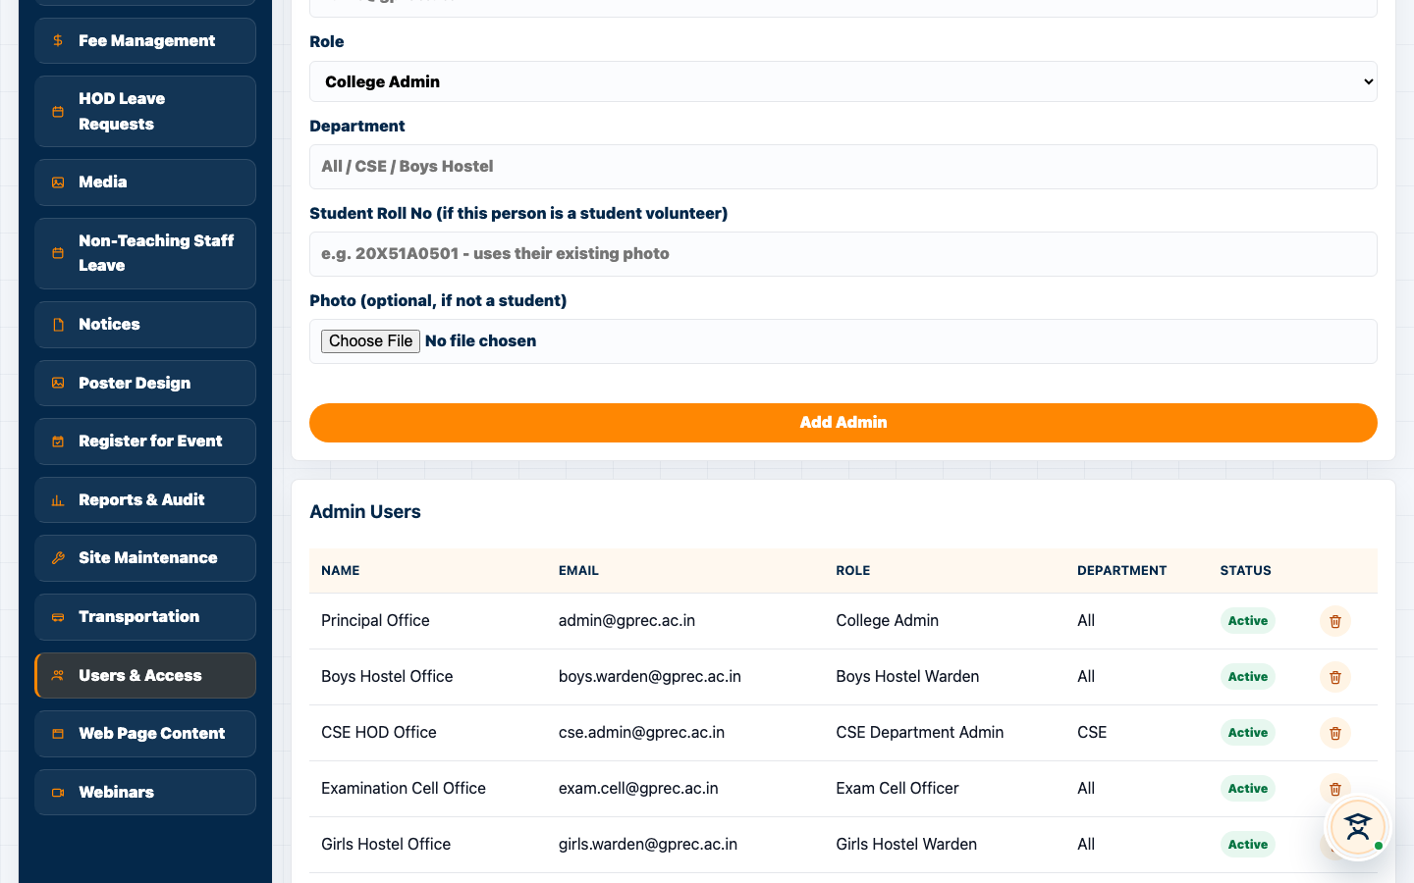
ADMIN CONSOLE
Users & Access
Admin directory - roles, departments, access
GPREC College Portal
33

Slide 34
MODULE
Department / Hostel / Exam Cell / Placement
Scoped admin-family dashboards sharing one login

Slide 35
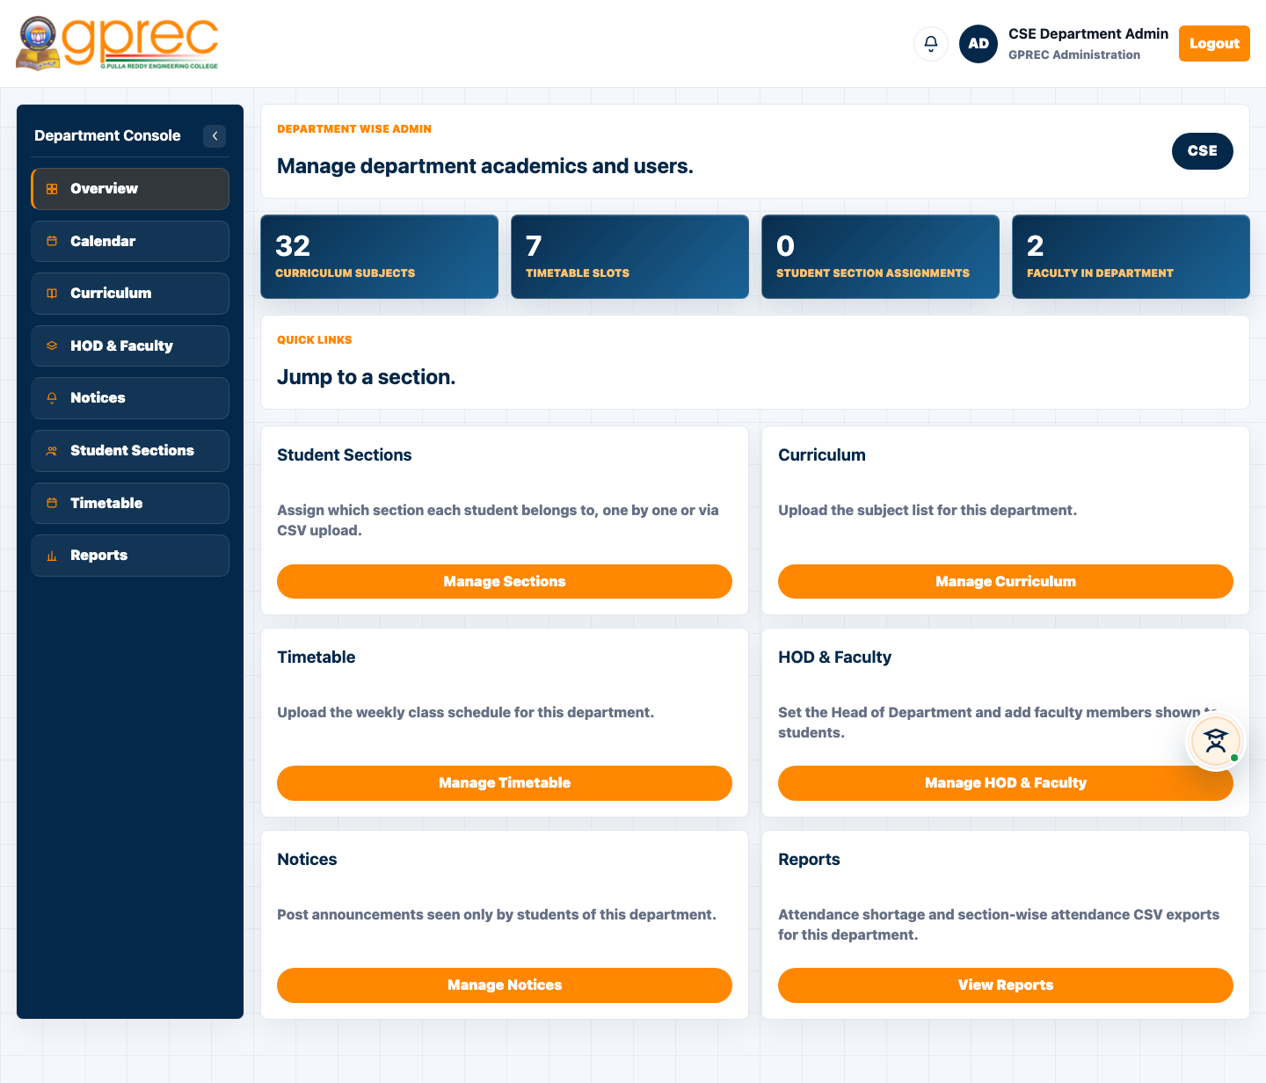
DEPARTMENT ADMIN
Department Dashboard (CSE)
Department-scoped student, faculty, and academic data
GPREC College Portal
35

Slide 36
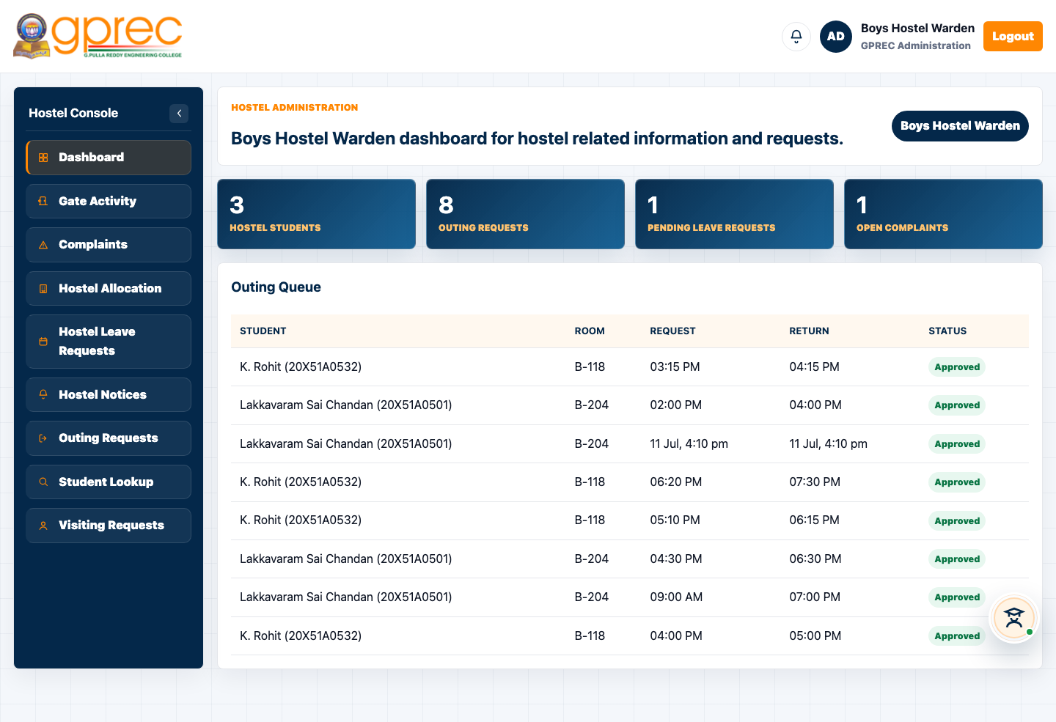
HOSTEL WARDEN
Hostel Dashboard
Allocations, outings, and leave approvals
GPREC College Portal
36

Slide 37
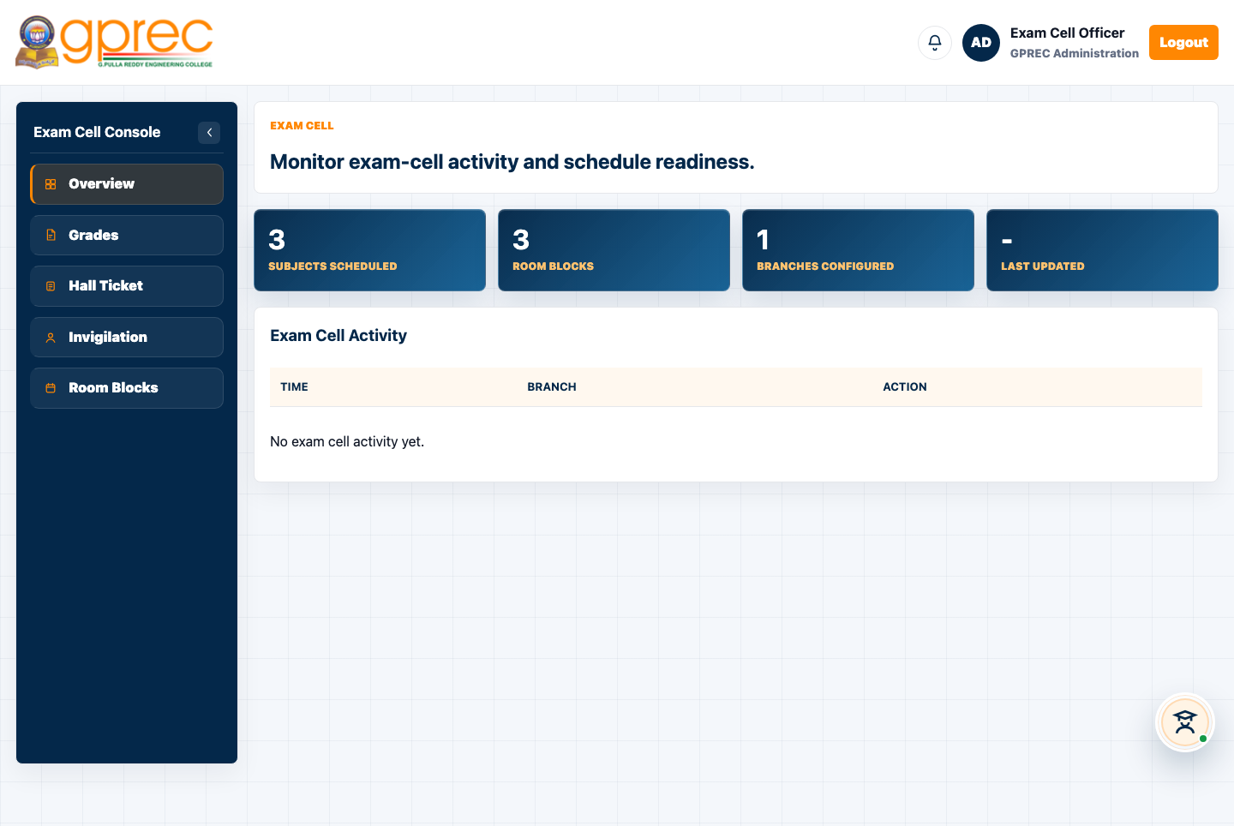
EXAM CELL
Exam Cell Dashboard
Exam schedules and applications
GPREC College Portal
37

Slide 38
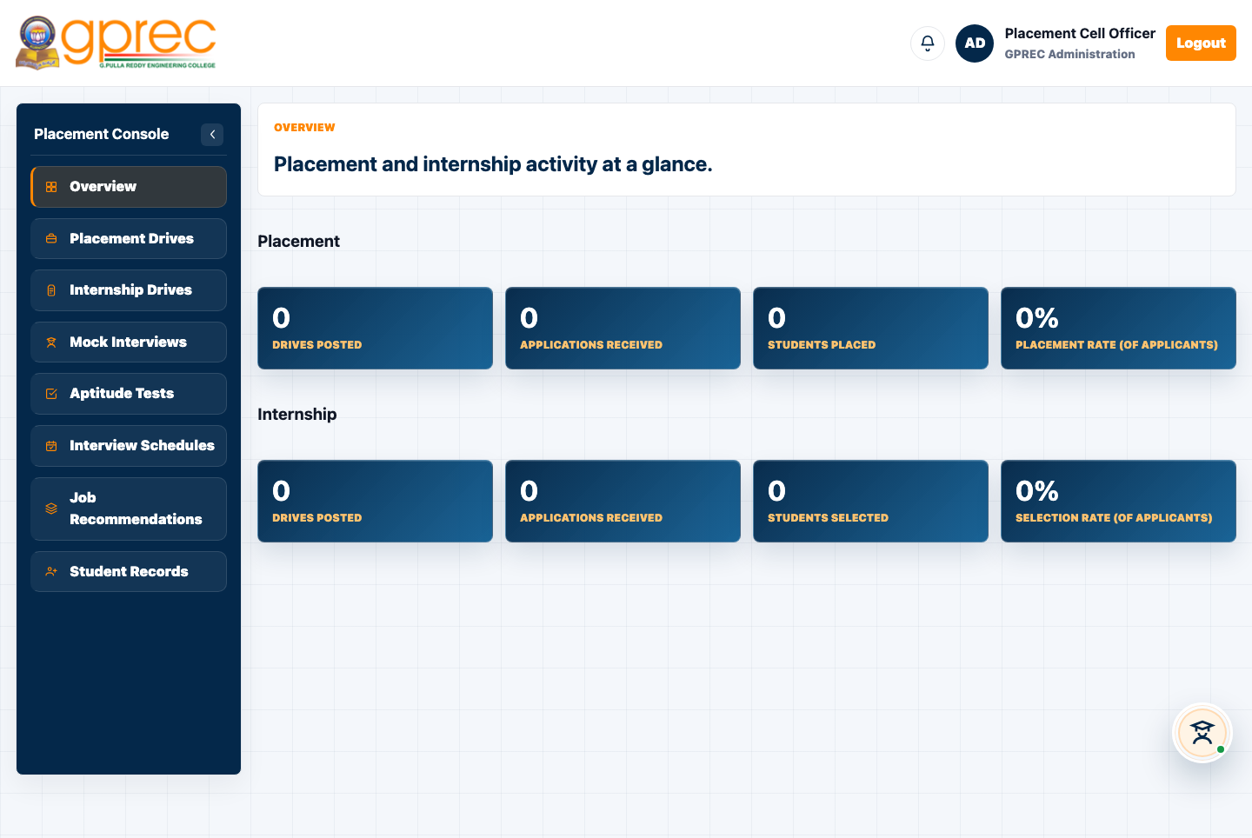
PLACEMENT CELL
Placement Dashboard
Placement drives and applicants
GPREC College Portal
38

Slide 39
MODULE
College Fest & Event Management System
Publishing, volunteers, visitor registration, digital passes, gate check-in

Slide 40
FEST SYSTEM
How the Fest System Works
▸ Admins publish fest activities and approve faculty coordinators.
▸ Faculty manage their own activities and assign student volunteers.
▸ Volunteers check attendees in at the gate - QR scan or manual fallback.
▸ The public event-visitor page lets outside guests sign up, register for open events, and download a digital pass.
▸ Compass/travel-themed design: ticker, zone map, announcements, schedule, sponsors, gallery, and section copy - all now admin-editable (new).
GPREC College Portal
40

Slide 41
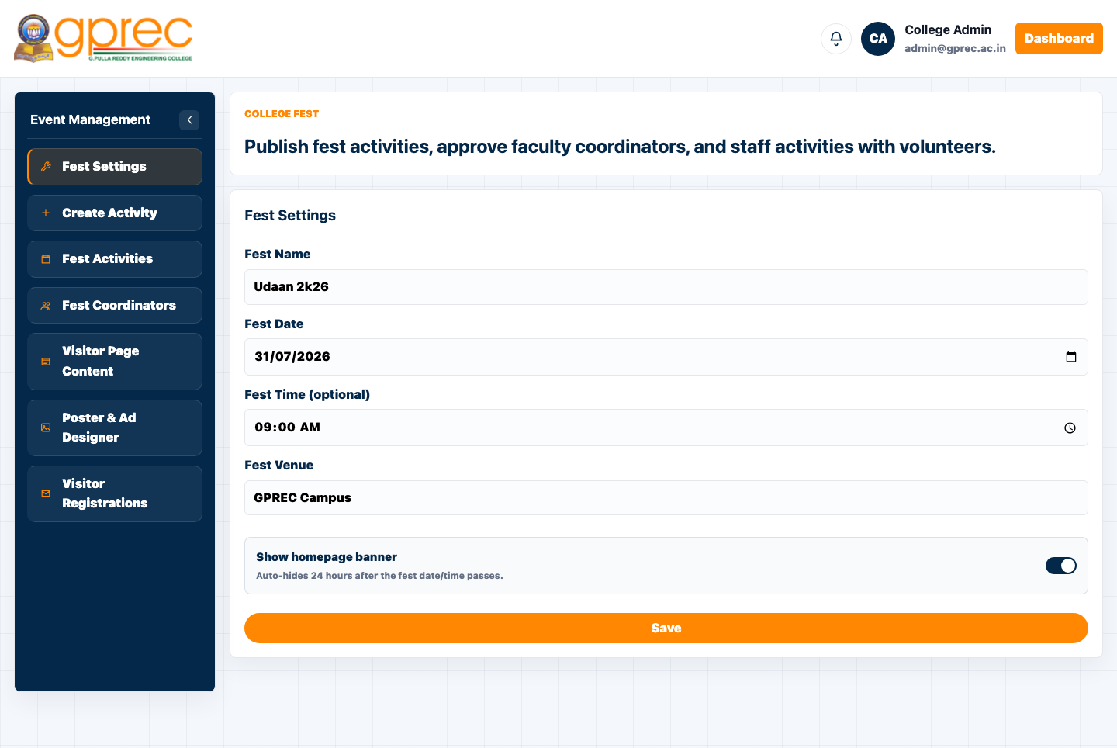
FEST SYSTEM
Event Management Dashboard
Fest Settings, activities, coordinators, and Visitor Page Content
GPREC College Portal
41

Slide 42
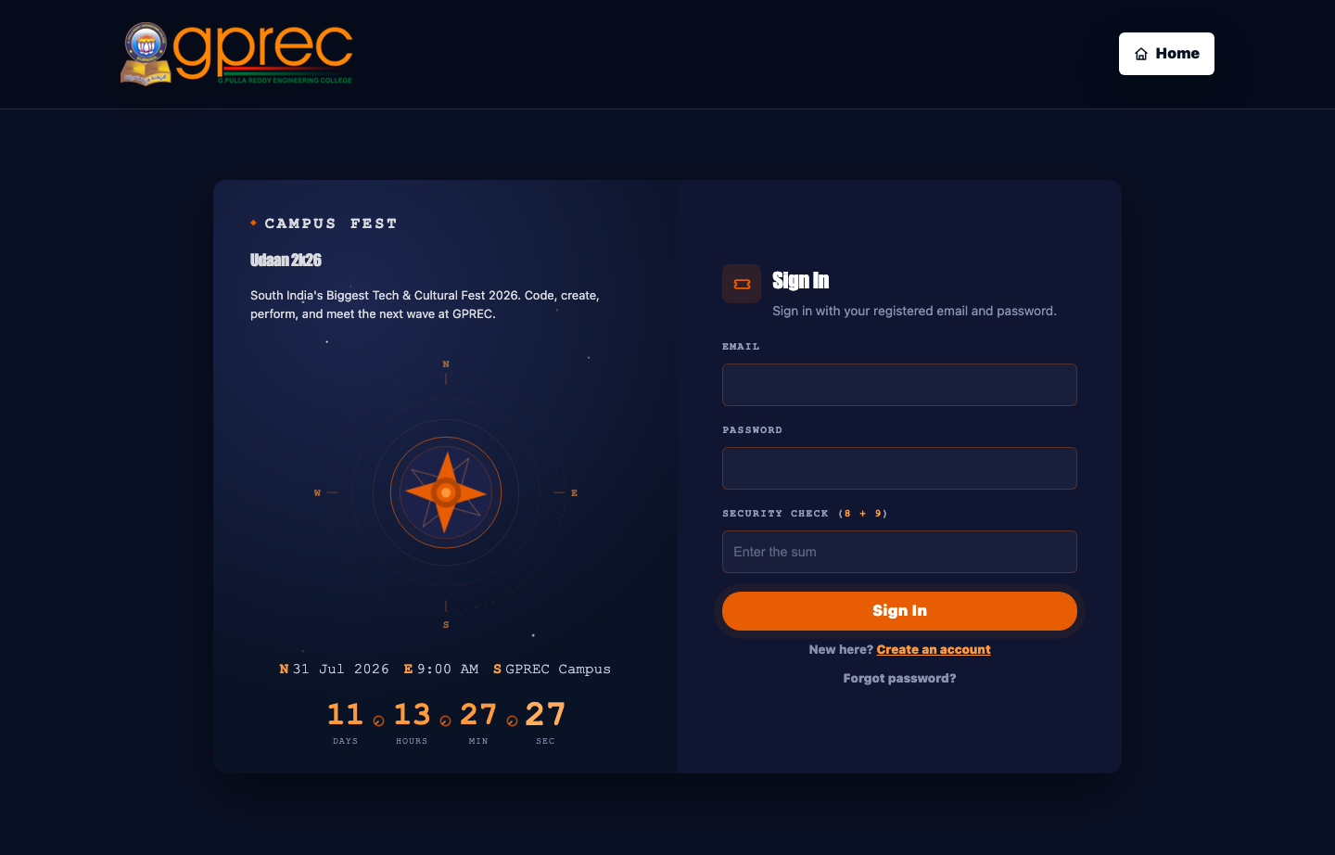
FEST SYSTEM
Public Event Visitor Page
Sign in / create an account to register for fest events
GPREC College Portal
42

Slide 43
DATA
Database Design
Group | Representative Tables
Identity & Auth | admins, faculty, students, guardians, alumni_accounts, non_teaching_staff, event_visitor_accounts, user_credentials
Academics | attendance_records, student_grades, internal_marks, curriculum, class_timetable, assignments
Fees & Payroll | fee_dues, fee_amount_overrides, bank_details
Hostel | hostel_allocations, hostel_outing_requests, hostel_leave_requests
Campus Events / Fest | campus_event_registrations, event_visitor_accounts, activity_log
Content & Comms | notices, notifications, contact_messages, calendar_reminders, site_content
Library | library_books, library_issues, book_favorites
GPREC College Portal
43

Slide 44
DATA
78 Tables · One Schema · gprec_erp
▸ All portal data lives in PostgreSQL under the gprec_erp schema.
▸ A generic site_content key/value table backs every admin-editable content block across the portal (fest settings, poster/ad designs, ticker messages, and more).
▸ Read via a single getSiteContent(key, fallback) helper on the frontend.
▸ Written through one admin-only /api/site-content endpoint on the backend.
GPREC College Portal
44

Slide 45
SECURITY
Security & Access Control
▸ Every dashboard requires a real, server-issued session token matched to its exact role.
▸ Passwords stored salted and hashed (user_credentials table) - never in plain text.
▸ One-time First-Time Setup flow bootstraps the very first admin password, then locks itself.
▸ Self-hosted math CAPTCHAs on every login/signup form.
▸ Server-side login throttling blocks repeated failed attempts per identity.
▸ Role-scoped API authorization on the backend, independent of what the frontend shows or hides.
▸ Uploaded files written to a dedicated uploads/ directory, separate from application code.
GPREC College Portal
45

Slide 46
THIS SESSION
Notable Recent Enhancements
Three features shipped in this development session

Slide 47
ENHANCEMENT 1
Dynamic Fest Content (Event Visitor Page)
▸ Ticker, zone map, announcements, schedule, sponsors, gallery labels, and 6 section blurbs were previously hardcoded on event-visitor-dashboard.html.
▸ Now admin-editable from a new "Visitor Page Content" card in the Event Management Dashboard.
▸ Backed by the existing generic site_content API - no new backend endpoints needed.
▸ Every field falls back to its original placeholder copy until an admin saves real content.
GPREC College Portal
47

Slide 48
ENHANCEMENT 2
Register for Event - Faculty & Admin
▸ Previously only students (and public visitors) could self-register as an event attendee.
▸ Generalised behind one getCampusEventRegistrant() identity resolver.
▸ Keys the registration by roll number (students) or login email (faculty/admin).
▸ Surfaced as a new "Register for Event" section on both the Faculty and Admin dashboards.
▸ Reuses the exact same registration + digital pass flow the student dashboard already had.
GPREC College Portal
48

Slide 49
ENHANCEMENT 3
Manual Check-In - Student Dashboard
▸ Volunteers previously needed a separate, mobile-oriented QR scanner page to check attendees in manually.
▸ New Manual Check-In section added directly to the Student Dashboard's own navigation.
▸ Desktop-friendly - no camera required.
▸ Reuses the existing /campus-event/manual-checkin endpoint unchanged.
GPREC College Portal
49

Slide 50
CONCLUSION
Conclusion
▸ A complete, role-aware digital front door for the college.
▸ Spans a public marketing site through to a full academic and administrative ERP.
▸ Plus a purpose-built system for running the annual fest end-to-end.
▸ A dependency-light stack keeps it easy to run, audit, and extend without a framework build pipeline.
GPREC College Portal
50

Slide 51
FUTURE SCOPE
Future Scope
▸ Native mobile apps (or a PWA) for student and volunteer QR check-in flows.
▸ Deeper analytics/reporting for placements, attendance trends, and fee collection.
▸ Real Google/PayU/SMS integrations wired end-to-end in production.
▸ Automated test coverage for authentication and registration flows.
GPREC College Portal
51

Slide 52
Thank You
GPREC College Portal · gprec.ac.in

