Slide 1


C BYREGOWDA INSTITUTE OF TECHNOLOGY
DEPARTMENT OF COMPUTER SCINCE AND ENGINEERING KOLAR 563101
PROJECT PRESENTATION
ON
MUSIC MANAGEMENT SYSTEM
PRESENTED BY
CHANDAN B (1CK21CS015)
CHANDAN GOWDA M(1CK21CS016)
UNDER THE GUIDANCE OF
PROF.VANITHA L B
ASST.PROF.CES,CBIT

Slide 2

AGENDA
Abstract
Introduction
Existing System
Proposed System
System Specifications
ER Diagram
System Design
Modules
Snapshots
Conclusion
References

Slide 3
ABSTRACT
The Music Database project is to categorize and catalog every single piece of music, for Internet music service, listing record collections, music downloading and sharing, etc.
The System features both on online digital music store and people who are into the online digital music trading activity
Music store have to sale various musical items and each items comes with number of models and variety.
This system will having the ability to store the vendors shop address, their contact number of type of instruments that has been purchased from their shop.
Through this contact information, shop owner will able to contact their vendors whenever they are in need of purchasing any items.

Slide 4
INTRODUCTION
Music Management System is a Website that contains Audio Clips .
User can listen the Songs.
Songs are stored in database in the form of bytes,
Reduces storage space and load
Makes the website quick.

Slide 5
EXISTING SYSTEM
Maintaining customers records was not so easy manually and every time whenever customers visit this music store have to show their customer card to get rebate on any special offers.
If due to any reasons they will lost their card, customer will not able to get exclusive offers while purchasing and have to make new cards by which they have to paid again for taking the same service.
Customers were not free within the shop to search their particular musical items on their own and select under their shop cart.
The manual system was not able to create a virtual environment within their shop by which more working assistants were required to handle the customers and thus increase in investment by which shop owner not able to make more profits.

Slide 6
PROPOSED SYSTEM
With this system audit any particular section can be easily be known by using single option which has been provided under the account section.
Even preparing salary sheet and balance sheet can be easily achieve by using the options available under the account section.
It will also help the shop owner to set salary for each working members within their shop thus saving time and money for preparing final salary sheet for each working employee.

Slide 7

Hardware Requirements
1. Processor : Min IntelX86
2. Memory requirement : Min 20MB
3. Display type resolution : 1366x768 pixel
Software Requirements
1. Software type : XAMPP
2. Implementation Language : PHP, MYSQL
3. Source code lines : About 1000 lines
4. Operating System required : Windows 10

Slide 8
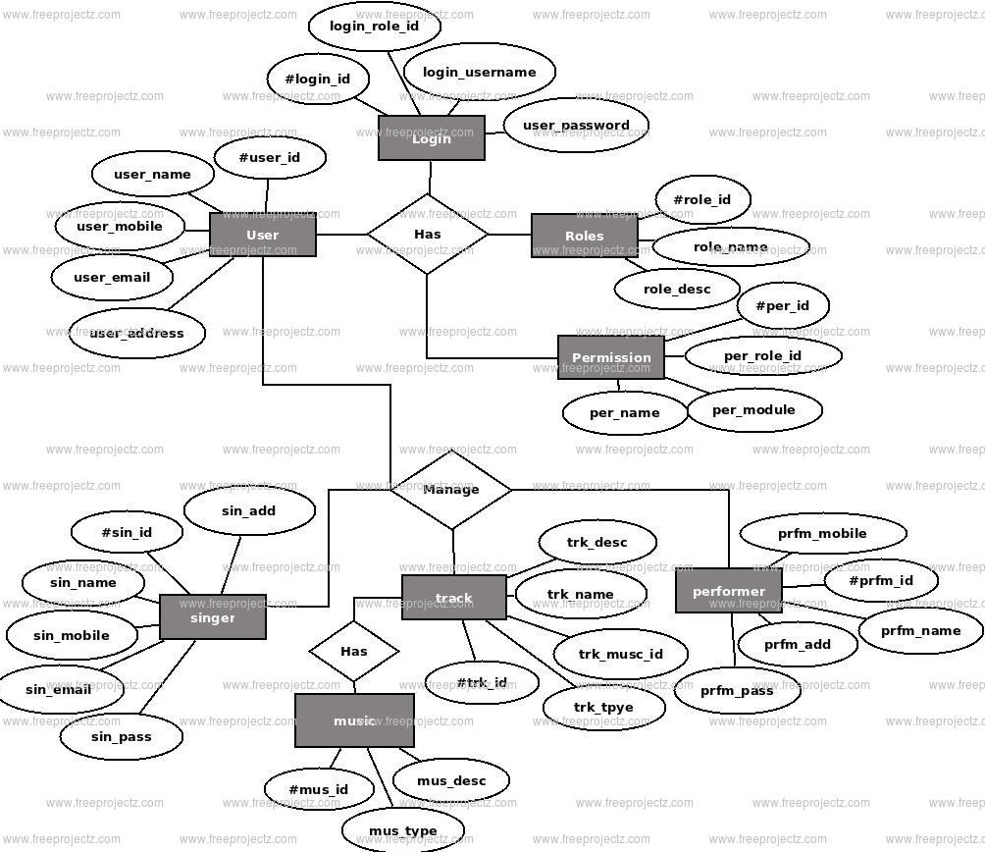
ER DIAGRAM

Slide 9
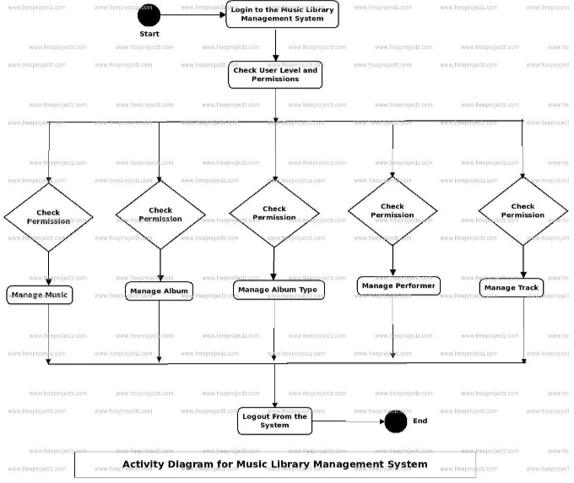
SYSTEM DESIGN

Slide 10
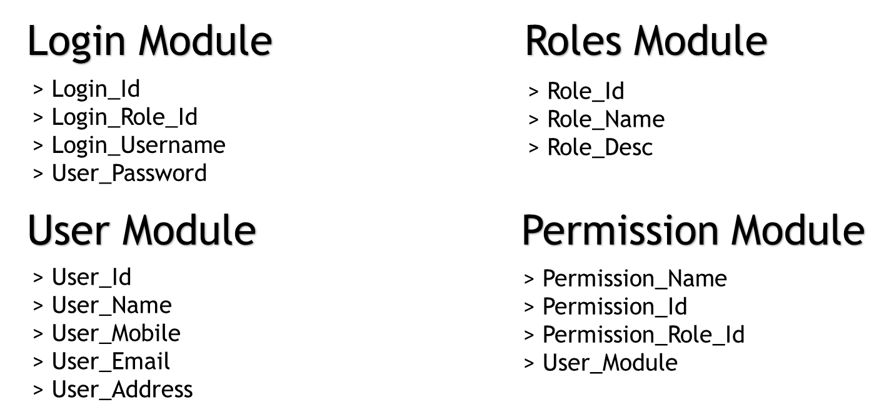
MODULES

Slide 11
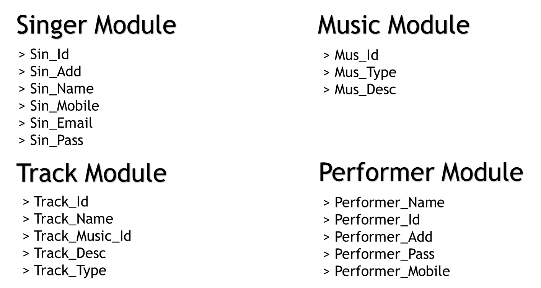

Slide 12
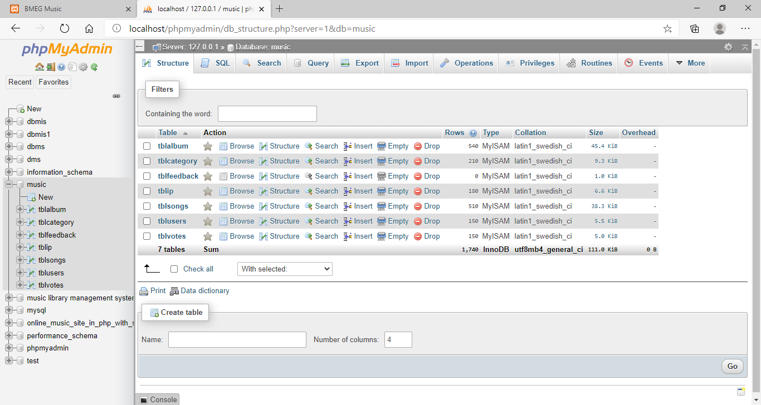
SNAPSHOTS
Table Organization Page

Slide 13
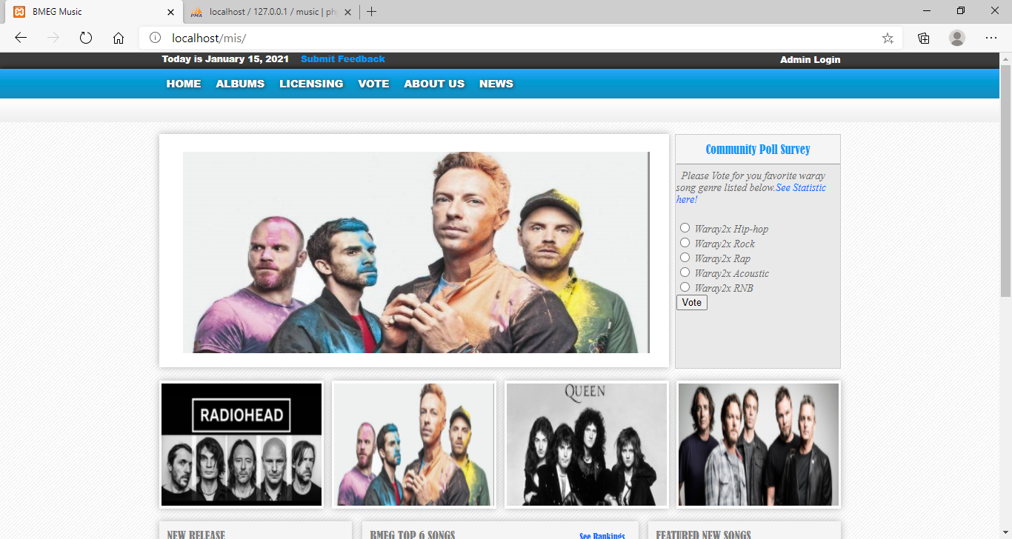
Home Page

Slide 14
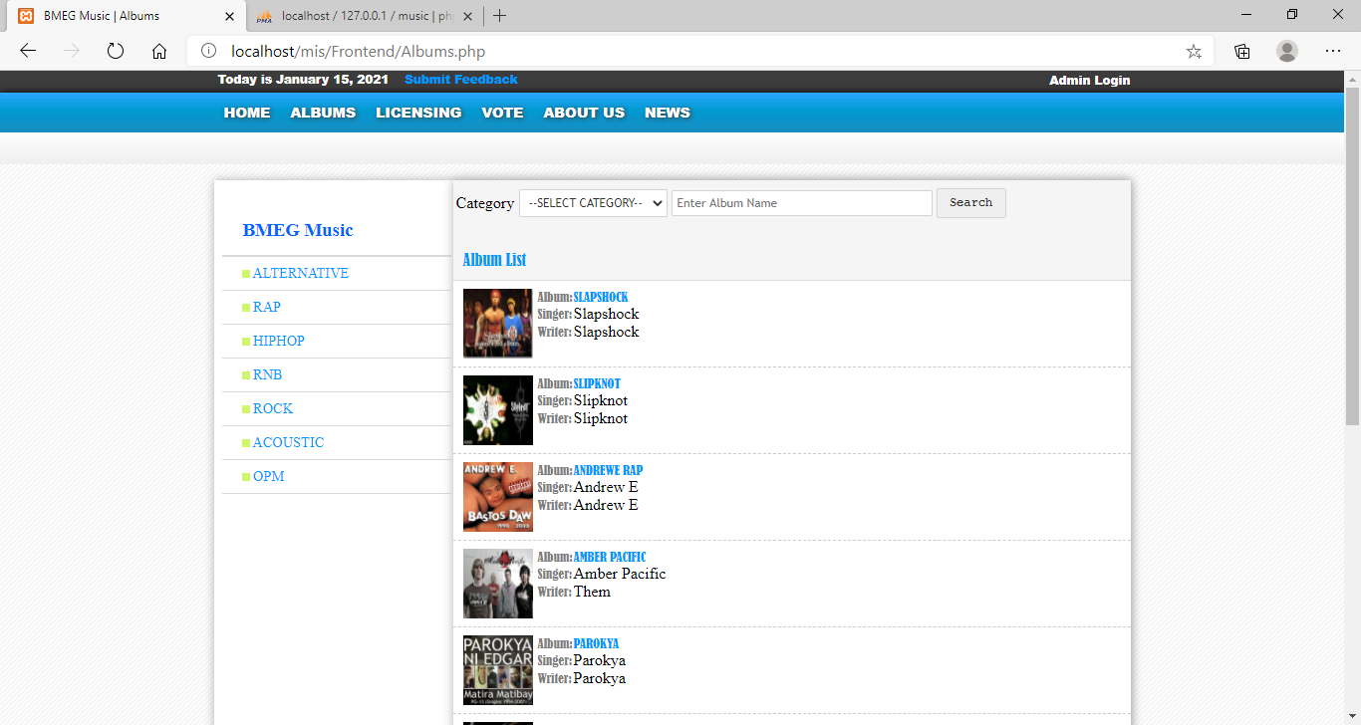
Albums

Slide 15
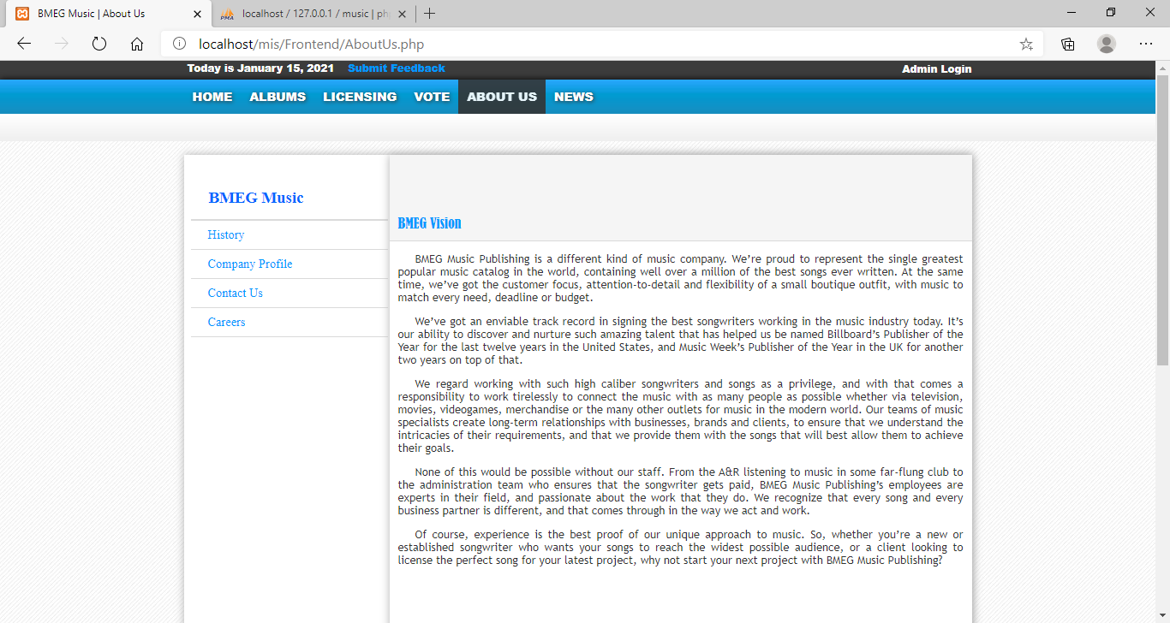
About As

Slide 16
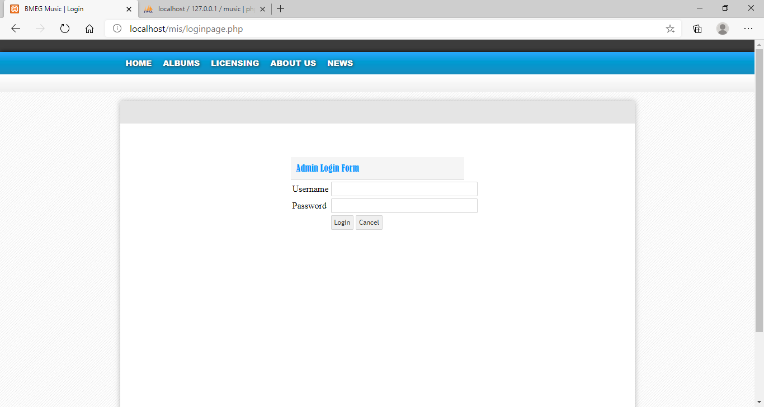
Admin Login Form

Slide 17
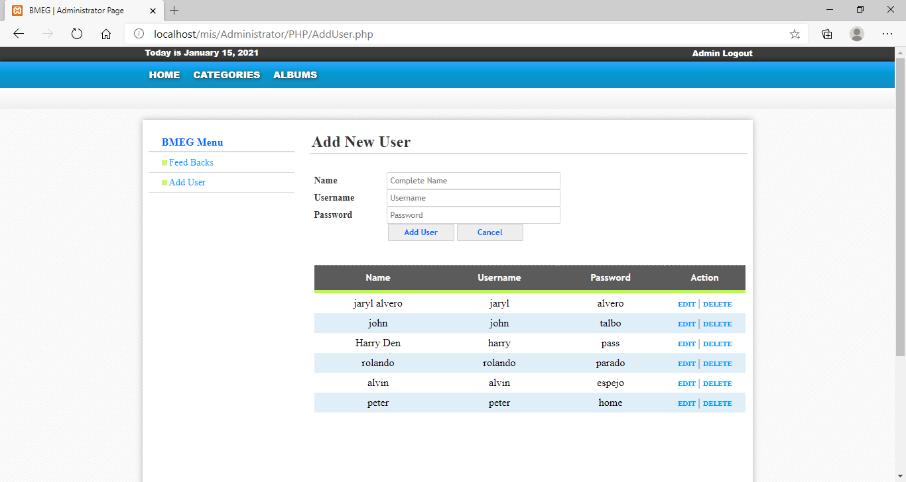
Admin Add New User

Slide 18
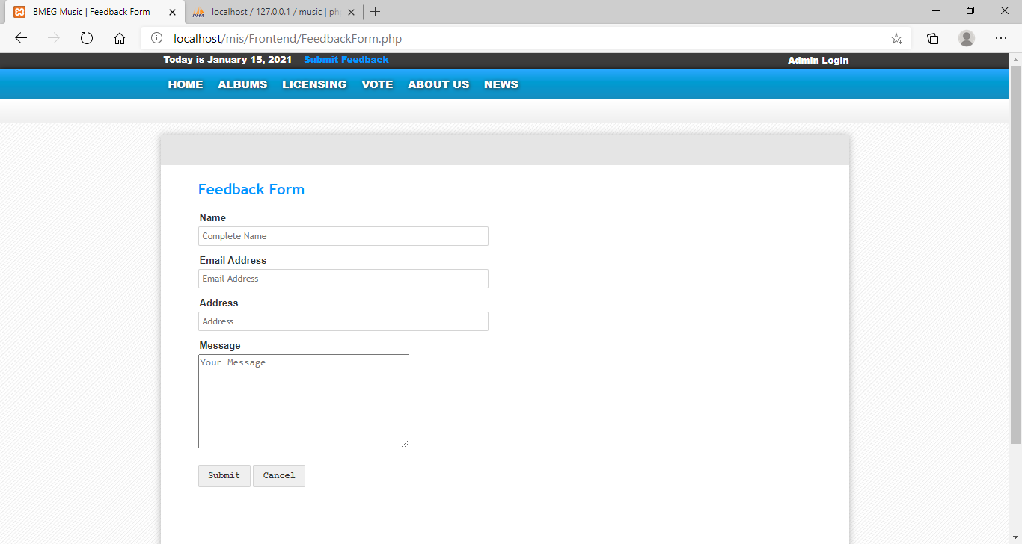
User Feedback Form

Slide 19
CONCLUSION
This Project concentrates on Online Music Streaming
Songs added by Admin, accessed by registered Users
Search a song as per album, genre, Lyrics, artist
Can create Playlists
Can Maintain Favorite Songs
Users can maintain their music files on their account

Slide 20
REFERENCES
Book : Ramez Elmasri and Shamkant B.Navanthe, 7th Edition,2017,Pearson
Book : Ramakrishnan and 3rd Edition, 2014, McGraw Hill Reference
www.freeprojectz.com
www.googlegroups.com/MUKESHKUMAR
www.slideshare.net

Slide 21
Thank You

