Slide 1
AZ-203.3 Module 03: Develop solutions that use a relational database
Subtitle or speaker name
Notes:
In this module, you will cover:
Microsoft Azure SQL Database.
Create, read, update and delete database entities by using code.

Slide 2
Topics
Azure SQL Database
Create, read, update, and delete database entities by using code
Notes:
These are the topics that will be covered in this module.

Slide 3
Lesson 01: Azure SQL Database
Notes:
In this lesson, you will cover:
Azure SQL Database.
Choosing the right SQL option in Azure.
Create a copy of an Azure SQL database.

Slide 4
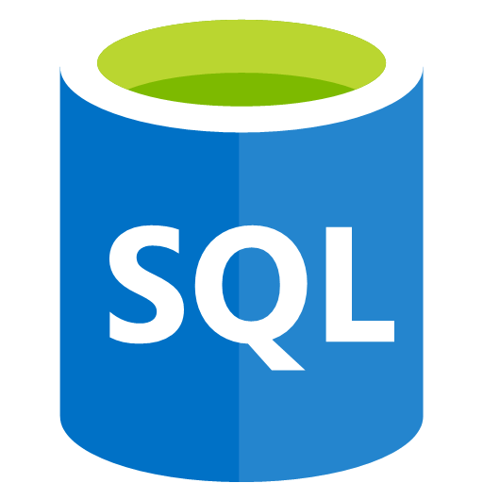

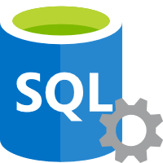
Azure SQL Database
Relational database managed service
Microsoft handles patching and updates
Shares code and features with SQL Server
Two purchasing models
vCore-based compute purchasing
DTU-based throughput purchasing
SQL Database
SQL Server
Notes:
SQL Database is a general-purpose relational database managed service in Microsoft Azure that supports structures such as relational data, JSON, spatial, and XML. SQL Database delivers dynamically scalable performance within two different purchasing models: a vCore-based purchasing model and a DTU-based purchasing model. SQL Database also provides options such as columnstore indexes for extreme analytic analysis and reporting, and in-memory OLTP for extreme transactional processing. Microsoft handles all patching and updating of the SQL code base seamlessly and abstracts away all management of the underlying infrastructure.
SQL Database shares its code base with the Microsoft SQL Server database engine. With the Microsoft cloud-first strategy, the newest capabilities of SQL Server are released first to SQL Database, and then to SQL Server itself. This approach provides you with the newest SQL Server capabilities with no overhead for patching or upgrading—and with these new features tested across millions of databases.

Slide 5

SQL Database Server and SQL Database
SQL Database server
Databases
Tabular data stream protocol
Notes:
Similar to SQL Server, the SQL Database service has two concepts in its hierarchy:
SQL Database server. An SQL Database server is a container for database instances. It provides the ability to establish sign-ins, create a firewall, and expose a tabular, data protocol endpoint. A server is required to create databases. Client devices will connect directly to your logical server in Azure.
SQL database. An SQL database is the implementation of an individual database by using the service, and it includes its tables and any other features.

Slide 6




Azure SQL Database deployment options
SQL Database
(Platform as a Service or PaaS)
Managed instance
Single
Elastic pool
Elastic Pool
Single
Elastic Pool
Managed Instance
Single
Managed Instance
Notes:
Azure SQL Database provides the following deployment options for an Azure SQL Database:
As a part of a collection of databases known as a managed instance that contains system and user databases and shared set of resources.
As a single database with its own set of resources managed via a logical server.
As a pooled database in an elastic pool with a shared set of resources managed via a logical server.

Slide 7
Choosing the right SQL option in Azure
SQL Server on a virtual machine (VM) | Azure SQL Database (Managed Instance) | Azure SQL Database (Logical server)
You have full control over the SQL Server engine Up to 99.95% availability Full parity with the matching version of on-premises SQL Server Fixed, well-known database engine version Easy migration from SQL Server on-premises Private IP address within Azure VNet You have the ability to deploy application or services on the host where SQL Server is placed | High compatibility with SQL Server on-premises 99.99% availability guaranteed Built-in backups, patching, recovery Latest stable Database Engine version Easy migration from SQL Server Private IP address within Azure VNet Built-in advanced intelligence and security Online change of resources (CPU/storage) | The most commonly used SQL Server features are available 99.99% availability guaranteed Built-in backups, patching, recovery Latest stable Database Engine version Ability to assign necessary resources (CPU/storage) to individual databases Built-in advanced intelligence and security Online change of resources (CPU/storage)
Notes:
In Azure, you can have your SQL Server workloads running in a hosted infrastructure (IaaS) or running as a hosted service (PaaS). The key question that you need to ask when deciding between PaaS or IaaS is this: Do you want to manage your database, apply patches, and take backups, or do you want to delegate these operations to Azure? Depending on the answer, you have the following options:
Azure SQL Database
A fully-managed SQL database engine, based on the latest stable Enterprise Edition of SQL Server. This is a relational database as a service (DaaS) hosted in the Azure cloud that falls into the industry category of platform as a service (PaaS). SQL Database is built on standardized hardware and software that is owned, hosted, and maintained by Microsoft. With SQL Database, you can use built-in features and functionality that require extensive configuration in SQL Server. When using SQL Database, you pay as you go, with options to scale up or out for greater power with no interruption. SQL Database has additional features that are not available in SQL Server, such as built-in intelligence and management. Azure SQL Database offers several deployment options:
You can deploy a single database to a logical server. A logical server containing single and pooled databases offers most of database-scoped features of SQL Server. This option is optimized for modern application development of new cloud-born applications.
You can deploy to a Azure SQL Database Managed Instances. With Azure SQL Database Managed Instance, Azure SQL Database offers shared resources for databases and additional instance-scoped features. Azure SQL Database Managed Instance supports database migration from on-premises with minimal to no database change. This option provides all of the PaaS benefits of Azure SQL Database but adds capabilities that were previously only available in SQL VMs. This includes a native virtual network (VNet) and near 100% compatibility with on-premises SQL Server.
SQL Server on Azure Virtual Machines
Infrastructure as a service (IaaS) that allows you to run SQL Server inside a fully managed virtual machine in the Azure cloud. SQL Server virtual machines also run on standardized hardware that is owned, hosted, and maintained by Microsoft. When using SQL Server on a VM, you can either pay as you go for a SQL Server license already included in a SQL Server image or easily use an existing license. You can also stop or resume the VM as needed. SQL Server is installed and hosted in the cloud on Windows Server or Linux virtual machines (VMs) running on Azure, also known as an infrastructure as a service (IaaS). SQL Server on Azure virtual machines is a good option for migrating on-premises SQL Server databases and applications without any database change. All recent versions and editions of SQL Server are available for installation in an IaaS virtual machine. The most significant difference from SQL Database is that SQL Server VMs allow full control over the database engine. You can choose: when maintenance/patching will start, to change the recovery model to simple or bulk logged to enable faster load less log, to pause or start engine when needed, and you can fully customize the SQL Server database engine. With this additional control comes with added responsibility to manage the virtual machines.

Slide 8
SQL option weaknesses
SQL Server on VM | Azure SQL Database (Managed Instance) | Azure SQL Database (Logical server)
You need to manage your backups and patches You need to implement your own high-availability solution There is downtime while changing the resources (CPU/storage) | There is still a minimal number of SQL Server features that are not available No guaranteed exact maintenance time (but nearly transparent) Compatibility with the SQL Server version can be achieved only by using database compatibility levels | Migration from SQL Server might be difficult Some SQL Server features are not available No guaranteed exact maintenance time (but nearly transparent) Compatibility with the SQL Server version can be achieved only by using database compatibility levels Private IP address cannot be assigned (you can limit the access using firewall rules)

Slide 9
Demo: Creating an Azure SQL Database
Notes:
This revision of the course does not ship with demo instructions. For each demo, you will be given a list of specific tasks you should demonstrate to your students. The flow, content and structure of your demo is left to you to decide as an instructor.
In this demo, you should show students how to:
Create a new SQL Server instance using the portal.
Create a new SQL database instance using the portal and the existing server.
Query the SQL database instances using the Azure CLI.

Slide 10
Copying a SQL database
Copy
SQL database
SQL database
Notes:
Besides creating an SQL database, you can also copy an SQL database. The copy feature creates a transactionally-consistent copy of the SQL database and deploys the copy as a new instance.
This copy can be on the same server or a new server instance in Azure.

Slide 11
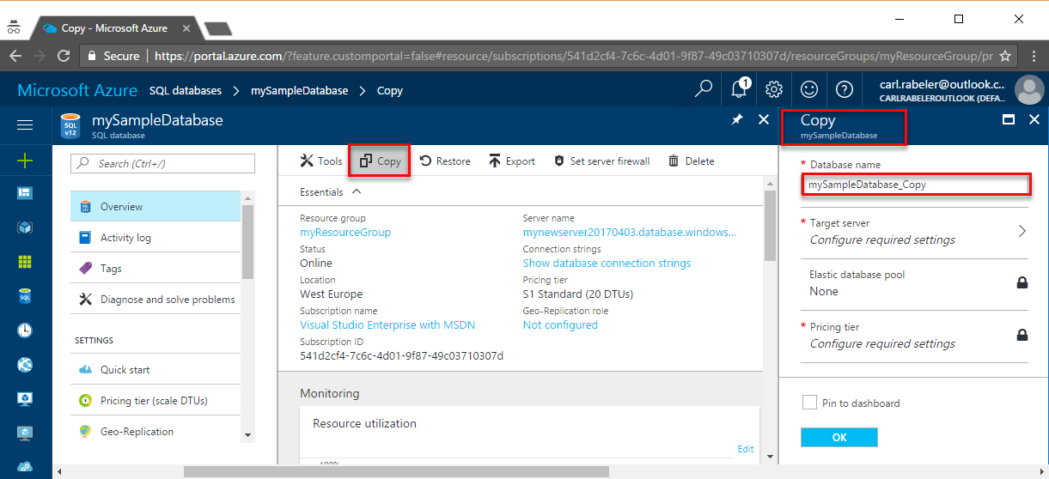
Copy an Azure SQL database - Azure portal
Notes:
A database copy is a snapshot of the source database as of the time of the copy request. You can select the same server or a different server, its service tier and compute size, or a different compute size within the same service tier (edition). After the copy is complete, it becomes a fully functional, independent database. At this point, you can upgrade or downgrade it to any edition. The logins, users, and permissions can be managed independently.
When you copy a database to the same logical server, the same logins can be used on both databases. The security principal that you use to copy the database becomes the database owner on the new database. All database users, their permissions, and their security identifiers (SIDs) are copied to the database copy. When you copy a database to a different logical server, the security principal on the new server becomes the database owner on the new database. If you use contained database users for data access, ensure that both the primary and secondary databases always have the same user credentials, so that after the copy is complete you can immediately access it with the same credentials.
After the new database is online on the destination server, use the ALTER USER statement to remap the users from the new database to logins on the destination server.

Slide 12
Copy an Azure SQL database – Azure PowerShell
New-AzSqlDatabaseCopy `
-ResourceGroupName "myResourceGroup" `
-ServerName $sourceserver `
-DatabaseName "MySampleDatabase" `
-CopyResourceGroupName "myResourceGroup" `
-CopyServerName $targetserver `
-CopyDatabaseName "CopyOfMySampleDatabase"
Notes:
To copy a database by using Azure PowerShell, use the New-AzSqlDatabaseCopy cmdlet..

Slide 13


Importing a .bacpac file
SQL database
.bacpac
Azure Storage
Notes:
If a database is persisted by using the .bacpac file format, you can import that file into the SQL database to create a new database instance. This process is referred to as importing a database.

Slide 14
Importing a .bacpac file - PowerShell
$importRequest = New-AzSqlDatabaseImport
-ResourceGroupName "<your_resource_group>" `
-ServerName "<your_server>" `
-DatabaseName "<your_database>" `
-DatabaseMaxSizeBytes "<database_size_in_bytes>" `
-StorageKeyType "StorageAccessKey" `
-StorageKey "<storage_access_key>"
-StorageUri "https://[account].blob.core.windows.net/example/demo.bacpac" `
-Edition "Standard" `
-ServiceObjectiveName "P6" `
-AdministratorLogin "<your_server_admin_account_user_id>" `
-AdministratorLoginPassword $(ConvertTo-SecureString –String `
"<your_server_admin_account_password>" -AsPlainText -Force)
Notes:
To import a .bacpac file by using PowerShell, use the New-AzSqlDatabaseImport cmdlet.

Slide 15
Exporting a .bacpac file
Check
Status
SQL database
.bacpac
Azure Storage
Notes:
To persist a point-in-time version of a database, you can export a database and save the database copy as a .bacpac file. Typically, this export is done to an Azure Storage account in an asynchronous (or job) manner. You can check on the status of a long-running export job.

Slide 16
Create a .bacpac export job - PowerShell
$exportRequest = New-AzSqlDatabaseExport `
-ResourceGroupName $ResourceGroupName `
-ServerName $ServerName `
-DatabaseName $DatabaseName `
-StorageKeytype $StorageKeytype `
-StorageKey $StorageKey `
-StorageUri $BacpacUri `
-AdministratorLogin $creds.UserName `
-AdministratorLoginPassword $creds.Password
Notes:
Create a new job to export a database in PowerShell by using the New-AzSqlDatabaseExport cmdlet.

Slide 17
Observing a .bacpac export - PowerShell
$exportStatus = Get-AzSqlDatabaseImportExportStatus `
-OperationStatusLink $exportRequest.OperationStatusLink
while ($exportStatus.Status -eq "InProgress")
{
Start-Sleep -s 10
$exportStatus = Get-AzSqlDatabaseImportExportStatus `
-OperationStatusLink $exportRequest.OperationStatusLink
}
$exportStatus
Notes:
Check on the status of a running, or completed export job, by using the Get-AzSqlDatabaseImportExportStatus cmdlet.

Slide 18
Exporting and importing databases
Export
Import
Check
Status
SQL database
SQL database
.bacpac
Azure Storage
Notes:
You will often use a combination of import and export functionalities to implement a specific workflow. For example, you can use a combination of export and import features to:
Create a hot backup of a database.
Migrate a database from one server to another.
Create a replica of a database for test, quality assurance, or staging.

Slide 19
Lesson 02: Create, read, update, and delete database entities by using code
Notes:
In this lesson, you will cover:
Entity Framework.
Entity Framework providers.
Modeling a database by using Entity Framework Core.
Querying databases by using Entity Framework Core.

Slide 20
Entity Framework
Object-relational mapper library for .NET
Designed to reduce the impedance mismatch between the relational and object-oriented world
Goal is to enable developers to interact with data stored in relational databases by using strongly typed .NET objects that represent the application's domain
Eliminates the need for a large portion of the data access "plumbing" code that they usually need to write to access data in a database
Notes:
Entity Framework is an object-relational mapper library for Microsoft .NET that is designed to reduce the impedance mismatch between the relational and object-oriented worlds. The goal of the library is to enable developers to interact with data stored in relational databases by using strongly typed .NET objects that represent the application's domain and to eliminate the need for a large portion of the data access "plumbing" code that they usually need to write to access data in a database.

Slide 21
Entity Framework Core and Entity Framework
Entity Framework Core (EF Core) is a recent rewrite of the entire Entity Framework library to target .NET standard
Entity Framework Core can be used with .NET Framework applications and .NET Core applications
Entity Framework Core was built to be more lightweight and agile than the full Entity Framework, by dropping many of the earlier features from Entity Framework and implementing new, modern, and extensible features at an agile pace
For new applications, we recommend considering using Entity Framework Core over Entity Framework
Notes:
Entity Framework Core (EF Core) is a recent rewrite of the entire Entity Framework library to target .NET Standard. Entity Framework Core can be used with .NET Framework applications and .NET Core applications. Entity Framework Core was built to be more lightweight and agile than the full Entity Framework by dropping many of the earlier features from Entity Framework and implementing new, modern, and extensible features at an agile pace. For new applications, we recommend considering using Entity Framework Core over Entity Framework.

Slide 22






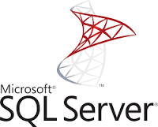
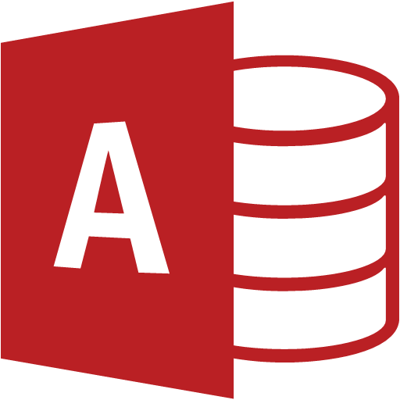
Entity framework providers
There are many database providers in the current market, including:
SQL Server
PostgreSQL
MyCAT
DB2
Firebird
Informix
Microsoft Access
Notes:
The Entity Framework (EF) provider model allows EF to be used with different types of database servers. For example, one provider can be plugged in to allow EF to be used against SQL Server, whereas another provider can be plugged in to allow EF to be used against Oracle Database. There are many current providers in the market for databases, including:
SQL Server
SQLite
PostgreSQL
MySQL
MariaDB
MyCAT Server
SQL Server Compact
Firebird
DB2
Informix
Oracle
Microsoft Access
Note: If a provider you need is unavailable, you can write a provider yourself, although you should understand that it will not be a trivial undertaking.
Entity Framework Core also ships with an InMemory provider. This database provider allows Entity Framework Core to be used with an in-memory database. The InMemory provider is useful when you want to test components by using something that approximates connecting to the real database, without the overhead of actual database operations.
Note: EF Core database providers do not have to be relational databases. InMemory is designed to be a general-purpose database for testing and is not designed to mimic a relational database.

Slide 23
MySQL providers
MySql.Data.EntityFrameworkCore
https://aka.ms/AA4gbio
Pomelo.EntityFrameworkCore.MySql
https://aka.ms/AA4gbih
Notes:
The MySQL team maintains a database provider for both Entity Framework and Entity Framework Core as part of the MySQL Connector for .NET library. Along with the MySQL team, other third-party groups have written providers for MySQL. Two of the MySQL providers are:
MySql.Data.EntityFrameworkCore (https://aka.ms/AA4gbio).
Pomelo.EntityFrameworkCore.MySql (https://aka.ms/AA4gbih).

Slide 24
PostgreSQL providers
Npgsql.EntityFrameworkCore.PostgreSQL
https://aka.ms/AA4gbii
Devart.Data.PostgreSql.EFCore
https://aka.ms/AA4gj9r
PostgreSQL
Notes:
There are multiple third-party organizations that have written .NET libraries to access PostgreSQL. Many of them have rewritten their Entity Framework providers to support Entity Framework Core. These libraries include:
Npgsql.EntityFrameworkCore.PostgreSQL (https://aka.ms/AA4gj9r).
Devart.Data.PostgreSql.EFCore (https://aka.ms/AA4gj9r).

Slide 25
Modeling a database by using Entity Framework Core
BlogId | URL | Description
1 | /first-post | This is my first post on this platform
2 | /follow-up-post | NULL
public class Blog
{
public int BlogId { get; set; }
public string Url { get; set; }
public string Description { get; set; }
}
Notes:
To use Entity Framework to query, insert, update, and delete data using .NET objects, you first must create a model that maps the entities and relationships defined in your model to tables in a database.
Entity Framework uses a set of conventions to build a model based on the shapes of your entity classes. You can specify additional configuration to supplement and override what was discovered by convention. The conventions can be applied to a model targeting any data store and when targeting any relational database. Providers might also enable a configuration that is specific to a particular data store.
First, let’s observe how we can model a database with a single table named Blogs.
If we want to use plain-old CLR objects (POCOs), such as existing domain objects, to model this table, we would have a class that is similar to the code on the slide.

Slide 26
Modeling classes
public class BlogDatabase
{
public IEnumerable<Blog> Blogs { get; set; }
}
Notes:
Logically, our database has a table that is a collection of these blog instances. Without knowing anything about Entity Framework, we would probably create a class similar to the code on the slide.

Slide 27
Entity Framework fluent API
protected override void OnModelCreating(ModelBuilder modelBuilder)
{
modelBuilder.Entity<Blog>()
.HasKey(c => c.BlogId)
.Property(b => b.Url)
.IsRequired()
.Property(b => b.Description);
}
Notes:
Now, we need to find a way to mark these classes in C# as models of our database. Including a type in the model means that Entity Framework has metadata about that type and will attempt to read and write instances from and to the database. There are two methods for modeling a database: the fluent API or data annotations.
You can override the OnModelCreating method in your derived context class and use the ModelBuilder API to configure your model. This is the most powerful method of configuration and allows the configuration to be specified without modifying your entity classes. The fluent API configuration has the highest precedence and will override conventions and data annotations.

Slide 28
Entity Framework data annotations
public class Blog
{
[Key]
public int BlogId { get; set; }
[Required]
public string Url { get; set; }
public string Description { get; set; }
}
Notes:
You can apply attributes, known as data annotations, to your classes and properties. Data annotations will override conventions but will be overwritten by a fluent API configuration (if it exists).

Slide 29
Entity Framework DbContext implementation
public class BlogContext : DbContext
{
public DbSet<Blog> Blogs { get; set; }
}
Notes:
After you have a model, the primary class your application interacts with is System.Data.Entity.DbContext (often referred to as the context class). You can use a DbContext class associated to a model to:
Write and execute queries.
Materialize query results as entity objects.
Track changes that are made to those objects.
Persist object changes back on the database.
Bind objects in memory to UI controls.
We recommended that you work with the context by defining a class that derives from DbContext and exposes DbSet properties that represent collections of the specified entities in the context.

Slide 30
Querying databases by using Entity Framework Core
List<Blog> allblogs = context.Blogs.ToList();
IEnumerable<Blog> someblogs = context.Blogs
.Where(b => b.Url.Contains("dotnet"))
Blog specificblog = context.Blogs
.Single(b => b.BlogId == 1);
Notes:
The DbSet<> generic class includes methods that will allow you to query your database by using language-integrated query (LINQ).
If you are already familiar with the LINQ syntax, you can perform many queries in Entity Framework Core without the need to learn too much. This is because the DbSet<>generic class implements the IEnumerable<> interface, giving you access to many of the existing LINQ queries.
For example, you can load all the data from a table by enumerating the collection with a call to the ToList method.
You can use LINQ methods such as the Where method to filter your resulting list.
You can also use the Single method to get a single instance that matches a specific filter.
When you call LINQ operators, you are simply building up an in-memory representation of the query. The query is sent to the database only when the results are consumed (enumerated).

Slide 31
Creating records by using Entity Framework
using (var context = new BlogContext())
{
var blog = new Blog { Url = "/sample-post", Description = "This is an example of a post." };
context.Blogs.Add(blog);
context.SaveChanges();
Console.WriteLine(blog.BlogId + ": " + blog.Url);
}
Notes:
You can also use the Add method of the DbSet<> class and the SaveChanges method of the DbContext class to persist new records to the database.
Note: Remember that all changes to entities are tracked but not persisted until you call SaveChanges.

Slide 32
Modifying records by using Entity Framework
using (var context = new BlogContext())
{
var blog = context.Blogs.First();
blog.Url = "/original-post";
context.SaveChanges();
}
Notes:
Because entity changes are tracked, you can use Entity Framework to query for entities from a database, make a change and then call SaveChanges to persist that change to the database.

Slide 33
Demo: Writing Entity Framework code by using C#
Notes:
This revision of the course does not ship with demo instructions. For each demo, you will be given a list of specific tasks you should demonstrate to your students. The flow, content and structure of your demo is left to you to decide as an instructor.
In this demo, you should show students how to:
Add Entity Framework to a .NET Core project.
Use Entity Framework to create database and table entities.
Issue queries to a SQL Database using LINQ and Entity Framework.

Slide 34
Review
Azure SQL Database
Create, read, update, and delete database entities by using code
Notes:
These are the topics that we discussed in this module.

