Slide 1
AZ-203.5 Module 02: Develop for code scalability
Subtitle or speaker name
Notes:
In this module, you will cover:
Implement autoscale.
Implement code that addresses singleton instances.
Implement code that handles transient faults.

Slide 2
Topics
Implement Autoscale
Implement code that addresses singleton instances
Implement code that handles transient faults
Notes:
These are the topics that will be covered in this module.

Slide 3
Lesson 01: Implement Autoscale
Notes:
In this lesson, you will cover:
Autoscale.
Autoscale patterns.
Autoscale setting schema.
Best practices.

Slide 4
Autoscale
A primary advantage of the cloud is elastic scaling (the ability to use as much capacity as you need)
Scaling out as load increases
Scaling in when the extra capacity is not needed
Many Microsoft Azure services provide the capability to scale both manually and automatically
Autoscale refers to the capability of many of these services to monitor the application instances and automatically scale appropriately to handle the current usage of the application
Using autoscale, your cloud service can scale out and in to exactly match the amount of instances needed for your specific computing pattern
Notes:
Autoscale is a built-in feature of Azure Cloud Services, Mobile Services, Virtual Machines, and websites that helps applications perform their best when demand changes. Of course, performance means different things for different applications. Some apps are CPU bound, others memory bound. For example, you could have a web app that handles millions of requests during the day and none at night. Autoscale can scale your service by any of these—or by a custom metric you define.

Slide 5
Autoscale metrics
Metric | Metric identifier | Description
CPU | CpuPercentage | The average amount of CPU time used across all instances of the plan
Memory | MemoryPercentage | The average amount of memory used across all instances of the plan
Data in | BytesReceived | The average incoming bandwidth used across all instances of the plan
Data out | BytesSent | The average outgoing bandwidth used across all instances of the plan
HTTP queue | HttpQueueLength | The average number of both read and write requests that were queued on storage. A high disk queue length is an indication of an application that might be slowing down due to excessive disk I/O.
Disk queue | DiskQueueLength | The average number of HTTP requests that had to sit in the queue before being fulfilled. A high or increasing HTTP queue length is a symptom of a plan under a heavy load.
Notes:
Azure Monitor autoscaling allows you to scale the number of running instances up or down, based on telemetry data (metrics).
By default, Resource Manager-based virtual machines (VMs) and virtual machine scale sets (VMSSs) emit basic (host-level) metrics. In addition, when you configure diagnostics data collection for an Azure VM and VMSS, the Azure diagnostic extension also emits guest-OS performance counters (commonly known as guest-OS metrics). You use all these metrics in autoscale rules.
You can also perform autoscale based on common web server metrics such as the Http queue length. It's metric name is HttpQueueLength. This table lists available server farm (Web Apps) metrics.
You can scale by Storage queue length, which is the number of messages in the storage queue. Storage queue length is a special metric and the threshold is the number of messages per instance. For example, if there are two instances and if the threshold is set to 100, scaling occurs when the total number of messages in the queue is 200. That can be 100 messages per instance, 120 and 80, or any other combination that adds up to 200 or more.
You can scale by Service Bus queue length, which is the number of messages in the Service Bus queue. Service Bus queue length is a special metric and the threshold is the number of messages per instance. For example, if there are two instances and if the threshold is set to 100, scaling occurs when the total number of messages in the queue is 200. That can be 100 messages per instance, 120 and 80, or any other combination that adds up to 200 or more.

Slide 6
Autoscale patterns
Scale based on CPU
Scale differently on weekdays vs. weekends
Scale differently during holidays
Scale based on custom metric
Notes:
Azure Monitor Autoscale applies only to Virtual Machine Scale Sets, Cloud Services, App Service - Web Apps, and API Management services.

Slide 7
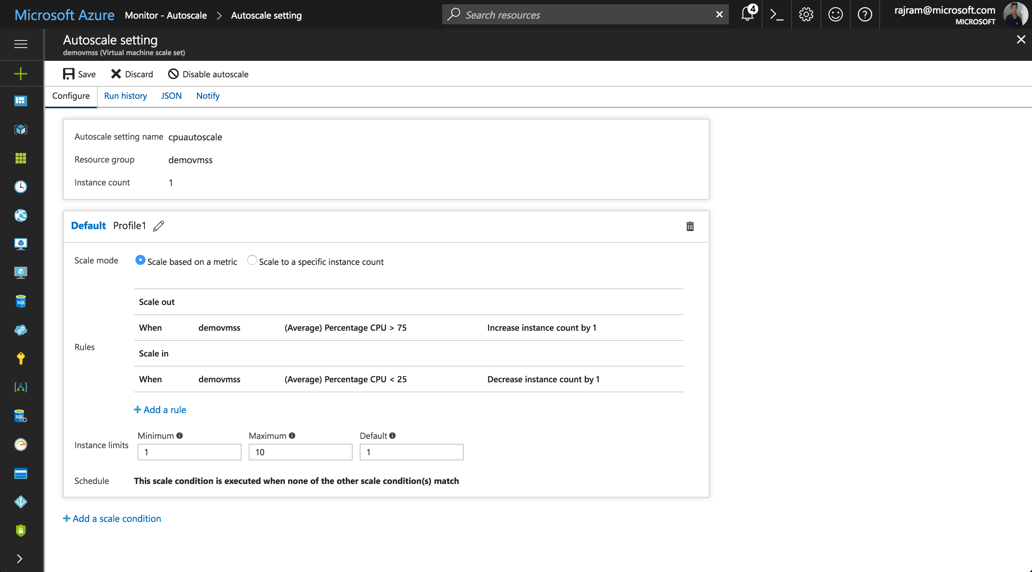
Scale based on CPU
Notes:
You have a web app (/VMSS/cloud service role) and:
You want to scale out/scale in based on CPU.
Additionally, you want to ensure there is a minimum number of instances.
Also, you want to ensure that you set a maximum limit to the number of instances you can scale to.

Slide 8
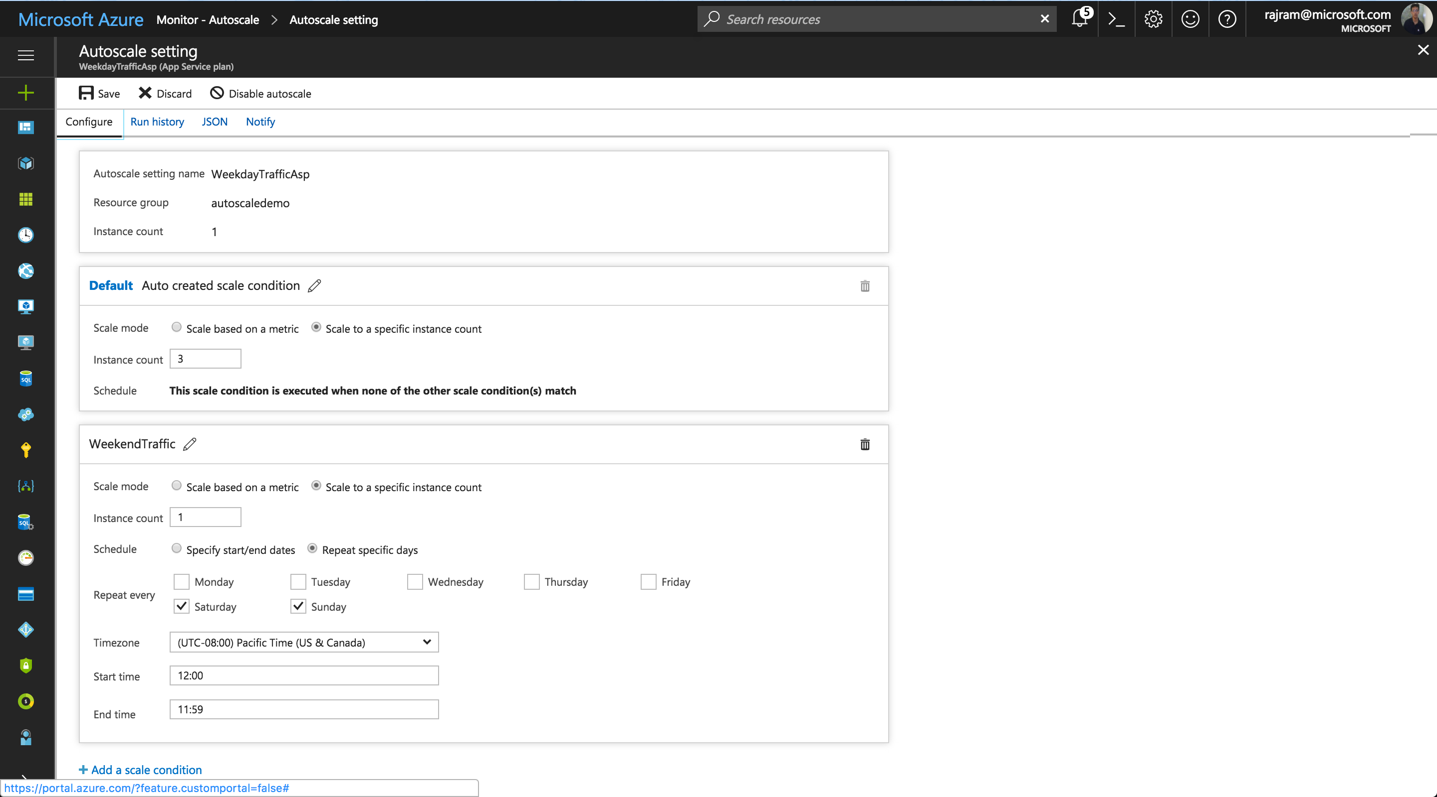
Scale differently on weekdays vs. weekends
Notes:
You have a web app (/VMSS/cloud service role) and:
You want three instances by default (on weekdays).
You don't expect traffic on weekends and therefore you want to scale down to 1 instance on weekends.

Slide 9
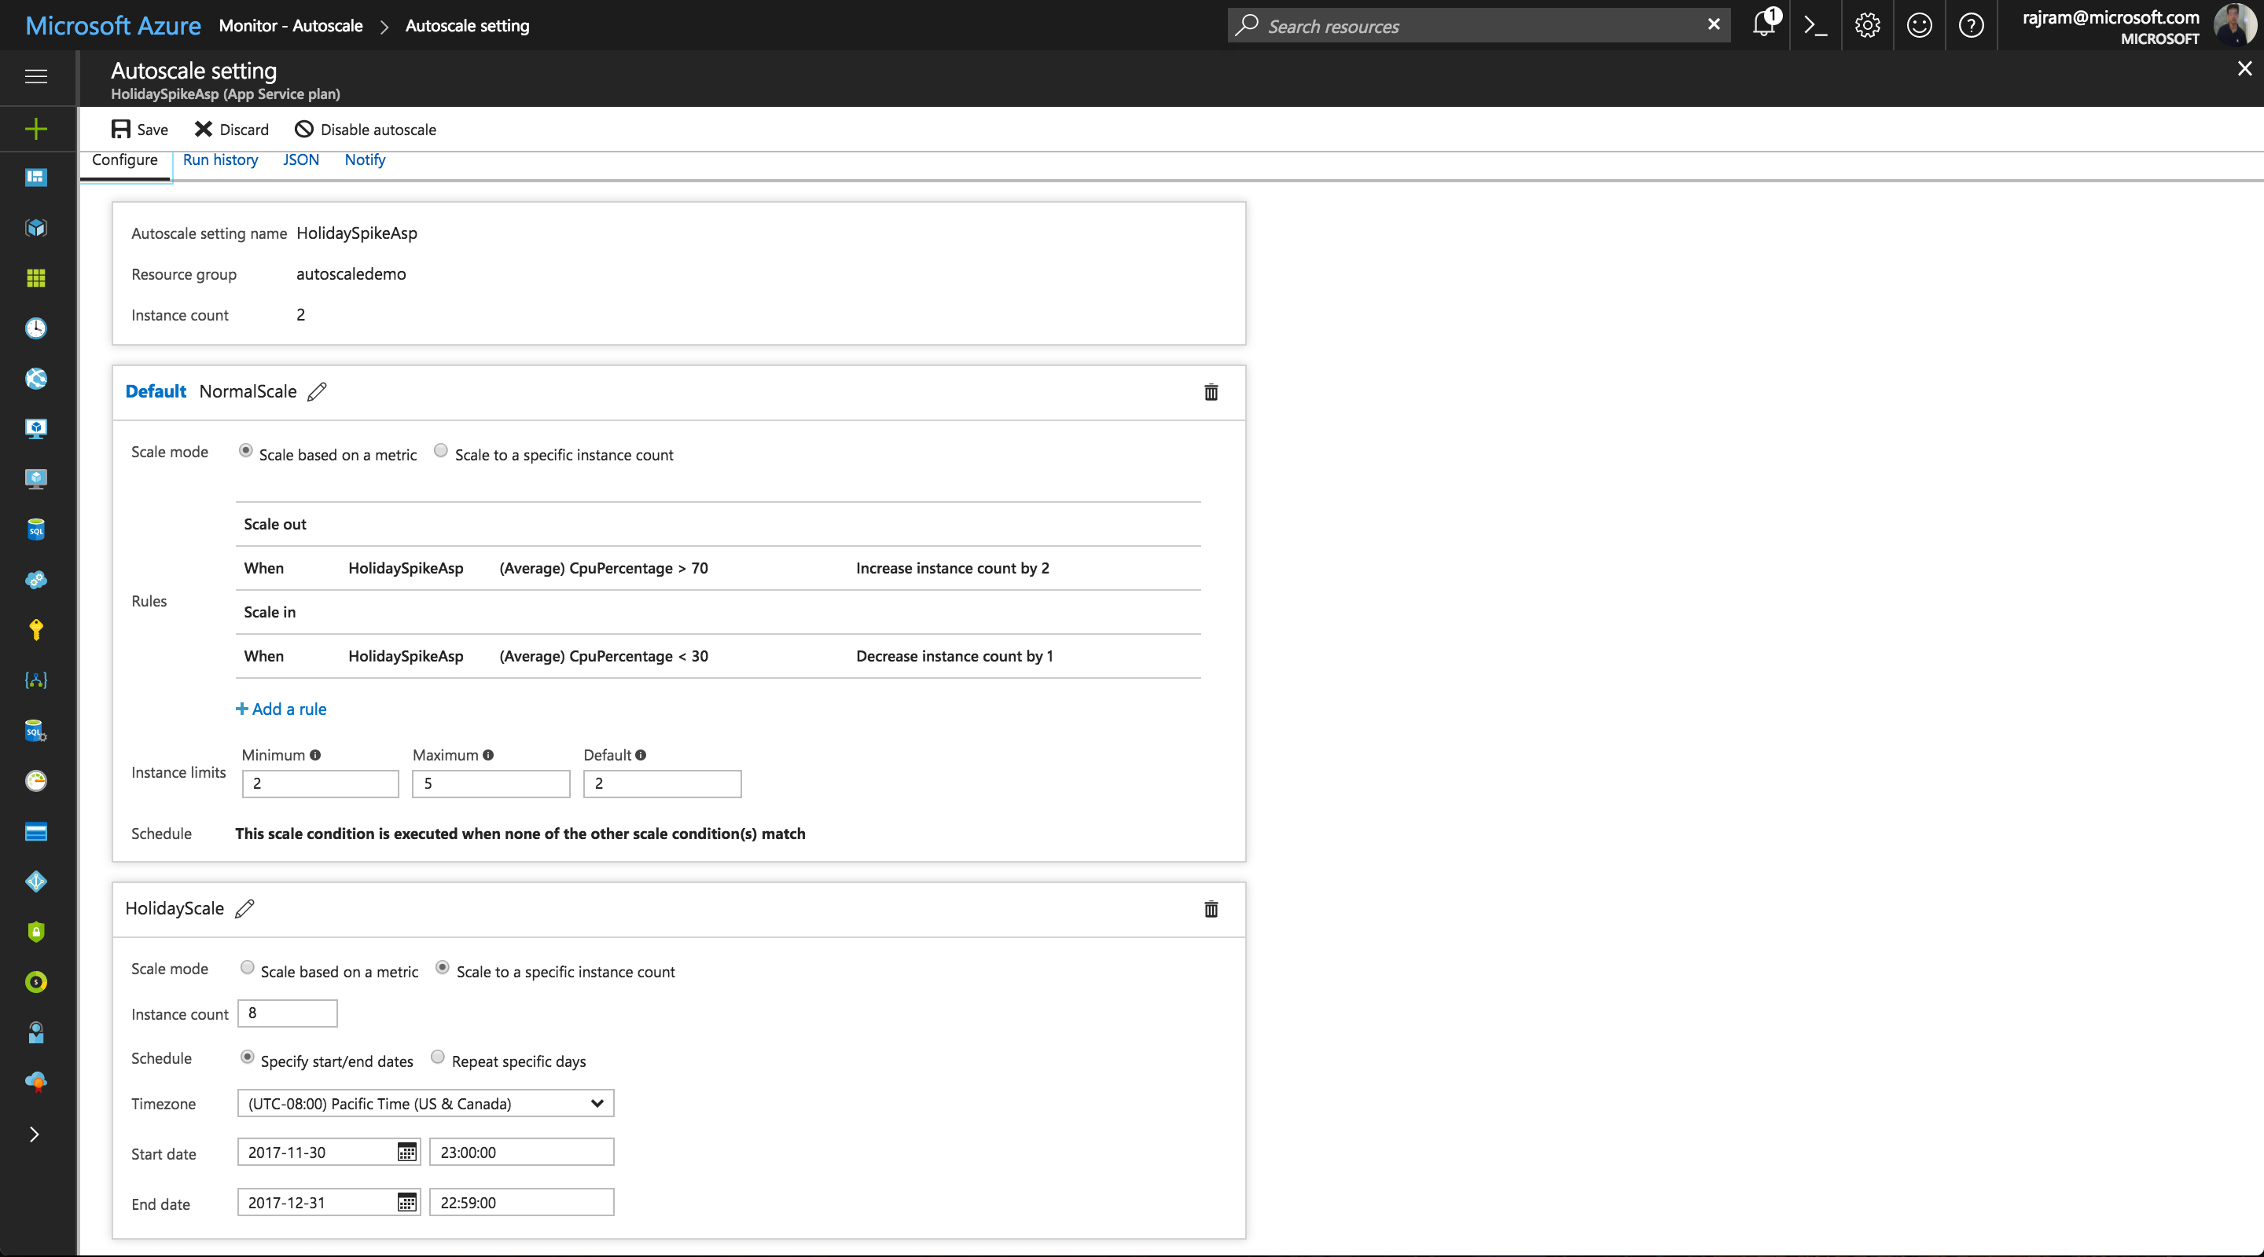
Scale differently during holidays
Notes:
You have a web app (/VMSS/cloud service role) and:
You want to scale up/down based on CPU usage by default.
However, during holiday season (or specific days that are important for your business) you want to override the defaults and have more capacity at your disposal.

Slide 10
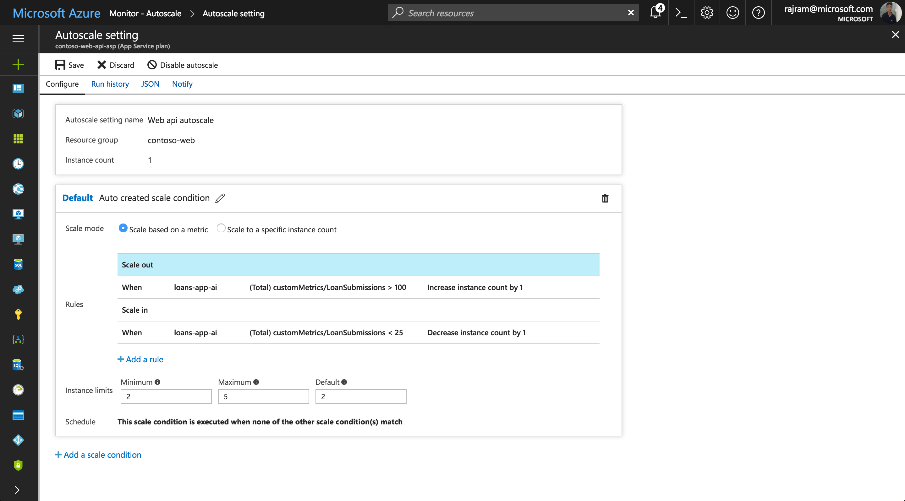
Scale based on custom metric

Slide 11
Autoscale setting schema
{
"id": "...", "name": "demoSetting", "type": "Microsoft.Insights/autoscaleSettings",
"location": "East US",
"properties": {
"enabled": true, "targetResourceUri": "...",
"profiles": [
{
"name": "mainProfile",
"capacity": {
"minimum": "1", "maximum": "4", "default": "1"
},
"rules": [ ... ]
}
]
}
}
Notes:
Autoscale settings help ensure that you have the right amount of resources running to handle the fluctuating load of your application. You can configure autoscale settings to be triggered based on metrics that indicate load or performance, or triggered at a scheduled date and time.
To illustrate the autoscale setting schema, this autoscale setting has:
One profile.
An array of profiles and an array of rules.

Slide 12
Autoscale setting schema – scale-out rule
{
"metricTrigger": {
"metricName": "Percentage CPU", "metricResourceUri": "...",
"timeGrain": "PT1M",
"statistic": "Average",
"timeWindow": "PT10M",
"timeAggregation": "Average",
"operator": "GreaterThan",
"threshold": 85
},
"scaleAction": {
"direction": "Increase", "type": "ChangeCount",
"value": "1",
"cooldown": "PT5M"
}
}
Notes:
To illustrate the autoscale setting schema, this autoscale setting has:
Two metric rules in this profile: one for scale out, and one for scale in.
The scale-out rule is triggered when the virtual machine scale set's average percentage CPU metric is greater than 85 percent for the past 10 minutes.

Slide 13
Autoscale setting schema – scale-in rule
{
"metricTrigger": {
"metricName": "Percentage CPU", "metricResourceUri": "...",
"timeGrain": "PT1M",
"statistic": "Average",
"timeWindow": "PT10M",
"timeAggregation": "Average",
"operator": "LessThan",
"threshold": 60
},
"scaleAction": {
"direction": "Decrease", "type": "ChangeCount",
"value": "1",
"cooldown": "PT5M"
}
}
Notes:
To illustrate the autoscale setting schema, this autoscale setting has:
Two metric rules in this profile: one for scale out, and one for scale in.
The scale-in rule is triggered when the virtual machine scale set's average is less than 60 percent for the past minute.

Slide 14
Autoscale setting schema – fixed date profile
"fixedDate": {
"timeZone": "Pacific Standard Time",
"start": "2020-12-26T00:00:00",
"end": "2020-12-26T23:59:00"
}
Notes:
This profile is for special cases. For example, let’s say you have an important event coming up on December 26, 2020 (PST). You want the minimum and maximum capacities of your resource to be different on that day, but still scale on the same metrics. In this case, you should add a fixed date profile to your setting’s list of profiles. The profile is configured to run only on the event’s day. For any other day, Autoscale uses the regular profile.

Slide 15
Autoscale setting schema – weekdays and weekends
"recurrence": {
"frequency": "Week",
"schedule": {
"timeZone": "Pacific Standard Time",
"days": [
"Saturday"
],
"hours": [
0
],
"minutes": [
0
]
}
}
Notes:
Let’s say that on weekends, you want your maximum capacity to be 4. On weekdays, because you expect more load, you want your maximum capacity to be 10. In this case, your setting would contain two recurrence profiles, one to run on weekends and the other on weekdays.
The JSON setting displayed here shows that each recurrence profile has a schedule. This schedule determines when the profile starts running. The profile stops when it’s time to run another profile.
For example, in the JSON setting displayed here, “weekdayProfile” is set to start on Monday at 12:00 AM. That means this profile starts running on Monday at 12:00 AM. It continues until Saturday at 12:00 AM, when “weekendProfile” is scheduled to start running.

Slide 16
Demo: Autoscale by using custom metrics
Notes:
This revision of the course does not ship with demo instructions. For each demo, you will be given a list of specific tasks you should demonstrate to your students. The flow, content and structure of your demo is left to you to decide as an instructor.
In this demo, you should show students how to:
Create a App Service plan resource.
Define a new custom metric using Application Insights.
Create a new autoscale rule in the App Service plan using the custom metric as criteria.

Slide 17
Autoscale concepts
Each resource can have one autoscale setting
Autoscale settings can have one-to-many profiles
Profiles can have one-to-many rules
Autoscale increases instances horizontally within bounds
Bounds are set by using the minimum, maximum, and default values
Thresholds are calculated at an instance level
Autoscale successful actions and failures are logged to the Activity Log
Notes:
A resource can have only one autoscale setting.
An autoscale setting can have one or more profiles, and each profile can have one or more autoscale rules.
An autoscale setting scales instances horizontally, which is moved out by increasing the instances and in by decreasing the number of instances. An autoscale setting has a maximum, minimum, and default value of instances.
An autoscale job always reads the associated metric to scale by checking if it has crossed the configured threshold for scale-out or scale-in.
All thresholds are calculated at an instance level. For example, "scale out by one instance when average CPU > 80% when instance count is 2", means scale-out when the average CPU across all instances is greater than 80%.
All autoscale failures are logged to the Activity Log. You can then configure an activity log alert so that you can be notified via email, SMS, or webhooks whenever there is an autoscale failure.
Similarly, all successful scale actions are posted to the Activity Log. You can then configure an activity log alert so that you can be notified via email, SMS, or webhooks whenever there is a successful autoscale action. You can also configure email or webhook notifications to get notified for successful scale actions via the notifications tab on the autoscale setting.

Slide 18

Autoscale thresholds
Scale is constrained to a minimum and maximum
Your current instance count must be between the minimum and maximum
Minimum can help guarantee availability
Maximum can help control costs
Min = 2
+/- VMs as needed
Max = 5
VM
VM
VM
VM
VM
3 currently running
Notes:
With autoscale, you can add the right amount of resources to handle increased load on your application. It also helps you save money by removing idle resources.
You specify a minimum and maximum number of instances to run, and the system will automatically add or remove VMs based on a set of rules.
Having a minimum ensures that an application is always running, even under no load.
Having a maximum limits your total possible hourly cost.

Slide 19








Autoscale workflow
Azure Infrastructure
Autoscale
Resources
Metrics are measured for a resource
When conditions are met (threshold surpassed), autoscale triggers
Perform scale actions
Send notifications (alerts)
Send messages to webhooks for external automation
Metrics
Rule
Criteria met
Actions
Time
+/- VMS
email
webhook
Automate
Automation
Runbook
Function
Logic Apps
3rd Party URL
(ex PagerDuty)
3
rd
Notes:
Resources emit metrics, and these metrics are later processed by rules. When autoscale rule conditions are met, one or more autoscale actions are triggered. You can add and remove VMs or perform other actions by using automation tools.

Slide 20
Autoscale hierarchy
Autoscale setting
min
profile 1
max
One autoscale setting
Settings have one or more profiles
Profiles have one or more rules
Profiles can also have recurrences and capacity settings
Notifications can be directly associated with an autoscale setting
capacity
default
rule 1
trigger
rule (n)
scale action
recurrence
profile (m)
admin?
notification
coadmin?
Emails
custom 1-(n)
Webhooks
webhook 1
webhook (n)
Notes:
Autoscale uses the following terminology and structure:
The autoscale engine reads an autoscale setting to determine whether to scale up or down. It contains one or more profiles, information about the target resource, and notification settings:
An autoscale profile is a combination of a:
Capacity setting, which indicates the minimum, maximum, and default values for a number of instances.
Set of rules, each of which includes a trigger (time or metric) and a scale action (up or down).
Recurrence, which indicates when autoscale should put this profile into effect.
You can have multiple profiles, which enables you to take care of different overlapping requirements. For example, you can have different autoscale profiles for different times of the day or days of the week.
A notification setting defines what notifications should occur when an autoscale event occurs based on satisfying the criteria of one of the autoscale setting’s profiles. Autoscale can notify one or more email addresses or make calls to one or more webhooks.

Slide 21
Best practices
Ensure that the maximum and minimum values are different and have an adequate margin between them
Manual scaling is reset by autoscale min and max
Always use a scale-out and scale-in rule combination that performs an increase and decrease
Choose the appropriate statistic for your diagnostics metric
Choose the thresholds carefully for all metric types
Notes:
Ensure that the maximum and minimum values are different and have an adequate margin between them
If you have a setting that has minimum=2, maximum=2 and the current instance count is 2, no scale action can occur. Keep an adequate margin between the maximum and minimum instance counts, which are inclusive. Autoscale always scales between these limits.
Manual scaling is reset by autoscale min and max
If you manually update the instance count to a value above or below the maximum, the autoscale engine automatically scales back to the minimum (if below) or the maximum (if above). For example, you set the range between 3 and 6. If you have one running instance, the autoscale engine scales to three instances on its next run. Likewise, if you manually set the scale to eight instances, on the next run autoscale will scale it back to six instances. Manual scaling is temporary unless you also reset the autoscale rules.
Always use a scale-out and scale-in rule combination that performs an increase and decrease
If you use only one part of the combination, autoscale will only take action in a single direction (scale out, or in) until it reaches the maximum, or minimum instance counts defined in the profile. This is not optimal because ideally, you want your resource to scale up at times of high usage to ensure availability. Similarly, at times of low usage you want your resource to scale down, so you can realize cost savings.
Choose the appropriate statistic for your diagnostics metric
For diagnostics metrics, you can choose among Average, Minimum, Maximum and Total as a metric to scale by. The most common statistic is Average.
Choose the thresholds carefully for all metric types
We recommend carefully choosing different thresholds for scale-out and scale-in based on practical situations.
We do not recommend autoscale settings like the examples below with the same or very similar threshold values for out and in conditions:
Increase instances by 1 count when Thread Count <= 600
Decrease instances by 1 count when Thread Count >= 600
Estimation during a scale-in is intended to avoid "flapping" situations, where scale-in and scale-out actions continually go back and forth. Keep this behavior in mind when you choose the same thresholds for scale-out and -in.
Considerations for scaling threshold values for special metrics
For special metrics such as Storage or Service Bus Queue length metric, the threshold is the average number of messages available per current number of instances. Carefully choose the threshold value for this metric.

Slide 22
Lesson 02: Implement code that addresses singleton instances
Notes:
In this lesson, you will cover:
Querying resources using Azure CLI.
Querying resources by using the fluent Azure SDK.

Slide 23
Querying resources by using Azure CLI
Azure CLI
Microsoft cross-platform command-line experience for managing Azure resources
Can be installed on macOS, Linux, or Windows
Can be run in-browser by using the Azure Cloud Shell
Supports JMESPath queries over the results of individual commands
JMESPath is a query language for JavaScript Object Notation (JSON) that gives you the ability to select and present data from JSON object or array output
Notes:
The Azure Command-Line Interface (Azure CLI) is the Microsoft cross-platform command-line experience for managing Azure resources. You can use it in your browser with Azure Cloud Shell or install it on macOS, Linux, or Windows and run it from the command line. Azure CLI is optimized for managing and administering Azure resources from the command line and for building automation scripts that work against the Azure Resource Manager.
The Azure CLI uses the --query argument to execute a JMESPath query on the results of commands. JMESPath is a query language for JavaScript Object Notation (JSON) that gives you the ability to select and present data from Azure CLI output. These queries are executed on the JSON output before they perform any other display formatting. The --query argument is supported by all commands in the Azure CLI.

Slide 24
Getting Azure Virtual Machines
az vm list
[
{
...
"hardwareProfile": {
"vmSize": "Standard_B1s"
},
"location": "eastus",
"name": "simple",
...
}
]
Notes:
Many CLI commands will return more than one value. These commands always return a JSON array instead of a JSON document. Arrays can have their elements accessed by index, but there's never an order guarantee from the Azure CLI. To make the arrays easier to query, we can flatten them by using the JMESPath [] operator.
In the example, we use the az vm list command to query for a list of VM instances.
The query will return an array of large JSON objects for each VM in your subscription.

Slide 25
Projecting virtual machine properties
az vm list --query '[].{name:name, image:storageProfile.imageReference.offer}'
[
{
"image": "UbuntuServer",
"name": "linuxvm"
},
{
"image": "WindowsServer",
"name": "winvm"
}
]
Notes:
Using the --query argument, we can specify project-specific fields to make the JSON object more useful and easier to read. This is useful if you are deserializing the JSON object into a specific type in your code.

Slide 26
Querying result set and projecting properties
az vm list --query "[?starts_with(storageProfile.imageReference.offer, 'Ubuntu')].{name:name, id:vmId}"
[
{
"name": "linuxvm",
"id": "6aed2e80-64b2-401b-a8a0-b82ac8a6ed5c"
}
]
Notes:
Using the [ ] operator, you can create queries that filter your result set by comparing the values of various JSON properties.
You can even combine filtering and projection to create custom queries that only return the resources that you need and project only the fields that are useful to your application.

Slide 27
Querying resources by using the fluent Azure SDK
Newest Azure SDK for .NET supports fluent queries
Fluent methods can be chained together to create easy-to-read queries
Prior to using the fluent SDK, you had to create an authorization file that contains metadata about a service principal
The authorization file is used to authenticate the SDK
Notes:
In a manner similar to how you use the Azure CLI, you can use the Azure SDK to query resources in your subscription. The SDK may be a better option if you intend to write code to find connection information for a specific application instance. For example, you might need to write code to get the IP address of a specific VM in your subscription.

Slide 28
Creating authorization file by using Azure CLI
az ad sp create-for-rbac --sdk-auth > azure.auth
{
"clientId": "b52dd125-9272-4b21-9862-0be667bdf6dc",
"clientSecret": "ebc6e170-72b2-4b6f-9de2-99410964d2d0",
"subscriptionId": "ffa52f27-be12-4cad-b1ea-c2c241b6cceb",
"tenantId": "72f988bf-86f1-41af-91ab-2d7cd011db47",
"activeDirectoryEndpointUrl": "https://login.microsoftonline.com",
"resourceManagerEndpointUrl": "https://management.azure.com/",
"activeDirectoryGraphResourceId": "https://graph.windows.net/",
"sqlManagementEndpointUrl": "https://management.core.windows.net:8443/",
"galleryEndpointUrl": "https://gallery.azure.com/",
"managementEndpointUrl": "https://management.core.windows.net/"
}
Notes:
The authentication file, referenced as azure.auth above, contains information necessary to access your subscription by using a service principal.
The authorization file will appear similar to the JSON example shown.
If you do not already have a service principal, you can generate a service principal and this file by using the Azure CLI and output the file to any filename. In this example, we use the az ad sp create-for-rbac command to create a service principal by using the --sdk-auth flag. We then pipe the output JSON array to a file named azure.auth.

Slide 29
Authentication by using the fluent SDK
Azure azure = Azure.Authenticate("azure.auth")
.WithDefaultSubscription();
Notes:
To use the APIs in the Azure management libraries for Microsoft .NET, as the first step, you need to create an authenticated client. The Azure SDK requires that you invoke the Azure.Authenticate static method to return an object that can fluently query resources and access their metadata. The Authenticate method requires a parameter that specifies an authorization file.

Slide 30
Listing virtual machines by using the fluent Azure SDK
var vms = await azure.VirtualMachines.ListAsync();
foreach(var vm in vms)
{
Console.WriteLine(vm.Name);
}
Notes:
After you have a variable of type IAzure, you can access various resources by using properties of the IAzure interface. For example, you can access VMs by using the VirtualMachines property and a LINQ expression.
The properties have both synchronous and asynchronous versions of methods to perform actions such as Create, Delete, List, and Get. If we wanted to get a list of VMs asynchronously, we could use the ListAsync method.

Slide 31
Listing virtual machines by using the fluent Azure SDK (continued)
var allvms = await azure.VirtualMachines.ListAsync();
IVirtualMachine targetvm = allvms
.Where(vm => vm.Name == "simple")
.SingleOrDefault();
Console.WriteLine(targetvm?.Id);
Notes:
You can also use any language-integrated query mechanism, like language-integrated query (LINQ) in C#, to filter your VM list to a specific subset of VMs that match a filter criteria.

Slide 32
Access virtual machine metadata by using the fluent Azure SDK
INetworkInterface targetnic = targetvm
.GetPrimaryNetworkInterface();
INicIPConfiguration targetipconfig = targetnic
.PrimaryIPConfiguration;
IPublicIPAddress targetipaddress = targetipconfig
.GetPublicIPAddress();
Console.WriteLine($"IP Address:\t{targetipaddress.IPAddress}");
Notes:
Now that we can filter to a specific VM, we can access various properties of the IVirtualMachine interface and other related interfaces to get that resource’s IP address.
To start, the IVirtualMachine.GetPrimaryNetworkInterface method implementation will return the network adapter that we need to access the VM.
The INetworkInterface interface has a property named PrimaryIPConfiguration that will get the configuration of the primary IP address for the current network adapter.
The INicIPConfiguration interface has a method named GetPublicIPAddress that will get the IP address resource that is public and is associated with the current specified configuration.
Finally, the IPublicIPAddress interface has a property named IPAddress that contains the current IP address as a string value.
Your application can now use this specific IP address to communicate directly with the intended compute instance.

Slide 33
Lesson 03: Implement code that handles transient faults
Notes:
In this lesson, you will cover:
Transient errors.
Handling transient errors.
Handling transient errors in code.
Detecting if an error is transient.

Slide 34
Transient errors
Transient faults are temporary faults
Could be caused by environmental issues
Loss of network connectivity
Busy hardware components
Temporary unavailability of a connected service
Server timeouts
Typically are self-correcting
Notes:
An application that communicates with elements running in the cloud has to be sensitive to the transient faults that can occur in this environment. Faults include the momentary loss of network connectivity to components and services, the temporary unavailability of a service, or timeouts that occur when a service is busy.
These faults are typically self-correcting, and if the action that triggered a fault is repeated after a suitable delay, it's likely to be successful. For example, a database service that's processing a large number of concurrent requests can implement a throttling strategy that temporarily rejects any further requests until its workload has eased. An application trying to access the database might fail to connect, but if it tries again after a delay, it might succeed.

Slide 35
Handling transient errors
If an application detects a failure when it tries to send a request to a remote service, it can handle the failure by using the following strategies:
Cancel
If the fault indicates that the failure isn't transient or is unlikely to be successful if repeated, the application should cancel the operation and report an exception. For example, an authentication failure caused by providing invalid credentials is not likely to succeed no matter how many times it's attempted.
Retry
If the specific fault reported is unusual or rare, it might have been caused by unusual circumstances, such as a network packet becoming corrupted while it was being transmitted. In this case, the application could retry the failing request again immediately, because the same failure is unlikely to be repeated and the request will probably be successful.
Retry after a delay
If the fault is caused by one of the more commonplace connectivity or busy failures, the network or service might need a short period of time while the connectivity issues are corrected or the backlog of work is cleared. The application should wait for a suitable amount of time before retrying the request.
Notes:
In the cloud, transient faults aren't uncommon, and an application should be designed to handle them elegantly and transparently. This minimizes the effects faults can have on the business tasks that the application is performing.
If an application detects a failure when it tries to send a request to a remote service, it can handle the failure by using the three strategies displayed here.
For the more common transient failures, the period between retries should be chosen to spread requests from multiple instances of the application as evenly as possible. This reduces the chance of a busy service continuing to be overloaded. If many instances of an application are continually overwhelming a service with retry requests, it'll take the service longer to recover.
If the request still fails, the application can wait and make another attempt. If necessary, this process can be repeated with increasing delays between retry attempts, until some maximum number of requests have been attempted. The delay can be increased incrementally or exponentially depending on the type of failure and the probability that it'll be corrected during this time.

Slide 36


Retrying after a transient error
The application invokes an operation on a hosted service. The request fails, and the service host responds with HTTP response code 500 (internal server error).
The application waits for a short interval and tries again. The request still fails with HTTP response code 500.
The application waits for a longer interval and tries again. The request succeeds with HTTP response code 200 (OK).
1
500
2
500
3
200
Notes:
The following diagram illustrates invoking an operation in a hosted service using the retry pattern described in this slide. If the request is unsuccessful after a predefined number of attempts, the application should treat the fault as an exception and handle it accordingly.
The application should wrap all attempts to access a remote service in code that implements a retry policy matching one of the strategies listed above. Requests sent to different services can be subject to different policies. Some vendors provide libraries that implement retry policies, where the application can specify the maximum number of retries, the amount of time between retry attempts, and other parameters.
An application should log the details of faults and failing operations. This information is useful to operators. If a service is frequently unavailable or busy, it's often because the service has exhausted its resources. You can reduce the frequency of these faults by scaling out the service. For example, if a database service is continually overloaded, it might be beneficial to partition the database and spread the load across multiple servers.

Slide 37
Handling transient errors in code
int retryCount = 3; readonly TimeSpan delay = TimeSpan.FromSeconds(5);
public async Task OperationWithBasicRetryAsync()
{
int currentRetry = 0;
for (;;)
{
try
{ await TransientOperationAsync(); break; }
catch (Exception ex)
{
Trace.TraceError("Operation Exception");
if (currentRetry++; > this.retryCount || !IsTransient(ex))
{ throw; }
}
await Task.Delay(delay);
}
}
Notes:
This example in C# illustrates an implementation of this pattern. The OperationWithBasicRetryAsync method, shown below, invokes an external service asynchronously through the TransientOperationAsync method. The details of the TransientOperationAsync method will be specific to the service and are omitted from the sample code.
The statement that invokes this method is contained in a try/catch block wrapped in a for loop. The for loop exits if the call to the TransientOperationAsync method succeeds without throwing an exception. If the TransientOperationAsync method fails, the catch block examines the reason for the failure. If it's believed to be a transient error, the code waits for a short delay before retrying the operation.
The for loop also tracks the number of times that the operation has been attempted, and if the code fails three times, the exception is assumed to be more long lasting. If the exception isn't transient or it's long lasting, the catch handler will throw an exception. This exception exists in the for loop and should be caught by the code that invokes the OperationWithBasicRetryAsync method.

Slide 38
Detecting if an error is transient
private bool IsTransient(Exception ex)
{
if (ex is OperationTransientException) return true;
var webException = ex as WebException;
if (webException != null)
{
return new[] {
WebExceptionStatus.ConnectionClosed,
WebExceptionStatus.Timeout,
WebExceptionStatus.RequestCanceled
}.Contains(webException.Status);
}
return false;
}
Notes:
The IsTransient method, shown here, checks for a specific set of exceptions that are relevant to the environment that the code is run in. The definition of a transient exception will vary according to the resources being accessed and the environment that the operation is being performed in.
For example, if the request is a web request, there are specific HTTP status codes that will indicate a transient error. A HTTP status code of 500 (Internal Server Error) indicates that something is broken so a retry may not occur. As an alternative, a HTTP status code of 503 (Service Unavailable) indicates that the error might be temporary and a retry is warranted.

Slide 39
Review
Implement autoscale
Implement code that addresses singleton instances
Implement code that handles transient faults
Notes:
These are the topics that we discussed in this module.

