Slide 1
CROP PRODUCTION ANALYSIS IN INDIA FROM 1997-2015
Submitted by:
Chandan Bhattacharya

Slide 2
Problem Statement
In this project aims to analyse the historical crop production data, rainfall patterns, and crop choices made by farmers to identify the relevant correlation between them. Crop production of state-wise and year-wise. This analysis can help in predicting the impact of rainfall on crop production, identifying the most suitable crops for a particular region based on the same and lay emphasis on unsustainable aspects of agricultural practices across the country. The dataset covers four major crop ng seasons, namely Kharif, Rabi, Summer, and Autumn, ant from the year 1997 to 2017.

Slide 3
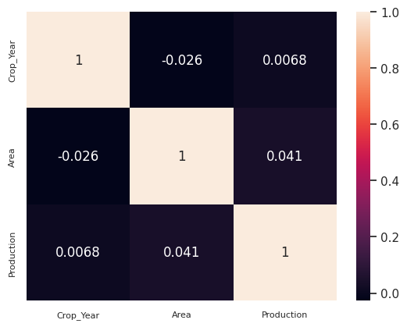
Checking for correlation between the Dataset

Slide 4
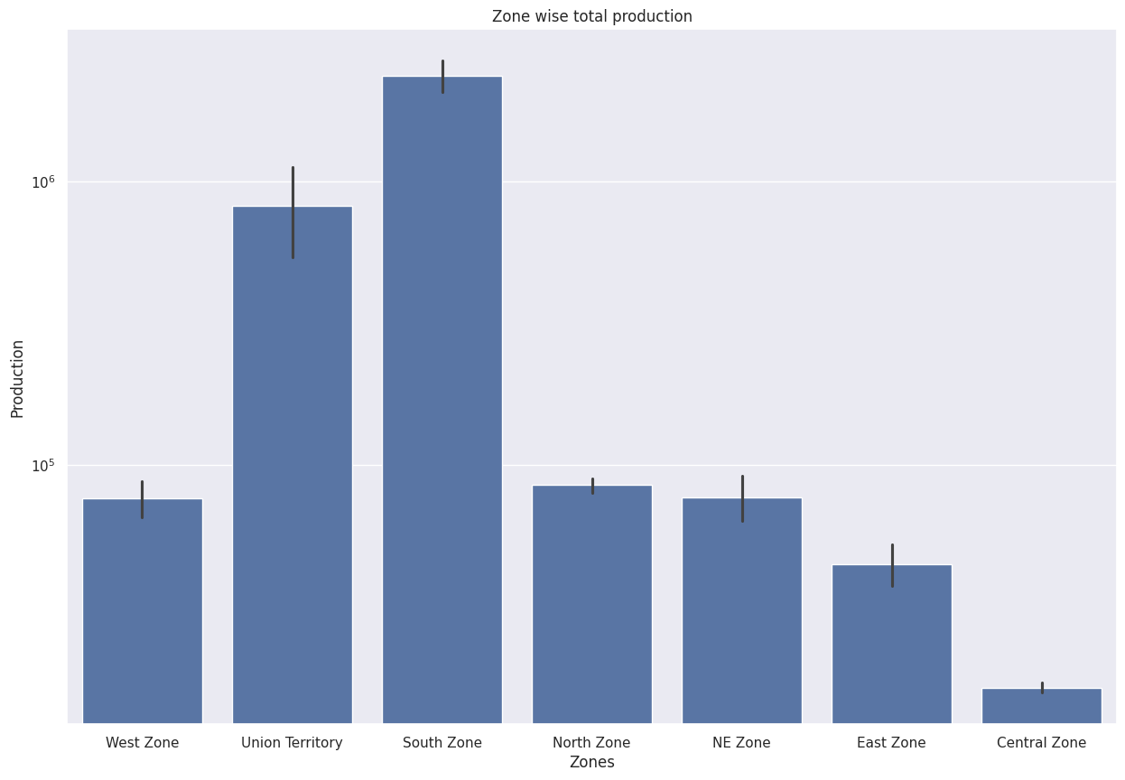
Zone wise Production
Among the top 10 zone, the South Zone is having Maximum Production

Slide 5
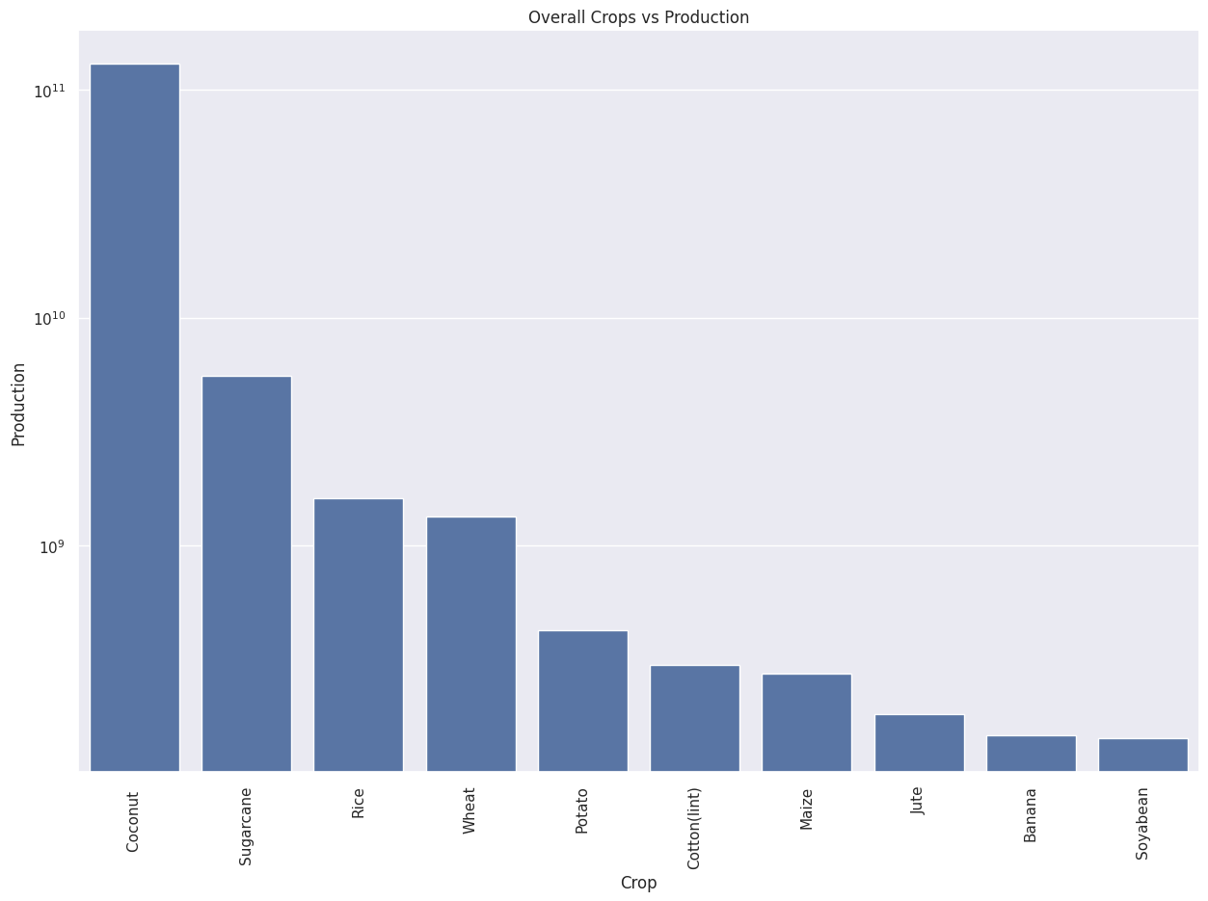
Top 10 Crop Production
Among the Top 10 Crop Production, Coconut is having maximum produced

Slide 6
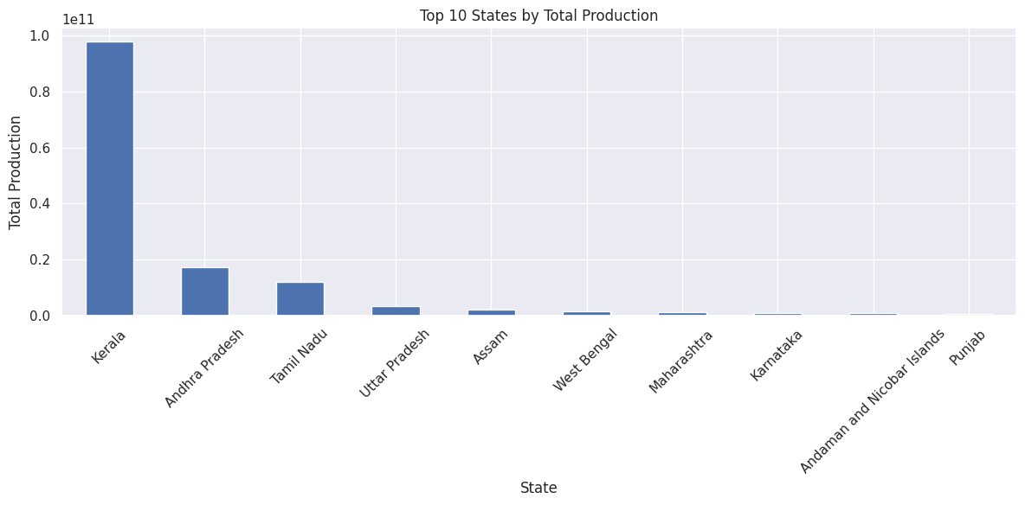
Top 10 States by Total Production
Among the top 10 states, the Kerala is having maximum crop production

Slide 7
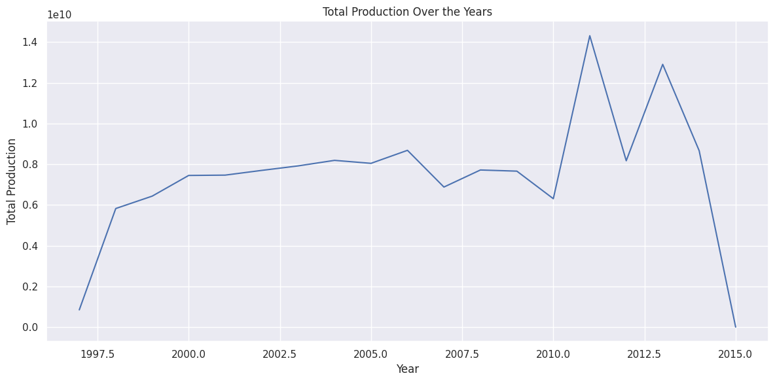
Total Production Over the Years

Slide 8
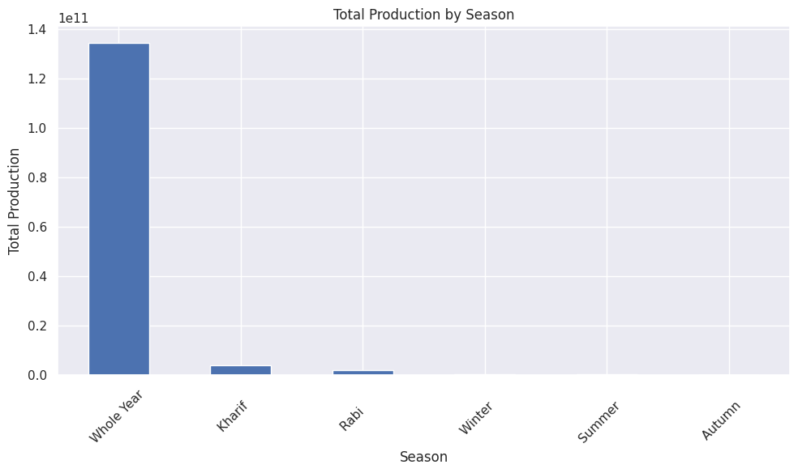
Total Production by Season

Slide 9
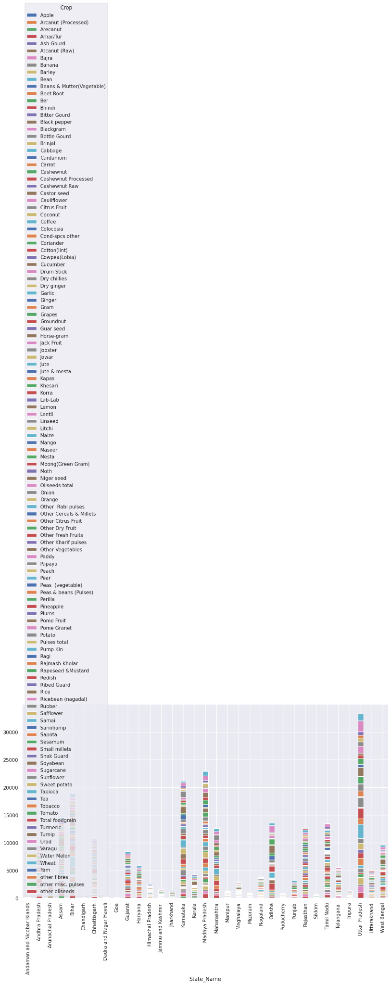
State that Dominates in Crop Production by Producing a Variety of Crop Categories

Slide 10
Key Points from Output Results
• Maximum growth in production was in between year 2007-2008.
• Maximum downfall of growth was in year 1997-1998.
• Production of North Zone is decreased and West Zone, Union Territory production increased.
• Production in whole year season declined continuously after the year 2003 but production In Rabi and Kharif Season increased after year 2003.

Slide 11
Thank You

