Slide 1
Capstone Project – Coursera (IBM Applied Data Science Certification)
Recommending Location for Building Pub in Banglore,India
By : Chandan Kumar Tiwari
Submitted on : January 2020

Slide 2
Introduction:
This project is intended to recommend places where pub’s can be started in the city of
Banglore, India.
Banglore is place inviting several startup’s in India. There are several corporate sectors
moving to Banglore. Pub could be a very beneficial business, if opened in Banglore.

Slide 3
Business Problem:
Opening pub’s in the city of Banglore can make a good scope of business. It is very
attractive place for lot of multi national companies and startups. Millions of people
move to Banglore to enhance their career and reside in Banglore, thus providing
evergreen scope for the business of pub culture.In project we will figure out which
cities in Banglore have more pubs and which location don’t have many, where it is
recommended for a pub opening.

Slide 4
Data Extraction:
The list of cities has been extracted from Wikipedia using following link.
(https://commons.wikimedia.org/wiki/Category:Suburbs_of_Bangalore). Cities data
has been scraped from the above link of wikipedia using Beautiful soup.
Location coordinates for the above obtained cities is gathered from geocoder package.
The venues information for this cities has been gathered from foursquare developer api,
which provides all the information regarding the neighborhood of a city.

Slide 5
Methodology:
First we are concerned on finding the list of cities in Banglore and then we find all the
neighborhoods and venues using FoursquareAPI.We are using Folium for data
visualization.Then we find all the coordinates of the cities using Geocoder.Then we
filter the data having VenueCategory as Pub. Then grouping the data based on the
VenueCategory Then we merge cities data with coordinates data and then use the data
for Clustering.
Kmeans Clustering algorithm is used for clustering the banglore cities data.We cluster
data into 5 clusters.

Slide 6
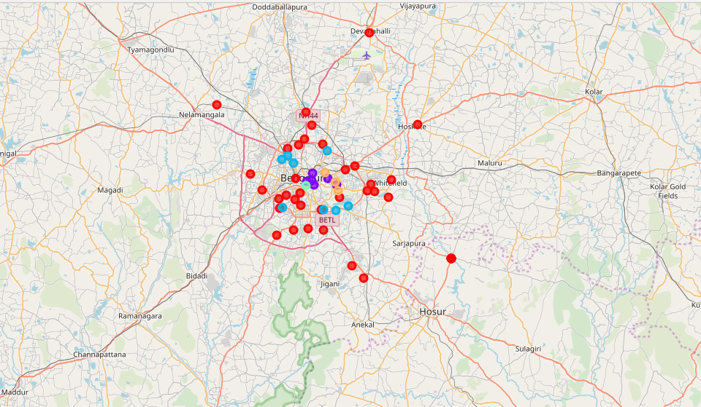
Results
Based on the clustering results.Complete data is seperated into 5 clusters and based on
the clusters, it is clear that cluster 3 is best for opening the Pub as it has only one pub.
Cluster 0 :
Cluster 1 :
Cluster 2 :
Cluster 3 :
Cluster 4 :
39 datapoints
6 datapoints
8 datapoints
1 datapoints
3 datapoints
Cluster 0 : Red Colour
Cluster 1 : Blue Colour
Cluster 2 : Purple Colour
Cluster 3 : Green Colour
Cluster 4 : Orange Colour

Slide 7
THANKYOU !!!
By : Chandan Kumar Tiwari
Submitted on : January 2020

