Slide 1

SPAM MESSAGE DETECTOR
-Using Machine Learning and PYTHON
By-
Chandan Sharma

Slide 2

INTRODUCTION
Spam messages can be not only annoying but also dangerous to consumers. Lazy advertiser and criminals who wish to lead you to phishing sites. Spam detection is a part of security of our system. With the help of the spam detection we can easily get aware from those message or e-mails which are not good for our system, because if we don’t have spam detection then we can’t get the information of wrong mails or message. Detecting spam alerts in message and e-mails is one of the main application that every company tries to improve for their customers.

Slide 3
PROBLEM STATEMENT
Unwanted e-mails irritating internet connection.
Important e-mails or messages are missed/ or delayed.
Spam can crash mail servers and fill up hard drives.
Billions of money lost worldwide by these types of fake messages of e-mails.
Our sensitive information will be lost by these types of spam messages.

Slide 4
OBJECTIVE
The objective of identification of Spam messages or e-mail are:-
To give knowledge to the user about the fake e-mail or messages.
To classify that email spam or not.
Spam detection means detecting spam message by understanding text content, so that you can only receive notification of that message that are important for you.
By the help of spam detection the experience of users will be better.

Slide 5
SCOPE OF THE PROJECT
It provides sensitivity to the client and adapts well to the future spam techniques.
It increase Security and Control.
It also reduce Network Resource Costs.
It helps the users by give them a notification of SPAM or HAM, So the scope of SPAM DETECTION is more in the future.

Slide 6
MODEL WORKING
● Tokenization:-
Tokenization is a process of breaking a stream of text up into words, phrases, symbols, or other meaningful elements called tokens.
The list of token will be the input for further processing such as text meaning.
● Training and testing the model:-
Firstly we train the model on a dataset (dataset is a collection of data or related information that is composed for separate elements.).
Then we test the model by using the comparing the trained data to test the data.

Slide 7
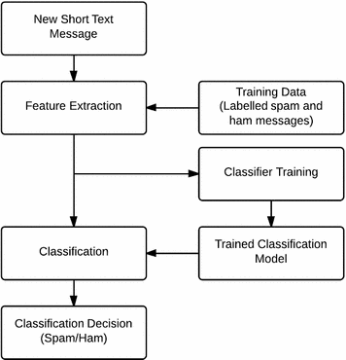
WORKING (flow chart)

Slide 8
.
-THANK YOU

