Slide 1
.
1
Welcome
.

Slide 2
.
Student management
System
.

Slide 3
.
AIM:-
Our aim is to develop a student management system by which we can easily access the data of all students. By this we can easily see all students data and do other things.
Notes:
Dd more data

Slide 4
.
PROBLEM DESCRIPTION
The student management system is an application by which we can easily access any student data. By the help of student management system we can add new data, search data of student, view all students data, delete any student data, edit any student data.
Notes:
Dd more data

Slide 5
.
BENEFITS
• Reduce data loss.
• For better performance.
• Reducing man power.
• For doing work more accurately.
• Faster performance.
Notes:
Dd more data

Slide 6
.
LANGUAGE USED
The C++ code used for student management system, includes file system access, so all the data gets stored in external ‘.dat’ binary file that will be created during runtime.
Notes:
Dd more data

Slide 7
.
ADMINISTRATOR MENU
1. Enter new data
2. View student data
3. Delete student data
4. Search data
5. Edit student data
6. Logout
7. Exit from the page
Notes:
Dd more data

Slide 8
.
MENU
cout<<"\t====================================";
cout<<"\n\t\t1. ENTER STUDENT DATA";
cout<<"\n\t\t2. VIEW STUDENT DATA";
cout<<"\n\t\t3. DELETE STUDENT DATA";
cout<<"\n\t\t4. SEARCH STUDENT DATA";
cout<<"\n\t\t5. EDIT STUDENT DATA";
cout<<"\n\t\t6. START AGAIN";
cout<<"\n\t\t7. EXIT CONSOLE"<<endl;
cout<<"\t===================================="<<endl;
Notes:
Dd more data

Slide 9
.
Some part of code
int l,m;
int c;
char s[3];
m:
clrscr();
cout<<"\n\t"<<endl;
cout<<"\t\t\tMENU"<<endl;
cout<<"\t====================================";
cout<<"\n\t\t1. ENTER STUDENT DATA";
cout<<"\n\t\t2. VIEW STUDENT DATA";
cout<<"\n\t\t3. DELETE STUDENT DATA";
cout<<"\n\t\t4. SEARCH STUDENT DATA";
cout<<"\n\t\t5. EDIT STUDENT DATA";
Notes:
Dd more data

Slide 10
.
cout<<"\n\t\t6. START AGAIN";
cout<<"\n\t\t7. EXIT CONSOLE"<<endl;
cout<<"\t===================================="<<endl;
cout<<endl<<"\n\tChoose option from menu......"<< endl;
cin>>c;
cin.ignore();
clrscr();
switch(c)
{
case 1:
{
l:
write_data();
cout<<"\n***Data written to file successfully***"<<endl;
cout<<"\nDo you want to enter more data";
cout<<"\n Type N or Y"<<endl;
cin>>s;
Notes:
Dd more data

Slide 11
.
cin.ignore();
if(strcmp(s,"y")==0||strcmp(s,"Y")==0)
goto l;
else
{
clrscr();
goto m;
break;
}
}
case 2:
{
cout<<"\n\t***Showing Data***"<<endl;
read_data();
getch();
goto m;
break;
}
Notes:
Dd more data

Slide 12
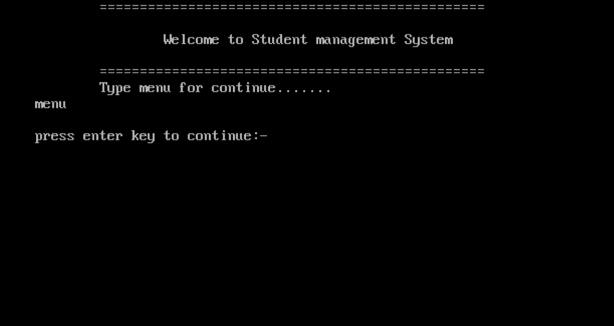
.
SNAPSHOTS
1. Welcome page
Notes:
Dd more data

Slide 13
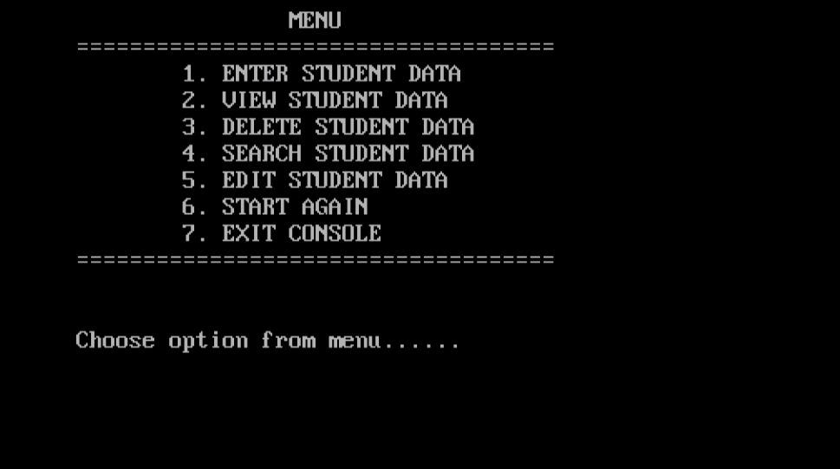
.
2. Menu page
Notes:
Dd more data

Slide 14
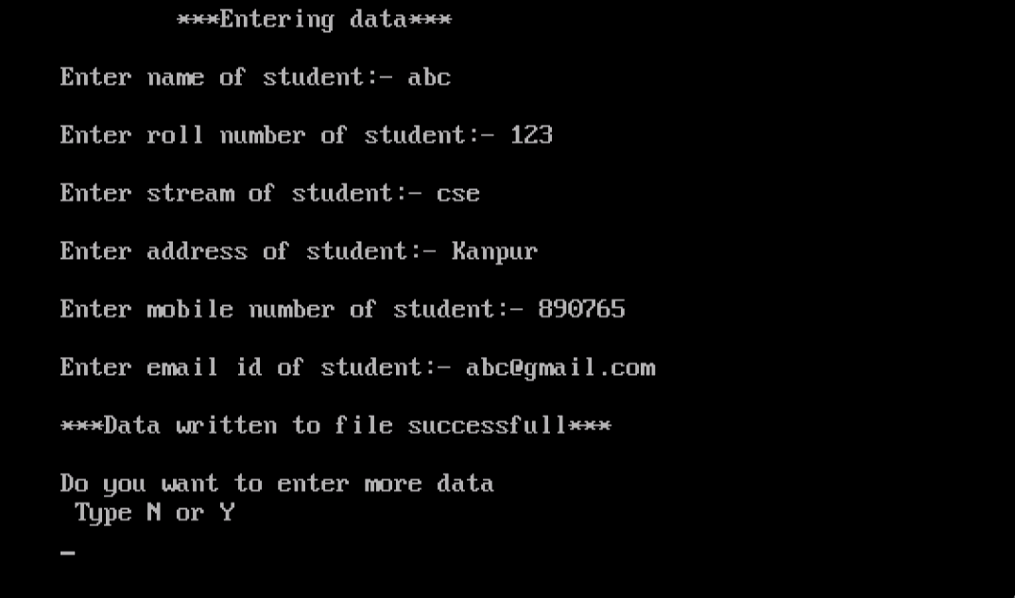
.
3. Enter data
Notes:
Dd more data

Slide 15
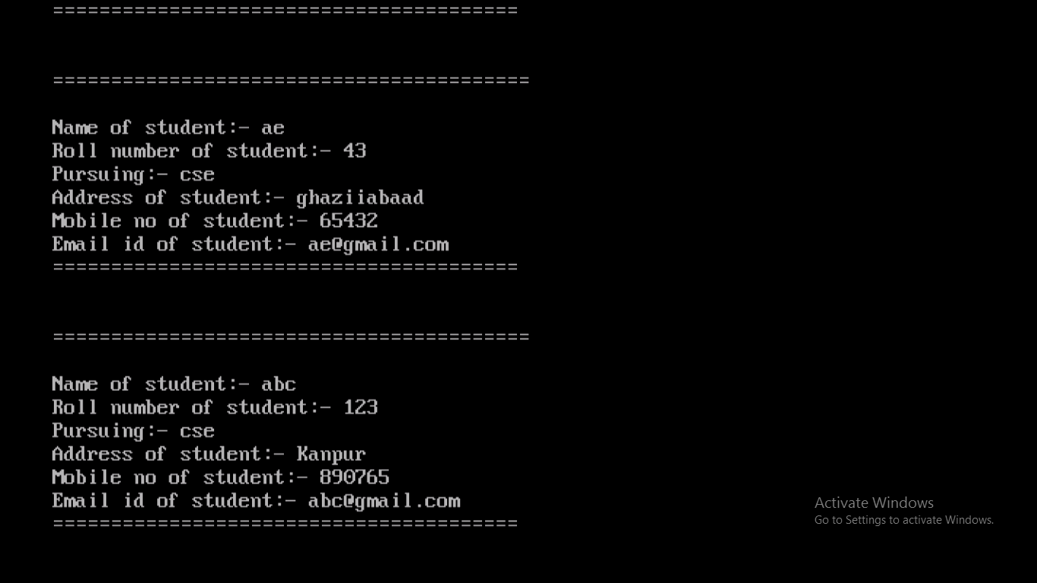
.
4. View data
Notes:
Dd more data

Slide 16
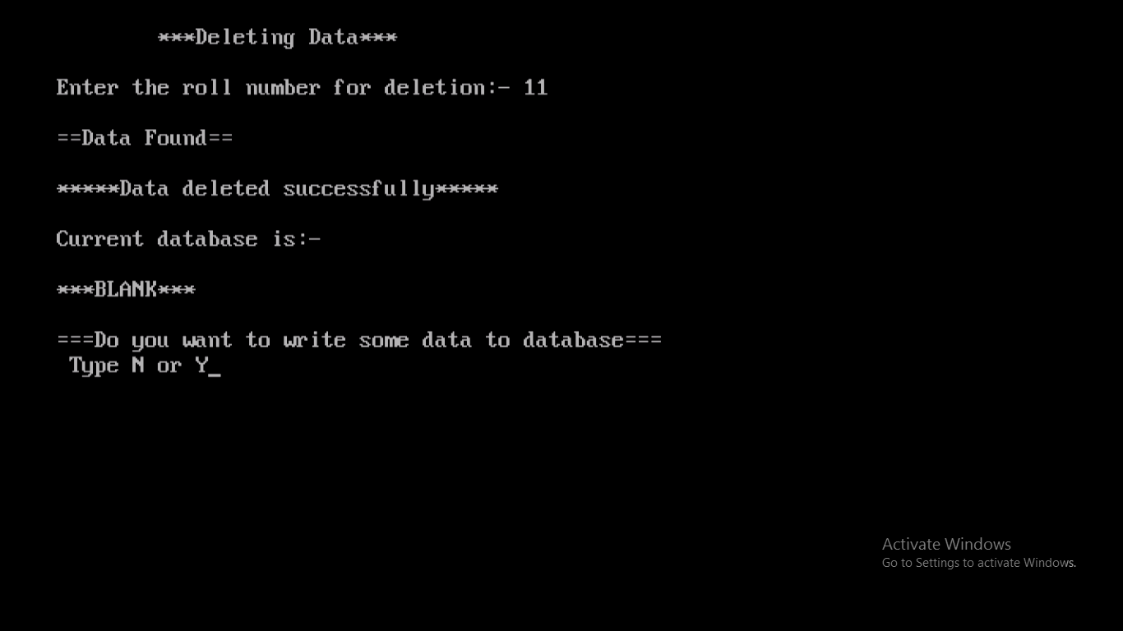
.
5. Delete data
Notes:
Dd more data

Slide 17
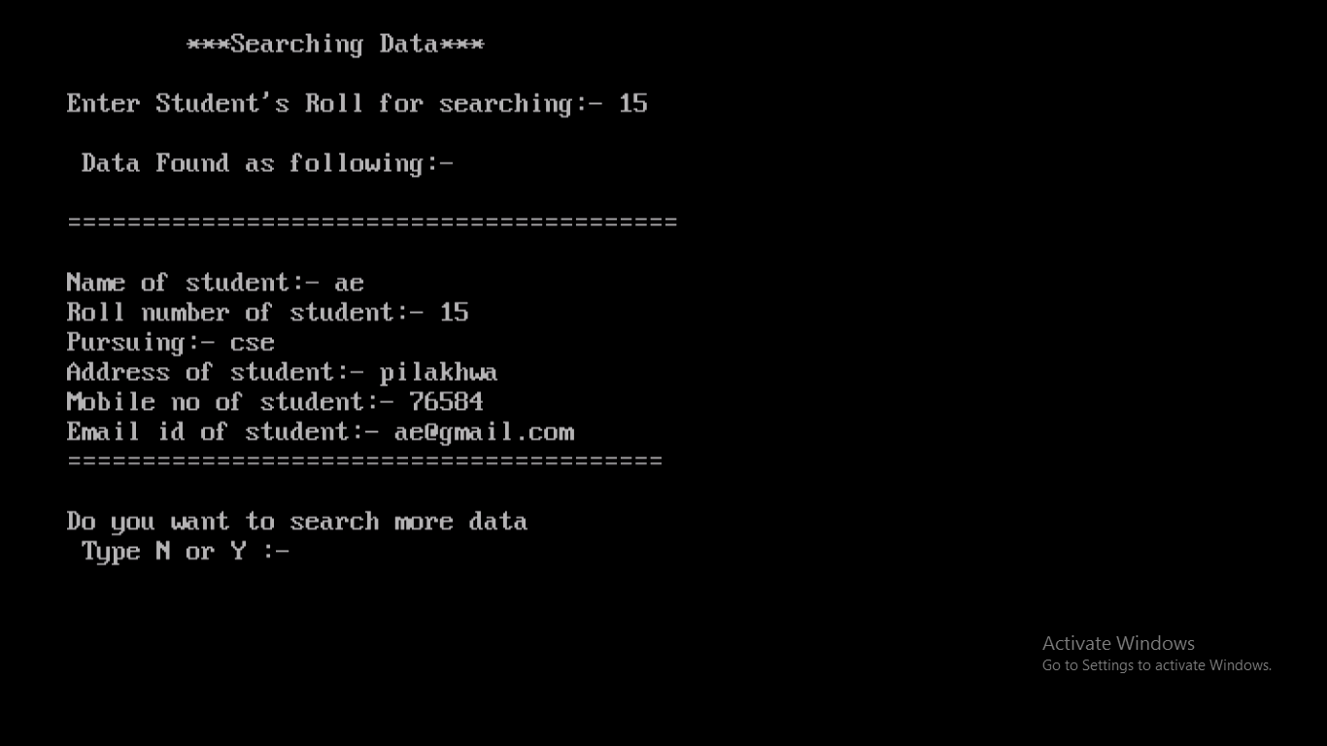
.
6. Search data
Notes:
Dd more data

Slide 18
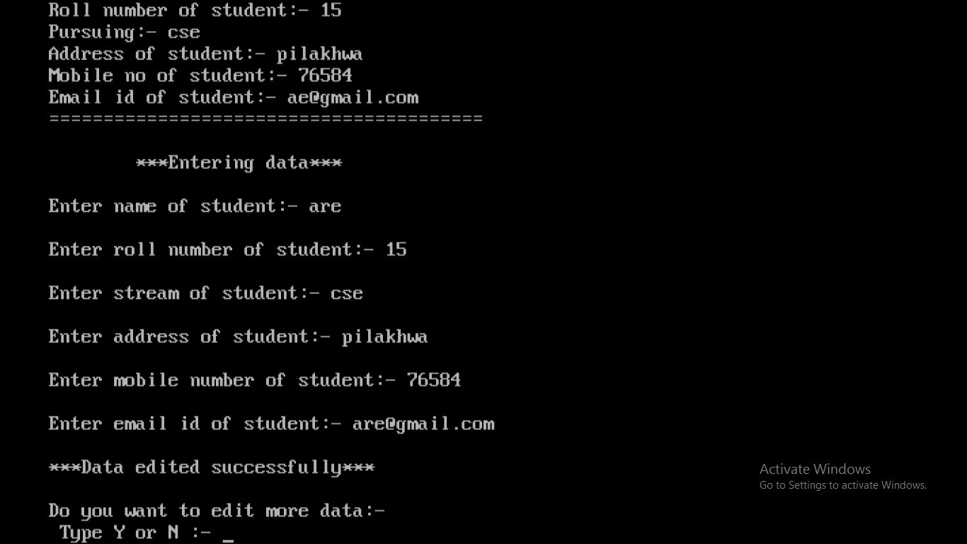
.
7. Edit data
Notes:
Dd more data

Slide 19
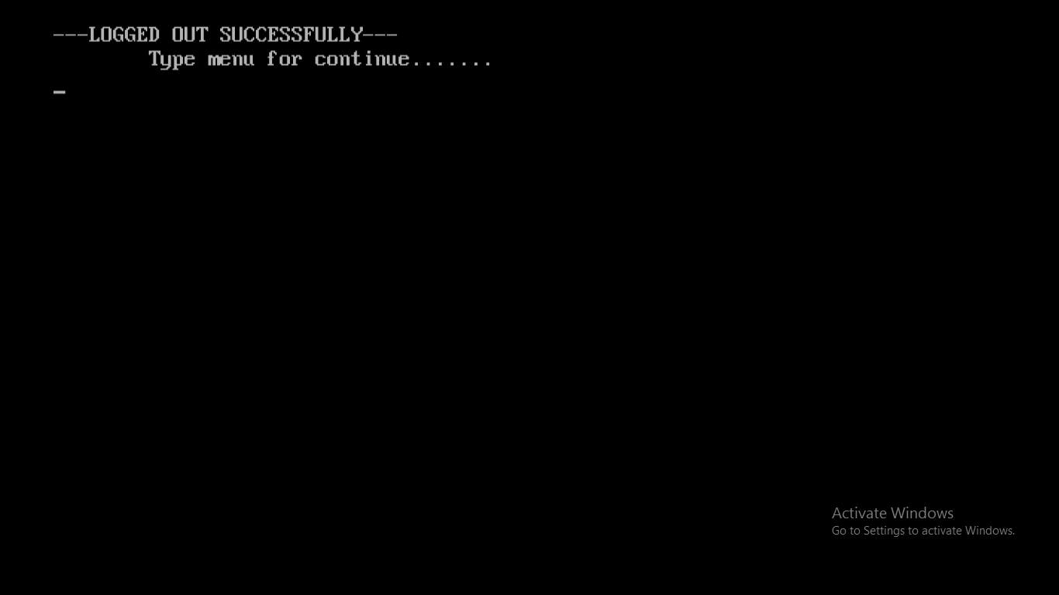
.
8. Start again
Notes:
Dd more data

Slide 20
.
Thank you
Notes:
Dd more data

