Slide 1

Seth Vishambhar Nath Group of Educational Institutions
Safedabad, Lucknow-Barabanki Highway, Barabanki - 225003, Uttar Pradesh, India

Slide 2

RecipeBox — A Web Application for Managing and Sharing Recipes
Chandan Chaudhary
Roll no: 2203451650008
Ram Prem Verma
Roll no: 2203450100058
Abhay Chaudhary
Roll no: 2203451650002
Shivam
Roll no: 2203451650019
Guide : Beer Singh
Designation: Assistant Professor
Date of Synopsis:
Seth Vishambhar Nath Group of Educational Institutions
Safedabad, Lucknow-Barabanki Highway, Barabanki - 225003, Uttar Pradesh, India

Slide 3
CONTENT
Introduction
Motivation
Literature review
Research gap
Problem statement
Objective
Proposed methodology
Timeline
References

Slide 4
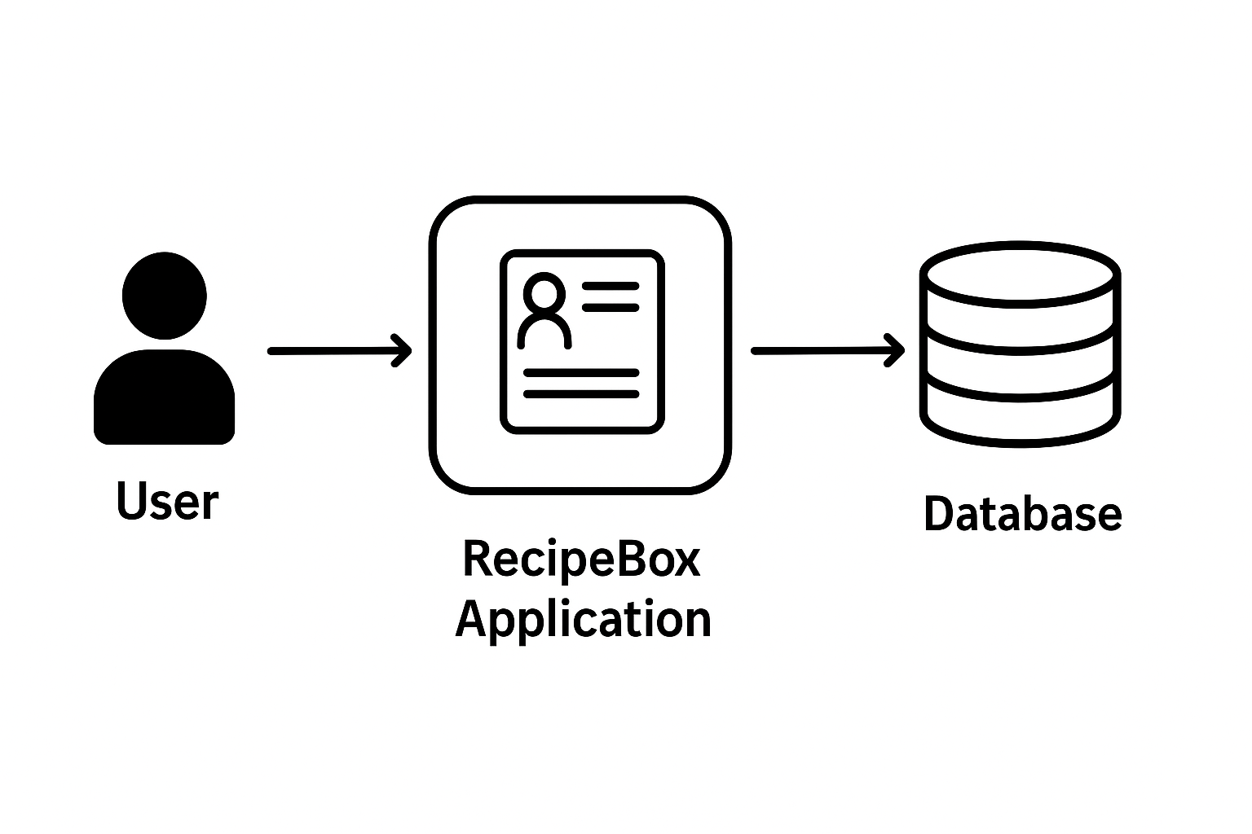
Introduction
Recipe Box is an online recipe management system built using React and Vite.
It allow to user see recipe, ingredients, chef and add to favourite.
And seller to browse, create, update, and delete recipes.
Using React.js for frontend , (Node.js and Express.js) for backend and MongoDB for database.
Supports user-friendly interface and responsive design.
Goal: Help users store, organize, and access recipes easily.

Slide 5
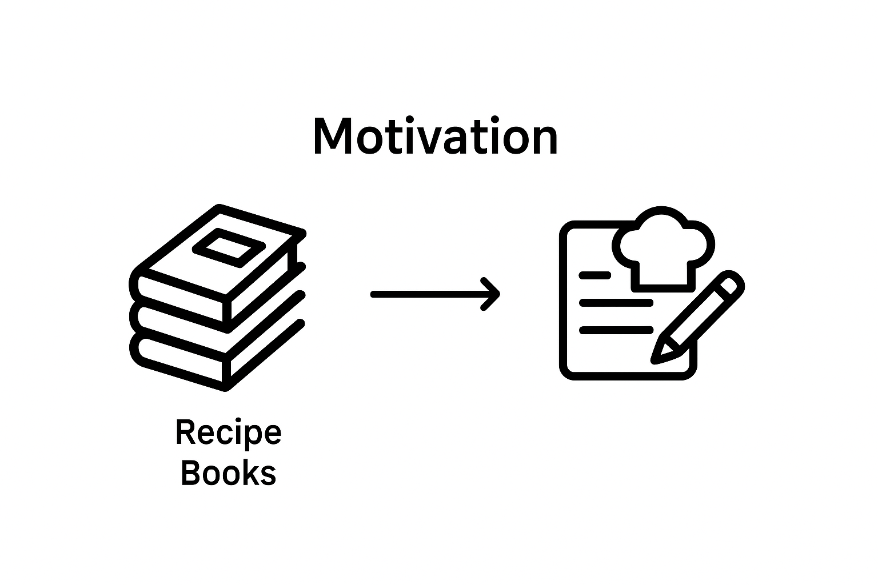
Motivation
Managing recipes manually is time-consuming and prone to loss.
Existing apps can be complex or not user-friendly.
Users need easy-to-use digital platforms for storing and accessing recipes.
Recipe Box aims to simplify recipe management and improve user experience.

Slide 6
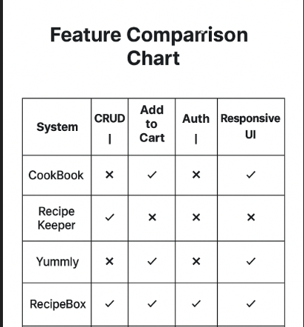
Literature review
Many apps like Yummly, All Recipes, Tasty exist for recipes.
Literature suggests that simple UI and CRUD operations are critical.
Users prefer fast search and categorization feature
React-based frontends provide smooth interactivity and better user experience.
Recipe Box builds on these findings with a lightweight, responsive design.

Slide 7
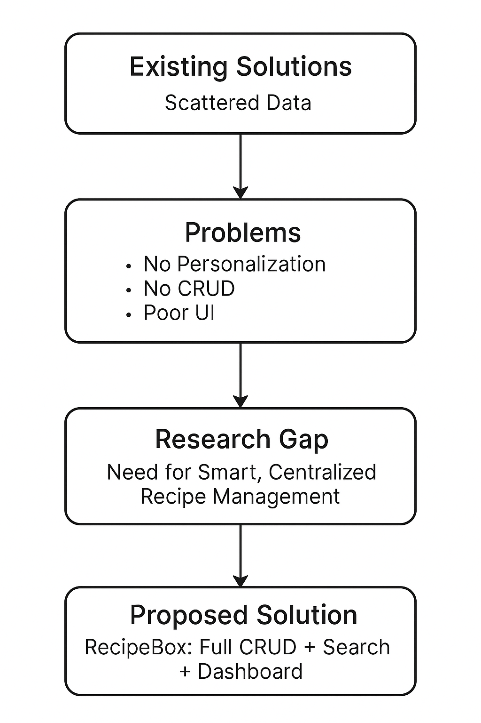
Research gaps
Many recipe apps are feature-heavy, overwhelming beginners.
Limited apps provide customizable categories or easy editing.
Offline support and simplicity are often missing.
RecipeBox addresses these by offering:
Simple CRUD operations.
Responsive and intuitive UI.
Easy search and categorization.

Slide 8
Problem statement
Recipe management is often disorganized and inefficient.
Users struggle with losing or forgetting recipes.
Current solutions are either complicated or incomplete.
RecipeBox provides a centralized, easy-to-use platform for all users.

Slide 9
Objectives
Allow seller to add, edit, delete, and view recipes.
Categorize recipes by meal type or cuisine.
Provide fast search functionality for ingredients or recipe names.
Ensure responsive design for mobile and desktop users.
Maintain secure and persistent data storage.

Slide 10
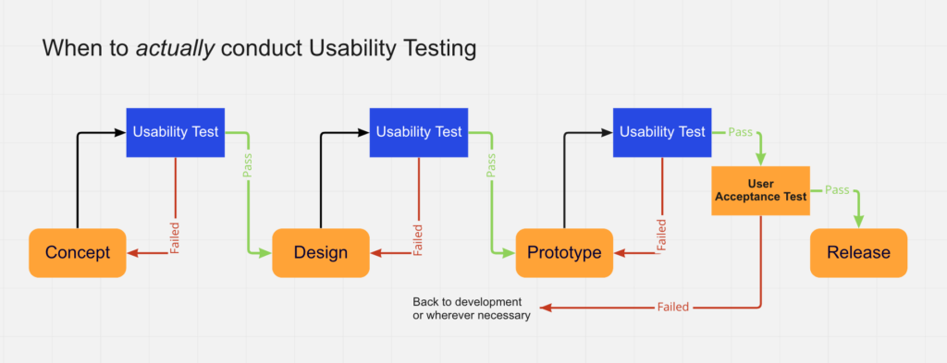
Proposed methodology

Slide 11
Frontend: React + Vite for interactive UI.
Backend: Node.js / Express (or any REST API).
Database: MongoDB / JSON storage for recipe data.
CRUD Operations: Full implementation for recipe management.
Workflow:
User Registration/Login.
Dashboard access.
Add/Edit/Delete recipes.
Search, filter, add to add to cart recipes.
Testing: Ensure responsive design and functionality.

Slide 12
Timeline
• Week 1–2: Requirement analysis & project setup
• Week 3–4: Frontend development (React, components)
• Week 5–6: Backend development & API integration
• Week 7: Database setup & connection
• Week 8: Implement CRUD and search features
• Week 9: Testing, debugging & optimization

Slide 13
References
1. ReactJS Documentation – https://react.dev
2. Node.js and Express.js Documentation – https://nodejs.org
3. MongoDB Documentation – https://www.mongodb.com/docs
4. Research papers on web-based recipe management systems.

