Slide 1




Host my ML Model to Internet
👀
❤️
By Chandan Saroj
chandansaroj.in

Slide 2
🧠
Hugging Face is the home for all Machine Learning tasks.
demos, use cases, models, datasets, and more!
step-by-step guide to hosting your application from scratch.

Slide 3
Step 1: Create Your Hugging Face Space
Log in to Hugging Face.
Click on your profile picture in the top-right corner and select New Space.
Space Name: Enter a name for your project (rent-estimator-ml).
License: You can leave this blank or select mit.
Select the Space SDK: Click on Gradio.
Space Hardware: Ensure ZeroGPU (Free) is selected.
Click the Create Space button.
👍

Slide 4
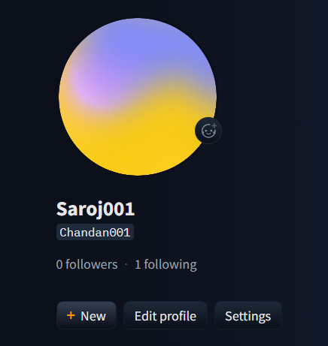
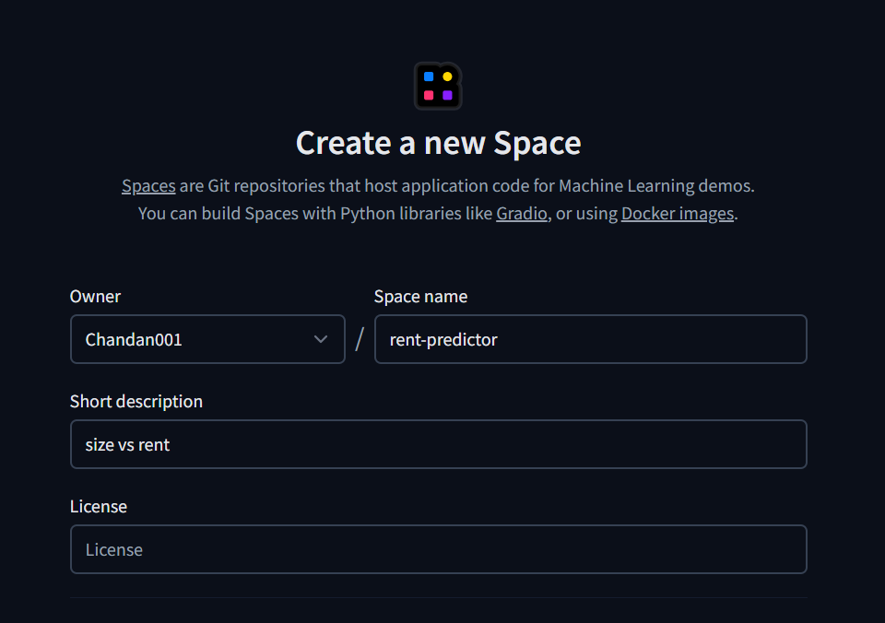
Create space on huggingface
Create New space
“✚ New”
2. Enter a name of your space
“rent-predictor”
➜
👆

Slide 5
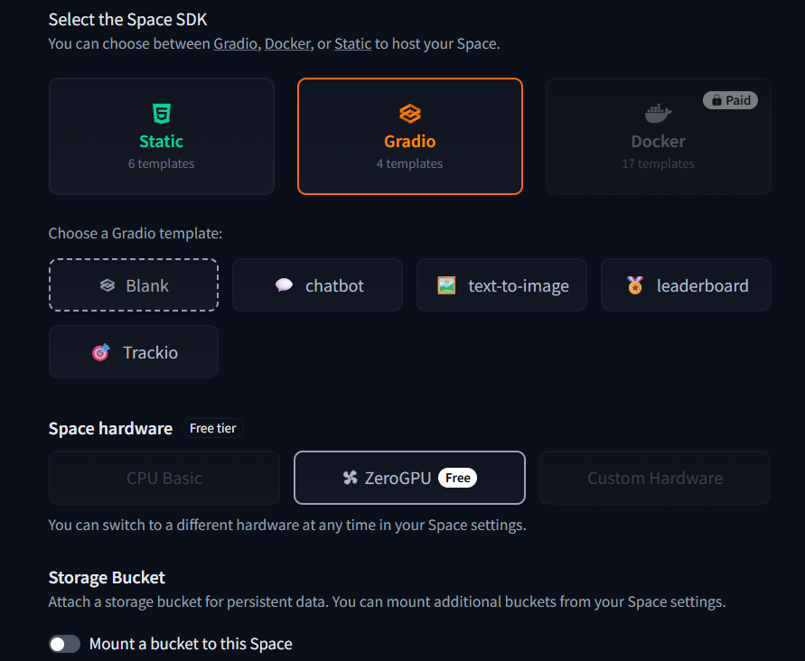
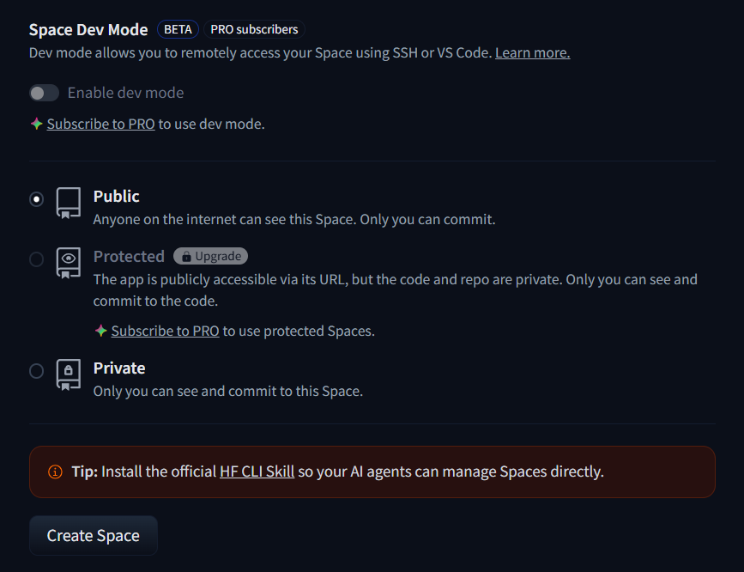
Select Gradio, select public then Create Space
👆
👆
👆

Slide 6
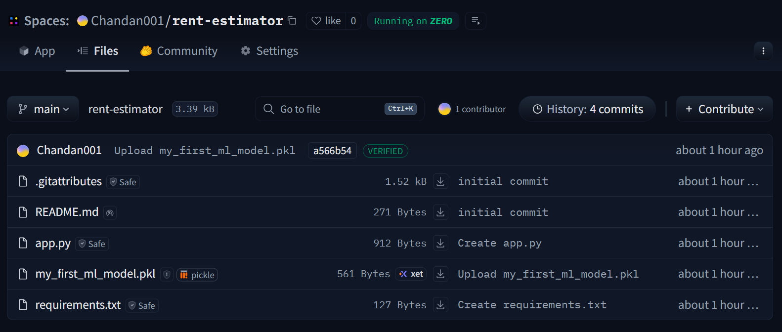
Open your Newly Created Space
👆
👆
👆
👆

Slide 7
Step 2: Prepare Your Project Files
You need to create two text files on your computer to go alongside your .pkl model file.
File 1: requirements.txt
joblib
scikit-learn==1.6.1
gradio

Slide 8
File 2: app.py
import gradio as gr
import joblib
import spaces
# We load the model once when the app starts
deployed_lr = joblib.load('my_first_ml_model.pkl')
# --- ZERO-GPU DECORATOR AND PREDICTION LOGIC ---
@spaces.GPU
def predict_rent(size_of_prop):
# The model expects a 2D array: [[size]]
prediction = deployed_lr.predict([[size_of_prop]])
# Extract the single prediction value and format it
return f"Estimated Rent: {prediction[0]:.2f}"
# Create the web interface
interface = gr.Interface(
fn=predict_rent,
inputs=gr.Number(label="Please Enter the Size of Your Property for rent"),
outputs=gr.Text(label="Predicted Rent"),
title="Property Rent Predictor",
description="Enter the property size to get a rent estimate powered by Machine Learning."
)
if __name__ == "__main__":
interface.launch()

Slide 9
File 3: Upload your .pkl file
⬇️
my_first_ml_model.pkl

Slide 10
Step 3: Upload and Deploy
On your newly created Hugging Face Space page, navigate to the Files tab.
Click Add file and then select Upload files.
Drag and drop all three of your files into the upload box:
my_first_ml_model.pkl (Your trained machine learning model)
requirements.txt (The dependencies file)
app.py (The application script)
Add a quick commit message like "Initial deployment" and click Commit changes to main.
🔥

Slide 11

Once committed, navigate to the App tab. You will see a "Building" status as Hugging Face installs your requirements.
Once the build is complete, your app will automatically transition to "Running" and your user interface will be live!

Slide 12
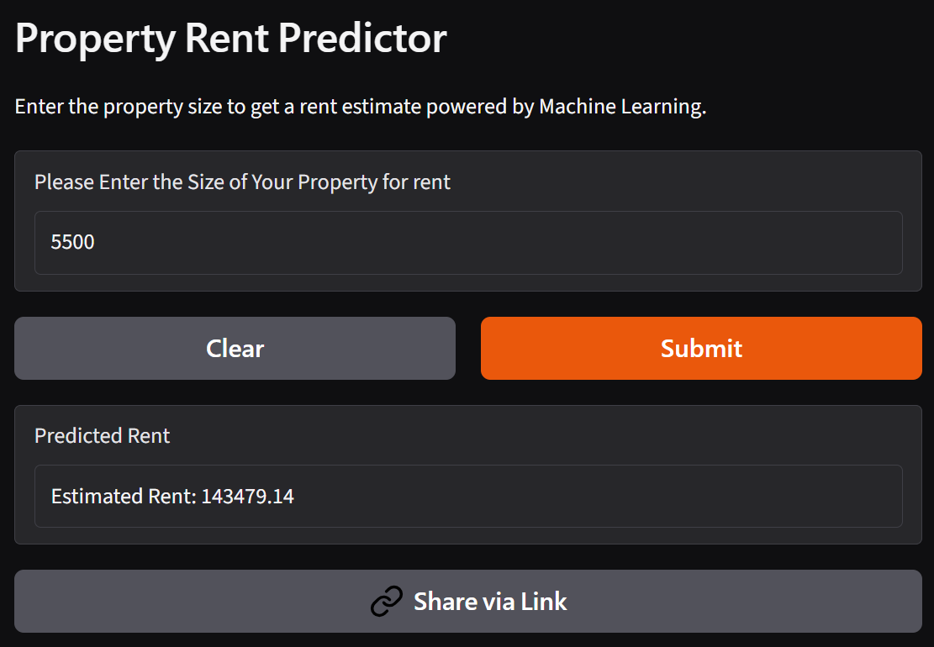
model hosted on Hugging Face ready to flex my first ML Project!!!

Slide 13


Thank You
🤝
Check my live ML project
https://chandan001-rent-estimator.hf.space/?__theme=system&deep_link=RoRhbMQ308Q
https://www.linkedin.com/in/chandan-saroj/
_chandan_saroj

