Slide 1

Agentic AI
Chandan Saroj

Slide 2
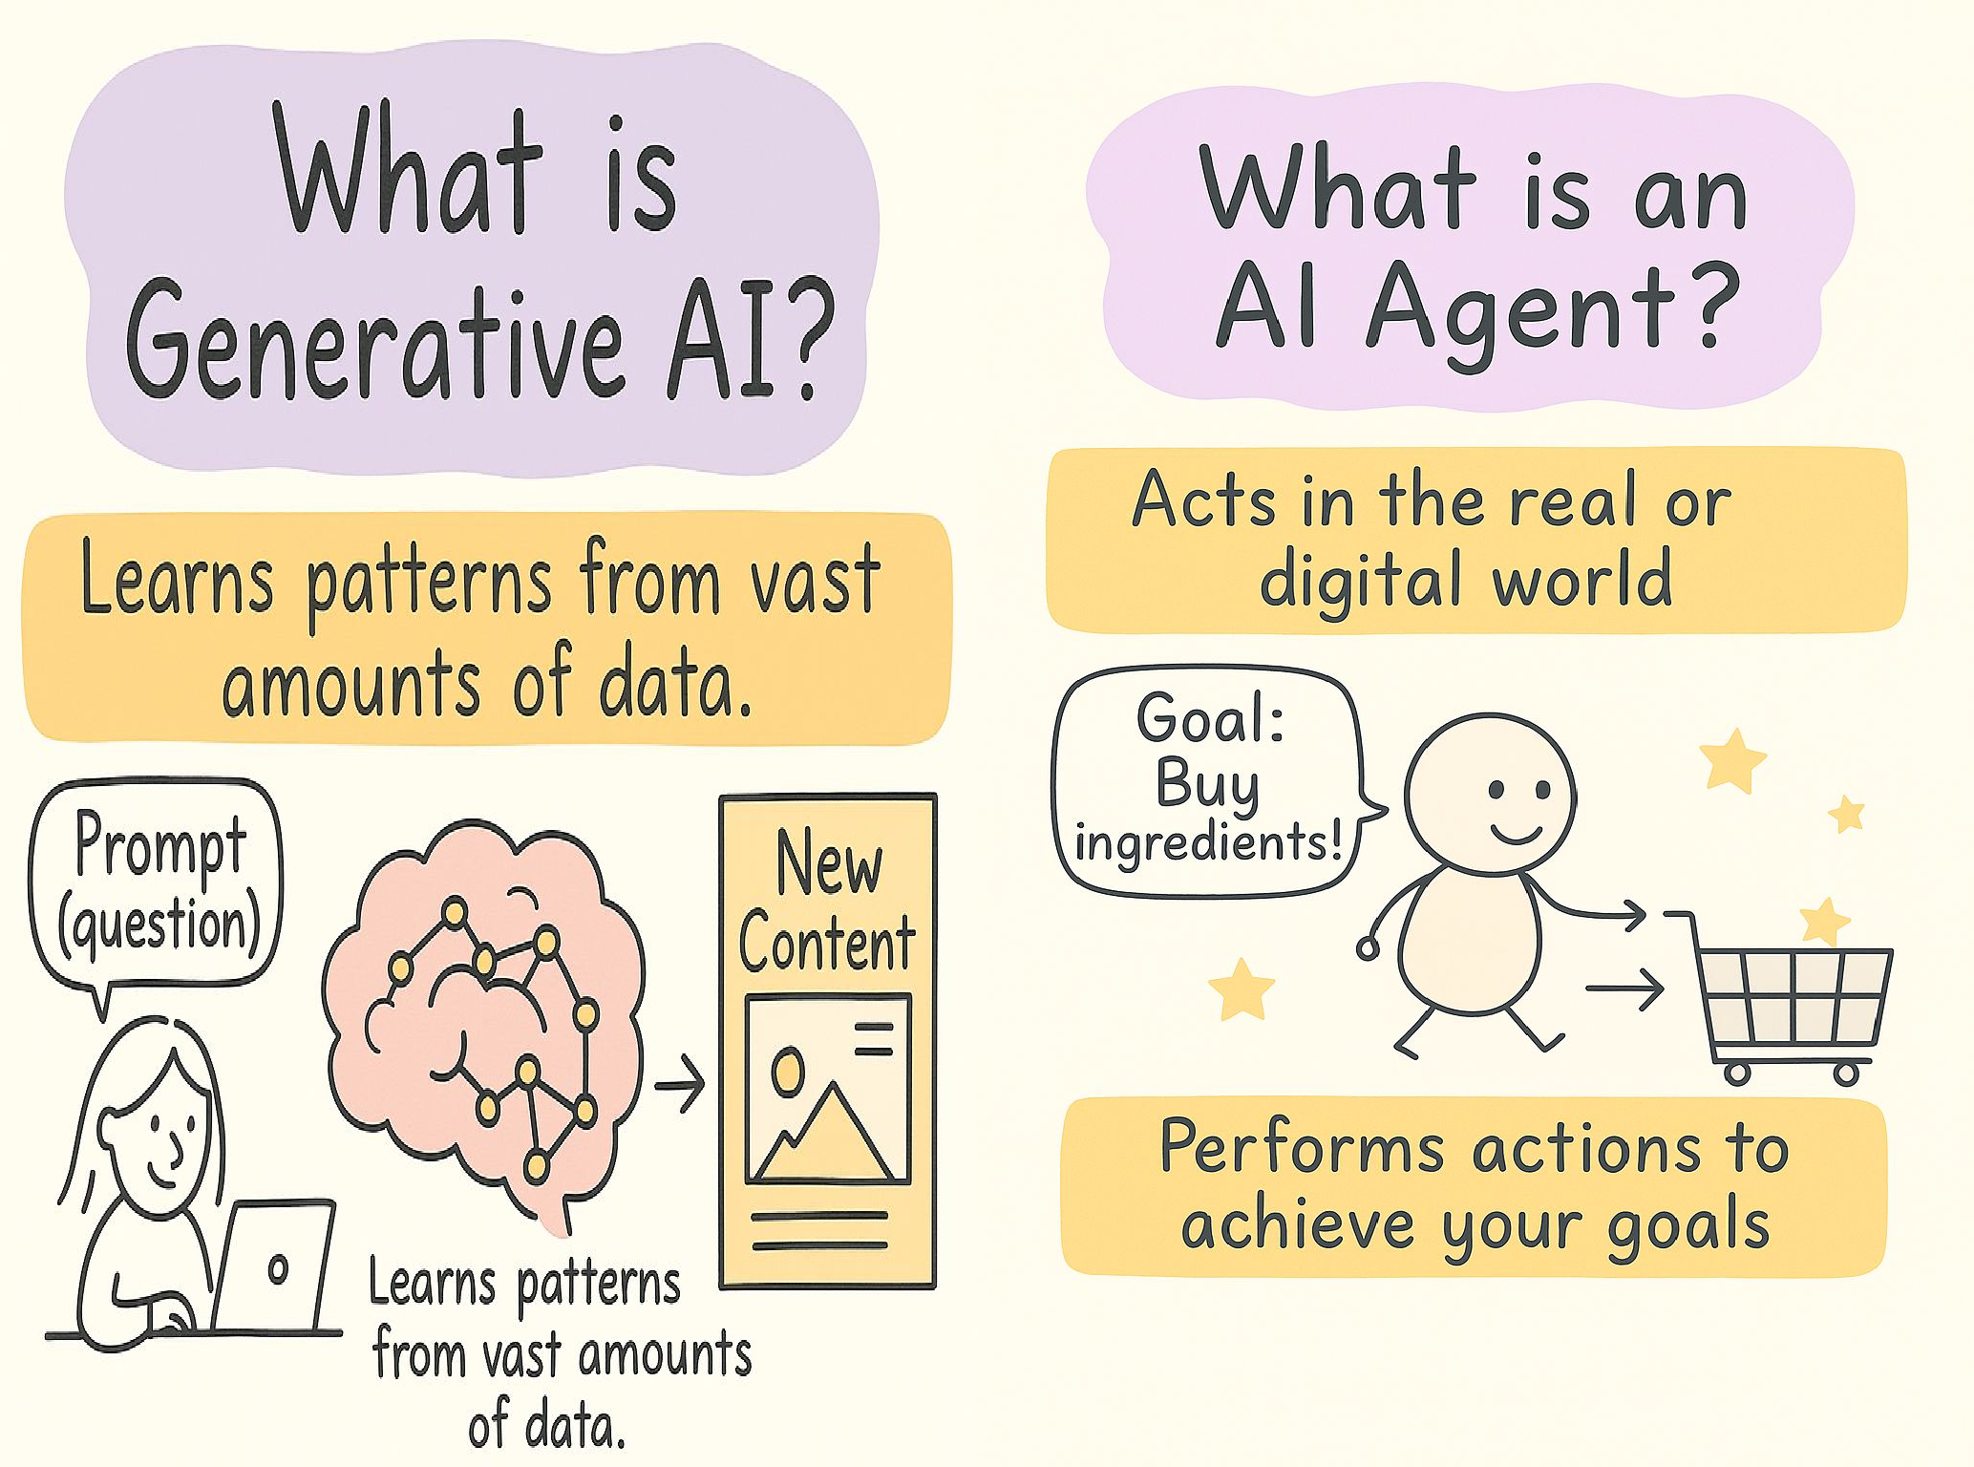
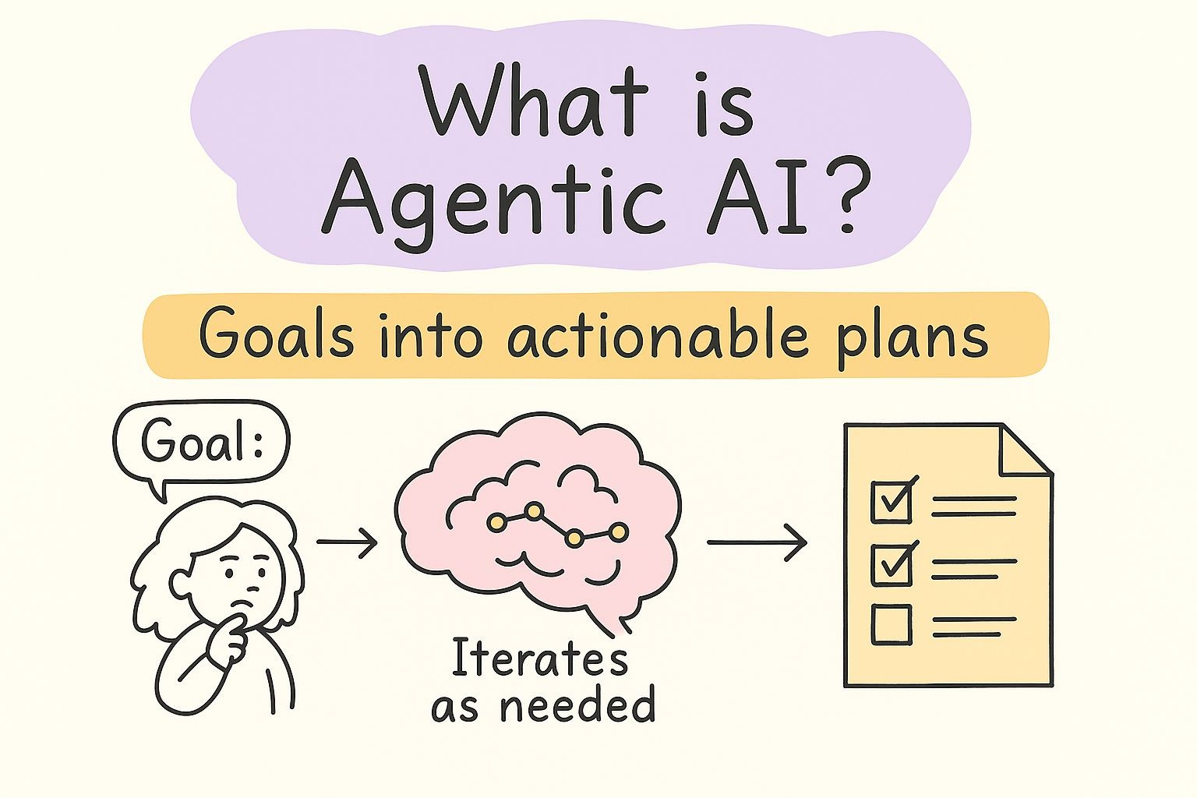

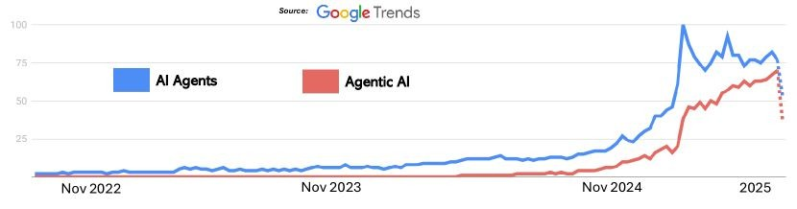

Slide 3
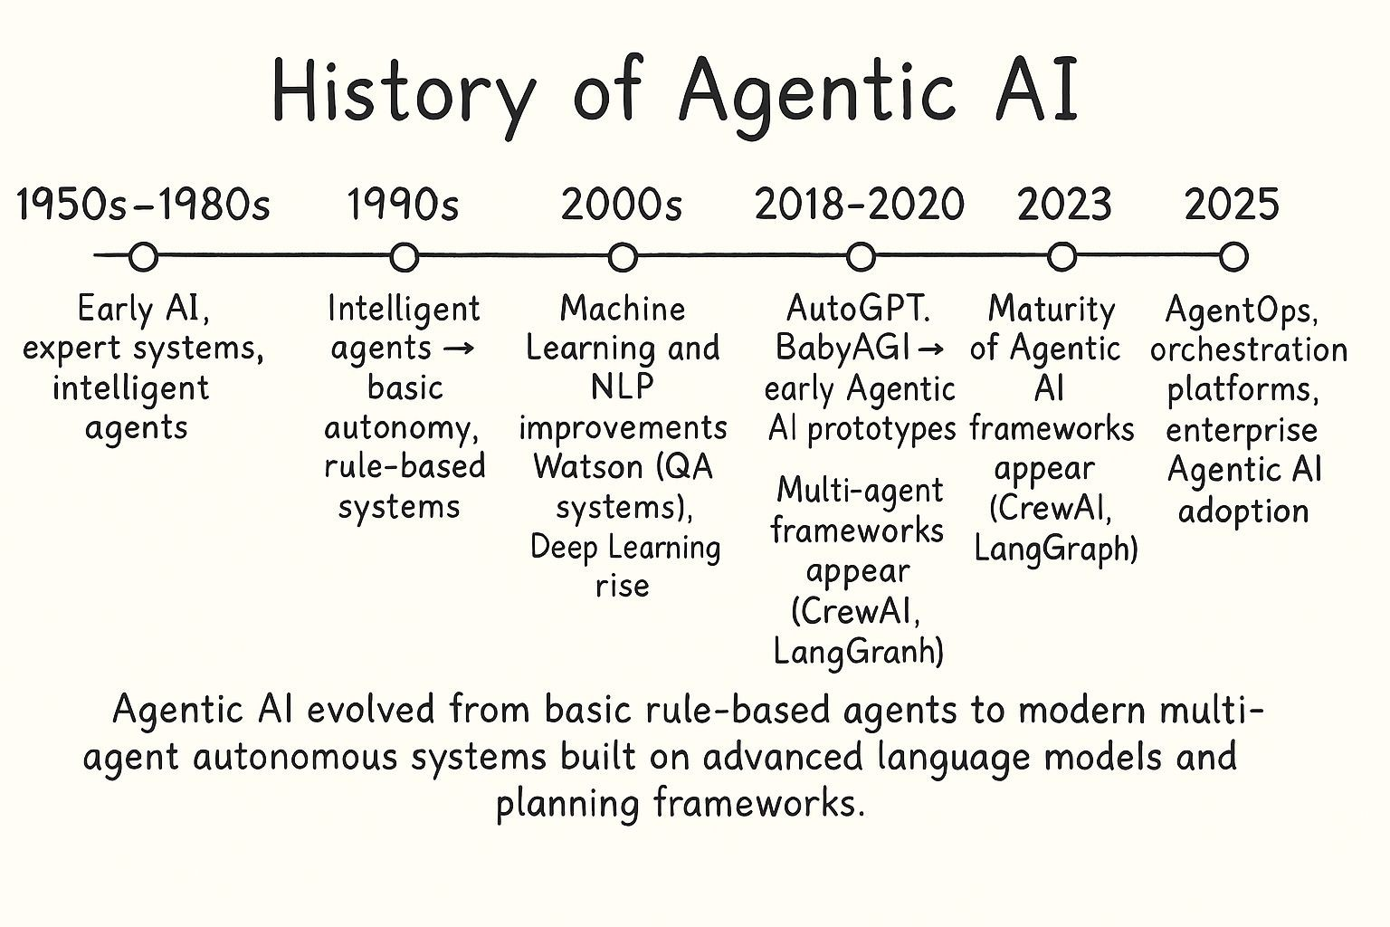

Slide 4
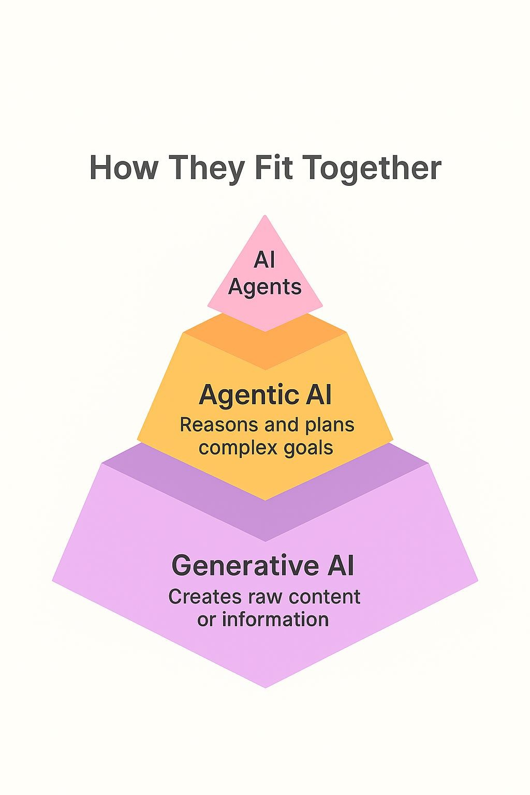
In essence, Agentic AI provides the brain and the plan, while AI Agents provide the hands and feet to interact with the world and carry out that plan.
A sophisticated system often combines all three: Generative AI might produce text or code, Agentic AI orchestrates a complex workflow using that output, and various AI Agents perform the necessary steps by interacting with tools and environments.
Relationship
Agentic AI

Slide 5
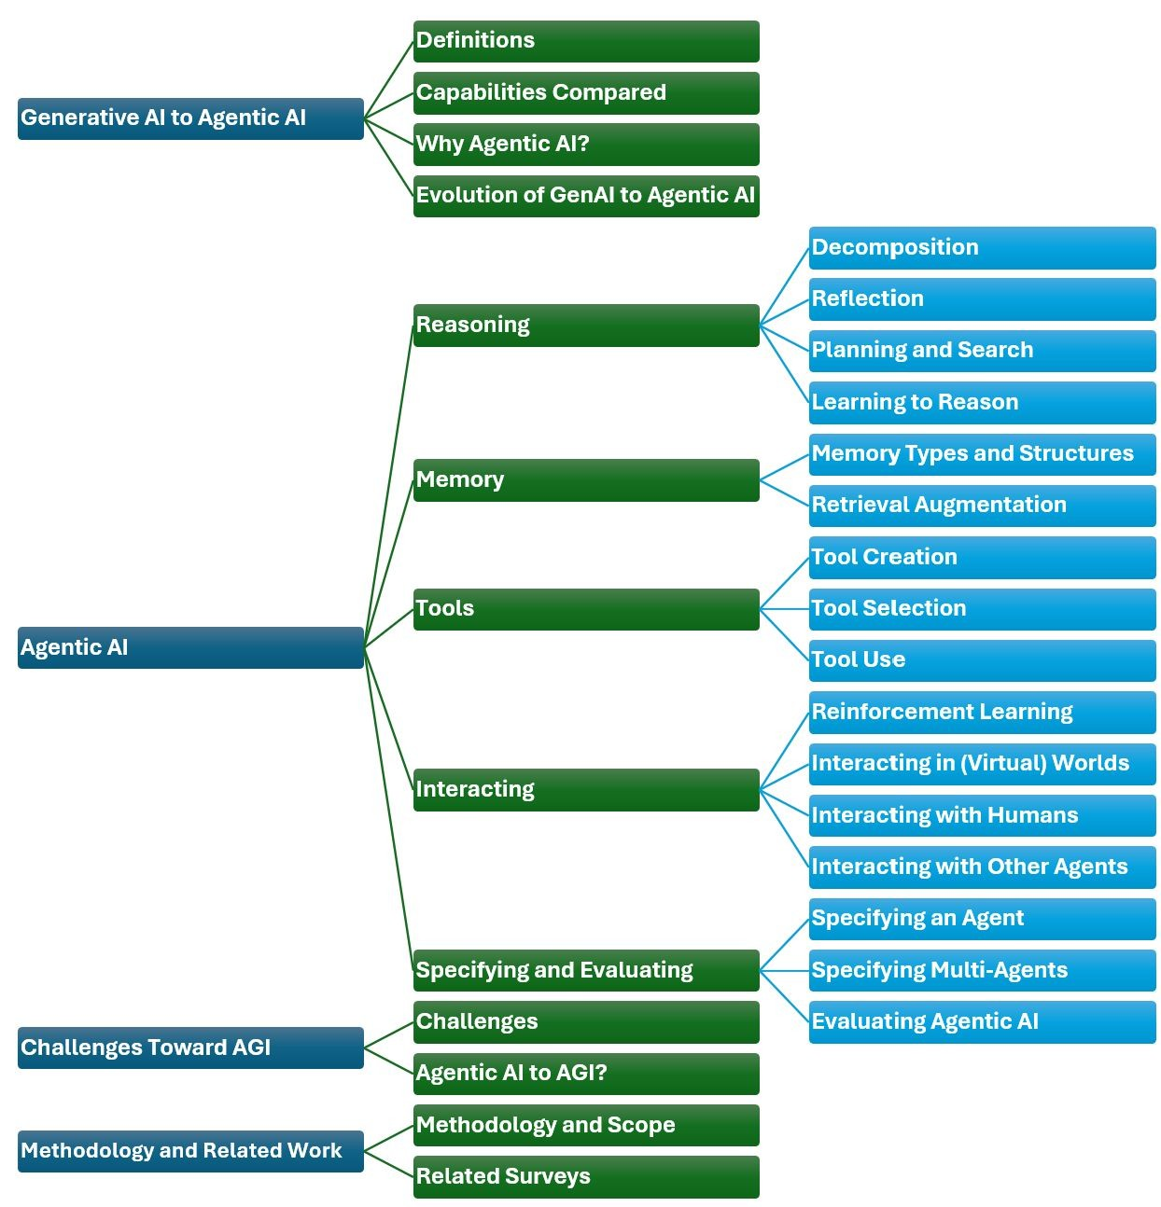
Table
Presentation Title

Slide 6
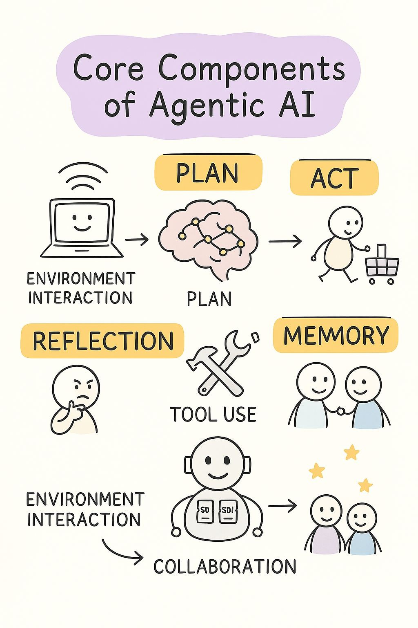
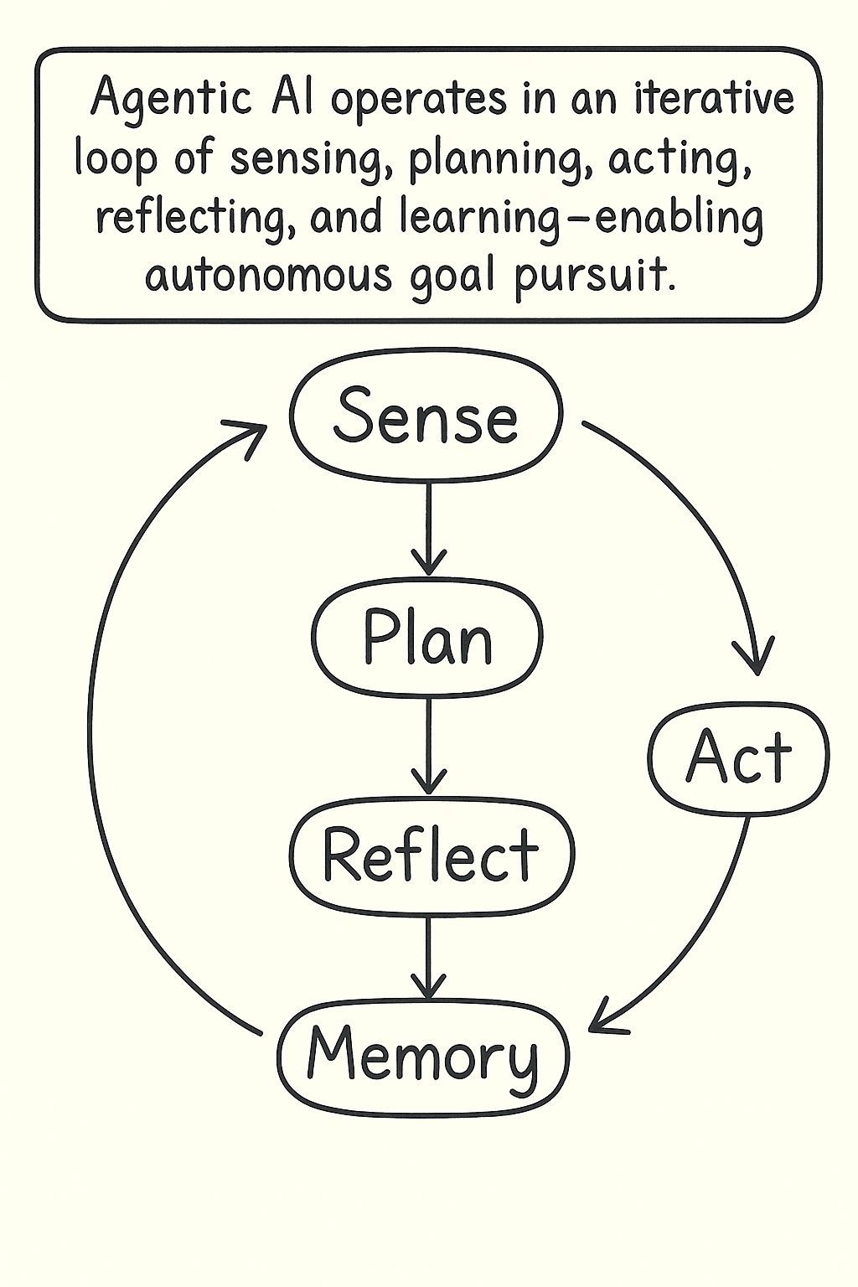

Slide 7
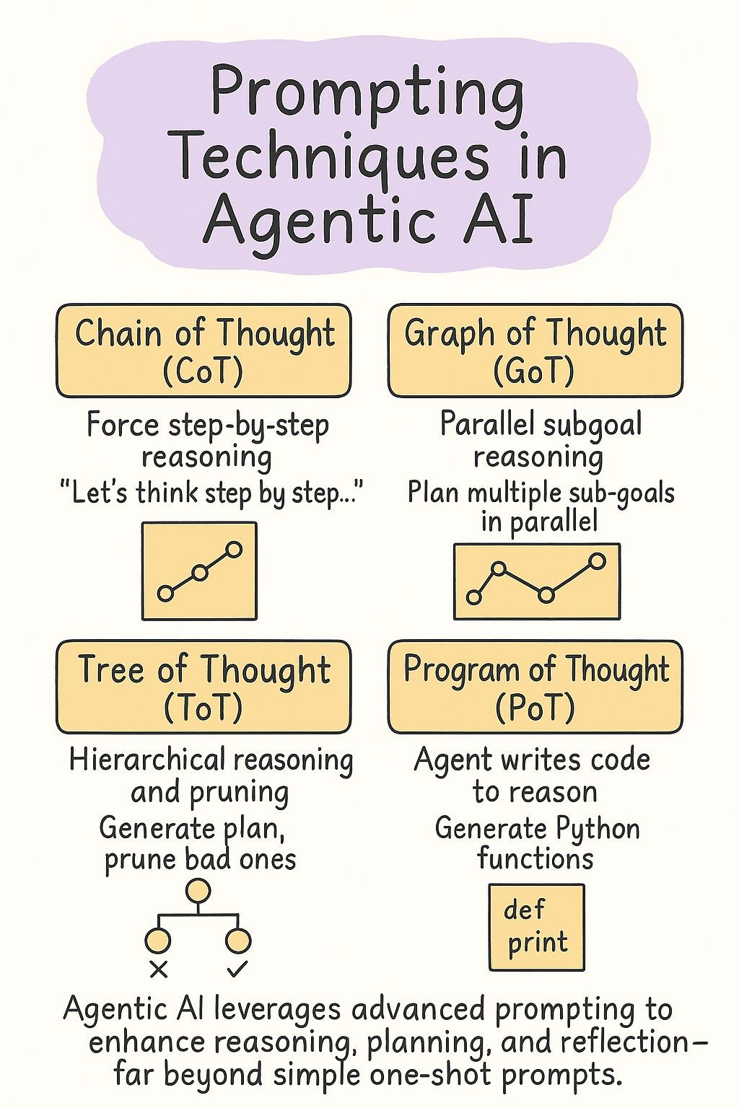

Slide 8
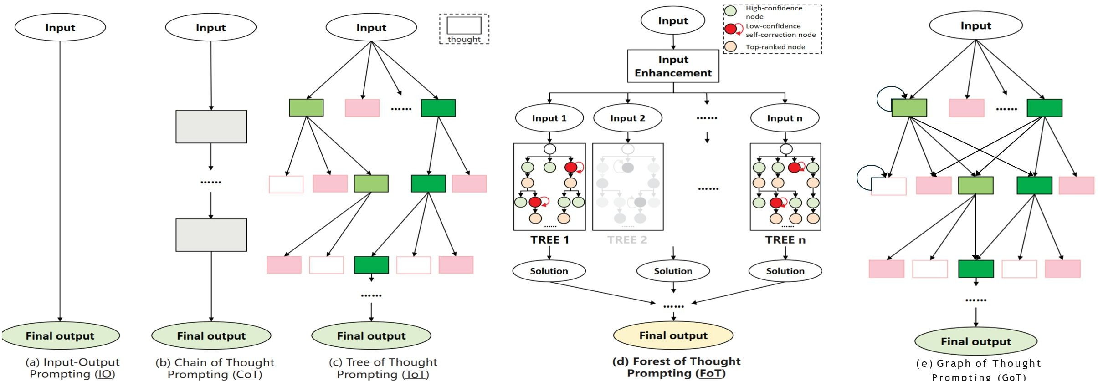

Slide 9
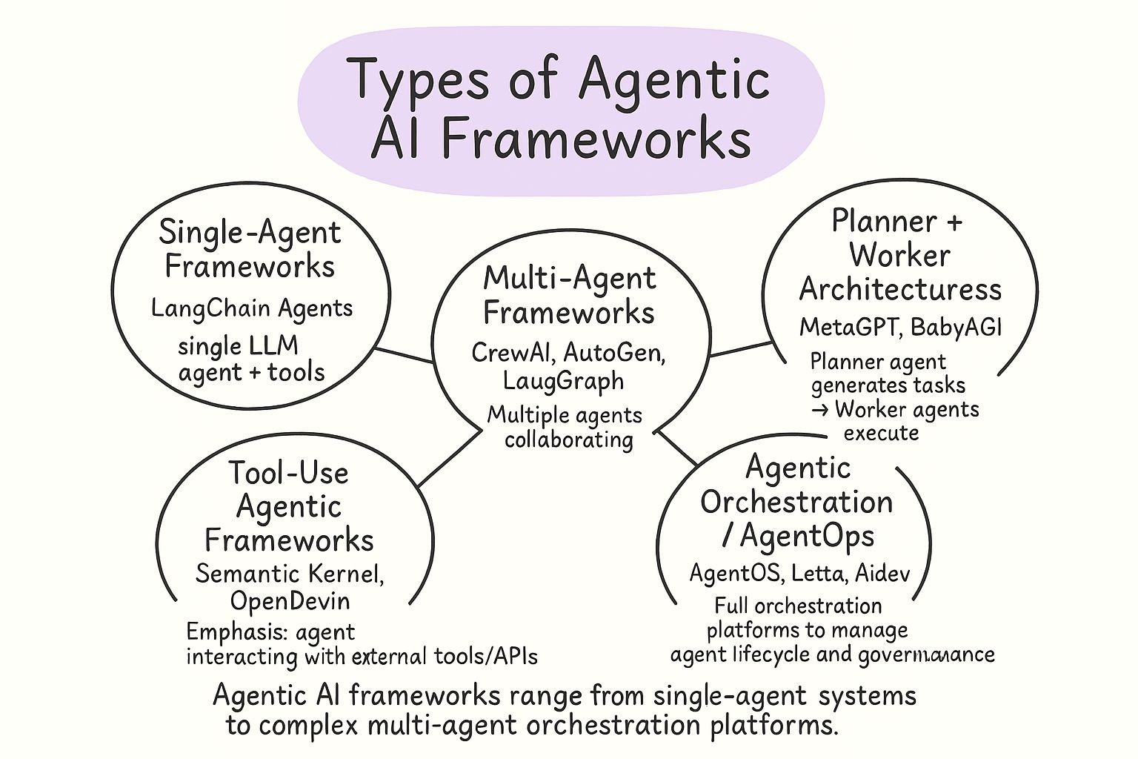
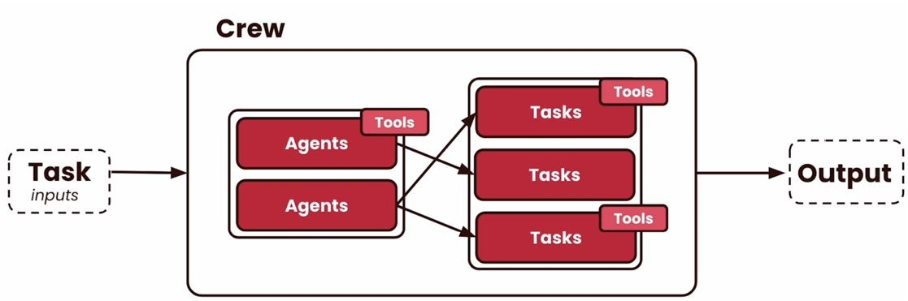

Slide 10
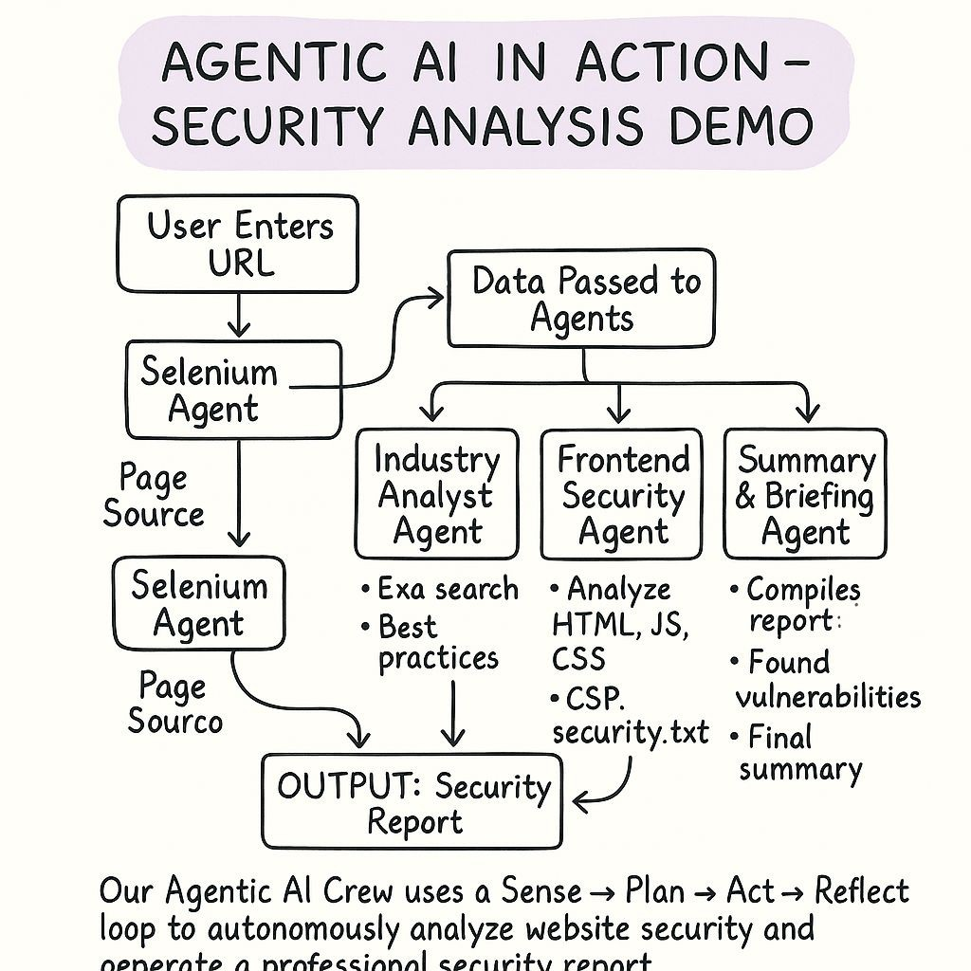

Slide 11




Thank you
Chandan Saroj
Ramchandani.toni@gmail.com
https://www.chandansaroj.in https://www.linkedin.com/in/chandan-saroj/

