Slide 1


HYI.AI
DAY 4 CONTENT
OF HYI.AI
PYTHON BASIC — BECOME A PYTHON EXPLORER
Level up your Python skills — earn XP, complete missions, and defeat the Boss Battle.
PYTHON
EXPLORER
START ADVENTURE
LEVEL 1
Rank: Rookie Coder
Missions:
0/8
XP 0 / 500
Badges:
0/8
“Think first. Code second. Debug fearlessly.”

Slide 2
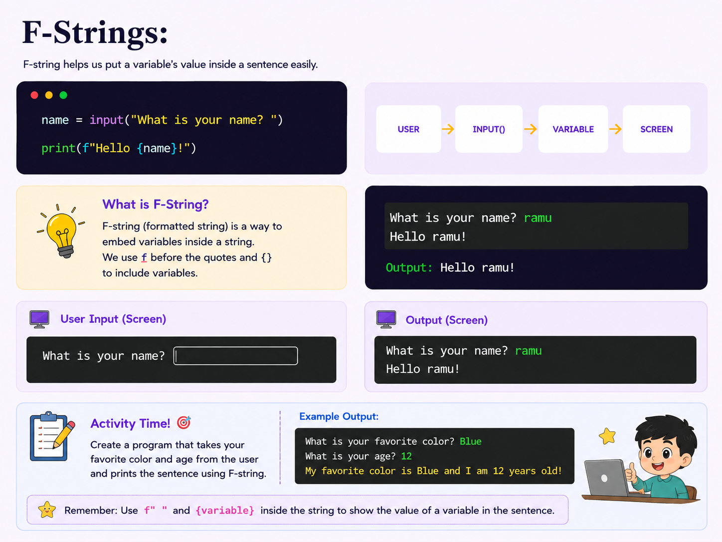

Slide 3
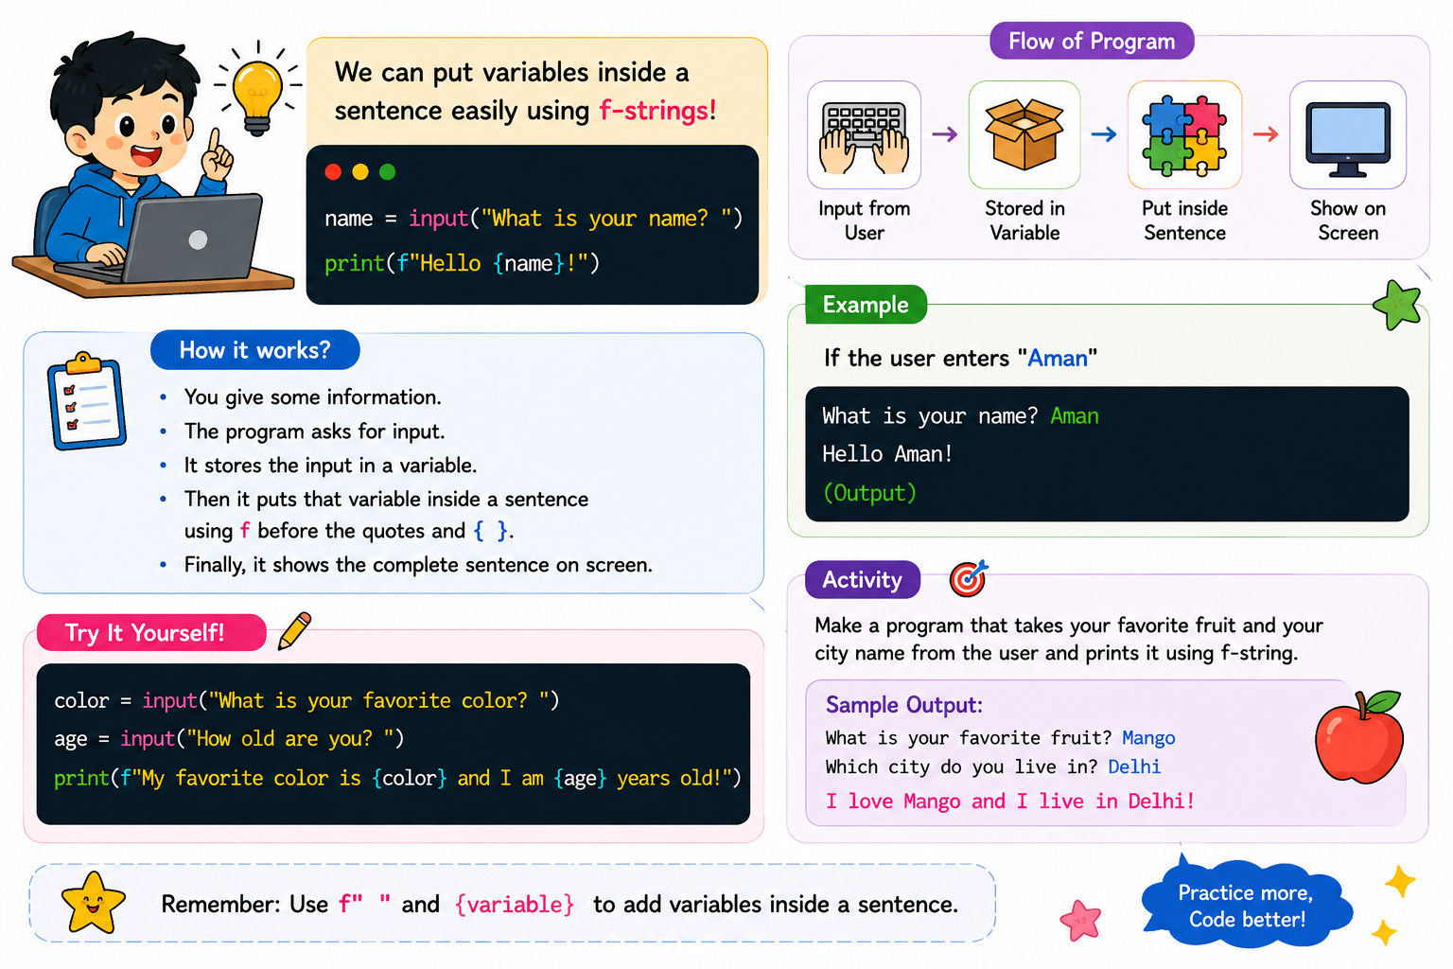

Slide 4
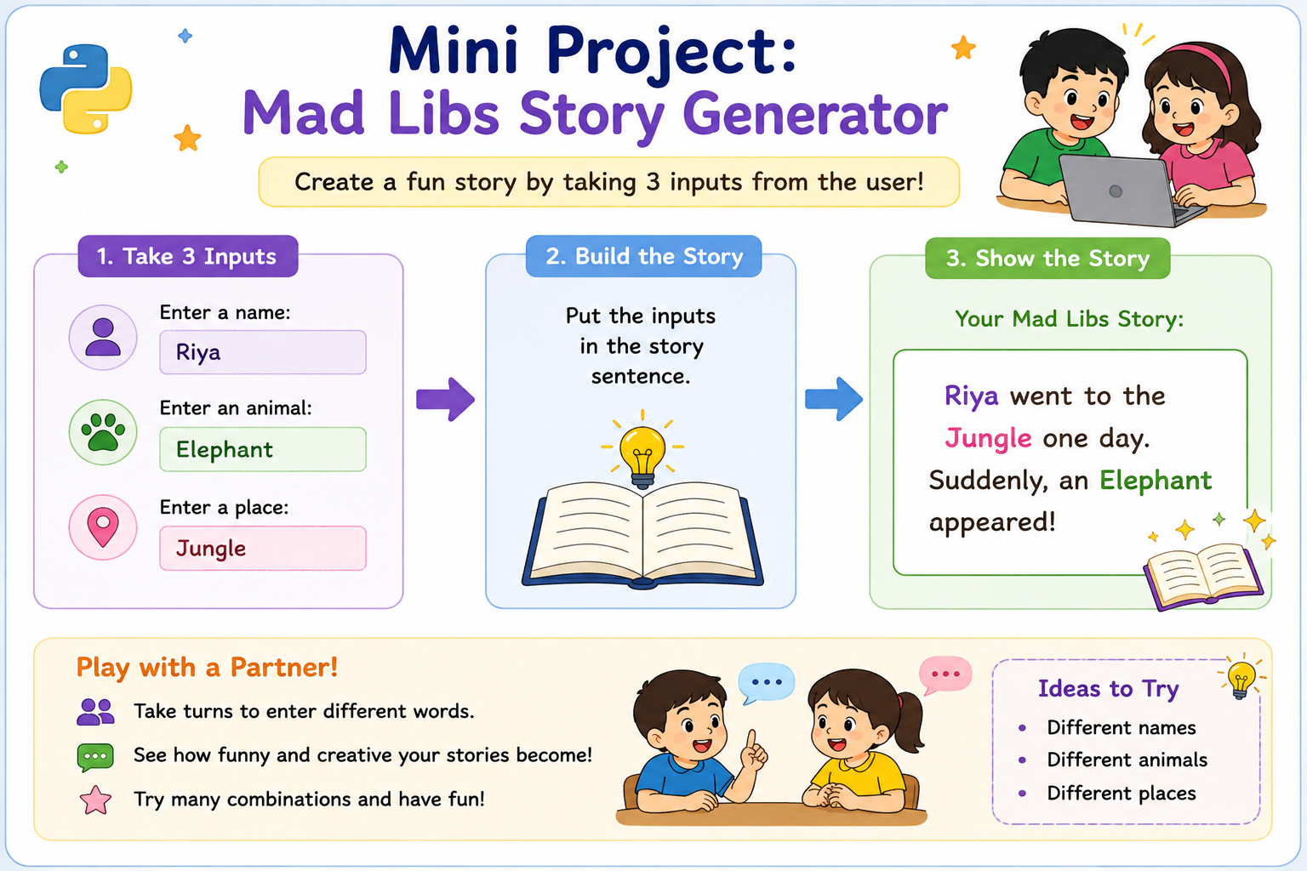

Slide 5
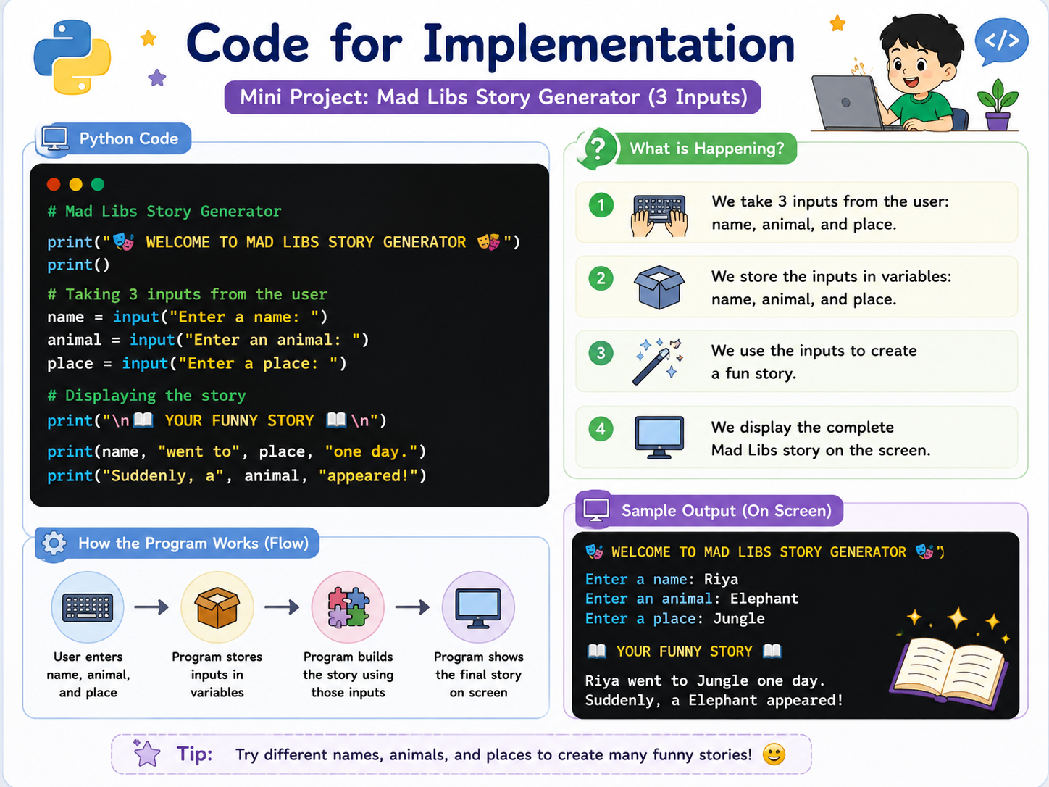

Slide 6
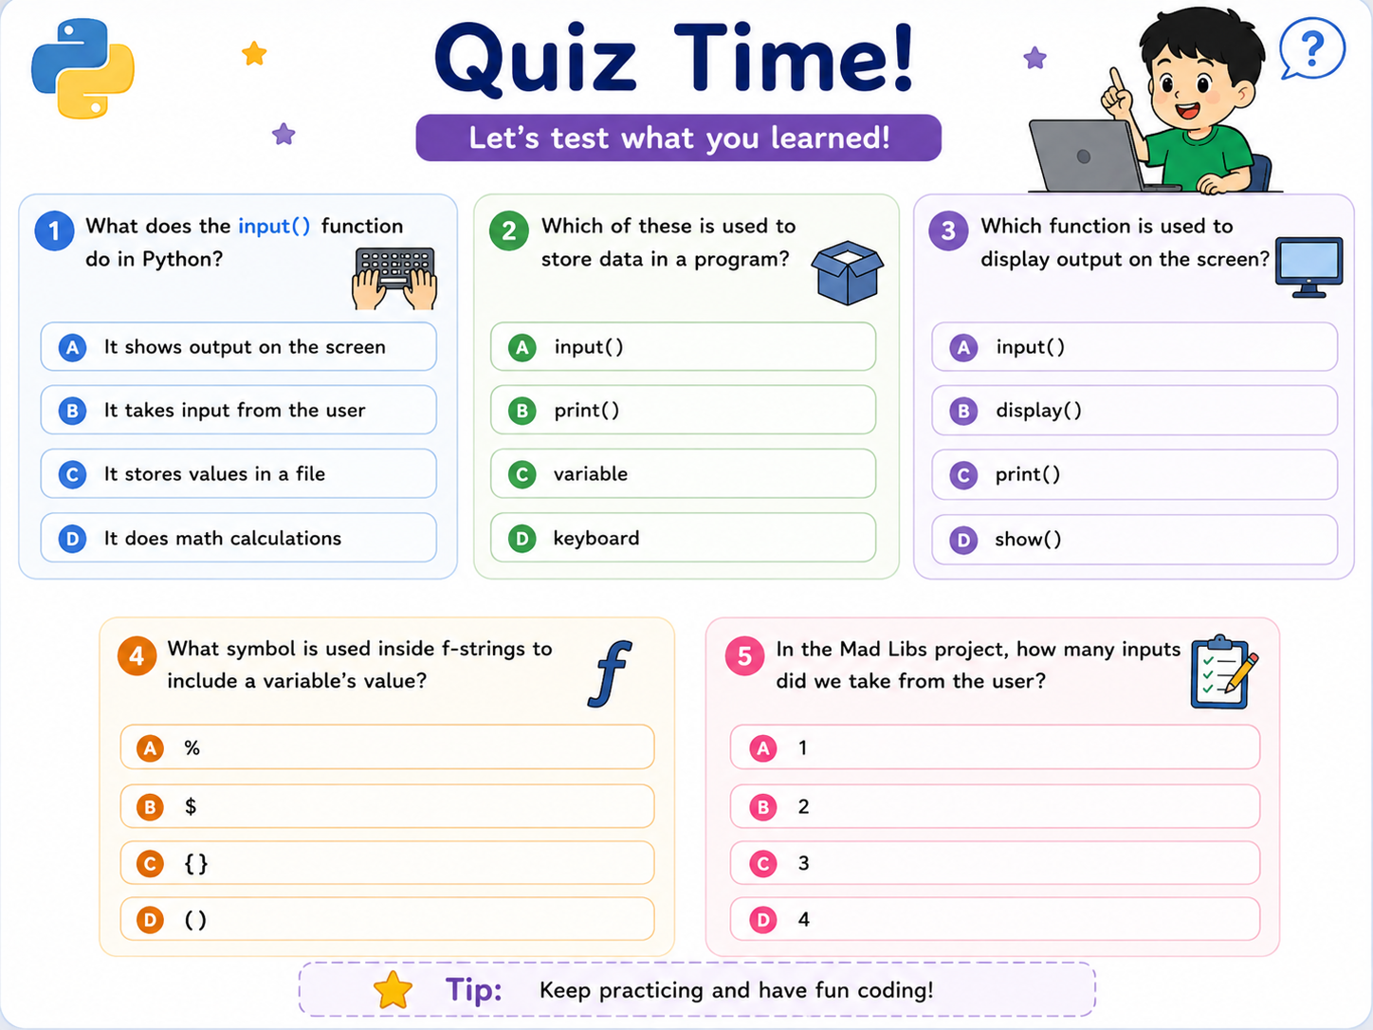

Slide 7
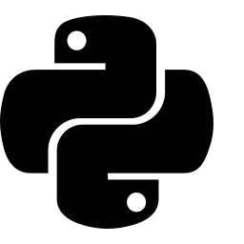




Typecasting:
Typecasting means converting one data type into another — like turning text into a number!
age = input("How old are you? ")
age = int(age)
print(age + 1)
TEXT
int()
NUMBER
What is Typecasting?
int("25")
25
Typecasting (type conversion) changes a value from one data type to another. We use int(), float(), and str() to convert between whole numbers, decimals, and text.
float("3.14")
3.14
str(100)
"100"
Activity Time!
Create a program that takes two numbers as text input, converts them to integers, and prints their sum.
Enter first number: 4
Enter second number: 7
Output: Sum is 11
Remember: input() always gives text — use int() or float() to do math with it!

Slide 8

Quiz Time!
Let's test what you learned about Typecasting!
1
What does int("25") return in Python?
2
Which function converts a value to a decimal number?
3
What data type does input() always return?
A
"25"
A
int()
A
int
B
25
B
str()
B
float
C
25.0
C
float()
C
str
D
Error
D
input()
D
bool
4
What does print(str(5) + str(3)) output?
5
Why do we need typecasting with input()?
A
8
A
To make code longer
B
"53"
B
To turn text into numbers for math
C
Error
C
To print faster
D
"15"
D
It's not needed
Tip: Always typecast input() before doing math with it!

Slide 9

Loops:
A loop lets Python repeat the same action again and again — without repeating your code!
for i in range(1, 6):
print(i)
# Output: 1 2 3 4 5
CHECK
RUN CODE
REPEAT
loops back until the condition stops
What is a Loop?
FOR LOOP
WHILE LOOP
for i in range(3):
print("Hi")
count = 1
while count <= 3:
print(count)
count += 1
A loop repeats a block of code automatically. Python has two kinds: for loops (repeat a known number of times) and while loops (repeat while a condition is true).
Activity Time!
Write a program that prints your name 5 times using a loop.
Riya
Riya
Riya
... (5 times)
Remember: for loops count for you — while loops keep going until you say stop!

Slide 10
Quiz Time!
Let's test what you learned about Loops!
1
Which keyword repeats code using range()?
2
What does range(5) produce?
3
Which loop repeats while a condition stays true?
A
while
A
Numbers 1 to 5
A
for loop
B
for
B
Numbers 0 to 4
B
if loop
C
if
C
Numbers 0 to 5
C
while loop
D
def
D
Numbers 5 to 0
D
def loop
4
for i in range(3): print(i) — how many times does it print?
5
What can make a while loop run forever?
A
2
A
Using range()
B
3
B
Forgetting to update the condition
C
4
C
Using print()
D
Infinite
D
Using for
Tip: Always double check your loop will eventually stop!

