Slide 1
Berlin Weather EDA
API-based exploratory analysis of DWD weather observations for data quality, trend, seasonality, and weather-pattern reporting
2020-2025
Berlin
DWD API
Observation period
Location analyzed
Bright Sky weather data
Summary Report : Chandana Nuthangi

Slide 2
AGENDA
A clean EDA story: from data reliability to weather insights
Problem statement and analytical questions
API data extraction and missing-value assessment
Temperature trend and seasonal pattern analysis
Precipitation and extreme-weather day analysis
Correlation view and final recommendations for the project
Bright Sky API / Deutscher Wetterdienst (DWD) | Berlin | 2020-2025
1

Slide 3
PROBLEM
Can API weather data explain Berlin's seasonal and extreme-weather patterns?
The project demonstrates API handling, data cleaning, time-series feature engineering, visualization, and concise reporting.
Questions answered
Which weather variables have data-quality issues?
How does Berlin temperature evolve over time?
What are the strongest monthly and seasonal patterns?
How do rainfall and extreme-weather days vary by year?
Which variables move together or against each other?
Bright Sky API / Deutscher Wetterdienst (DWD) | Berlin | 2020-2025
2

Slide 4
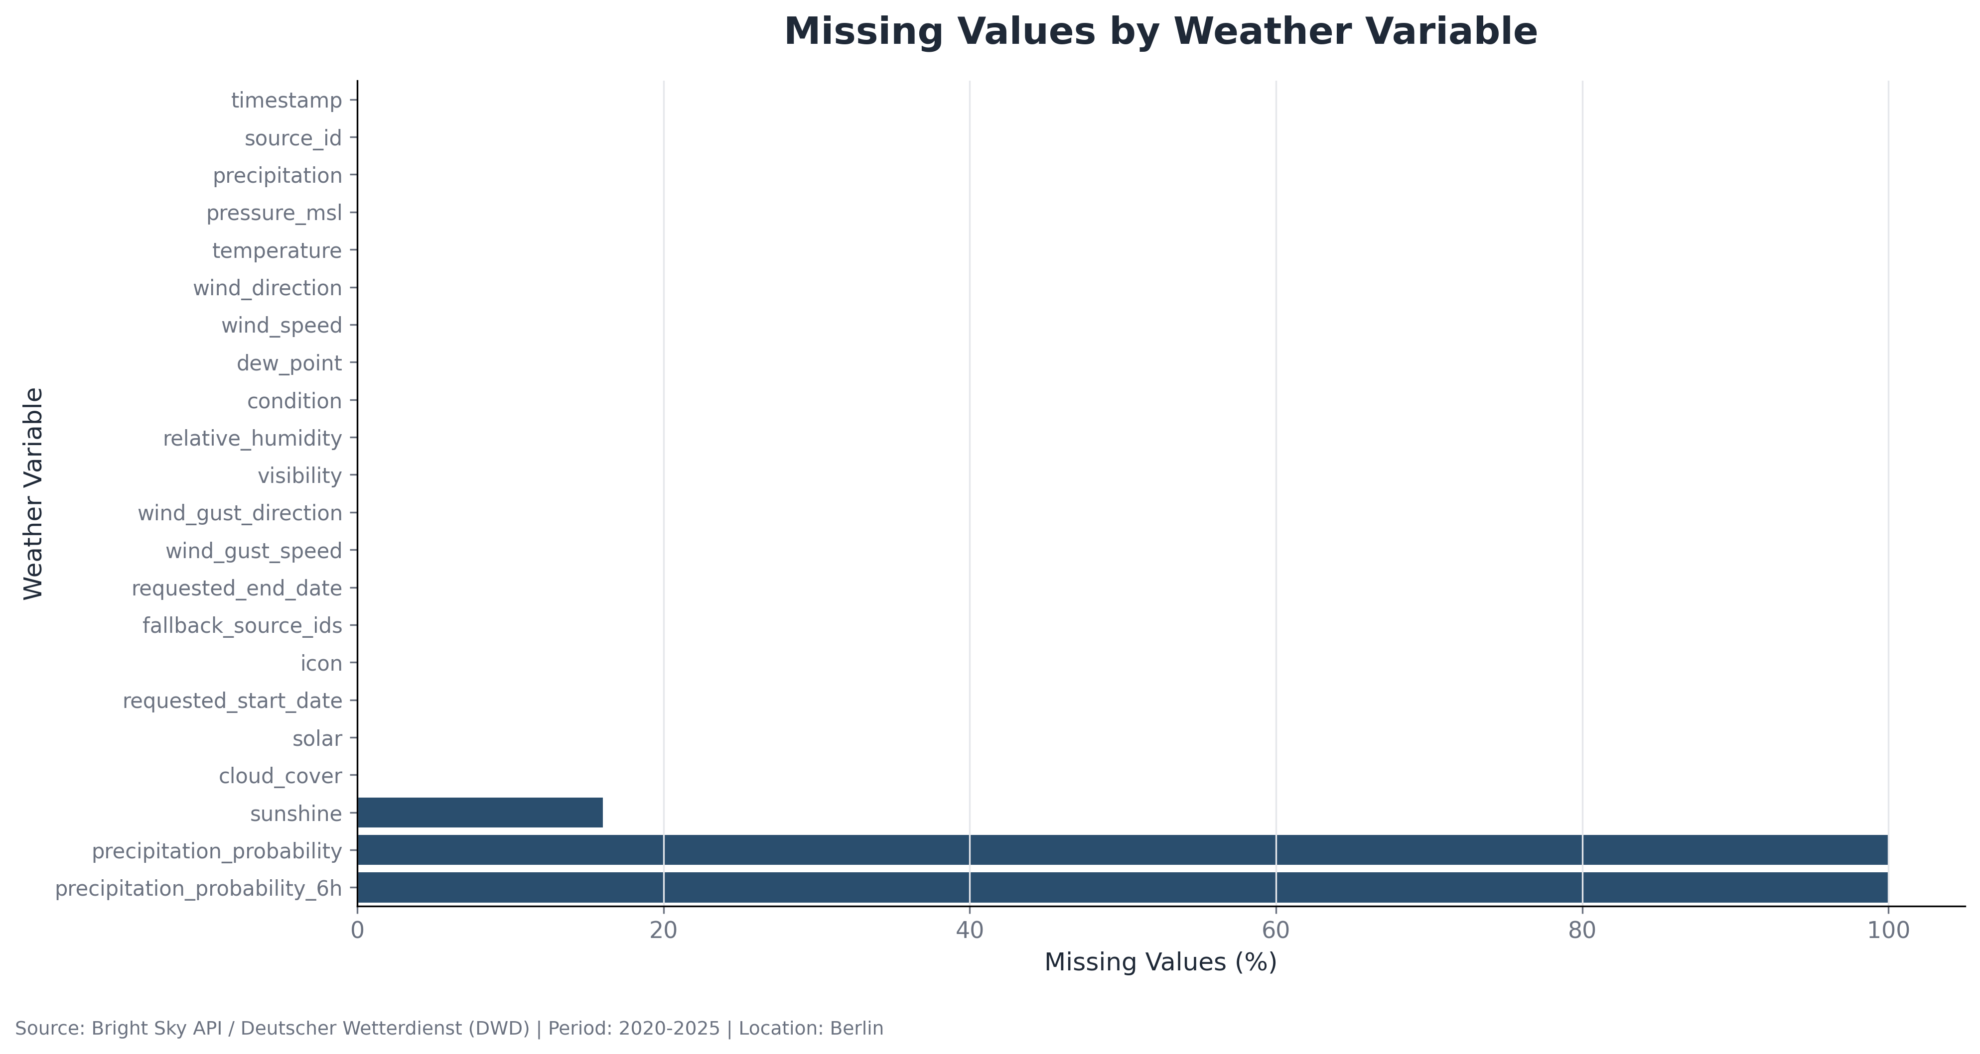
DATA QUALITY
Missingness is concentrated in a small number of API fields
This check separates reliable observation variables from fields that are unavailable or only partially populated.
Core observation fields such as timestamp, temperature, precipitation, wind, pressure, humidity, and cloud cover are mostly complete.
Precipitation probability fields are unavailable for the historical observation period and should be excluded from core analysis.
Sunshine has partial missingness, so it needs a clear cleaning decision before being used in conclusions.
Bright Sky API / Deutscher Wetterdienst (DWD) | Berlin | 2020-2025
3

Slide 5
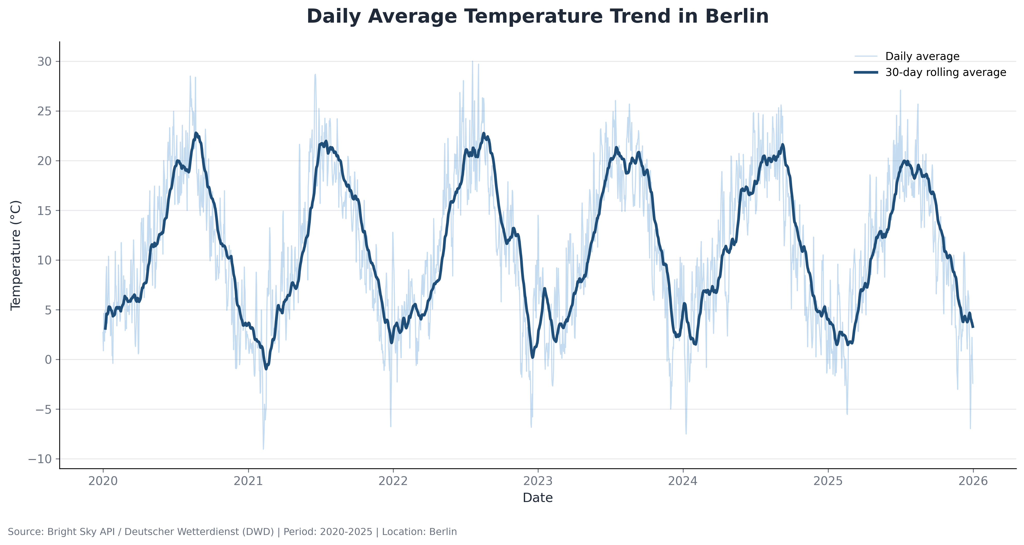
TREND
Berlin temperatures show a stable annual cycle across the period
The 30-day rolling average makes the repeated winter lows and summer peaks easier to interpret.
Daily values are noisy, but the smoothed line reveals a clear yearly rhythm.
Summer peaks regularly approach or exceed 20°C on the rolling average.
Winter troughs remain near low single digits, with occasional below-zero daily averages.
Bright Sky API / Deutscher Wetterdienst (DWD) | Berlin | 2020-2025
4

Slide 6
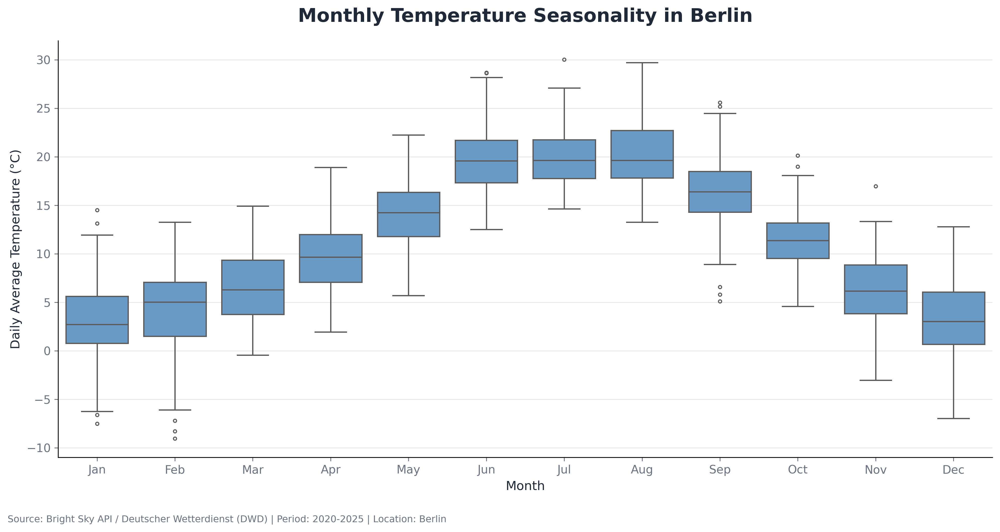
SEASONALITY
Monthly distributions confirm Berlin's strongest temperature seasonality
Boxplots show both the median monthly pattern and the spread of daily temperature values.
Temperatures rise steadily from March through August and decline from September onward.
June to August have the highest medians and widest warm-weather ranges.
January, February, and December contain the lowest values and most cold-weather outliers.
Bright Sky API / Deutscher Wetterdienst (DWD) | Berlin | 2020-2025
5

Slide 7
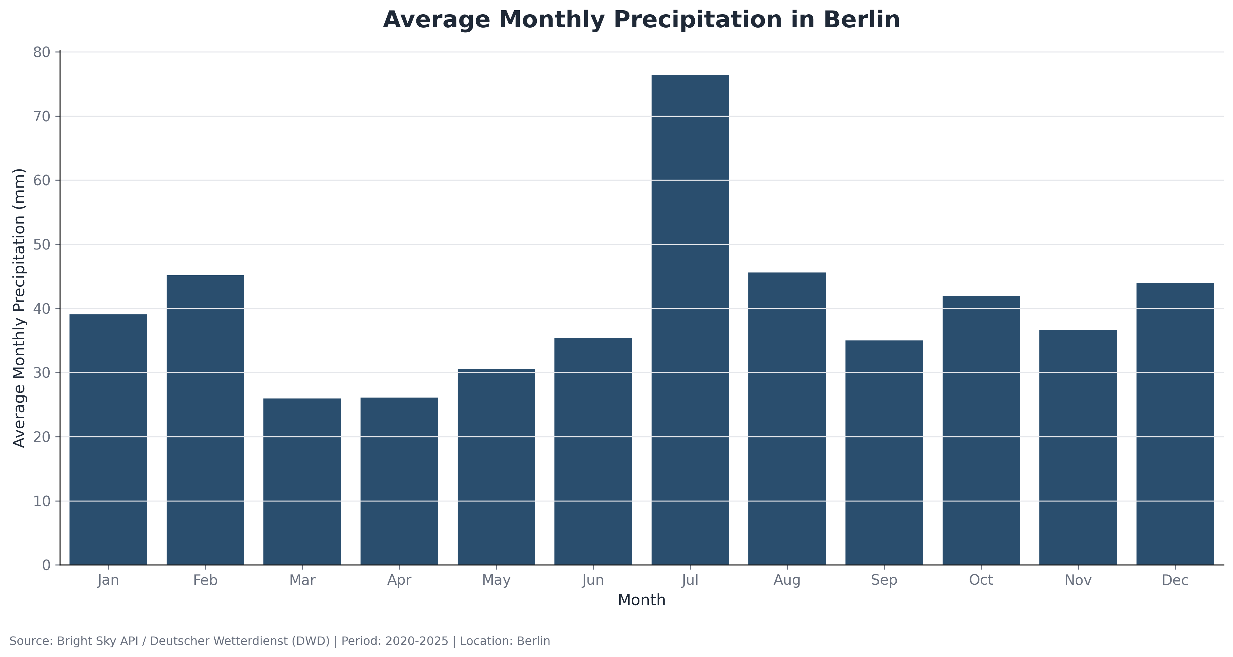
RAINFALL
July stands out as the wettest month on average
Monthly precipitation is less smooth than temperature, which suggests rainfall is driven by irregular high-intensity events.
Average rainfall is highest in July, with a visible gap versus most other months.
March and April are comparatively dry in this period.
Precipitation seasonality is weaker and more event-driven than temperature seasonality.
Bright Sky API / Deutscher Wetterdienst (DWD) | Berlin | 2020-2025
6

Slide 8
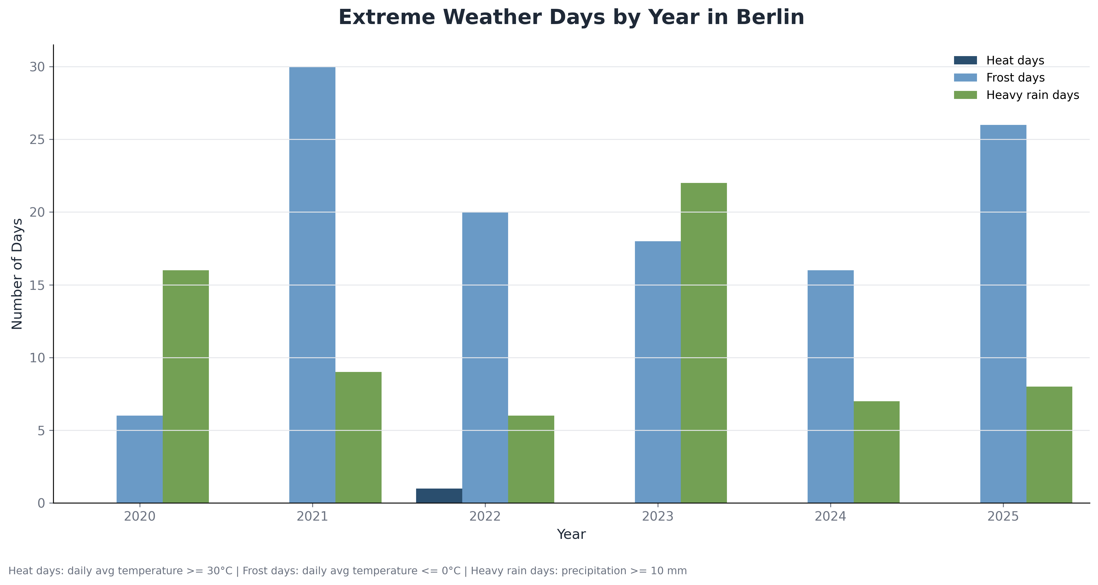
EXTREMES
Frost and heavy-rain days vary materially year to year
Extreme-day indicators convert hourly weather observations into simple, explainable features.
Frost days are highest in 2021 and 2025 in this analysis window.
Heavy-rain days peak in 2023, making it the strongest rainfall-risk year in this view.
Heat days are rare under the daily-average >= 30°C definition, so the threshold should be explained clearly.
Bright Sky API / Deutscher Wetterdienst (DWD) | Berlin | 2020-2025
7

Slide 9
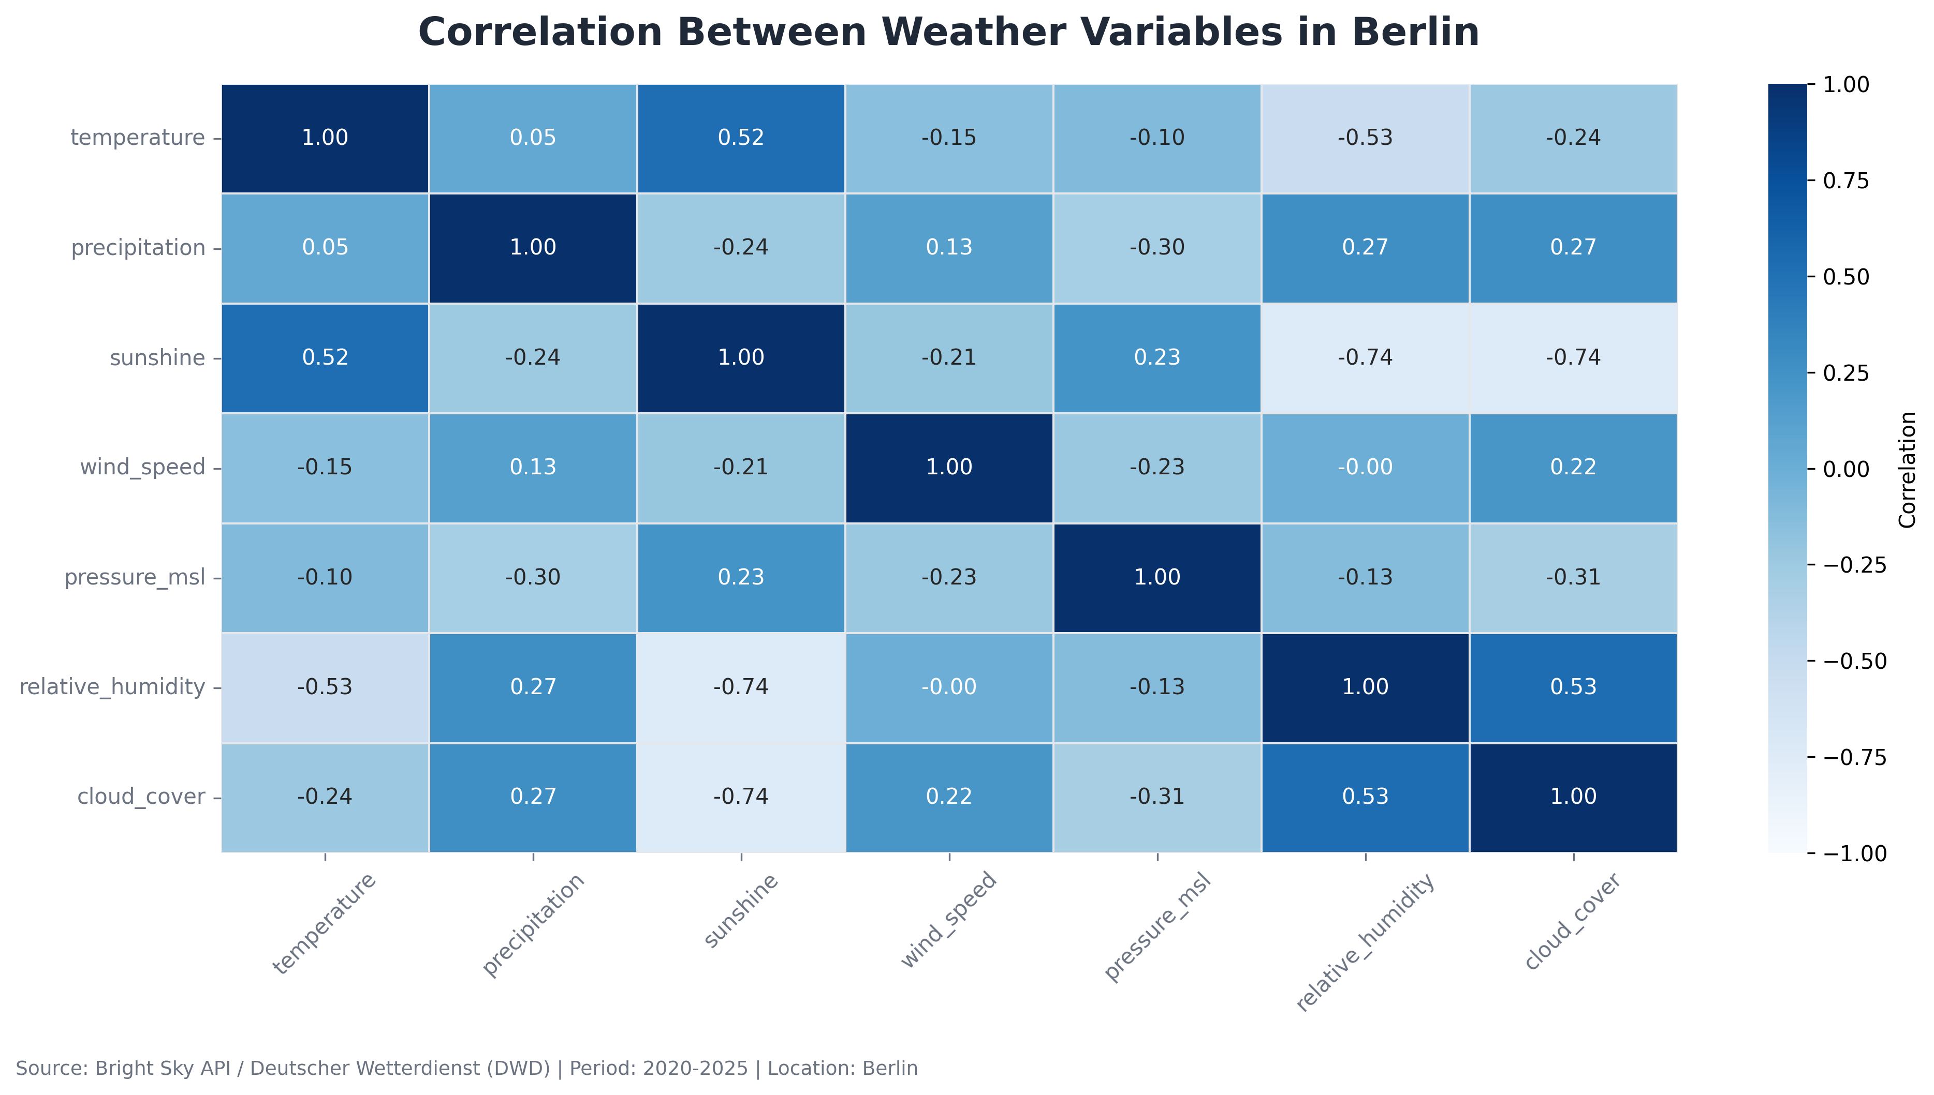
RELATIONSHIPS
Sunshine, humidity, and cloud cover explain much of the weather structure
The correlation matrix provides a compact check of expected meteorological relationships.
Temperature is positively related to sunshine and negatively related to relative humidity.
Sunshine has strong negative relationships with humidity and cloud cover.
Precipitation has weaker linear relationships, consistent with more irregular event behavior.
Bright Sky API / Deutscher Wetterdienst (DWD) | Berlin | 2020-2025
8

Slide 10
SUMMARY
The project demonstrates a complete EDA workflow, not only plotting
Key takeaways
Berlin weather data is suitable for analysis after excluding unavailable probability fields and documenting sunshine missingness.
Temperature has a clear annual pattern across 2020-2025, with stable winter troughs and summer peaks.
Rainfall is more irregular than temperature and should be discussed as event-driven rather than smoothly seasonal.
The notebook showcases API extraction, missing-value handling, time features, aggregation, trend analysis, seasonality, extreme-day flags, and reporting.
Bright Sky API / Deutscher Wetterdienst (DWD) | Berlin | 2020-2025
9

