Slide 1
Paper Presentation:
Erosion Band Features for Cell Phone Image Based Plant Disease Classification
Marion Neumann, Lisa Hallau, Benjamin Klatt, Kristian Kersting and Christian Bauckhage

Slide 2
Questions addressed for understanding the paper
What problem(s) are they solving?
Why are these problems important?
What did they really do?
What is the contribution of the work? (i.e. what is interesting or new?)
What methods are they using?
What were the results? Did they do what they set out to do?

Slide 3
What problem(s) are they solving?
Leaf Disease Classification – distinguish between symtoms caused by 5 diseases in beet leaves
Erosion Band Feature in image analysis
Efficient detector of potential disease regions and a robust classification method based on texture features
Minimal computational costs on the cellular device

Slide 4
Why are these problems important?
Automatic recognition of symptoms of five common kinds of infections in beet leaves
Early recognition of disease – limits the amount of fungicides needed for pest control
It can thus reduce costs and environmental burden
To overcome the challenges faced during the implementations of image processing algorithms on a cell phone

Slide 5
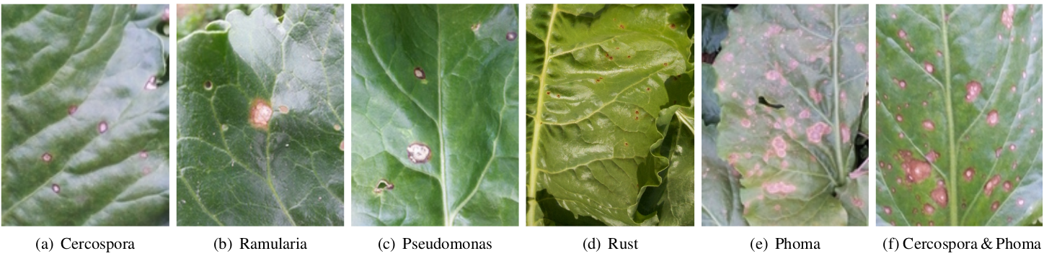
What did they really do?
Cell phone camera images of beet leaves showing leaf spots caused by (a) Cercospora beticola (cerc), (b) Ramularia beticola (ram), (c) Pseudomonas syringae (pseu), (d) Uromyces betae (rust), (e) Phoma betae (phom), and (f) combined infestation of Cercospora and Phoma.

Slide 6
What did they really do?
Present an efficient image preprocessing, feature extraction, and classification steps tailored to the recognition of pathogens that infect beet plants
A statistical approach using field data reflecting the variety of the real environment.
Develop discriminant features by applying multiple erosion steps to the extracted regions
Computing several first- and second-order statistical texture features on the RGB color channels, as well as on the local binary patterns ( LBP s) of the gradient magnitude values
The resulting erosion feature ensemble ( EFE ) proves superior classification performance, in comparison to solely applying the same texture descriptors to the whole image regions, leading to disease detection rates of 95% and classification accuracies of 84%

Slide 7
What is the contribution of the work?
Similar to existing approaches to plant disease classification, rely on texture descriptors for efficient and accurate classification.
In contrast to these existing approaches, however, we leverage an ensemble of local features reflecting the spatial structure of the considered leaf spots.
Further, data processing is performed on a cellular device and the consulting system provides advice in an online fashion while the farmer is still in field.
The issues arising in such a scenario covering efficient region detection and feature computation on the smart phone followed by reliable disease classification have not been addressed in previous approaches.

Slide 8
What methods are they using?
3-steps involved in the proposed classification method:
  Region Detection: applied to whole input image
  Feature Extraction: performed on each extracted region
  Class Prediction: performed on each extracted region
An extensive feature study comparing a wide range of texture features computed on the proposed erosion bands
Evaluate the best performing feature combination on a comprehensive dataset of 2957 regions extracted from 495 images recorded with six different cell phone camera types.

Slide 9
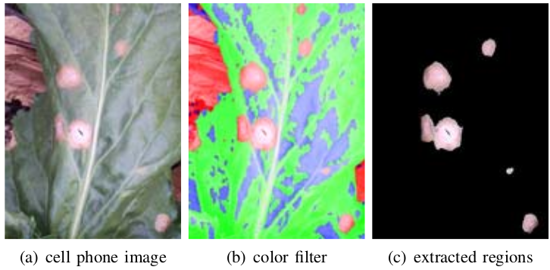
What methods are they using?
Region Detection:
Given - an RGB image I of 5 resp. 8 megapixels in JPG format
Preprocessing steps:
Down-scale the input image I by 25%; the resulting image D is of size 484 × 648 × 3 resp. 612 × 816 × 3 depending on the used smart phone camera; this increases sharpness and facilitates further computation
Compute a binary image B from D such that the foreground pixels are the pixels with a red value higher than both the green and the blue value; this pronounces reddish/brownish image regions which may hint at leaf spots caused by fungus or bacteria
compute a region image R from B; since leaf spots tend to be compact, too elongated regions can be discarded from further analysis.
Suppress all pixels in D that are background pixels in R; the information in the new image G forms the basis for the subsequent analysis

Slide 10
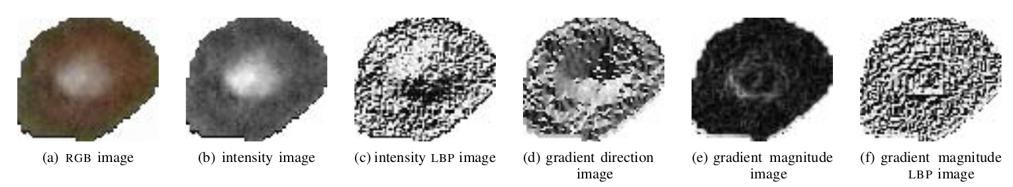
What methods are they using?
Statistical Texture Features:
Analysis of color-, intensity-, and gradient-based features. From the original RGB values of each r_{i} we compute the following values
red ( R ), green ( G ), blue ( B ) channels,
intensities ( INT ) ,
LBP s of intensities ( INT LBP ) ,
gradient magnitudes ( G mag ) ,
gradient directions ( G dir ), and
LBP s of gradient magnitudes ( G mag LBP )
LBP is the basic local binary pattern

Slide 11
What methods are they using?
Statistical Texture Features:
To analyse the color and gradient information of the extracted regions, simple and co-occurrence based statistical texture features are considered.
First-order statistics: computed from the respective normalized histogram h_{i} of n bins lead to simple characteristics of image texture
  Mean, Variance, Entropy
Second-order statistics: computed from the spatial co- occurrence of pixel values analyse relationships among pairs of pixels and therefore constitute more powerful texture descriptors
  Correlation, Entropy, Inverse Difference Moment, Variance, Sum Entropy, Difference Entropy, Sum Variance

Slide 12

What methods are they using?
Erosion Band Features:
Extracting more fine grained texture features following the circular structure of the leaf spots. Given the erosion width w, binary erosion is applied iteratively to the extracted region r_{i} . Given the extracted region r_{i} = r_{i}⁽⁰⁾ and E_{w} a spherical structuring element, the erosion band at the t-th erosion step b_{i} is computed as
t = [1, . . . , t_{max} ].

Slide 13
What methods are they using?
Classification:
To predict the disease per region we train a one-vs-one multi-class support vector machine ( SVM ) using the radial basis function ( RBF ) kernel.
The classifier is trained on 6 classes, where 5 are leaf spots caused by the previously introduced pathogens.
To handle regions extracted by the region detector not belonging to one of these classes a sixth class, non-infected (n-inf ) is considered.

Slide 14
What methods are they using?
Experimental Evaluation
  we evaluate each combination of statistical texture feature and input value on the whole region and further on the erosion bands.
  Then, we create a feature ensemble of the best performing but most diverse feature/value combinations from the first evaluation step.
  This feature ensemble, called erosion feature ensemble, is then evaluated on a comprehensive dataset of 2 957 regions extracted from 495 cell phone images.

Slide 15
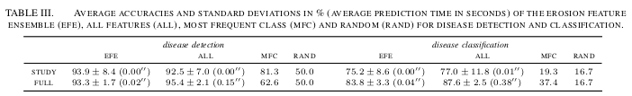
What were the results?
Two tasks: Disease Detection, Disease Classification tested on STUDY and FULL dataset

Slide 16
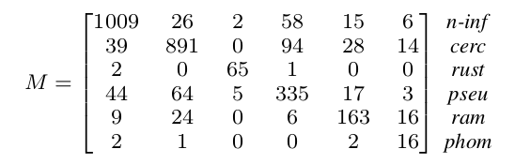
What were the results?
Confusion Matrix

Slide 17
Conclusions
A new feature derivation scheme is introduced for leaf spot classification based on statistical texture features computed on multiple erosion bands of regions of interest extracted from cell phone images of beet leaves.
The success of erosion-based texture features suggests to apply similar techniques to disease classification of other plants

