Slide 1
Group1:CoWinApp

Slide 2
Problem Statement
To Create an Application for The user to register for vaccination(CoWin App).
User can login, and do the following actions
Register for Vaccination.
Checking Whether user is fully vaccinated or not.
To check available slots/ Type of Vaccine
employee & Admin can do login ,and do the following actions
Dose details (dose1 or dose2)
Vaccine type(covishield or covaxin)
To display whether Vaccine/slots available or not
CRUD operations on Vaccination centers

Slide 3
Road Map
Application will be developed in following Sprints –
Spring Boot + Rest Controller + JPA with Hibernate
Micro services

Slide 4
Plan
Design
Generate the skeleton as per class design provided
TDD approach
Identify test cases for each module
Write Failing Test cases
Convert the Test Cases in GREEN
Implement the case study in incremental manner

Slide 5
Modules
Login Module
Beneficiary
Admin Module
Employee

Slide 6
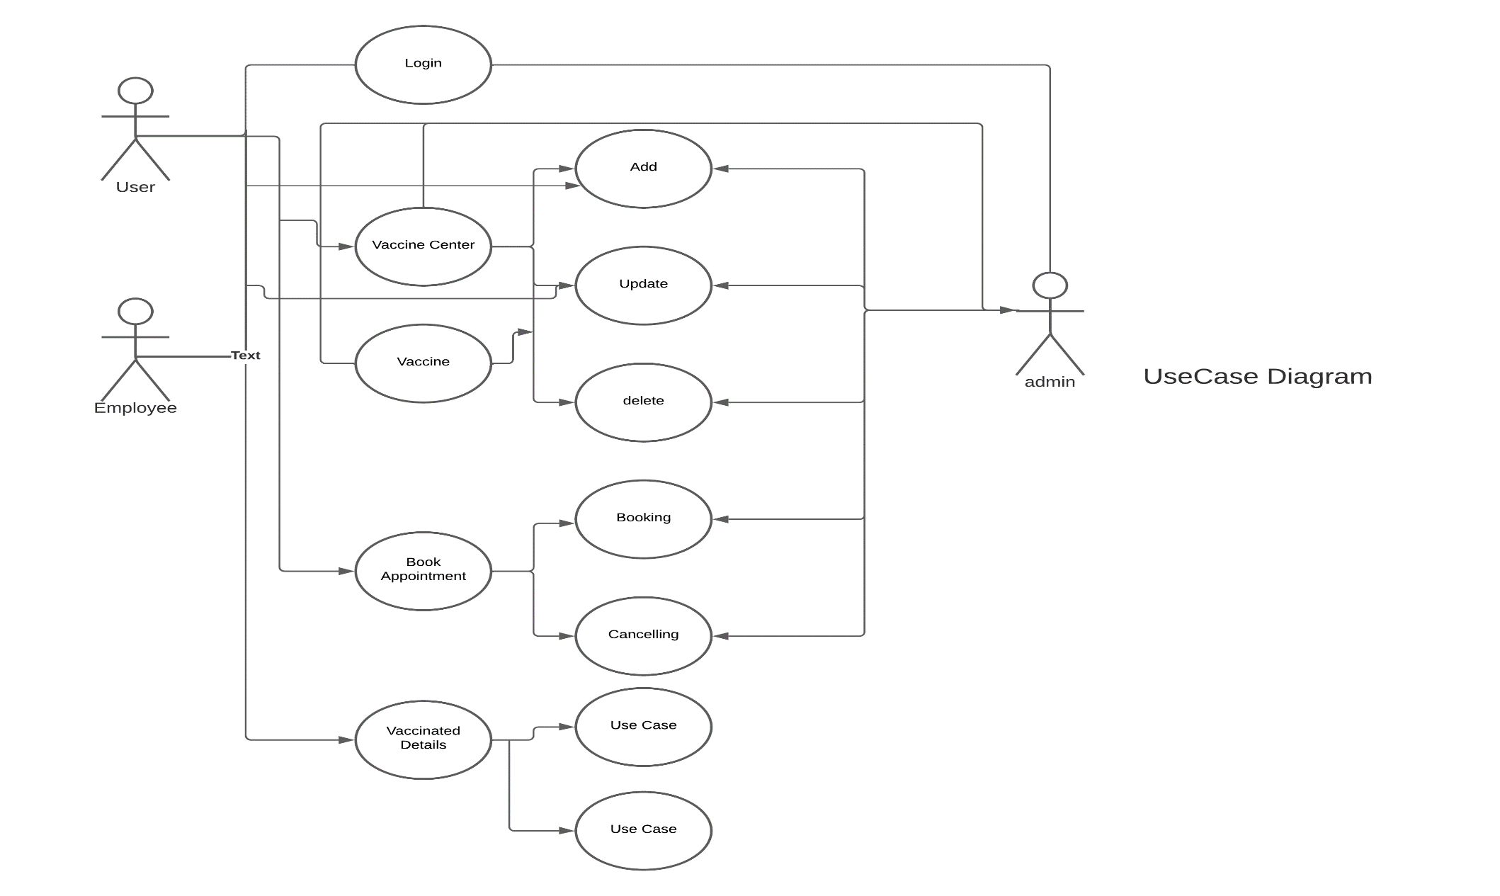
USE-CASE DIAGRAM

Slide 7
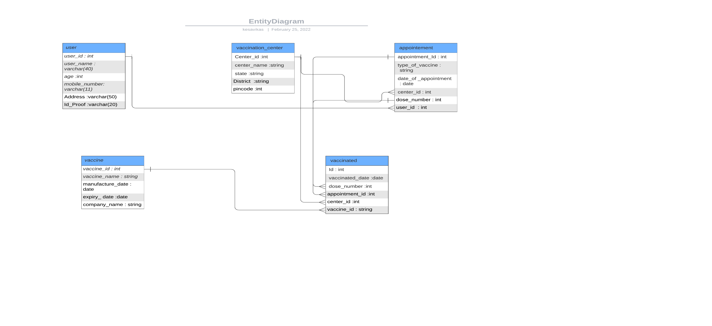
ENTITY DIAGRAM

Slide 8
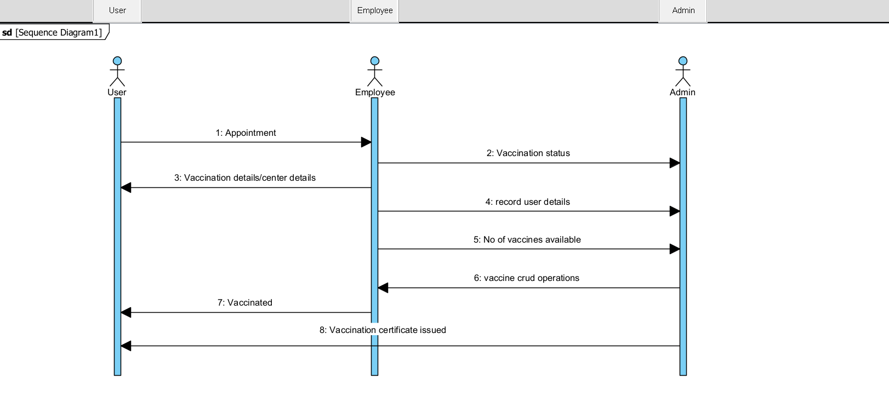
SEQUENCE DIAGRAM

Slide 9
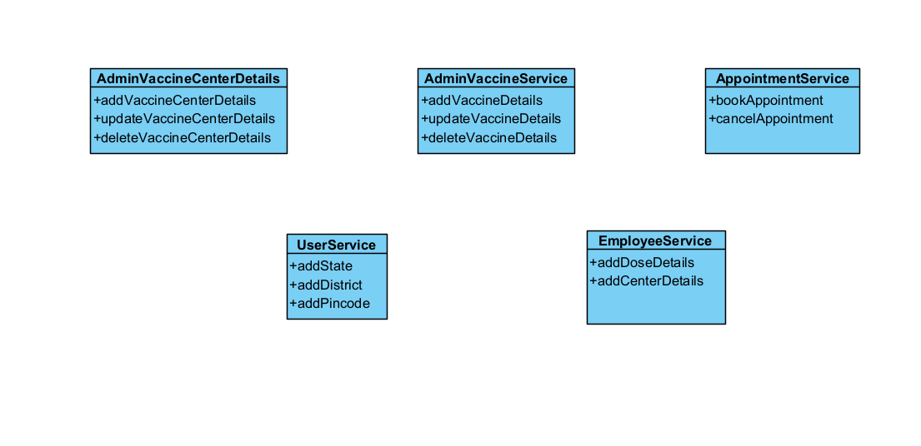
Service Interface

Slide 10




Questions

