Slide 1
MOBILE REVIEWS
CHETHAN M 01FB17ECS708
CHANDANA M 01FB17ECS706
DIVYA D V 01FB17ECS709
UE16CS333 project submission

Slide 2
About the project
Project idea:
Merchants selling products through ecommerce often received a high amount of customers reviews too large in scale for human processing. These reviews often have important business insights that can be leveraged to perform actions that can improve profits. In this project we analyze ~400,000 mobile phone reviews from Amazon.com aiming to find trends and patterns to determine which product characteristics are mentioned most by customers and with what sentiment. Our task is performed in six steps:
pre-processing to prepare the data for analysis including tokenization and part-of-speech tagging,
product names standardization,
characteristics extraction,
reviews filtering to remove reviews considered as outliers, unbalanced or meaningless,
sentiment extraction for each product-characteristic and
performance analysis to determine the accuracy of the model where we evaluate characteristic extraction separately from sentiment scores.

Slide 3
Uniqueness and analysis
Why you think your project is somewhat uncommon ?
Businesses do not necessarily need to have a sentiment score for reviews, especially for ecommerce sites such as Amazon where a rating is also available. For manufactures in particular even if they have a score they would not know exactly where to prioritize their efforts to improve their products. Instead, by giving them the specifics characteristics where their products are failing or not they get valuable insights to tackle problems as they arise. Hence, the challenge of correctly extracting the products characteristics is of major importance. This application underperforms in the capabilities of extracting the characteristics and seems to perform fairly well in assigning the correct sentiments to them.

Slide 4
Dataset source and preprocessing done
Dataset source
This project is based on the dataset provided for the following Kaggle competition:
https://www.kaggle.com/PromptCloudHQ/amazon-reviews-unlocked-mobile-phones

Slide 5
pre-processing steps performed
This part includes:
Tokenization
Part of Speech tagging
Vector Space Model and TF * IDF transformation
Product Names Standardization
Characteristics Extraction
Filtering
Characteristics Sentiment Extraction

Slide 6
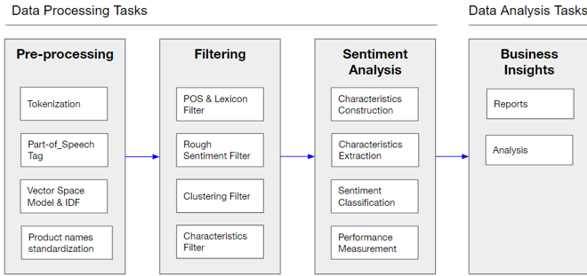
Quantity of work - High level block diagram of our implementation

Slide 7
Quantity of work – the main code modules
Serial no | Code module | Status (% complete) | What it does ?
1 | numpy | 100% | NumPy is the fundamental package for scientific computing with Python
2 | nltk | 100% | NLTK is a leading platform for building Python programs to work with human language data
3 | pandas | 100% | Pandas is the most popular python library that is used for data analysis
4 | seaborn | 40% | Seaborn is a Python data visualization library based on matplotlib

Slide 8
Quantity of work – MILESTONES THAT ARE DONE AND WORKING
Serial no | Milestone description | Status(%complete) | Comments
1 | Tokenization | 100% | It involves removal of stopwords, treating stemming of words, case-folding, removing characters that are not alphanumeric and breaking at whitespace.
2 | Vector Space Model | 80% | A vector space model was created based on a normalized (by euclidean distance) Term-Document-Matrix via bags-of-words for both product names as well as reviews in preparation for clustering purposes.
3 | Part Of Speech Tagging | 100% | The function pos_tag from NLTK package was used for this task.
4 | Characteristics Extraction | 80% | identifying NN/NNP POS tagged terms that exceeded a specific threshold of reviews occurrences.

Slide 9
Our top three learning in this project
Learning # 1 : In this project we analyzed the performance of measuring sentiment analysis on specific characteristics of mobile phones mentioned in customer reviews to provide manufacturers with actionable insights to improve their products and for sellers to improve their offerings.
Learning # 2 : Learned about how to use the preprocessing techniques of NLP for mobile reviews.
Learning # 3 : Learned about varius kinds of of filtering.

Slide 10
Top Challenges unresolved so far
Issue #1
Results shows the worst performance on characteristic extraction where Recall is critically low.
Issue #2
However the test set was too small to have a clear statistical significance on the results.
Issue #3
Sentiment scores on characteristics extraction revealed a good but not great performance.

Slide 11
Our Going forward plan
Step 1 : Results shows the worst performance on characteristic extraction where Recall is critically low. This topic is also the main challenge which could be further improved by implementing topic modelling.
Step 2 : Sentiment scores on characteristics extraction revealed a good but not great performance suggesting that further improvements could be made using Relationship Extraction.
Step 3 : Because of computational limitations we worked only on a subsample of the ~400,000 reviews. In the future using cloud computing as well as parallelization and improving the algorithm will allow to process an even larger amount of reviews.

