Slide 1
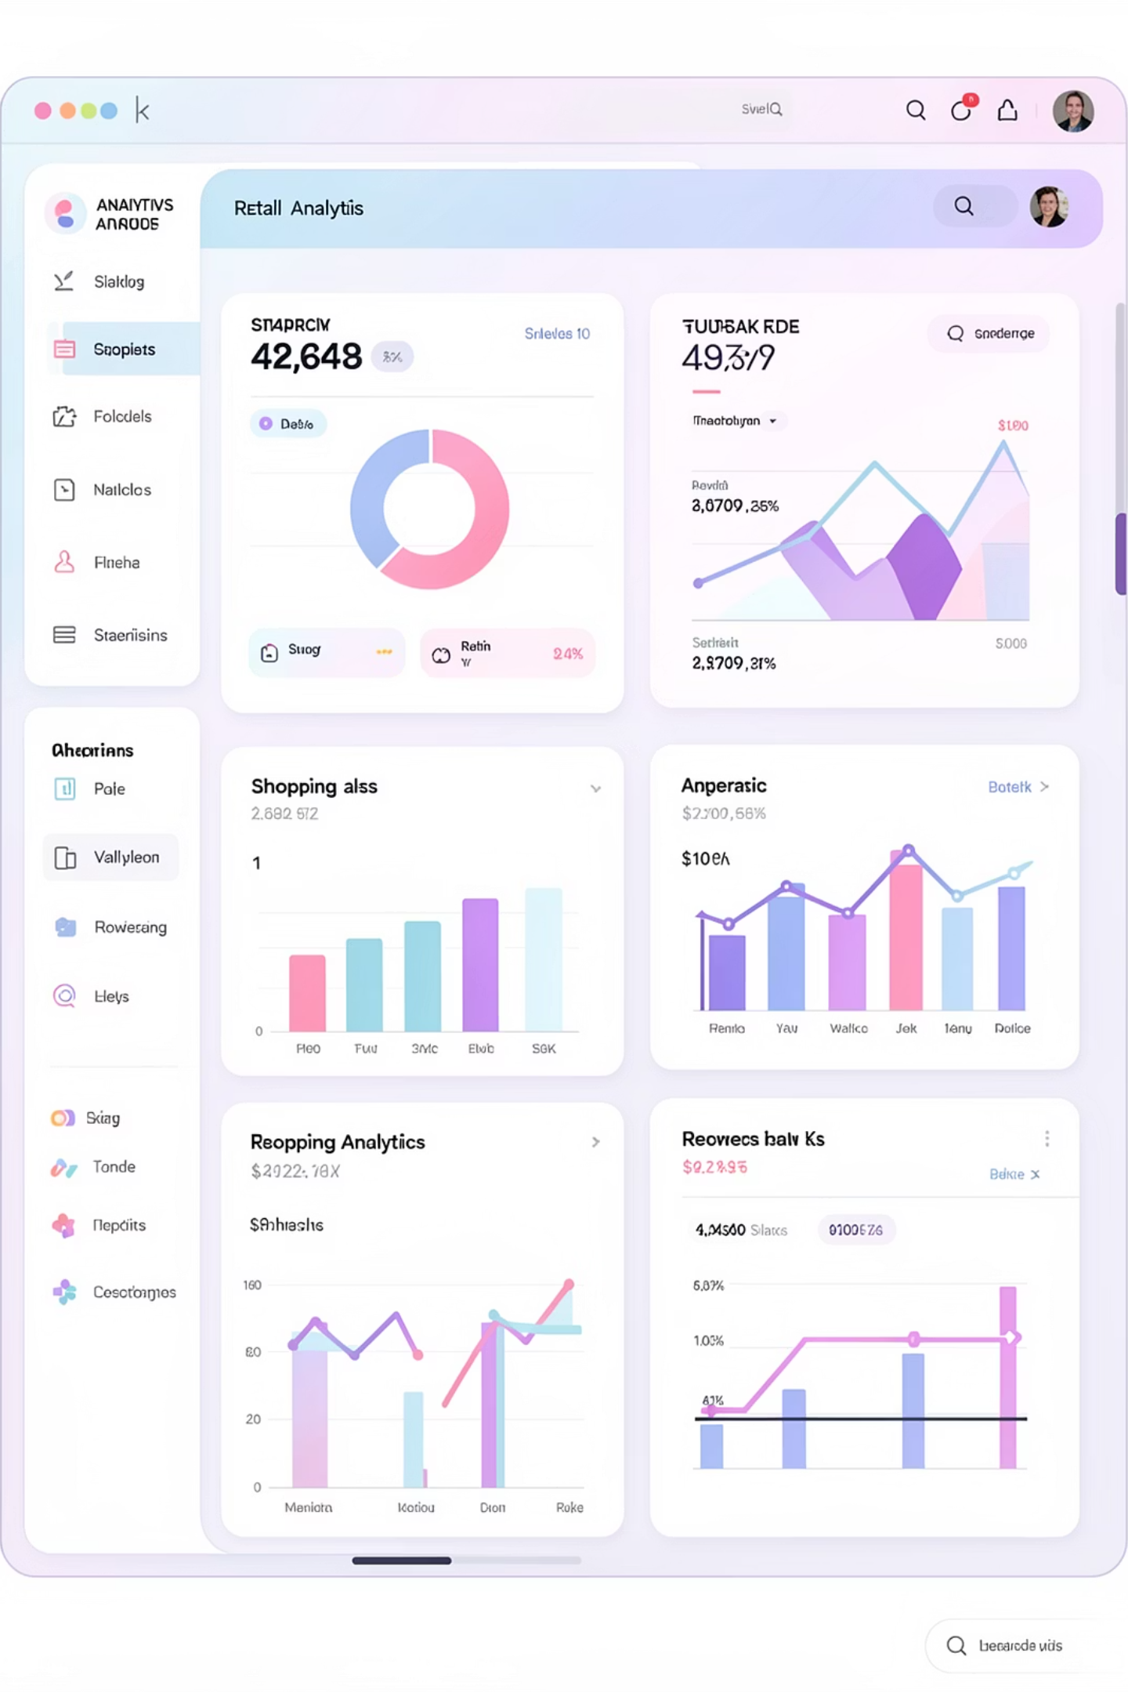
Customer Shopping Behavior Analysis
Analyzing 3,900 purchases to identify spending patterns and customer segments

Slide 2

DATASET OVERVIEW
The Data Behind the Insights
3.9K
18
37
Total Purchases
Data Points
Missing Values
Transactions analyzed
Features per customer
In review ratings only
Key Features Tracked
Customer demographics: age, gender, location
Purchase details: category, amount, season
Shopping behavior: discounts, reviews, frequency
Subscription and shipping preferences

Slide 3
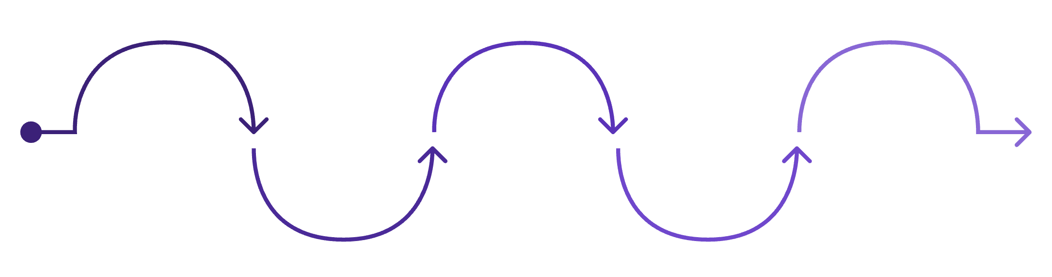
DATA PREPARATION
Python Analysis Pipeline
Key Transformations
Missing Data
Engineer Features
Imputed with category median ratings
Explore & Clean
Load Data
Handle Missing Values
Export to MySQL
Ingest sources into Python
Inspect structure and anomalies
Create groups and frequency metrics
Write cleaned table to DB
Feature Engineering
Impute with median or mode
Created age groups and frequency metrics
Systematic approach to ensure data quality and consistency
Standardization
Renamed columns, removed redundancies

Slide 4
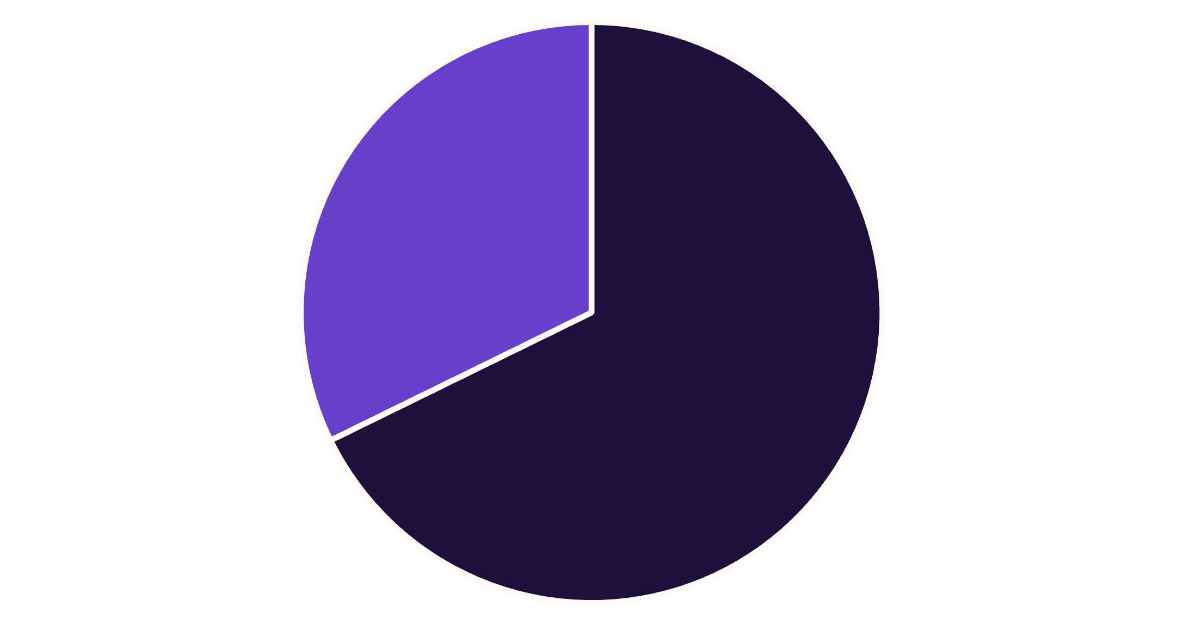
Revenue Insights by Gender
Male Customers Drive Revenue
Male customers generate 68% of total revenue, more than double female customer spending.
This significant gap suggests opportunities for targeted marketing to female segments.
Male
Female

Slide 5





TOP PERFORMERS
Product Performance Analysis
Gloves
Sandals
Boots
Hat
Highest rated at 3.86 stars
Strong rating of 3.84 stars
Rated 3.82 stars by customers
Solid 3.80 star rating

Slide 6
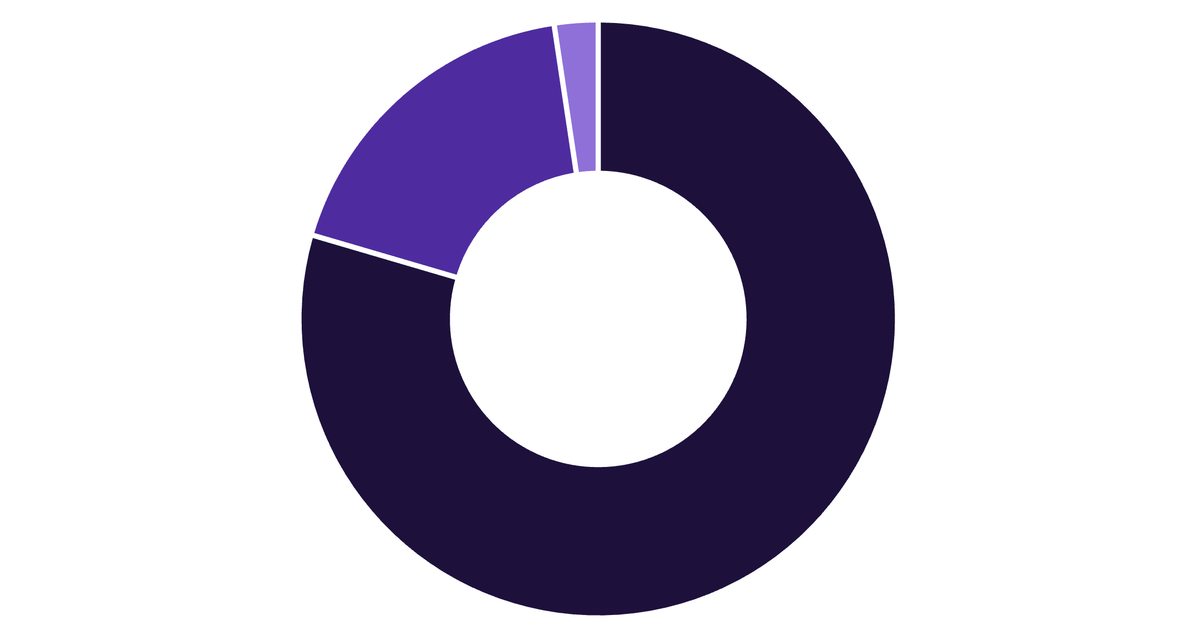
Customer Segmentation Breakdown
Loyalty Dominates Customer Base
80% of customers are loyal, representing repeat buyers with strong purchase history.
Loyal
Returning
New
3,116 Loyal
701 Returning
83 New
Frequent repeat purchases
Multiple purchases made
First-time buyers

Slide 7
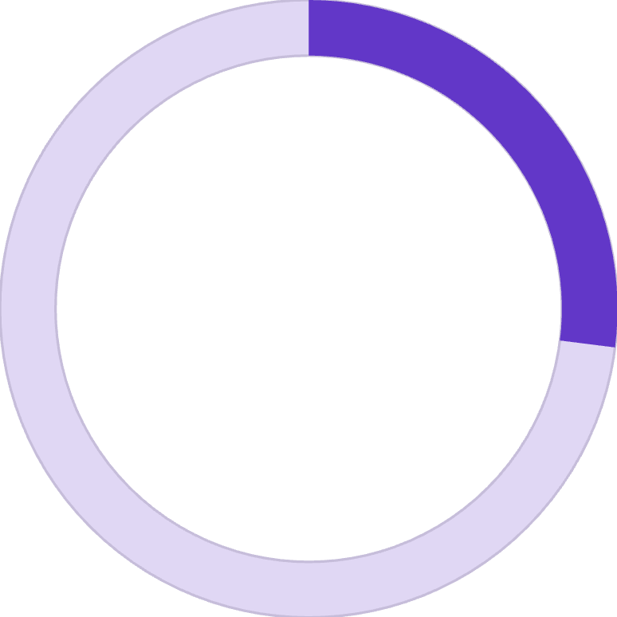
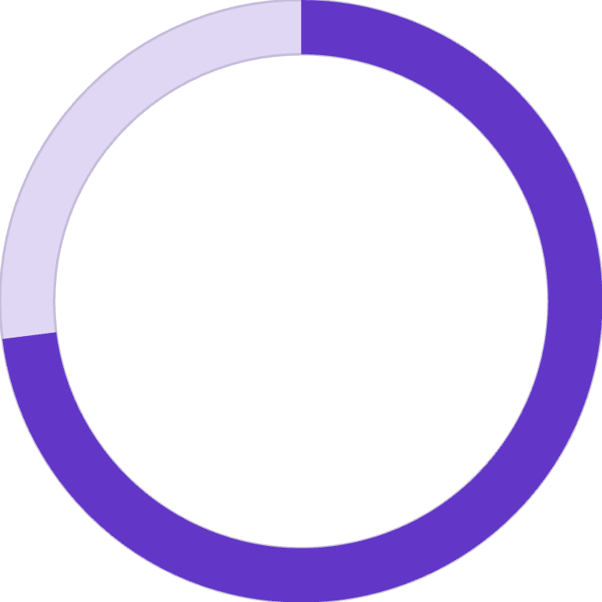
SUBSCRIPTION ANALYSIS
Subscription vs. Non-Subscription Performance
The Numbers
27%
73%
Subscribed
Non-Subscribed
1,053 customers with subscriptions
2,847 customers without subscriptions
Despite lower subscription rates, average spend is nearly identical: $59.49 vs. $59.87

Slide 8
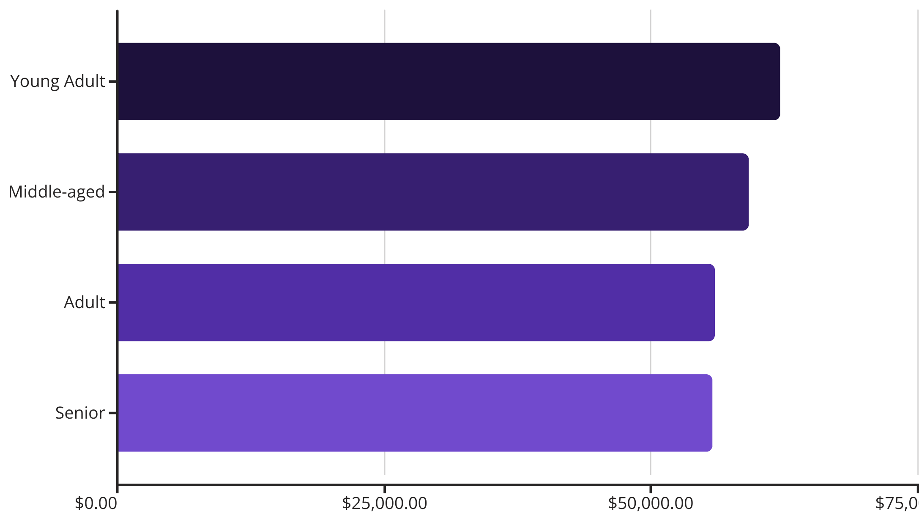
Revenue Distribution by Age Group
Young Adults Lead Spending
Relatively balanced revenue across age groups, with young adults contributing slightly more.
All segments show strong engagement and purchasing power.

Slide 9
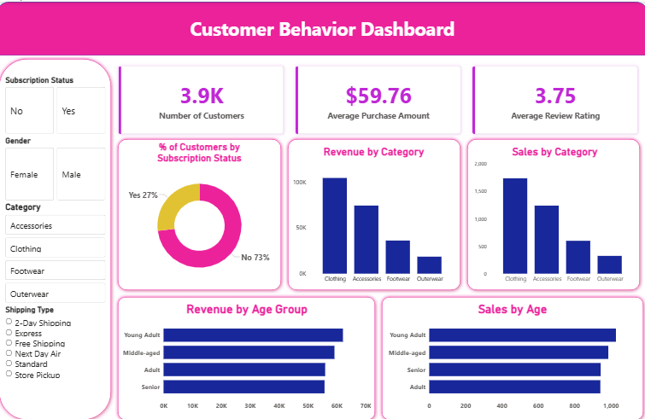



POWER BI DASHBOARD
Interactive Visual Analytics
KPI Tracking
Monitor customers, purchase amounts, and ratings
Revenue Analysis
Visualize performance by category and age group
Interactive Filters
Slice data by gender, category, subscription, shipping

Slide 10





STRATEGIC RECOMMENDATIONS
Key Business Actions
Boost Subscriptions
Loyalty Programs
Targeted Marketing
Promote exclusive benefits to increase 27% subscription rate
Reward repeat buyers to strengthen 80% loyal segment
Focus on high-revenue age groups and express shipping users
Additional Opportunities
Review discount strategy to balance sales and margins
Highlight top-rated products in marketing campaigns
Develop female customer engagement initiatives

