Slide 1
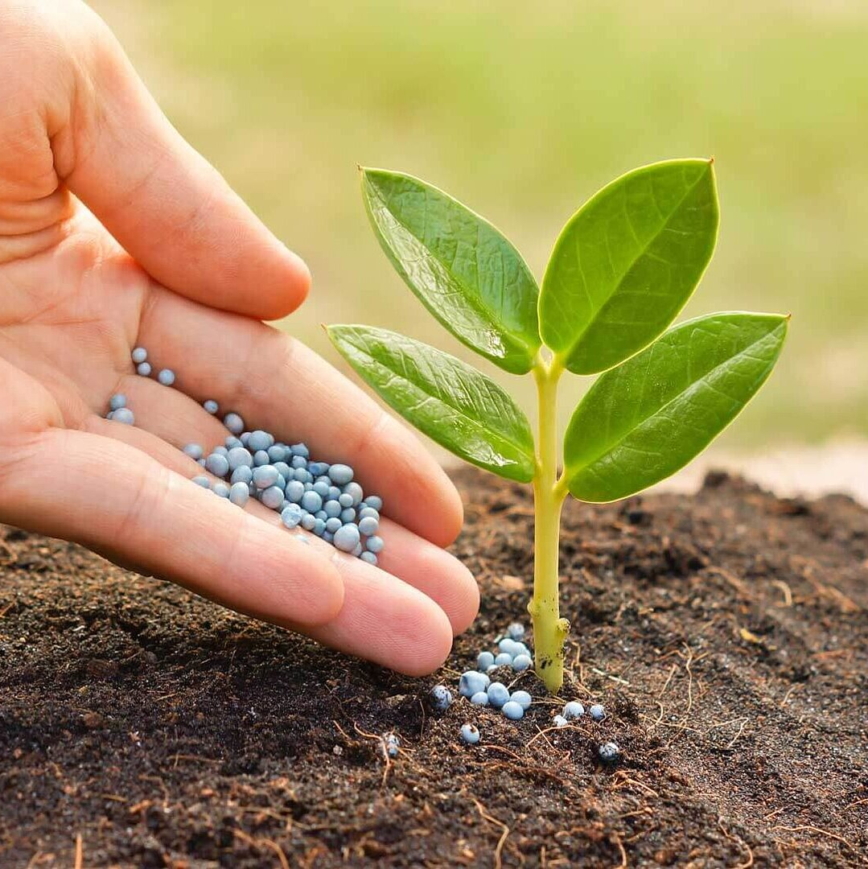
AgriAdvisor
Apoorva Gonegari
Chandana Kolluru
Dheeraj Chetti

Slide 2
Introducing a Greener Tomorrow: Empowering Agriculture with AI
The global population is projected to reach 9.7 billion by 2050, leading to an unprecedented demand for food production.
In today's fast-paced world, agriculture faces an incredible challenge: how to feed a growing global population while conserving resources and minimizing environmental impact.
Imagine a world where every farmer, regardless of their experience, can make informed decisions that boost crop yields, reduce waste, and ensure healthier plants.
Traditional farming methods can be resource-intensive and often lead to unpredictable outcomes. This is where our project steps in.
Welcome to the future of agriculture, where data science and AI are revolutionizing farming practices.

Slide 3
Harnessing the Power of Data
We've scoured vast datasets, such as the Crop Recommendation Dataset and supplementary sources like fertilizer suggestions dataset.
We've also tapped into the rich and diverse New Plant Diseases Dataset to gather insights into crop health.
Weather is a critical factor in agriculture. We obtained historical and real-time weather data from meteorological agencies to analyze its impact on crop performance.
Our approach is holistic. It's not just about identifying diseases and suggesting treatments. It's about recognizing the entire ecosystem of farming, where art and science come together to nurture crops, ensure food security, and sustain livelihoods.

Slide 4
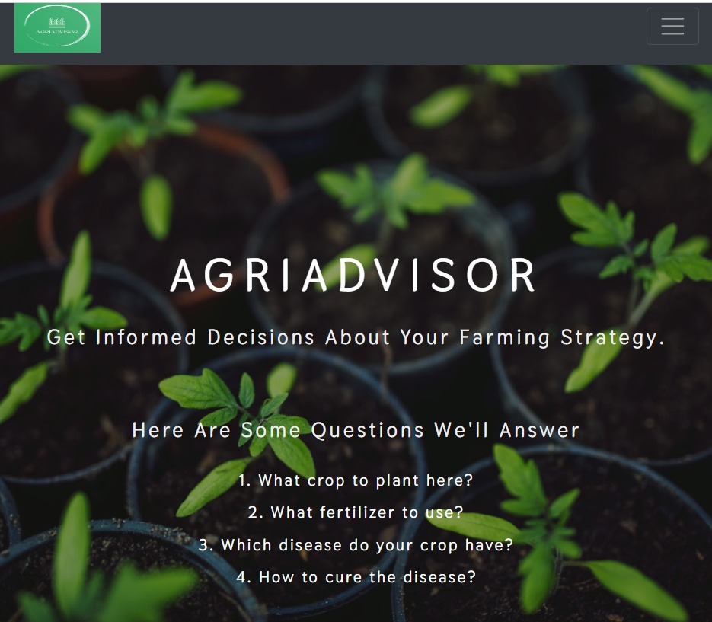
Initial Discoveries
Home page of the website we have created

Slide 5
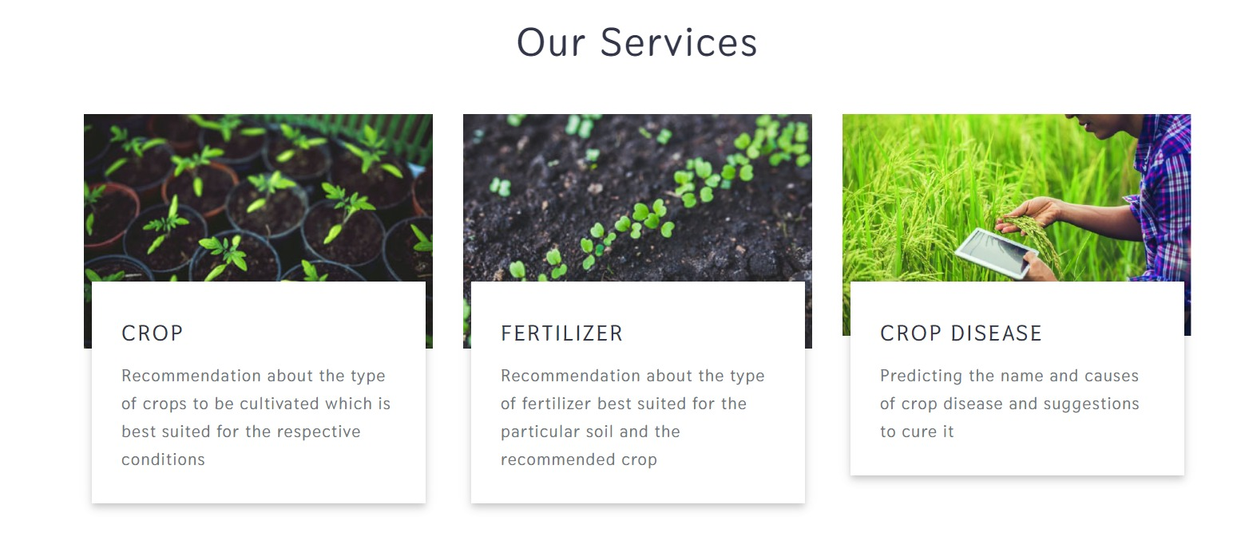
Initial Discoveries
The services we provide in the AgriAdvisor

Slide 6
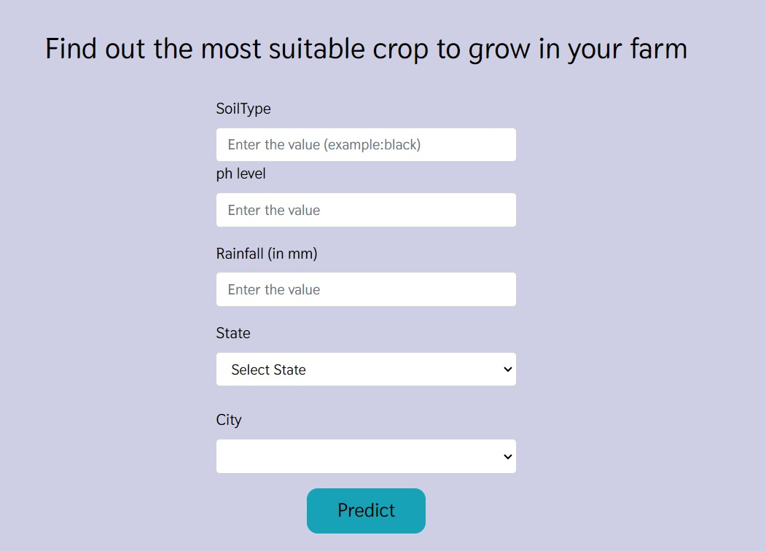
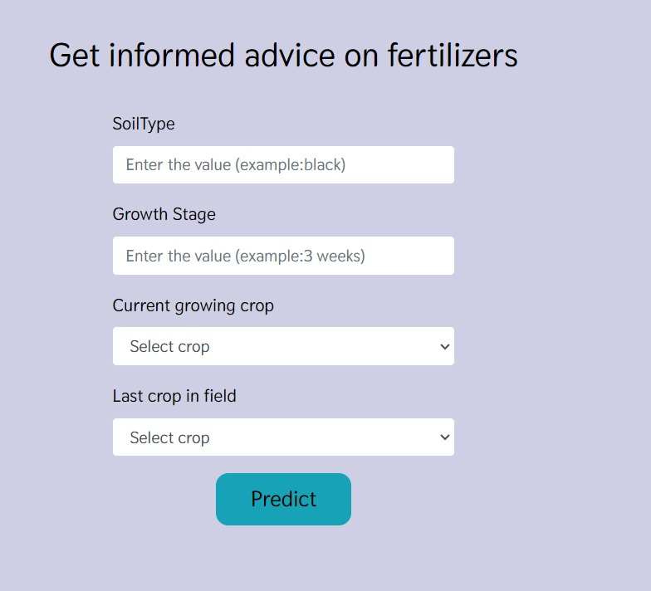
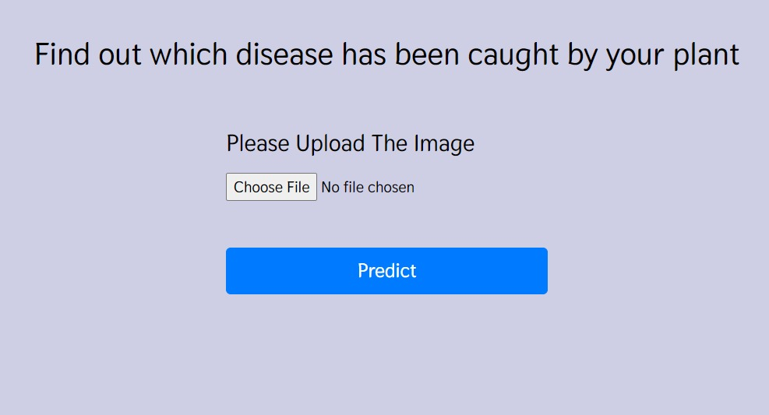
Initial Discoveries
Other web pages in AgriAdvisor for crop recommendation, fertilizer recommendation and disease prediction

Slide 7
Methodologies
Seamlessly combining agricultural expertise with the precision of data science and AI.
Our approach is a harmonious blend of art and science. On one hand, we harness the power of state-of-the-art technologies like ResNet-9, Support Vector Machines, Random Forest, Gaussian Naïve Bayes, and XGBoost to decode plant diseases from images. These cutting-edge techniques allow us to provide accurate and data-driven insights.
Through our advanced algorithms, we extract valuable insights from images of plant leaves. We can identify diseases, assess their severity, and recommend suitable treatments.
These insights are based on rigorous data analysis, ensuring precision and reliability.

Slide 8

Our Path Forward
1
Phase 1: Data collection and cleaning
Understand the data collected and clean the data line removing the null values,
filling the missing values etc.
2
Phase 2: Front end Design
Develop the front-end design for the Agri advisor website for the all the pages defined.
3
Phase 3: Model Training
Develop and train our machine learning models using diverse datasets to ensure accuracy.
4
Phase 4: Integration
Integrate our AI-powered system into existing farming practices to provide real-time recommendations and insights.
5
Phase 5: Continuous Improvement
Continuously refine and enhance our algorithms based on user feedback and new data sources.

Slide 9
What to Expect
Picture this: a farmer inputs their soil data into our system. In seconds, it recommends the best crop for their land. No more guesswork, just science-backed decisions that optimize yield.
Moving on to fertilizer recommendations, our AI considers the crop type and soil conditions. It pinpoints deficiencies or excesses, offering precise suggestions for improvement.
And for the final act, the plant disease prediction application. Farmers upload an image of a diseased plant leaf, and our AI springs into action. It identifies the disease, provides background information, and suggests remedies. It's like having a plant doctor at your fingertips.
Join us on this journey to empower agriculture with AI. Together, we can cultivate a greener, more sustainable future for generations to come. The seeds of change have been sown, and we invite you to be a part of the harvest.

Slide 10
Future Works
Currently, we focus on plant disease prediction and remedies. Our future vision includes proactive disease prediction from plant leaf images.
We plan to expand services to include yield prediction, aiding farmers in making informed decisions about planting and harvesting.
We aim to address waste management, predicting waste quantities and providing sustainable disposal guidance for farming.

Slide 11
References
1.United States Department of Agriculture
https://www.nass.usda.gov/Statistics_by_Subject/index.php?sector=CROPS
2.Food and Agriculture Organization of United Nations.
https://www.fao.org/faostat/en/#data/domains_table
https://github.com/anshukrsingh/crop-recommendation-system-based-on-machine-learning-using-python
https://github.com/simranvolunesia/Irrigreat

