Slide 1
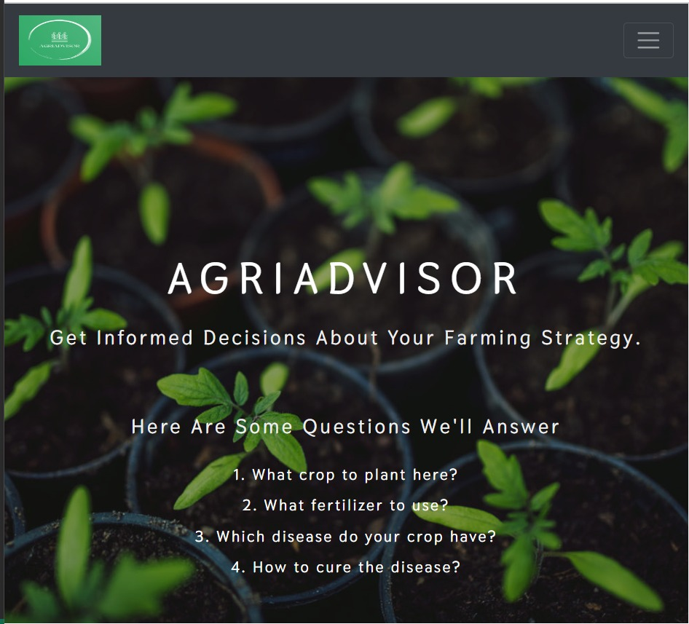
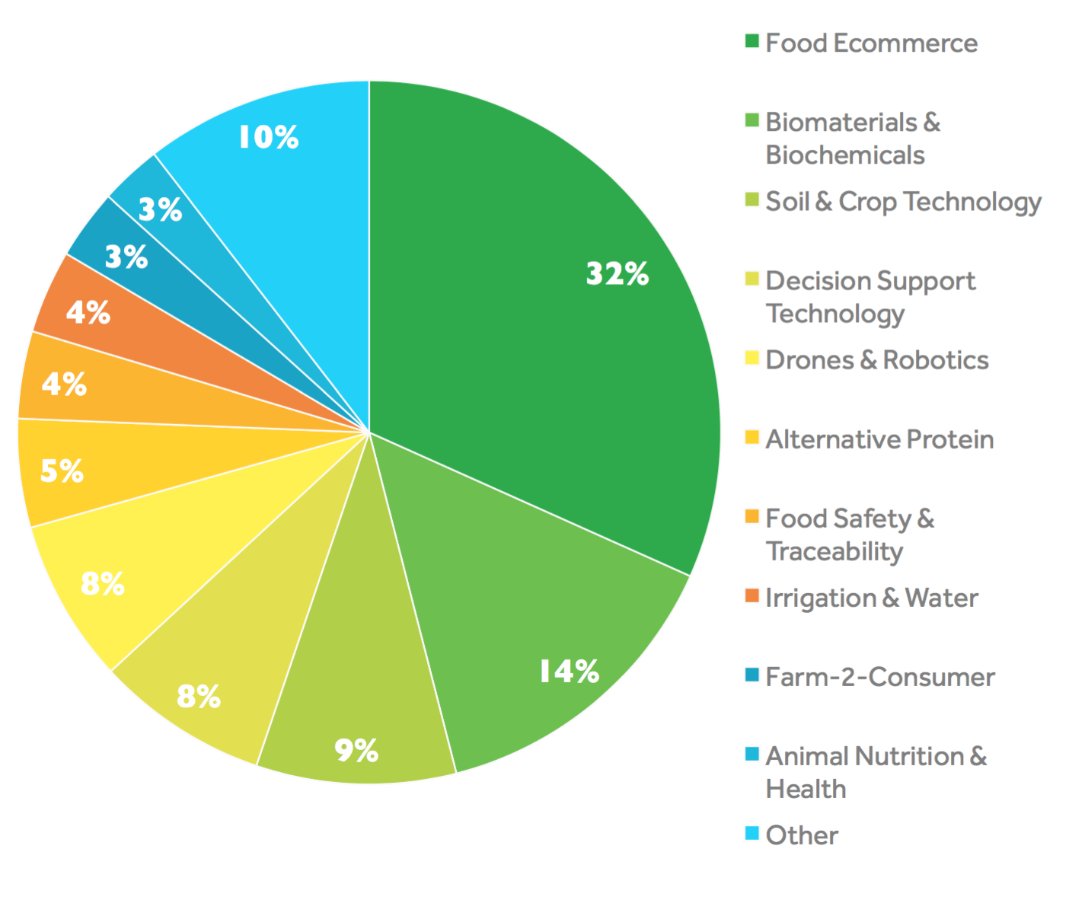
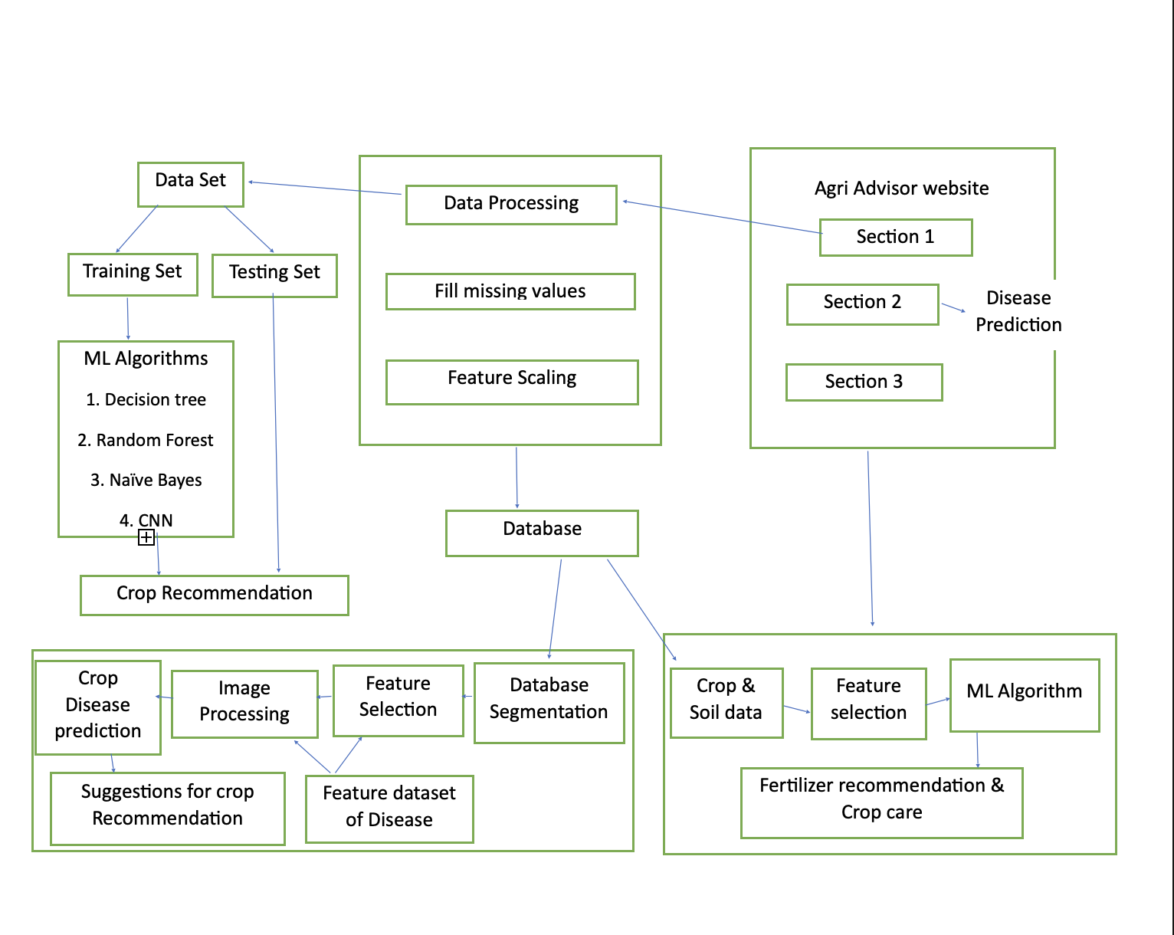
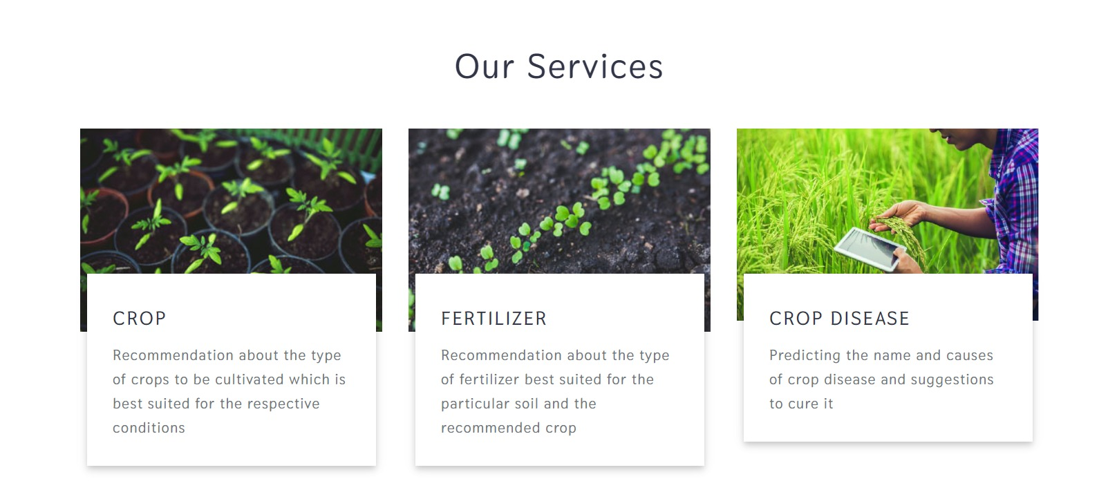
AGRIADVISOR
Chandana Kolluru, Apoorva Gonegari, Dheeraj Chetti
University of Missouri- Kansas City
THE PROBLEM
THE TECHNOLOGY
THE SOLUTION
FUTURE ENHANCEMENTS
The global population is projected to reach 9.7 billion by 2050, leading to an unprecedented demand for food production.
In today's fast-paced world, agriculture faces an incredible challenge: how to feed a growing global population while conserving resources and minimizing environmental impact.
Imagine a world where every farmer, regardless of their experience, can make informed decisions that boost crop yields, reduce waste, and ensure healthier plants.
Traditional farming methods can be resource-intensive and often lead to unpredictable outcomes. This is where our project steps in.
Welcome to the future of agriculture, where data science and AI are revolutionizing farming practices.
Seamlessly combining agricultural expertise with the precision of data science and AI.
Through our advanced algorithms, we extract valuable insights from images of plant leaves. We can identify diseases, assess their severity, and recommend suitable treatments.
Our approach is a harmonious blend of art and science. On one hand, we harness the power of state-of-the-art technologies like ResNet-9, Support Vector Machines to predict and recommend the crops and fertilizers ,XGBoost to decode plant diseases from images. These cutting-edge techniques allow us to provide accurate and data-driven insights.
These insights are based on rigorous data analysis, ensuring precision and reliability.
A farmer inputs their soil data into our system. In seconds, it recommends the best crop for their land. No more guesswork, just science-backed decisions that optimize yield.
Moving on to fertilizer recommendations, our AI considers the crop type and soil conditions. It pinpoints deficiencies or excesses, offering precise suggestions for improvement.
Currently, we focus on plant disease prediction and remedies. Our future vision includes proactive disease prediction from plant leaf images.
We plan to expand services to include yield prediction, aiding farmers in making informed decisions about planting and harvesting.
We aim to address waste management, predicting waste quantities, and providing sustainable disposal guidance for farming.
We extend to build a chatbot that aims to display agriculture-related data.
REFERENCES
[1] Smith, A., & Johnson, M. (2021). "Incorporating Machine Learning in Precision Agriculture for Sustainable Crop Management." Journal of Agricultural Science and Technology, 13(3), 221-235.
[2] United Nations. (2019). "Sustainable Development Goal 2: Zero Hunger." Retrieved from [URL]
[3] Patel, P., & Gupta, D. (2020). "Advancements in Precision Agriculture: A Review." International Journal of Advanced Research in Computer Engineering & Technology, 9(2), 187-193.
[4] Food and Agriculture Organization of the United Nations (FAO). (2021). "Digital Agriculture for Sustainable Food Systems." Retrieved from [URL]
[5] Li, B., Wu, H., & Zhang, Q. (2017). "DeepPlant: A deep learning approach for plant species recognition." Neurocomputing, 235, 228-235.
Crop recommendation: AgriAdvisor employs advanced algorithms and machine learning to analyze environmental factors, historical data, and market trends. It provides personalized crop recommendations, helping farmers make informed decisions for optimal yield and market value.
Fertilizer recommendation: AgriAdvisor tackles this issue by offering precise fertilizer recommendations based on soil composition, crop type, and growth stage. This targeted approach minimizes waste, improves nutrient uptake, and promotes sustainable farming practices.
Plant Disease recommendation: AgriAdvisor integrates image recognition technology and data analytics to identify early signs of plant diseases. By analyzing images of crops, the platform can diagnose potential issues and recommend timely and targeted interventions, reducing the impact of diseases on crop yield.
Decision Trees for Crop Recommendation and Disease Prediction: Decision Trees are employed to analyze complex relationships in environmental and historical data. They enable the platform to provide personalized crop recommendations and predict potential diseases based on identified patterns.
Regression Models for Fertilizer Optimization: Regression models are utilized to analyze soil composition, weather conditions, and historical farming data.
Neural Networks for Image Recognition in Disease Identification: Neural Networks, specifically ResNet architecture, are employed for image recognition. Images of crops are labeled for diseases, allowing the model to identify and diagnose plant health issues
Support Vector Machines (SVM) for Data Classification: SVM is utilized for classification tasks, such as categorizing crops based on specific characteristics.
XGBoost for Enhanced Predictive Analytics: XGBoost is employed to enhance predictive analytics, considering multiple factors like weather, soil, and historical trends.
And for the final act, the plant disease prediction application. Farmers upload an image of a diseased plant leaf, and our AI springs into action. It identifies the disease, provides background information, and suggests remedies. It's like having a plant doctor at your fingertips
Join us on this journey to empower agriculture with AI. Together, we can cultivate a greener, more sustainable future for generations to come. The seeds of change have been sown, and we invite you to be a part of the harvest.

