Slide 1
SQL

Slide 2
What is sql
Structured Query Language, is a standard programming language used for
Managing
Manipulating relational databases.
Perform a variety of operations on database data,
Retrieving
Inserting
Updating
Deleting records
SQL is widely used in data management and is essential for interacting with relational database management systems (RDBMS) like MySQL, PostgreSQL, SQL Server, Oracle, and SQLite.
SQL provides powerful, optimized ways to access, analyze, and manipulate large volumes of data, making it crucial for database management in applications across industries.

Slide 3
Importance of SQL
Why SQL is Important
Standardized Language: SQL is widely supported across database systems.
Declarative Approach: Instead of specifying how to do something, SQL allows users to specify what they want.
Efficient Data Management: SQL provides powerful, optimized ways to access, analyze, and manipulate large volumes of data, making it crucial for database management in applications across industries.

Slide 4
Key Purpose of SQL
Schema Management
Data Manipulation (CRUD Operations)
Permissions/DATA control
Transactions
Data Retrieval
Types of SQL Statements
Data Query Language (DQL): Focused on querying or retrieving data (SELECT).
Data Definition Language (DDL): For defining database structure (CREATE, ALTER, DROP).
Data Manipulation Language (DML): For modifying data (INSERT, UPDATE, DELETE).
Data Control Language (DCL): For controlling access to data. (GRANT, REVOKE).
Transaction Control Language (TCL): For managing the integrity of transactions. (COMMIT, ROLLBACK).

Slide 5
Schema Management
Schema Management: SQL provides commands to create, modify, and delete database structures (like tables, indexes, and relationships) using Data Definition Language (DDL) statements like
CREATE, ALTER, and DROP
Command | Purpose | Example Usage
CREATE | Define new objects (tables, indexes, etc.) | CREATE TABLE Employees (EmployeeID INT PRIMARY KEY, ...);
ALTER | Modify existing objects | ALTER TABLE Employees ADD Email VARCHAR(100);
DROP | Delete objects | DROP TABLE Employees;

Slide 6
2. Data Manipulation
Data Manipulation refers to the CRUD operations. CRUD stands for Create, Read, Update, and Delete, and each of these operations corresponds to a specific SQL command:
CREATE - CREATE/INSERT
READ
UPDATE
DELETE
Create (INSERT) new records.
Read (SELECT) data from the database.
Update (UPDATE) existing data.
Delete (DELETE) records.

Slide 7
3. Permissions
SQL allows for managing user access to data. GRANT and REVOKE statements control who can view or modify data within a database.
GRANT SELECT, INSERT ON employees TO user_name;

Slide 8
4. Transactions
SQL can manage multiple operations as a single unit of work, known as a transaction, which ensures data integrity. Commands like BEGIN, COMMIT, and ROLLBACK control transactions.
BEGIN; UPDATE employees SET age = 31 WHERE name = 'John Doe'; COMMIT;

Slide 9
5. Data Retrieval / Querying
SQL allows users to retrieve specific data from databases based on various conditions. The SELECT statement is the most common command, used to extract data.

Slide 10
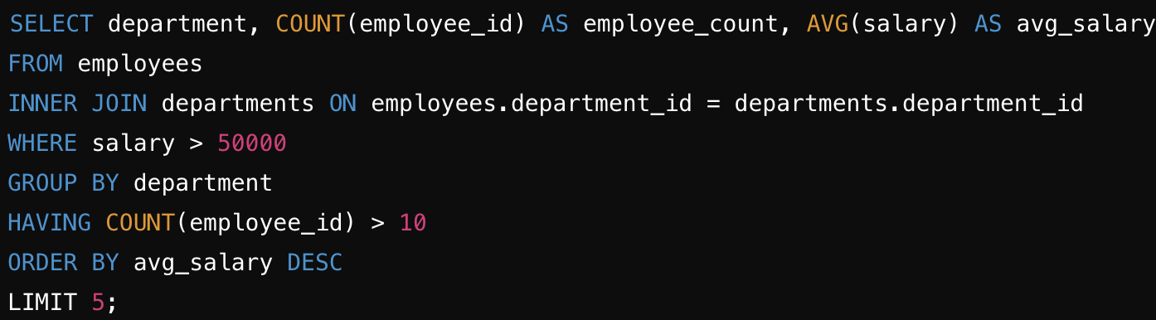
Basic SQL Query
A basic SQL query is structured to define what data to retrieve, from where, and how to organize it.
Explanation of the Example Query
SELECT: Retrieves the department, employee_count, and avg_salary.
FROM: Specifies employees as the source table.
JOIN: Combines employees and departments based on department_id.
WHERE: Filters for employees with a salary greater than 50,000.
GROUP BY: Groups results by department.
HAVING: Filters out departments with fewer than 10 employees.
ORDER BY: Sorts results by avg_salary in descending order.
LIMIT: Returns only the top 5 departments in the results.

Slide 11
Now we know how to build a query Lets go to the advanced
Manipulate
Data
Perform calculations on query

Slide 12
Functions
Aggregate Functions
Window (or Analytic) Functions
String Functions
Date and Time Functions
Mathematical Functions
Conditional Functions
Conversion Functions
JSON Functions (Available in databases supporting JSON data types)

Slide 13
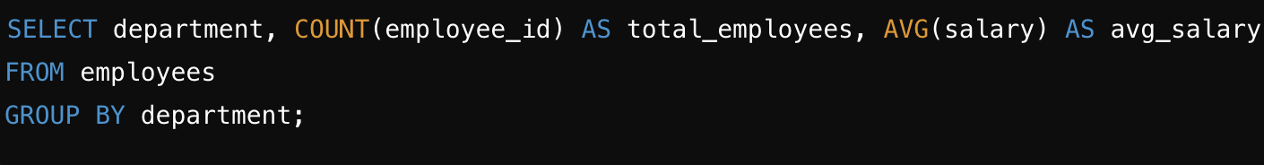
Aggregate Functions
VARIANCE() - Calculates the variance of a set of values.
STDDEV() - Calculates the standard deviation of a set of values.
GROUP_CONCAT() - Concatenates values from a group into a single string.
FIRST() - Retrieves the first value in a column for a group (not universally supported).
LAST() - Retrieves the last value in a column for a group (not universally supported).
PERCENTILE_CONT() - Returns a percentile value as a continuous distribution (in some SQL systems).
PERCENTILE_DISC() - Returns a percentile value as a discrete distribution (in some SQL systems).
MEDIAN() - Finds the median value of a column (supported in some databases).
MODE() - Retrieves the most frequently occurring value in a column (rarely supported directly).
ARRAY_AGG() - Aggregates column values into an array (PostgreSQL, SQL Server).
Aggregate functions perform calculations on a set of rows and return a single result, often used with GROUP BY clauses.
SUM(): Calculates the total sum of a numeric column.
COUNT(): Counts the number of rows or non-null values in a column.
AVG(): Calculates the average of a numeric column.
MIN(): Returns the minimum value in a column.
MAX(): Returns the maximum value in a column.

Slide 14
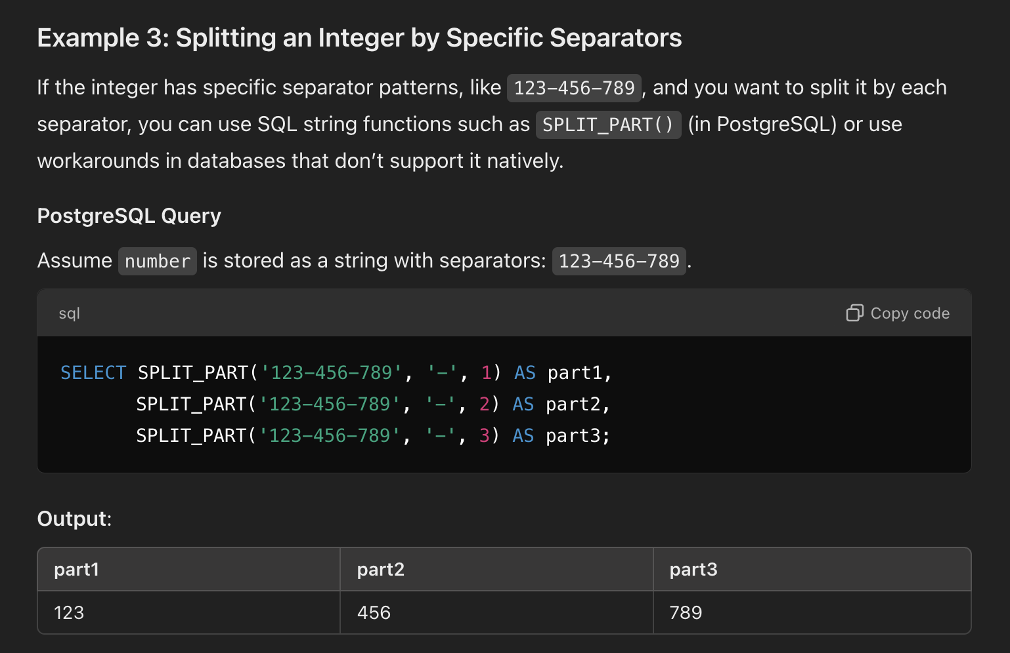
Splitting with a separator - SPLIT_PART(column, ‘-’, 1) AS part1

Slide 15
2. Window Function
Window functions perform calculations across a set of table rows that are related to the current row, providing more granular analysis over groups of rows. They use the OVER() clause to define a “window” of rows.
ROW_NUMBER(): Assigns a unique number to each row in a partition.
RANK(): Assigns a rank to each row within a partition, skipping ranks for tied values.
DENSE_RANK(): Similar to RANK(), but without gaps for tied values.
LAG() / LEAD(): Accesses data from previous or next rows in a window.
SUM(), AVG(), MIN(), MAX(): Also work as window functions to calculate rolling or cumulative totals.
NTILE() - Distributes rows into a specified number of ranked groups.
FIRST_VALUE() - Returns the first value in a partition.
LAST_VALUE() - Returns the last value in a partition.
SUM() OVER() - Calculates a running or cumulative sum.
AVG() OVER() - Calculates a running or cumulative average.
PERCENT_RANK() - Calculates the relative rank as a percentage.
CUME_DIST() - Calculates the cumulative distribution, showing the proportion of rows.
NTH_VALUE() - Returns the nth value in a partition.
MIN() OVER() - Returns a running minimum.
MAX() OVER() - Returns a running maximum.

Slide 16
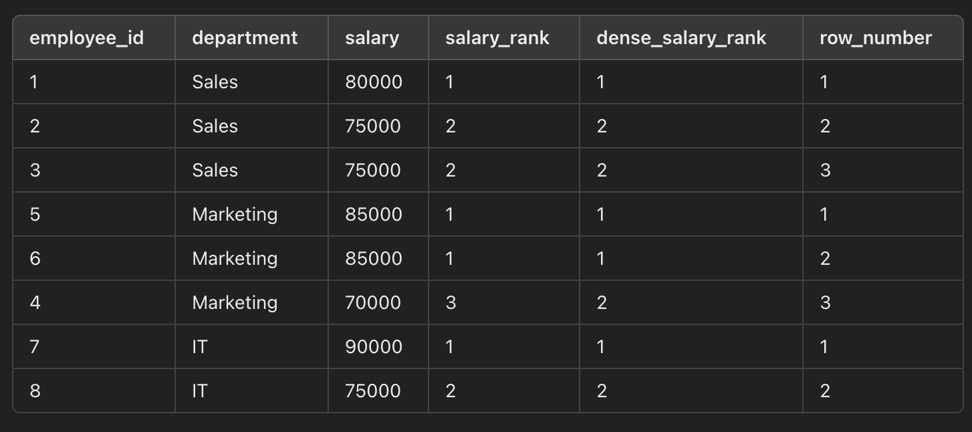
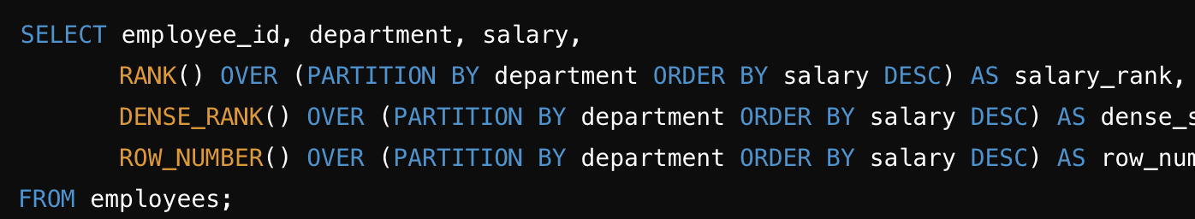
RANK()
RANK()
DENSE_RANK()
ROW_NUMBER()
WITH OVER() clause

Slide 17
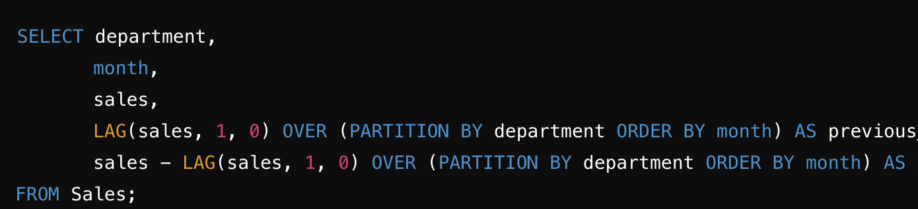
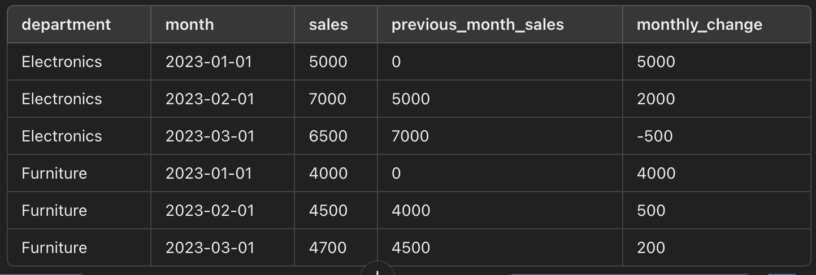
LAG() LEAD()
The LAG() and LEAD() functions in SQL are window functions used to access data from a previous (lag) or next (lead) row within the same result set, based on a specified ordering

Slide 18
3. String Function
String functions allow you to manipulate text data.
UPPER() / LOWER(): Converts text to uppercase or lowercase.
CONCAT(): Combines two or more strings into one.
SUBSTRING(): Extracts a substring from a string.
TRIM(): Removes whitespace or specified characters from the beginning and end of a string.
LENGTH(): Returns the length of a string.
REPLACE() - Replaces occurrences of a substring within a string.
LEFT() - Returns the left part of a string.
RIGHT() - Returns the right part of a string.
CHARINDEX() - Finds the position of a substring within a string (SQL Server).
INSTR() - Finds the position of a substring within a string (MySQL).
REVERSE() - Reverses the characters in a string.
FORMAT() - Formats numbers as a string (SQL Server).
ASCII() - Returns the ASCII value of the first character in a string.
SOUNDEX() - Returns a code representing how a string sounds when spoken.

Slide 19
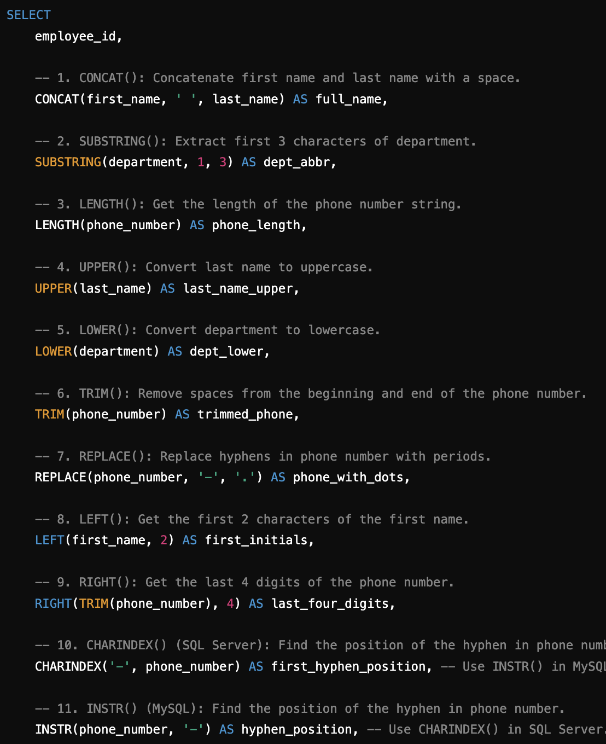
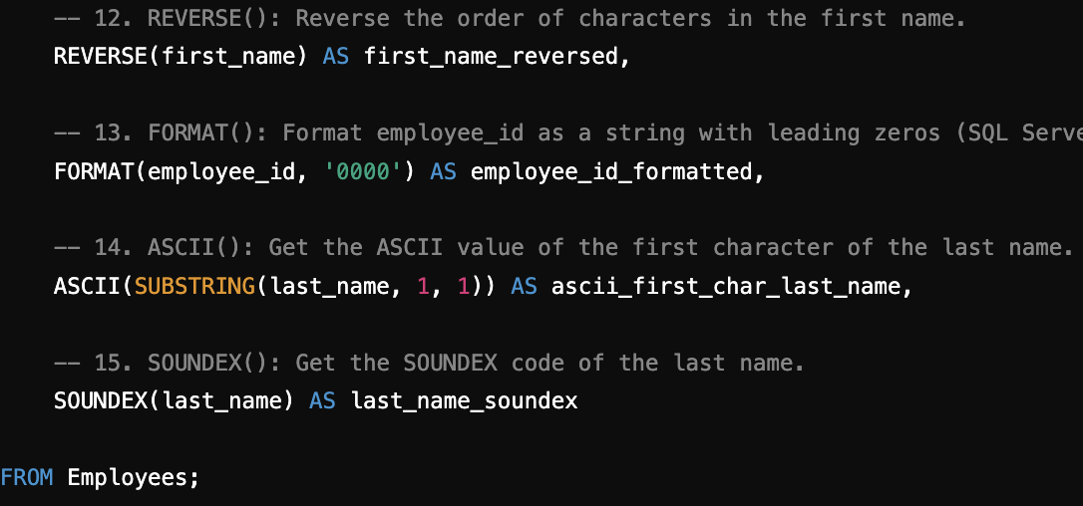

Slide 20
4.Date and Time Function
ate functions manipulate and perform calculations on date and time data.
NOW() / CURRENT_DATE(): Returns the current date and time or just the date.
DATEADD() / DATEDIFF(): Adds a specified interval to a date or calculates the difference between two dates.
YEAR(), MONTH(), DAY(): Extracts the year, month, or day from a date.
DATE_FORMAT(): Formats a date based on specified output patterns.
NOW() - Returns the current date and time.
CURRENT_DATE() - Returns the current date.
CURRENT_TIME() - Returns the current time.
DATEADD() - Adds a specified interval to a date.
DATEDIFF() - Returns the difference between two dates.
YEAR() - Extracts the year from a date.
MONTH() - Extracts the month from a date.
DAY() - Extracts the day from a date.
DATE_FORMAT() - Formats a date in a specified pattern (MySQL).
TO_CHAR() - Formats a date or timestamp (Oracle, PostgreSQL).
EXTRACT() - Extracts parts of a date (PostgreSQL, MySQL).
DAYOFWEEK() - Returns the day of the week from a date.
TIMESTAMPDIFF() - Returns the difference between timestamps.
DATE_TRUNC() - Truncates a date to a specified unit (PostgreSQL).
STR_TO_DATE() - Converts a string to a date (MySQL).

Slide 21
5. Mathematical Functions
ROUND() - Rounds a number to a specified number of decimal places.
CEILING() - Rounds a number up to the nearest integer.
FLOOR() - Rounds a number down to the nearest integer.
ABS() - Returns the absolute value of a number.
POWER() - Raises a number to the power of another number.
SQRT() - Calculates the square root of a number.
MOD() - Returns the remainder of a division.
EXP() - Returns e raised to the power of a given number.
LOG() - Returns the natural logarithm of a number.
LOG10() - Returns the base-10 logarithm of a number.
PI() - Returns the value of pi.
SIGN() - Returns the sign of a number (+1, 0, or -1).
SIN() - Calculates the sine of a number.
COS() - Calculates the cosine of a number.
TAN() - Calculates the tangent of a number.
ROUND(): Rounds a number to a specified number of decimal places.
FLOOR() / CEILING(): Rounds a number down or up to the nearest integer.
ABS(): Returns the absolute value of a number.
POWER(): Raises a number to the power of another number.

Slide 22
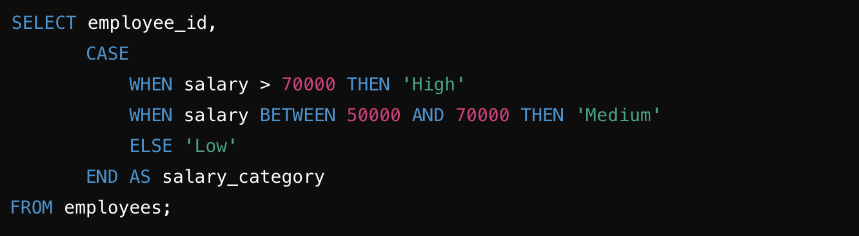
6. Conditional Functions
Conditional Functions
Conditional functions let you handle conditions within queries, often using the CASE statement.
CASE WHEN: Allows for conditional logic, similar to an if-else statement.
IFNULL() / COALESCE(): Returns a default value if a column is NULL.
CASE WHEN - Implements conditional logic (if-else).
IF() - Conditional function in MySQL (similar to CASE WHEN).
NULLIF() - Returns NULL if two expressions are equal.
COALESCE() - Returns the first non-null expression.
IFNULL() - Returns a specified value if an expression is NULL (MySQL).
ISNULL() - Checks if an expression is NULL (SQL Server).
IIF() - Inline conditional function (SQL Server).
DECODE() - Works like CASE in Oracle SQL.
GREATEST() - Returns the largest value among provided values.
LEAST() - Returns the smallest value among provided values.

Slide 23
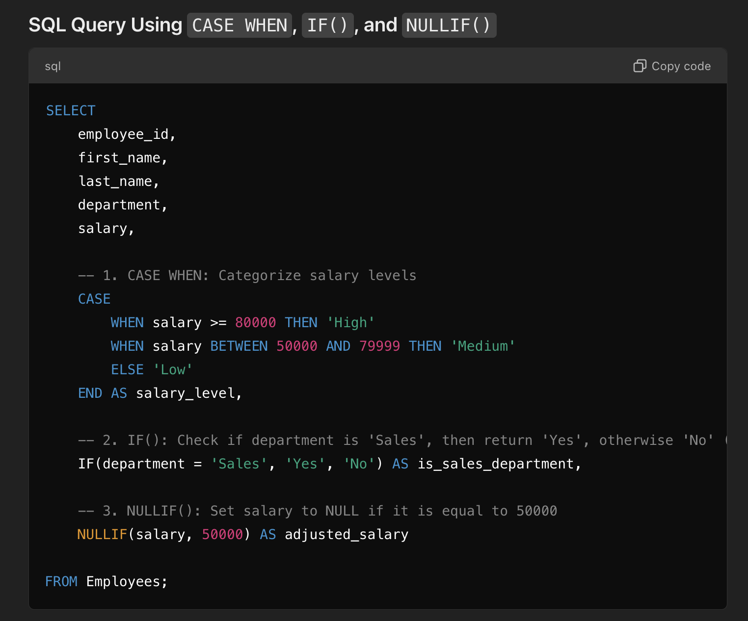

Slide 24
7. Conversion Function
CAST() - Converts data from one type to another.
CONVERT() - Similar to CAST, but with formatting options in some systems.
TO_DATE() - Converts a string to a date (Oracle).
TO_CHAR() - Converts a date or number to a string (Oracle).
TO_NUMBER() - Converts a string to a number (Oracle).
STR() - Converts a number to a string (SQL Server).
TRY_CAST() - Attempts to convert data; returns NULL if conversion fails (SQL Server).
TRY_CONVERT() - Attempts to convert data with formatting options (SQL Server).
FORMAT() - Formats a value as a string (SQL Server).
DATE_FORMAT() - Formats a date as a string (MySQL).
PARSE() - Parses a string and converts it to a specified data type (SQL Server).
TIMESTAMP() - Converts data to a timestamp (PostgreSQL).
TIME() - Converts a value to a time format (MySQL).
HEX() - Converts a number to a hexadecimal string (MySQL).
UNHEX() - Converts a hexadecimal string to a number (MySQL).

Slide 25
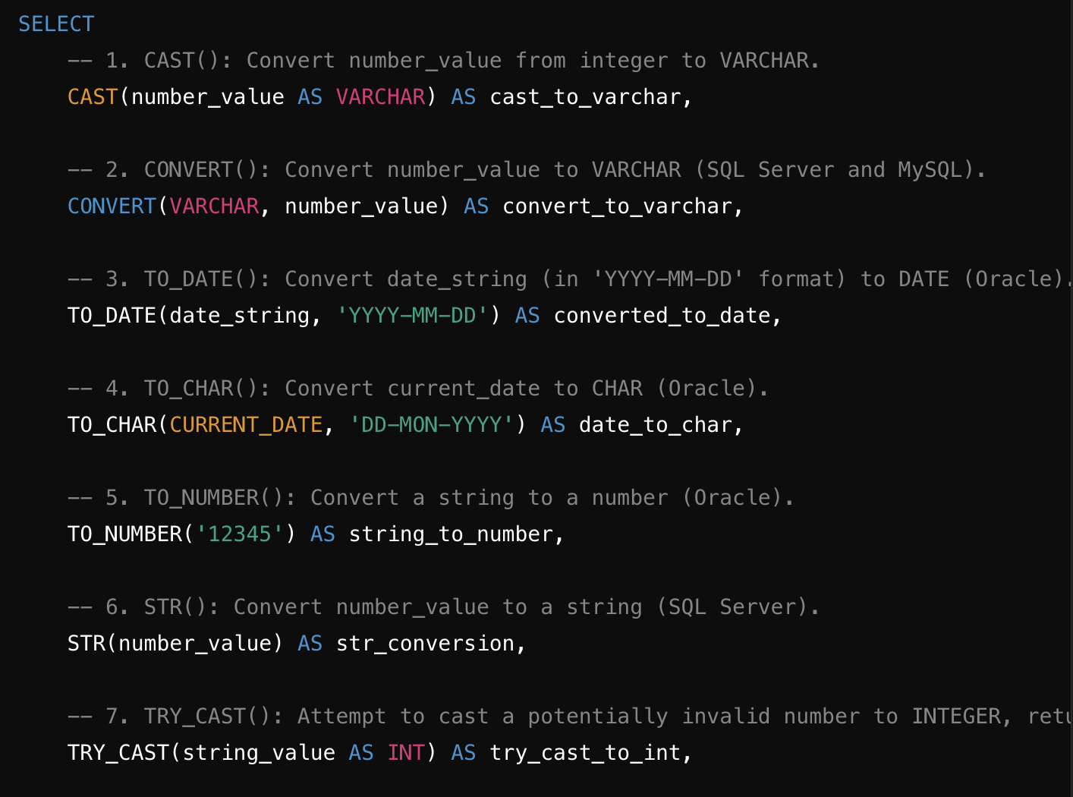
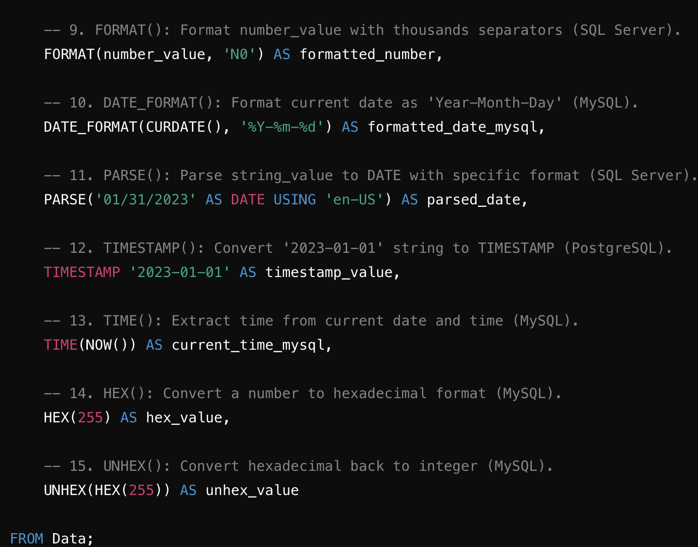

Slide 26
Working with Multiple Tables

Slide 27
Multiple tables
Joins – Combining Data from Multiple Tables
Subqueries – Queries within Queries
Set Operations – Combining Results from Multiple Queries
Table Aliases – Simplifying Table and Column Names

Slide 28
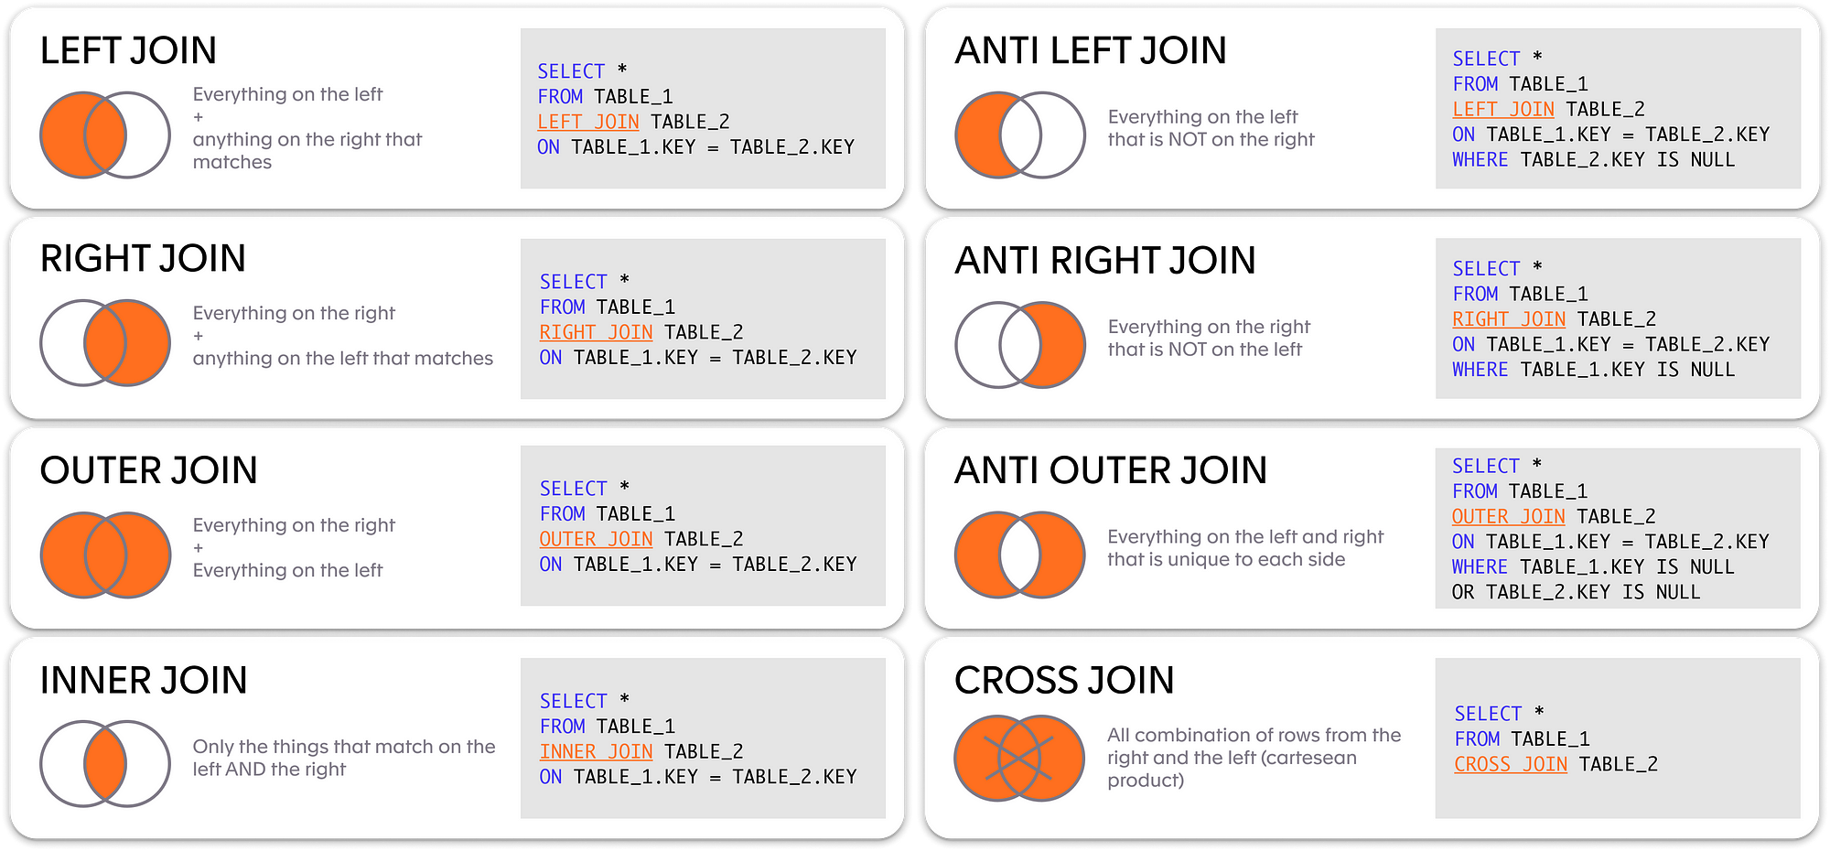
Joins

Slide 29
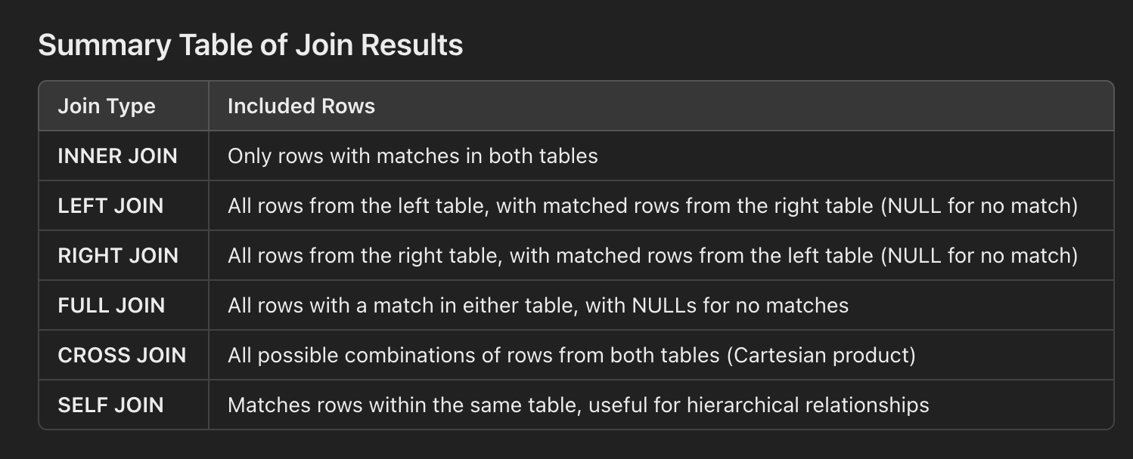
TABLE JOINS

Slide 30
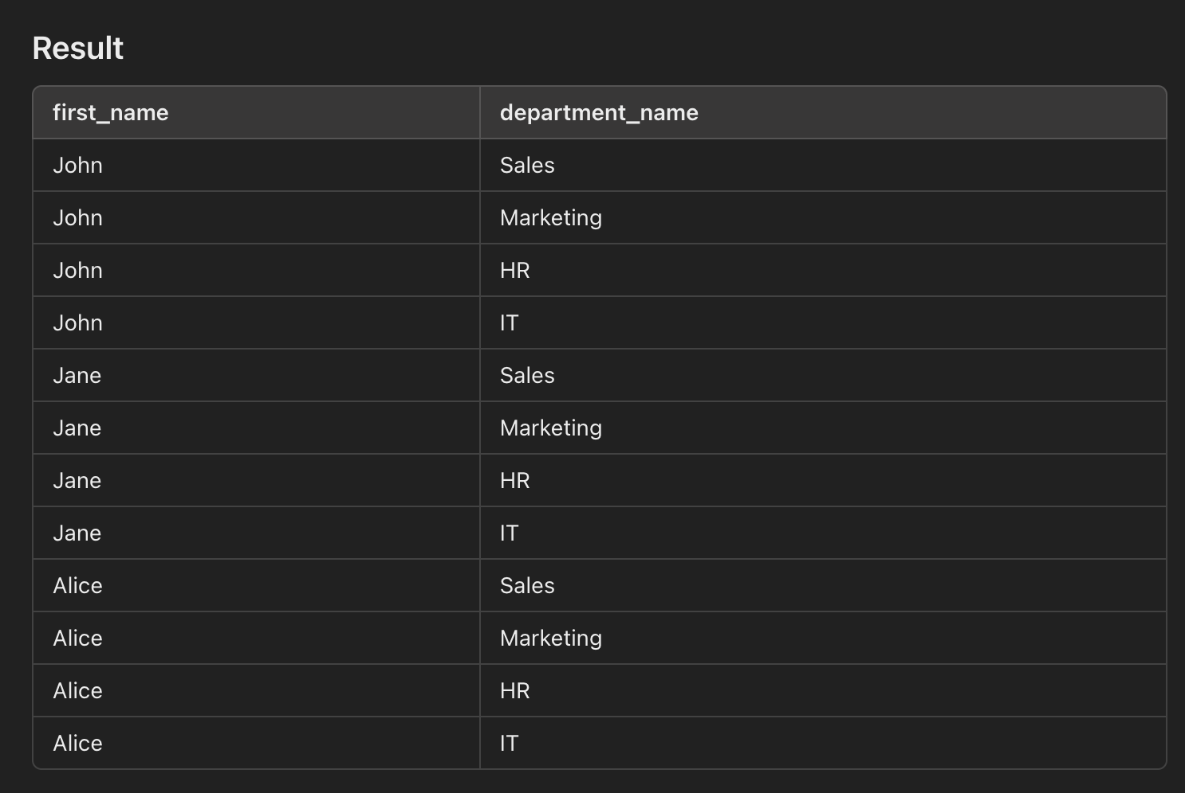
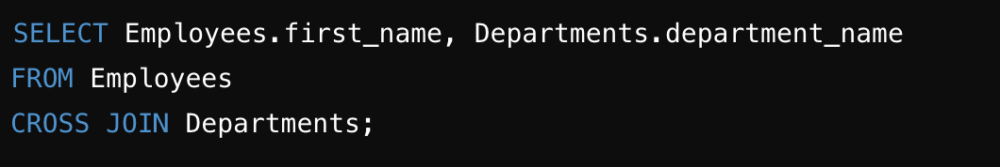
CROSS JOIN
A CROSS JOIN returns the Cartesian product of two tables, which means every row from the first table is paired with every row from the second table. This join can generate a large result set, as it multiplies the number of rows in both tables.

Slide 31
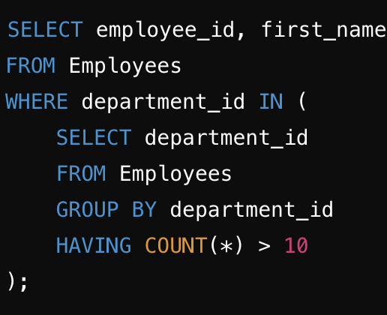
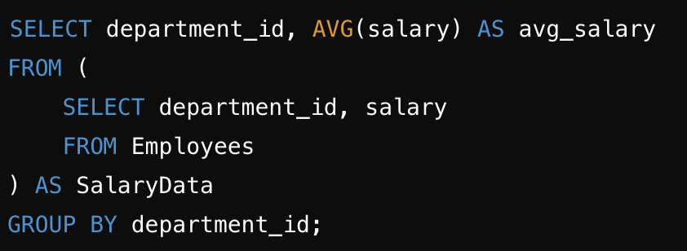
2. SUB QUERIES
Subqueries are queries nested within another SQL query. They’re useful for filtering or aggregating data from one table to apply to another. Subqueries can be used in the SELECT, FROM, WHERE, or HAVING clauses.
a) Subquery in the WHERE Clause . Select employees who work in a department with more than 10 employees.
b) Subquery in the FROM Clause

Slide 32
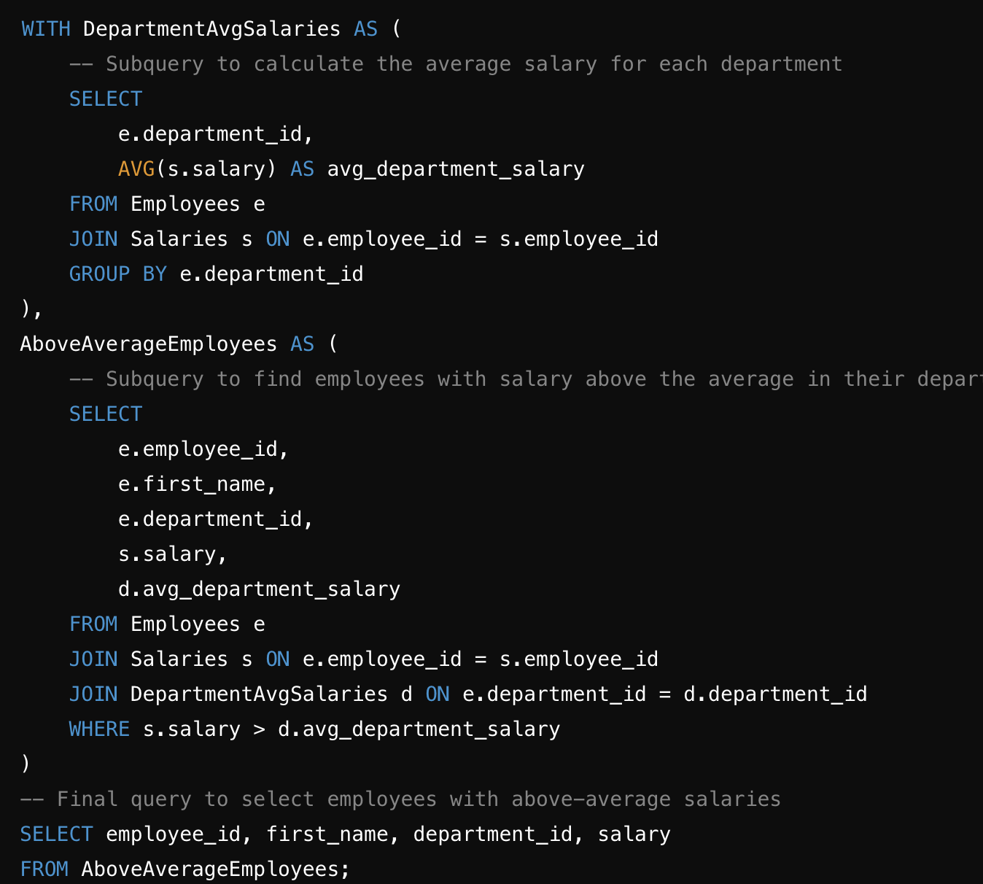
WITH
easier to read, maintain, and debug, especially when you’re working with multiple subqueries or layers of logic.WITH CLAUSE

Slide 33
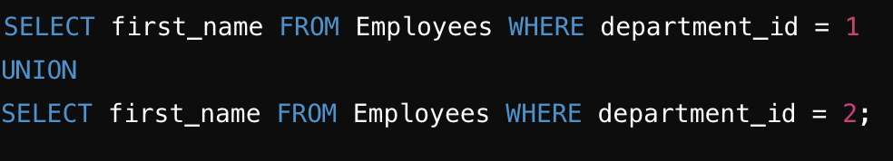
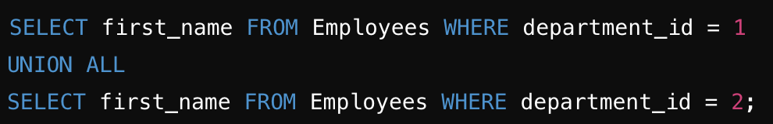
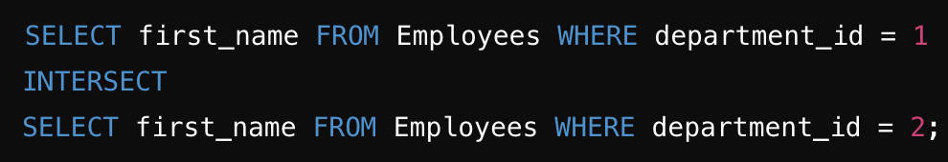
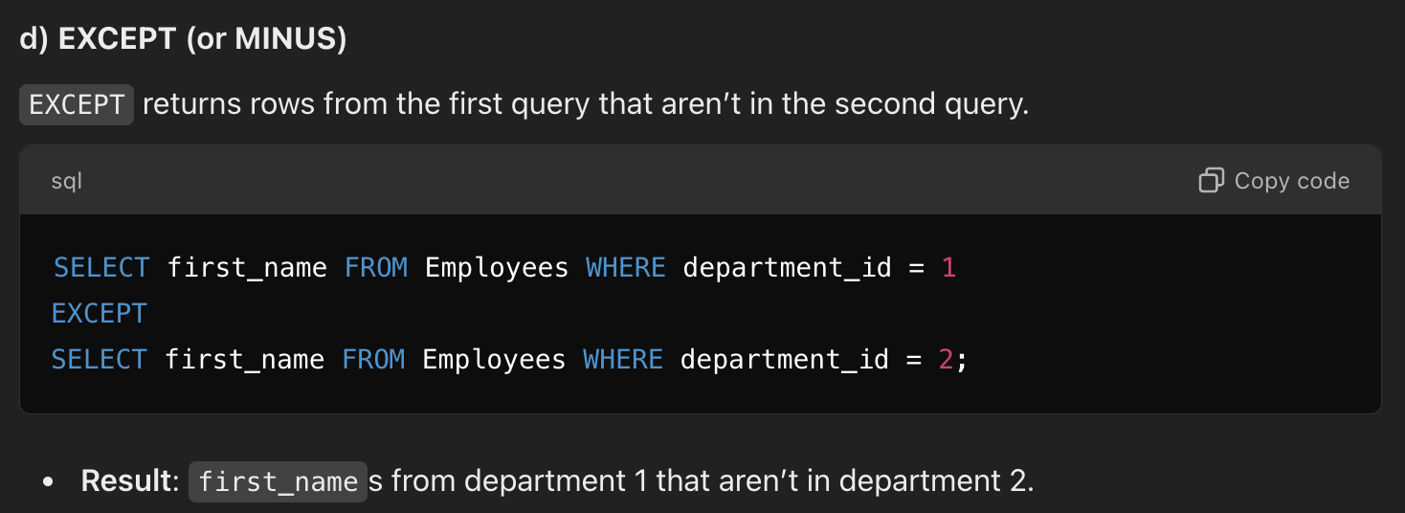
3. SET OPERATIONS
Set operations combine the results of two or more SELECT queries. Common set operations include UNION, UNION ALL, INTERSECT, and EXCEPT (or MINUS in Oracle).
a) UNION
UNION combines the results of two queries and removes duplicates.
b) UNION ALL
UNION ALL combines results without removing duplicates.
c) INTERSECT
INTERSECT returns only rows that are common in both queries.
d) EXCEPT (or MINUS)
EXCEPT returns rows from the first query that aren’t in the second query.

Slide 34
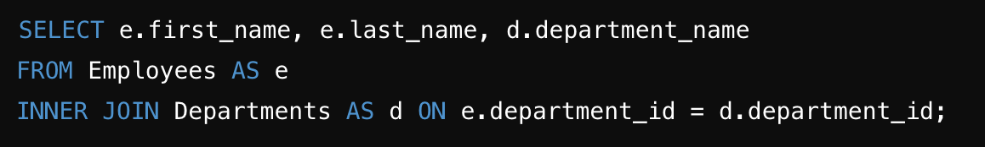
4. Table Aliases
Table aliases are temporary names assigned to tables (or columns) in SQL queries to make queries easier to read, write, and understand. They are especially useful when working with multiple tables, as they allow you to reference tables and columns with shorter names instead of the full table names.

Slide 35
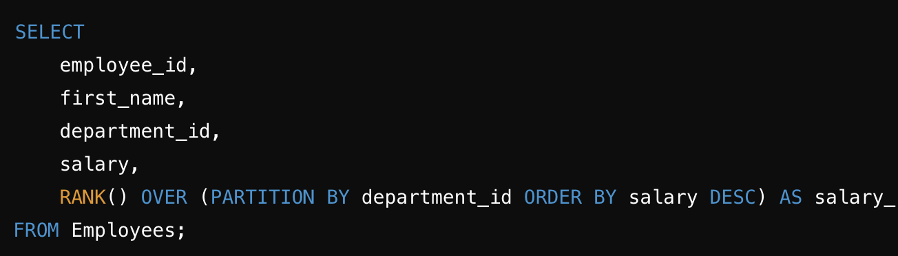
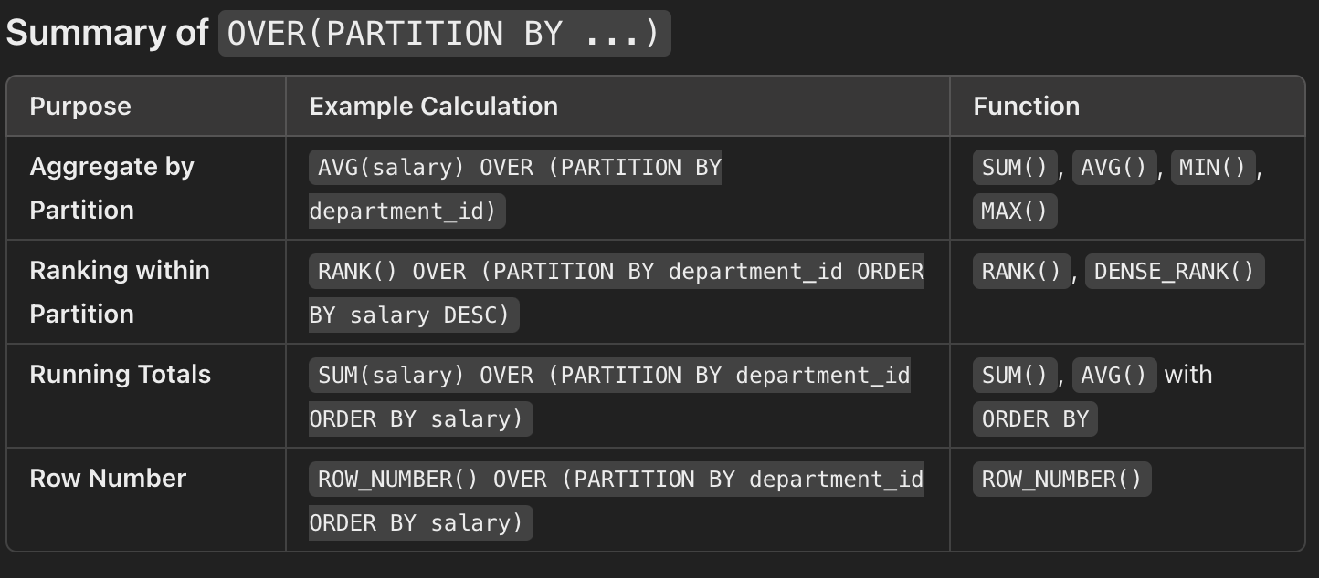
OVER
The OVER(PARTITION BY ...) clause in SQL is used in conjunction with window functions to perform calculations across a set of table rows that are related to the current row. By partitioning data, you can create "windows" or groups of rows over which a function (like SUM(), AVG(), RANK(), etc.) is calculated.

