Slide 1



SMART INDIA HACKATHON 2025
TITLE PAGE
Problem Statement ID –
Problem Statement Title-
Theme-
PS Category- Software/Hardware-
Team ID-
Team Name (Registered on portal)
LIFE TUBE
YOUR SAFTY IS OUR RESPONSIBILITY

Slide 2

Smart Spark
Digital Guidance Platform for Student Career Awareness & Enrollment in Government Colleges
A One-Stop Personalized Career and Education Advisor

Slide 3

Smart spark
PROBLEM STATEMENT:
Students & parents unaware of:
Importance of graduation
Career opportunities after different degrees
How to choose subjects based on interests & prospects
Results in:
Poor academic decisions
High dropout rates
Migration to private colleges

Slide 4
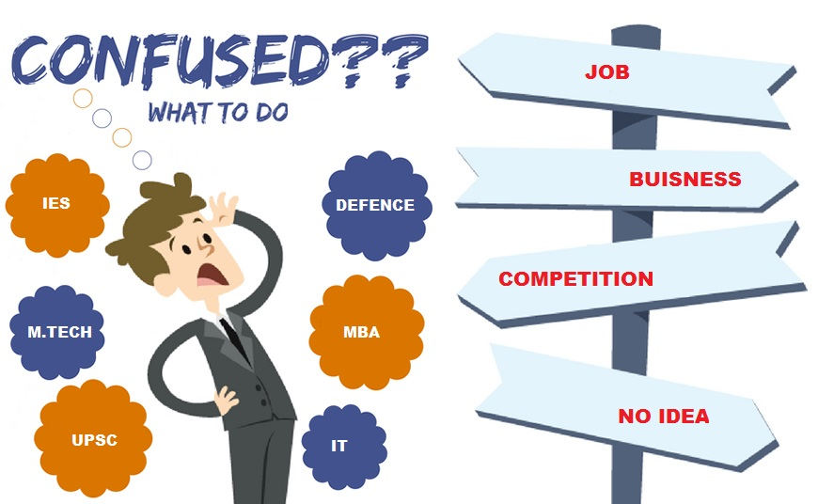
Smart spark
Student Challenges :
Confusion in subject selection (Arts, Science, Commerce)
Limited knowledge of nearby government college options
Uncertainty about jobs/higher studies after graduation
Short-term courses seem more attractive than degrees

Slide 5
Smart spark
Title: Proposed Solution – Digital Guidance Platform
Develop a mobile + web-based platform as a one-stop career advisor
Helps students choose the right subject stream after Class 10/12
Provides course-to-career pathways with clear future opportunities
Offers a directory of nearby government colleges with program details
Delivers personalized guidance using AI-driven recommendations
Visual Idea:
A simple graphic showing a student in the center, with arrows pointing to:
Subject Selection
Career Mapping
Nearby Colleges
Personalized Advice

Slide 6
Smart spark
Key Features
Aptitude & Interest Quiz: Suggests suitable streams & courses
Course-to-Career Path Mapping: Visual charts of career outcomes
Nearby College Directory: Location-based government college info
Timeline Tracker: Alerts for admissions, scholarships, tests
Customization & Personalization: AI-driven recommendations ,User
profiles track student details
Learning Resources: Open-source e-books, skill materials, scholarships
Offline Support: Works in low-internet areas

Slide 7
Smart spark
Implementation Strategy
Stakeholder Collaboration: Govt. departments, teachers, NGOs
Technology Development: Scalable, lightweight app
Pilot Launch: Select districts with low enrollment
Full Rollout: State-wide / national expansion
Monitoring & Feedback: Real-time analytics

Slide 8
Smart spark
Expected Impact
📈 Higher Enrollment – More students join government degree colleges
🎯 Reduced Dropouts – Students continue after Class 10 & 12 with confidence
🧭 Informed Career Choices – Students pick streams & courses based on aptitude, not guesswork
🤝 Equity in Education – Rural & underprivileged students get equal access to guidance
🚀 Future-Ready Workforce – More graduates with the right skills for jobs, exams, or entrepreneurship
✨ Empowered students → Stronger communities → Better nation

Slide 9
Smart spark
Conclusion
The challenge is awareness, not infrastructure
Students and parents need guidance in academic & career choices
A Digital Guidance Platform bridges this gap effectively
Ensures:
- Informed decisions
-Higher government college enrollment
-Reduced dropouts
-Long-term career empowerment

