Slide 1


THEATRE MANAGEMENT SYSTEM
USING JDBC
Presenters
Chandana Murthy
Frazer Akshita
Under the Guidance of
Roja Mani

Slide 2
INTRODUCTION
The Theatre Management System is a Java-based application developed using JDBC and MySQL.
It is a menu-driven console application that performs CRUD operations on theatre booking records.
The system allows users to add new bookings, search bookings by ID, update booking details, and cancel bookings efficiently using JDBC.

Slide 3
STRUCTURE OF JDBC
JDBC is used to connect Java applications with databases.
It allows sending SQL queries and update statements to the database.
The results returned from the database are processed using ResultSet.

Slide 4
JDBC DRIVER
Type 4 Driver (Thin Driver) is used.
It is fully written in Java.
No additional software or middleware is required.
Provides better performance and portability.

Slide 5
DATABASE DESIGN
Database Name: theatre_DB
Table Name: theatre_management
The table stores booking details such as theatre name, movie name, show details, customer details, and booking status.

Slide 6
MENU OPTIONS
1. Add Booking
2. View Booking by ID
3. View All Bookings
4. Update Booking by ID
5. Delete Booking by ID
6. Exit

Slide 7
CRUD OPERATIONS
Create: Insert new booking records into the database.
Read: View booking details by ID or view all bookings.
Update: Modify movie name or seat number using booking ID.
Delete: Cancel booking after confirmation.

Slide 8
PROGRAM EXECUTION
The user selects an option from the menu.
Based on the selection, the corresponding JDBC operation is performed.
The result of the operation is displayed on the console.

Slide 9
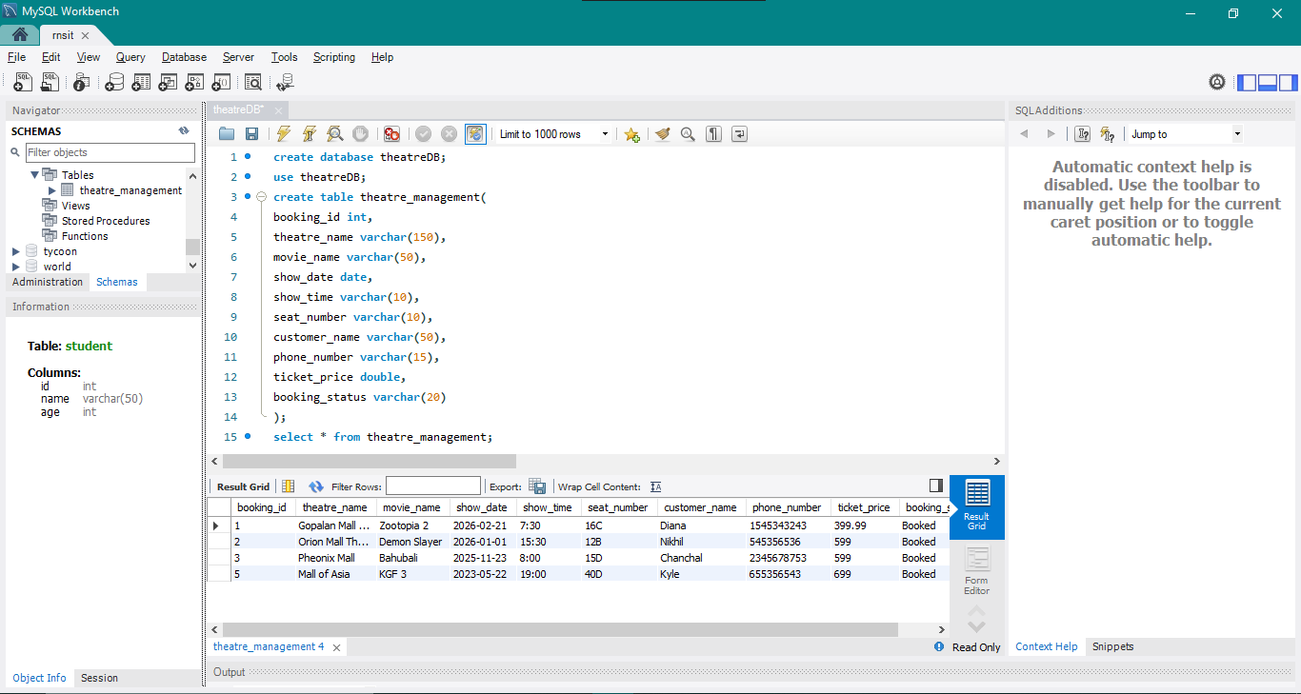
MYSQL SNAPSHOT

Slide 10
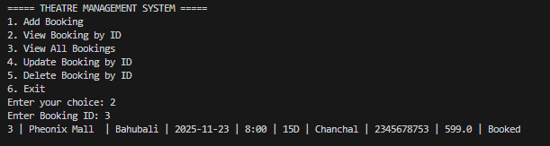
Program Snapshots
Menu to choose from coice: 2

Slide 11
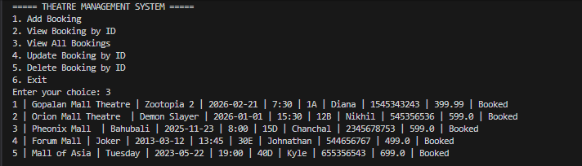
Program snapshots
Menu to choose from choice

Slide 12
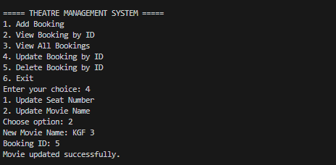
Program Snapshots
Menu to choose from choice:4
Choosing option:2

Slide 13
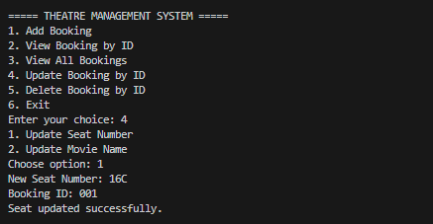
Program Snapshot
Menu to choose from choice:4
Choosing option:1

Slide 14
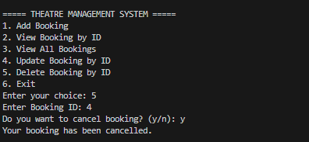
Program Snapshot
Menu to choose from choice:5

Slide 15
CONCLUSION
The Theatre Management System demonstrates the practical implementation of JDBC with MySQL.
It simplifies theatre booking management using a menu-driven approach.
The project follows core JDBC concepts taught during training.

Slide 16
Thank You!

