Slide 1


SMT.KAMALA AND SRI VENKAPPA M. AGADI COLLEGE OF ENGINEERING AND TECHNOLOGY LAKSHMESHWAR 582116
DEPERTAMENT OF INFORMATION SCIENCE & ENGINEERING
PRESENTATION ON “IPL WIN PREDICTION USING MACHINE LEARNING”
SUB CODE : 21ISMP67
UNDER THE GUIDANCE OF
Mr. Shambulingappa H S
ASSISTANT PROFESSOR OF ISE DEPT, SKSVMACET
PRESENTED BY:
ABHISHEK N A 2KA21IS001
CHANADANA K A 2KA21IS009
IRSHADAHMAD S K 2KA21IS018
MANOJ S M 2KA21IS029

Slide 2
CONTENTS
Introduction
Learning Objective
Prerequisites
Flowchart
Implementation
Model Selection
Model Development & Evaluation
Results & Conclusion

Slide 3
INTRODUCTION
IPL (Indian Premier League) is one of the most popular cricket leagues in the world, with millions of fans coming in to watch the games. With the sport's increasing popularity, there has been a growing demand for accurate predictions of the outcome of the games. This article explains one Data Science Project related to Cricket.
To address this, we are going to build a Machine Learning model that can forecast the winning chances of either of the teams during the middle of the match, based on the first innings performance of a team. Coaches and management of the team can use this model to make data- driven decisions during the game, for example: changing tactics, replacing players, and modifying their plans based on the projected winning likelihood.

Slide 4
LEARNING OBJECTIVE
The main objective of this project is to give the team players information about how each venue makes a difference to the game. And give feedback of how the players can improve their own performance in each game. And also give have a better planning of how the match should be played overall by the whole team regardless of the toss decision.

Slide 5
PREREQUISITES
Basic Python Jupyter Notebook
Familiarity with data analysis and machine learning libraries like numpy, Pandas, matplotlib, and Scikit-learn.
Basic Knowledge of Data Science Projects, EDA, and Data Preprocessing Supervised.

Slide 6
FLOWCHART
START
COLLECTION OF DATA
DATA PREPROCESSING
SPLIT DATA IN TO TRAINING & TEST SETS
DEPLOY MODEL
MAKE PREDICTIONS
EVALUATION OF MODEL
TRAIN LOGISTIC REGRESSION MODEL

Slide 7
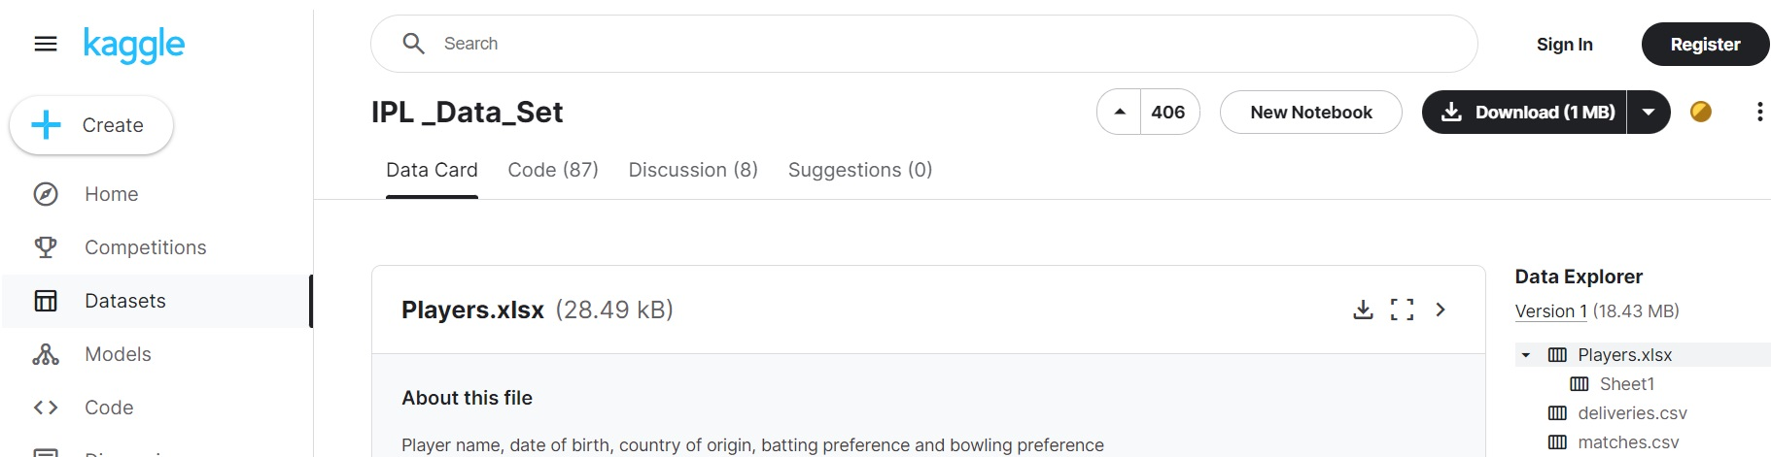
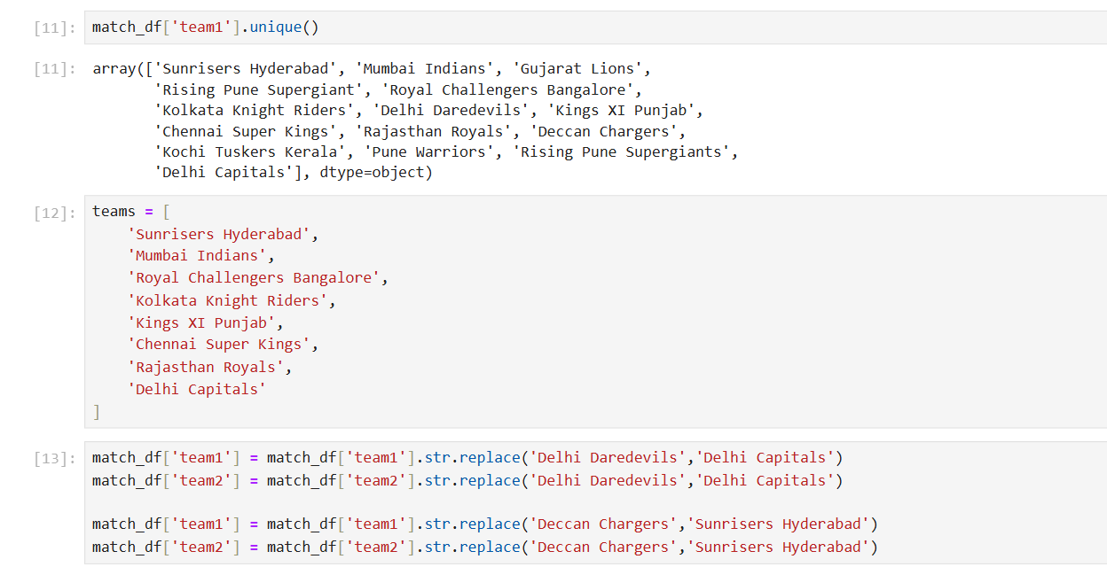
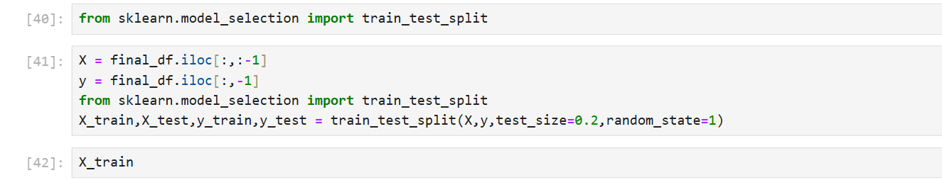
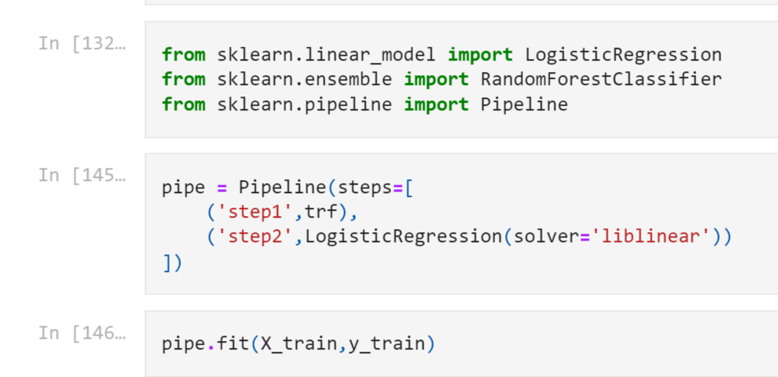
IMPLEMENTATION
Fig: Collection of Data Fig: Data Preprocessing
Fig: Train & Test model Fig: Logistic regression model

Slide 8
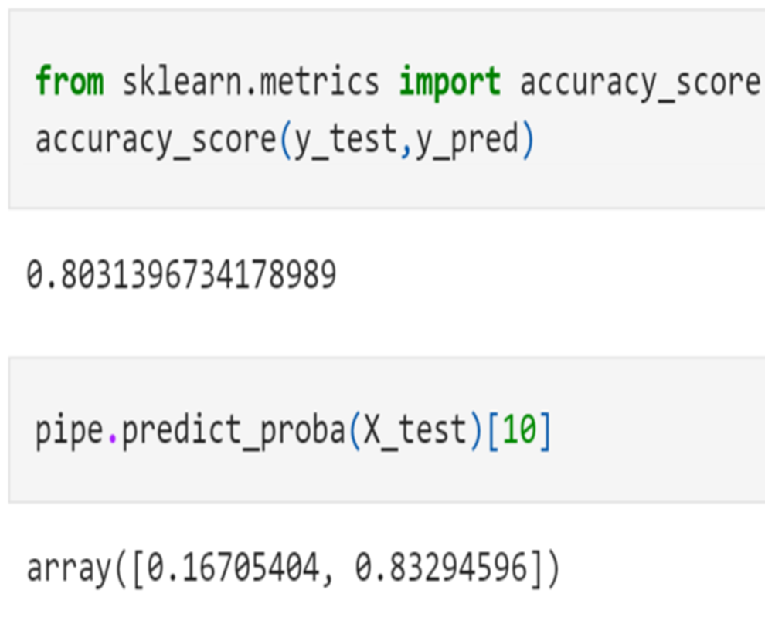
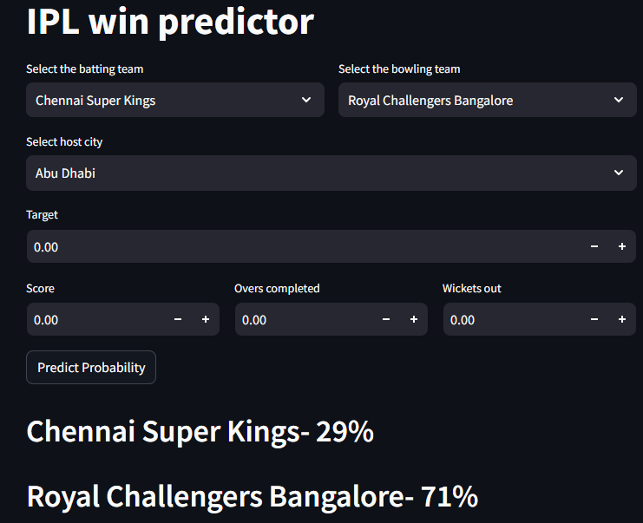
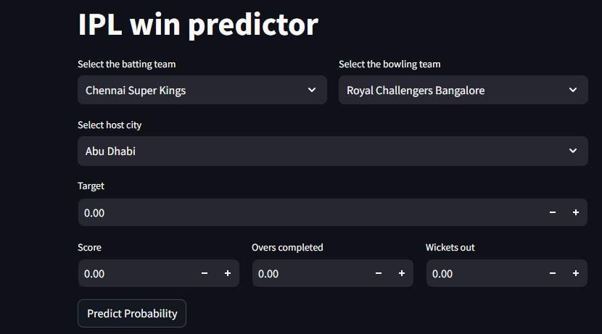
Fig: Evaluation of model
Fig: Prediction Fig: Deploy of Model

Slide 9
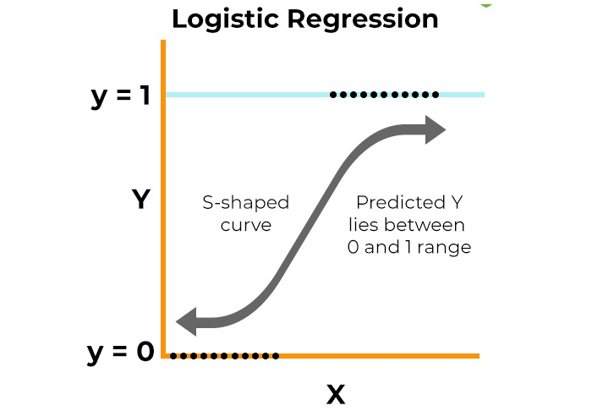
Model Selection
Logistic Regression
Algorithm Type: Supervised learning (classification).
Purpose: Logistic regression is widely used for binary classification tasks, such as predicting whether a team will win or lose an IPL match.
How It Works:
Logistic regression models the probability of an event (winning) using a logistic function.
It estimates the odds of the event occurring based on input features (e.g., team performance, player statistics).
The model learns coefficients for each feature to maximize the likelihood of observed outcomes.
Advantages:
Simple and interpretable.
Works well for binary outcomes.
Can handle both numerical and categorical features.
Limitations:
Assumes a linear relationship between features and log-odds.
Sensitive to outliers.

Slide 10

MODEL DEVELOPMENT & EVALUATION

Slide 11
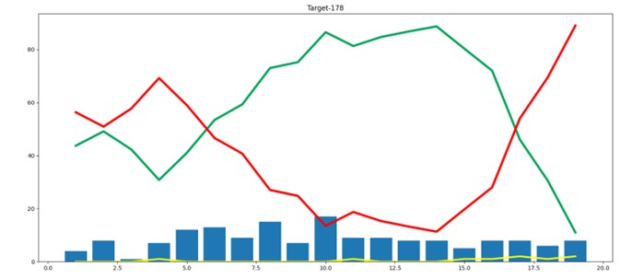
MODEL EVALUATION
This shows the winning probability of a team per over.
This shows the losing probability of a team per over.
This shows the wickets per over.

Slide 12
RESULTS & CONCLUSION
The IPL Win Predictor demonstrates promising results in forecasting match outcomes based on real-time game variables. By leveraging historical data and advanced machine learning techniques, the model provides valuable insights into the likelihood of a team winning given the current match conditions.
Future improvements could include incorporating additional features such as player performance, weather conditions, and venue statistics to enhance the model's accuracy further.

