Slide 1
STORES MANAGEMENT SYSTEM

Slide 2
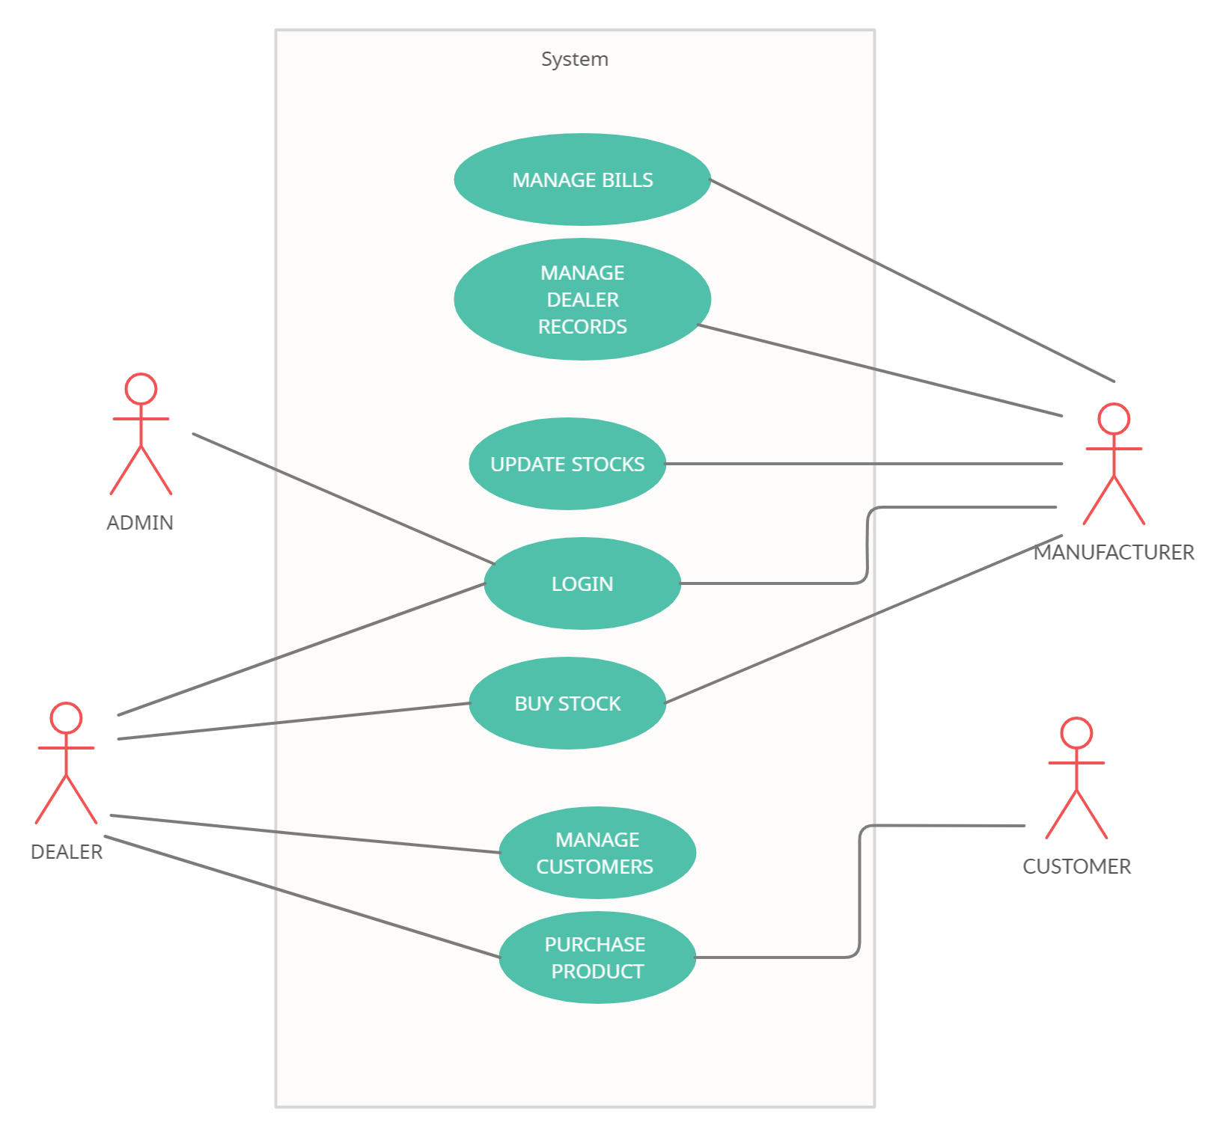
USE CASE- DIAGRAM

Slide 3
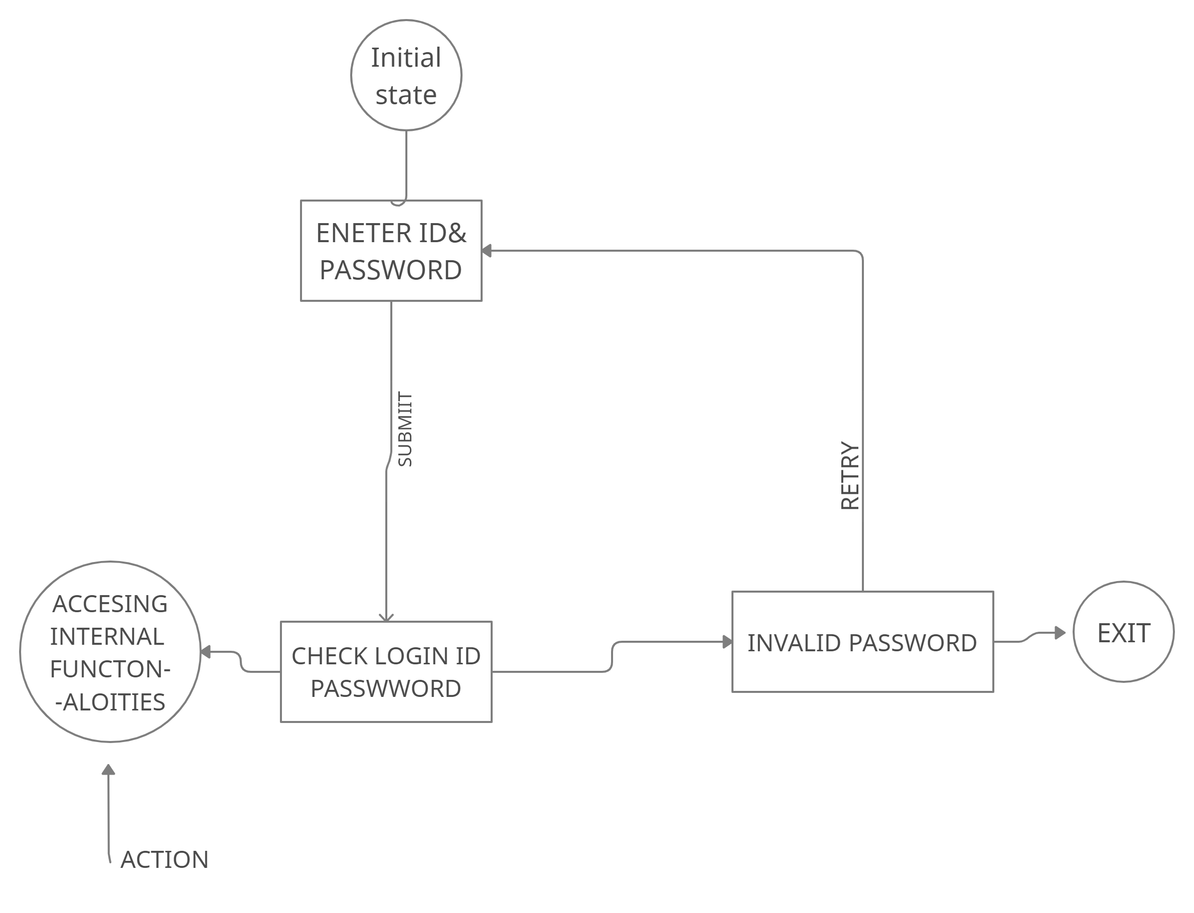
ADMIN-STATECHART DIAGRAM

Slide 4
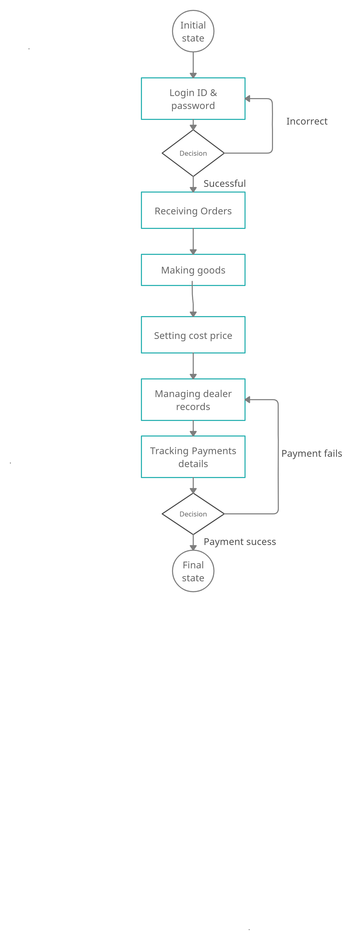
MANUFACTURER-STATE CHART DIAGRAM

Slide 5
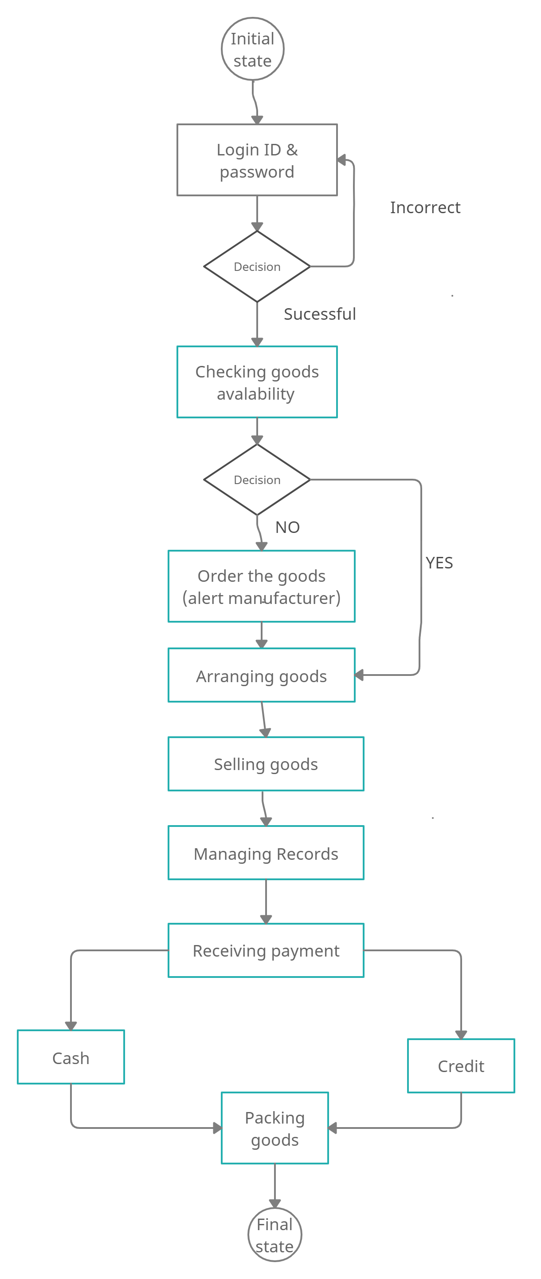
DEALER-STATE CHART DIAGRAM

