Slide 1
MEDICINAL PLANT IDENTIFICATION USING YOLOV8

Slide 2
ABSTRACT | SYSTEM ARCHITECTURE | HARDWARE /SOFTWARE REQUIREMENT
DOMAIN INTRODUCTION | FLOWCHART | SCOPE PROJECT
INTRODUCTION | USECASE- DIAGRAM | CONCLUSION
OBJECTIVES | ER DIAGRAM | FUTURE ENCHANCEMENT
EXISTING SYSTEM | SEQUENCE DIAGRAM | PROBLEM STATEMENT
DISADAVANTAGE | MODULES | SAMPLE CODE
PROPOSED SYSTEM | MODULES DESCRIPTION | SAMPLE SCREENSHOT
ADAVANTAGE | LITECTURE SURVEY(1-5) | REFERENCE

Slide 3
ABSTRACT
In preserving the physical and psychological state of persons, ayurvedic medicines have an important role. The research aims to identify indigenous ayurvedic medicinal plant species using deep learning techniques. The social relevance of the proposal is so high as it would solve the problems of a wide range of stakeholders like physicians, pharmacy, government, and public. The identification of rare plant species may lead to a significant impact on the research associated with medical and other related areas. Another application can be the identification of plant species in forest and remote areas, where access to humans is limited. In such cases, the image of a particular plant species may be captured using drones and further analyzed. Currently, a lot of research work has been going on in the area of plant species identification using machine learning algorithms. The performance of Convolutional Neural Network (CNN), and pretrained models VGG16, and VGG19 has been compared for leaf identification problem. The dataset proposed in this research work contains indigenous medicinal plants of Kerala. The dataset consists of leaf images of 64 medicinal plants. CNN obtained a classification accuracy of 95.79%. VGG16 and VGG19 achieve an accuracy

Slide 4
DOMAIN INTRODUCTION
It is a method of protecting information and communications through the use of codes, so that only those for whom the information is intended can read and process it.
There are two types of methods used for processing namely,
Image processing
Data processing
The information obtained from Security processing is hopefully both new and useful.

Slide 5
INTRODUCTION
Leaves being the most sensitive part of plants show disease symptoms at the earliest. The crops need to be monitored against diseases from the very first stage of their life-cycle to the time they are ready to be harvested.
Initially, the method used to monitor the plants from diseases was the traditional naked eye observation that is a time-consuming technique which requires experts to manually monitor the crop fields.
In the recent years, a number of techniques have been applied to develop automatic and semi-automatic plant disease detection systems and automatic detection of the diseases by just seeing the symptoms on the plant leaves makes it easier as well as cheaper.
These systems have so far resulted to be fast, inexpensive and more accurate than the traditional method of manual observation by farmers In most of the cases disease symptoms are seen on the leaves, stem and fruit.
The plant leaf for the detection of disease is considered which shows the disease symptoms.

Slide 6
OBJECTIVES
The main objective of our project is Medicinal plant Detection and Classification
To enhance the performance of the earliest possible prediction.
To increase the accuracy of the Classification results.
To enhance the performance of the overall prediction results.
To enhance the overall performance analysis.
Improved Performance Analysis

Slide 7
PROBLEM STATEMENT
Applied an image transformation technique Flipping and shifting to generate a new image from the Available data set. The more generalize capability of a Machine learning model can be achieved by training with the Original image and with the augmented image. In the past Several researchers have used data augmentation technique to Reduce the error rate of the machine learning model .In the present study data set is a collection of the different types Of the human Knee

Slide 8
SCOPE OF PROJECT
Design and implement a deep learning architecture, such as a convolutional neural network (CNN), for the classification of Medicinal plantosteoarthritis.
Train the model using the preprocessed X-ray images and the corresponding ground truth labels (healthy or osteoarthritis).
Optimize the model's hyperparameters and architecture to achieve the best possible performance.

Slide 9
ALGORITHM
Densenet121 Algorithm

Slide 10
EXISTING SYSTEM
In existing system propose a Long Short Term Memory neural network algorithm to accomplish the leaf disease classiﬁcation task.
Plant disease recognition is an interesting and practical topic. However, this problem has not been sufficiently explored due to the lack of systematically investigation and large-scale dataset.
The most challenging step in constructing such a dataset is providing a reasonable structure from both the agriculture and image processing perspective.

Slide 11
DISADVANTAGE
No comparison is made between the accuracies of several algorithm
It is not proper Segmentation
The overall classification accuracy was found to be the same irrespective of the kernel types. Processing building the model requires fast and efficient processors which is cost consuming

Slide 12
PROPOSED SYSTEM
The proposed model is introduced to overcome all the disadvantages that arise in the existing system.
This system will increase the accuracy of the neural network results by classifying the leaf disease digital image dataset using Deep learning algorithm.
It enhances the performance of the overall classification results. Predict the leaf disease image is to find the accuracy more reliable.

Slide 13
ADVANTAGE
High performance.
Provide accurate prediction results.
It avoid sparsity problems.
Reduces the information Loss and the bias of the inference due to the multiple estimates.

Slide 14
LITERATURE SURVEY

Slide 15
Title | Year | Author | Methodology
Plant Disease Prediction using Machine Learning Algorithms | 2018 | G. Prem Rishi Kranth, M. Hema Lalitha, Laharika Basava and Anjali Mathur | In the above information about prediction of plant disease a dataset is taken with 11 attributes and 310 rows. With the data different techniques like decision tree, Naive Bayes, Neural network and different plots like box plot, bar plot are performed. By performing the techniques it is concluded that, Here some statistical tests are performed to find out possible output predictions with the help of some inbuilt dataset and compared with the techniques with the help of the data set. While techniques are compared, other techniques may be better or poor. But the accuracy differs from each sample taken from dataset.

Slide 16
Title | Year | Author | Methodology
Leaf disease Detection and Climatic Parameter Monitoring of Plants Using IoT | 2015 | Dr. G. H. Agrawal, Prof. S. G. Galande, Shalaka R. Londhe | We have actualized a framework which indicates usage for Internet of Things utilized for observing general climatic parameters conditions by method for minimal effort, effectively accessible detecting framework. The depiction about the incorporated system building design and the interconnecting components for solid estimation of parameters by savvy sensors and transmission of information through web is being displayed in straightforward dialect. By surveying past writing we came to realize that there is have to advise rancher about wellbeing state of his field specifically by means of web so all outcomes are straightforwardly sent to agriculturist through send letters charge in Matlab.

Slide 17
Title | Year | Author | Methodology
The boosting approach to machine learning: An overview" in Nonlinear estimation and classification. | 2014 | R.E.Scahpire | Boosting is a general method for improving the accuracy of any given learning algorithm. Focusing primarily on the AdaBoost algorithm, this chapter overviews some of the recent work on boosting including analyses of AdaBoost’s training error and generalization error boosting’s connection to game theory and linear programming; the relationship between boosting and logistic regression extensions of AdaBoost for multiclass classification problems; methods of incorporating human knowledge into boosting; and experimental and applied work using boosting

Slide 18
Title | Year | Author | Methodology
Support vector clustering | 2012 | A. Ben-Hur, D. Horn, H. T. Siegelmann, V. Vapnik | Data points are mapped by means of a Gaussian kernel to a high dimensional feature space, where we search for the minimal enclosing sphere. This sphere, when mapped back to data space, can separate into several components, each enclosing a separate cluster of points. We present a simple algorithm for identifying these clusters. The width of the Gaussian kernel controls the scale at which the data is probed while the soft margin constant helps coping with outliers and overlapping clusters. The structure of a dataset is explored by varying the two parameters, maintaining a minimal number of support vectors to assure smooth cluster boundaries.

Slide 19
Title | Year | Author | Methodology
Land cover change assessment using decision trees support vector machines and maximum likelihood classification algorithms | 2017 | J. R. Otukei, T. Blaschke | Land cover change assessment is one of the main applications of remote sensed data. A number of pixel based classification algorithms have been developed over the past years for the analysis of remotely sensed data. The most notable include the maximum likelihood classifier (MLC), support vector machines (SVMs) and the decision trees (DTs). The DTs in particular offer advantages not provided by other approaches. They are computationally fast and make no statistical assumptions regarding the distribution of data. The challenge to using DTs lies in the determination of the “best” tree structure and the decision boundaries.

Slide 20
Title | Year | Author | Methodology
ImageNet Classification with Deep Convolutional Neural Networks | 2013 | Alex Krizhevsky, Ilya Sutskever and Geoffrey E. Hinton | Our results show that a large, deep convolutional neural network is capable of achieving record breaking results on a highly challenging dataset using purely supervised learning. It is notable that our network’s performance degrades if a single convolutional layer is removed. For example, removing any of the middle layers results in a loss of about 2% for the top-1 performance of the network. So the depth really is important for achieving our results. To simplify our experiments, we did not use any unsupervised pre-training even though we expect that it will help, especially if we obtain enough computational power to significantly increase the size of the network without obtaining a corresponding increase in the amount of labelled data.

Slide 21
Title | Year | Author | Methodology
iCassava 2019 Fine-Grained Visual Categorization Challenge | 2019 | Ernest Mwebaze, Timnit Gebru, Andrea Frome, Solomon Nsumba, Jeremy Tusubira and Chris Omongo | We presented a dataset of cassava plants annotated with the types of disease inflicting the plants, as well as an unlabeled set of cassava images taken by farmers. Our dataset and accompanying Kaggle challenge hope to encourage the computer vision community to work on problems that affect the very serious issue of food security. Fine-grained image classification can be used to help small-holder farmers monitor their plants and increase yields. While the research community has made significant improvements in fine-grained image classification using large training data, as can be seen in our setting, many real world problems require the use of smaller datasets and semi supervised methods to leverage unlabelled images.

Slide 22
SYSTEM ARCHITECTURE
IMAGE PREPROCESING
IMAGE SPLIITING
80% Training
IMAGE SELECTION
20% Testing
PERFORMANCE ANALYSIS
PREDICTION
CLASSIFICATION

Slide 23
FLOWCHART
IMAGE SELECTION
IMAGE PREPROCESING
IMAGE SPLIITING
80% Training
20% Testing
CNN
CLASSIFICA
-TION
Densenet121
PREDICTION
PERFORMANCE ANALYSIS

Slide 24
USECASE- DIAGRAM
DATA SELECTION
DATA PREPROCESING
DATA SPLIITING
USER
SYSTEM
CLASSIFICATION
PREDICTION
PERFORMANCE ANALYSIS

Slide 25
ER ARCHITECTURE
START
DATA SELECTION
DATA PREPROCESING
DATA SPLIITING
LOAD DATASET
PERFORMANCE ANALYSIS
PREDICTION
CLASSIFICATION

Slide 26
SEQUENCE DIAGRAM
START
DATA SELECTION
PREDICTION
DATA SPLIITING
SELECT DATASET
DATA
PREPROCESING
LOAD DATASET
MODEL SELECTION
PERFORMANCE ANALYSIS
CLASSIFICATION

Slide 27
SYSTEM REQUIREMENT
SOFTWARE REQUIREMENTS
• O/S : Windows 10
• Language : Python
• Front End : Spyder

Slide 28
MODULES
Image selection and loading
Image preprocessing
Splitting dataset into train and test data
Classification
Prediction
Result generation

Slide 29
IMAGE SELECTION AND LOADING
The data selection is the process of selecting the data for detecting the attacks.
In this project, the Medicinal plant image dataset is used for detecting disease.
Medicinal plant image
Normal /Abnormal
Image selection
Opencv Package

Slide 30
DATA PREPROCESSING
Resizing and Cropping: Adjusting the size and dimensions of the image to a standard or desired format. This can be done using techniques like nearest-neighbor, bilinear, or bicubic interpolation.
Color Space Conversion: Converting the image from one color space (e.g., RGB, HSV, or CMYK) to another, which can be useful for specific applications or algorithms.
Normalization: Scaling the pixel values to a common range, usually between 0 and 1 or -1 and 1, to ensure consistent input for the subsequent algorithms.
Noise Removal: Applying filters or techniques to reduce or eliminate unwanted noise or artifacts in the image, such as Gaussian blur, median filtering, or wavelet-based denoising.
Medicinal plant image
Image Pre-processing
Opencv Package

Slide 31
SPLITTING DATASET INTO TRAIN AND TEST DATA
Data splitting is the act of partitioning available data into two portions, usually for cross-validator purposes. One Portion of the data is used to develop a predictive model and the other to evaluate the model's performance.
Separating data into training and testing sets is an important part of evaluating data mining models.
Typically, when you separate a data set into a training set and testing set, most of the data is used for training, and a smaller portion of the data is used for testing.
To train any machine learning model irrespective what type of dataset is being used you have to split the dataset into training data and testing data.
Medicinal plant preprocessing
image
Train Image
Test Image
traintestsplit Package

Slide 32
CLASSIFICATION
Classification is the problem of identifying to which of a set of categories, a new observation belongs to, on the basis of a training set of data containing observations and whose categories membership is known.
The method of detecting driver fatigue based on cascaded MTCNN and EM-CNN is expected to play an important role in preventing car accidents caused by driving fatigue. For face detection and feature point location, we use the MTCNN architecture of a hierarchical convolutional network, which outputs the facial bounding box and the five feature points of the left and right eyes, nose, and the left and right mouth corners. Then, the ROI of the driver image is extracted using the feature points. To evaluate the state of the eyes and mouth, this paper has proposed the EM-CNN-based detection method. In an experimental evaluation, the proposed method demonstrated high accuracy
CNN Model CNNAlgorithm Train
Image Dataset Model
Tensor flow and Keras
Model .h5

Slide 33
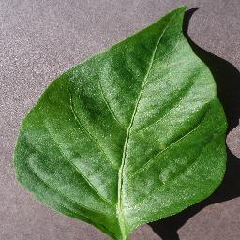
CNNALGORITHM
FCN layer
Input Image 256*256*3
Convolutional Layer
0
Pooling layer
Normal
Abnormal
1

Slide 34
PREDICTION
It’s a process of predicting the diseases from the dataset.
This project will effectively predict the data from dataset by enhancing the performance of the overall prediction results.
And also find the accuracy of the prediction for the output.
Test Image Dataset Model
Model. Predict(TI)
Model .h5
Medicinal plantNormal /Abnormal

Slide 35
PERFORMANCE ANALYSIS
The Final Result will get generated based on the overall classification and prediction.
The performance of this proposed approach is evaluated using some measures like,
Accuracy
Precision
Recall
ROC
Confusion matrix
Classification report
PERFORMANCE ANALYSIS

Slide 36
SYSTEM REQUIREMENT
SOFTWARE REQUIREMENTS
System : Pentium IV 2.4 GHz
Hard Disk : 200 GB
Mouse : Logitech.
Keyboard : 110 keys enhanced
Ram : 4GB

Slide 37
CONCLUSION
First the deep CNN are trained with the 90% of the sample and testing has performed with 10% of the samples. The activation function softmax was used for 100 epochs with batch size of 40. After that the activation function Adam was used for 100 epochs with a batch size of 40.The batch normalization was applied to minimize the fluctuation of the performance

Slide 38
FUTURE ENCHANCEMENT
In future, it is possible to Deep learning Algorithm
It is based on LSTM algorithm

Slide 39
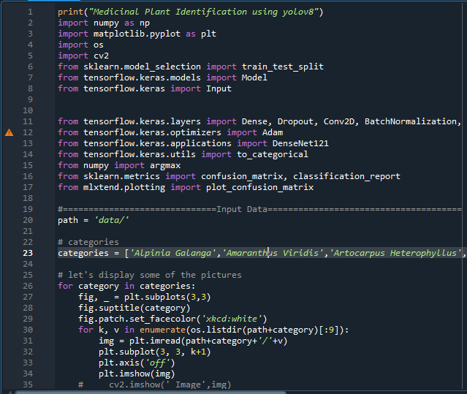
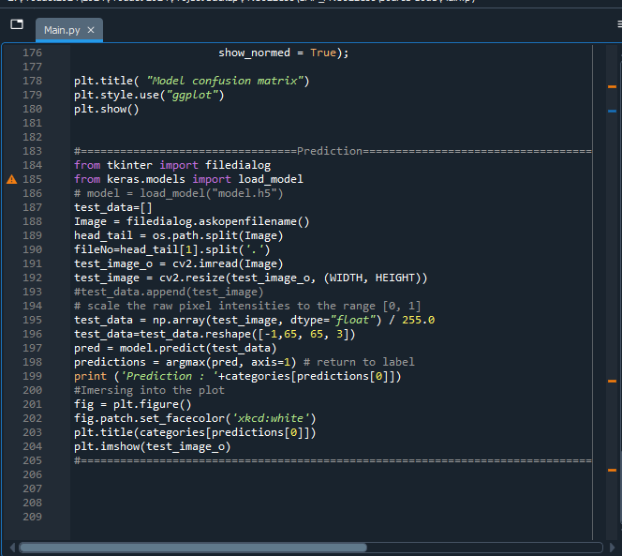
SAMPLE CODE

Slide 40
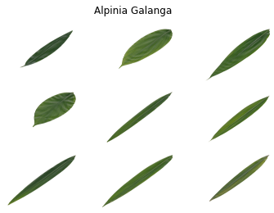
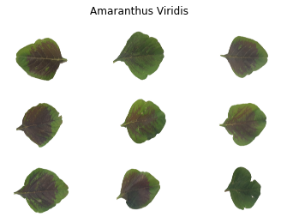
SCREENSHOT 1
Figure 1: Select a image based on the Medicinal plant dataset
Figure 1. Select an image based on the Medicinal
Plant dataset

Slide 41
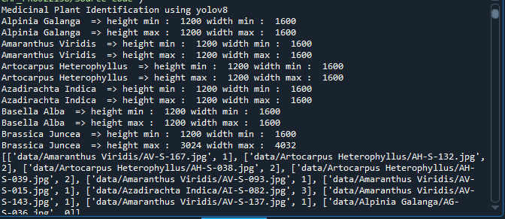
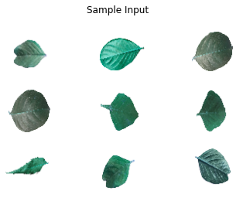
SCREENSHOT 2
Figure 2 Resize image based on the Medicinal plantdataset

Slide 42

SCREENSHOT 3
Figure 3 Using the Medicinal plantdataset, split images into 80% training and 20% testing

Slide 43
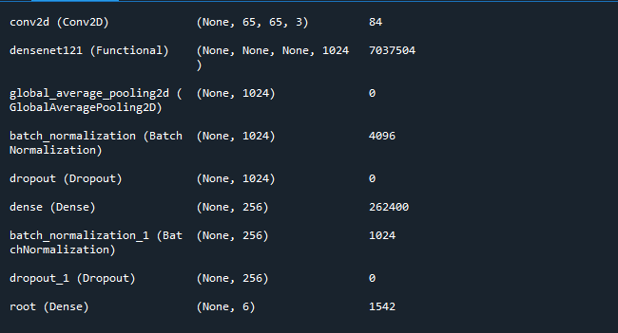
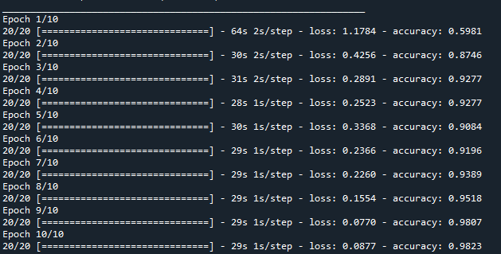
SCREENSHOT 4
Figure 4 CNN Architecture Layer
Figure 5 CNN Epochs 10

Slide 44
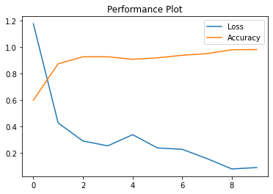
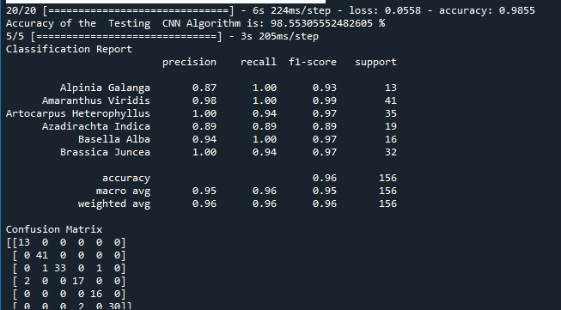
SCREENSHOT 5
Figure 6 CNN based on accuracy and loss plot
Figure 7 CNN based on Classification Report

Slide 45
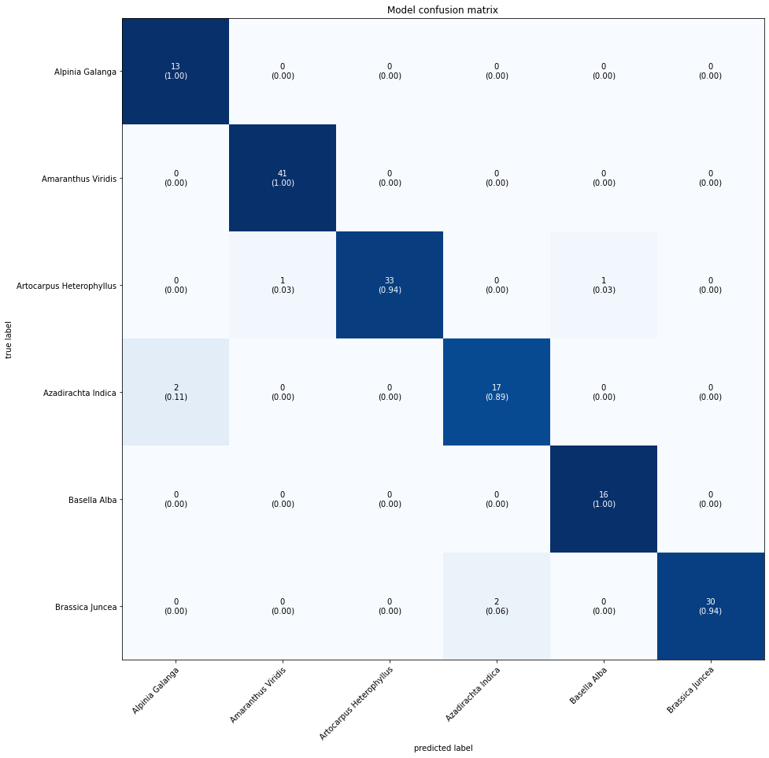
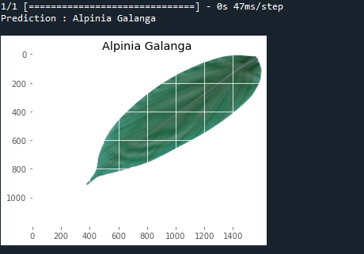
SCREENSHOT 5
Figure 8 CNN according to the test image's prediction on plant

Slide 46
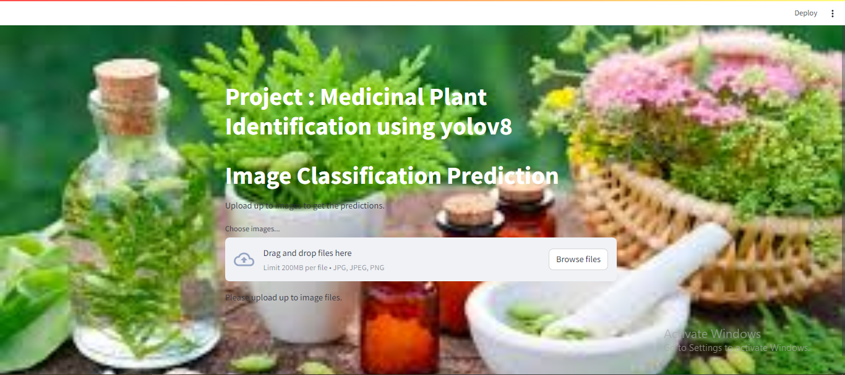
SCREENSHOT 6
Figure 10 CNNaccording to Web page

Slide 47
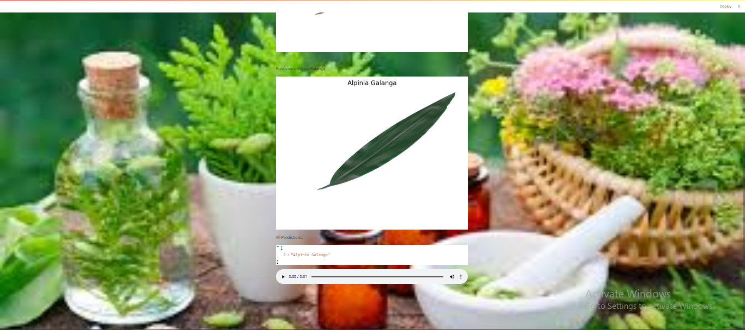
SCREENSHOT 7
Figure 10 CNNaccording to Web page

Slide 48
REFERENCE PAPER
Z. Li et al., “Non-invasive plant disease diagnostics enabled by smartphone-based fingerprinting of leaf volatiles,” Nature Plants, vol. 5, no. 8, pp. 856–866, Aug. 2019.
G. Litjens et al., “A survey on deep learning in medical image analysis,” Med. Image Anal., vol. 42, pp. 60–88, Dec. 2017.
W. Min, S. Jiang, L. Liu, Y. Rui, and R. Jain, “A survey on food computing,” ACM Comput. Surv., vol. 52, no. 5, pp. 92:1–92:36, 2019.
E. Moen, D. Bannon, T. Kudo, W. Graf, M. Covert, and D. Van Valen, “Deep learning for cellular image analysis,” Nature Methods, vol. 16, no. 12, pp. 1233–1246, 2019.
A. Krizhevsky, I. Sutskever, and G. E. Hinton, “ImageNet classification with deep convolutional neural networks,” in Proc. Neural Inf. Process. Syst., 2012, pp. 1106–1114.
A. Bauer et al., “Combining computer vision and deep learning to enable ultra-scale aerial phenotyping and precision agriculture: A case study of lettuce production,” Horticulture Res., vol. 6, no. 1, pp. 1–12, Dec. 2019.

Slide 49
REFERENCE PAPER
S. Sladojevic, M. Arsenovic, A. Anderla, D. Culibrk, and D. Stefanovic, “Deep neural networks based recognition of plant diseases by leaf image classification,” Comput. Intell. Neurosci., vol. 2016, pp. 1–11, May 2016.
J. Wang, L. Chen, J. Zhang, Y. Yuan, M. Li, and W. Zeng, “CNN transfer learning for automatic image-based classification of crop disease,” in Image and Graphics Technologies and Applications. Beijing, China: Springer, 2018, pp. 319–329.
K. P. Ferentinos, “Deep learning models for plant disease detection and diagnosis,” Comput. Electron. Agricult., vol. 145, pp. 311–318, Feb. 2018.
G. Wang, Y. Sun, and J. Wang, “Automatic image-based plant disease severity estimation using deep learning,” Comput. Intell. Neurosci., vol. 2017, pp. 1–8, Jul. 2017.
M. RuBwurm and M. Korner, “Temporal vegetation modelling using long short-term memory networks for crop identification from mediumresolution multi-spectral satellite images,” in Proc. IEEE Conf. Comput. Vis. Pattern Recognit. Workshops (CVPRW), Jul. 2017, pp. 11–19.
M. Brahimi, M. Arsenovic, S. Laraba, S. Sladojevic, K. Boukhalfa, and A. Moussaoui, “Deep learning for plant diseases: Detection and saliency map visualisation,” in Human and Machine Learning. Cham, Switzerland: Springer, 2018, pp. 93–117.

Slide 50
Thank You…

