Slide 1


Slide 2
Meet the Team
Name | Role | Core Tech / Focus
Vadathala Chandana | Frontend Lead | React.js, Tailwind CSS
Tavishi | Backend Developer | Admin Dashboard
Shekhar Shelke | Backend Developer | Owner Dashboard
Cherukuri Puneeth | Backend Developer | User Dashboard

Slide 3
The Parking Crisis
Driving in the city shouldn't feel like a scavenger hunt. Current systems are failing because:
Wasted Time: Drivers spend an average of 15–20 minutes just circling for a spot.
Manual Inefficiency: Current lots rely on outdated, paper-based, or manual tracking.
Zero Visibility: Drivers have no way to know if a lot is full until they arrive.
Traffic Congestion: 30% of urban traffic is caused by drivers looking for parking.

Slide 4
The Mission of ParkZen
Maximize Efficiency: Drastically reduce the time drivers spend searching for spots through precision tracking
Live Visibility: Deliver 100% accurate, real-time data on parking availability to eliminate guesswork.
Seamless Transactions: Integrated secure booking and automated payments for a "one-tap" user experience.
Operational Intelligence: Empower lot owners with data-driven tools to optimize space and revenue.
Urban Sustainability: Help decrease city traffic congestion and carbon emissions by streamlining vehicle flow.

Slide 5
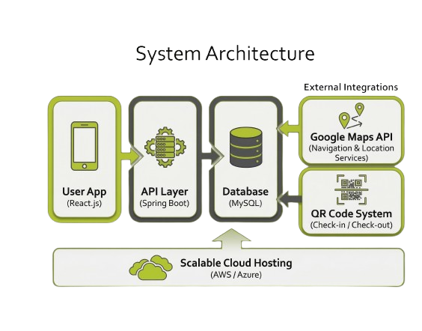

Slide 6
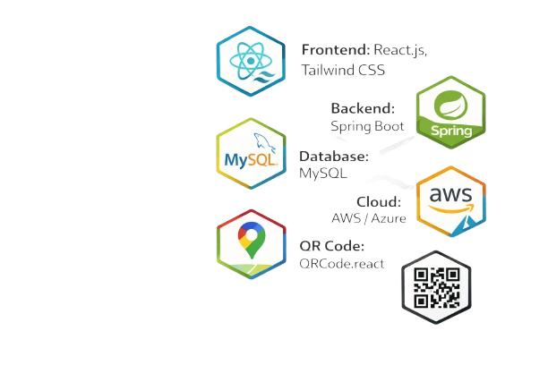
Our Technology Stack
Frontend: React.js, Tailwind CSS
Backend: Spring Boot
Database: MySQL
Maps: Google Maps API
Cloud: AWS / Azure
QR Code: QRCode.react

Slide 7


The ParkZen AI Ecosystem
Predictive Heatmaps : Context-Aware Analytics
Vision Intelligence : YOLO-Based Detection
Conversational Interface:
AI Chatbot
Voice Recognition

Slide 8
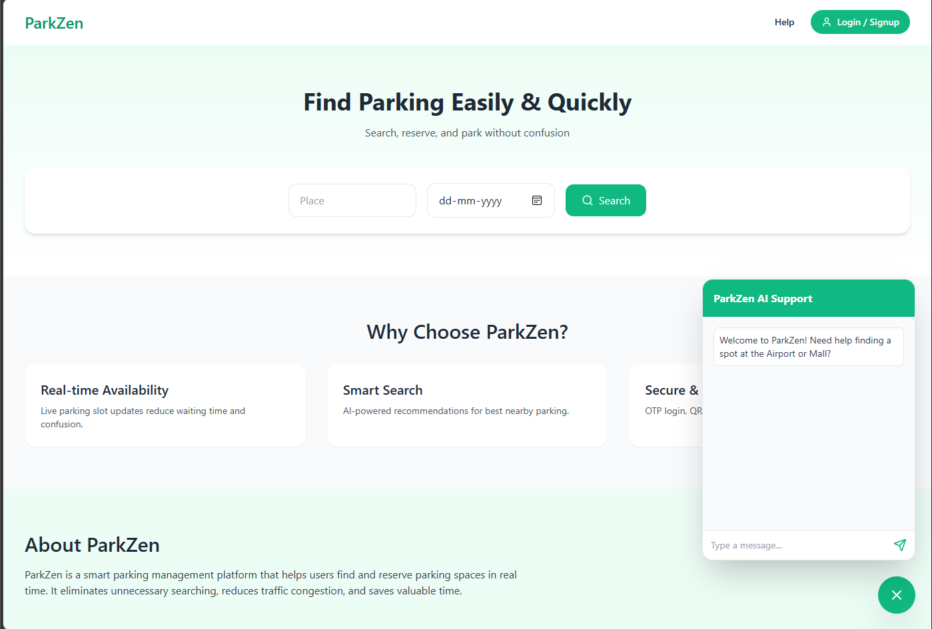
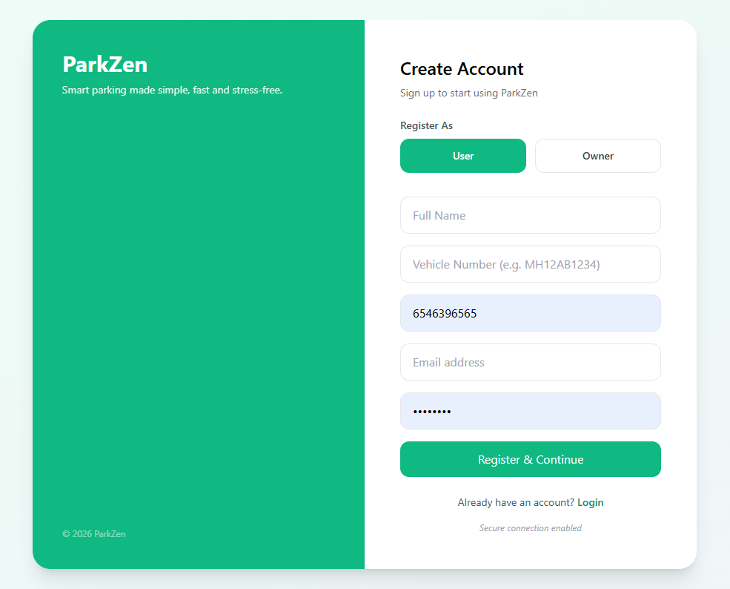
Screenshots of the Project

Slide 9
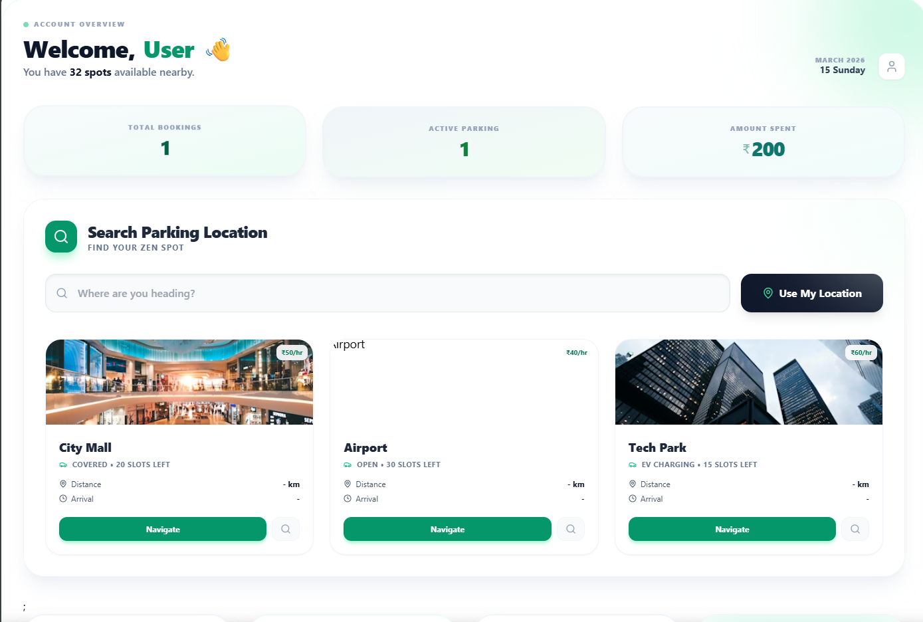

Slide 10
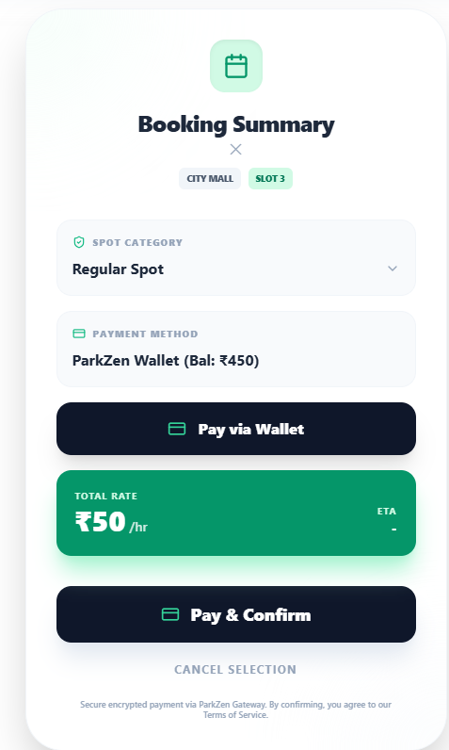
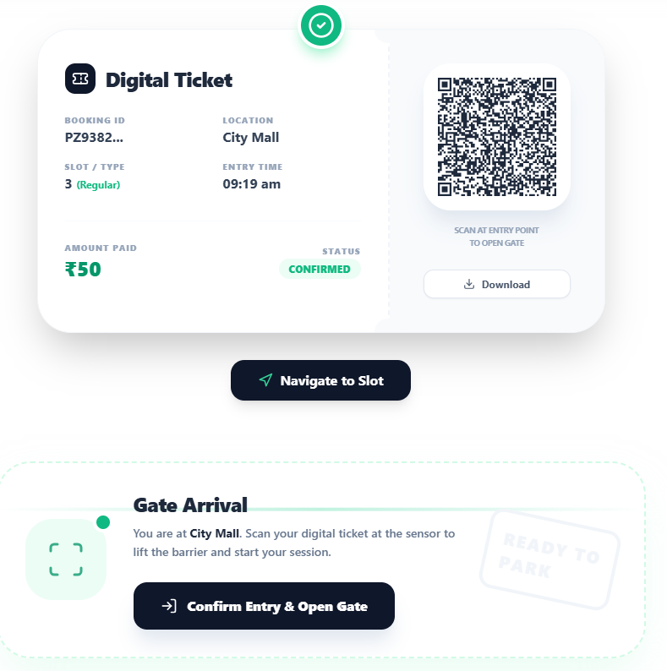

Slide 11
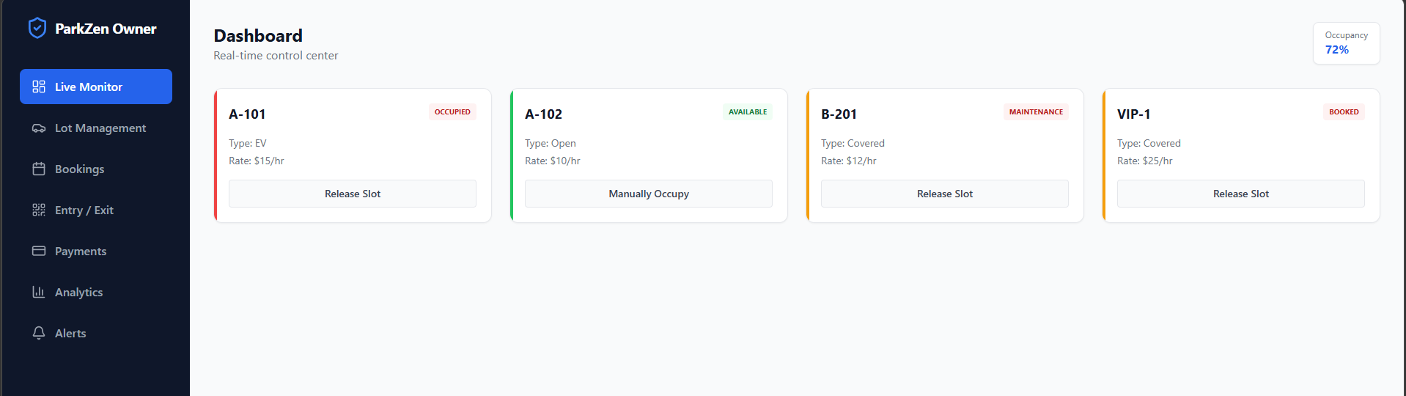
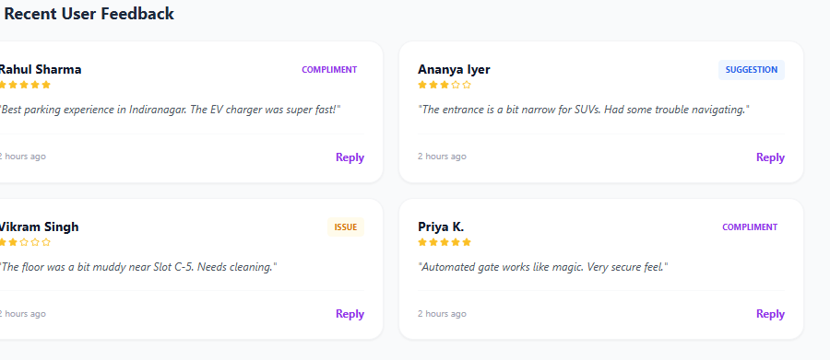

Slide 12
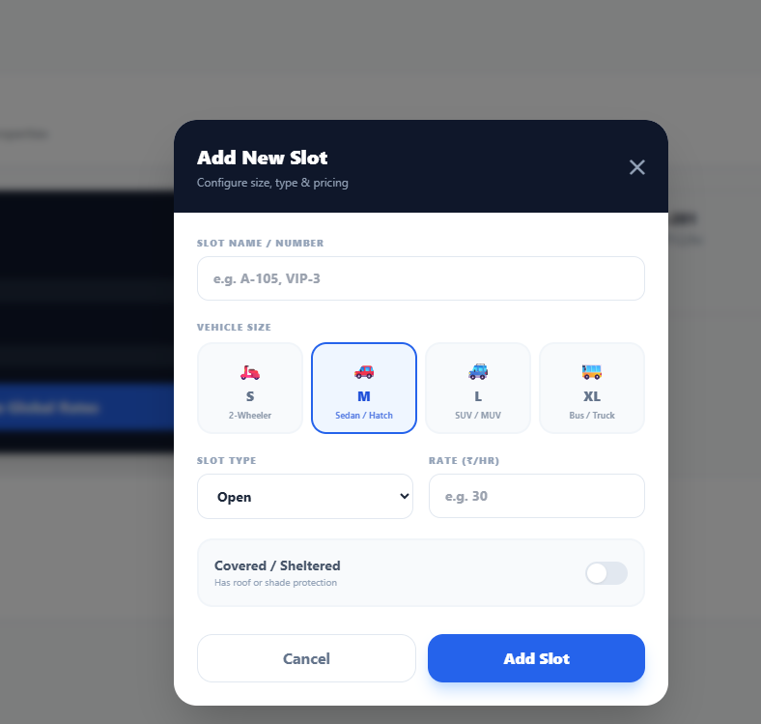
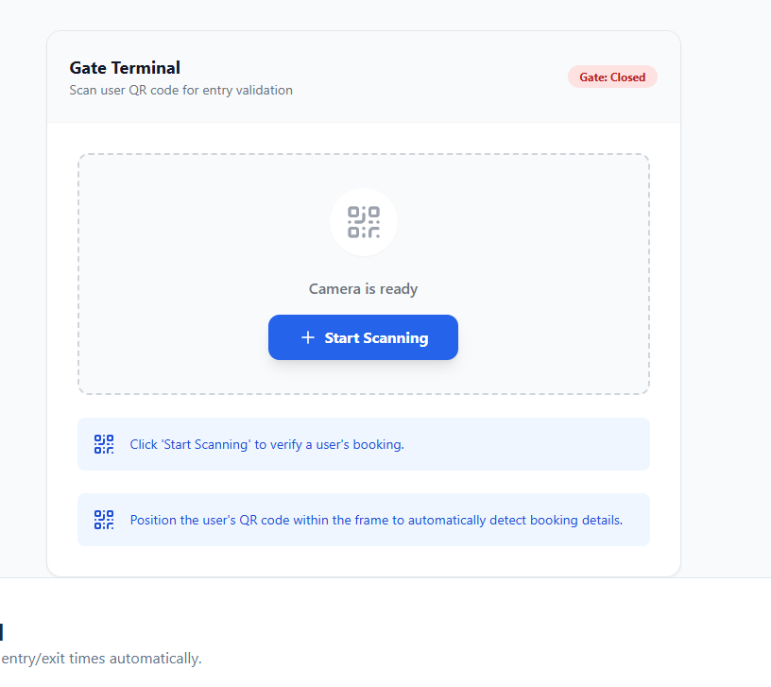

Slide 13
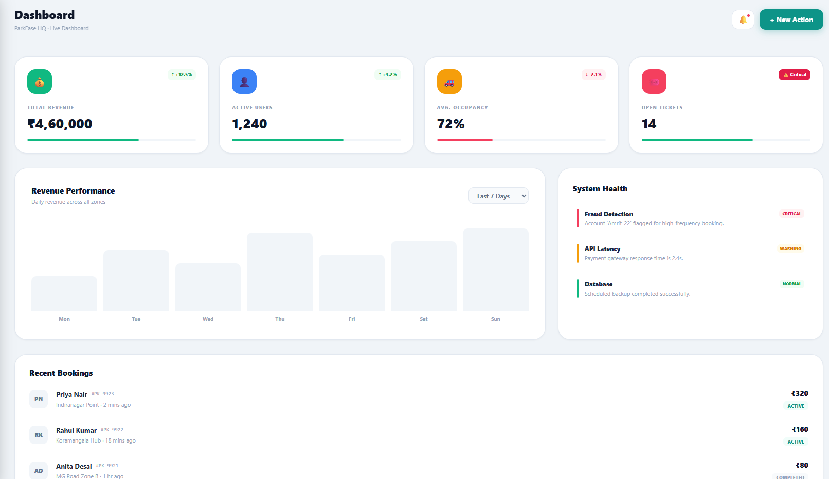
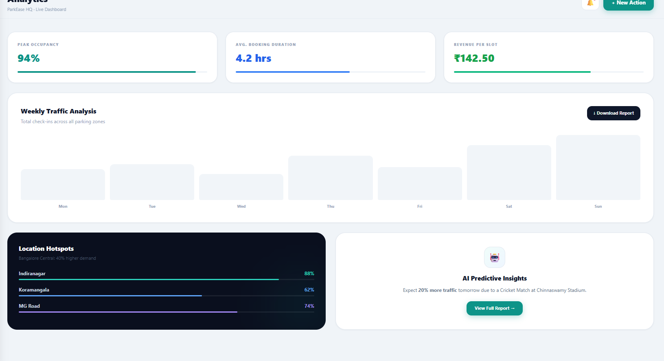

Slide 14
Future Scope
Category | Enhancement | Core Focus
Prediction | AI occupancy forecasting | Use historical data to predict future availability.
Scale | Multi-city expansion | Roll out the system beyond the pilot region.
Automation | IoT sensor integration | Fully automated, hardware-based spot detection.
E-Mobility | EV charger locator/booking | Integrate with electric vehicle infrastructure.
Retention | User loyalty program | Gamify frequent parking with rewards/discounts.

Slide 15
ParkZen: Smart. Seamless. Scalable.
Urban Solution: Tackling modern parking challenges with an intuitive, end-to-end digital platform.
User Centric: Eliminating the stress of searching for spots through real-time availability and 1-tap booking.
Owner Empowered: Transforming parking lots into data-driven assets with advanced analytics and management tools.

Slide 16
Thank You!!
https://github.com/chandanavadathala/ParkZen

