Slide 1
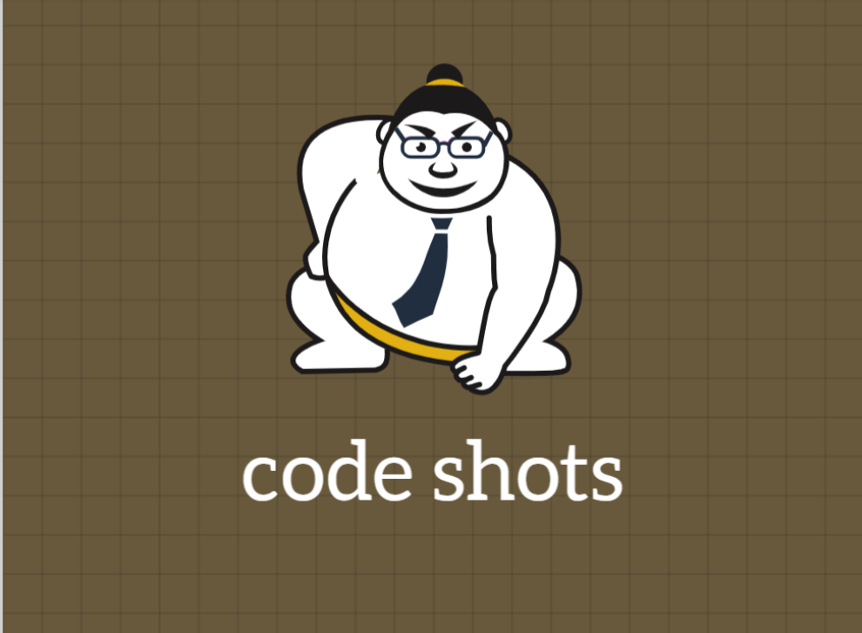

Slide 2
Python Object and Data Structure Basics
Variable Assignment
Names can not start with a number
Names can not contain spaces, use underscore (_) instead
Names can not contain any of these symbols: :'",<>/?|\!@#%^&*~-+
It's considered best practice (PEP8) that names are lowercase with underscores
Avoid using Python built-in keywords like list and str
Avoid using the single characters l (lowercase letter el), O (uppercase letter oh) and I (uppercase letter eye) as they can be confused with 1 and 0.
Creating Strings
Printing Strings

Slide 3
Python Object and Data Structure Basics
Strings
String Slicing: string[start:stop:step]
start (optional) - Starting integer where the slicing of the object starts. Default to None if not provided.
stop - Integer until which the slicing takes place. The slicing stops at index stop -1 (last element).
step (optional) - Integer value which determines the increment between each index for slicing. Defaults to None if not provided.
String length
String concatenate

Slide 4
Python Object and Data Structure Basics
List
A list is a collection which is ordered and changeable. In Python lists are written with square brackets.
Indexing and Slicing in Lists.
Basic List Methods
Append() : Add a single element to end of the list,
reverse() : Reverse a List,
sort() : sorts elements of a list,
pop() : Removes element at given index

Slide 5
Python Object and Data Structure Basics
Tuple
A tuple is a sequence of immutable Python objects. Tuples are sequences, just like lists. The differences between tuples and lists are, the tuples cannot be changed unlike lists and tuples use parentheses, whereas lists use square brackets.
Basic Tuple Methods
count() returns occurrences of element in a tuple
index() returns smallest index of element in tuple

Slide 6
Python Object and Data Structure Basics
Dictionaries
A dictionary is a collection which is unordered, changeable and indexed. In Python dictionaries are written with curly brackets, and they have keys and values.
Basic Dictionary Methods
Values() : Return a list of all values in the dictionary, keys() : Returns a list containing the dictionary’s keys,
items() : Return a list containing a tuple for each key value pair.

