Slide 1

Employee Data Analysis using Excel
STUDENT NAME: Chandanbala.D
REGISTER NO: 322200093
DEPARTMENT: Bcom honours
COLLEGE: Shri Shankarlal Sundarbai Shasun Jain College for Women
1
Notes:
1

Slide 2

PROJECT TITLE
Employee Performance Analysis using Excel
2

Slide 3



AGENDA
Problem Statement
Project Overview
End Users
Our Solution and Proposition
Dataset Description
Modelling Approach
Results and Discussion
Conclusion
3/21/2024 Annual Review
3

Slide 4

PROBLEM STATEMENT
LACK OF MOTIVATION: When the employees are not motivated their performance May suffer
WORK OVERLOAD: Excessive overload can overwhelm employees leading to stress
MISMATCHED SKILLS : Assign employees to task that do not align with their skills and strengths
INADEQUATE RESOURCES: If employees to not have resources to do their job effectively
4

Slide 5

PROJECT OVERVIEW
EMPLOYEE EVALUATION: The project typically coversall the employees within the organisation
.
PERFORMANCE METRICS: Identify key performance indicators relevant to roles being evaluated such as productivity, attendance , adherence to deadline
TIMELINE: Determine a specific period of time such as quarterly, semi annual and annually
5

Slide 6

WHO ARE THE END USERS?
TEAM MEMBERS: In some system , Peeta might be involved in the performance evaluation process , either through peer review or 360 degree feedback
SYSTEM ADMINISTRATION: In the case of digital performance management system , administration might manage user access , configure the system and ensure it runs smoothly
EMPLOYEES: Employees are primary users of performance evaluation system
6

Slide 7

OUR SOLUTION AND ITS VALUE PROPOSITION
SOLUTION: A system or a tool designed to enhance employee performance. This could be a performance management system, a set of metrics or a strategy like continue feedback
PROPOSITION: The value that this solution brings to a organisation . For instance , it might help in identifying high performance , improving overall productivity or providing actionable insights for employees development
7

Slide 8
DATASET DESCRIPTION
Employee ID
Employee status
First name
Employee classification type
Last name
Gender code
Business unit
Performance score
Employee type
Current employee rating

Slide 9

THE "WOW" IN OUR SOLUTION
FORMULA📝
=IFS(Z8>=5,"VERY HIGH",Z8>=4,"HIGH",Z8>=3,"MED",TRUE,"LOW")
3/21/2024 Annual Review
9

Slide 10
MODELLING
Historical Performance Data: Gather past performance data for each employee. This can include productivity reports, performance reviews, peer feedback, etc.
Feature collection: The listed 10 features were taken for the analysis of the data
10

Slide 11
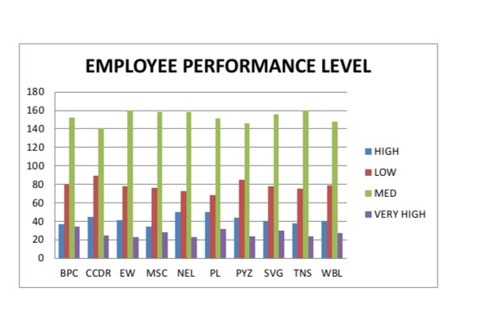
RESULT
11

Slide 12
conclusion
Areas for Improvement: Identify any areas where the employee could improve. Offer constructive feedback and suggest specific actions or training that could help them grow.
Development Opportunities: Discuss potential opportunities for the employee's career growth within the organization, such as promotions, leadership roles, or new projects.

