Slide 1
.jpg
File Type Classifier
.pdf
Identifying JPG, PDF, PNG, TXT and GIF files from their raw bytes
.png
Advanced Python Programming Lab
.txt
Group No.: 03 Members: Chandan kumar, Nityaraj Rathod
Date: 30-10-2026
.gif

Slide 2
Problem Statement
1
The problem
2
Why it matters
3
Scope
A file’s extension can be wrong, missing or deliberately changed.
The goal: tell what a file really is by looking at its content.
Upload filters and security tools must not trust names alone.
Useful in forensics and recovering unlabelled files.
Included: 5 classes (JPG, PDF, PNG, TXT, GIF), content-only features, a Random Forest model.
Excluded: other formats, corrupted or encrypted files, deep learning.

Slide 3
Dataset
505
5
101
256
files in total
classes
files per class
features per file
Source and balance
Preprocessing
Custom folder dataset (dataset.zip), one folder per file type
Perfectly balanced: 101 samples in every class
Empty files skipped
Count how often each byte value (0–255) occurs
Divide by file length to normalise

Slide 4
Methodology / Approach
Raw file
read as bytes
Byte histogram
256 counts
Normalise
divide by length
Random Forest
100 trees
Prediction
file type
›
›
›
›
Libraries
Why Random Forest
Validation
NumPy, scikit-learn, joblib, Matplotlib, Seaborn
Handles 256 numeric features with no scaling and gives a strong baseline fast
80/20 stratified split (404 train, 101 test), random_state = 42

Slide 5
Implementation Highlights
Size-independent features
Dividing by length makes a small and a large file of the same type look alike.
# feature extraction
data = open(path, "rb").read()
features = np.bincount(
np.frombuffer(data, np.uint8),
minlength=256)
features = features / len(data)
# train, save, reuse
model = RandomForestClassifier(
n_estimators=100, random_state=42)
model.fit(X_train, y_train)
joblib.dump(model, "file_classifier.pkl")
Safe handling
Empty files are skipped, so no division by zero.
Reusable model
Saved with joblib; an uploaded screenshot was correctly predicted as PNG.
No tuning yet
Default forest settings, so there is room to improve.

Slide 6
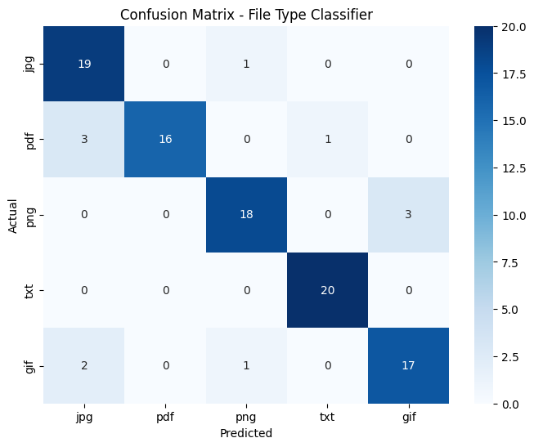
Results
89.1%
test accuracy (90 of 101)
Baseline
Random guessing across 5 balanced classes gives 20%. The model is about 4.5x better.
Most errors involve JPG: PDFs and GIFs are sometimes read as JPG, and PNGs as GIF.

Slide 7
Conclusion & Future Work
1
Achieved
2
Limitations
3
Next steps
A simple 256-number byte histogram is enough to reach 89.1% accuracy.
TXT was classified perfectly; the model is saved and works on new uploads.
Small dataset: 505 files, 101 test samples.
Compressed image and PDF data look statistically similar, so some mix-ups remain.
Only 5 formats.
Add byte-pair, entropy and file-header (magic number) features.
Tune hyperparameters and compare other models.
Cover more formats and a larger dataset.

Slide 8
References
Dataset
Libraries
Team contribution
dataset.zip (JPG, PDF, PNG, TXT, GIF folders), stored on Google Drive and extracted in Google Colab
NumPy, scikit-learn (RandomForestClassifier), joblib, Matplotlib, Seaborn
Member 1:Chandan Kumar
Member 2: Nityaraj Rathod

