Slide 1

BANGALORE INSTITUTE OF TECHNOLOGY K. R. Road, V. V. Puram, Bengaluru - 560 004 DEPARTMENT OF COMPUTER SCIENCE AND ENGINEERING Internship on “Tracking and Counting Vehicles using Machine Learning” Presented by CHANDAN B S D 1BI17CS034 Under the Guidance of
Prof. Nagamani D. R.
Department of CS&E
BIT, Bengaluru
Madhusudhana AS
Team Leader
Chira information technologies
Bengaluru

Slide 2
AGENDA
About Company / Organization
About Supervisor
Objectives
Details of Internship Project
Tasks Performed
Tools / Technologies Used
Architecture / Data Flow Diagram
Algorithm / Implementation Details
Results & Applications
Reflections
Conclusion
References

Slide 3
About Company/Organization
Chira Information Technologies is an IT services company started in the year 2002.
Range of services that includes Cloud Computing, Embedded Systems and Application Software.
Provider of corporate training and workshops.

Slide 4
About Supervisor
Name: Mr. Madhusudhana A S
7 Years of experience in embedded systems, IOT and software development.
Main team lead at Chira Information Technologies.

Slide 5
Objectives
To implement a system to detect cars in highway video feed.
To implement a system that tracks the detected vehicle throughout its appearance in the video feed.
To implement a system that counts the number of cars along with the direction of travel once it crosses a baseline.

Slide 6
Details of Internship Project
Project utilized 3 fundamental operations :
Video Pre-Processing
Object Detection
Object Tracking
Input: RAW Video Feed of highway traffic
Output: Processed video with contours drawn around cars along with visualization of results

Slide 7
Tasks Performed
Implemented all 7 modules required for the full functioning of the proposed system.
Apply various video preprocessing techniques to extract meaningful information from RAW Footage.
Utilized the openCV library to implement Video Processing components.

Slide 8




Tools / Technologies Used
Programming Language: Python
Libraries: openCV, numpy, pandas
IDE: Visual Studio Code

Slide 9
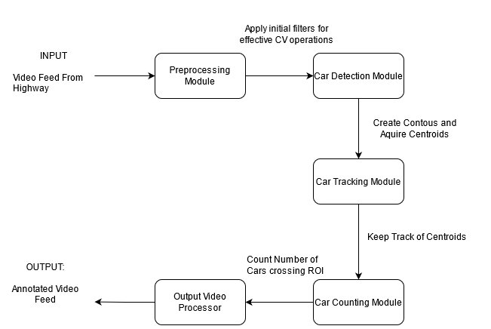
Architecture Diagram

Slide 10
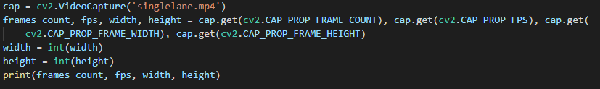
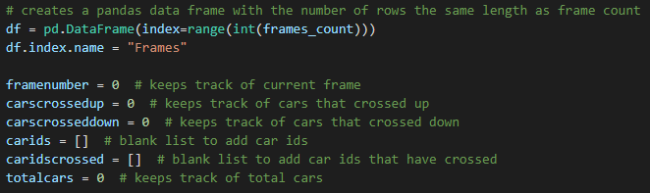
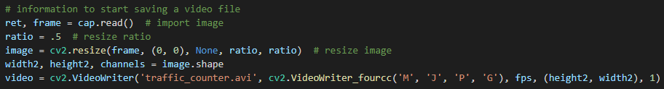
Implementation Details: Preprocessing Module
Sequence of Steps:
Read and Preprocess input Feed
Initialize all major placeholders as per requirements
How is video processed?
Videos are read one frame at a time and requires preprocessing to be applied on each frame
We apply certain limiter to ensure the
characteristics of video are suitable for
frame extraction
Finally the output must be annotate
before being saved

Slide 11

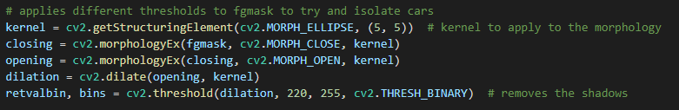
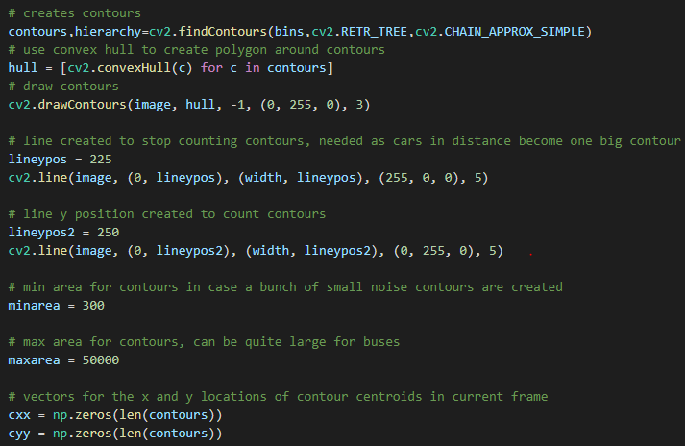
Implementation Details: Preprocessing Module Contd.
Sequence of Steps:
Step1: Convert Each from RGB to
Grayscale
Step 2: Apply 3 morphological transformation
Closing
Opening
Dilation
Step 3: Decide on parameters for object detection module such as:
Size of car
Baseline 1 to start tracking cars
Baseline 2 to determine if the car is moving up the road or down the road.

Slide 12
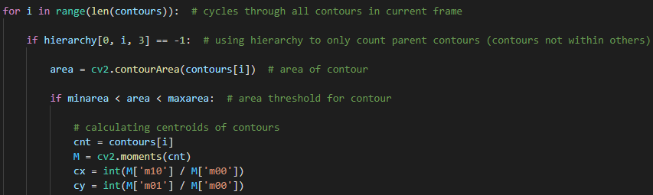
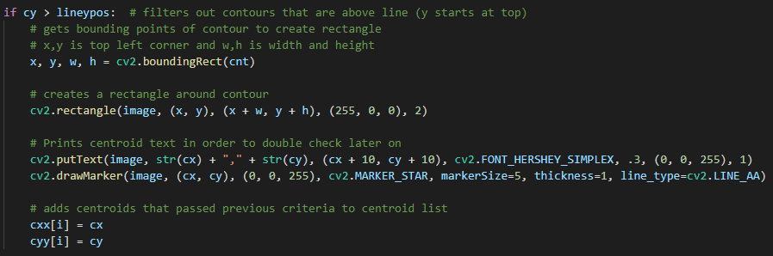
Implementation Details: Car Detection Module
Step 1: Draw the contours around
objects detected
Step 2: Determine if the object is a
car or not
Step 3: If yes then compute its centroid
Step 4: Draw the bounding rectangles
to visualize the detected cars

Slide 13
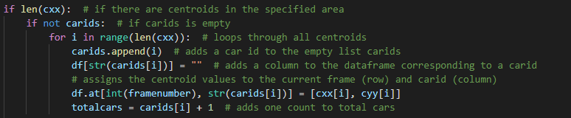
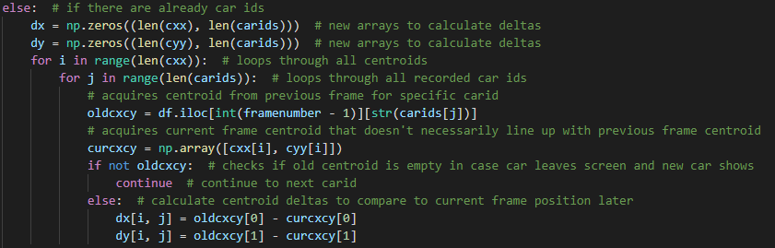
Implementation Details: Car Tracking Module Contd.
Sequence of Steps:
Step 1: For each detected car assign a unique id
Step 2: If there is an id previously assigned then
update the centroid

Slide 14
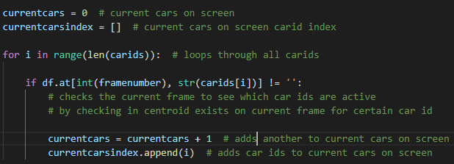
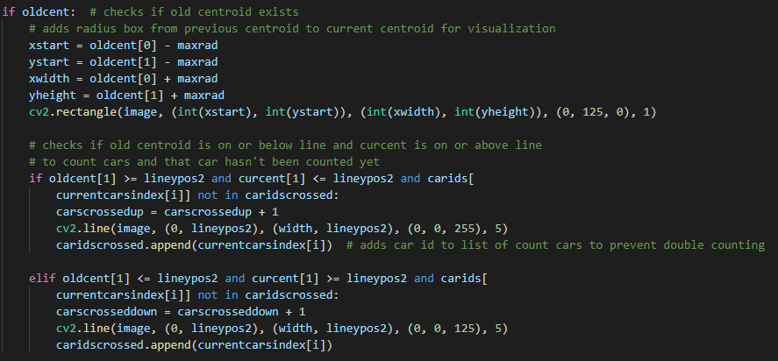
Implementation Details: Car Counting Module
Sequence of Steps:
Step 1: Find the list of cars id’s in the current frame.
Step 2: Use the centroid of these car id’s to determine if the have crossed our baseline and the direction of the motion.

Slide 15
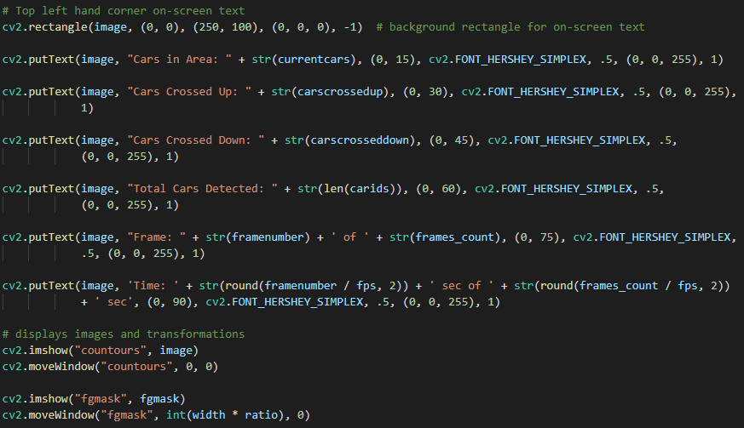
Implementation Details: Output Video Processor
Description
Step 1: Annotate the real time video
feed to display the following
parameters:
Cars in Area
Cars Crossed Up
Cars Crossed Down
Total Cars Detected
Frame number
Time
Step 2: Finally display two windows
1. One depicting the
annotated RGB video
2. The other video
preprocessed through
fgmask filter

Slide 16
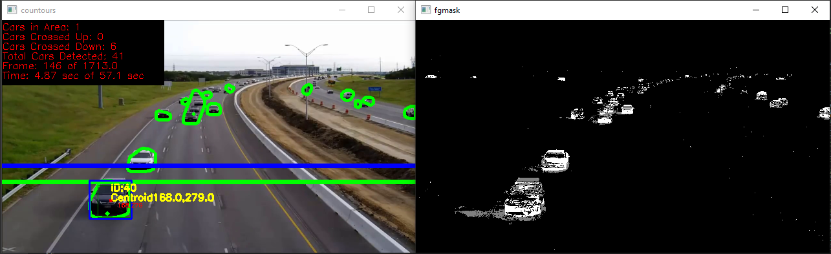
Results: Unidirectional Traffic

Slide 17
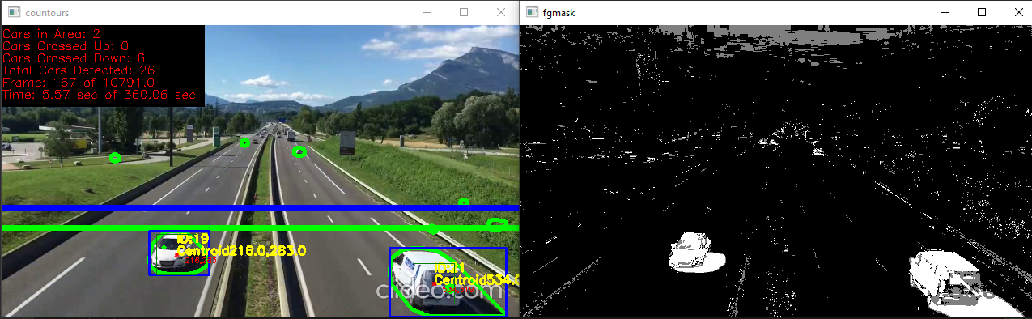
Results: Bi-Directional Traffic

Slide 18
Application
Better Road Planning and Maintenance: Analysing the collected traffic data along with timestamps can better help in scheduling road maintained.
Smart Traffic Lights: Quantitative data on the number of vehicles on a road can be important input for automated controlling of traffic lights.

Slide 19
Reflection
Better understanding and importance of libraries such as openCV
Understood the fundamentals of computer vision.
Use of scientific computation libraries such as pandas and numpy.
Better understanding of the flexibility and advantages of using Python in machine learning operations

Slide 20
Conclusion
The end result meets all the objectives set at the start of the internship.
The solution implemented works well with video feed having the camera positioned parallel to the direction of traffic.
Future implementation can extend the existing functionality to obtain speed of the vehicle, type of vehicle and also lane discipline.

Slide 21
References
Official Documentation of openCV: https://docs.opencv.org/master/
Research papers:
K.Sreedhar and B. Panlal, “Enhancement Of Images Using Morphological Transformations,” International Journal of Computer Science & Information Technology, 2012
Official Documentation of Pandas: https://pandas.pydata.org/docs/
Official Documentation of numPy: https://numpy.org/doc/

Slide 22
Thank You

