Slide 1


LIFE EXPECTANCY PREDICTION MODEL USING
MACHINE LEARNING
CHANDAN D.CHAUDHARI

Slide 2
OUTLINE
Introduction
About Dataset
Factors Affecting The Life Expectancy
Descriptive Statistics
Data Cleaning & Inference Modeling
Data Visualization
Machine Learning Model Building & Validation
Best Model Selection
Conclusion
Questions & Answer

Slide 3
Introduction
Life Expectancy, estimate of the average number of additional years that a person of a given age can expect to live.
Dataset Link
https://raw.githubusercontent.com/chandanc5525/LifeExpectancy_ModelPipeline/main/notebook/Data/LifeExpectancyData.csv
Machine Learning Pipeline
1. Understanding the Problem Statement
2. Data Collection
3. Data Checks to perform
4. Exploratory data analysis
5. Data Pre-Processing
6. Model Training & Validation
7. Choose best model
GitHub Model Link
https://github.com/chandanc5525/LifeExpectancy_ModelPipeline

Slide 4
Feature Columns Information
1) Country
2) Year
3) Status – Developed or Developing status
4) Life expectancy – Life Expectancy in age
5) Adult Mortality – Adult Mortality Rates of both sexes (probability of dying between 15 and 60 years per 1000 population)
6) infant deaths – Number of Infant Deaths per 1000 population
7) Alcohol – Alcohol, recorded per capita (15+) consumption (in litres of pure alcohol)
8) percentage expenditure – Expenditure on health as a percentage of Gross Domestic Product per capita(%)
9) Hepatitis B – Hepatitis B (HepB) immunization coverage among 1-year-olds (%)
10) Measles – Measles – number of reported cases per 1000 population
11) BMI – Average Body Mass Index of entire population

Slide 5
12) under-five deaths – Number of under-five deaths per 1000 population
13) Polio – Polio (Pol3) immunization coverage among 1-year-olds (%)
14) Total expenditure – General government expenditure on health as a percentage of total government expenditure (%)
15) Diphtheria – Diphtheria tetanus toxoid and pertussis (DTP3) immunization coverage among 1-year-olds (%)
16) HIV/AIDS – Deaths per 1 000 live births HIV/AIDS (0-4 years)
17) GDP – Gross Domestic Product per capita (in USD)
18) Population – Population of the country
19) thinness 1-19 years – Prevalence of thinness among children and adolescents for Age 10 to 19 (% )
20) thinness 5-9 years – Prevalence of thinness among children for Age 5 to 9(%)
21) Income composition – Human Development Index in terms of income composition of resources (index ranging from 0 to 1) & Schooling – Number of years of Schooling(years)

Slide 6
Data Set Information
1. The Above Dataset Contains 2938 Rows and 22 Columns.
2. Out of 22 Columns, The LifeExpectancy Column acts as Target Column.
3. There are Total 133 Countries including Developed and Developing, and Few Feature Columns such as Percentage_Expenditure and Measles,Total Expenditure, Population and Schooling.
4. In Order to Evaluate Life Expectancy there are two possible ways:
[a]. Simply drop all the rows having null values in it, Since this dataset will be for 133 different countries w.r.t Years.
[b]. We can go for Imputing Method so that Null values can be taken care.

Slide 7
Questionarise to Answer Using EDA
1. Does various predicting factors which has been chosen initially really affect Life
expectancy? What are the predicting variables actually affecting life expectancy?
2. Should a country having a lower life expectancy value(<65) increase its healthcare
expenditure in order to improve its average lifespan?
3. How do Infant and Adult mortality rates affect life expectancy?
4. Does Life Expectancy has a positive or negative correlation with eating habits,
lifestyle, exercise, smoking, drinking alcohol etc?
5. What is the impact of schooling on the lifespan of humans?
6. Does Life Expectancy have a positive or negative relationship with drinking
alcohol?
7. Do densely populated countries tend to have lower life expectancy?
8. What is the impact of Immunization coverage on Life Expectancy?

Slide 8
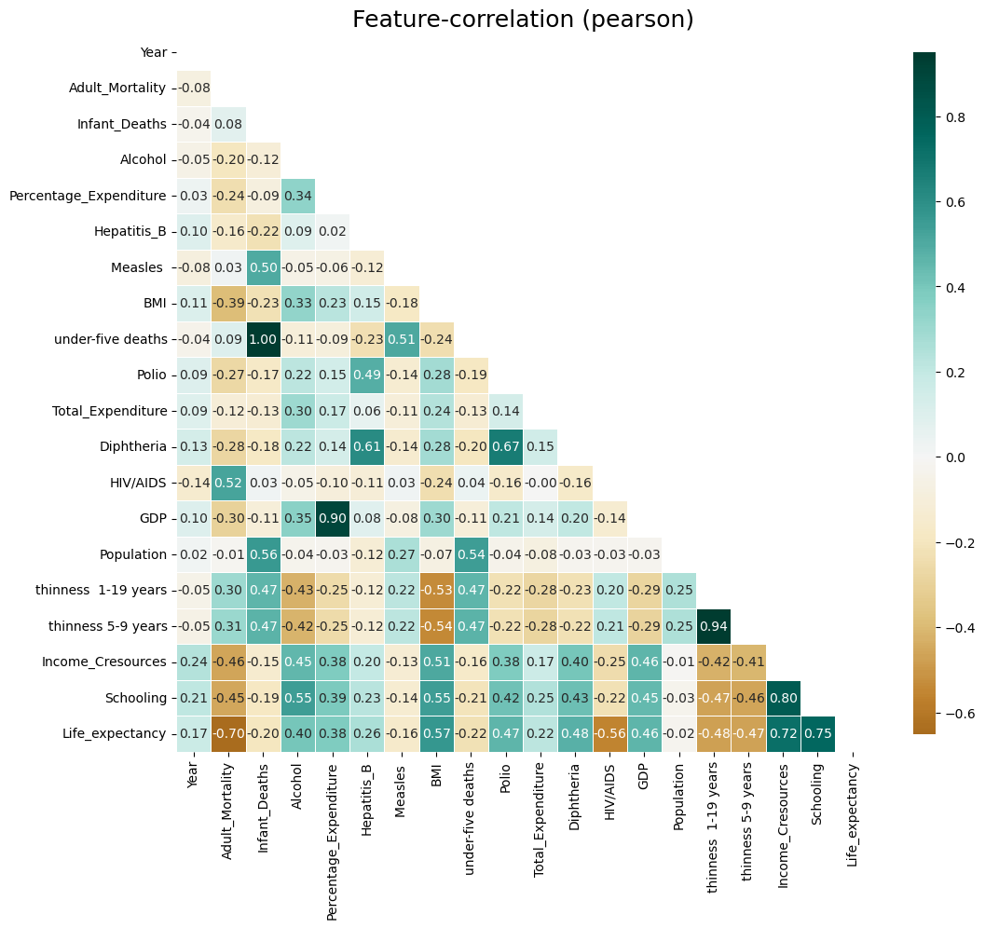
Correlation Table Before Dropping Null Values

Slide 9
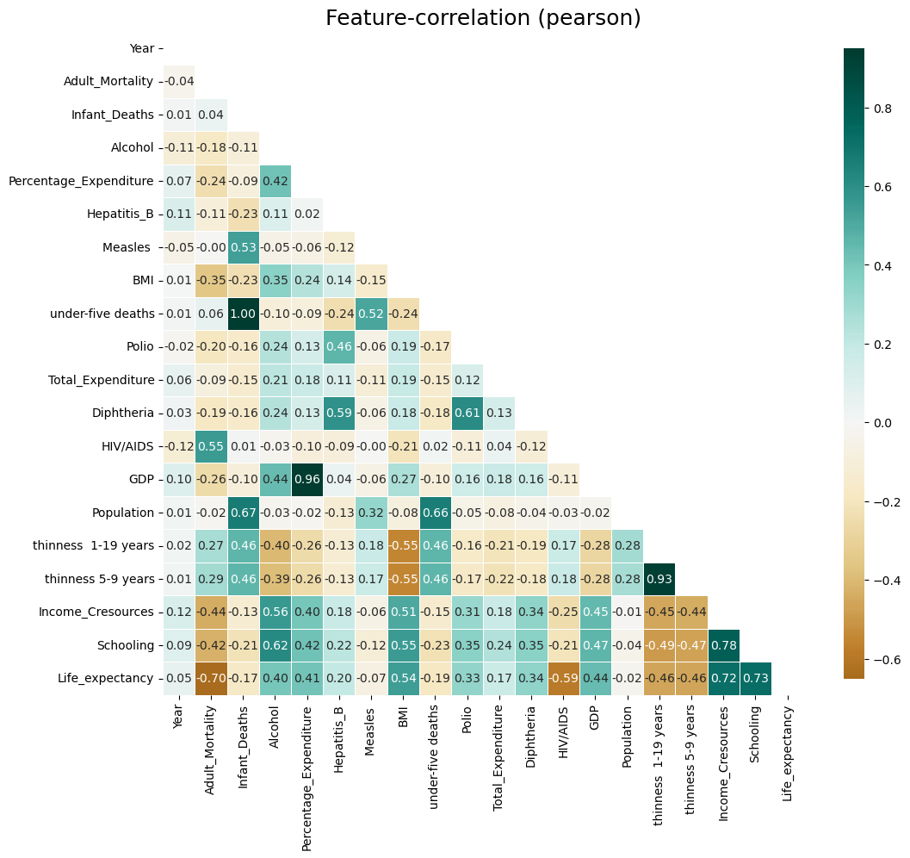
Correlation Table After Dropping Null Values

Slide 10
Observation 1:
1. Life Expectancy is found to be Positively Correlated with Following Feature Columns such as….
[a]. Schooling with 73%
[b]. Income Composition Resources with 72%
[c]. GDP with 44%
[d]. BMI with 54%
[e]. Percentage Expenditure and Alcohol with 40%
[f]. Immunization we consider i.e. Hepetitis_B, Polio and Diphtheria having Positive Correlation with Life Expectancy
2 . Life Expectancy is found to be Negatively Correlated with Following Feature Columns such as -
[a]. Adult Mortality with 70%
[b]. HIV/AIDS with 59%
[c]. Thiness 1-19 Years and Thiness 5-9 Years with with 46%

Slide 11
Observation 2:
[Q]. Should a country having a lower life expectancy value (<65) increase its healthcare expenditure in order to improve its average lifespan?
1. Developing Countries having Lower Life Expectancy i.e. Less than 65.
2. Income Composition Resources for such countries found to be very poor and also if we compare Total Expenditure for such countries are very less than Percentage Expenditure, Meaning Government has to focus more Expenditure in order to improve life expectancy.
3. BMI value is also found to be in Normal range i.e. Between 18.5 to 24.5.
4. Following are the Country Names Having Less Than 65 Years of Life Expectancy
'Afghanistan', 'Angola', 'Benin', 'Bhutan', 'Botswana’, 'Burkina Faso', 'Burundi', 'Cambodia', 'Cameroon’, 'Central African Republic', 'Chad', 'Comoros', 'Djibouti’, 'Equatorial Guinea', 'Eritrea', 'Ethiopia', 'Gabon', 'Ghana’, 'Guinea', 'Guinea-Bissau', 'Haiti', 'India', 'Iraq', 'Kazakhstan’, 'Kenya', 'Kiribati', 'Lesotho', 'Liberia', 'Madagascar’, 'Malawi’, 'Mali', 'Mauritania', 'Mongolia', 'Mozambique', 'Myanmar’, 'Namibia', 'Nepal', 'Niger', 'Nigeria', 'Pakistan’, 'Papua New Guinea', 'Russian Federation', 'Rwanda’, 'Sao Tome and Principe', 'Senegal', 'Sierra Leone', 'South Africa’, 'Swaziland', 'Tajikistan', 'Togo', 'Turkmenistan', 'Uganda’, 'Zambia', 'Zimbabwe'

Slide 12
Observation 3:
[Q]. How do Infant and Adult mortality rates affect life expectancy?
1. Infant and Adult Mortality Rate found to be very poor for Developing Countries as Compared with Developed Countries.
2. There are Plenty of reason for the same few reasons are listed below - High GDP, Lesser Total Expenditure, Comparatively Less immunization for Developing Countries
3. Interesting Fact is Alcohol Consumption found to be very high for Developing Countries
CORRELATION PLOT W.R.T LIFE EXPECTANCY

Slide 13
Observation 4:
[Q]. Does Life Expectancy has a positive or negative correlation with eating habits, lifestyle, exercise, smoking, drinking alcohol etc?
1. From Above Data, We Found that the Value of BMI is Good for Developed Countries in comparison with Developing Country.
2. As Already Mentioned, The Alcohol Consumption is very high for Developing Countries.
3. Life Expectancy is found to be Positively Correlated with Following Feature Columns such as -
[a]. Income Composition Resources with 72%
[b]. BMI with 54%
[c]. Percentage Expenditure and Alcohol with 40%

Slide 14
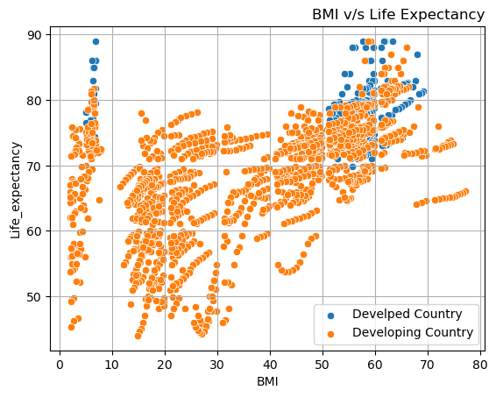
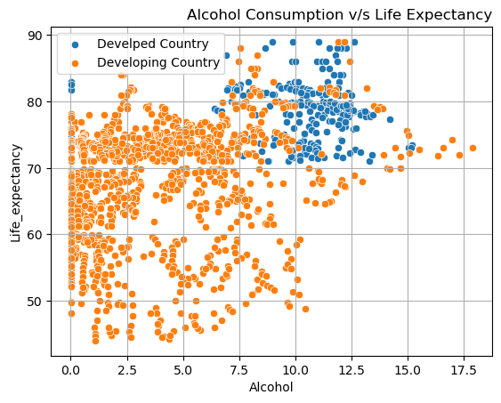

Slide 15
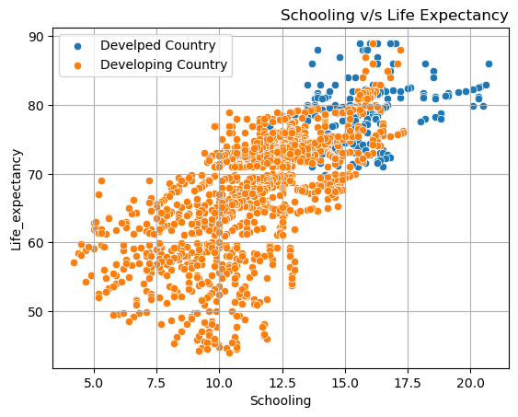
Observation 5:
[Q]. What is the impact of schooling on the lifespan of humans?
1. Schooling has positive correlation w.r.t Life Expectancy i.e. 73%
2. For Developed Countries - Schooling found to be very higher compared with Developing Countries.
3. Schooling also further related with Life style and Health Consciousness and Eating Habits. This might be the reason for higher life expectancy found for developed countries than developing countries

Slide 16
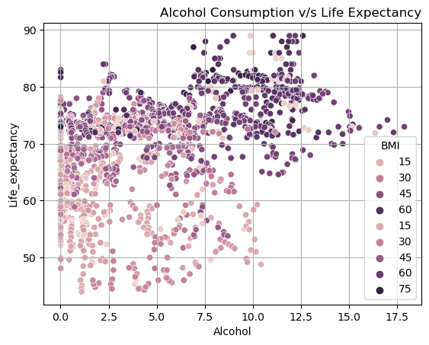
Observation 6:
[Q]. Does Life Expectancy have a positive or negative relationship with drinking alcohol?
Life Expectancy found to be Positively correlated with Alcohol i.e. 40%
Average Alcohol consumption rate is higher for Developed Countries
BMI Values also found to be very high for Developed Countries

Slide 17
Observation 7:
[Q]. Do densely populated countries tend to have lower life expectancy?
From Above Analysis, The Dense Populated Country have Average Life Expectancy of 65.42 Years.
1. Based on Above Observation we find, Average Life Expectancy for Dense Populated Country is 65 to 69 Years.
2. To understand the trend pattern, we have segregated dataset into %years of span length i.e. Year 2000,2005,2010,2015. Interesting Insight is highlighted through snippet codes.
3. In Year 2000 - Brazil is found to be Mostly Populated Country with Avg Life Expectancy of 75 Years.
-- In Year 2005 - India is found to be Mostly Populated Country with Avg Life Expectancy of 64.4 Years.
-- In Year 2010 - Indonesia is found to be Mostly Populated Country with Avg Life Expectancy of 68.1 Years.
-- In Year 2015 - Afghanistan is found to be Mostly Populated Country with Avg Life Expectancy of 65 Years.
4. All Dense Populated Countries are Developing Countries Only

Slide 18
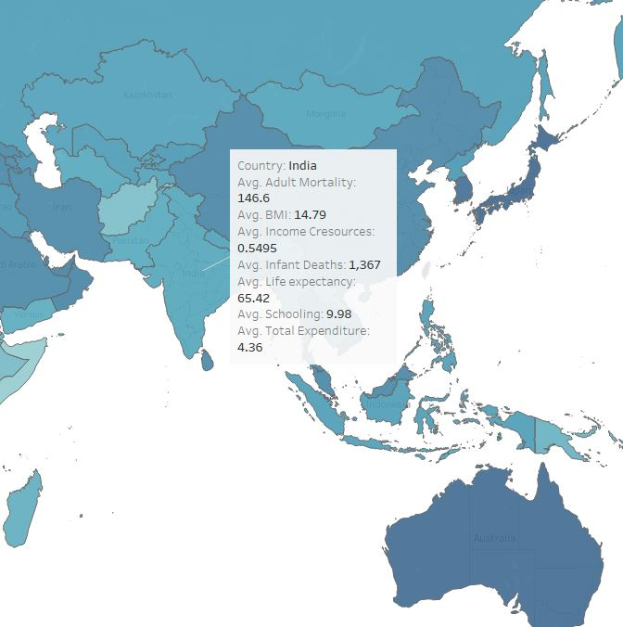
Densely populated country

Slide 19
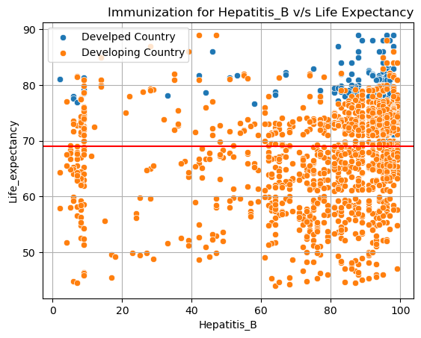
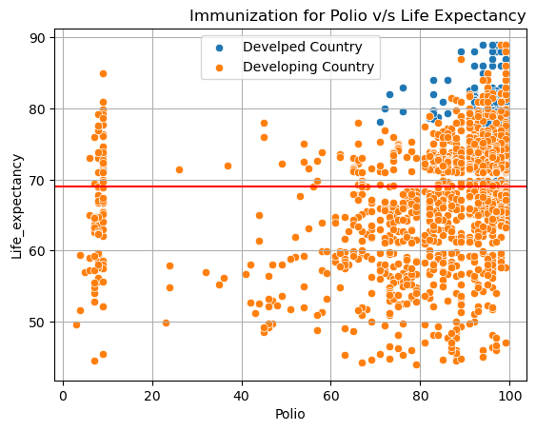
Observation 8:
[Q]. What is the impact of Immunization coverage on Life Expectancy?

Slide 20
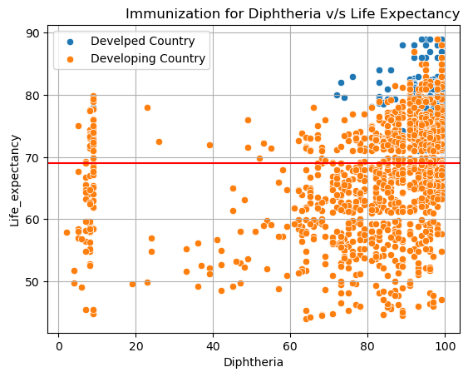
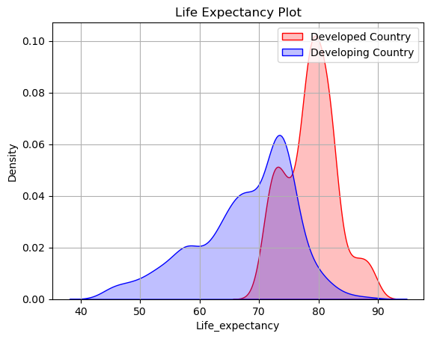
1. Higher the Immunization Higher will be the Life Expectancy.
2. From Above EDA, As Immunization Increases The Life Expectancy found to be increased more than Avg Life Expectancy Level i.e. More than 69 Years
3. Total Expenditure plays an vital role in order to predict Life Expectancy. Since From Above Graph we can observed that higher the government expenditure on health care more will be Life Expectancy Rate for Developed Countries

Slide 21
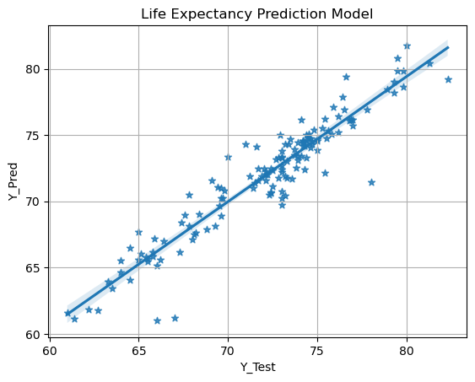
Optimized XGB Regressor got the following scores on the test set:
R-squared: 0.88977
MSE: 2.17933
RMSE: 1.4762
MAE: 1.02183

Slide 22
Our Optimized XGB Regressor got the following scores on the test set:
R-squared: 0.8897756796050695
MSE: 2.179334571879111
RMSE: 1.4762569464287412
MAE: 1.0218386278084828

Slide 23
Questions & answers

Slide 24
THANK YOU

