Slide 1
Module 02: Implement Azure Functions

Slide 2
Topics
Azure Functions overview
Developing Azure Functions
Implement Durable Functions

Slide 3
Lesson 01: Azure Functions overview

Slide 4
What can Azure Functions do?
Run code based on HTTP requests
Schedule code to run at predefined times
Process new and modified:
Azure Cosmos DB documents
Azure Storage blobs
Azure Queue storage messages
Respond to Azure Event Grid events by using subscriptions and filters
Respond to high volumes of Azure Event Hubs events
Respond to Azure Service Bus queue and topic messages
Notes:
Microsoft Azure Functions is a powerful solution for processing bulk data, integrating systems, working with the Internet of Things (IoT), and building simple APIs and microservices.
Azure includes a series of templates you can use for the key scenarios that are listed on this slide.

Slide 5
Azure Functions
Solution for running small pieces of code, or "functions," in the cloud:
Write only code that is relevant to business logic
Removes the necessity to write “plumbing” code to connect or host application components
Build on open-source WebJobs code
Supports a wide variety of programming languages, for instance:
C#
JAVA
PHP
PY
JS
Even supports scripting languages, such as:
PS
SH
Notes:
Azure Functions is a solution for easily running small pieces of code, or "functions," in the cloud. You can write just the code you need for the problem at hand, without worrying about a whole application or the infrastructure to run it. Functions can make development even more productive, and you can use your development language of choice, such as C#, F#, Node.js, Java, or PHP. Pay only for the time your code runs and trust Azure to scale as needed. Azure Functions lets you develop serverless applications on Microsoft Azure.
Functions is a great solution for processing data, integrating systems, working with the internet-of-things (IoT), and building simple APIs and microservices. Consider Functions for tasks such as image or order processing, file maintenance, or any tasks that you want to run on a schedule.

Slide 6







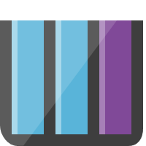




Function integrations
Notification Hubs
Event Grid
Event Hubs
Cosmos DB
Twilio
Azure
Functions
Storage
Service Bus
Queue
Blob
Table
Topics
Queues
Notes:
Azure Functions integrates with various Azure and third-party services. These services can trigger your function and start execution, or they can serve as input and output for your code.
The following service integrations are supported by Azure Functions:
Azure Cosmos DB
Azure Event Hubs
Azure Event Grid
Azure Notification Hubs
Azure Service Bus (queues and topics)
Azure Storage (blob, queues, and tables)
On-premises (using Service Bus)
Twilio (SMS messages)

Slide 7
Azure Function (Java program – Function.java)
public class Function {
public String echo(
@HttpTrigger(
name = "request",
methods = {"post"},
authLevel = AuthorizationLevel.ANONYMOUS
)
String request, ExecutionContext context) {
return String.format(request);
}
}
Notes:
This sample Java function provides echo functionality by taking in the body of a HTTP POST request as a string and returning that same body as a response.

Slide 8
Azure Function (Python script – __init__.py)
import logging
import azure.functions as func
def main(myblob: func.InputStream):
logging.info(f"Python blob trigger function processed\n"
f"Name: {myblob.name}\n"
f"Blob Size: {myblob.length} bytes")
Notes:
This sample Python function is triggered by the creation of a new Azure Storage blob. When triggered, it logs information about the blob.

Slide 9
Scale and hosting
You can choose between three types of plans:
Consumption:
Instances are dynamically instanced and you are charged based on compute time
Premium
Instances of the Azure Functions host are added and removed based on the number of incoming events just like the Consumption plan, but provides additional features like: VNet connectivity; unlimited execution duration; and more predictable pricing
App Service plan:
Traditional App Services model used with Web Apps, API Apps, and Mobile Apps
The type of plan controls:
How host instances are scaled out
The resources that are available to each host
Notes:
Azure Functions runs in two different modes: Consumption plan and Azure App Service plan. The Consumption plan automatically allocates compute power when your code is running. Your app is scaled out when needed to handle load, and scaled down when code is not running. You don't have to pay for idle VMs or reserve capacity in advance.
In either plan, an instance of the Azure Functions host executes the functions.
Consumption Plan
When you're using a Consumption plan, instances of the Azure Functions host are dynamically added and removed based on the number of incoming events. This serverless plan scales automatically, and you're charged for compute resources only when your functions are running. On a Consumption plan, a function execution times out after a configurable period of time.
Premium Plan
Premium plan supports the following features:
Perpetually warm instances to avoid any cold start
VNet connectivity
Unlimited execution duration
Premium instance sizes (one core, two core, and four core instances)
More predictable pricing
High-density app allocation for plans with multiple function apps
App Service Plan
In the dedicated App Service plan, your function apps run on dedicated VMs on Basic, Standard, Premium, and Isolated SKUs, which is the same as other App Service apps. Dedicated VMs are allocated to your function app, which means that the functions host can be always running. App Service plans support Linux.

Slide 10


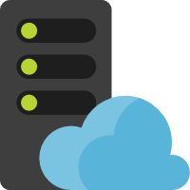
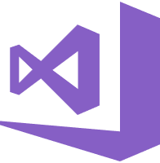

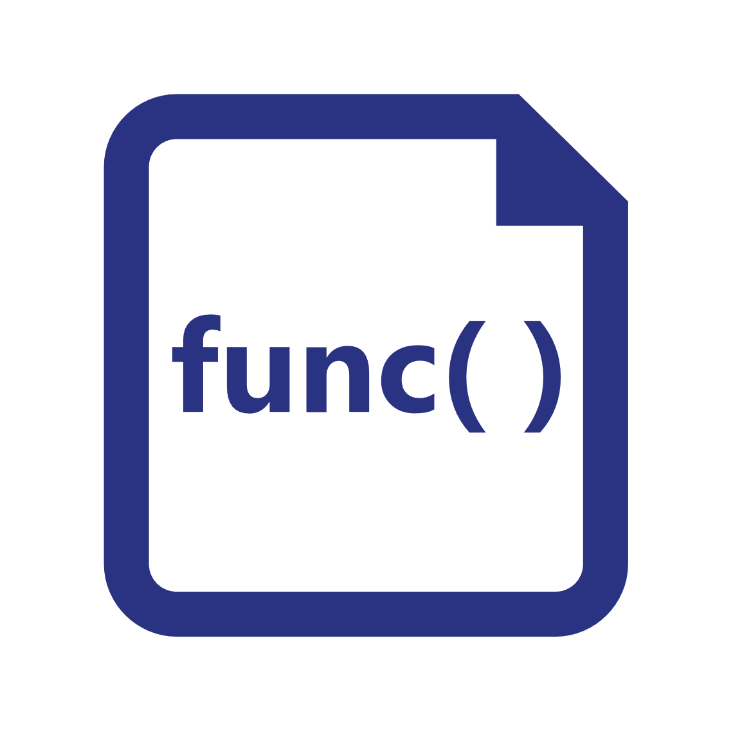



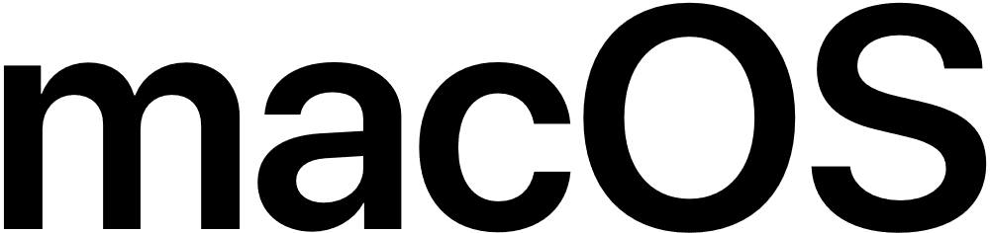
Azure Functions hosting
https://github.com/azure/azure-functions-host (+other repos)
Azure Functions host runtime
Azure Functions Core Tools
Azure Functions base Docker image
Azure Functions .NET Docker image
Azure Functions Node Docker image
●●●
Development
Hosting
Local dev machine
Azure Functions service
Azure Functions service
Azure Functions service
Core Tools + favorite editor
Consumption plan
App Service plan
Premium plan
Platform
+
●●●
Code or container
Code
Code or container
Code or container
App delivery
Windows, macOS, or Linux
Windows or Linux
Windows or Linux
Windows or Linux
OS
Notes:
Azure Functions are designed to be portable and to be hosted in a variety of places, including:
Azure Functions service by using Resource consumption, Premium, or App Service Plans
Internet of Things (IoT) devices
Only Linux containers are supported as of now

Slide 11




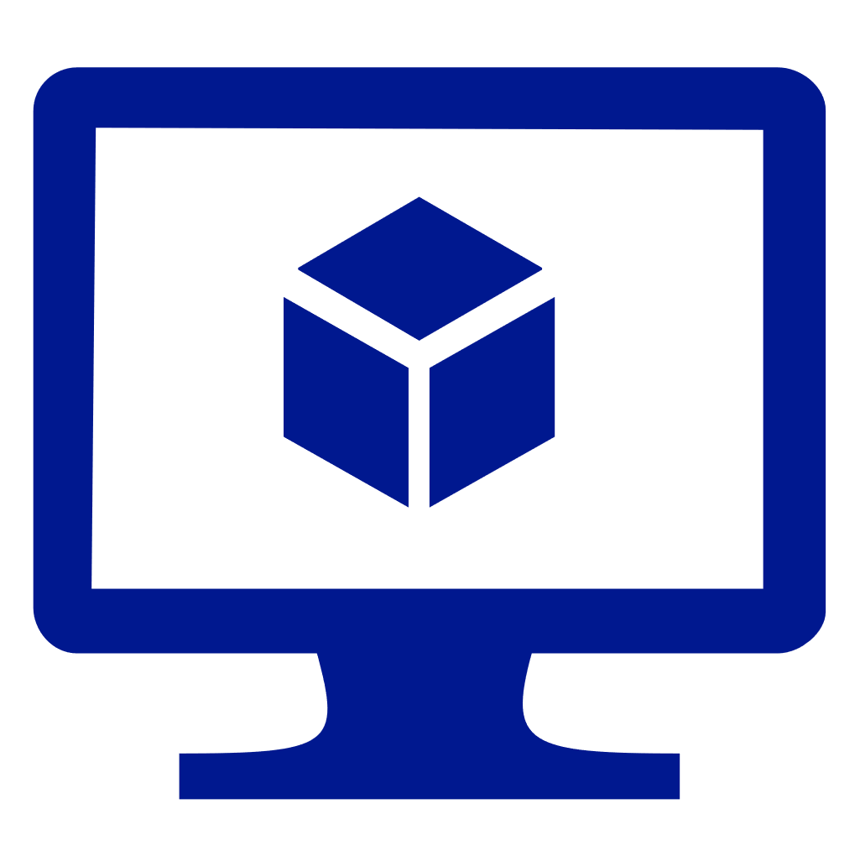

Azure Functions hosting (continued)
https://github.com/azure/azure-functions-host (+other repos)
Azure Functions host runtime
Azure Functions Core Tools
Azure Functions base Docker image
Azure Functions .NET Docker image
Azure Functions Node Docker image
●●●
Hosting
IoT devices
Additional Azure hosts
Non-Azure hosts
On-premises
Azure IoT Edge
AKS, Service Fabric Mesh, …
K8s, raw VMs, & more
App Service on
Azure Stack Hub
●●●
●●●
Platform
Container
Container
Container
Code
App delivery
Linux
Linux
Linux
Windows
OS
Notes:
Azure Functions are designed to be portable and to hosted in a variety of places, including:
Azure services that support containerization (Azure Kubernetes Service, Service Fabric, and Azure Container Instances)
Non-Azure container hosts (Kubernetes, Virtual Machines, other cloud providers)
On-premises by using App Service on Azure Stack

Slide 12


Triggers
Execution
Service
Function
Notes:
A trigger defines how a function is invoked. A function must have exactly one trigger. Triggers have associated data, which is usually the payload that triggers the function.

Slide 13
Trigger types
Triggers based on Azure services:
Cosmos DB
Blob and queues
Service Bus
Event Hub
Triggers based on common scenarios:
HTTP request
Scheduled timer
Triggers based on third-party services:
GitHub
And more…
Notes:
There are many types of triggers for Azure services including:
HTTPTrigger - Trigger the execution of your code by using an HTTP request.
TimerTrigger - Execute cleanup or other batch tasks on a predefined schedule.
GitHub webhook - Respond to events that occur in your GitHub repositories. Generic webhook - process webhook HTTP requests from any service that supports webhooks.
CosmosDBTrigger - Process Azure Cosmos DB documents when they are added or updated in collections in a NoSQL database.
BlobTrigger - Process Azure Storage blobs when they are added to containers. You might use this function for image resizing.
QueueTrigger - Respond to messages as they arrive in an Azure Storage queue.
EventHubTrigger - Respond to events delivered to an Azure Event Hub. Particularly useful in application instrumentation, user experience, or workflow processing, and Internet of Things (IoT) scenarios.
ServiceBusQueueTrigger - Connect your code to other Azure services or on-premises services by listening to message queues.
ServiceBusTopicTrigger - Connect your code to other Azure services or on-premises services by subscribing to topics.

Slide 14

Input and Output Bindings
Service
Input bindings
Output bindings
Output bindings
Trigger
Function
Input bindings
Service
Service
Notes:
Input and output bindings provide a declarative way to connect to data from within your code. Bindings are optional and an Azure Function can have multiple input and output bindings.

Slide 15
Bindings
Declarative way to connect to data from your code:
Connect to services without writing plumbing code
Service credentials are not stored in code
Bindings are optional
Function can have multiple input and output bindings
Output bindings can send data to Azure services such as:
Storage
Azure Cosmos DB
Service Bus
Notes:
Triggers and bindings let you avoid hard-coding the details of the services that you're working with. Your function receives data (for example, the content of a queue message) in function parameters. You send data (for example, to create a queue message) by using the return value of the function. In C# and C# script, alternative ways to send data are out parameters and collector objects.

Slide 16



Trigger and Bindings example
L
Blobs
Azure Storage
Schedule trigger
Logs
Query docs
Function
P
Cosmos DB input binding
Event Hubs
Notes:
In this example, the Function is triggered by a recurring schedule (nightly) and queries Azure Cosmos DB for a set of documents. The function then processes the documents, outputs blobs to Azure Storage, and outputs logs to Event Hubs.

Slide 17


Integrating with Azure Virtual Network
Requires the Premium plan
Secures the inbound HTTP access to your app to one subnet in a Virtual Network
Allows secure outbound calls to resources in a Virtual Network
Internet
HTTP front-ends
Virtual Network
Functions runtime
Notes:
Under the Premium plan, Azure Functions has the same hosting capabilities as the Web Apps in Azure App Service. This means that Azure Functions also has the Virtual Network Integration feature.
When Virtual Network Integration is used with an Azure Virtual Network in the same region as your app, it requires you to use a delegated subnet with at least 32 addresses in it. You won’t be able to use the subnet for anything else. Outbound calls from your app will be made from the addresses in the delegated subnet. When you use this version of Virtual Network Integration, the calls are made from addresses in your Virtual Network.

Slide 18


Azure Virtual Network integration example
Premium App Service plan
Virtual Network Integration
Virtual Network
Internet
Virtual Machines
Function
Notes:
Using addresses in your VNET enables your app to:
Make calls to service-endpoint secured services.
Access resources across Azure ExpressRoute connections.
Access resources in the Virtual Network that you are connected to.
Access resources across peered connections, including ExpressRoute connections.

Slide 19
Best practices
Avoid long-running functions:
Functions that run for a long time can time out
Use queues for cross-function communication:
If you require direct communication, consider Durable Functions or Azure Logic Apps
Write stateless functions:
Functions should be stateless and idempotent
State data should be associated with your input and output payloads
Code defensively:
Assume that your function might need to continue from a previous fail point
Notes:
Avoid long running functions
Large, long-running functions can cause unexpected time-out issues. A function can become large due to many Node.js dependencies. Importing dependencies can also cause increased load times that result in unexpected time-outs. Dependencies are loaded both explicitly and implicitly. A single module loaded by your code may load its own additional modules.
Cross function communication
Durable Functions and Azure Logic Apps are built to manage state transitions and communication between multiple functions. If you are not using Durable Functions or Logic Apps to integrate with multiple functions, it is generally a best practice to use storage queues for cross function communication. The main reason is storage queues are less costly and much easier to provision.
Write functions to be stateless
Functions should be stateless and idempotent if possible. Associate any required state information with your data. For example, an order being processed would likely have an associated state member. A function could process an order based on that state while the function itself remains stateless.
Write defensive functions
Assume that your function could encounter an exception at any time. Design your functions with the ability to continue from a previous fail point during the next execution.

Slide 20
Lesson 02: Developing Azure Functions

Slide 21
Azure Functions in Visual Studio Code
Use the Azure Functions extension for Visual Studio Code to:
Build and run functions locally
Publish functions to Azure
Build C# pre-compiled class libraries
Build C# scripts by adjusting the extension settings
Use the many built-in features and extensions for Visual Studio Code to make development easier
Notes:
You can use the Azure Functions extension for Microsoft Visual Studio Code to locally develop functions and deploy them to Azure.
Using the Azure Functions extension, you can:
Edit, build, and run functions on your local development computer.
Publish your Azure Functions project directly to Azure.
Write your functions in various languages while utilizing the benefits of Visual Studio Code.

Slide 22
Azure Functions in Visual Studio
Visual Studio project type:
Develop, test, and deploy C# functions to Azure
Requires an Azure development workload installation
Use WebJobs attributes to configure functions in C#
Precompile C# functions:
Better cold-start performance
Notes:
Azure Functions is a built-in project type for Visual Studio that lets you develop, test, and deploy C# functions to Azure.
Using the Azure Functions project type enables you to:
Edit, build, and run functions on your local development computer.
Publish your Azure Functions project directly to Azure.
Use WebJobs attributes to declare function bindings directly in the C# code instead of maintaining a separate function.json for binding definitions.
Develop and deploy precompiled C# functions. Precompiled functions provide a better cold-start performance than C# script-based functions.
Code your functions in C# while retaining all the benefits of Visual Studio development.

Slide 23
Demonstration: Creating an HTTP trigger function by using the Azure portal

Slide 24
Function code
using System;
using Microsoft.Azure.WebJobs;
using Microsoft.Azure.WebJobs.Host;
namespace FunctionApp1
{
public static class Function1
{
[FunctionName("QueueTriggerCSharp")]
public static void Run([QueueTrigger("myqueue-items", Connection = "QueueStorage")]string myQueueItem, TraceWriter log)
{
log.Info($"C# Queue trigger function processed: {myQueueItem}");
}
}
}
Notes:
The C# class represents a basic Queue storage triggered function.
A binding-specific attribute is applied to each binding parameter supplied to the entry point method. The attribute takes the binding information as parameters. In the previous example, the first parameter has a QueueTrigger attribute applied, indicating queue triggered function. The queue name and connection string setting name are passed as parameters to the QueueTrigger attribute.

Slide 25
Binding configuration
Name of input parameter
{
"bindings": [
{
"name": "order",
"type": "queueTrigger",
"direction": "in",
"queueName": "myqueue-items",
"connection": "MY_STORAGE_ACCT_APP_SETTING"
},
{
"name": "$return",
"type": "table",
"direction": "out",
"tableName": "outTable",
"connection": "MY_TABLE_STORAGE_ACCT_APP_SETTING"
}
]
}
Notes:
Suppose you want to write a new row to Azure Table storage whenever a new message appears in Azure Queue storage. You can implement this scenario by using an Azure Queue storage trigger and an Azure Table storage output binding.
The first element in the bindings array is the Queue storage trigger. The type and direction properties identify the trigger. The name property identifies the function parameter that receives the queue message content. The name of the queue to monitor is in queueName, and the connection string is in the app setting identified by connection.
The second element in the bindings array is the Azure Table Storage output binding. The type and direction properties identify the binding. The name property specifies how the function provides the new table row, in this case by using the function return value. The name of the table is in tableName, and the connection string is in the app setting identified by connection.
Note: The value of connection is the name of an app setting that contains the connection string, not the connection string itself. Bindings use connection strings stored in app settings to enforce the best practice, which is that function.json does not contain service secrets.

Slide 26
Binding-based code
#r "Newtonsoft.Json"
using Microsoft.Extensions.Logging;
using Newtonsoft.Json.Linq;
public static Person Run(JObject order, ILogger log)
{
return new Person() {
PartitionKey = "Orders",
RowKey = Guid.NewGuid().ToString(),
Name = order["Name"].ToString(),
MobileNumber = order["MobileNumber"].ToString()
};
}
Name of input parameter
Notes:
Here is C# script code that works with this trigger and binding. Notice that the name of the parameter that provides the queue message content is order. This name is required because the name property value in function.json is order.
The method takes an incoming queue message that is a JSON object, adds fields, and then writes to Table storage. The method's return value creates a new row in Table Storage.

Slide 27
Function folder structure
FunctionApp
host.json
FirstFunction
SecondFunction
SharedCode
function.json
run.csx
function.json
run.csx
bin
Notes:
The code for all the functions in a specific function app is located in a root project folder that contains a host configuration file and one or more subfolders.
Each subfolder contains the code for a separate function.
In version 2.x and newer of the Functions runtime, all functions in the function app must share the same language stack.

Slide 28
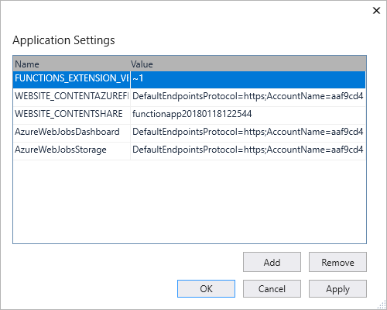
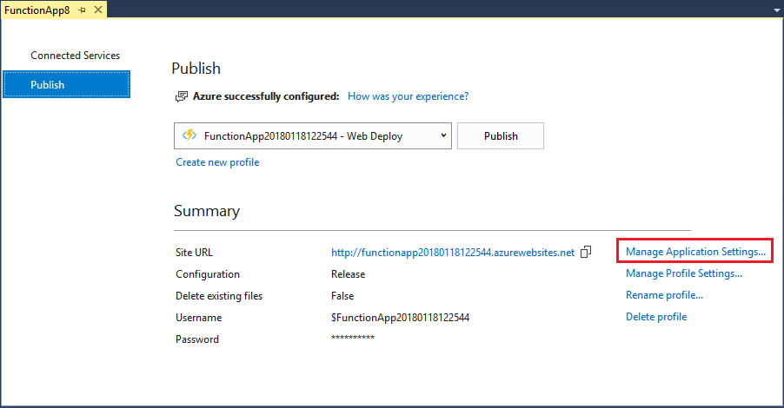
Function App settings
Notes:
Any settings that you added in the local.settings.json must be also added to the Function app in Azure. These settings are not uploaded automatically when you publish the project.
The easiest way to upload the required settings to your function app in Azure is to use the Manage Application Settings link that is displayed after you successfully publish your project.
You can also manage application settings in one of these other ways:
By using the Azure portal.
By using the --publish-local-settings publish option in the Azure Functions Core Tools.
By using the Azure CLI.

Slide 29
Lesson 03: Implement Durable Functions

Slide 30
Durable Functions
Write stateful functions in a stateless environment
Manages state, checkpoints, and restarts
Defines an Orchestrator function
Workflows are defined in code
Calls other functions synchronously or asynchronously
Checkpoint progress whenever function awaits
Notes:
Durable Functions is an extension of Azure Functions and Azure WebJobs that lets you write stateful functions in a serverless environment. The extension manages state, checkpoints, and restarts for you.
The extension lets you define stateful workflows in a new type of function called an Orchestrator function. Here are some of the advantages of Orchestrator functions:
They define workflows in code. No JSON schemas or designers are needed.
They can call other functions synchronously and asynchronously. Output from called functions can be saved to local variables.
They automatically checkpoint their progress whenever the function awaits. Local state is never lost if the process recycles or the virtual machine (VM) reboots.
Note: Durable Functions is an advanced extension for Azure Functions that is not appropriate for all applications. The rest of this section assumes that you have a strong familiarity with Azure Functions concepts and the challenges involved in serverless application development.
The primary use case for Durable Functions is simplifying complex, stateful coordination problems in serverless applications.

Slide 31
Durable Functions types
Orchestrator
Defines function workflows
Stateful
Activity
Stateless
Entity
Stateful
Client
Stateless
The functions and tasks being orchestrated
Reads and updates small pieces of state
Sends messages to trigger Orchestrator and Entity functions
State is checkpointed and maintained in Azure Storage
Notes:
There are currently four durable function types in Azure Functions: activity, orchestrator, entity, and client.
Orchestrator
Defines function workflows using procedural code
Can call other durable functions synchronously and asynchronously. Output from called functions can be reliably saved to local variables
Execution progress is automatically checkpointed when the function "awaits" or "yields"
The total lifespan of an orchestration instance can be seconds, days, months, or never-ending
Activity
Activity functions are the functions and tasks that are orchestrated in the process
Example: You might create an orchestrator function to process an order. The tasks involve checking the inventory, charging the customer, and creating a shipment. Each task would be a separate activity function.
Can be executed serially, in parallel, or some combination of both
Entity
Entity functions are functions with a special trigger type, entity trigger
Can be invoked from client functions or from orchestrator functions
Manages state explicitly
Client
Sends the messages to the task hub used to trigger orchestration and entity trigger bindings
What makes a function a client function is its use of the durable client output binding
The following sections describe some typical application patterns that can benefit from Durable Functions.

Slide 32

Durable Function scenario - Chaining
Function chaining refers executing a sequence of functions in a particular order. Often, the output of one function needs to be applied to the input of another function.
F1
F2
F3
F4
Notes:
Function chaining refers to the pattern of executing a sequence of functions in a particular order. Often, the output of one function needs to be applied to the input of another function.

Slide 33
Durable Function scenario - Chaining code
[FunctionName("Chaining")]
public static async Task<object> Run(
[OrchestrationTrigger] IDurableOrchestrationContext context)
{
try
{
var x = await context.CallActivityAsync<object>("F1", null);
var y = await context.CallActivityAsync<object>("F2", x);
var z = await context.CallActivityAsync<object>("F3", y);
return await context.CallActivityAsync<object>("F4", z);
}
catch (Exception)
{
// Error handling or compensation goes here.
}
}
Notes:
The values "F1", "F2", "F3", and "F4" are the names of other functions in the function app. Control flow is implemented by using normal imperative coding constructs. That is, code executes top down and can involve existing language control flow semantics, like conditionals and loops. Error handling logic can be included in try/catch/finally blocks.
The ctx parameter (DurableOrchestrationContext) provides methods for invoking other functions by name, passing parameters, and returning function output. Each time the code calls await, the Durable Functions framework checkpoints the progress of the current function instance. If the process or VM recycles midway through the execution, the function instance resumes from the previous await call. We will cover more on this restart behavior later.

Slide 34
Durable Function scenario - Fan-out/fan-in
Fan-out/fan-in refers to the pattern of executing multiple functions in parallel, and then waiting for all to finish
F1
F3
F2
Notes:
Fan-out/fan-in refers to the pattern of executing multiple functions in parallel, and then waiting for all to finish. Often, some aggregation work is done on results returned from the functions.
With normal functions, fanning out can be done by having the function send multiple messages to a queue. However, fanning back in is much more challenging. You'd have to write code to track when the queue-triggered functions end and store function outputs. The Durable Functions extension handles this pattern with relatively simple code.

Slide 35
Durable Function scenario - Fan-out/fan-in code
[FunctionName("FanOutFanIn")]
public static async Task Run([OrchestrationTrigger] IDurableOrchestrationContext context)
{
var parallelTasks = new List<Task<int>>();
// Get a list of N work items to process in parallel.
object[] workBatch = await context.CallActivityAsync<object[]>("F1", null);
for (int i = 0; i < workBatch.Length; i++)
{
Task<int> task = context.CallActivityAsync<int>("F2", workBatch[i]);
parallelTasks.Add(task);
}
await Task.WhenAll(parallelTasks);
// Aggregate all N outputs and send the result to F3.
int sum = parallelTasks.Sum(t => t.Result);
await context.CallActivityAsync("F3", sum);
}
Notes:
The fan-out work is distributed to multiple instances of function F2, and the work is tracked by using a dynamic list of tasks. The .NET Task.WhenAll API is called to wait for all the called functions to finish. Then the F2 function outputs are aggregated from the dynamic task list and passed on to the F3 function.
The automatic checkpointing that happens at the await call on Task.WhenAll ensures that any crash or reboot midway through does not require a restart of any already completed tasks.

Slide 36
Durable Function scenario - Async HTTP APIs
Durable Functions provides built-in APIs that simplify the code that you write for interacting with long-running function executions
Start
DoWork
GetStatus
Notes:
The third pattern is all about the problem of coordinating the state of long-running operations with external clients. A common way to implement this pattern is by having the long-running action triggered by an HTTP call, and then redirecting the client to a status endpoint that they can poll to learn when the operation completes.
Durable Functions provides built-in APIs that simplify the code you write for interacting with long-running function executions. After an instance is started, the extension exposes webhook HTTP APIs that query the Orchestrator function status. The following example shows the REST commands to start an Orchestrator and to query its status. For clarity, some details are omitted from the example.

Slide 37
Durable Function scenario - Async HTTP APIs response
> curl -X POST https://myfunc.azurewebsites.net/orchestrators/DoWork -H "Content-Length: 0" -i
HTTP/1.1 202 Accepted Content-Type: application/json
{ "id":"b79baf67f717453ca9e86c5da21e03ec", ... }
> curl https://myfunc.azurewebsites.net/admin/extensions/DurableTaskExtension/b79baf67f717453ca9e86c5da21e03ec -i
HTTP/1.1 202 Accepted Content-Type: application/json
{ "runtimeStatus":"Running", "lastUpdatedTime":"2017-03-16T21:20:47Z", ... }
> curl https://myfunc.azurewebsites.net/admin/extensions/DurableTaskExtension/b79baf67f717453ca9e86c5da21e03ec -i
HTTP/1.1 200 OK Content-Length: 175 Content-Type: application/json
{ "runtimeStatus":"Completed", "lastUpdatedTime":"2017-03-16T21:20:57Z", ... }
Notes:
Because the state is managed by the Durable Functions runtime, you don't have to implement your own status-tracking mechanism.

Slide 38
Durable Function scenario - Async HTTP APIs code
// HTTP-triggered function to start a new orchestrator function instance.
[FunctionName("HttpStart")]
public static async Task<HttpResponseMessage> Run(
[HttpTrigger(AuthorizationLevel.Function, methods: "post", Route = "orchestrators/{functionName}")] HttpRequestMessage req,
[DurableClient] IDurableClient starter,
string functionName,
ILogger log)
{
// Function input comes from the request content.
object eventData = await req.Content.ReadAsAsync<object>();
string instanceId = await starter.StartNewAsync(functionName, eventData);
log.LogInformation($"Started orchestration with ID = '{instanceId}'.");
return starter.CreateCheckStatusResponse(req, instanceId);
}
Notes:
Even though the Durable Functions extension has built-in webhooks for managing long-running orchestrations, you can implement this pattern yourself by using your own function triggers (such as HTTP, queue, or Event Hub) and the orchestrationClient binding. For example, you could use a queue message to trigger termination. Or you could use an HTTP trigger protected by an Azure Active Directory authentication policy instead of the built-in webhooks that use a generated key for authentication.
The DurableOrchestrationClient starter parameter is a value from the orchestrationClient output binding, which is part of the Durable Functions extension. It provides methods for starting, sending events to, terminating, and querying for new or existing Orchestrator function instances. In the previous example, an HTTP triggered-function takes in a functionName value from the incoming URL and passes that value to StartNewAsync. This binding API then returns a response that contains a Location header and additional information about the instance that can later be used to look up the status of the started instance or terminate it.

Slide 39
Durable Function scenario - Monitoring
The monitor pattern refers to a flexible recurring process in a workflow—for example, polling until certain conditions are met
Notes:
The monitor pattern refers to a flexible recurring process in a workflow—for example, polling until certain conditions are met. A regular timer-trigger can address a simple scenario, such as a periodic cleanup job, but its interval is static and managing instance lifetimes becomes complex. Durable Functions enables flexible recurrence intervals, task lifetime management, and the ability to create multiple monitor processes from a single orchestration.
An example would be reversing the earlier async HTTP API scenario. Instead of exposing an endpoint for an external client to monitor a long-running operation, the long-running monitor consumes an external endpoint, waiting for some state change.
Using Durable Functions, multiple monitors that observe arbitrary endpoints can be created in a few lines of code. The monitors can end execution when some condition is met, or be terminated by the DurableOrchestrationClient, and their wait interval can be changed based on some condition (that is, exponential backoff). The code on the next slide implements a basic monitor.

Slide 40
Durable Function scenario - Monitoring code
[FunctionName("MonitorJobStatus")]
public static async Task Run([OrchestrationTrigger] IDurableOrchestrationContext context)
{
int jobId = context.GetInput<int>(); int pollingInterval = GetPollingInterval();
DateTime expiryTime = GetExpiryTime();
while (context.CurrentUtcDateTime < expiryTime)
{
var jobStatus = await context.CallActivityAsync<string>("GetJobStatus", jobId);
if (jobStatus == "Completed")
// Perform an action when a condition is met.
{ await context.CallActivityAsync("SendAlert", machineId); break; }
// Orchestration sleeps until this time.
var nextCheck = context.CurrentUtcDateTime.AddSeconds(pollingInterval);
await context.CreateTimer(nextCheck, CancellationToken.None);
}
// Perform more work here, or let the orchestration end.
}
Notes:
When a request is received, a new orchestration instance is created for that job ID. The instance polls a status until a condition is met and the loop is exited. A durable timer controls the polling interval. Then, more work can be performed, or the orchestration can end.
When nextCheck exceeds expiryTime, the monitor ends.

Slide 41



Durable Function scenario - Human interaction
Many processes involve human interaction. Automated processes must allow for human low availability, and they often do so by using time-outs and compensation logic.
ProcessApproval
RequestApproval
Escalate
Notes:
Many processes involve some kind of human interaction. The tricky thing about involving humans in an automated process is that people are not always as highly available and responsive as cloud services. Automated processes must allow for this, and they often do so by using timeouts and compensation logic.
One example of a business process that involves human interaction is an approval process. For example, approval from a manager might be required for an expense report that exceeds a certain amount. If the manager does not approve within 72 hours (maybe the manager went on vacation), an escalation process starts to get the approval from someone else (perhaps the manager's manager).
This pattern can be implemented by using an Orchestrator function. The Orchestrator would use a durable timer to request approval and escalate in case of timeout. It would wait for an external event, which would be the notification generated by some human interaction.

Slide 42
Durable Function scenario - Human interaction code
[FunctionName("ApprovalWorkflow")]
public static async Task Run([OrchestrationTrigger] IDurableOrchestrationContext context)
{
await context.CallActivityAsync("RequestApproval", null);
using (var timeoutCts = new CancellationTokenSource())
{
DateTime dueTime = context.CurrentUtcDateTime.AddHours(72);
Task durableTimeout = context.CreateTimer(dueTime, timeoutCts.Token);
Task<bool> approvalEvent = context.WaitForExternalEvent<bool>("ApprovalEvent");
if (approvalEvent == await Task.WhenAny(approvalEvent, durableTimeout))
{
timeoutCts.Cancel();
await context.CallActivityAsync("ProcessApproval", approvalEvent.Result);
} else
{ await context.CallActivityAsync("Escalate", null); }
}
}
Notes:
The durable timer is created by calling ctx.CreateTimer. The notification is received by ctx.WaitForExternalEvent. And Task.WhenAny is called to decide whether to escalate (timeout happens first) or process approval (approval is received before time-out).

Slide 43
Durable Function scenario - Human interaction code (continued)
[FunctionName("RaiseEventToOrchestration")]
public static async Task Run(
[HttpTrigger] string instanceId,
[DurableClient] IDurableOrchestrationClient client)
{
bool isApproved = true;
await client.RaiseEventAsync(instanceId, "ApprovalEvent", isApproved);
}
Notes:
An external client can deliver the event notification to a waiting Orchestrator function by using either the built-in HTTP APIs or by using DurableOrchestrationClient.RaiseEventAsync API from another function.

Slide 44

Lab: Implementing task processing logic by using Azure Functions
Notes:
This lab is scheduled to take 45 minutes.

Slide 45

Lab sign-in information
Duration
Lab 02: Implementing task processing logic by using Azure Functions
http://aka.ms/az204labs
AZ204-SEA-DEV
Username: Admin
Password: Pa55w.rd
Notes:
Students will also have access to the following scenario description in their lab guide:
Your company has built a desktop software tool that parses a local JavaScript Object Notation (JSON) file for its configuration settings.
During its latest meeting, your team decided to reduce the number of files that are distributed with your application by serving your default configuration settings from a URL instead of from a local file.
As the new developer on the team, you've been tasked with evaluating Microsoft Azure Functions as a solution to this problem.

