Slide 1
Module 05: Implement IaaS solutions

Slide 2
Topics
Provisioning VMs in Azure
Create and deploy Azure Resource Manager templates
Create container images for solutions
Publish a container image to Azure Container Registry
Create and run container images in Azure Container Instances

Slide 3
Lesson 01: Provisioning VMs in Azure

Slide 4

Azure virtual machine creation checklist
Before you create a VM, you should consider the following:
Checklist
Network configuration
VM name
Location
Size
Pricing model
Storage
Operating system
Notes:
Provisioning virtual machines (VMs) to Microsoft Azure requires planning. The items listed above only provides a subset of the things one should consider before creating a VM.

Slide 5
Naming a VM
The VM name is used as the computer name, which is configured as part of the operating system
Rules:
Up to 15 characters for a Windows VM
Up to 64 characters for a Linux VM
Notes:
This name also defines a manageable Azure resource, and it's not trivial to change later. That means that you should choose names that are meaningful and consistent, so that you can easily identify what the VM does.

Slide 6
Naming a VM (continued)
Current best practices for VM name choices:
Element | Example | Notes
Environment | dev, prod, QA | Identifies the environment for the resource
Location | uw (US West), ue (US East) | Identifies the region into which the resource is deployed
Instance | 01, 02 | For resources that have more than one named instance (such as web servers)
Product or Service | service | Identifies the product, application, or service that the resource supports
Role | sql, web, messaging | Identifies the role of the associated resource
Notes:
This table offers a set of best practices you can use when naming a VM.
For example, devusc-webvm01 might represent the first development web server hosted in the US South Central location.

Slide 7
VM pricing models
Two primary costs for every VM:
Storage – The cost of storing data in every virtual hard disk. This cost is independent of whether the VM is running
Compute – The usage-based price for compute capacity when the VM is currently allocated
There are two payment options for compute costs:
Pay as you go – Compute capacity is billed and paid as it is used without a long-term commitment
Reserved instances – Compute capacity can be pre-purchased at a reduced rate for anticipated usage
Notes:
There are two separate costs the subscription will be charged for every VM: compute and storage. By separating these costs, you scale them independently and only pay for what you need.
Compute costs – Compute expenses are priced on a per-hour basis but billed on a per-minute basis. For example, you are only charged for 55 minutes of usage if the VM is deployed for 55 minutes. You are not charged for compute capacity if you stop and deallocate the VM because this releases the hardware. The hourly price varies based on the VM size and OS you select. The cost for a VM includes the charge for the Windows operating system. Linux-based instances are less expensive because there is no operating system license charge.
Storage costs – You are charged separately for the storage the VM uses. The status of the VM has no relation to the storage charges that will be incurred; even if the VM is stopped/deallocated and you aren’t billed for the running VM, you will be charged for the storage used by the disks.
Pay as you go – With the pay-as-you-go option, you pay for compute capacity by the second, with no long-term commitment or upfront payments. You're able to increase or decrease compute capacity on demand and start or stop at any time. Prefer this option if you run applications with short-term or unpredictable workloads that cannot be interrupted. For example, if you are doing a quick test, or developing an app in a VM, this would be the appropriate option.
Reserved Virtual Machine Instances – The Reserved Virtual Machine Instances (RI) option is an advance purchase of a virtual machine for one or three years in a specified region. The commitment is made up front, and in return, you get up to 72% price savings compared to pay-as-you-go pricing. RIs are flexible and can easily be exchanged or returned for an early termination fee. Prefer this option if the VM must run continuously, or if you need budget predictability and you can commit to using the VM for at least a year.

Slide 8
VM storage options
Virtual disks can be backed by either Standard or Premium Storage accounts
Azure Premium Storage leverages solid-state drives (SSDs) to enable high performance and low latency for VMs running I/O-intensive workloads
You can choose either unmanaged disks or managed disks
Notes:
Azure Storage is the Microsoft cloud-based data storage solution. It supports almost any type of data and provides security, redundancy, and scalable access to the stored data. A Storage account provides access to objects in Azure Storage for a specific subscription. VMs always have one or more storage accounts to hold each attached virtual disk.
Use Azure Premium Storage for production workloads, especially those that are sensitive to performance variations or are I/O intensive. For development or testing, Standard storage is suitable.

Slide 9



Managed and unmanaged disks
Managed disks
The Azure platform manages the disk and the backing storage
You don't have to worry about storage account limits and thresholds
Unmanaged disks
You manually create and manage virtual hard disks (VHDs) in your Storage account
You will need to consider account throughput and capacity limits when using this model
Storage
Unmanaged disks
Resource Group
Managed disk
Managed disk
Notes:
Managed disks. Managed disks are the newer and recommended disk storage model. They elegantly solve this complexity by putting the burden of managing the storage accounts onto Azure. You specify the size of the disk, which can be up to 4 terabytes (TB), and Azure creates and manages both the disk and the storage. You don't have to worry about storage account limits, which makes managed disks easier to scale out than managed discs.
Unmanaged disks. With unmanaged disks, you’re responsible for the storage accounts that hold the virtual hard disks (VHDs) that correspond to your VM disks. You pay the storage account rates for the amount of space you use. A single storage account has a fixed-rate limit of 20,000 input/output (I/O) operations per second. This means that a storage account is capable of supporting 40 standard VHDs at full utilization. If you need to scale out with more disks, then you'll need more storage accounts, which can get complicated.

Slide 10
Azure virtual machine creation and management
Azure portal
Browser-based user interface that allows you to create and manage all your Azure resources
Azure Resource Manager
Allows you to create templates, which can be used to create and deploy specific configurations of multiple Azure resources
Azure PowerShell
Optional package that adds Azure-specific commands to PowerShell
Azure CLI
Cross-platform command-line tool for managing Azure resources
Programmatic (APIs)
Notes:
Azure portal
The Azure portal provides an easy-to-use browser-based user interface that allows you to create and manage all your Azure resources. For example, you can set up a new database, increase the compute power of your virtual machines, and monitor your monthly costs. It's also a great learning tool, because you can survey all available resources and use guided wizards to create the ones you need.
Azure Resource Manager
Typically, your Azure infrastructure will contain many resources, many of them related to one another in some way. For example, the VM that we created has the virtual machine itself, storage, network interface, web server, and a database—all created together to run the WordPress site. Azure Resource Manager makes working with these related resources more efficient. It organizes resources into named resource groups that let you deploy, update, or delete all of the resources together. When we created the WordPress site, we identified the resource group as part of the VM creation, and Resource Manager placed the associated resources into the same group.
Azure PowerShell
PowerShell is a cross-platform shell that provides services like the shell window and command parsing. Azure PowerShell is an optional add-on package that adds the Azure-specific commands (referred to as cmdlets). You can learn more about installing and using Azure PowerShell in a separate training module.
Azure CLI
The Azure Command-Line Interface (Azure CLI) is the Microsoft cross-platform command-line tool for managing Azure resources such as virtual machines and disks from the command line. It's available for macOS, Linux, and Windows, or in the browser by using the Azure Cloud Shell. Like Azure PowerShell, the Azure CLI is a powerful way to streamline your administrative workflow. Unlike Azure PowerShell, the Azure CLI does not need PowerShell to function.
Programmatic (APIs)
Generally speaking, both Azure PowerShell and Azure CLI are good options if you have simple scripts to run and want to use only command-line tools. When it comes to more complex scenarios, where the creation and management of VMs form part of a larger application with complex logic, you can choose to interact with every type of resource in Azure programmatically.

Slide 11
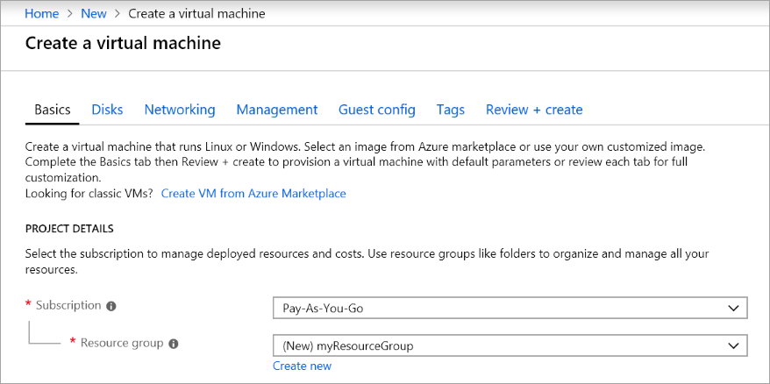
Create an Azure VM by using the Azure portal
Notes:
Azure virtual machines (VMs) can be created through the Azure portal. This method provides a browser-based user interface to create VMs and their associated resources.

Slide 12
Demonstration: Creating an Azure VM by using the Azure portal

Slide 13
Create an Azure VM by using PowerShell
Connect-AzAccount
New-AzResourceGroup -Name "myResourceGroup" -Location EastUS
New-AzVM `
-ResourceGroupName "myResourceGroup" `
-Name "myVM" `
-Location "East US" `
-VirtualNetworkName "myVnet" `
-SubnetName "mySubnet" `
-SecurityGroupName "myNetworkSecurityGroup" `
-PublicIpAddressName "myPublicIpAddress" `
-OpenPorts 80,3389
Notes:
The Azure PowerShell module is used to create and manage Azure resources from the PowerShell command line or in scripts.
Launch Cloud Shell
If you choose to install and use the PowerShell locally, this tutorial requires the Azure PowerShell module version 3.3.0 or later. Run Get-Module -ListAvailable Az to find the version, you also need to run Connect-AzAccount to create a connection with Azure.
Create resource group
Create an Azure resource group with New-AzResourceGroup. A resource group is a logical container into which Azure resources are deployed and managed.
Create a virtual machine
Create a VM with New-AzVM. Provide names for each of the resources and the New-AzVM cmdlet creates if they don't already exist.

Slide 14
Demonstration: Creating an Azure VM by using PowerShell

Slide 15
Accessing an Azure VM by using PowerShell
Get-AzPublicIpAddress -ResourceGroupName "myResourceGroup" `
| Select "IpAddress" mstsc /v:publicIpAddress
Install-WindowsFeature -name Web-Server –IncludeManagementTools
Notes:
The Azure PowerShell module is used to create and manage Azure resources from the PowerShell command line or in scripts.
Connect to virtual machine
After the deployment has completed, RDP to the VM. To examine the public IP address of the VM, use the Get-AzPublicIpAddress cmdlet. Create a remote desktop session from your local computer. Replace the IP address with the public IP address of your VM.
Install web server
To examine your VM in action, install the IIS web server using PowerShell.

Slide 16




Capturing performance diagnostics for a VM
Report
VM
Azure Portal
Run PerfInsights
Notes:
The performance diagnostics tool helps you troubleshoot performance issues that can affect a Windows VM. Supported troubleshooting scenarios include quick checks on known issues and best practices, and complex problems that involve slow VM performance or high usage of CPU, disk space, or memory. You can run performance diagnostics directly from the Azure portal, where you can also review insights and a report on various logs, rich configuration, and diagnostics data. Performance diagnostics installs a VM extension that runs a diagnostics tool that is named PerfInsights.

Slide 17
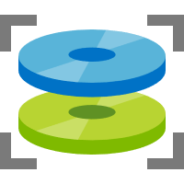


Recovering a failed VM by using a rescue VM
STOP
START
Snapshot
Failed VM
Rescue VM
Notes:
If an Azure VM is inaccessible, it may be necessary to attach the operating system (OS) disk to another Azure VM to perform the recovery steps.
To perform a recovery, you must:
Stop the failed VM.
Take a snapshot of the failed VM's OS disk.
Create a new temporary VM (rescue VM).
Attach the failed VM's OS disk as a data disk on the rescue VM.
Connect to the rescue VM to investigate and mitigate issues with the failed VM's OS disk.
Detach the failed VM's OS disk from the rescue VM.
Perform a disk swap to swap the failed VM's OS disk from the rescue VM back to the failed VM.
Remove the resources that were created for the rescue VM.

Slide 18
Sizing a VM
Each VM size offers a variation of the following characteristics:
Processing power
Memory
Storage capacity
Based on the workload, you're able to choose from a subset of available VM sizes
Notes:
Rather than specify processing power, memory, and storage capacity independently, Azure provides different VM sizes that offer variations of these characteristics.
The best way to determine the appropriate VM size is to consider the type of workload your VM needs to run.

Slide 19
VM configuration options
Computational performance
1 virtual CPU (vCPU) - 128 vCPUs
Memory
1 gibibyte (GiB) - 4 tebibyte (TiB)
Disk storage
4GiB - 64TiB
Up 160,000 IOPs
Networking
30 GB Ethernet 100 GB InfiniBand
Availability
Single VM service-lvel agreement (SLA) 99.9% Multi AZ SLA 99.99%
Notes:
The size of the VM that you use is determined by the workload that you want to run. The size that you choose then determines factors such as processing power, memory, and storage capacity. Azure offers a wide variety of sizes to support many types of uses.
Each size provides a range of configuration options to support various workloads that may possibly run in Azure.

Slide 20

VM categories
Virtual machines
Purpose built
Entry level
Burstable
General purpose
Compute intensive
Memory optimized
GPU accelerated
High performance computing
Storage optimized
Notes:
You can design Azure Virtual Machines for a wide variety of workloads, starting from economical entry-level virtual machines to high-performance virtual machines for specialized workloads.
There are multiple categories listed here including:
Entry level. Economical, low-cost virtual machines for workloads that normally don't use a lot of CPU, but occasionally need to burst to handle higher workloads.
Burstable. Designed for workloads that will run for a long time by using a small fraction of the allocated CPU performance and then spike to the full power of the CPU due to incoming traffic or required work.
General purpose. Balanced CPU-to-memory ratio. Ideal for testing and development, small to medium databases, and low to medium traffic web servers.
Compute intensive. High CPU-to-memory ratio. Good for medium traffic web servers, network appliances, batch processes, and application servers.
Memory optimized. High memory-to-CPU ratio. Great for relational database servers, medium to large caches, and in-memory analytics.
GPU accelerated. Specialized virtual machines targeted for heavy graphic rendering and video editing as well as model training and inferencing (ND) with deep learning. Available with single or multiple GPUs.
High performance computing. Fastest and most powerful CPU virtual machines with optional high-throughput network interfaces (RDMA).
Storage optimized. High disk throughput and IO ideal for Big Data, SQL, NoSQL databases, data warehousing, and large transactional databases.

Slide 21
VM categories (cont.)
Option | Description
General purpose | General-purpose VMs are designed to have a balanced CPU-to-memory ratio. Ideal for testing and development, small to medium databases, and low to medium traffic web servers.
Compute optimized | Compute optimized VMs are designed to have a high CPU-to-memory ratio. Suitable for medium traffic web servers, network appliances, batch processes, and application servers.
Memory optimized | Memory optimized VMs are designed to have a high memory-to-CPU ratio. Great for relational database servers, medium to large caches, and in-memory analytics.
Storage optimized | Storage-optimized VMs are designed to have high disk throughput and IO. Ideal for VMs running databases.
GPU | GPU VMs are specialized virtual machines targeted for heavy graphics rendering and video editing. These VMs are ideal options for model training and inferencing with deep learning.
High performance compute | High-performance compute is the fastest and most powerful CPU virtual machine with optional high-throughput network interfaces.
Notes:
Rather than specify processing power, memory, and storage capacity independently, Azure provides different VM sizes that offer variations of these characteristics.
The best way to determine the appropriate VM size is to consider the type of workload your VM needs to run.

Slide 22
Manage the availability of your Azure VMs
Availability is the percentage of time a service is available for use
In the event of a physical failure within the Azure datacenter:
Azure will move the VM to a healthy host server automatically
“Self-healing” migration could take several minutes
If your VM is isolated to a single instance, the application(s) hosted on that VM will not be available
VMs could also be affected by periodic updates initiated by Azure itself
Notes:
What is availability?
Availability is the percentage of time a service is available for use. Let's assume you have a website and you want your customers to be able to access information at all times. Your expectation is 100% availability of concerning website access.
Azure VMs run on physical servers hosted within the Azure datacenter. As with most physical devices, there's a chance that there could be a failure. If the physical server fails, the virtual machines hosted on that server will also fail. If this happens, Azure will move the VM to a healthy host server automatically. However, this self-healing migration could take several minutes, during which the application(s) hosted on that VM will not be available.
Maintenance events range from software updates to hardware upgrades and are required to improve platform reliability and performance. These events usually are performed without impacting any guest VMs, but sometimes the virtual machines will be rebooted to complete an update or upgrade.

Slide 23
High availability and disaster recovery
Higher Latency
Region 1
Region 2
Region pairs
Protection from disaster with Data Residency compliance
Availability zones
Protection from entire datacenter failures
Availability sets / VM Scale Sets
Protection against failures within datacenters
Increased resiliency
Notes:
An availability set is a logical grouping of VMs within a datacenter that allows Azure to understand how your application is built to provide for redundancy and availability. Two or more VMs should be created within an availability set to provide for a highly available application and to meet the 99.95% Azure SLA. An availability set is composed of two additional groupings that protect against hardware failures and allow updates to safely apply—fault domains (FDs) and update domains (UDs).
Availability zones are alternatives to availability sets and expand the level of control you have over maintaining the availability of the applications and data on your VMs. An availability zone is a physically separate zone within an Azure region. There are three availability zones per supported Azure region. Each availability zone has a distinct power source, network, and cooling. By architecting your solutions to use replicated VMs in zones, you can protect your apps and data from the loss of a datacenter. If one zone is compromised, then replicated apps and data are instantly available in another zone.
Each Azure region is paired with another region within the same geography (such as US, Europe, or Asia), together making a region pair. This approach allows for the replication of resources, such as VM storage, across a geography. This should reduce the likelihood of natural disasters, civil unrest, power outages, or physical network outages affecting availability.

Slide 24
Availability sets
Availability set – logical feature used to ensure that a group of related VMs are deployed so that:
They are not all subject to a single physical point of failure
They are not all upgraded at the same time
Update domain – logical group of hardware that can undergo a maintenance update at the same time
Notes:
What is an availability set?
An availability set is a logical feature used to ensure that a group of related VMs are deployed so that they aren't all subject to a single point of failure and not all upgraded at the same time during a host operating system upgrade in the datacenter. VMs placed in an availability set should perform an identical set of functionalities and have the same software installed.
What is an update domain?
An update domain is a logical group of hardware that can undergo maintenance or be rebooted at the same time. Azure will automatically place availability sets into update domains to minimize the impact when the Azure platform introduces host operating system changes. Azure then processes each update domain one at a time.

Slide 25



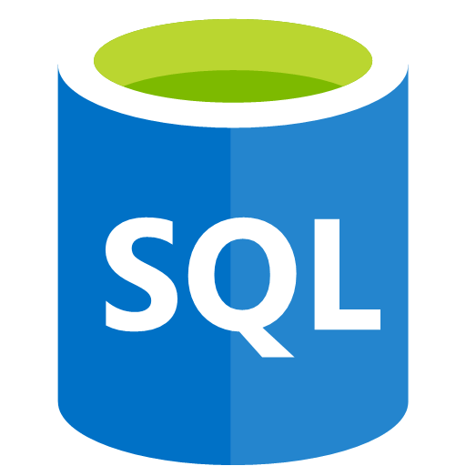
Fault domains
Fault domain – a logical group of hardware in Azure that shares a common power source and network switch
Fault domain
Fault domain
Rack
Rack
Virtual machine
Availability
set
Virtual machine
IIS1
IIS2
Virtual machine
Availability
set
Virtual machine
SQL1
SQL2
Notes:
What is a fault domain?
A fault domain is a logical group of hardware in Azure that shares a common power source and network switch. You can think of it as a rack within an on-premises datacenter. The first two VMs in an availability set will be provisioned into two different racks so that if the network or the power failed in a rack, only one VM would be affected. Fault domains are also defined for managed disks attached to VMs.

Slide 26
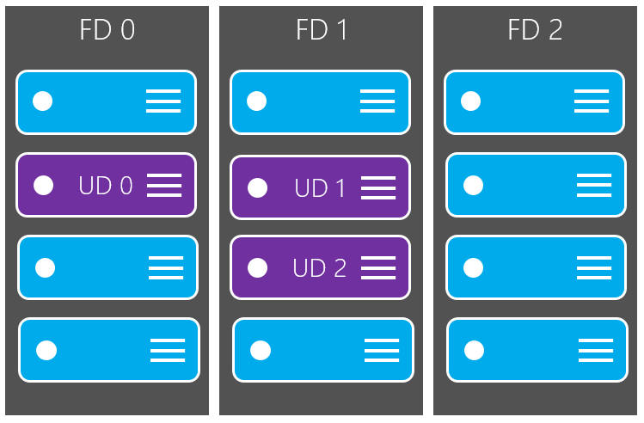
Update domains
Update domains enable targeting specific sets of hardware for maintenance or rebooting.
Notes:
Each virtual machine in your availability set is assigned an update domain and a fault domain by the underlying Azure platform.
For a given availability set, five non-user-configurable update domains are assigned by to indicate groups of virtual machines and underlying physical hardware that can be rebooted at the same time.

Slide 27
Image in Azure Marketplace
Images in Azure Marketplace are grouped into the following categories:
Publisher
Organization that creates an image
Offer
Group of related images
SKU
Instance of an offer, typically a release
Version
A specific release version number
Publisher
Offer
SKU
Notes:
A Marketplace image in Azure has the following attributes:
Publisher. The organization that created the image. Examples include Canonical and MicrosoftWindowsServer.
Offer. The name of a group of related images created by a publisher. Examples include UbuntuServer and WindowsServer.
SKU. An instance of an offer, such as a major release of a distribution. Examples include 18.04-LTS and 2019-Datacenter.
Version. The version number of an image SKU.
To identify a Marketplace image when you deploy a VM programmatically, supply these values individually as parameters.
Note: Images are unique to Azure regions and you may find a different list of images in each region.

Slide 28
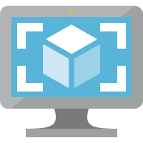
Image Sources - Windows Server example
Microsoft Windows Server
Windows Server Semi-Annual
Windows Server
2012 Datacenter
2012-R2-Datacenter
2016-Datacenter
2016-Datacenter-Core
2016-Datacenter-with-Containers
2019-Datacenter
2019-Datacenter-Core
2019-Datacenter-with-Containers
PUBLISHER
2019.0.20181107
2019.0.20181122
2019.0.20181218
2019.0.20190115
2019.0.20190214
2019.0.20190314
2019.0.20190410
2019.0.20190603
2019.0.20190620
IMAGE
OFFER
IMAGE
OFFER
IMAGE
SKU
IMAGE
SKU
IMAGE
IMAGE
SKU
IMAGE
SKU
IMAGE
SKU
IMAGE
SKU
SKU
SKU
Notes:
In this example, we are looking for Windows Server 2019 Datacenter VM images. We can first find the Publisher (Microsoft Windows Server) and then list each offer made available by the publisher. After we find the Windows Server offer, we can look for the 2019 Datacenter SKU, and then an appropriate version image within that SKU.

Slide 29
Image Sources - Ubuntu example
Canonical
Ubuntu Core
Ubuntu Snappy
Ubuntu Server
12.04
14.04
16.04
18.04-LTS
18.10
19.04
19.10-DAILY
PUBLISHER
19.10.201905250
19.10.201905290
19.10.201905300
19.10.201905310
19.10.201906040
19.10.201906050
19.10.201906120
19.10.201906140
19.10.201906220
19.10.201906230
IMAGE
OFFER
IMAGE
IMAGE
OFFER
IMAGE
OFFER
IMAGE
SKU
IMAGE
SKU
IMAGE
SKU
IMAGE
SKU
IMAGE
IMAGE
SKU
SKU
SKU
Notes:
As another example, we can pull Ubuntu images by looking at the Canonical publisher. If we want the latest VM image for the Ubuntu Server offer, we can select the 19.10-DAILY SKU (the latest when this course was written), and then find the latest versioned image.

Slide 30
Image Uniform Resource Name (URN)
Short-hand string to quickly access a known VM image Format
PUBLISHER:OFFER:SKU:VERSION
MicrosoftWindowsServer
WindowsServer
SKU
Version
Offer
Publisher
2019-Datacenter
2019.0.20190603
Canonical
UbuntuServer
19.10-DAILY
19.10.201906230
Notes:
Some tools accept an image Uniform Resource Name (URN), which combines the attributes of the image, separated by the colon (:) character.
In an URN, you can replace the version number with "latest", which selects the latest version of the image.

Slide 31
Finding image sources by using the Azure CLI
# Get a list of all publishers available in the East US region
az vm image list-publishers --location eastus
# Get a list of all offers for the MicrosoftWindowsServer publisher
az vm image list-offers --location eastus --publisher MicrosoftWindowsServer
# Get a list of SKUs for the WindowsServer offer
az vm image list-skus --location eastus --publisher MicrosoftWindowsServer --offer WindowsServer
# Get a list of all images available for the 2019-Datacenter SKU
az vm image list --all --location eastus --publisher MicrosoftWindowsServer --offer WindowsServer --sku 2019-Datacenter
Notes:
You can search for images by using the Azure Command-Line Interface (CLI).
Use the az vm image list-publishers command to list publishers in your region. Then, use the az vm image list-offers command to list offers for the MicrosoftWindowsServer publisher. Next, use the az vm image list-skus command to list the SKUs for the WindowsServer offer.
Finally, use the az vm image list command to list all image versions for the 2019-Datacenter SKU. This command has a special all parameter that is used to get a list of all images from the server. Typically, the list of images is cached to your local machine and commands are executed against that cached list.

Slide 32
Finding image sources by using the Azure CLI (cont.)
# Get the 2019.0.20190603 version of the VM image
az vm image show --location eastus --publisher MicrosoftWindowsServer --offer WindowsServer --sku 2019-Datacenter --version 2019.0.20190603
# Alternatively, use an URN to get the specified version of the VM image
az vm image show --location eastus --urn MicrosoftWindowsServer:WindowsServer:2019-Datacenter:2019.0.20190603
Notes:
After you have an image version, you can use all the four attributes to find the specific image that you need.
You can use the az vm image show command in two ways:
You can specify all four parameters including publisher, offer, sku, and version. This will pull your specific image.
Alternatively, you can use the URN to get the same image by only using the urn parameter.

Slide 33
Finding image sources by using Azure PowerShell
# Get a list of all publishers available in the East US region
Get-AzVMImagePublisher -Location eastus
# Get a list of all offers for the Canonical publisher
Get-AzVMImageOffer -Location eastus -PublisherName Canonical
# Get a list of SKUs for the UbuntuServer offer
Get-AzVMImageSku -Location eastus -PublisherName Canonical -Offer UbuntuServer
# Get a list of all images available for the 19.10-DAILY SKU
Get-AzVMImage -Location eastus -PublisherName Canonical -Offer UbuntuServer -Sku 19.10-DAILY
Notes:
You can also search for images by using Azure PowerShell.
This example will look very similar to the Azure CLI example. You use the Get-AzVMImagePublisher cmdlet to find publishers, the Get-AzVMImageOffer cmdlet to find offers, and then the Get-AzVMImageSku cmdlet to find an appropriate SKU. After you’ve all of your metadata, you can get a list of image versions by using the generic Get-AzVMImage cmdlet.

Slide 34
Finding Image Sources using Azure PowerShell (cont.)
# Get the 19.10.201906230 version of the VM image
Get-AzVMImage -Location eastus -PublisherName Canonical -Offer UbuntuServer -Sku 19.10-DAILY -Version 19.10.201906230
Notes:
PowerShell has a unique workflow where you re-use the Get-AzVMImage cmdlet to first find all the image versions, and then find a specific image.
In this example, the difference in the code is that you specify the -Version parameter to get a specific VM image.

Slide 35
Azure Shared Image Gallery
Service to manage your images
Provides
Global replication
Versioning
Grouping
High availability
Image sharing across subscriptions
Image replicas
Shared Image Gallery
Image definition 1
Image definition 2
1.0.0
1.0.1
2.02
1.0.0
1.0.1
1.0.2
Version
Version
Version
Version
Version
Version
1.0.3
1.0.4
1.0.5
Version
Version
Version
Image definition 3
Image definition N
1.0.0
2.0.0
3.0.0
1.0.0
Version
Version
Version
Version
Notes:
Shared Image Gallery is a service that helps you build structure and organization around your managed images.
The Shared Image Gallery service provides:
Managed global replication of images.
Versioning and grouping of images for easier management.
Highly available images with Zone Redundant Storage (ZRS) accounts in regions that support availability zones. ZRS offers better resilience against zonal failures.
Sharing across subscriptions, and even between Active Directory (AD) tenants, using role-based access control (RBAC).
Scaling your deployments with image replicas in each region.

Slide 36
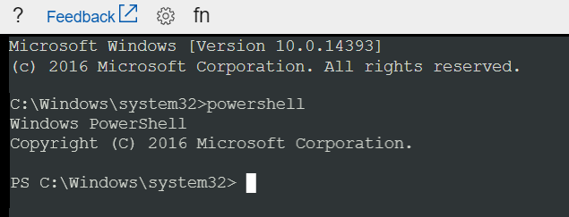
VM Serial Console
Console access to a VM independent of network or OS state
Available in Linux or Windows
Bash, CMD, PowerShell, NMI, SysRq, vi, GRUB, etc…
Notes:
The Serial Console in the Azure portal provides access to a text-based console for virtual machines (VMs). This serial connection connects to the ttys0 serial port for Linux VMs and COM1 serial port for Windows VMs.
The Serial Console provides access to the VM independent of the network or operating system state. The serial console can only be accessed by using the Azure portal.

Slide 37
Lesson 02: Create and deploy Azure Resource Manager templates

Slide 38








Azure Resource Manager overview
Resource Manager provides a consistent management layer to perform tasks
Azure PowerShell
Azure CLI
Azure portal
REST API
Client SDKs
+
+
Tools
Portal
Command line
Visual Studio
AZURE RESOURCE MANAGER API
RESOURCE MANAGER
ADFS
AAD
+
Cloud
On-Premises
RESOURCE PROVIDER CONTRACT
Provider
REST Points
…
…
Notes:
Consistent management layer
Resource Manager provides a consistent management layer to perform tasks through Azure PowerShell, Azure CLI, Azure portal, REST API, and client SDKs. All capabilities that are available in the Azure portal are also available through Azure PowerShell, Azure CLI, the Azure REST APIs, and client SDKs. Functionality initially released through APIs will be represented in the portal within 180 days of initial release.

Slide 39
Terminology
Resource
Single manageable item available through Azure
Resource group
Container holding related resources
Resource provider
Service that supplies resource instances in accordance with a predefined contract
Resource Manager template
JSON file that defines one or more resources, specifying their resource providers, to be deployed to a resource group
Declarative syntax
The act of describing your resources by using a template instead of manually creating the resources
Notes:
Resource
A manageable item that is available through Azure. Some common resources are a virtual machine, storage account, web app, database, and virtual network, but there are many more.
Resource group
A container that holds related resources for an Azure solution. The resource group can include all the resources for the solution, or only those resources that you want to manage as a group. You decide how you want to allocate resources to resource groups based on what makes the most sense for your organization.
Resource provider
A service that supplies the resources that you can deploy and manage through Resource Manager. Each resource provider offers operations for working with the resources that are deployed. Some common resource providers are Microsoft.Compute, which supplies the virtual machine resource, Microsoft.Storage, which supplies the storage account resource, and Microsoft.Web, which supplies resources related to web apps.
Resource Manager template
A JavaScript Object Notation (JSON) file that defines one or more resources to deploy to a resource group. It also defines the dependencies between the deployed resources. The template can be used to deploy the resources consistently and repeatedly.
Declarative syntax
Syntax that lets you state "Here is what I intend to create" without having to write the sequence of programming commands to create it. The Resource Manager template is an example of declarative syntax. In the file, you define the properties for the infrastructure to deploy to Azure.

Slide 40
Resource Manager template deployment
"resources": [
{
"apiVersion": "2016-01-01",
"type": "Microsoft.Storage/storageAccounts",
"name": "mystorageaccount",
"location": "westus",
"sku": {
"name": "Standard_LRS"
},
"kind": "Storage",
"properties": {}
}
]
PUT
https://management.azure.com/subscriptions/{subscriptionId}/resourceGroups/{resourceGroupName}/providers/Microsoft.Storage/storageAccounts/mystorageaccount?api-version=2016-01-01
REQUEST BODY
{
"location": "westus",
"properties": {},
"sku": {
"name": "Standard_LRS"
},
"kind": "Storage"
}
Notes:
With Resource Manager, you can create a template (in JSON format) that defines the infrastructure and configuration of your Azure solution. By using a template, you can repeatedly deploy your solution throughout its lifecycle and have confidence that your resources are deployed in a consistent state. When you create a solution from the portal, the solution automatically includes a deployment template. You don't have to create your template from scratch because you can start with the template for your solution and customize it to meet your specific needs. You can also retrieve a template for an existing resource group by either exporting the current state of the resource group, or viewing the template used for a particular deployment. Viewing the exported template is a helpful way to learn about the template syntax.

Slide 41


Three-tier Azure Resource Manager template
Three-tier application through a single Resource Manager template
3 tier
template
SQL DB
App
Service
Virtual
Machine
reference()
Reference Group
Notes:
How you define templates and resource groups is entirely up to you and how you want to manage your solution. For example, you can deploy your three-tier application through a single template to a single resource group.

Slide 42
Nested Resource Manager template
Nested templates deploying a similar three-tier application
Main template
Nested
DB
template
Nested
Web
template
Nested
VM
template
SQL DB
App
Service
Virtual
Machine
reference()
Reference Group
Notes:
To deploy complex solutions, you can break your Azure Resource Manager template (ARM template) into many related templates, and then deploy them together through a main template. The related templates can be separate files or template syntax that is embedded within the main template.
The following image shows how to deploy a three tier solution through a parent template that includes three nested templates.
If you envision your tiers having separate lifecycles, you can deploy your three tiers to separate resource groups. Notice the resources can still be linked to resources in other resource groups.

Slide 43
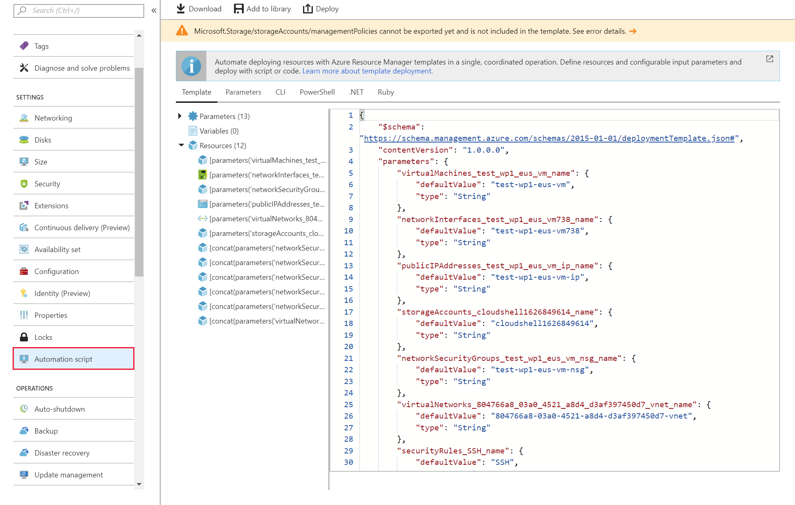
Create Resource Manager templates by using the Azure portal
Notes:
Resource Manager templates are JSON files that define the resources that you need to deploy for your solution.
You can create resource templates from the Settings section for a specific VM by selecting the Automation script option.

Slide 44
Demonstration: Creating Azure Resource Manager templates by using the Azure portal

Slide 45
Deploying Azure Resource Manager templates by using Azure CLI
az group create --name $resourceGroupName --location $location
az group deployment create --name $deploymentName --resource-group $resourceGroupName --template-file "azuredeploy.json"
az storage account show --resource-group $resourceGroupName --name $storageAccountName
Notes:
You can create Resource Manager templates in Visual Studio Code and use Azure CLI to deploy them.

Slide 46
Demonstration: Creating Azure Resource Manager templates by using Visual Studio Code

Slide 47
Lesson 03: Create container images for solutions

Slide 48






Virtualization and containers
Operating system
Operating system
Device running virtual machines
Device running containers
Virtual machine
Container
Apps
Services
Kernel
Apps
Services
Kernel / Operating System
Hardware
Hardware
Notes:
Containers and VMs each have their uses. In fact, many container deployments use VMs as the host operating system rather than running directly on the hardware, especially when running containers in the cloud.
A container is an isolated, lightweight silo for running an application on a host operating system. Containers build on top of a host operating system's kernel, and they contain only apps and some lightweight operating system APIs and services that run in user mode.
In contrast to containers, VMs run complete operating systems, including their own kernels.

Slide 49





Container Images
Mechanism to package and deploy an application
Linux
Container Image
Windows
Development
Application code
Dependencies
Datacenter
Files
Cloud
Notes:
A container is a loosely isolated environment that allows us to run software packages. These software packages include the code and all dependencies to run applications quicker and more reliably in most computing environments. These packages are known as container images.
A container image becomes the unit for distributing applications. Software containerization is an operating system virtualization method that you can use to deploy and run containers without using a VM. Containers can run on physical hardware, in the cloud, on VMs, and across multiple operating systems.
Container images become containers at runtime.
Note: Container image is like a VM image, a container is like a running VM.

Slide 50

Docker
Containerization platform
Runs "on top of" an operating system
Doesn't require a hypervisor
Runs anywhere
Your desktop/laptop
Server environment
DevOps tools
Cloud services
Containerized applications
Infrastructure
Operating system
Docker
Application 1
Application 2
Application 3
Application 4
Application 5
Notes:
Docker is a containerization platform that you can use to develop, ship, and run containers. Docker doesn't use a hypervisor, and you can run it on a desktop or laptop if you're developing and testing applications. The desktop version of Docker supports Linux, Windows, and macOS. For production systems, Docker is available for server environments, including many variants of Linux and Windows Server 2016 and newer versions.
The Docker platform consists of several components that you can use to build, run, and manage containerized applications.

Slide 51
Docker terminology
Container
An instance of a Docker image
Container Image
A standardized "unit of software" that contains everything required for an application to run
Build
The process of creating a container image using a set of instructions
Pull
The process of downloading a container image from a container registry
Push
The process of uploading a container image to a container registry
Dockerfile
A text file that contains instructions required to build a Docker image.
Registry
A service that stores container images
Notes:
You should be familiar with the following key terms before using Docker and Azure Container Instances to create, build, and test containers:
Container: This is an instance of a Docker image. It represents the execution of a single application, process, or service. It consists of the contents of a Docker image, an execution environment, and a standard set of instructions. When scaling a service, you create multiple instances of a container from the same image. Or a batch job can create multiple containers from the same image, passing different parameters to each instance.
Container image: This refers to a package with all the dependencies and information required to create a container. The dependencies include frameworks and the deployment and execution configuration that a container runtime uses. Usually, an image derives from multiple base images that are layers stacked on top of each other to form the container's file system. An image is immutable once it has been created.
Build: This refers to the action of building a container image based on the information and context provided by its Dockerfile, plus additional files in the folder where the image is built. You can build images by using the Docker docker build command.
Pull: This refers to the process of downloading a container image from a container registry.
Push: This refers to the process of uploading a container image to a container registry.
Dockerfile: This refers to a text file that contains instructions on how to build a Docker image. It's like a batch script; the first line states the base image, followed by instructions to install required programs, copy files, and so on until you get the working environment you need.
Registry: A service that stores container images. For example the ACR is built on Docker registry 2.0

Slide 52
Retrieving a new container image from Docker Hub
# Get Ubuntu container image
docker pull ubuntu
# Get version 5.7 of MySQL container image
docker pull mysql:5.7
# Get the latest version of the nginx container image
docker pull nginx:latest
Container image name
Container image tag
Notes:
The docker pull command retrieves images by image name, image tag, or by most recent version.

Slide 53
Running the retrieved container image
# Get the .NET application sample container image
docker pull mcr.microsoft.com/dotnet/core/samples:dotnetapp
# Run your container locally
docker run mcr.microsoft.com/dotnet/core/samples:dotnetapp
# View running containers
docker container ls -a
Image name and tag
Notes:
Before deploying a container to Container Instances, use the docker run command to run it locally and confirm that it works.

Slide 54
Demonstration: Retrieving and deploying an existing Docker image locally

Slide 55
Creating a container image specification with a Dockerfile
FROM node:8.9.3-alpine
RUN mkdir -p /usr/src/app
COPY ./app/ /usr/src/app/
WORKDIR /usr/src/app
RUN npm install
CMD node /usr/src/app/index.js
Start with this container image
Run this command
Copy these files from the host
Change the working directory
Start the container with this command
Notes:
The sample application in this tutorial is a simple web app built in Node.js. The application serves a static HTML page, and you can use Git to clone the sample application's repository:
git clone https://github.com/Azure-Samples/aci-helloworld.git
The Dockerfile for an application indicates how the container is built.
The Dockerfile starts from an official Node.js image that’s based on Alpine Linux, a small distribution that’s well suited for use with containers. It then copies the application files into the container, installs dependencies by using the Node Package Manager, and finally, starts the application.

Slide 56
Building the container image
# Build your container
docker build ./application -t tutorial-app
# After building, use the following command to view your new container image
docker images
Path to build
Docker tag
Notes:
Use the docker build command to create the container image and tag it as aci-tutorial-app.
Output from the docker build command is similar to the following (truncated for readability):
$ docker build ./aci-helloworld -t aci-tutorial-app
Sending build context to Docker daemon 119.3kB
Step: FROM node:8.9.3-alpine
8.9.3-alpine: Pulling from library/node
88286f41530e: Pull complete
84f3a4bf8410: Pull complete
d0d9b2214720: Pull complete
Digest: sha256:c73277ccc763752b42bb2400d1aaecb4e3d32e3a9dbedd0e49885c71bea07354
Status: Downloaded newer image for node:8.9.3-alpine
---> 90f5ee24bee2
...
Step: CMD node /usr/src/app/index.js
---> Running in f4a1ea099eec
---> 6edad76d09e9
Removing intermediate container f4a1ea099eec
Successfully built 6edad76d09e9
Successfully tagged aci-tutorial-app:latest
Use the docker images command to examine the built image. Your newly built image should appear in the list:
$ docker images
REPOSITORY TAG IMAGE ID CREATED SIZE
aci-tutorial-app latest 5c745774dfa9 39 seconds ago 68.1 MB

Slide 57
Running the custom container image as a container
# Run your container locally
docker run -d -p 8080:80 tutorial-app
# View running containers
docker container ls -a
Notes:
Before you deploy a container to Container Instances, use the docker run command to run it locally and confirm that it works. The -d switch lets the container run in the background, while -p allows you to map an arbitrary port on your computer to port 80 in the container.
Output from the docker run command displays the running container's ID if the command is successful:
$ docker run -d -p 8080:80 aci-tutorial-app
A2e3e4435db58ab0c664ce521854c2e1a1bda88c9cf2fcff46aedf48df86cccf

Slide 58
Demonstration: Creating a container image by using Docker

Slide 59
Lesson 04: Publish a container image to Azure Container Registry

Slide 60
Azure Container Registry (ACR)
Managed Docker registry service
Based on the open-source Docker Registry 2.0
Stores and manages private Docker container images
Tight integration with multiple Azure services that support these Docker containers:
Azure App Service
Azure Batch
Azure Service Fabric
Azure Kubernetes Service
Notes:
Container Registry is a managed Docker registry service based on the open-source Docker Registry 2.0. Create and maintain Azure container registries to store and manage your private Docker container images.
Use container registries in Azure with your existing container development and deployment pipelines. Use Azure Container Registry Build (ACR Build) to build container images in Azure. Build on demand, or fully automate builds with source code commit and base image update build triggers.

Slide 61
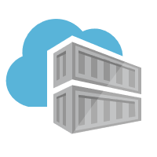

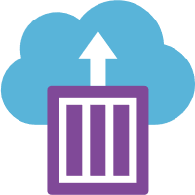

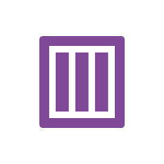
Docker containers and registries
Registry
Container
Repository
Docker host
Notes:
Let’s examine how container repositories function in the Docker ecosystem.
In the Docker ecosystem, a container registry contains a set of container repositories. Container repositories function like code source-control repositories as they store versioned copies of a container image. A machine running Docker can pull a container image from a registry and create a new container instance from the image.

Slide 62
Container Registry SKUs
SKU | Description
Basic | Ideal for developers learning about Container Registry Same programmatic capabilities as Standard and Premium, however, there are size and usage constraints
Standard | Same capabilities as Basic, but with increased storage limits and image throughput. Should satisfy the needs of most production scenarios.
Premium | Higher limits on constraints, such as storage and concurrent operations, including enhanced storage capabilities to support high-volume scenarios. Adds features like geo-replication for managing a single registry across multiple regions
Notes:
Container Registry is available in several different SKUs that provide predictable pricing and options for aligning to capacity and usage patterns of a private Docker registry in Azure.
Basic
A cost-optimized entry point for developers learning about Container Registry. Basic registries have the same programmatic capabilities as Standard and Premium (Azure Active Directory authentication integration, image deletion, and web hooks), however, there are size and usage constraints.
Standard
The Standard registry offers the same capabilities as Basic, but with increased storage limits and image throughput. Standard registries should satisfy the needs of most production scenarios.
Premium
Premium registries have higher limits on constraints, such as storage and concurrent operations, including enhanced storage capabilities to support high-volume scenarios. In addition to higher image throughput capacity, Premium adds features like geo-replication for managing a single registry across multiple regions, maintaining a network-close registry to each deployment.

Slide 63
Create a container registry by using Azure CLI
# Create a Container Registry instance
az acr create --resource-group <group> --name <acr-name> --sku Basic
# Login to Container Registry
az acr login --name <acrName>
Notes:
Create a Container Registry instance by using the az acr create command. The registry name must be unique within Azure and must contain 5-50 alphanumeric characters.
When the registry is created, the output is similar to the following:
{
"adminUserEnabled": false,
"creationDate": "2017-09-08T22:32:13.175925+00:00",
"id": "/subscriptions/00000000-0000-0000-0000-000000000000/resourceGroups/myResourceGroup/providers/Microsoft.ContainerRegistry/registries/myContainerRegistry007",
"location": "eastus",
"loginServer": "myContainerRegistry007.azurecr.io",
"name": "myContainerRegistry007",
"provisioningState": "Succeeded",
"resourceGroup": "myResourceGroup",
"sku": {
"name": "Basic",
"tier": "Basic"
},
"status": null,
"storageAccount": null,
"tags": {},
"type": "Microsoft.ContainerRegistry/registries"
}
Before pushing and pulling container images, you must log in to the Container Registry instance. To do so, use the az acr login command. The command returns a Login Succeeded message after it is completed.

Slide 64
Push a Docker image to the Container Registry
# Pull existing Docker image
docker pull microsoft/aci-helloworld
# Obtain the full login server name of the Container Registry instance
az acr list --resource-group <group> --query "[].{acrLoginServer:loginServer}" --output table
# Tag image with full login server name prefix
docker tag microsoft/aci-helloworld <acrLoginServer>/aci-helloworld:v1
# Push image to Container Registry
docker push <acrLoginServer>/aci-helloworld:v1
Notes:
To push an image to an Azure Container registry, you must first have an image. If you don't yet have any local container images, you can pull an existing image from Docker Hub.
Before you can push an image to your registry, you must tag it with the fully qualified name of your Container Registry login server. Tag the image using the docker tag command.
Use Docker push to push the image to the Container Registry instance.

Slide 65
View a deployed image in Container Registry by using Azure CLI
# List container images
az acr repository list --name <acrName> --output table
# List the tags on the aci-helloworld repository
az acr repository show-tags --name <acrName> --repository aci-helloworld --output table
Notes:
Use the az acr repository list command to list all the repositories in the registry. The output should appear similar to the following:
Result
----------------
aci-helloworld
Use the az acr repository show-tags command to list all of the tags within the repository:
Result
--------
v1

Slide 66
Deploy an image to Container Instance by using Azure CLI
# Enable admin user
az acr update --name <acrName> --admin-enabled true
# Query for the password
az acr credential show --name <acrName> --query "passwords[0].value"
# Deploy container image
az container create --resource-group <group> --name acr-quickstart --image <acrLoginServer>/aci-helloworld:v1 --cpu 1 --memory 1 --registry-username <acrName> --registry-password <acrPassword> --dns-name-label <fqdn> --ports 80
# View container FQDN
az container show --resource-group myResourceGroup --name acr-quickstart ` --query instanceView.state
Notes:
To deploy a container instance from the registry you created, you must provide the registry credentials when you deploy it.
In production scenarios, you should use a service principal for container registry access, but in these examples, we will enable the admin user on your registry.
After admin is enabled, the username is the same as your registry name and you can retrieve the password by using the az acr credential show command.
You can use the az container create command to deploy your container image. In this example, we deploy a container with 1 CPU core and 1 GB of memory.

Slide 67
Demonstration: Deploying an image to ACR by using Azure CLI

Slide 68
Azure Container Registry Build (ACR Build)
Suite of features within Container Registry that provides streamlined and efficient Docker container image builds in Azure
Offloads docker build operations to Azure
Replaces manual build by using Docker tools on your local machine
Build on demand
Fully automate builds with source code commit and base image update build triggers
Notes:
ACR Tasks is a suite of features within Container Registry that provides streamlined and efficient Docker container image builds in Azure. ACR Build is one of the tasks available in ACR Tasks.

Slide 69



Building images in Container Registry
Repository
build agent
New container image
Container Registry
ACR BUILD
Local machine
Notes:
Let’s examine how a container registry handles the build task.
Azure-based container builds are executed by using the az acr build command.
The az acr build command using the Azure CLI tool receives a context (the set of files to build) from the local machine, sends the context to Azure Container Registry Tasks and, by default, pushes the built image to its registry upon completion.
You will learn about the components of the az acr build command next.

Slide 70
Trigger ACR Build by using Azure CLI
# Trigger build in Azure
az acr build --image <server>/<tag> --registry <registry> ./app
Registry server
Docker “tag”
Path to build
Notes:
The code from your local machine will be uploaded to the build server and then the Dockerfile will be used in the build process.

Slide 71
Lesson 05: Create and run container images in Azure Container Instances

Slide 72
Azure Container Instances (ACI)
Simplest way to run a container in Azure:
Doesn’t require IaaS provisioning
Doesn’t require the adoption of a higher-level service
Ideal for one-off, isolated container instances:
Simple applications
Task automation
Build jobs
Supports Linux and Windows containers
Supports direct mounting of Azure Files shares
Container can be provisioned with public IP address and DNS name
Notes:
Containers are becoming the preferred way to package, deploy, and manage cloud applications. Container Instances offers the fastest and simplest way to run a container in Azure, without having to manage any virtual machines and without having to adopt a higher-level service.
Container Instances is a good solution for any scenario that can operate in isolated containers, including simple applications, task automation, and build jobs. For scenarios where you need full container orchestration, including service discovery across multiple containers, automatic scaling, and coordinated application upgrades, we recommend Azure Kubernetes Service (AKS).

Slide 73


Container groups
Container group
80
Container
Web
DNS label
1433
IP address
Container
Azure Files
Notes:
Let’s examine the role of container group in Container Instances.
Container group is the top-level resource in Container Instances. A container group is a collection of containers that get scheduled on the same host machine. The containers in a container group share a lifecycle, resources, local network, and storage volumes.
This example of a container group:
Is scheduled on a single host machine.
Is assigned a DNS name label.
Exposes a single public IP address, with one exposed port.
Consists of two containers. One container listens on port 80, while the other listens on port 1433.
Includes two Azure File shares as volume mounts, and each container mounts one of the shares locally.

Slide 74
Container Instances features
Feature | Description
Fast startup times | Containers can start in seconds without the need to provision and manage VMs
Public IP connectivity and DNS name | Containers can be directly exposed to the internet with an IP address and a fully qualified domain name (FQDN)
Hypervisor-level security | Container applications are as isolated in a container as they would be in a VM
Custom sizes | Container nodes can be scaled dynamically to match actual resource demands for an application
Persistent storage | Containers support direct mounting of Azure Files shares
Linux and Windows containers | The same API is used to schedule both Linux and Windows containers
Co-scheduled groups | Container Instances supports scheduling of multicontainer groups that share host machine resources
Virtual network deployment | Container Instances can be deployed into an Azure virtual network
Notes:
Fast startup times
Containers offer significant startup benefits over virtual machines. Container Instances can start containers in Azure in seconds, without the need to provision and manage VMs.
Public IP connectivity and DNS name
Container Instances enables exposing your containers directly to the internet with an IP address and a fully qualified domain name (FQDN). When you create a container instance, you can specify a custom DNS name label so your application is reachable at customlabel.azureregion.azurecontainer.io.
Hypervisor-level security
Historically, containers have offered application dependency isolation and resource governance but have not been considered sufficiently hardened for hostile multi-tenant usage. Container Instances guarantees your application is as isolated in a container as it would be in a VM.
Custom sizes
As demand for resources increases, the nodes of an AKS cluster can be scaled out to match. If resource demand drops, nodes can be removed by scaling in the cluster. AKS scale operations can be completed using the Azure portal or the Azure CLI.
For compute-intensive jobs such as machine learning, Container Instances can schedule Linux containers to use NVIDIA Tesla GPU resources.
Persistent storage
To retrieve and persist state with Container Instances, we offer direct mounting of Azure Files shares.
Linux and Windows containers
Container Instances can schedule both Windows and Linux containers with the same API. Simply specify the OS type when you create your container groups. Some features are currently restricted to Linux containers. While we work to bring feature parity to Windows containers, you can find current platform differences in Quotas and region availability for Container Instances.
Container Instances supports Windows images based on Long-Term Servicing Channel (LTSC) versions. Windows Semi-Annual Channel (SAC) releases like 1709 and 1803 are unsupported.
Co-scheduled groups
Container Instances supports scheduling of multi-container groups that share a host machine, local network, storage, and lifecycle. This enables you to combine your main application container with other supporting role containers, such as logging sidecars.
Virtual network deployment
Container Instances enables deployment of container instances into an Azure virtual network. By deploying container instances into a subnet within your virtual network, they can communicate securely with other resources in the virtual network, including those that are on premises (through VPN gateway or ExpressRoute).

Slide 75
Deploy a container to Container Instances
# Get name of container registry login server
az acr show --name <acrName> --query loginServer
# Get container registry password
az acr credential show --name <acrName> --query "passwords[0].value"
# Deploy container
az container create --resource-group myResourceGroup --name aci-tutorial-app --image <acrLoginServer>/aci-tutorial-app:v1 --cpu 1 --memory 1 --registry-login-server <acrLoginServer> --registry-username <acrName> --registry-password <acrPassword> --dns-name-label <aciDnsLabel> --ports 80
Notes:
When you deploy an image that's hosted in a private container registry, you must supply the registry's credentials.
First, get the full name of the container registry login server (replace <acrName> with the name of your registry).
Next, get the container registry password.
Now, use the az container create command to deploy the container. Replace <acrLoginServer> and <acrPassword> with the values that you obtained from the previous two commands. Replace <acrName> with the name of your container registry and <aciDnsLabel> with desired DNS name.

Slide 76
Verify a deployed container in Container Instances
# Verify deployment progress
az container show --resource-group myResourceGroup --name aci-tutorial-app --query provisioningState
# View application URL
az container show --resource-group myResourceGroup --name aci-tutorial-app --query ipAddress.fqdn
# View container logs
az container logs --resource-group myResourceGroup --name aci-tutorial-app
Notes:
Example container log output:
$ az container logs --resource-group myResourceGroup --name aci-tutorial-app
listening on port 80
::ffff:10.240.0.4 - - [21/Jul/2017:06:00:02 +0000] "GET / HTTP/1.1" 200 1663 "-" "Mozilla/5.0 (Macintosh; Intel Mac OS X 10_12_5) AppleWebKit/537.36 (KHTML, like Gecko) Chrome/59.0.3071.115 Safari/537.36"
::ffff:10.240.0.4 - - [21/Jul/2017:06:00:02 +0000] "GET /favicon.ico HTTP/1.1" 404 150 "http://aci-demo.eastus.azurecontainer.io/" "Mozilla/5.0 (Macintosh; Intel Mac OS X 10_12_5) AppleWebKit/537.36 (KHTML, like Gecko) Chrome/59.0.3071.115 Safari/537.36“

Slide 77
Demonstration: Running Azure Container Instances by using Cloud Shell

Slide 78

Lab: Deploying compute workloads by using images and containers
Notes:
This lab is scheduled to take 45 minutes.

Slide 79

Lab sign-in information
Duration
Lab 05: Deploying compute workloads by using images and containers
http://aka.ms/az204labs
AZ204-SEA-DEV
Username: Admin
Password: Pa55w.rd
Notes:
Students will also have access to the following scenario description in their lab guide:
Your organization is seeking a way to automatically create VMs to run tasks and immediately terminate.
You're tasked with evaluating multiple compute services in Azure and determining which service can help you automatically create VMs and install custom software on those machines.
As a proof of concept, you have decided to try creating VMs from built-in images and container images so that you can compare the two solutions. To keep your proof of concept simple, you'll create a special “IP check” application written in .NET that you'll automatically deploy to your machines.
Your proof of concept will evaluate the Azure Container Instances and Azure Virtual Machines services.

