Slide 1
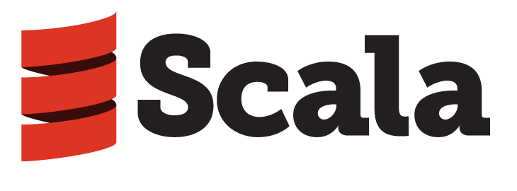
Introduction to
Hamed Khashechi, Hossein Rimaz
K.N. Toosi University of Technology

Slide 2
Table of Contents
Introduction
Getting Started
Features of Language
Programming Environment
Demo (Word Count with Spark, Simple Web App using Play, MongoDB, ReactiveMongo)
Resources
Q&A

Slide 3
Introduction
History
Why Scala
Scala Ecosystem and Use Cases

Slide 4
History

Slide 5


The design of Scala started in 2001 at the (EPFL) by Martin Odersky. Odersky formerly worked on Generic Java, and javac, Sun's Java compiler.

Slide 6

Martin decided take some of the ideas from functional programming and move them into the Java space. He has created a language called Pizza.
Pizza's initial distribution was in 1996, a year after Java came out. It was moderately successful in that it showed that one could implement functional language features on the JVM platform.
Notes:
Pizza já tinha:
- Generics
- Class cases
- Pattern matching

Slide 7
Then He got in contact with Gilad Bracha and David Stoutamire from the Sun core developer team.
They said, "We're really interested in the generics stuff you've been doing; let's do a new project that does just that.“
And that became GJ (Generic Java). So we developed GJ in 1997/98, and six years later it became the generics in Java 5, with some additions that we didn't do at the time.
Notes:
Pizza já tinha:
- Generics
- Class cases
- Pattern matching

Slide 8
In the generics design, there were a lot of very, very hard constraints.
The strongest constraint, the most difficult to cope with, was that it had to be fully backwards compatible with ungenerified Java.
That's why there were a number of fairly ugly things.
Like type eraser, raw types, unchecked warnings, … .
Notes:
Pizza já tinha:
- Generics
- Class cases
- Pattern matching

Slide 9
Pizza (Odersky and Wadler 96) was another language on the JVM that added functional elements to Java:
algebraic datatypes and pattern matching
function values
generics
Scala was more ambitious:
More innovation on the OOP side
More functional, e.g. immutable values, by-name parameters,
Better integration of functional/oop, e.g. case classes.
Not backwards compatible with Java

Slide 10


May 2011, Odersky
launched Typesafe Inc.
Currently named
Lightbend Inc.
Notes:
Criada na Suiça
Hoje mantêm o Scala e os frameworks Play e Akka

Slide 11
Why Scala

Slide 12
“ Scala is an acronym for Scalable Language ”
Is so named because it was designed to grow with the demands of its users.
Notes:
Tem esse nome pq é designada para crescer de acordo com a demanda do usuário.
criar linguagens (DSL)

Slide 13
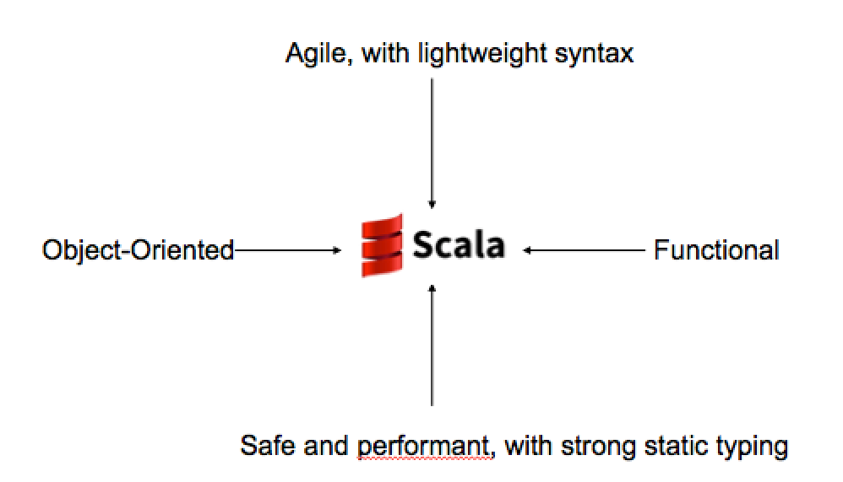
Why a new Language?
The work on Scala was motivated by two hypotheses:
Hypothesis 1: A general-purpose language needs to be scalable; the same concepts should describe small as well as large parts.
Hypothesis 2: Scalability can be achieved by unifying and generalizing functional and object-oriented programming concepts.
If we were forced to name just one aspect of Scala that helps scalability, we’d pick its combination of object-oriented and functional programming.

Slide 14
What is Scala?
Scala compiles to Byte Code in the JVM. Scala programs compile to JVM bytecodes. Their run-time performance is usually on par with Java programs.
You can write a .class being java or scala code.
Interoperability with Java, So you can easily use the Java Ecosystem.

Slide 15
Why Scala?
Scala is concise. No boilerplate code! (semicolons, return, getter/setter, …) Fewer lines of code mean not only less typing, but also less effort at reading and understanding programs and fewer possibilities of defects
Scala is high-level. OOP and FP let you write more complex programs.
Scala is statically typed, verbosity is avoided through type inference so it look likes it’s a dynamic language but it’s not.

Slide 16
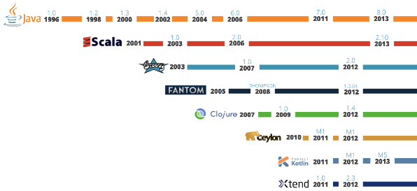
JVM Languages Timeline

Slide 17
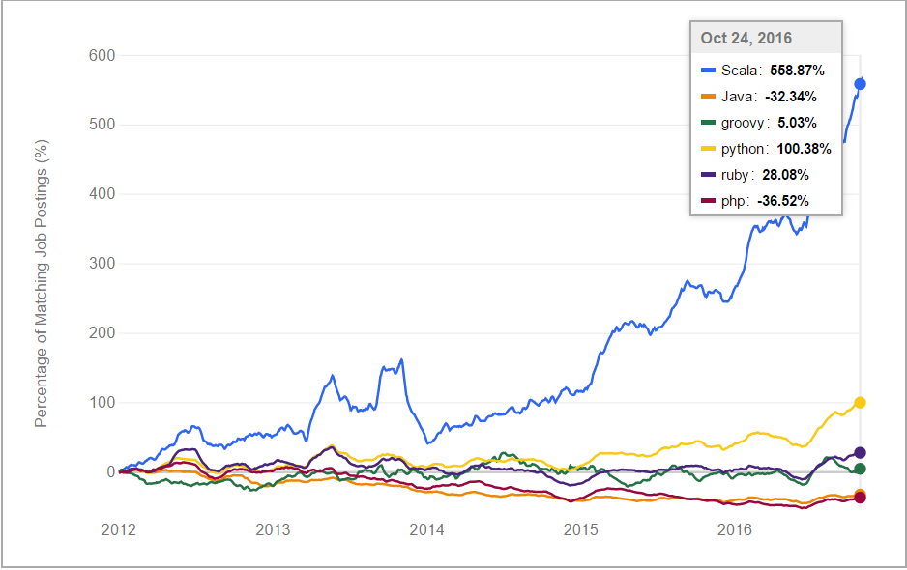
Indeed Scala Job Trend

Slide 18
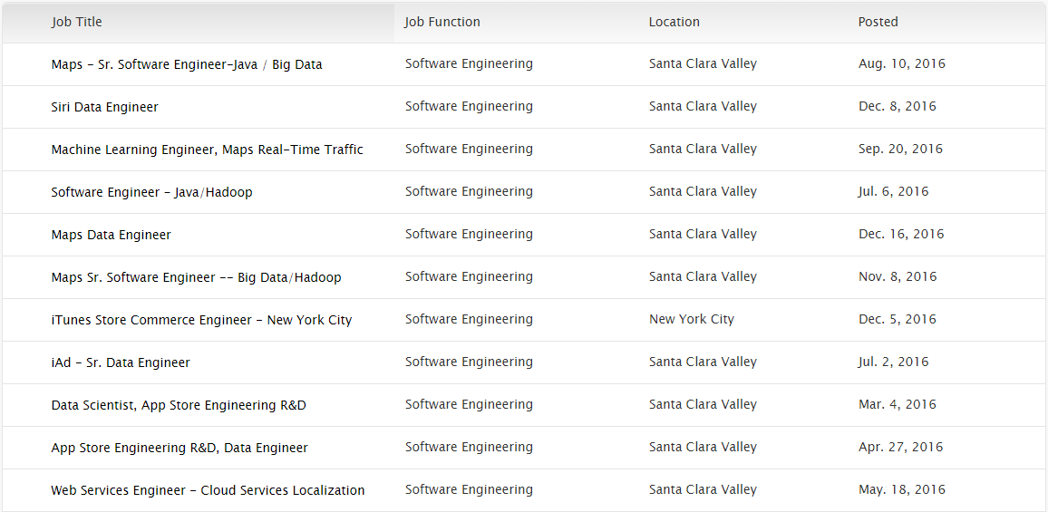
Even Apple needs Scala developer

Slide 19
If I were to pick a language to use today other than Java, it would be Scala.
“
”
James Gosling, the creator of the Java programming language
Notes:
“Se eu escolhesse uma língua para usar hoje além de Java, seria Scala”

Slide 20
Scala Ecosystem and Use Cases

Slide 21
Scala Use Cases
Big Data and Data Science
Web Application Development, REST API Development
Distributed System, Concurrency and Parallelism
Scientific Computation like NLP, Numerical Computing and Data Visualization

Slide 22

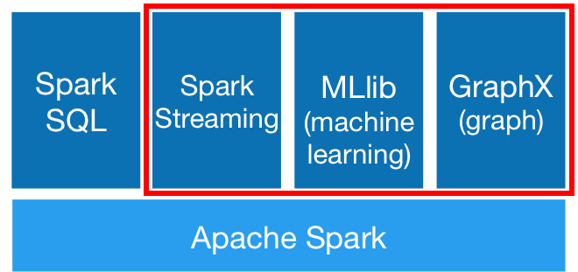
Scala Use Cases Big Data and Data Science
Apache Spark is written in Scala. You can use Spark for machine learning, graph processing, streaming and generally as an in-memory distributed, fault-tolerant data processing engine.

Slide 23
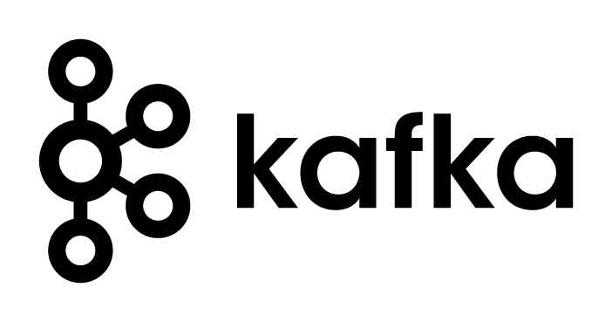
Scala Use Cases Big Data and Data Science
Apache Kafka is written in Scala and Java. It provides a unified, high-throughput, low-latency platform for handling real-time data feeds.

Slide 24

Scala Use Cases Big Data and Data Science
Apache Samza is a distributed stream processing framework written in Java and Scala. It uses Apache Kafka for messaging, and Apache Hadoop YARN to provide fault tolerance, processor isolation, security, and resource management.

Slide 25
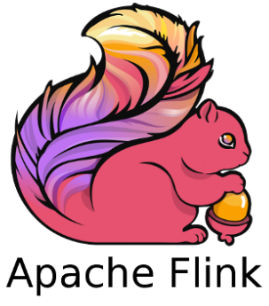
Scala Use Cases Big Data and Data Science
Apache Flink is a distributed streaming dataflow engine written in Java and Scala.

Slide 26

Scala Use Cases Web Application Development, REST API Development
Play is a stateless, asynchronous, and non-blocking framework that uses an underlying fork-join thread pool to do work stealing for network operations, and can leverage Akka for user level operations.
Play Framework makes it easy to build web applications with Java & Scala.

Slide 27

Scala Use Cases Web Application Development, REST API Development
Lift claim that it is the most powerful, most secure web framework available today.
It’s Secure, Scalable, Modular, Designer friendly, and Developer centric.

Slide 28

Scala Use Cases Web Application Development, REST API Development
Spray is an open-source toolkit for building REST/HTTP-based integration layers on top of Scala and Akka.
Being asynchronous, actor-based, fast, lightweight, modular and testable it's a great way to connect your Scala applications to the world.

Slide 29

Scala Use Cases Web Application Development, REST API Development
Scalatra is a simple, accessible and free web micro-framework.
It combines the power of the JVM with the beauty and brevity of Scala, helping you quickly build high-performance web sites and APIs.

Slide 30

Scala Use Cases Distributed System, Concurrency and Parallelism
Akka is open source middleware for building highly concurrent, distributed and fault-tolerant systems on the JVM.
Akka is built with Scala, but offers both Scala and Java APIs to developers.
At the heart of Akka is the concept of Actors, which provide an ideal model for thinking about highly concurrent and scalable systems.

Slide 31
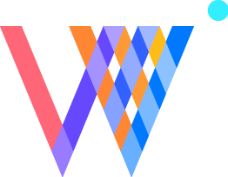

Scala Use Cases Scientific Computation
Scala NLP library including Breeze, Epic, Puck.
Wisp is a web-based plotting library.
ADAM is a genomics processing engine and specialized file format built using Apache Avro, Apache Spark and Parquet.
Scala-Chart is another library for creating and working with carts.
Scalalab is an easy and efficient MATLAB-like scientific computing library in Scala

Slide 32



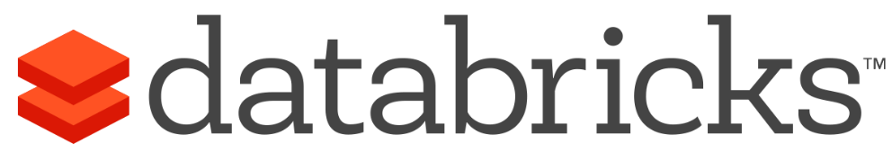






They all use Scala
https://www.lightbend.com/resources/case-studies-and-storie
Notes:
Pizza já tinha:
- Generics
- Class cases
- Pattern matching

Slide 33
We’ve found that Scala has enabled us to deliver things faster with less code.
“
”
Graham Tackley from TheGuardian.
Notes:
- Nós descobrimos que Scala nos permitiu entregar as coisas mais rápido, com menos código.
- Falar algum fato sobre eles. ????????????

Slide 34
Features of Language
Scala Language Design
The Basics of Scala
Functional Programming in Scala
Object-Oriented Programming in Scala

Slide 35
Scala Language Design
Scala Type System
Everything is an Expression
Lexical scope
Scopes

Slide 36
Scala Type System
Scala, unlike some of the other statically typed languages (C, Pascal, Rust, etc.), does not expect you to provide redundant type information. You don't have to specify a type in most cases, and you certainly don't have to repeat it.
Scala has a unified type system, enclosed by the type Any at the top of the hierarchy and the type Nothing at the
bottom of the hierarchy

Slide 37
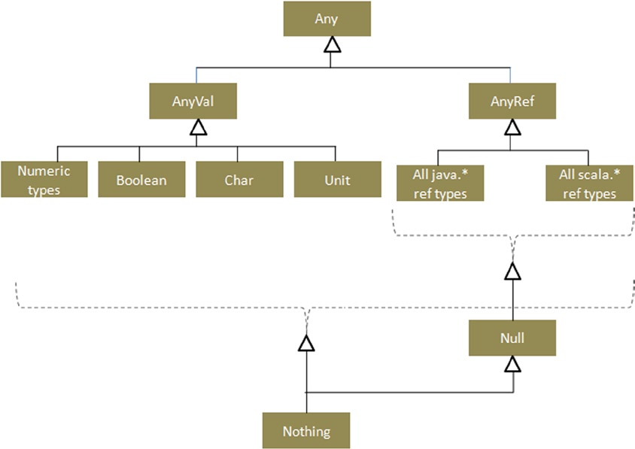
Scala Type System

Slide 38
Scala Type System
Null: Its a Trait.
null: Its an instance of Null- Similar to Java null.
Nil: Represents an empty List of anything of zero length. Its not that it refers to nothing but it refers to List which has no contents.
Nothing: is a Trait. Its a subtype of everything. But not superclass of anything. There are no instances of Nothing.
None: Used to represent a sensible return value. Just to avoid null pointer exception. Option has exactly 2 subclasses- Some and None. None signifies no result from the method.
Unit: Type of method that doesn’t return a value of anys sort.

Slide 39
Everything is An Expression
In programming language terminology, an "expression" is a combination of values and functions that are combined and interpreted by the compiler to create a new value, as opposed to a "statement" which is just a standalone unit of execution and doesn't return anything
def ifThenElseExpression(aBool:Boolean) = if aBool then 42 else 0

Slide 40
Lexical Scope (Static)
Scala using Lexical scoping like many other languages (why?)
Much easier for the user (programmer)
Much easier for the compiler to optimize

Slide 41
Scopes
In a Scala program, an inner variable is said to shadow a like-named outer variable, because the outer variable becomes invisible in the inner scope.
$$Local Definitions →Explicits imports →Wild card imports →Packages$$

Slide 42
The Basics of Language
Data Types
Casting
Opperations
If Expression
Arrays & Tuples & Lists
For & while Comprehension
Functions
Call By ...
Pattern Matching

Slide 43
Data Types
scala> var a:Int=2
a: Int = 2
scala> var a:Double=2.2
a: Double = 2.2
scala> var a:Float=2.2f
a: Float = 2.2
scala> var a:Byte=4
a: Byte = 4
scala> var a:Boolean=false
a: Boolean = false
Byte
Short
Int
Long
Float
Double
Char
Boolean
Unit

Slide 44
Casting
asInstanceOf
scala> var a:Char=(Char)955//Compile error
<console>:1: error: ';' expected but integer literal found.
var a:Char=(Char)955//Compile error
^
scala> var a:Int=955
a: Int = 955
scala> var b=a.asInstanceOf[Char]
b: Char = λ

Slide 45
Operations
scala> var a=955
a: Int = 955
scala> import scala.math._
import scala.math._
scala> print(4-3/5.0)
//compile time they will change to primitive not object any more to run faster 3.4
scala> print(a+3)//a.add(3) add=>+
958
scala> println(math.sin(4*Pi/3).abs)
//1)you can import classes 2)=>math.abs(math.sin(4*Pi/3))
0.8660254037844385
scala> if(a==955) | print("lambda")
Lambda
scala> println("HOLY".>=("EVIL"))
true

Slide 46
If Expression
scala> var m="wood"
m: String = wood
scala> println(m.length())
4
scala> println(s"$m is brown")
wood is brown
scala> println(f"$m%5s")
wood
scala> if(m=="wood"){//== is equivalent to equal
| print("brown");
| }else if(m.equals("grass")){
| println("green");
| }else{
| print("i don't know")
| }
brown

Slide 47
Arrays
scala> var arr=Array(5,4,47,7,8,7)
arr: Array[Int] = Array(5, 4, 47, 7, 8, 7)
scala> println(arr(1));println(arr(2));println(arr(3));
4 47 7
scala> var array=new Array[String](3);
array: Array[String] = Array(null, null, null)
scala> var at=Array(4,4.7,"Gasai Yuno")
at: Array[Any] = Array(4, 4.7, Gasai Yuno)
scala> var matrix=Array.ofDim[Int](2,2)
matrix: Array[Array[Int]] = Array(Array(0, 0), Array(0, 0))

Slide 48
Tuples
scala> var tuples=(2*5,"ten",10.0d,10.0f,10.0,(9,"NINE"))
tuples: (Int, String, Double, Float, Double, (Int, String)) = (10,ten,10.0,10.0,10.0,(9,NINE))
scala> print(tuples._1)
10
scala> print(tuples._2)
ten
scala> print(tuples._6._2)
NINE

Slide 49
Lists
scala> var lst=List("b","c","d")
lst: List[String] = List(b, c, d)
scala> print(lst.head)
b
scala> print(lst.tail)
List(c, d)
scala> var lst2="a"::lst
lst2: List[String] = List(a, b, c, d)
scala> var l=1::2::3::4::Nil
l: List[Int] = List(1, 2, 3, 4)
scala> var l2=l::List(5,6)
l2: List[Any] = List(List(1, 2, 3, 4), 5, 6)
scala> var l3=l:::List(5,6)
l3: List[Int] = List(1, 2, 3, 4, 5, 6)

Slide 50
While
while (Boolean Expression) { Expression }
do { Expression } while (Boolean Expression)
scala> var i=0;
i: Int = 0
scala> while(i<10){
| i+=1;
| print(i+" ")
| }
1 2 3 4 5 6 7 8 9 10
Note : In functional , It is preferred to not use while and in general imperative style.

Slide 51
For Comprehension
for (Iterations and Conditions)
val books = List("Beginning Scala", "Beginning Groovy", "Beginning Java", "Scala in easy steps", "Scala in 24 hours")
for (book<-books)
println(book)
var scalabooks = for{ book <-books if book.contains("Scala") }yield book
for(book<-books if book.contains("Scala") )
println(book)

Slide 52
foreach
foreach (Conditions)
scala> val list = List("Human","Dog","Cat")
list: List[String] = List(Human, Dog, Cat)
scala> list.foreach((s : String) => println(s))
Human
Dog
Cat
scala> list.foreach(s => println(s))
Human
Dog
Cat
scala> list.foreach(println)
Human
Dog
Cat

Slide 53
Foreach vs For Comprehension
Foreach VS for each
scala> for (s<- list) println(s)//it is actually calling foreach
Human
Dog
Cat
scala> for(s<-list if s.length==3) println(s)
Dog
Cat
scala> list.foreach((s : String) => if(s.length()==3) println(s))
Dog
Cat

Slide 54
Functions
scala> import scala.math._
import scala.math._
scala> def add(x:Int,y:Int):Int = {
| x+y//the last value if you dont specify return
|
| }
add: (x: Int, y: Int)Int
scala> def add(x:Double,y:Double) = x+y
add: (x: Double, y: Double)Double
Note: if you add “return” you need to specify return type else you are not obligated and one line function no need to bracket.

Slide 55
Functions
scala> def printAdd(x:Int,y:Int){// no equal mark no return
| println(x+y)
| }
printAdd: (x: Int, y: Int)Unit
scala> def printAdd(x:Double,y:Double):Unit ={// Unit = void
| println(x+y)
| }
printAdd: (x: Double, y: Double)Unit

Slide 56
Functions
scala> def distance1(x1:Double,y1:Double,x2:Double,y2:Double):Double={
| def dif(x1:Double,x2:Double)={
| pow(x2-x1,2)
| }
| return sqrt(dif(x1,x2)+dif(y1,y2))
| }
distance1: (x1: Double, y1: Double, x2: Double, y2: Double)Double
scala> def distance2(x1:Double,y1:Double,x2:Double,y2:Double,dif:(Double,Double)=>Double):Double={
| return sqrt(dif(x1,x2)+dif(y1,y2))
| }
distance2: (x1: Double, y1: Double, x2: Double, y2: Double, dif: (Double, Double) => Double)Double

Slide 57
Functions
scala> println(add(4.7,3.2))
7.9
scala> println(distance1(0, 0, 3, 0))
3.0
scala> var dif:(Double,Double)=>Double=(x:Double,y:Double)=>{pow(x-y,2)}
dif: (Double, Double) => Double = <function2>
scala> println(distance2(0, 0, 3, 0, dif))//unanonymous
3.0
scala> println(distance2(0, 0, 3, 0, (x:Double,y:Double)=>pow(x-y,2)))//anonymous
3.0

Slide 58
Tail Recursion
import scala.annotation.tailrec
// 1 - basic recursive factorial method
def factorial(n: Int): Int = {
if (n == 0) 1 else n * factorial(n-1)
}
// 2 - tail-recursive factorial method
def factorial2(n: Long): Long = {
@tailrec
def factorialAccumulator(acc: Long, n: Long): Long = {
if (n == 0) acc else factorialAccumulator(n*acc, n-1)
}
factorialAccumulator(1, n)
}

Slide 59
Call By Name
def delayed(t:=> Long) = {
println("Indelayed method")
println("Param:"+t)
t
}

Slide 60
Call By Ref
def notDelayed(t:Long) = {
println("Innotdelayed method")
println("Param:"+t)
t
}
Note : In Java, all method invocations are call-by-reference or call-by-value (for primitive types) .
Scala gives you an additional mechanism for passing parameters to methods (and functions):
call-by-name, which passes a code block to the callee. Each time the callee accesses the parameter, the code
block is executed and the value is calculated. Call-by-name allows you to pass parameters that might take a
longtime to calculate but may not be used.

Slide 61
Pattern Matching
scala> def matchChecking(a:Any):Unit={
| a match{
| case a:Int => {
| println("One");
| "ali"*5;
| }
| case "two" | "One" => {
| println("Two");
| 2*8;
| }
| case a if a<4.7 =>{
| println("four point seven");
| 3.8*2;
| }
| case _ => {
| println("Recognizing ...");
| a;
| }}}
matchChecking: (a: Any)Unit
scala> matchChecking(1);
One

Slide 62
Pattern Matching
scala> def simple_fun(list: List[Char]): List[Nothing] = list match {
| case x :: xs => {
| println(x)
| simple_fun(xs)
| }
| case _ => Nil
| } simple_fun: (list: List[Char])List[Nothing]
scala> simple_fun(simplelist)
a
b
c
d
res22: List[Nothing] = List()

Slide 63
Functional Programming in Scala
Lazy val & Eager Evaluation
Currying
Concurrency
Closures

Slide 64
Lazy val & Eager Evaluation
lazy val vs. val
The difference between them is, that a val is executed when it is defined whereas a lazy val is executed when it is accessed the first time.
In contrast to a method (defined with def) a lazy val is executed once and then never again. This can be useful when an operation takes long time to complete and when it is not sure if it is later used.
languages (like Scala) are strict by default, but lazy if explicitly specified for given variables or parameters.

Slide 65
Currying
Methods may define multiple parameter lists. When a method is called with a fewer number of parameter lists, then this will yield a function taking the missing parameter lists as its arguments.
scala> def nDividesM(m : Int)(n : Int) = (n % m == 0)
nDividesM: (m: Int)(n: Int)Boolean
scala> val isEven = nDividesM(2)_
isEven: Int => Boolean = <function1>
scala> println(isEven(4))
true
Note : when you give only a subset of the parameters to the function, the result of the expression is a partially applied function.

Slide 66
Closures
A closure is a function, whose return value depends on the value of one or more variables declared outside this function.
scala> var votingAge = 18
votingAge: Int = 18
scala> val isVotingAge = (age: Int) => age >= votingAge
isVotingAge: Int => Boolean = <function1>
scala> isVotingAge(16)
res2: Boolean = false

Slide 67
Concurrency
You have three options in concurrent programming:
Akka Actor Model
Thread
Apache Spark

Slide 68
Actor
Concurrency using threads is hard
Shared state – locks, race conditions, deadlocks
Solution – message passing + no shared state
Inspired by Erlang language
Erlang used at Ericsson since 1987, open source since 1998
Facebook chat backend runs on Erlang

Slide 69
What is an Actor?
Actor is an object that receives messages
Actor has a mailbox – queue of incoming messages
Message send is by default asynchronous
Sending a message to an actor immediately returns

Slide 70
Object-Oriented Programming in Scala
Classes
Objects
Traits
Case Classes
Exceptions

Slide 71
Classes
/** A Person class.
* Constructor parameters become
* public members of the class.*/
class Person(val name: String, var age: Int) {}
var p = new Person(“Peter", 21);
p.age += 1;

Slide 72
Objects
Scala’s way for “statics”
not quite – see next slide
(in Scala, there is no static keyword)
“Companion object” for a class
= object with same name as the class

Slide 73
Objects
// we declare singleton object "Person"
// this is a companion object of class Person
object Person {
def defaultName() = "nobody"
}
class Person(val name: String, var age: Int) {
def getName() : String = name
}
// surprise, Person is really an object
val singleton = Person;
var p:Person=new Person(" ",0)

Slide 74
Case Classes
Implicitely override toString, equals, hashCode
take object’s structure into account
Usefull in pattern matching
abstract class Expr
case class Number(n: Int) extends Expr
case class Sum(e1: Expr, e2: Expr) extends Expr
// true thanks to overriden equals
Sum(Number(1), Number(2)) ==
Sum(Number(1), Number(2))

Slide 75
Exceptions
object Main {
def main(args: Array[String]) {
try {
val elems = args.map(Integer.parseInt)
println("Sum is: " + elems.foldRight(0) (_ + _)) }
catch {
case e: NumberFormatException =>
println("Usage: scala Main <n1> <n2> ... ")
}
}
}

Slide 76
Traits
Like Java interfaces
But can contain implementations and fields
trait Pet {
var age: Int = 0
def greet(): String = {
return "Hi"
}
}

Slide 77
Extending Traits
class Dog extends Pet {
override def greet() = "Woof"
}
trait ExclamatoryGreeter extends Pet {
override def greet() = super.greet() + " !"
}

Slide 78
Mixins traits
Traits can be “mixed in” at instation time
trait ExclamatoryGreeter extends Pet {
override def greet() = super.greet() + " !"
}
val pet = new Dog with ExclamatoryGreeter
println(pet.greet()) // Woof !

Slide 79
Scala has Multiple inheritance!!!
Solving the Diamond Problem
Scala’s solution to the Diamond Problem is actually fairly simple: it considers the order in which traits are inherited. If there are multiple implementors of a given member, the implementation in the supertype that is furthest to the right (in the list of supertypes) “wins.” Of course, the body of the class or trait doing the inheriting is further to the right than the entire list of supertypes, so it “wins” all conflicts, should it provide an overriding implementation for a member

Slide 80
Programming Environment
Download & Install JDK
Download & Install Scala http://www.scala-lang.org/download/.
Add the installed software to your environment
Type scala in Console
Have fun ☺
Note: You can download plugins in eclipse and intelij and code

Slide 81
Resources
http://www.scala-lang.org/files/archive/spec/2.12/
https://www.tutorialspoint.com/scala/
http://stackoverflow.com/tags/scala/info
Beginning Scala

Slide 82
Q & A

Slide 83
THANKS FOR YOUR ATTENTION

