Slide 1


Slide 2
About Companies Act 1956
It came into force with effect from 1st April, 1956.
Companies Act 1956 was an Act of the Parliament of India, enacted in 1956, which enabled companies to be formed by registration, sets out the responsibilities of companies, their directors and secretaries and also provides for the procedures for its winding.
The Companies Act 1956 is administered by the Government of India through the Ministry of Corporate Affairs and the Offices of Registrar of Companies, Official Liquidators, Public Trustee, Company Law Board, Director of Inspection, etc.
It contains 658 sections and XV schedules
It mentions types of companies their differences, constitution , management, members , capital, how shares should be issued, debentures, registration of charge, at the end of the act it concludes the about winding up of a company, discussing the situations a company needs to be winded up. The ways it should be done by volunteer or through courts.

Slide 3
Special features of Companies Act are
It provides more stringent provisions relating to the company promoters and company management.
It provides elaborate provisions relating to the form and contents of a prospectus, maintenance of accounts by companies, reduction of share capital, etc.
This Act recognizes the institution of ‘Government Companies’ (in which government holds at least 51% share capital) and makes special provisions for them.
It gives extensive powers to the Central Government and the Company Law Board to intervene directly in affairs of a company in public interest, in recognition of the fact that a public company should be regarded as a national asset and not as something of exclusive concern to the shareholders or the directors.

Slide 4
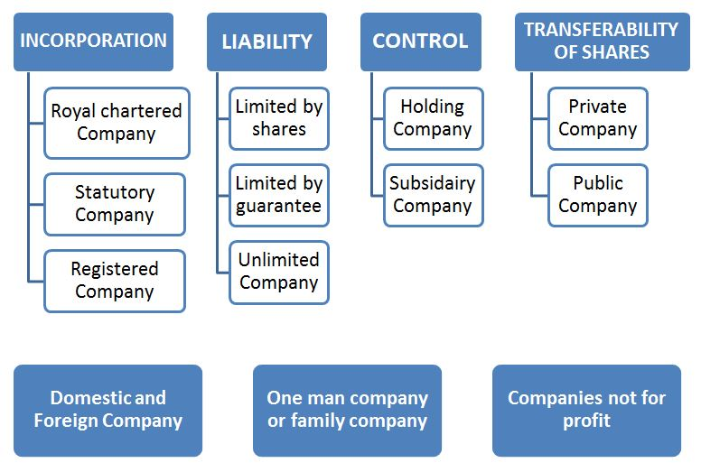
Types of companies under Companies Act

Slide 5

Introduction of companies Act, 2013
The Companies Act 2013 is an Act of the Parliament of India on Indian company law which regulates incorporation of a company, responsibilities of a company, directors, dissolution of a company.
The 2013 Act is divided into 29 chapters containing 470 sections and 7 schedules.
The Act has replaced The Companies Act, 1956 (in a partial manner) after receiving the assent of the President of India on 29 August 2013
Passed in Lok sabha - Dec 18, 2012
Passed in Rajya sabha - Aug 8, 2013
Effective from – Sep 12, 2013

Slide 6

What’s new?
Simplifies law.
Provide for better and more powerful oversight.
Enforce gender equality.
Ensure independence of boards.
Limit the terms of independent directors.
Limit the terms of auditor.
Spending on CSR.
Improve quality of financial statements.

Slide 7
Structural comparisons:
COMPANIES ACT 1956
COMPANIES ACT 2013
13 PARTS
29 CHAPTERS
658 SECTIONS
470 SECTIONS
15 SCHEDULES
7 SCHEDULES

Slide 8
OBJECTIVES OF THE ACT, 2013
To promote the development of the economy.
To encourage transparency and accountability.
To promote high standards of corporate governance.
To recognise to concept and procedures to support business and protect shareholders interests.
To setup institutional structure in the form of various authorities,
bodies and panels (NCLT and NCLAT)
To enforce strict action against fraud and gross non-compliance with company law provisions.

Slide 9

Meaning and Features of a Company
MEANING :
Section 2(20) of the Companies Act, 2013, defines the term ‘Company’ as follows: “A company is an artificial person created by law having separate legal entity with perpetual succession and a common seal”
FEATURES :
Separate Legal Entity
Perpetual Succession
Limited Liability
Artificial Legal Person
Common Seal
Transferability of shares.

Slide 10

New Concepts Introduced
33 new definitions were introduced in section 2
One persons company
Section 2(62) of Companies Act defines a one-person company as a company that has only one person as to its member.
Features
Private company
Single member
Nominee
No perpectual successions
Minimum one director (max 15 director)

Slide 11
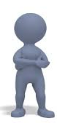
Dormant company
Section 455 of companies Act states that a company can be classified as dormant When it is formed and registered under this Act only to holds assets or intellectual property or for project office, having no other accounting transactions.
Such a company or an inactive one may apply to the ROC for such status of the dormant company.
Private company
Section 2(68) of Companies Act, 2013 defines that private companies are those companies whose articles of association restrict the transferability of shares and prevent the public at large from subscribing to them.
Limit of members here increased from 50 to 200.

Slide 12

Small company
Defined as a company other than a public company.
  Paid up capital does not exceed 50 lakh
  Turnover of which as per its last profit & loss a/c does not exceed 2 crore
Does not applicable for
  Holding and subsidiary company.
  A company registered under section 8.
  A co governed by any special Act .
Associate company
Section 2(6) defines it is the company in which another company
holds at least 20% or total share capital . It can have significance
influence on business decisions due to agreement or joint venture.

Slide 13
cont..
Private companies to have a max of 200 members (earlier it was 50) – Sec 2 (68)
E-Governance – maintenance and allowing inspection of documents by companies in electronic form. Sec-120
Vigil mechanism (whistle blowing) introduced. Sec 177 (10).
In prescribed class or class of companies there should be one women director. Sec 149 (1).
Financial year of any company can only be from April-March. Existing companies have to align within two years of commencement of the Act. Sec 2 (41)
Memorandum not to have ‘other objects’. Clause 4(1)

Slide 14
Cont..
A person cannot become director in more than 20 companies (earlier 15)
Out od this 20, he cannot be director of more than 10 public companies. (Sec 165)
Share holders have an exit option if money raised has not been utilised.( Sec 27)
Concept of CSR introduced.( Sec 135)
Condition and manner for issue of bonus share has been introduced. (Sec 63)
Consolidation of accounts. (Sec 129)
New provisions suggested for allowing re opening of accounts in certain cases with due safeguards.(Sec 130)

Slide 15
Monitoring and Regulatory Authorities
NFRA- National Financial reporting Authority
NCLT- National Company Law Tribunal
SFIO- Serious Fraud Investigation Authority Office

Slide 16

SFIO- Serious Fraud Investigation Authority Office
Investigation into affairs of company by serious fraud investigation office.
  On receipt of a report of inspector under section 208
  In public interest
  On request from any department
Treated as report filled by police officers.
Penalty provided for fraud related offences.

Slide 17

NCLT- National Company Law Tribunal
Established by central government through notification consisting of president and judicial and technical members to discharge such powers.
Any person aggrieved by an order of the tribunal may prefer an appeal to the Appellate Tribunal.
No appeal should lie to the Appellate Tribunal from an order made by the tribunal with the consent of parties.
Chapter 27 of the Act, Section 407-434

Slide 18
NFRA- National Financial reporting Authority
Section 132
To advise on matters related to auditing standard in addition to accounting standards.
Central government prescribes the standards
Monitor and enforce the compliance with accounting and auditing standards.
Oversee the quality of service of the professions
To investigate into the matters of professional or other misconduct committed by any member or the firm of chartered accounts.

Slide 19
Challenges before the profession
Voluntary Revision of Financial Statements by the Board( Sec 131)
  Revisions of accounts is a serious matter to be made.
  Applicable only for companies based on high turnover.
CSR- corporate social responsibility
  Every co having net worth of 500 cr or more, turnover of 1000 cr or more, net profit of 5 cr more should constitute a CSR of 2% average profit of 3 immediately preceding financial years.
  Spending for society.
  Reporting for spending
  Important to track and trail inflows and outflows.
Financial statement- Sec 2(40)
  Balance sheet at the end of the year.
  Profit and loss account.
  Cash flow statement
  Statement of changes in equity

Slide 20
Cont..
4. Key managerial person-Sec 2(51)
  Chief executive officer
  Company secretary
  Whole time director
  Chief financial officer
5. Promoter- Sec 2(69)
  Means a person who have the control over the affairs of the co.
  Mentioned in the prospectus
  In accordance with whose advise, directions, instructions co is accustomed.

Slide 21
Other important provisions
Classification and Registration
  Concept of one person company and small companies.
  Provisions for conversions of company.
  Registration process made faster.
  Provisions for enrichment.
Registered office
  Verify registration within 30 days of incorporation.
  Notice of change given within 15 days of the change.
Commencement of business
  paid up capital is not less than l lac in case of public co and 1 lac in private co.

Slide 22
Cont..
General meeting
  Every general annual meeting shall be called during business hours i.e. 9 am to 6 pm.
  First meeting should be held within 9 months from the end of the financial year.
  Called by giving not less than prior 21 days notice.
  Prepare a report and shall be filled with the register within 30 days of the conclusion of the meeting.
  Quorum or public co has increased from 5 to 30 members
Board meetings
  At least 7 days notice to be given for Board Meeting.
  The Board need to meet at least 4 times within a year.
  There should not be a gap of more than 120 days between two consecutive meetings.

Slide 23
Cont..
6. Appointment of Statutory Auditors
  Every Listed company can appoint an individual auditor for 5 years and a firm of auditors for 10 years.
  This period of 5 / 10 years commences from the date of their appointment.
  Therefore, those companies who have reappointed their statutory auditors for more than 5 / 10 years, have to appoint another auditor in their Annual General Meeting.
7. Other specialized services which cannot be provided by Statutory Auditors
  The Statutory Auditor of the Company cannot give following specialized services directly or indirectly to the company .
  Accounting and book keeping services and Internal audit
  Design and implementation of any financial information system
  Investment advisory and banking services
  Rendering of outsourced financial services
  Management and/or any other services as may be prescribed

Slide 24
Cont.
8. Independent Directors:
  The Companies Act 2013 provides that all listed companies should have at least one-third of the Board as independent directors.
  Such other class or classes of public companies as may be prescribed by the Central Government shall also be required to appoint independent directors.
  No independent director shall hold office for more than two consecutive terms of five years.

