Slide 1

Submitted to – Pravesh (Deputy Director) Submitted by – Chandani Kumari
Enroll. No - 25021111089081002

Slide 2
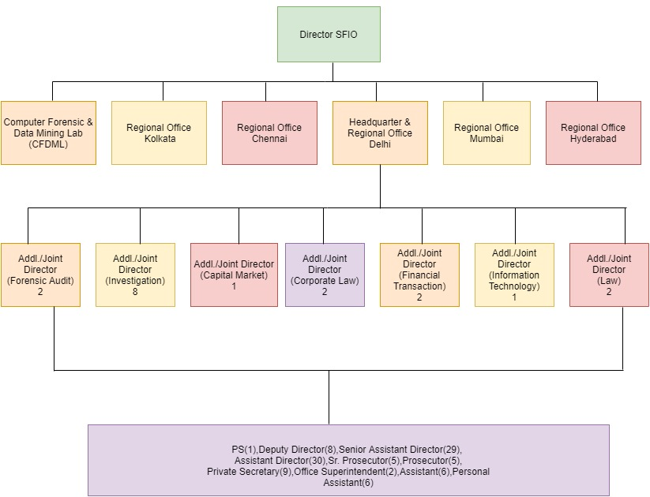
SFIO Hierarchy

Slide 3
FRAUD UNDER COS. ACT 2013
Section 447-
Without prejudice to any liability including repayment of any debt under this Act or any other law for the time being in force, any person who is found to be guilty of fraud [involving an amount of at least ten lakh rupees or one per cent. of the turnover of the company, whichever is lower] shall be punishable with imprisonment for a term which shall not be less than six months but which may extend to ten years and shall also be liable to fine which shall not be less than the amount involved in the fraud, but which may extend to three times the amount involved in the fraud:
Provided that where the fraud in question involves public interest, the term of imprisonment shall not be less than three years. Provided further that where the fraud involves an amount less than ten lakh rupees or one per cent. of the turnover of the company, whichever is lower, and does not involve public interest, any person guilty of such fraud shall be punishable with imprisonment for a term which may extend to five years or with fine which may extend to fifty lakh rupees or with both.

Slide 4
FRAUD UNDER COS. ACT 2013
Explanation.—For the purposes of this section— (i) “fraud” in relation to affairs of a company or any body corporate, includes any act, omission, concealment of any fact or abuse of position committed by any person or any other person with the connivance in any manner, with intent to deceive, to gain undue advantage from, or to injure the interests of, the company or its shareholders or its creditors or any other person, whether or not there is any wrongful gain or wrongful loss; (ii) “wrongful gain” means the gain by unlawful means of property to which the person gaining is not legally entitled; (iii) “wrongful loss” means the loss by unlawful means of property to which the person losing is legally entitled.

Slide 5
In the case of Vimla v. State, SC held that the idea of deceit is a necessary ingredient of fraud, but it does not exhaust it. The expression ‘defraud’ involves two elements, namely, deceit and injury to the person deceived.
The offence under Section 447 of the Act is cognisable, non-bailable and non-compoundable.
Section 446A of the Act lays down five factors to be considered by the Court while deciding the amount of fine or imprisonment under the Act: (a) size of the company; (b) nature of business carried on by the company; (c) injury to public interest; (d) nature of the default; and (e) repetition of the default.
Section 447 provides for a maximum term of 10 years of Imprisonment.

Slide 6
SERIOUS FRAUD INVESTIGATION OFFICE
The Serious Fraud Investigation Office (‘SFIO’) is an organisation established under the aegis of the Ministry of Corporate Affairs (‘MCA’) – for investigation and prosecution of white-collar crimes.
SFIO was constituted in July 2003 following the recommendations of the Naresh Chandra Committee.
Naresh Chandra Committee had recommended setting up a ‘Corporate Serious Fraud Office’, to uncover corporate fraud, and supervise prosecutions under various economic legislations.

Slide 7
Section 211 of Companies Act 2013 provides for the establishment of SFIO and empowers the body to investigate frauds relating to company.
Investigation into the affairs of a company is assigned to SFIO, where Government is of the opinion that it is necessary to investigate into the affairs of a company –
(a) on receipt of a report of the Registrar or inspector under section 208 of the Companies Act, 2013;
(b) on intimation of a special resolution passed by a company that its affairs are required to be investigated;
(c) in the public interest; or
(d) on request from any department of the Central Government or a State Government
SFIO was established by the Central Government in exercise of the powers conferred by sub section (i) of section 211 of the companies Act, 2013.
Earlier this office was established vide Government of India's Resolution No.45011/16/2003-admn-1 dated 2nd July, 2003.

Slide 8
SFIO was established by the Central Government in exercise of the powers conferred by sub section (i) of section 211 of the companies Act, 2013.
Earlier this office was established vide Government of India's Resolution No.45011/16/2003-admn-1 dated 2nd July, 2003.

Slide 9
Objectives of SFIO
The SFIO is a multi-disciplinary organisation consisting of experts in the field of accountancy, forensic auditing, law, information technology, investigation, company law, capital market and taxation for detecting and prosecuting or recommending for prosecution white collar crimes/frauds.
The SFIO will normally take up for investigation only such cases, which are characterized by –
i) complexity and having inter-departmental and multi- disciplinary ramifications;
ii) substantial involvement of public interest to be judged by size, either in terms of monetary iii) the possibility of investigation leading to or contributing towards a clear improvement in systems, laws or procedures.
The SFIO shall investigate serious cases of fraud received from Department of Company Affairs. It can also take up cases on its own
Whether or not an investigation should be taken up by the SFIO would be decided by the Director, SFIO who will be expected to record the reasons in writing.

Slide 10
SFIO under Companies Act
Section 210 of Companies Act 2013 provides for the power of SFIO to investigate into affairs of a company.
Section 210(1) states that where the Central Government is of the opinion that it is necessary to investigate into the affairs of a company — (a) on the receipt of a report of the Registrar or inspector under Section 208; (b) on intimation of a special resolution passed by a company that the affairs of the company ought to be investigated; or (c) in public interest, it ‘may’ order an investigation into the affairs of the company.
The use of the word ‘may’ indicates that the Central Government can exercise its discretion, and need not compulsorily order an investigation.
On the other hand, Section 210(2) is a mandatory provision which states that the Central Government ‘shall’ order an investigation into the affairs of that company – when an order to this effect is passed by a Court/ Tribunal.

Slide 11
The procedure for investigation by the SFIO is laid down under Section 212.
It allows the central government to assign or order SFIO to investigate into the affairs of a company if it is of the “opinion” that investigation is necessary.
No other investigative agency can proceed with an investigation for any offence under the 2013 Act, if a case has been ‘assigned’ by the Central Government to the SFIO.
Madras High Court in the case of Church of South India v. Union of India held that the words ‘is of the opinion’ under Section 212 imposes a jurisdictional duty on the Central Government to form an opinion on the necessity of an investigation by the SFIO. Any order passed by the Central Government without forming an “opinion” under Section 212 shall lack merit.

Slide 12
Power to arrest by SFIO
Section 212(8) read with the Companies (Arrests in Connection with Investigation by Serious Fraud Investigation Office) Rules, 2017 confers the SFIO with the power to arrest if it has a ‘reason to believe’ that any person has been guilty of any offence punishable under the sections referred to in Section 212(6).
‘Reason to believe’ should be recorded in writing by the investigating officer. Provisions in relation to arrest under the CrPC shall apply mutatis mutandis to arrests made by the SFIO.

