Slide 1

AI-Powered Drug Discovery: Accelerating the Development of Safer and More Effective Medicines
How machine learning and generative models are reshaping each stage of the drug pipeline — cutting time, lowering cost, and improving candidate quality while preserving safety and ethical oversight.

Slide 2

The Cost of Waiting: 10–15 Years and $2.5B+
Traditional discovery averages 10–15 years and often exceeds $2.5B per approved drug.
High attrition: the majority of candidates fail before reaching patients, amplifying cost and delay.
Opportunity: speed up early stages and improve decision quality to reduce downstream failures.

Slide 3
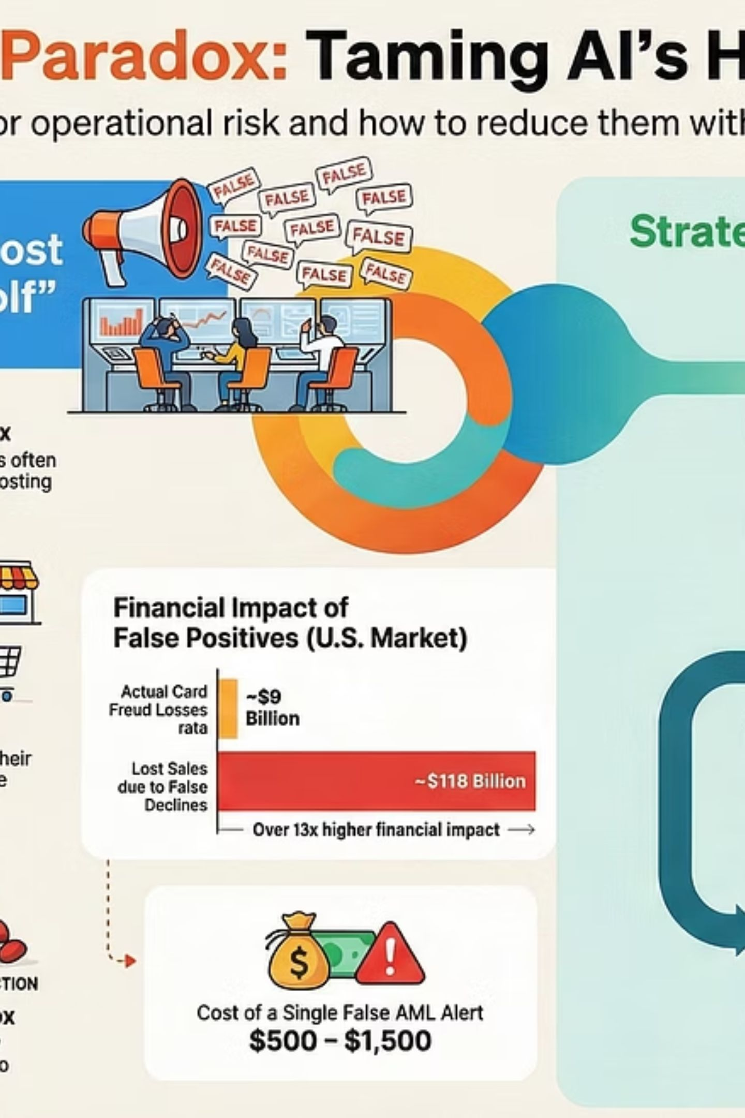
Where AI Inserts Speed: The Pipeline Map
AI augments decisions across the entire pipeline: target identification → hit discovery → lead optimization → preclinical → clinical trials. Rather than brute-force screening, AI enables prediction-driven choices that prioritize high-value experiments and shorten iteration cycles.

Slide 4
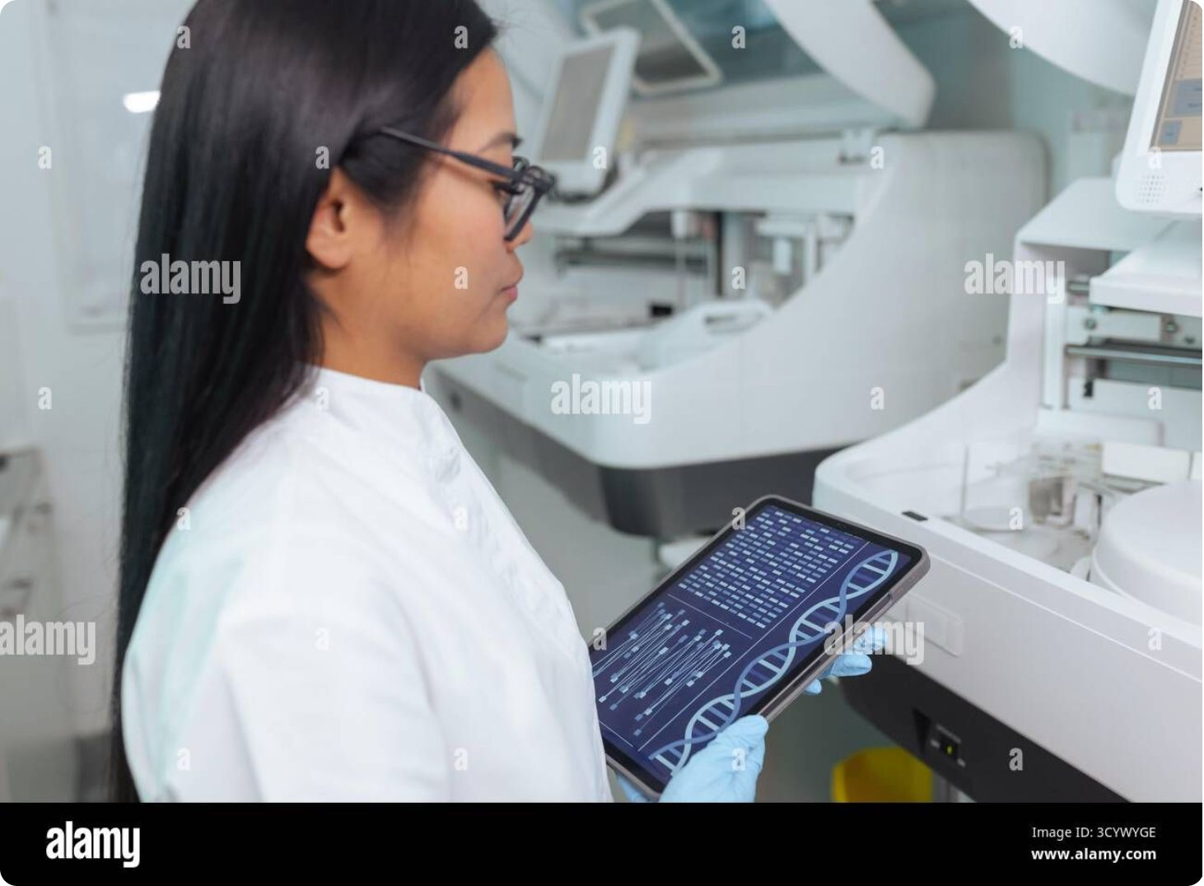
Breakthrough Step 1: Targets From Protein Predictions
Advances like AlphaFold provide high-confidence protein structure models at scale.
Speeds identification of disease-relevant binding pockets and functional sites.
Enables structure-based virtual screening and rational design earlier in the process.
Reduces reliance on slow, costly experimental structure determination.

Slide 5

Breakthrough Step 2: Screening Billions, Faster Than Labs
Virtual screening pipelines powered by ML can evaluate millions-to-billions of compounds in silico, ranking candidates for wet-lab validation.
Prioritizes compounds with predicted binding, solubility, and synthetic feasibility.
Reduces bench experiments — lab resources focus on high-confidence hits.
Integrates docking, pharmacophore models, and learned scoring functions for improved hit rates.

Slide 6

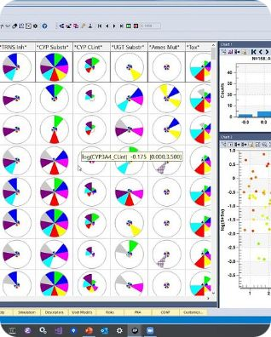
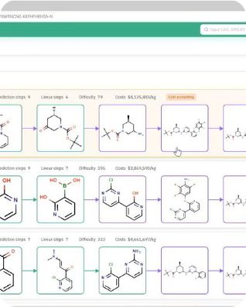
Breakthrough Step 3: Generative Design + Early Safety Signals
Generative models create novel chemotypes optimized for potency and drug-like properties while built-in predictors flag toxicity and metabolic liabilities early.
Design for Efficacy
Early Safety Filtering
Synthesis-Aware Design
Models propose modifications to improve binding affinity and selectivity.
Toxicity and ADMET predictors filter out risky designs before synthesis.
Generative systems incorporate synthetic accessibility to improve real-world feasibility.

Slide 7

The Proof Moments: AI-Designed Candidates Reaching Trials
Real-world milestones demonstrate measurable impact.
Insilico Medicine’s AI-designed candidate for pulmonary fibrosis entered Phase II (ISM001-055).
Reported benefits: accelerated discovery timelines (~80% faster) and reduced early discovery costs (~70% lower) in some programs.
These case studies validate AI as a tool for shortening the runway from idea to IND-ready candidate.

Slide 8

The Reality Check: Ethics, Bias, and Regulation Still Matter
AI is powerful, but limits and responsibilities remain central to adoption.
"Black box" models require explainability and auditability for regulatory confidence.
Data bias and gaps (underrepresented populations, rare diseases) risk uneven performance — diverse datasets and fairness audits are essential.
Privacy, IP, and evolving regulatory pathways must be navigated — no fully AI-discovered drug has yet achieved broad regulatory approval without human-led validation.

Slide 9

What Comes Next — Human + AI Partnership
There was an error generating this image
Looking ahead: integrated human–AI workflows, larger and more diverse biomedical datasets, and improved trial-outcome prediction promise faster, safer, and more personalized medicines.
Thank you
Questions? Contact: research@yourlab.org
Scale
Trust
Impact
Expand dataset variety: multi-omics, EHRs, and real-world evidence.
Explainable models, regulatory engagement, and ethical frameworks.
Faster entry to trials, fewer late-stage failures, and more targeted therapies.

