Slide 1

IMPACT OF AI IN REAL LIFE
PRESENTED BY:
C.Jagruthi-45

Slide 2

AI
Artificial
Intelligence

Slide 3
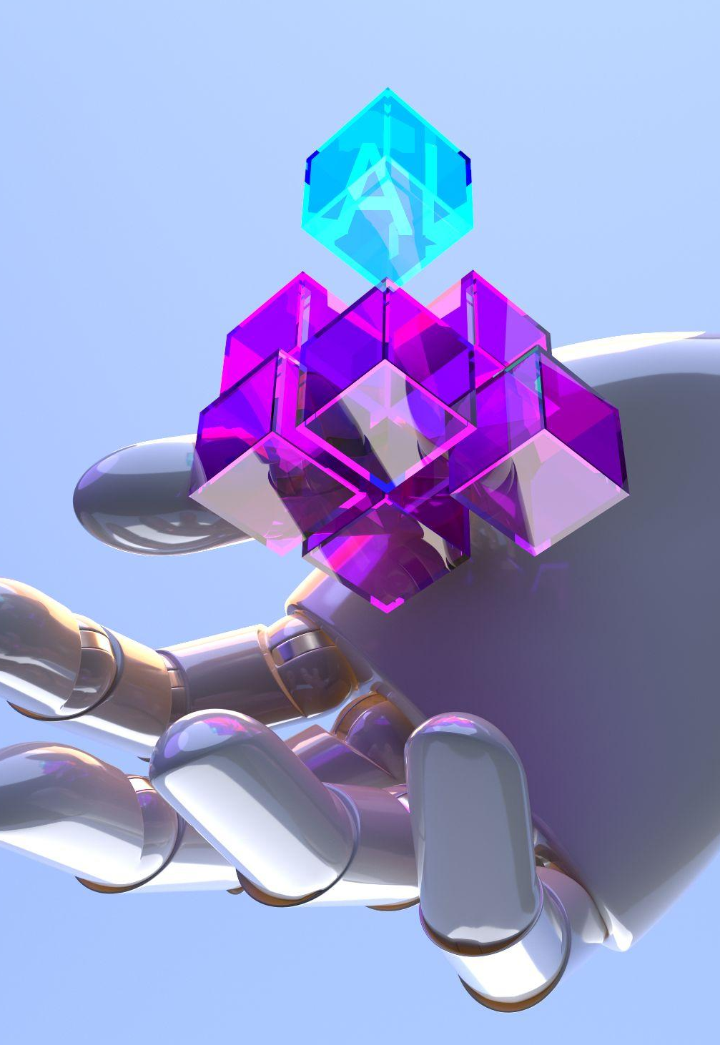
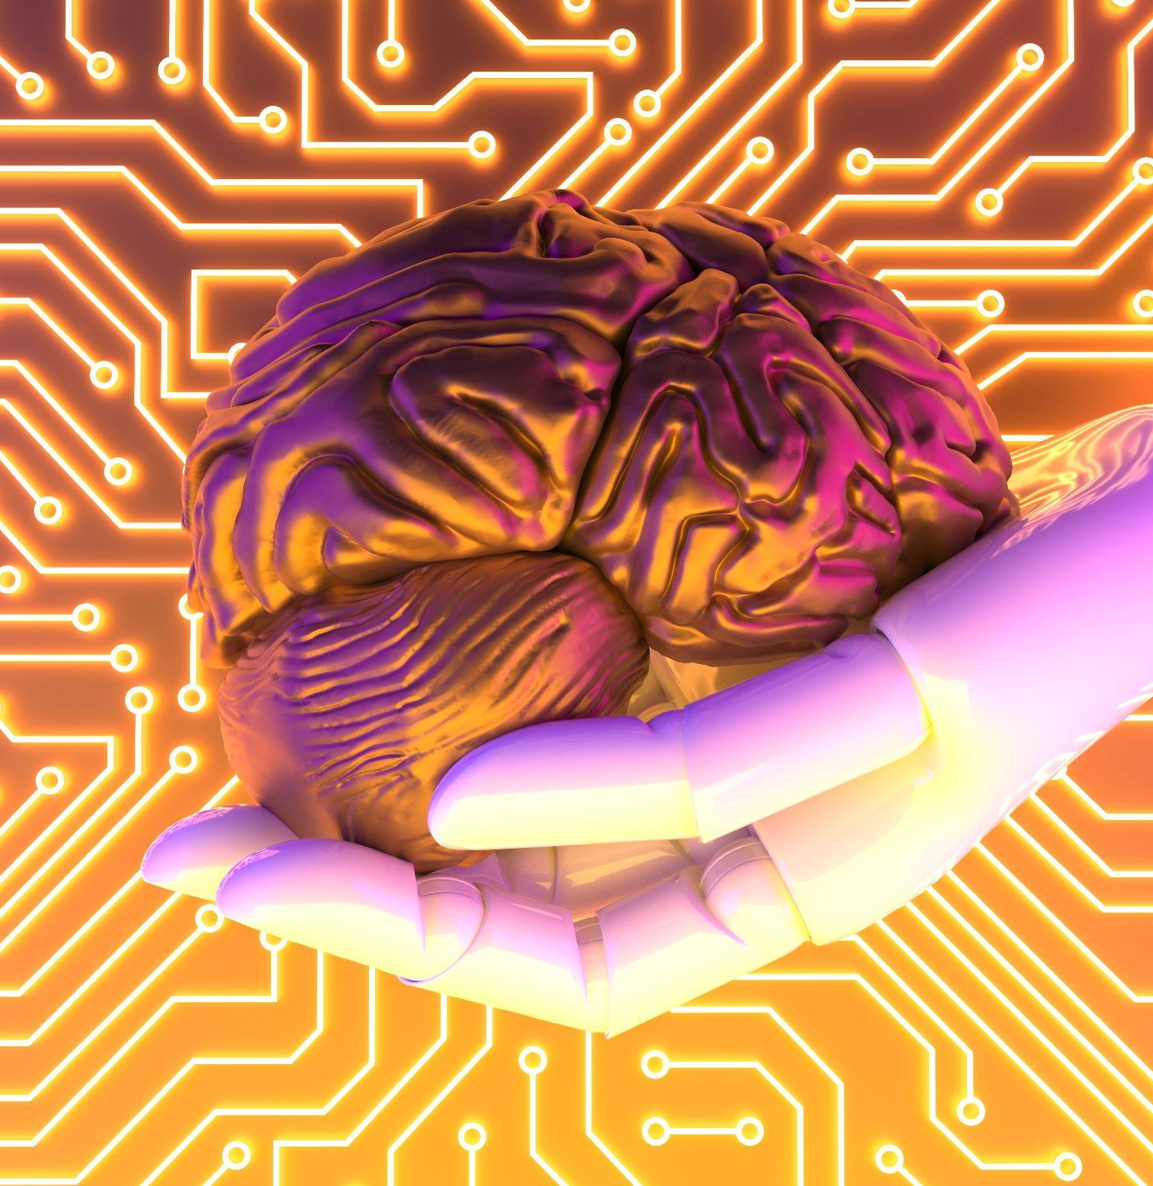
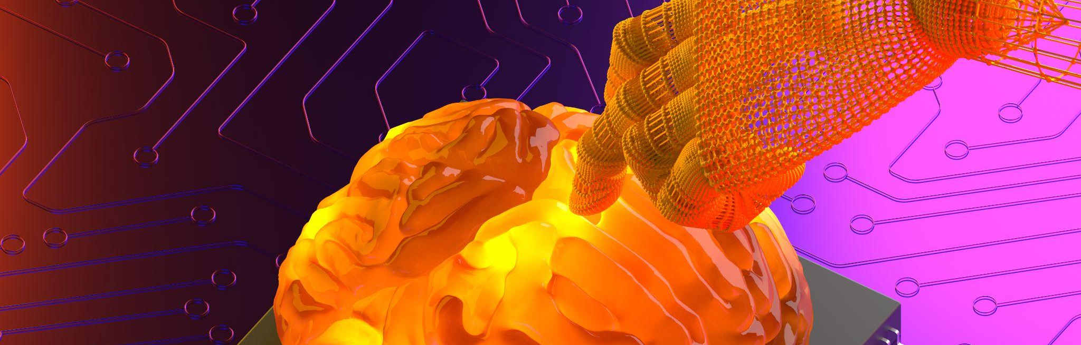
“A day working with me”
Working
partner
AI is something that works like your assistant and helps you complete your works and even gives you the suggestions

Slide 4

1,000,000,000
More than 1 billion people use AI across the world

Slide 5

AI Is Everywhere: From Dawn to Dusk
Artificial Intelligence has seamlessly integrated into the fabric of our daily lives, often operating in the background to enhance convenience and efficiency.
Smart Start
AI wakes you up gently with smart alarms, analyzing your sleep patterns to ensure you rise at the optimal moment (e.g., Sleep Cycle, Google Nest Hub).
Digital Assistants
Your smartphone’s digital assistants like Siri, Alexa, and Google Assistant simplify daily tasks and information retrieval through intuitive voice commands.

Slide 6
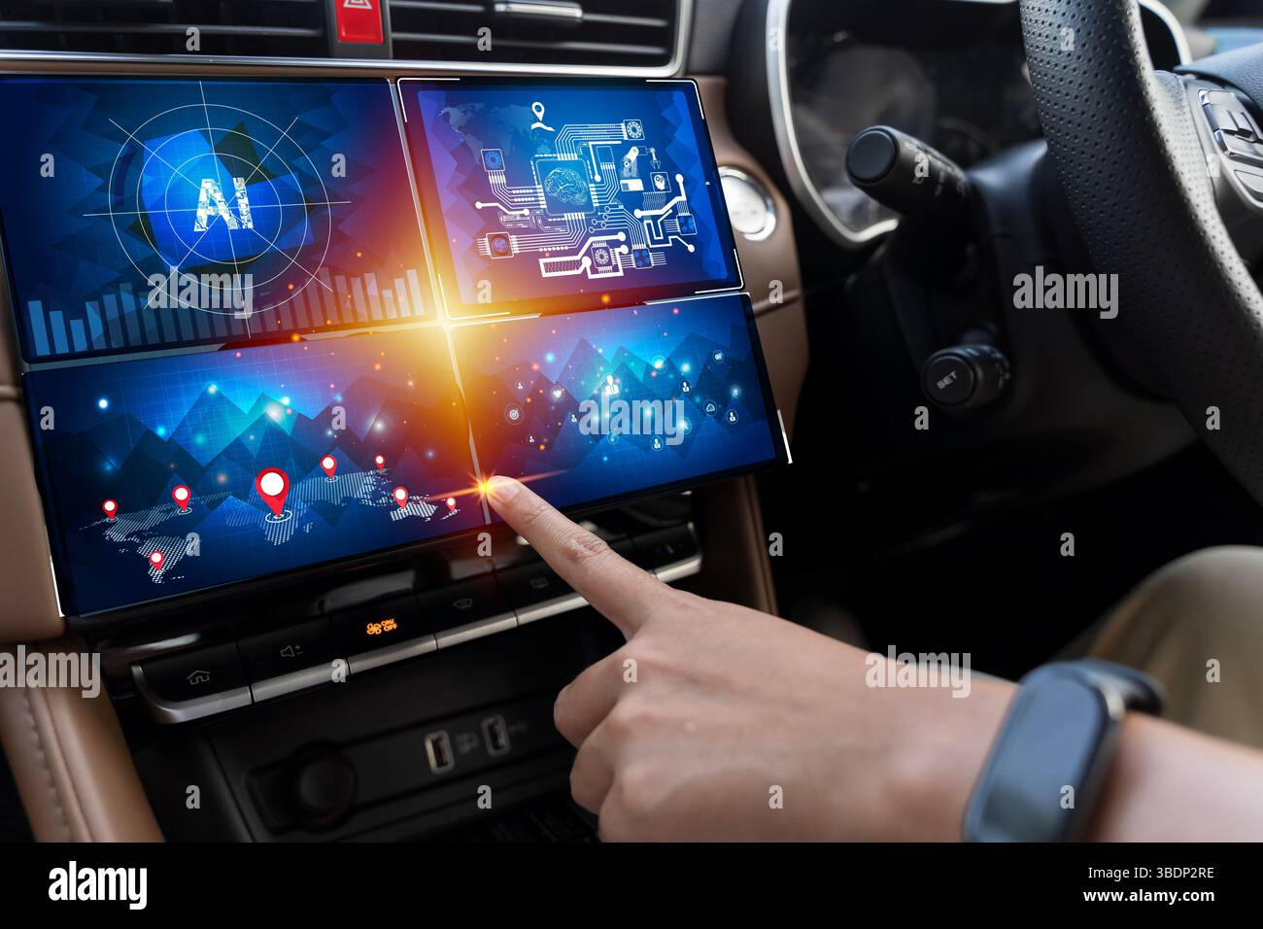
Smarter Travel: AI Navigates Your World
Real-Time Route Optimization
Navigation apps like Google Maps and Waze use predictive AI for real-time traffic updates and route optimization, saving users millions of hours daily in congestion.
Enhanced Vehicle Safety
AI-powered safety features in modern cars, such as adaptive cruise control and lane assist, detect hazards and actively prevent accidents (e.g., EU-funded VI-DAS sensors).

Slide 7
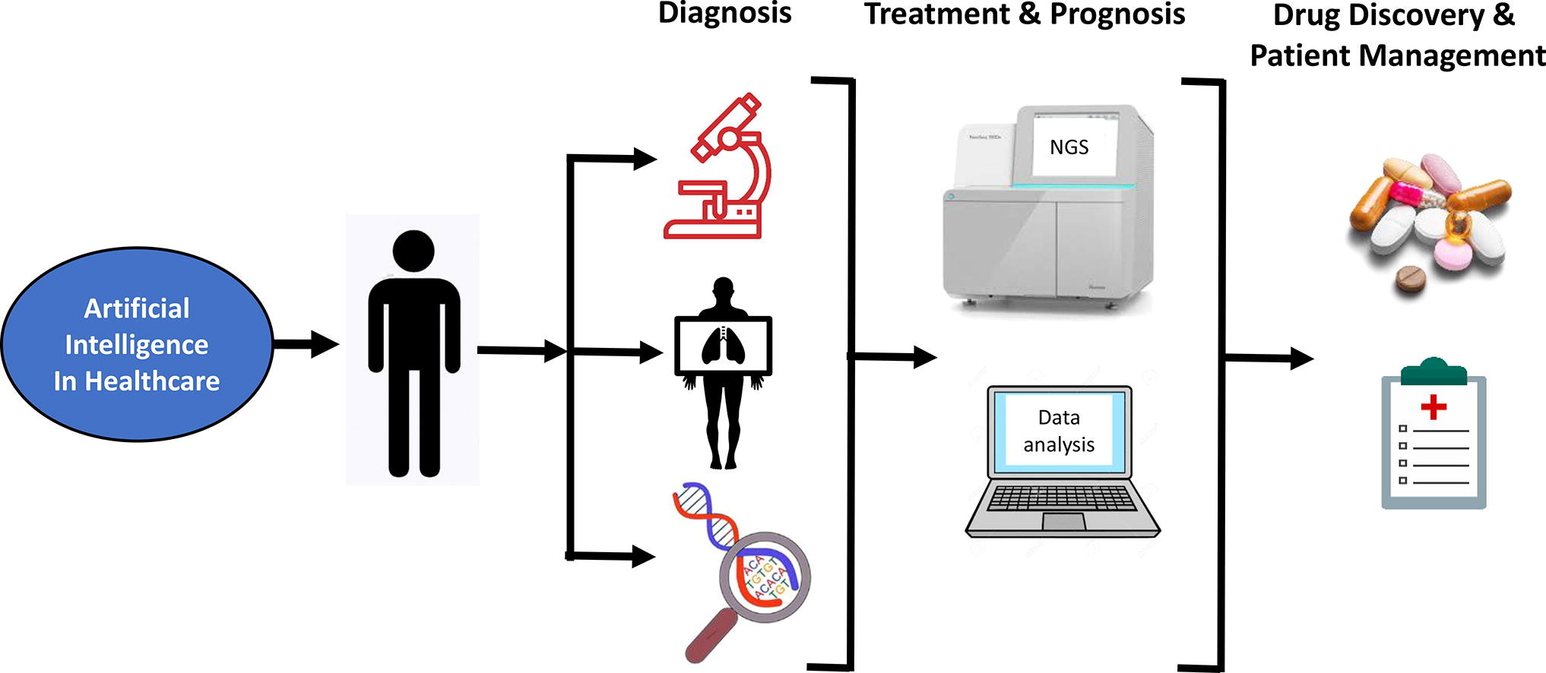
Revolutionizing Healthcare with AI
AI Tech Strategy
Diagnostic Precision
AI algorithms analyze complex medical images with exceptional precision, aiding in the early diagnosis of critical conditions like cancer and neurological diseases.

Slide 8

Revolutionizing Healthcare with AI
Streamlined Patient Care
AI-powered chatbots and virtual assistants handle scheduling, answer common queries, and streamline various administrative tasks in healthcare settings.

Slide 9

AI for students
It helps students know and understand about new things .
AI is helpful for students by providing personalized learning experiences, offering 24/7 access to tutoring and support, and accelerating learning through instant feedback and by streamlining research and content comprehension.
It can also act as a creative partner for idea generation and assist students with disabilities through adaptive tools and assistive technologies.

Slide 10



IT’S US WHO HAS TO RULE THE WORLD WITH AI ; NOT LET AI RULE US INSTEAD

Slide 11
THANK
YOU
Hope you all liked it

