Slide 1


MALLA REDDY ENGINEERING COLLEGE FOR WOMEN
Smart Garbage: An AI + IoT System for Cleaner Cities
Concise proposal for municipal decision-makers: a connected network of smart bins, AI segregation, and route optimisation that reduces overflow, cuts emissions and stretches collection budgets.
A.Akarsha-25RH1A6607
C.Jagruthi-25RH1A6645

Slide 2
Problem Statement — Why Change Is Urgent
Overflow & Health
Bins frequently overflow before collection, creating hygiene, pest and odour issues.
Lack of Visibility
No real-time monitoring or alerts; collections are reactive, not data-driven.
Poor Segregation
No effective source segregation → higher processing costs and lower recycling rates.
Inefficient Collections
Trucks run fixed routes regardless of need, wasting fuel and labour.
No Analytics
Absence of data prevents performance tracking and predictive planning.

Slide 3
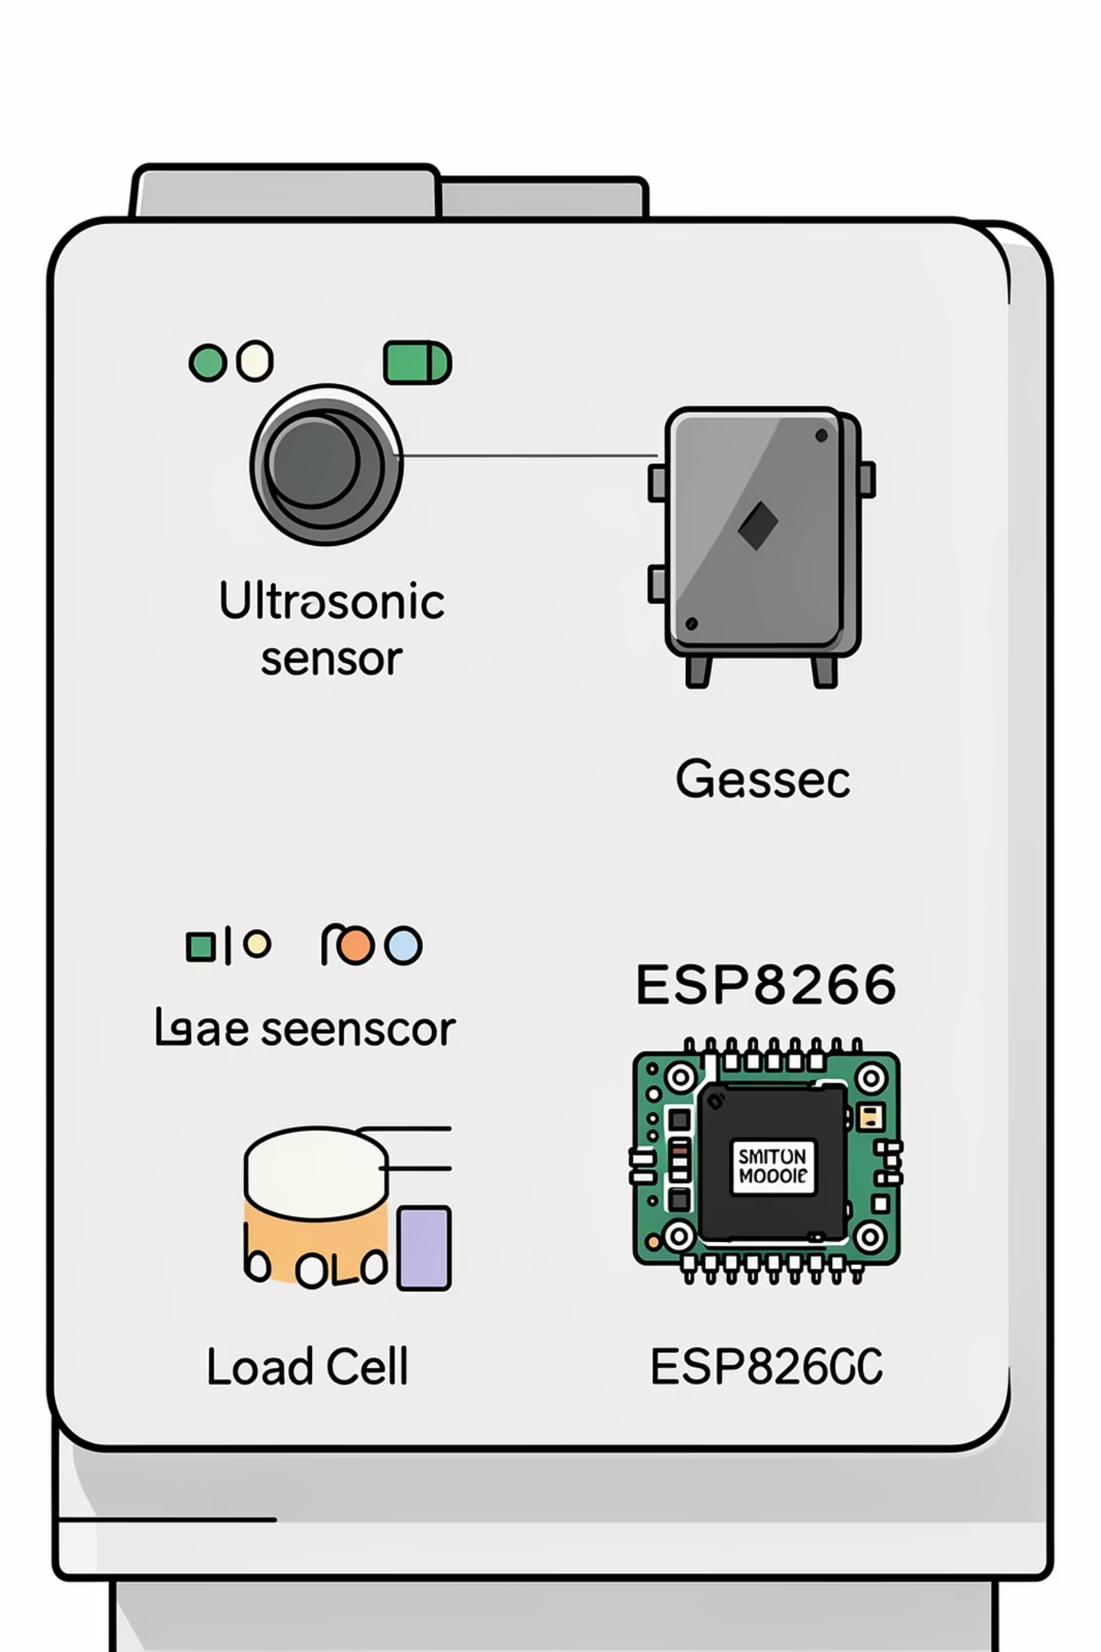
System Components — Smart Bin Hardware
Robust, field-tested sensors and connectivity for accurate, reliable telemetry.
Ultrasonic Sensor
Gas & Moisture Sensors
Load Cell
Measures weight to corroborate volume and detect illegal dumping.
Real-time fill-level detection (distance → percentage).
Detect harmful gases & identify wet/organic waste signatures.
Connectivity
ESP8266 / GSM modules send secure packets to cloud when thresholds cross.

Slide 4
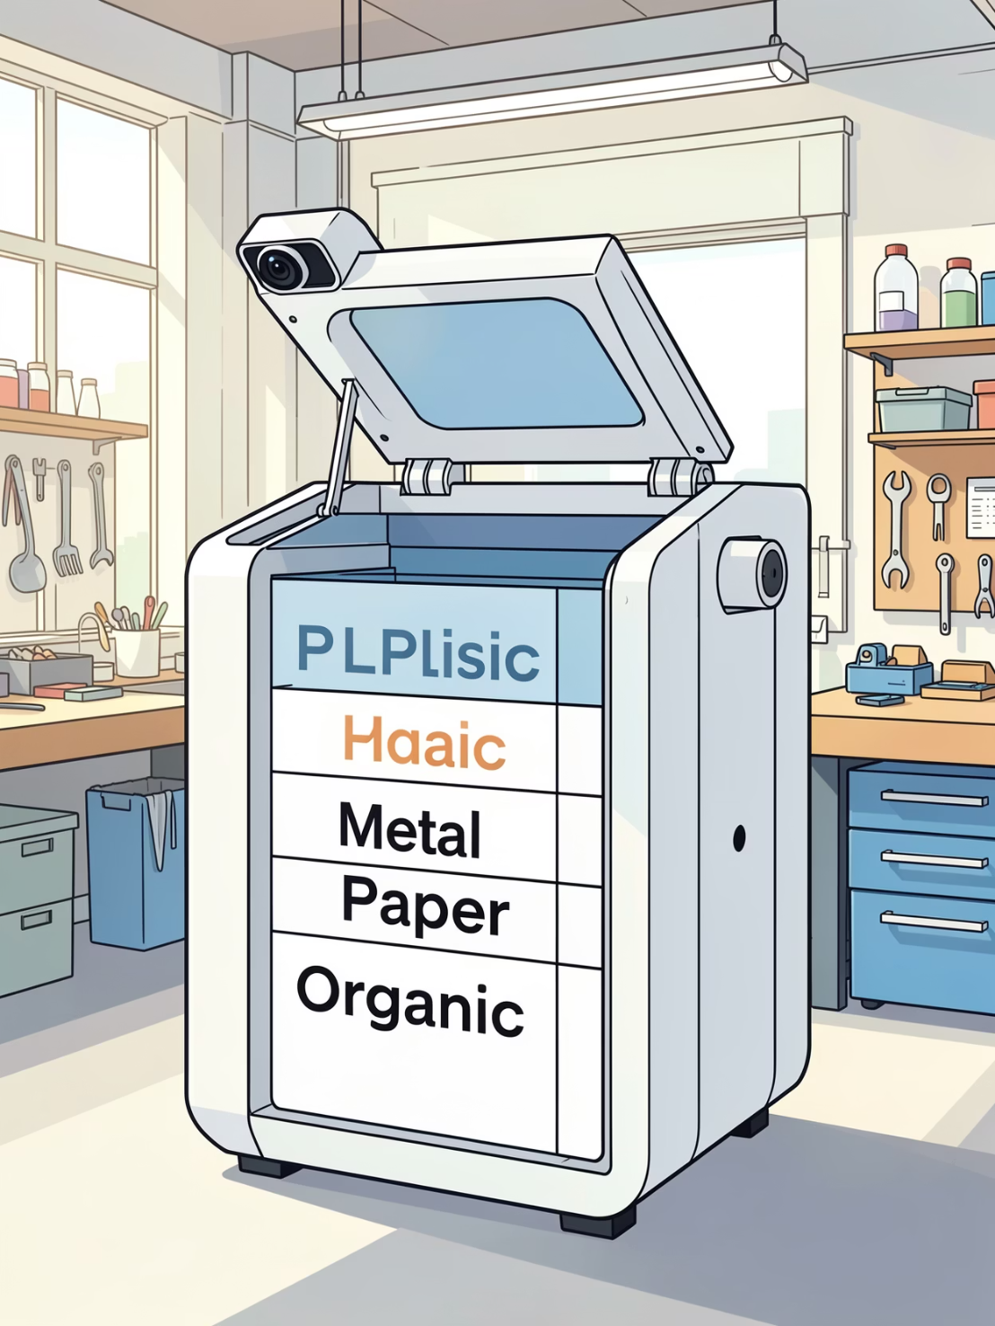
AI-Based Waste Segregation
Camera module with lightweight image-classification model runs locally or at edge. The model recognises common items (plastic, metal, paper, organic) and triggers an automatic flap to route waste to the correct compartment.
Low-latency inference on-device or micro-edge cluster
Periodic model updates using anonymised municipal images
Fallback sensors (moisture, weight) to reduce misclassification

Slide 5
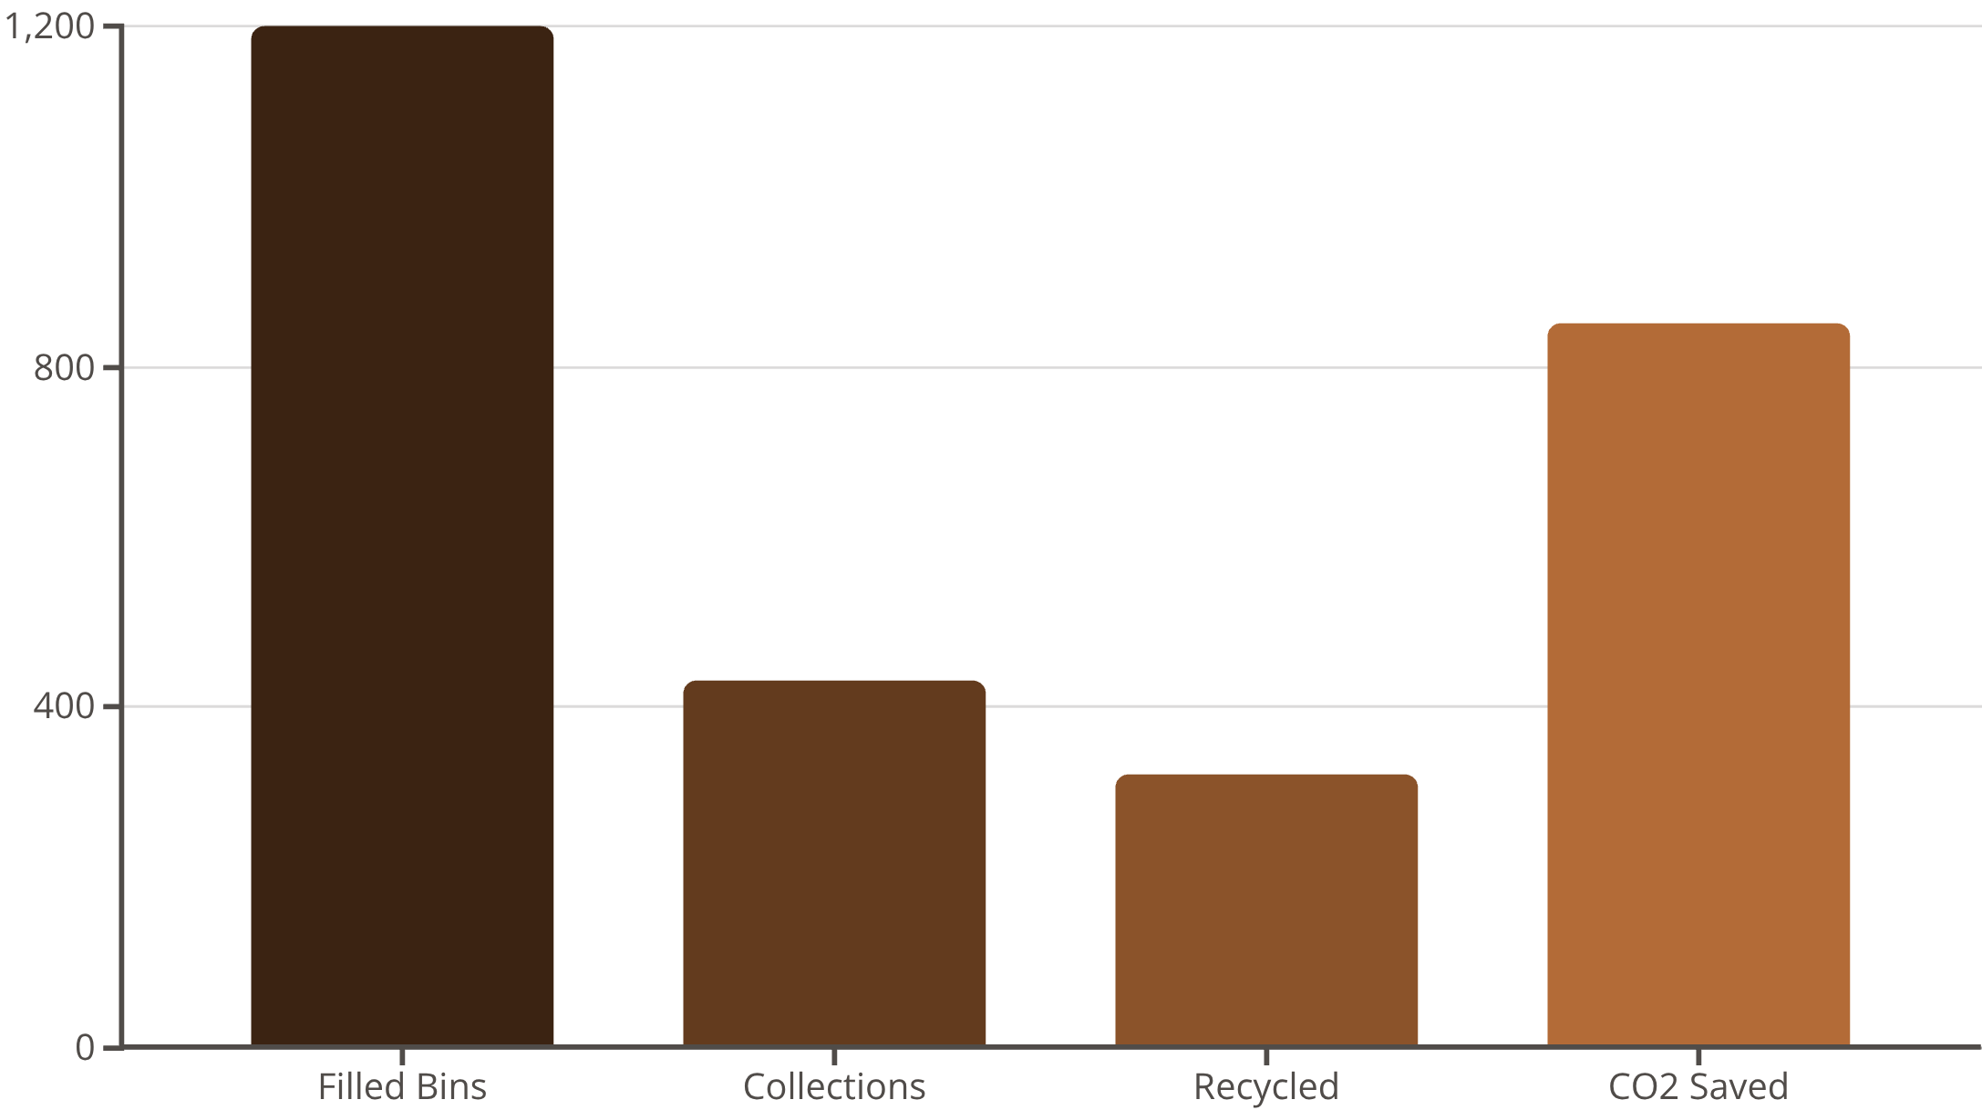
Operational Dashboard & Analytics
The web/app dashboard displays live bin-fill percentages, geo‑locations, historical trends and CO₂-equivalent savings. Features:
Custom alerts when bins exceed thresholds
Heatmaps of hotspot zones and seasonal trends
Role-based access for field crews and managers

Slide 6

Route Optimisation & Field Efficiency
Dynamic routing uses fill-threshold triggers (>80% full), Google Maps API and shortest-path algorithms to produce fuel- and time-efficient runs. Benefits:
Selective Visits
Predictive Scheduling
Operational Savings
Only service bins that require collection, reducing idle miles.
AI forecasts near-future fill states so crews pre-plan shifts and vehicles.
Lower fuel costs, fewer vehicle hours and improved truck utilisation.

Slide 7
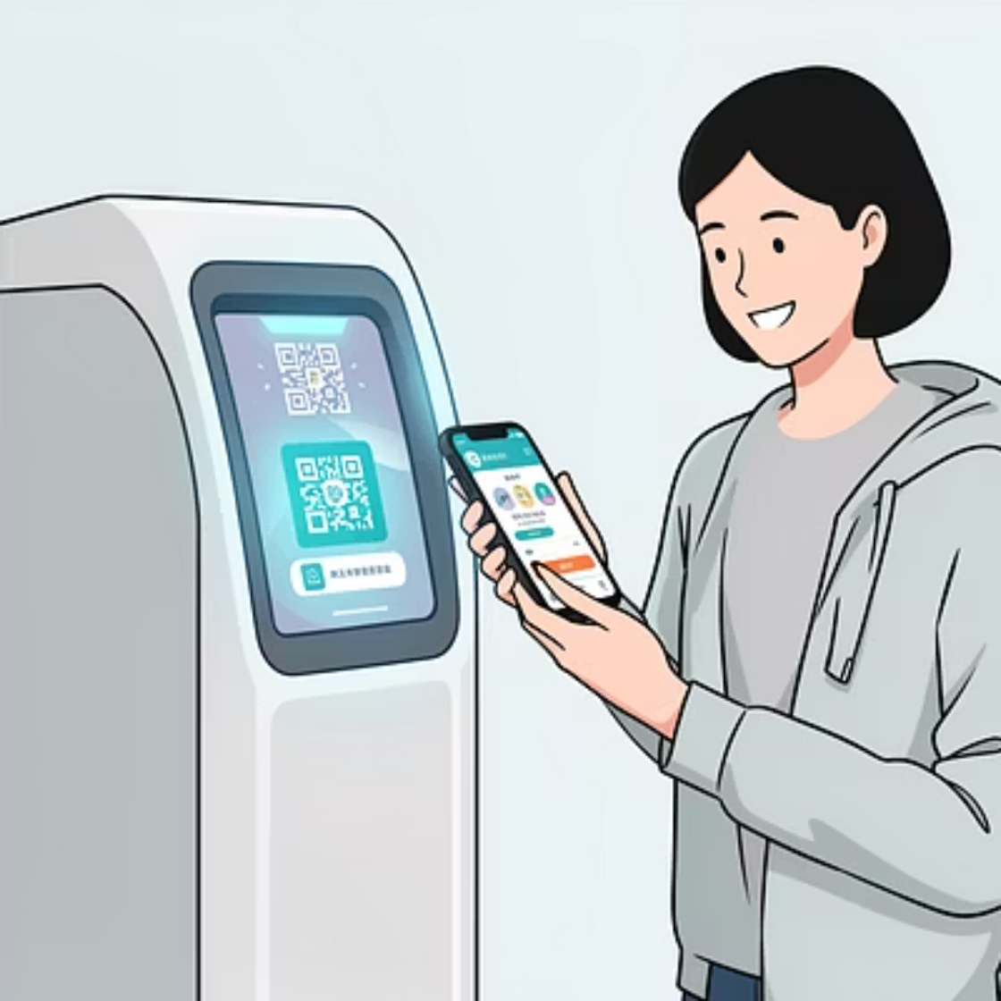
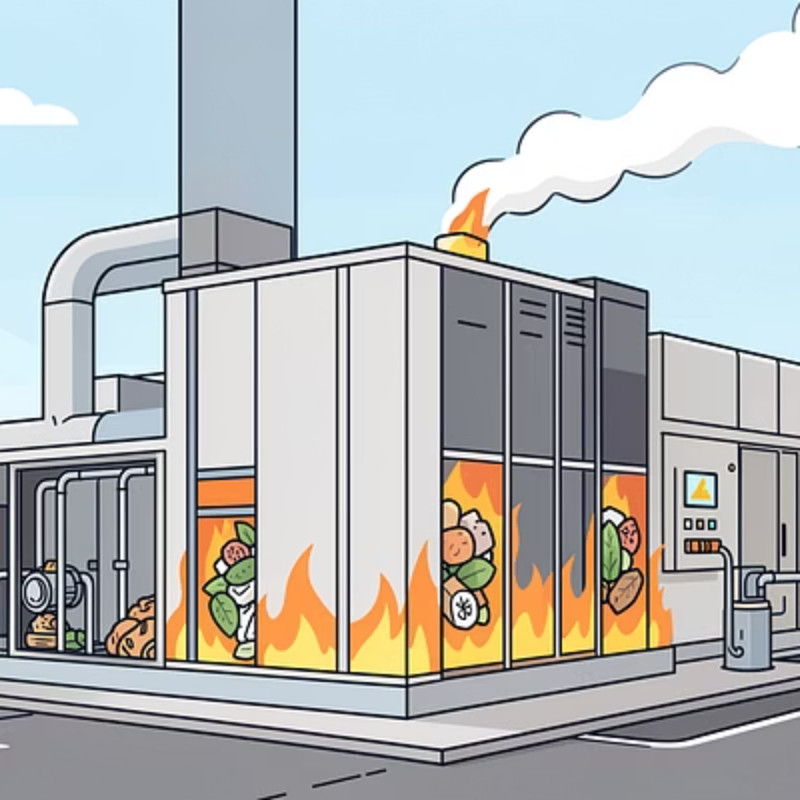
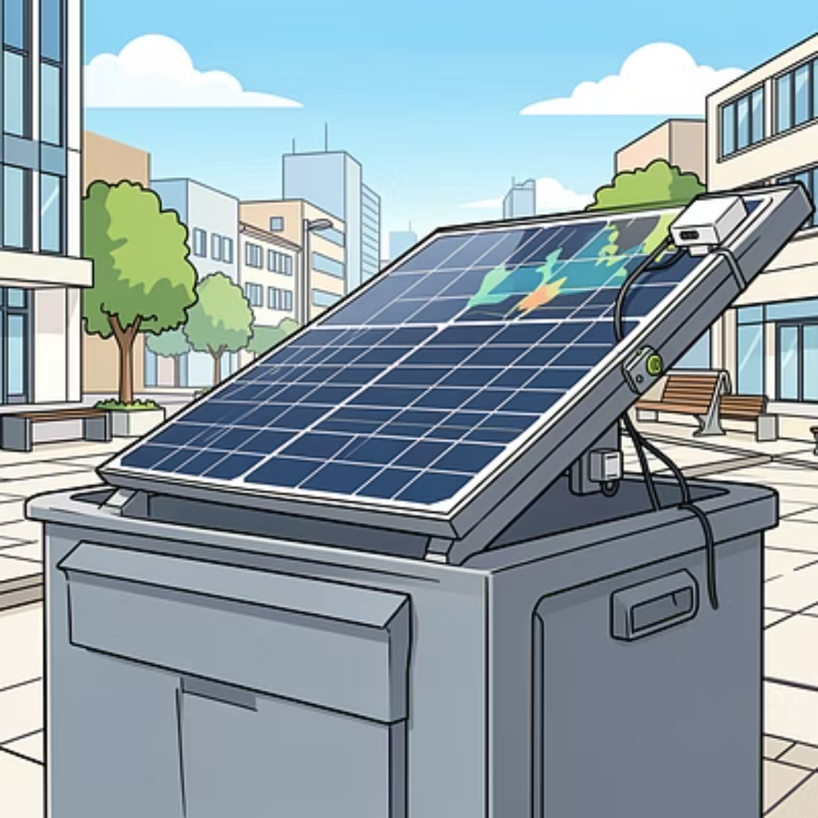



Innovation & Value‑Add Features
Judge‑pleasing innovations that increase engagement and sustainability:
Overflow Prediction
Waste Heat Recovery
Citizen Rewards
Machine learning predicts overflow risk 24–72 hours ahead for proactive action.
Localised systems convert organic heat into small-scale energy for street lighting or bin heating.
QR-based points for correct segregation, redeemable for municipal incentives.

Slide 8

Campaign: Waste Credit Score — Social Incentives
Introduce a “Waste Credit Score”: citizens earn eco-points for correct segregation verified by bin sensors and occasional camera validation. Points can be redeemed for municipal benefits.
Rewards: electricity bill discounts, metro coupons, educational certificates
Transparency: anonymised scoring and public leaderboards for neighbourhoods
Behavioural impact: encourages sustained good habits and increases diversion rates
Next steps: Pilot 50 bins across diverse neighbourhoods for 3 months → measure overflow reduction, collection miles saved and citizen engagement → scale city-wide based on KPIs.

Slide 9
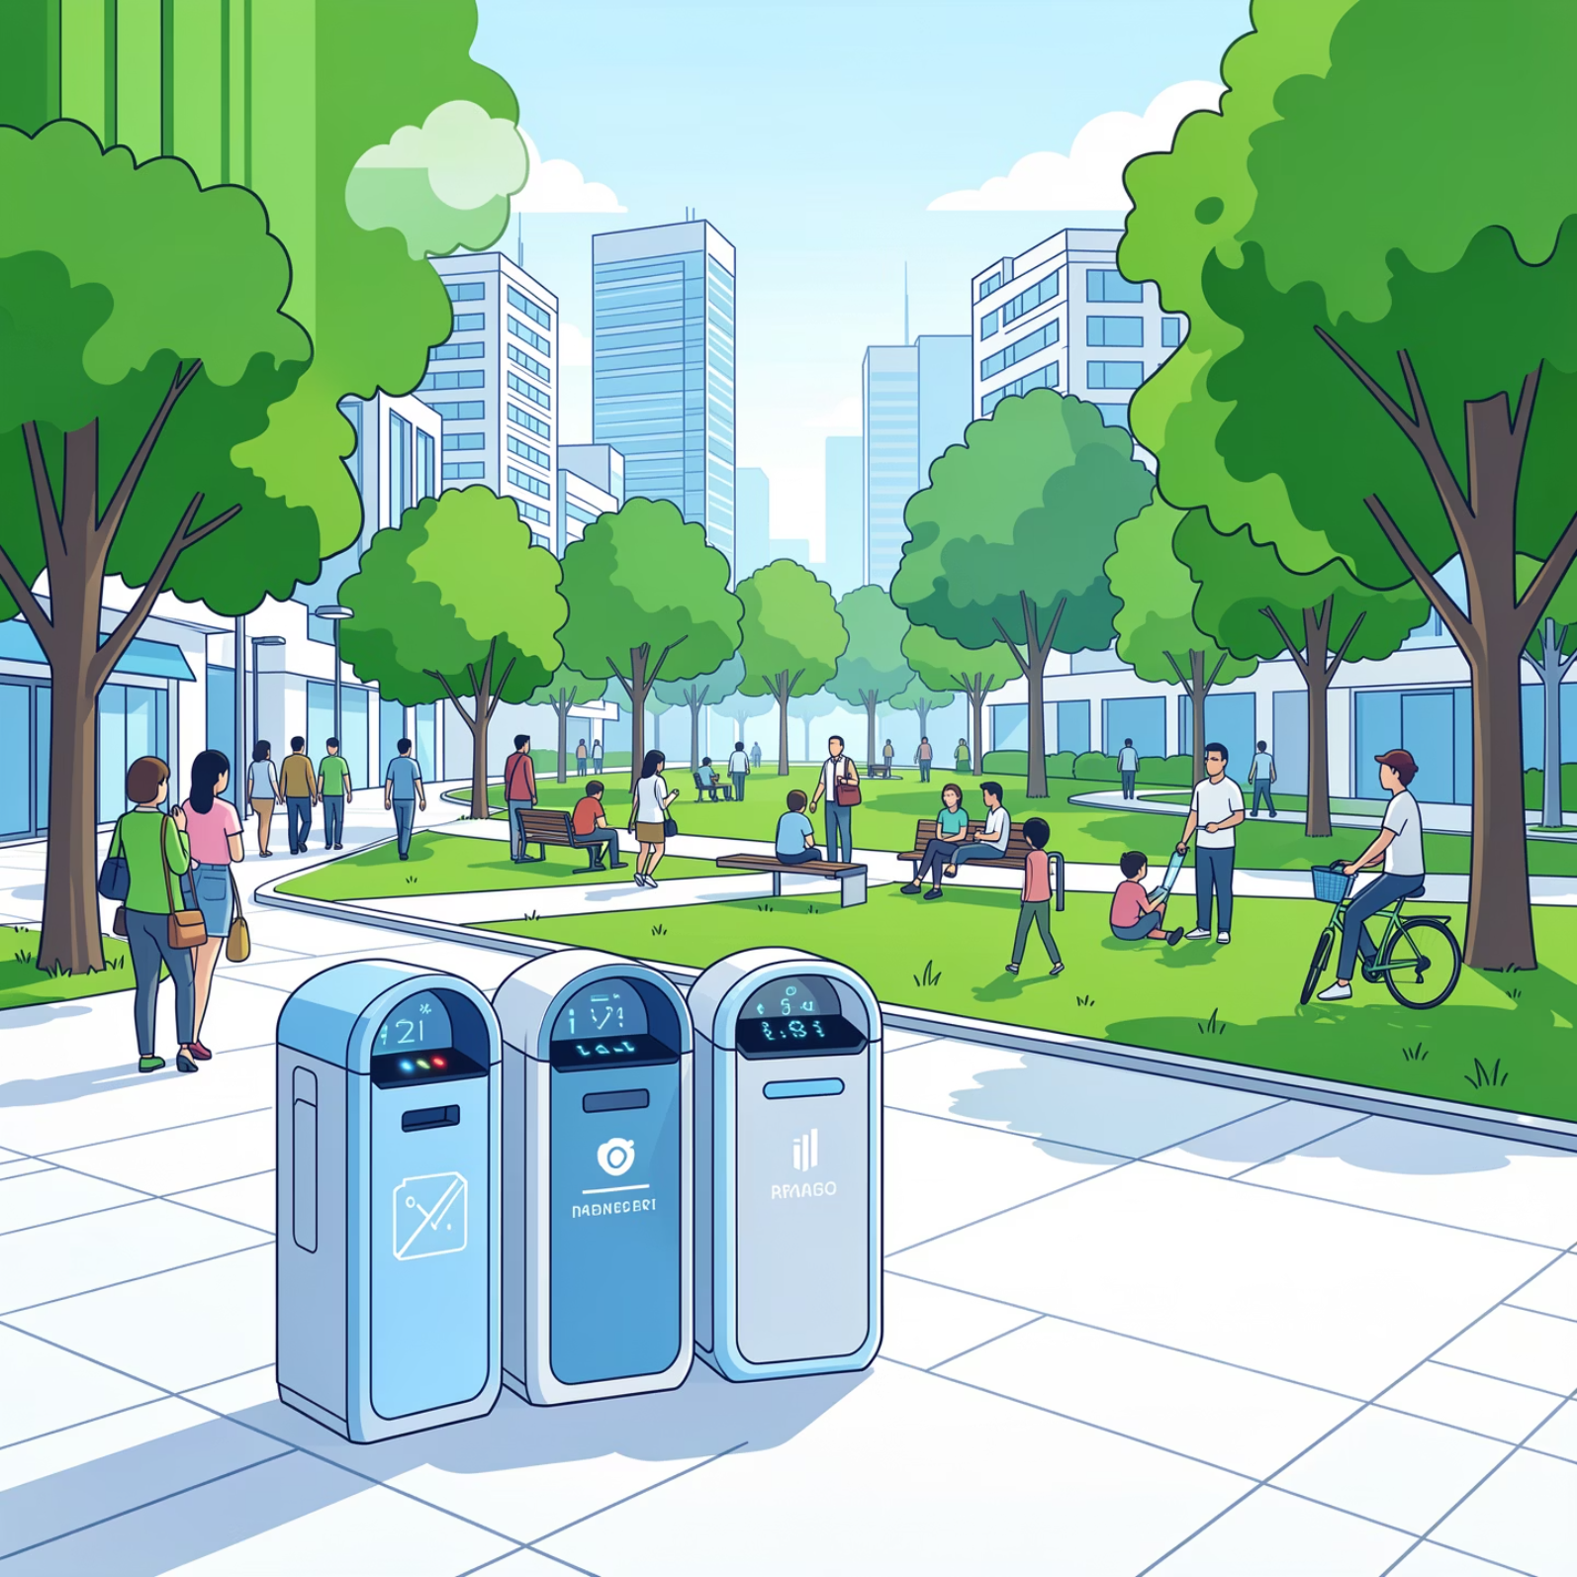
Thank You

