Slide 1



Predictive Adaptive Sampling for Energy-Efficient Edge IoT
3 sensing policies compared
23 papers reviewed
A Quantitative Trade-off Study Against Fixed-Rate and Threshold-Based Baselines
ESP32 · MQTT · MongoDB · React
IoT & Industrial IoT Course Project
Notes:
Introduce the project in one sentence: an IoT sensing node that adapts how often it samples, and a predictive trigger that speeds up sampling before an event starts rather than after. Everything in this talk is a design, a simulation, and a working prototype in code; physical-hardware results are still to come.

Slide 2



Always-On Sensing Wastes Energy
Fixed-rate sensing
Threshold-based sensing
Samples and transmits constantly, even when nothing is happening
Reacts only after a threshold is crossed, so the response is late
Battery-powered nodes: lifetime is the binding constraint
Replacing batteries at scale is costly: buried sensors, remote sites
Fewer transmissions also relieve bandwidth and network congestion
Notes:
Two failure modes. Fixed-rate sensing wastes energy because it samples and transmits constantly even when nothing is happening. Threshold-based adaptive sensing improves on that, but it only reacts after the threshold is crossed, so the response is late. Both matter most for battery-powered nodes, where battery replacement at scale is costly and where fewer transmissions also ease bandwidth.

Slide 3
Literature Review and Research Gap
23
Most adaptive schemes are reactive, not predictive
1
papers reviewed across 5 themes
Results are reported at a single operating point, not a full trade-off curve
2
Classical adaptive sampling
Predictive and event-driven triggers
Energy-harvesting duty-cycling
Edge-AI and TinyML inference
LoRaWAN adaptive data rate
Few studies pair a predictive trigger with real hardware and full multi-metric results
3
Notes:
We reviewed 23 papers across five themes: classical adaptive sampling, predictive and event-driven triggers, energy-harvesting duty cycling, edge-AI and TinyML, and LoRaWAN adaptive data rate. Three gaps recur. First, most schemes are reactive rather than predictive. Second, results are usually reported at a single operating point instead of a full trade-off curve. Third, few studies combine a predictive trigger with real hardware and full multi-metric reporting.

Slide 4

Research Question and Objectives
Can a lightweight predictive trigger beat threshold-based sampling on energy and data volume without hurting accuracy or latency?
1
Build an adaptive edge sensing node
2
Implement three sensing policies
3
Collect real data with induced events
4
Compare energy, data volume, accuracy and latency
5
Plot the full accuracy-vs-energy trade-off curve
Notes:
The question is whether a lightweight predictive trigger can beat threshold-based sampling on energy and data volume without hurting accuracy or latency. The five objectives run from building the node, to implementing the three policies, to collecting real data with induced events, to comparing all four metrics, and finally plotting the full accuracy-versus-energy trade-off curve rather than a single operating point.

Slide 5


Proposed Method: Three Sensing Policies
Baseline
Baseline
Proposed
Fixed-rate
Threshold-adaptive
Predictive-adaptive
Constant sampling interval
Slow by default; speeds up after a threshold is crossed
Trend estimator speeds up sampling before the threshold is crossed
Sampling instants, simulated 20 s trace
Sampling instants, simulated 20 s trace
Sampling instants, simulated 20 s trace
0 s
10 s
20 s
0 s
10 s
20 s
0 s
10 s
20 s
20 samples
52 samples
65 samples
No adaptation: same rate all the time
High rate starts 400 ms after the event starts
High rate starts 400 ms before the event starts
Notes:
All three policies run on identical hardware. Fixed-rate samples at a constant interval. Threshold-adaptive samples slowly until a reading crosses a threshold, then speeds up. The proposed predictive-adaptive policy watches the recent trend and speeds up before the threshold is crossed. The tick marks in each card are the real sampling instants from the simulated 20-second trace, so the shaded band is the event and the dense region shows when each policy switched to high-rate sampling.

Slide 6




System Architecture
ESP32 node
MQTT broker
Python logger
MongoDB
REST API
Dashboard
3 policies
Mosquitto
paho-mqtt
4 collections
FastAPI
React
Same hardware and logging path for all three policies
Energy measured directly with a current-sense sensor
Every reading is published, logged and analysed offline
MQTT topics: sensor/reading · sensor/event · sensor/energy
Notes:
The path is one straight line: the ESP32 node publishes readings over MQTT to a broker; a Python logger subscribes and writes every message into MongoDB; a REST API serves that data; and the dashboard displays it. Three things keep the comparison fair: all three policies share the same hardware and logging path, energy is measured directly with a current-sense sensor, and every reading is published, logged, and analysed offline. The three MQTT topics are sensor/reading, sensor/event, and sensor/energy.

Slide 7


Hardware and Prototype
ESP32 development board
Wiring overview
DC motor
event inducer
ADXL345 accelerometer (vibration)
vibration
ADXL345
accelerometer
ESP32
3 sensing policies
I²C
INA219 current sensor (energy)
MQTT broker
laptop or Raspberry Pi
18650 Li-ion battery
INA219
current sensor
I²C + power
Wi-Fi / MQTT
Small DC motor (event inducer)
power
18650 battery
Estimated hardware cost: about $30 to $50
ADXL345 (0x53) and INA219 (0x40) share one I²C bus
Notes:
The rig is deliberately small and cheap. An ESP32 runs the three policies. An ADXL345 accelerometer senses vibration and an INA219 measures the node's own current, so energy is measured rather than estimated. A small DC motor creates repeatable vibration events at known times. The two I2C sensors share one bus at different addresses. The cost is an estimate of roughly 30 to 50 dollars, using a laptop as the MQTT broker. The firmware is written but this rig has not been built or run yet.

Slide 8
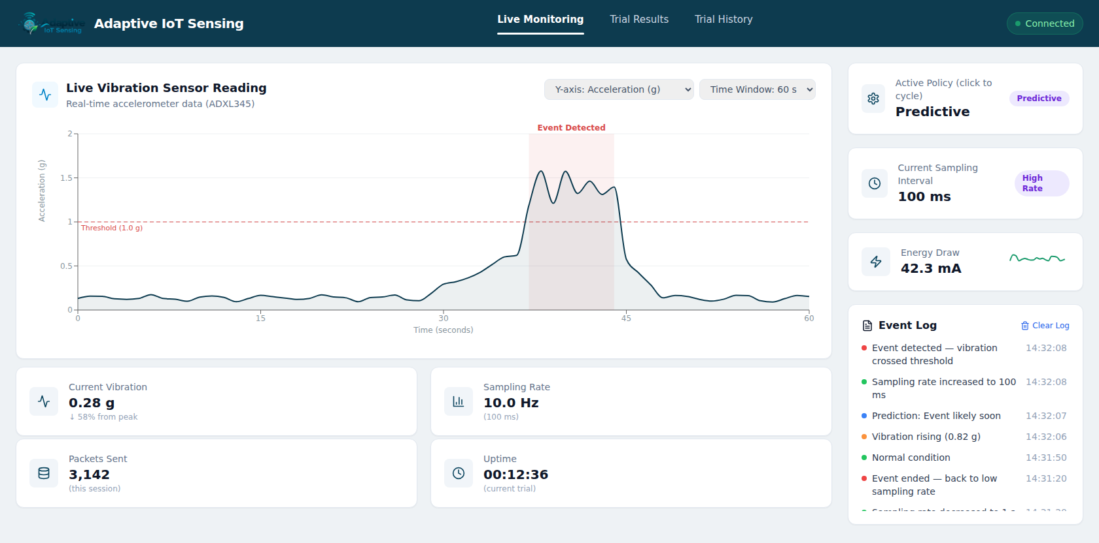


Monitoring Dashboard
Live Monitoring
Real-time vibration, active policy and energy draw
Trial Results
Accuracy-vs-energy trade-off curve
Trial History
Filter, sort and compare past trials
Interface preview (sample data)
React · FastAPI · MongoDB
Notes:
The dashboard has three pages. Live Monitoring shows the vibration signal, the active policy and sampling interval, energy draw, and an event log. Trial Results shows the accuracy-versus-energy trade-off curve and a policy comparison table. Trial History lets you filter, sort, and open past trials. Every control works, but the pages currently run on sample data, not measurements, so the screenshot is labelled as an interface preview. Connecting it to the FastAPI backend and MongoDB is the next integration step.

Slide 9

Experimental Design and Metrics
1
Run all three policies under identical induced events
2
Log ground-truth event times
Energy
Latency
(mJ)
(ms)
3
Sweep the predictive trigger's sensitivity
4
Ablate: with vs. without trend pre-emption
Accuracy
Bandwidth
(%)
(bytes sent)
Notes:
The plan is a controlled comparison. Run all three policies under identical induced events, log ground-truth event times so latency and accuracy can be scored objectively, sweep the predictive trigger's sensitivity to get a whole trade-off curve rather than one point, and run an ablation with and without trend pre-emption to show which component actually helps. The four metrics are energy in millijoules, detection latency in milliseconds, accuracy as a percentage, and bandwidth as bytes sent.

Slide 10
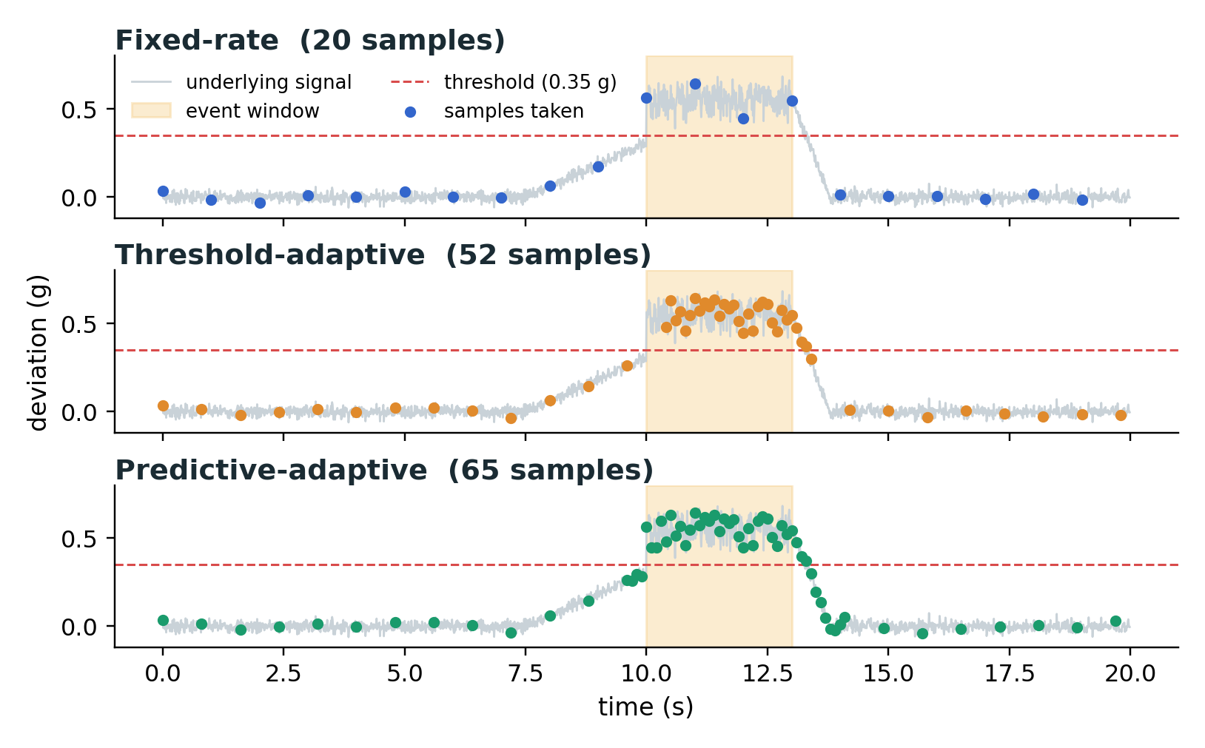
Results: Pre-Hardware Simulation
Policy | Samples | High-rate start
Fixed-rate | 20 | n/a
Threshold-adaptive | 52 | +400 ms
Predictive-adaptive | 65 | −400 ms
Times relative to event start (0 ms)
Predictive switched to high-rate sampling 800 ms earlier than the threshold policy, for 13 extra samples
Pre-hardware simulation (synthetic event)
Synthetic 20-second trace with one induced event. Trigger sensitivity was tuned on this same trace. Physical-hardware results pending.
Notes:
Be precise about what this is. It is a simulation of the decision logic on one synthetic 20-second trace with a single induced event, not a hardware result. Relative to the event start, the threshold policy switched to high-rate sampling 400 milliseconds after it, and the predictive policy 400 milliseconds before it: an 800 millisecond gap. The cost was 13 extra samples, 65 versus 52. Important caveat: the trigger sensitivity of 0.035 was tuned on this same trace, so this shows the logic works, not how it will perform on a real sensor. Physical-hardware results are pending.

Slide 11


Limitations and Future Work
Limitations
Future Work
Not yet validated on physical hardware
Simulation uses a single synthetic event
Accuracy metric is a placeholder until labelled data exists
Trigger value was tuned on the same trace it is evaluated on
Run real trials on the ESP32 rig
Sweep trigger sensitivity for the full trade-off curve
Compare light sleep with deep sleep
Add precision, recall and F1 scoring
Notes:
Stating the limits plainly: nothing has run on physical hardware yet; the simulation uses one synthetic event; the accuracy metric in the analysis scripts is a placeholder derived from detection latency until labelled multi-event data exists; and the trigger value was tuned on the same trace used to evaluate it. Next steps are real trials on the ESP32 rig, a sensitivity sweep for the full trade-off curve, a comparison of light sleep with deep sleep, and proper precision, recall and F1 scoring.

Slide 12


Conclusion and Expected Contribution
Full accuracy-vs-energy trade-off curve, not a single point
Reproducible low-cost reference design (under $50)
A lightweight on-device predictive trigger, tested against fixed-rate and threshold baselines
Early simulation: predictive triggers before the event begins
Notes:
The contribution is a lightweight on-device predictive trigger evaluated against fixed-rate and threshold baselines, reported as a full accuracy-versus-energy trade-off curve rather than one number, on a reproducible low-cost reference design. The early simulation shows the idea works as intended: the predictive policy switched to high-rate sampling before the event began. The remaining work is the real-hardware experiment that will show how much it actually helps.

Slide 13
Questions?
Thank you
Notes:
Likely questions: why trust a simulation tuned on one trace (answer: it only validates the logic; hardware trials are the real test); why light sleep rather than deep sleep (state is preserved, simpler first); how accuracy will be scored (labelled multi-event trials, precision/recall/F1).

Slide 14
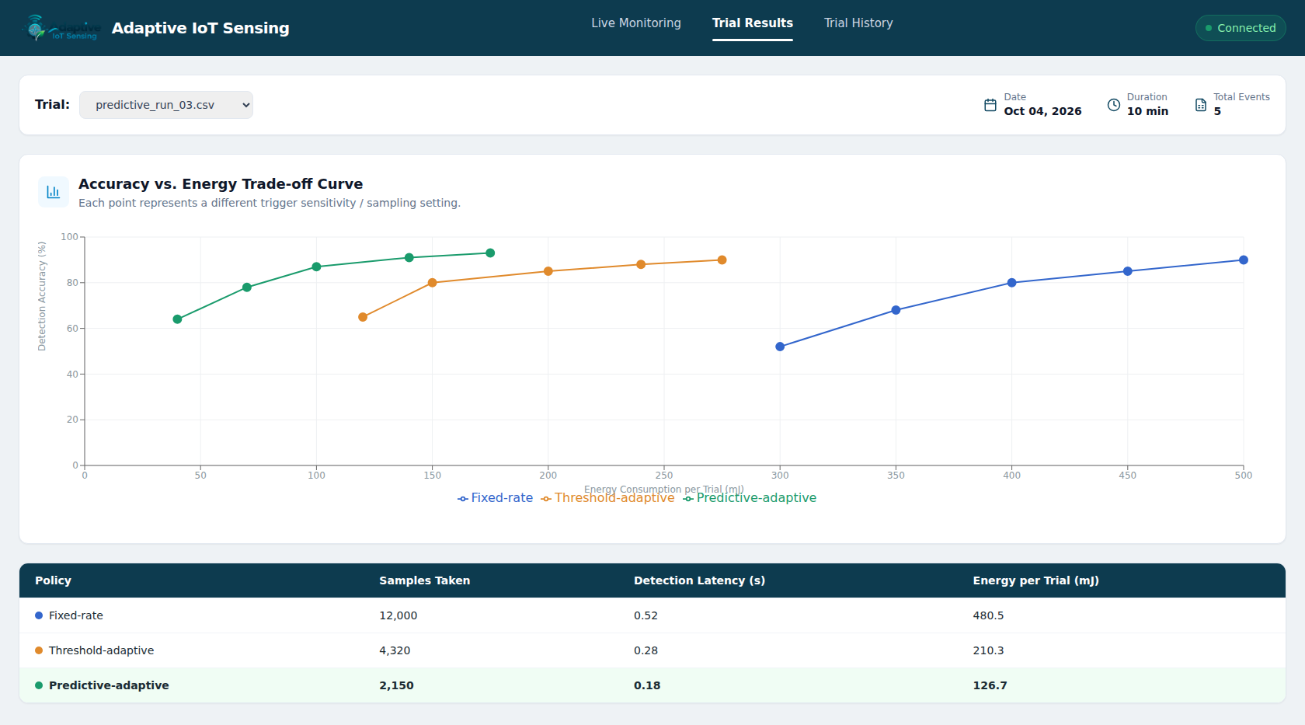
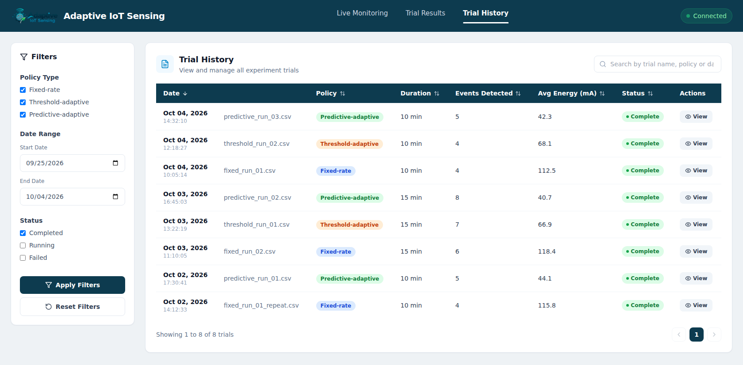
Appendix: Dashboard Pages
Trial Results
Trial History
Accuracy-vs-energy trade-off curve and policy comparison (sample data)
Filter, sort and open past trials (sample data)
Notes:
The other two dashboard pages. Both run on sample data for now; the trial list on Trial History and the Trial Results metadata are driven by the same sample trial list, so selecting View on a trial opens it in Trial Results.

Slide 15
Appendix: Closest Prior Work
Work | Reported result | Limitation | This project
Ambrosia (Sci. Rep. 2021) | 60% less data sent; 2x battery life (real LoRa/BLE deployment) | Adapts transmission only, not the sampling rate | Adapts sampling and transmission together
TinyML agri. sampling (2026) | 77.8% energy reduction vs. fixed interval (60-day field pilot) | One slow variable (temperature) | Targets fast vibration events
Two-to-One Trigger (2025) | 41.9% fewer CO2 measurements; MAE 0.0089 | Authors call for adaptive thresholds | Predictive, adaptive trigger
DGAST protocol | 78% energy reduction; 94.6% accuracy | Simulation and dataset replay only | Live energy measurement (planned)
EdgeSpike (2026) | 91.4% mean accuracy; 6.3x projected battery life | Best gains need neuromorphic hardware | Lightweight trigger on an ESP32-class node
Telemetry predictor (patent) | Predictor triggers a fast sampler before the fault | No quantitative benchmark disclosed | Real-hardware validation (planned)
Full 23-paper comparison matrix: Deliverable 2
Notes:
Six of the closest works from the 23-paper review. The reported results are as stated in each source. The right-hand column states how this project differs; items marked planned depend on the hardware experiment that has not been run yet. The full comparison matrix is in Deliverable 2.

Slide 16
Appendix: Bill of Materials
Component | Purpose | Approx. cost
ESP32 development board (deep-sleep capable) | Main compute and adaptive-sampling logic | $6–10
ADXL345 (or MPU6050) accelerometer | Vibration sensing over I²C | $3–8
INA219 current-sense breakout | Direct energy and current measurement | $5–8
Small DC motor | Induces repeatable vibration events | $5–10
18650 Li-ion cell and holder | Realistic battery-life projection | $5–8
Breadboard, jumper wires, USB cable | Prototyping | $5
Laptop (or Raspberry Pi) as MQTT broker host | Mosquitto broker and data logging | $0 laptop / ~$35 Pi
Total, without a Raspberry Pi |  | ≈ $29–$49
Rough estimates from Deliverable 1; prices vary by supplier
Notes:
Line items are the rough estimates from the Deliverable 1 bill of materials. They add up to about 29 to 49 dollars without a Raspberry Pi, using a laptop as the MQTT broker, which is why the slides say about 30 to 50 dollars. Treat them as estimates; prices vary by supplier.

Slide 17
Appendix: Selected References
Algabroun, H., & Håkansson, L. (2025). Parametric Machine Learning-Based Adaptive Sampling Algorithm for Efficient IoT Data Collection in Environmental Monitoring. Journal of Network and Systems Management, 33(5). doi:10.1007/s10922-024-09881-1
A data-driven approach to increasing the lifetime of IoT sensor nodes (2021). Scientific Reports, 11, 22459.
Smart Energy Management in Agricultural Wireless Sensor Nodes Using TinyML-Based Adaptive Sampling (2026). Sensors, 26(7), 2014. doi:10.3390/s26072014
Two-to-One Trigger Mechanism for Event-Based Environmental Sensing (2025). Sensors, 25(13), 4107. doi:10.3390/s25134107
EdgeSpike: Spiking Neural Networks for Low-Power Autonomous Sensing in Edge IoT Architectures (2026). arXiv:2604.27004.
Low-Power Embedded Sensor Node for Real-Time Environmental Monitoring with On-Board Machine-Learning Inference (2026). Sensors, 26(2), 703. doi:10.3390/s26020703
An energy-efficient adaptive sampling scheme for wireless sensor networks (DGAST protocol).
Telemetry-based anomaly detection (predictive triggering system). U.S. Patent/Publication No. 12,556,607.
ITU-T Recommendation L.1341 (2025). Energy efficiency requirements for IoT platforms.
Green Edge AI: A Contemporary Survey (2025). arXiv preprint.
Complete reference list: Deliverables 1 and 2
Notes:
Selected references from the project's literature review. The complete reference list is in Deliverables 1 and 2. Bibliographic details should be checked against each source and reformatted to the required citation style before final submission.

