Slide 1
Big Data Technology Twitter Live Data Analyzer
Prepared By: Chandan Karmakar
Mentor: Prof. Mrudula Mukadam

Slide 2
Content
Project Overview
Technologies Used
Project Architecture
Twitter API Overview
Kafka Overview
Spark Streaming
Kafka to HBase
Project Setup

Slide 3
Project Overview
First, I get the twitter real streaming data using Twitter API
I used Kapka topic of Kafka messaging tool for store tweets
Using Spark Streaming to get twitter data from Kafka and apply some filter and aggregation to give structure
Then use HBase table for store data

Slide 4
Technologies Used
CentOS Version 6.7
Java Version 8
Eclipse Version LUNA 4.4.2
Maven
Twitter API Version 2
Kafka Version 3.1.0
Spark Version 1.6.0
HBase Version 1.3.2

Slide 5




Project Architecture
Kafka Producer
Kafka Consumer
Twitter DataSource
Kafka Topic
Result

Slide 6
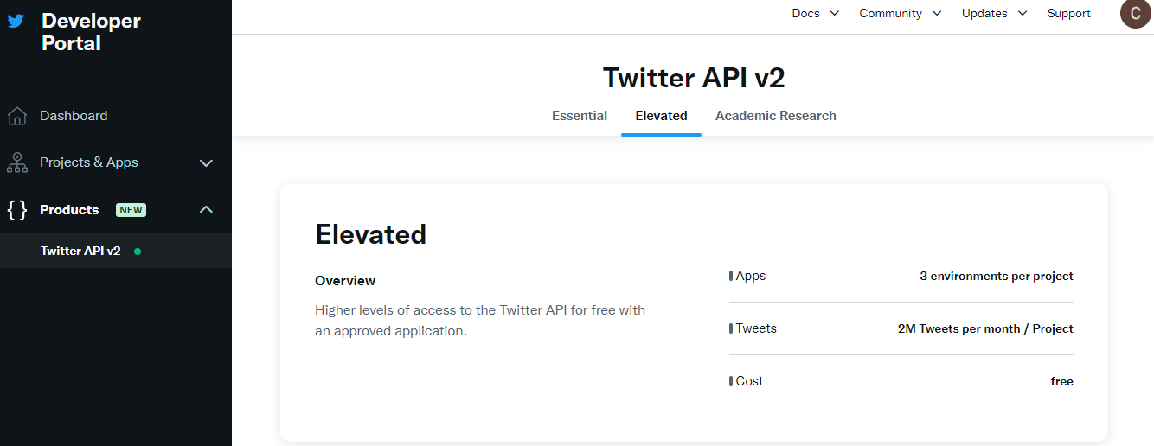
Twitter API Overview

Slide 7
Kafka Overview
Download Kafka (https://kafka.apache.org/downloads)
Start Zookeeper from Kafka directory (bin/zookeeper-server-start.sh config/zookeeper.properties)
Start Kafka server (bin/kafka-server-start.sh config/server.properties)
Create Kafka topic (bin/kafka-console-consumer.sh --bootstrap-server localhost:9092 --topic tweet-topic --from-beginning)
Kafka Producer (bin/kafka-console-producer.sh --broker-list localhost:9092 --topic tweet-topic)

Slide 8
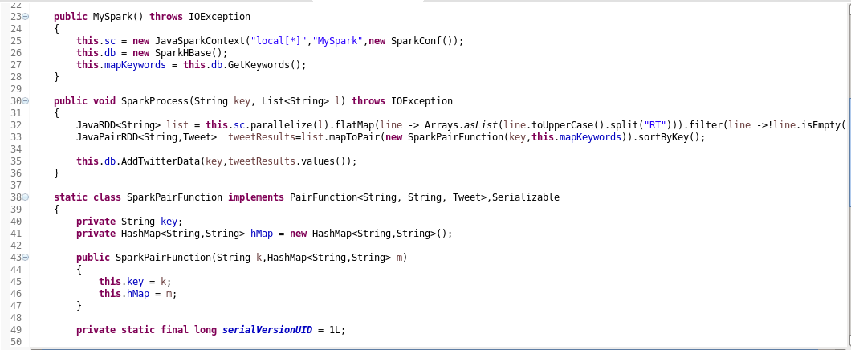
Spark Streaming
Using Twitter Bearer token get the tweets from Twitter API
Use Stream GET API https://api.twitter.com/2/tweets/sample/stream for streaming tweets

Slide 9
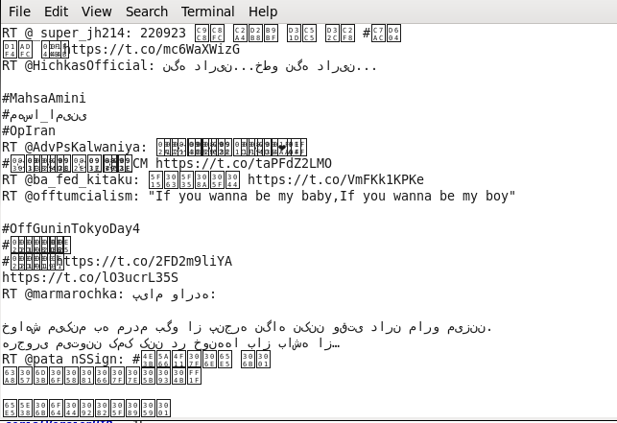
Spark Streaming …

Slide 10
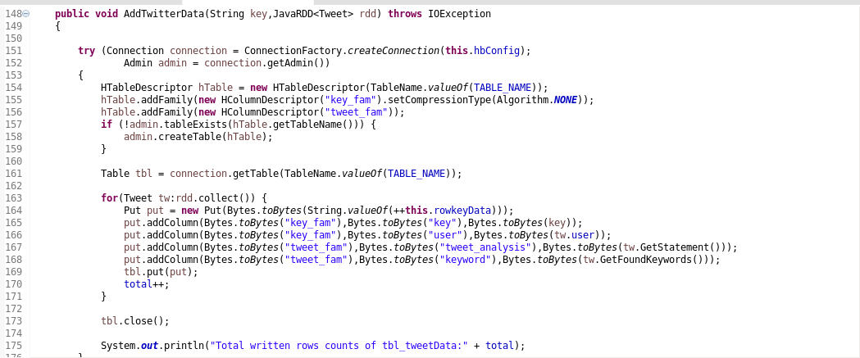
Kafka to HBase

Slide 11
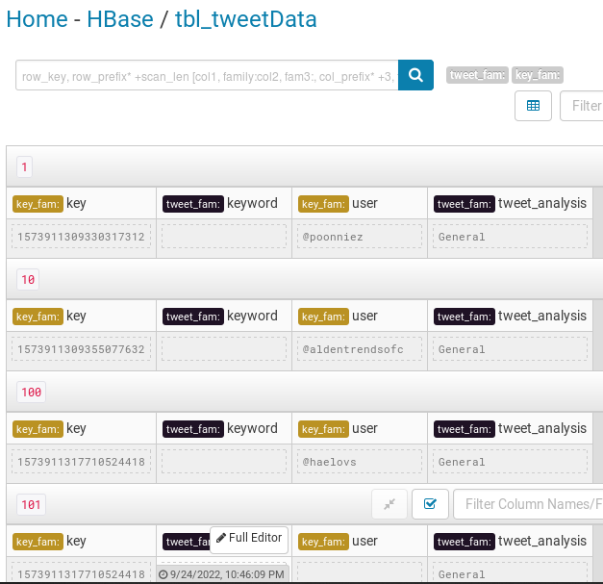
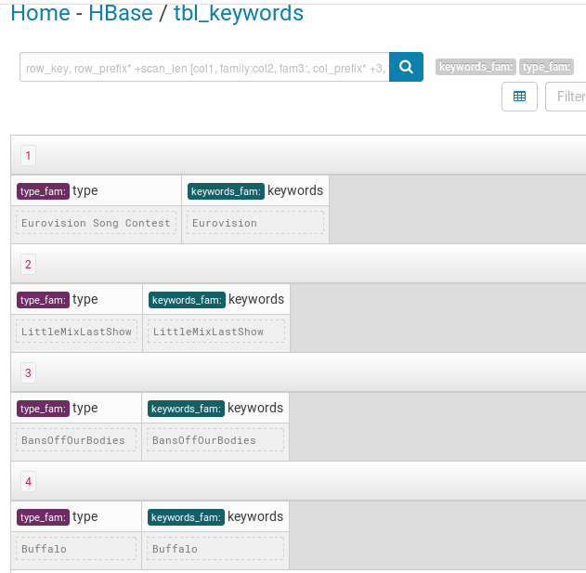
Kafka to HBase…

Slide 12
Project Setup
Step 1: Create a Twitter Developer Account.
Step 2: Create a Twitter App and change the access level into “Elevated”, then get Bearer Token
Step 3: Download the Kafka and put it into /opt directory
Step 4: Run Zookeeper using terminal from Kafka direcotry
Step 5: Run Kafka broker Server using terminal from Kafka directory
Step 6: Create Kafka topic using terminal

Slide 13
Project Setup…
Step 7: Run the KafkaTwitter project in Eclipse and we will see the tweets from the twitter in the console
Step 8: Run KafkaSpark project in Eclipse and it will filter and aggregate the data and save into HBase.
Step 9: Login Cloudera Manager and start Spark, Hue, Hbase in the browser.
Step 10: Go to the Hbase browser and we view see the two tables
Step 11: Then we will select the table and we can view the data

Slide 14
Thank you!

