Slide 1
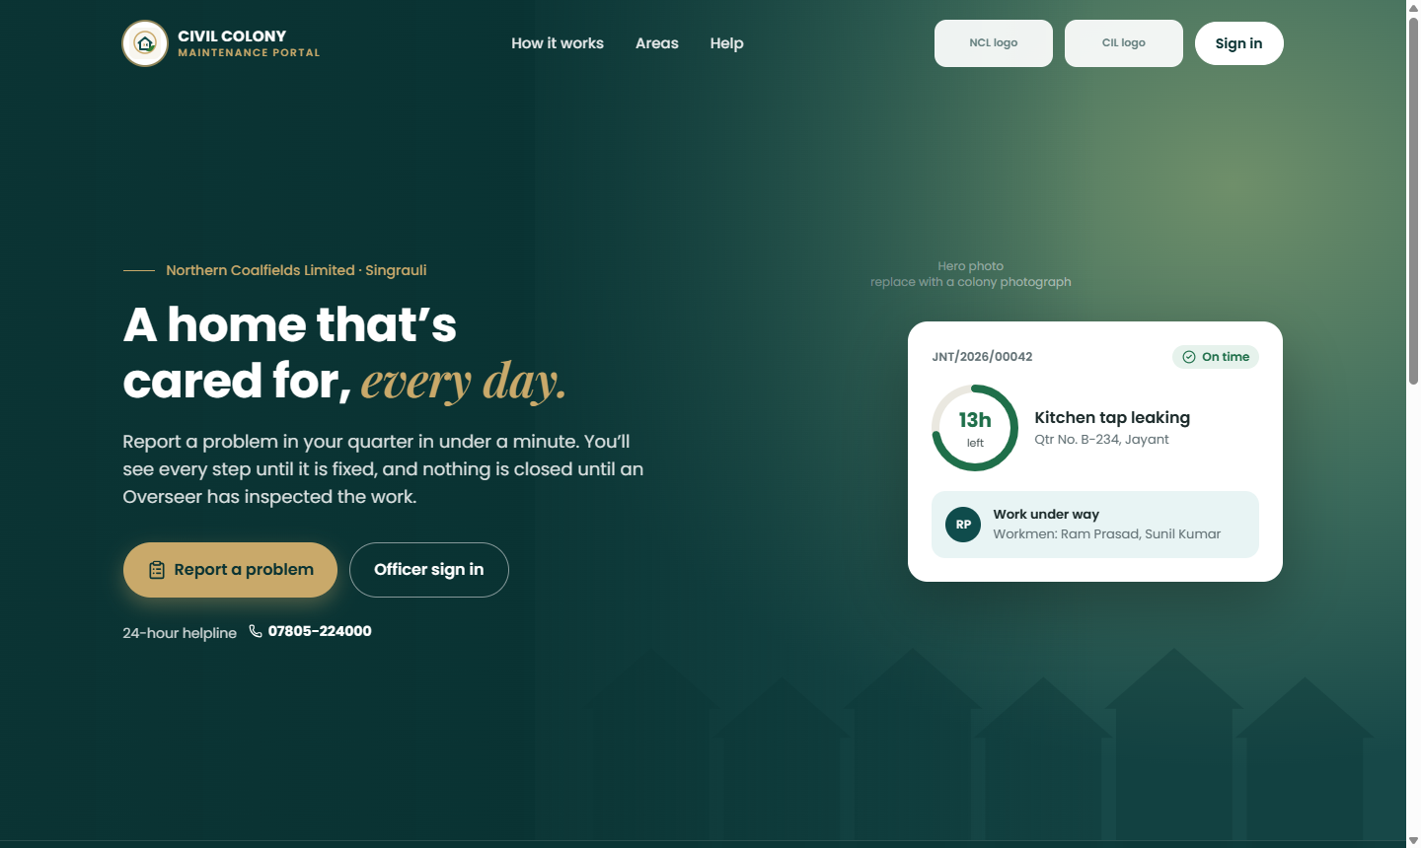
NORTHERN COALFIELDS LIMITED · CIVIL DEPARTMENT
Colony Maintenance Portal
A contract performance record that holds up in a dispute — for 15,000 quarters across 13 Areas
Presentation to management
October 2026

Slide 2
AGENDA
What this presentation covers
01
The situation today
02
What the portal must do
Scale, the comprehensive maintenance contract, the paper register
Requirements set by the department
03
How the portal works
04
Use cases
Roles, the complaint lifecycle, the contractor's clock, nine controls
Resident, contractor, Overseer and Incharge, Staff Officer, HQ
05
Benefits to NCL
06
Status, roadmap and decisions needed
What changes, measured capacity and cost of storage
What is built, what is next, what management must decide
Colony Maintenance Portal · NCL Civil Department
2

Slide 3
THE SITUATION TODAY
One portal for every NCL colony
13
15,000
~130
1
Areas, each with its own colony,
maintenance office and contract
quarters
non-residential buildings —
hostels, dispensaries, schools, offices
comprehensive maintenance
contractor per Area contract
The thirteen Areas — the code appears in every complaint number, e.g. JNT/2026/00042
AML Amlohri
NGH Nigahi
JNT Jayant
DCH Dudhichua
KHD Khadia
KSL Krishnashila
BINA Bina
KKR Kakri
JRD Jhingurda
BLB Block-B
CWS Central Workshop
NSC Nehru Shatabdi Chikitsalaya
NHQ NCL HQ Colony
Colony Maintenance Portal · NCL Civil Department
3

Slide 4
THE PROBLEM
Why the paper register no longer works
?
No evidence of performance
⏱
Delay cannot be attributed
✓
Closure on the contractor's word
A complaint book cannot prove when work was assigned, done or checked. Contract disputes become one word against another.
Contractor time, departmental waiting and the occupant's locked door are mixed together.
Work is "done" when the contractor says so; inspection is a signature, not a check.
↻
Repeat faults hidden
👁
No visibility upward
✎
Records can be altered
The same leak patched three times looks like three successes, not one failure.
Incharge, Staff Officer and HQ learn of backlogs only when a resident escalates in person.
Entries are rewritten, pages lost; nothing shows who changed what, or when.
Colony Maintenance Portal · NCL Civil Department
4

Slide 5
REQUIREMENTS
What the department asked for
1
Residents
2
Department
raise complaints from a phone, in English or Hindi, and see every step
verifies, assigns, inspects on site and closes — never the contractor
3
Contract
4
SLA
every complaint counts as evidence for or against the Area's contractor
response and completion figures per fault type, with escalation to GM
5
Fairness
6
Security
contractor judged only on time the job was in their hands
each Area sees only its own data; no passwords to share; tamper-proof history
7
Records
8
Evidence only
work orders, job cards and materials kept with reasons for every change
no penalties or bills computed — judgement stays with the department
Colony Maintenance Portal · NCL Civil Department
5

Slide 6
THE SOLUTION
The answer: a record built to be relied on
The portal is not mainly a work-assignment tool. Every complaint is evidence of whether the contractor is meeting the contract — so every design choice protects the integrity of that record.
Two keys to close
Fair clock
Database-enforced
Permanent history
Evidence only
Contractor claims, Overseer inspects on site with a geo-tagged photograph taken in the app.
Only the contractor's own time counts, across every round, less recorded pauses.
Area isolation and who-may-do-what are enforced by the database, not by screens.
Every act recorded against person and role; history cannot be edited or deleted.
No penalty, rate or bill is calculated. The department decides.
Colony Maintenance Portal · NCL Civil Department
6

Slide 7
HOW IT WORKS
Who uses it — roles belong to people
HQ — GM Civil, Directors, CMD All Areas, read-only · final escalation
One person, many hats
Area HR / System Administrator People and roles below own rank · officials' phones
An Overseer living in D-12 is both "Civil Colony Overseer · Jayant" and "My quarter — D-12".
Sign in once, choose the role, switch from the header. Every act is recorded against the role and the person.
Escalation: Overseer → Incharge → Staff Officer → GM.
Area Civil Staff Officer Second escalation · special repair · written dispute decisions
Civil Colony Incharge Assigns · work orders · appoints supervisors · first escalation
Civil Colony Overseer Verifies · inspects on site · closes · job card
Contractor & Supervisor Own jobs only · start, photograph, claim completion
Resident / Custodian Own quarter or building · raise, object, confirm, reopen
Colony Maintenance Portal · NCL Civil Department
7

Slide 8
HOW IT WORKS
How a complaint moves
Raised
Verified
Assigned
In progress
Claimed
Inspected
Closed
Resident, in the app
Overseer — SLA fixed here
Incharge or Overseer — job card prepared
Supervisor names workmen
With before / after photos
Overseer on site, geo-tagged photo
Resident confirms, rates or reopens in 24 h
Rejected
Rework
Reopened
Special repair
Reason shown to resident; may be contested once
Inspection failed — back to contractor, counted against them
Same ticket, never a new one; 3rd time goes to Staff Officer
Beyond the contract — Staff Officer
Every move is checked against a table of who may make it. Anything not listed is refused — the system administrator included.
Colony Maintenance Portal · NCL Civil Department
8

Slide 9
HOW IT WORKS
A fair clock: the contractor is judged on their own time
Only periods when the job is in the contractor's hands are counted, added across every round, less recorded occupant or force-majeure pauses.
Verification
(department)
Round 1
assigned → claim
Inspection
Round 2
send-back → claim
Pause:
quarter locked
Round 2
cont.
Inspection
Closed
Contractor time = Round 1 + Round 2 (less the pause) → compared with the SLA fixed at verification
Counts
Does not count
Deducted
Assignment, send-back or reassignment until the completion claim
Verification, assignment, inspection — measured as the department's own delay
Occupant (locked, access refused) and force majeure — recorded only by an officer. Want of material or labour is the contractor's obligation.
Colony Maintenance Portal · NCL Civil Department
9

Slide 10
HOW IT WORKS
Nine controls that protect the record
1
Two-key closure
2
Photos taken in the app
3
Area isolation in the database
Contractor claims; only the Overseer closes after physical inspection — never the assignee.
Location and time embedded at capture; no gallery upload.
Jayant cannot see Nigahi by any route.
4
Fixed field authority
5
Every state change checked
6
Only two pauses
SLA, deadlines and counters changed by no person at all.
Against a table of who may make it.
Occupant and force majeure; recorded by officers only.
7
Permanent history
8
Department sets inspection order
9
Evidence only
Audit and ticket history never edited or deleted.
Emergency, priority, premises type, verification date.
No penalty, damages or bill calculated.
Colony Maintenance Portal · NCL Civil Department
10

Slide 11
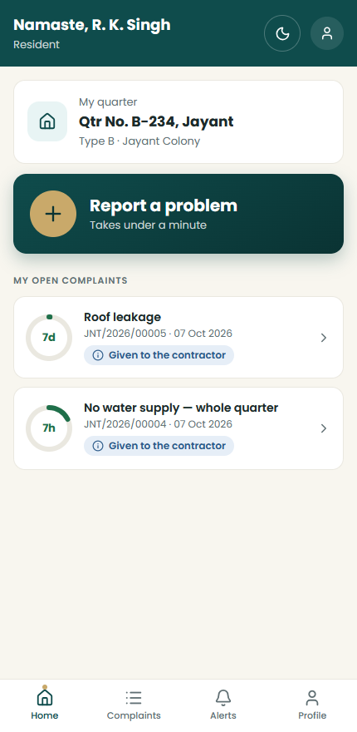
USE CASES
Use case — the resident
Report in under a minute — 3 steps: what needs fixing, describe and photograph, check and send. English or Hindi.
Emergency — No water, burst pipe, sewage overflow, structural crack — faster response and escalation.
See every step — Verified, assigned, in progress, inspected — with plain wording and notifications.
Object during work — Goes to the Overseer and Incharge, not the contractor; answer due in 24 hours.
Confirm, rate or reopen — "Not fixed" reopens the same complaint — before or within 24 h after closure.
Contest a rejection — Once; reviewed by the Overseer and Incharge, then the Staff Officer in writing.
Colony Maintenance Portal · NCL Civil Department
11

Slide 12
USE CASES
Use case — the contractor's supervisor
Only their own jobs — Grouped by stage: rework, to start, in progress, awaiting inspection.
JNT/2026/00042 · B-234
Leaking tap · In progress
Start work — Names the workmen — recorded permanently for that round.
Workmen
Ramesh, Suresh
Before photos
1 of 3
Record materials used — From the master list, quantities only, while the work is under way.
After photos
2 of 3
Before and after photographs — 1 to 3 of each, taken in the app; fresh ones every round.
Materials used
PVC pipe 20 mm · 2 Rm
Claim completion — The claim stops their clock. They cannot close, inspect or downgrade an emergency.
Mark complete
Kept out of the department's business — No objections, disputes, residents' data or anomaly flags; access ends with the contract.
Enabled only with at least one before and one after photograph
Colony Maintenance Portal · NCL Civil Department
Illustration of the job screen
12

Slide 13
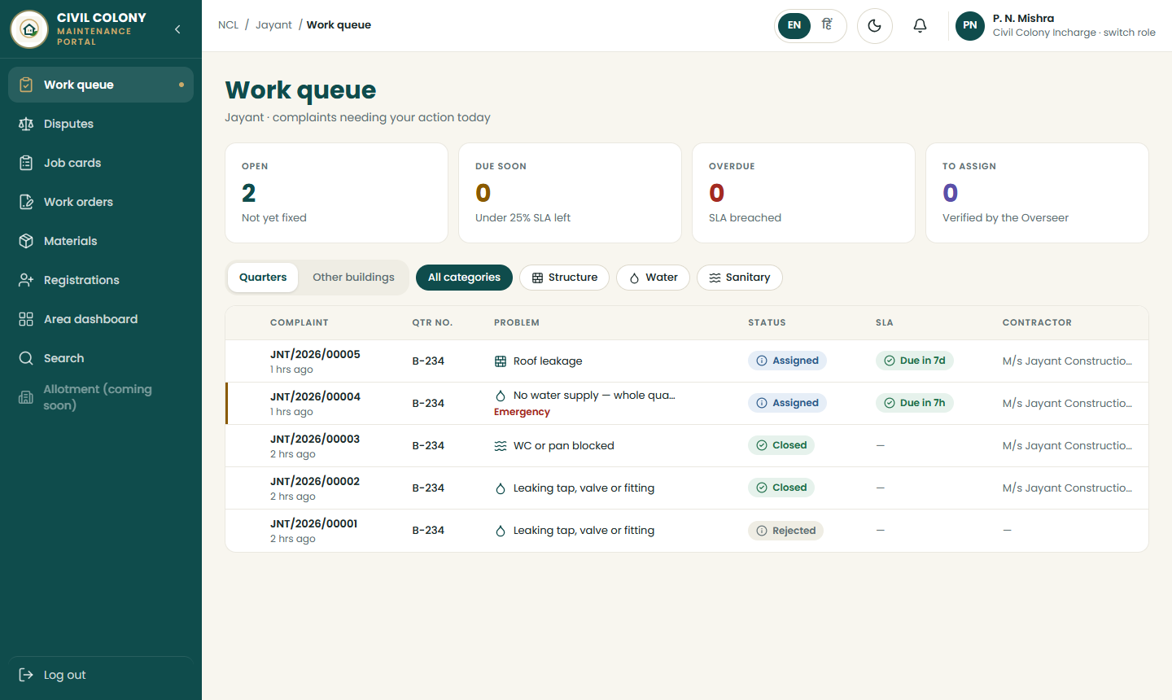
USE CASES
Use case — Overseer and Incharge: the work queue
Today's work at a glance
Open, due soon, overdue, to assign.
Verify and assign
Single or bulk (up to 200); firm shown under each supervisor.
Side panel
Every action for the complaint, job card, materials, disputes, history.
Pause and priority
Officers record occupant or force-majeure pauses and set inspection priority.
Colony Maintenance Portal · NCL Civil Department
13

Slide 14
USE CASES
Inspection: the gate that makes the record real
From the app only — Acceptance is refused from a web password session.
Every acceptance passes all five gates — enforced by the database
Signed in on the registered phone
✓
Overseer's own photograph — Taken after the claim being inspected, with location and time embedded.
Photograph taken in the app, with location
✓
Two keys by person — The inspector may never be the person the work was assigned to — whatever roles they hold.
Photograph is the inspector's own
✓
Taken after this completion claim
✓
Queue set by the department — Emergencies, priority, premises type, verification date — never the contractor's claim time.
Inspector is not the assigned person
✓
Rework counted — A send-back reopens the contractor's clock and is counted against them.
Inspected & accepted — then the resident is asked to confirm
Colony Maintenance Portal · NCL Civil Department
14

Slide 15
USE CASES
Disputes end with a written decision
Rejected
Resident contests (once)
Overseer / Incharge review
Staff Officer decides in writing
Reinstated at any stage → back to verification. Upheld by the officers → goes automatically to the Staff Officer.
Closed / accepted
Resident: "not fixed"
Reopened (same ticket)
3rd reopening → Staff Officer
Until the Staff Officer decides — redo the work, close, or refer for special repair — nobody can reassign it.
Final in the portal. The decision is shown to the resident, Overseer and Incharge — never to the contractor. The resident is told: "Further disputes are not taken in the portal; you may write to the Area Civil Office." Patch-fixing becomes visible: the Area dashboard lists the quarter under repeat complaints.
Colony Maintenance Portal · NCL Civil Department
15

Slide 16
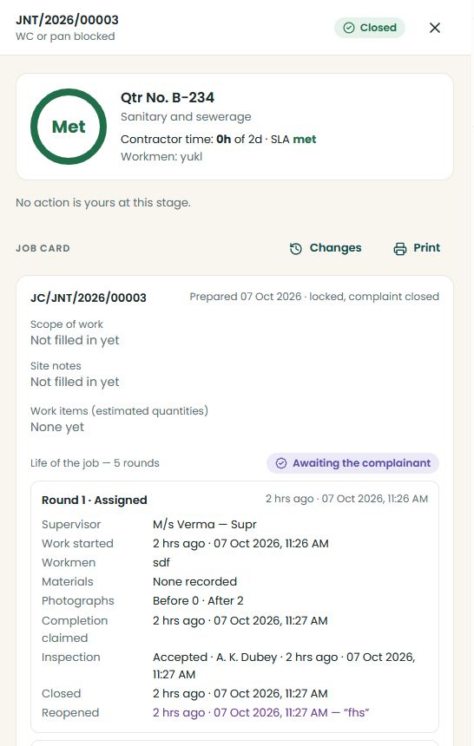
USE CASES
Job card and materials — quantities, never money
The job card in the complaint panel: every round of the job, from the first assignment.
Job card — the whole life of the job
Prepared by the database at first assignment (JC/JNT/2026/00042). Scope, site notes, work items with estimated quantities. Every round recorded from the first: supervisor, workmen, materials, photographs, inspection, the resident's answers. Prints on one A4 page with signature blocks.
Materials — a record, never a bill
Supervisor claims what was used; Overseer or Incharge verifies (never the claimant). Lines are withdrawn, never edited. Reports: consumption by contract and period (CSV) and anomaly flags — over-claim, above norm, repeat at the same premises within 90 days, unverified.
Colony Maintenance Portal · NCL Civil Department
16

Slide 17
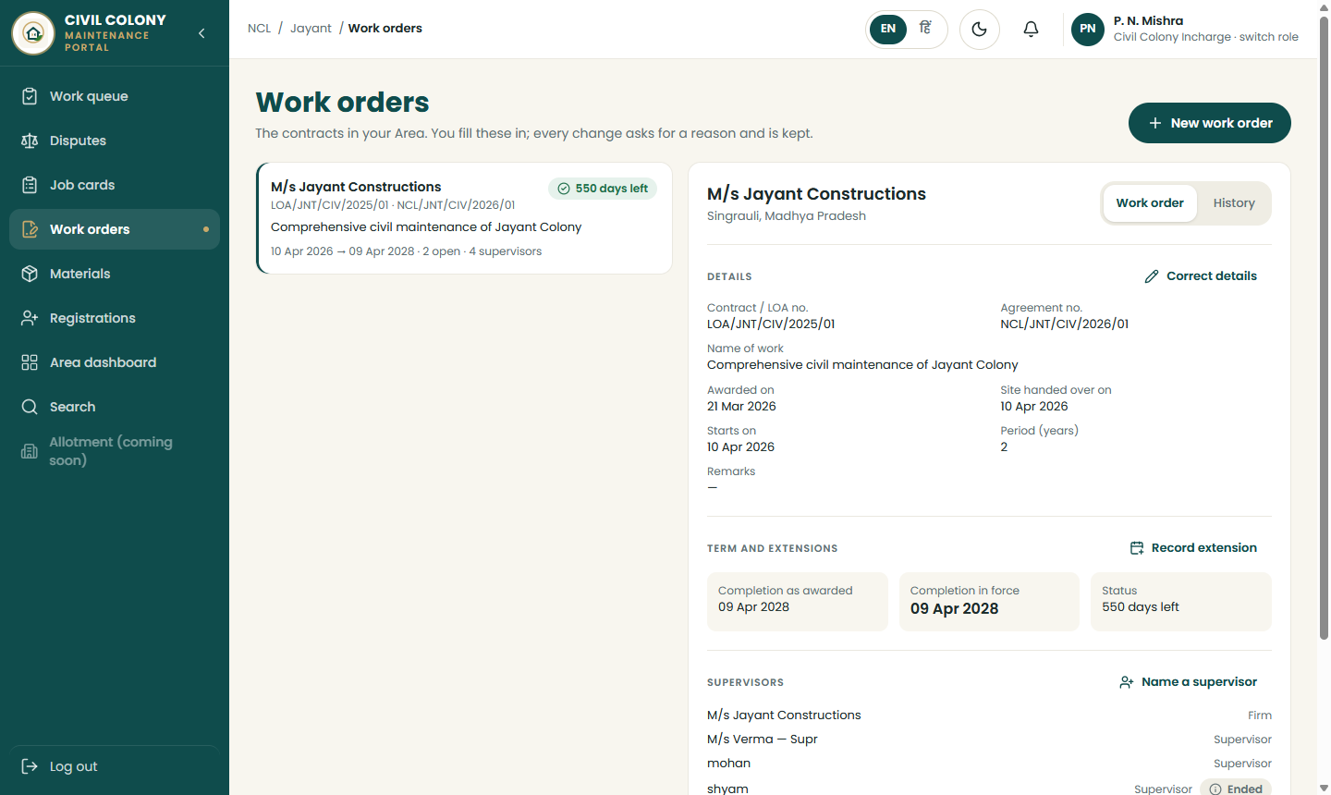
USE CASES
Work orders kept with a reason for every change
Several contracts per Area
Kept by the Incharge and Staff Officer.
Reasons compulsory
Old and new value logged by the database.
Extensions numbered
Order no., date, reason; date as awarded kept for ever.
Handover
Open complaints move with a clean cut-off; outgoing record frozen.
Colony Maintenance Portal · NCL Civil Department
17

Slide 18
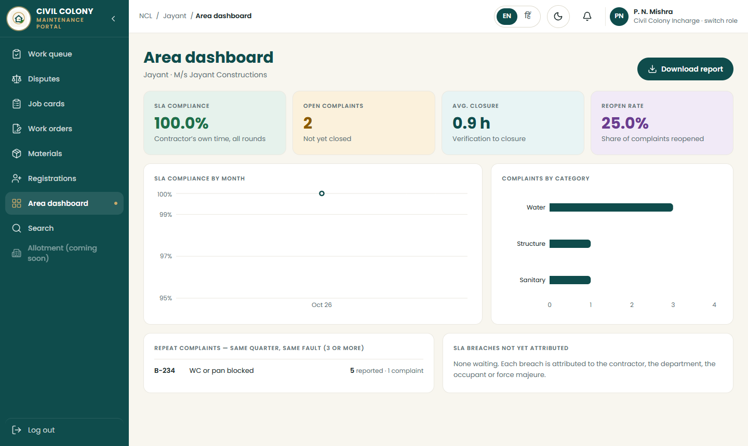
USE CASES
Area dashboard — live work at a glance
Configurable cards
Which figures, in what order, when amber or red.
Delay attribution
Contractor, department, occupant, force majeure.
Repeat complaints
Same quarter, same fault, 3+ reports — patch-fixing exposed.
Backlog warning
Inspection backlog flagged to the Incharge at 48 h.
Colony Maintenance Portal · NCL Civil Department
18

Slide 19
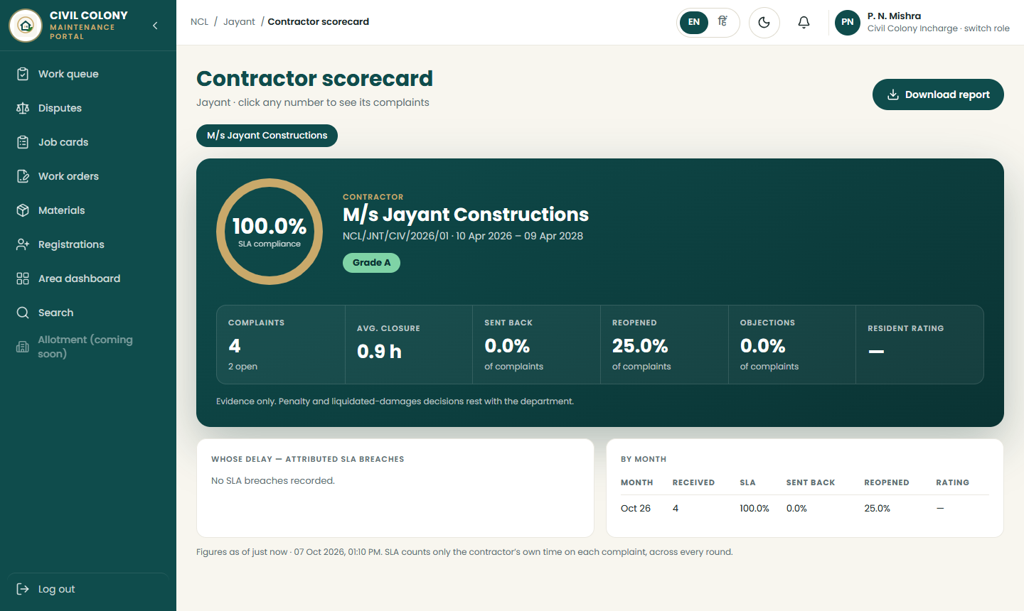
USE CASES
Contractor scorecard — evidence for the contract
SLA compliance
On the contractor's own clock.
Rework, objection, reopen rates
Counted by complaints, not events — defined so it cannot be read two ways.
CSV export
For the contract file.
No money
Penalty decisions rest with the department.
Colony Maintenance Portal · NCL Civil Department
19

Slide 20
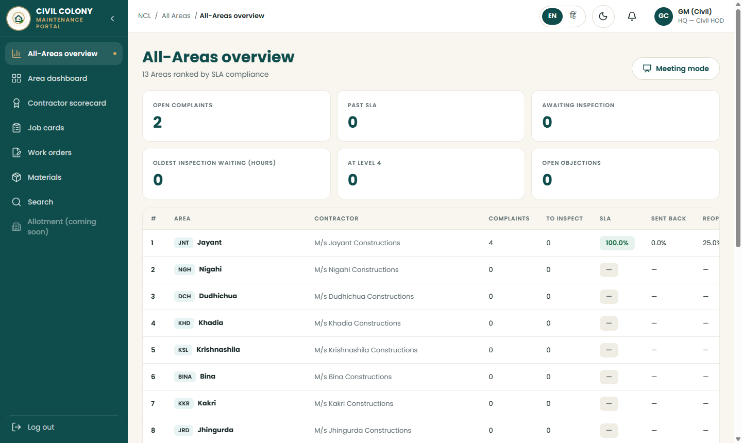
USE CASES
HQ overview — all thirteen Areas, read-only
For GM Civil, Directors, CMD
Every Area side by side.
Ranked by SLA compliance
Where to look first.
Meeting mode
Large type, rotates every 12 s for review meetings.
Escalation reaches the GM
Level 4 for emergencies and normal complaints.
Colony Maintenance Portal · NCL Civil Department
20

Slide 21
BENEFITS
From problem to answer
Today
With the portal
No evidence of performance
Time-stamped history of every act, by person and role, that cannot be altered
Delay cannot be attributed
Contractor's own clock across rounds; department's delay measured separately
Closure on the contractor's word
Two-key closure with on-site, geo-tagged inspection from the app
Repeat faults hidden
Reopenings counted; third reopening decided in writing by the Staff Officer
No visibility upward
Live Area dashboards, scorecards, HQ overview and four-level escalation
Records can be altered
Reasons compulsory; database-written audit; nothing deleted
Colony Maintenance Portal · NCL Civil Department
21

Slide 22
BENEFITS
What NCL gains
⚖
Stronger contract management
★
Better service to employees
◎
Accountability at every level
A performance record that holds up in a dispute — every claim, inspection and delay evidenced.
Residents report from their phone, see every step, and cannot be closed out while unsatisfied.
Escalation Overseer → Incharge → Staff Officer → GM, automatically and on time.
▣
Control of materials
⌂
One system, thirteen Areas
⇄
Reusable foundation
Quantities claimed against verified; anomalies flagged for the department.
Common rules, Area isolation, and the same figures for every Area at HQ.
The identity service (people, phones, premises) is built for the future E&M portal.
Colony Maintenance Portal · NCL Civil Department
22

Slide 23
LOAD SIMULATION
Measured: can three Overseers per Area keep up?
Planning rate 0.5
7.4 inspections per Overseer per day — 37 % of four field hours. Comfortable.
Above about 1.25
Not a software question: a fourth Overseer in heavier Areas, a longer inspection SLA, or a lighter rule for the lowest-risk faults. Watch the inspection backlog in the first two months.
Colony Maintenance Portal · NCL Civil Department
23

Slide 24
STATUS
Built and tested
115
826
4
API endpoints, all specified
automated tests passing
permission matrices, zero mismatches
< 25 ms
~214 GB
20,000
every everyday query at 90,000 complaints
photograph store, steady under 2-year retention
devices in the load simulation
Colony Maintenance Portal · NCL Civil Department
24

Slide 25
ROADMAP
Where it stands and what comes next
Done
Next
Then
Largest piece
Rollout
1
2
3
4
5
Web portal and server; users and roles; work orders; job card; materials; disputes and written decisions
MB-ready extract with Staff Officer check-measurement (quantities only); HQ executive dashboard; break-glass procedure; web passkeys
Deliberate attempt to break the system from every side; production hardening — deployment, backup and tested restore, monitoring
Android and iOS apps: camera capture with location at exposure; keys that never leave the handset
Premises register built through registration, Area by Area; training for Area offices
Colony Maintenance Portal · NCL Civil Department
25

Slide 26
ASKS
Decisions needed from management
1
Write portal use into the next maintenance tender
Contractor use must be a contractual obligation. Area contracts run on one- and two-year cycles: a tender floated without the clause locks that Area out for up to two years. Draft the clause and send it to all thirteen Area offices now.
2
SLA for non-residential premises
Should a dispensary or school have shorter times than a quarter for the same fault? The system supports it; today all premises share one set of figures.
3
Sign-off of the design decisions
By the Civil Maintenance Incharge, Staff Officer (Civil) and GM (Civil).
4
Resident adoption
Notice boards, visible escalation and reliable response decide whether residents use it.
Colony Maintenance Portal · NCL Civil Department
26

Slide 27
Thank you
Colony Maintenance Portal — evidence for the contract, service for the resident.
Northern Coalfields Limited · Civil Department

