Slide 1
DATA ENGINEERING PIPELINE
-CHANDAN MAKA

Slide 2
Pipeline Type
Batch data pipeline (reason is I don’t need any real time data and continuously I am just retrieving the data that is stored in raw schema in the relational DB)

Slide 3
Final Storage Format
CSV file and another schema/table
I have chosen csv file because its one of the most common data format and is portable and easy to use
I have also chosen another schema/ table because my input is from the relational DB and it can be wise decision to store the cleaned one in relational DB as well and querying the DB is efficient

Slide 4
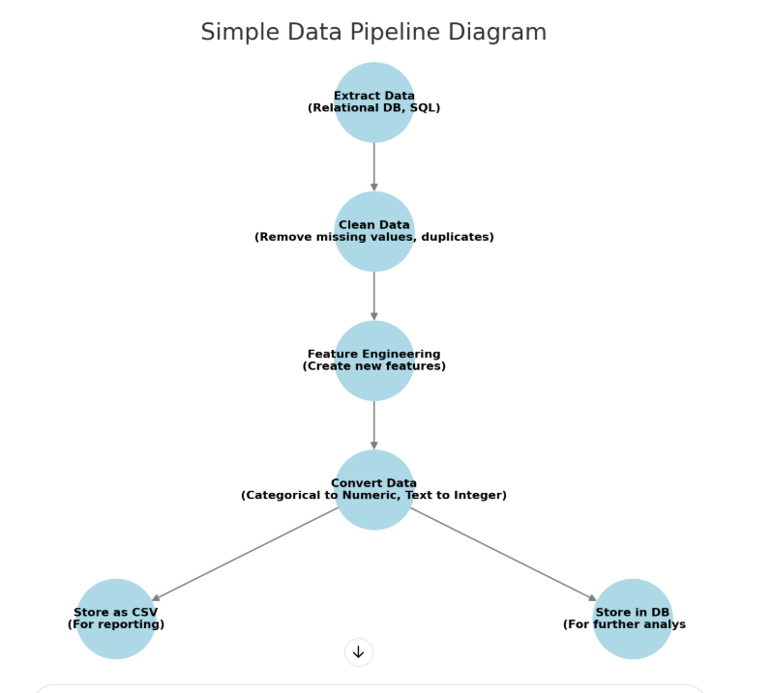
Data Pipeline Diagram

Slide 5
Data Quality Issues
Columns with Missing Values
normalized-losses
num-of-doors
bore
stroke
horsepower
peak-rpm
price
Solution is either we can impute the value with various method(eg mean) or if significantly low we can drop the record

Slide 6
Data Quality Issues
Data Type Mismatch (Columns with string value but the type should be integer)
normalized-losses
bore
stroke
horsepower
peak-rpm
Price
Solution convert the data type into correct one

Slide 7
Data Quality Issues
Label Encoding (conversion of string “two” to 2)
Following columns are converted to numeric, by interpreting the string values:
num-of-doors
num-of-cylinders
Solution is text to numeric conversion

Slide 8
Feature Engineering
engine_size_cc,power2weight_ratio were the two columns derived after feature engineering

Slide 9
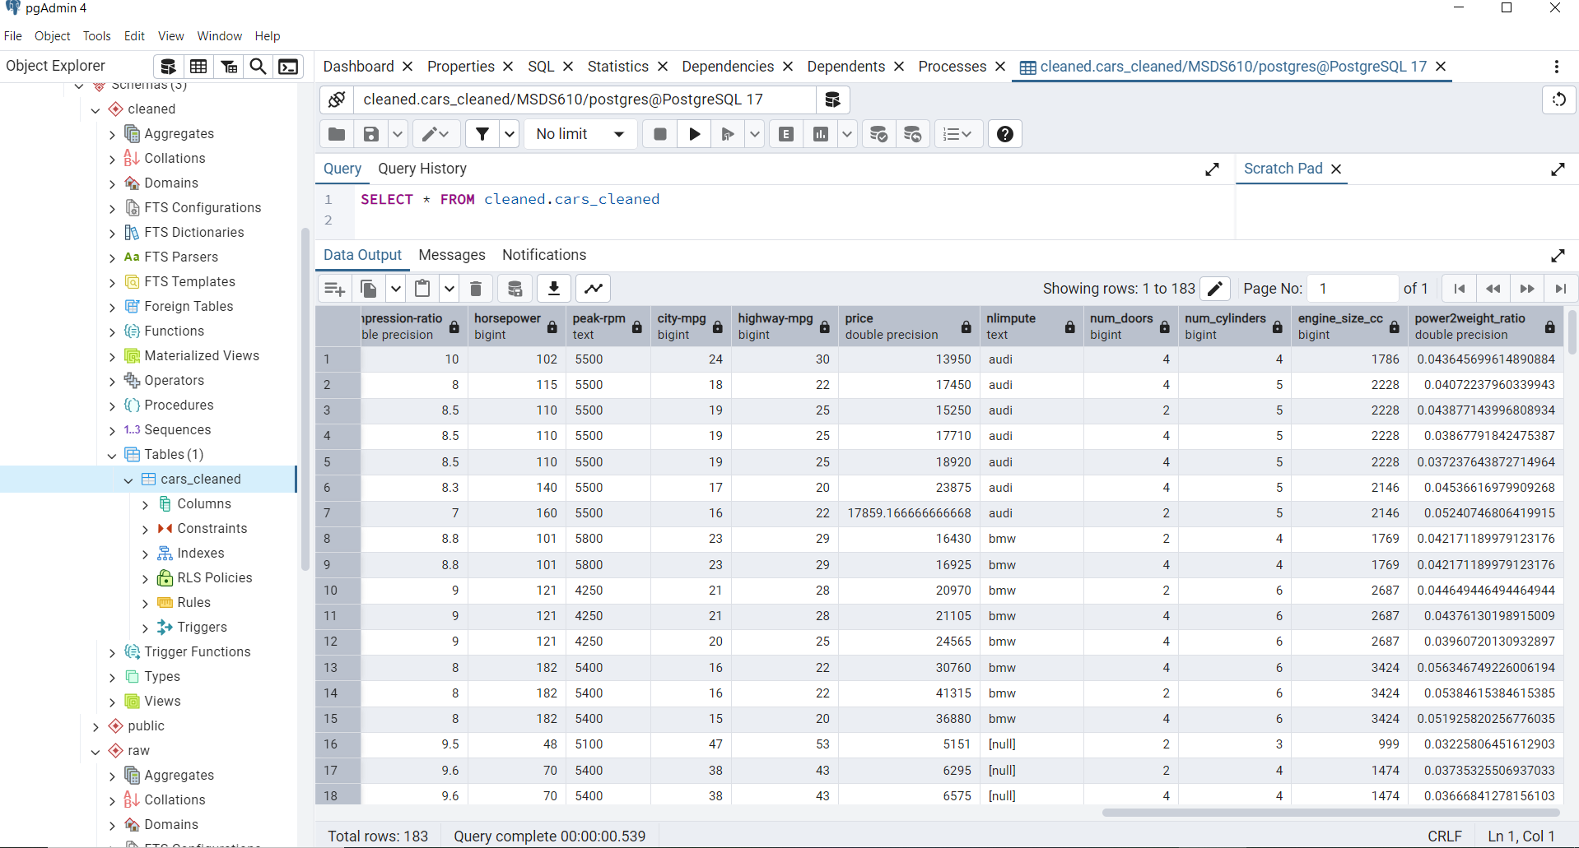
Screenshot of Cleaned Data

Slide 10
Star Schema Approach
Fact Table:
Fact_Car
Symboling
normalized-losses
curb-weight
engine-size
Horsepower
peak-rpm
city-mpg
highway-mpg
Price
engine_size_cc
power2weight_ratio

Slide 11
Star Schema Approach
Dimension Tables:
Dim_Car_Make (make)
Dim_Fuel (fuel-type, fuel-system)
Dim_Engine (engine-type, num-of-cylinders, bore, stroke, compression-ratio)
Dim_Body (body-style, num-of-doors, num_doors)
Dim_Drive (drive-wheels, engine-location, wheel-base, length, width, height)

