Slide 1
DATA ENGINEERING PIPELINE
-CHANDAN MAKA

Slide 2
Pipeline Type
Batch data pipeline (reason is I don’t need any real time data and continuously I am just retrieving the data that is stored in raw schema in the relational DB)
Notes:
The type of pipeline I have implemented is a batch data pipeline.
The reason for choosing a batch pipeline over a real-time one is that my data does not need to be processed continuously.
Instead, I am simply retrieving and transforming stored data from a relational database in a structured way.
This method is efficient for periodic processing and ensures that the data quality is maintained before storage.

Slide 3
Final Storage Format
CSV file and another schema/table
I have chosen csv file because its one of the most common data format and is portable and easy to use
I have also chosen another schema/ table because my input is from the relational DB and it can be wise decision to store the cleaned one in relational DB as well and querying the DB is efficient
Notes:
For storing the final output, I have used two formats:
CSV file – This is a widely used format because it is portable, easy to read, and simple to use.
Relational Database Table – Since my input data is from a relational database, it is efficient and logical to store the cleaned data in another table in the database.
Using a relational database allows for faster querying and structured data retrieval, while the CSV format makes it easy to share and analyze the data using various tools.

Slide 4
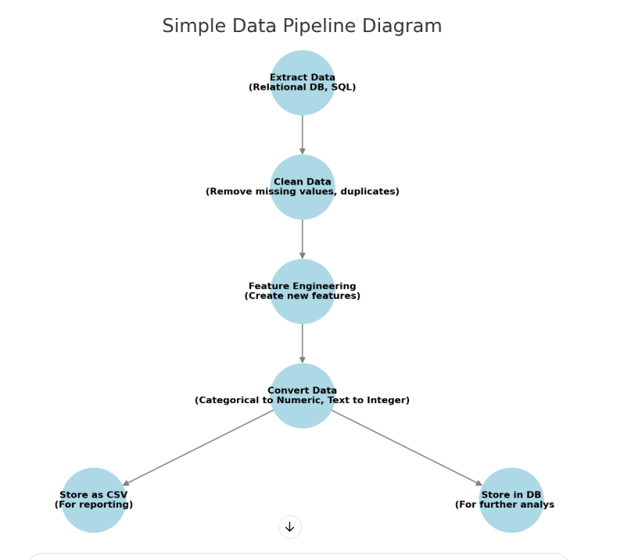
Data Pipeline Diagram
Notes:
This diagram visually represents the flow of data through my pipeline.
The raw data is first extracted from a relational database.
Next, data transformation is performed, where issues such as missing values and data type mismatches are handled.
After transformation, the cleaned data is stored in both a CSV file and a relational database.
Finally, the processed data is used for further analysis and reporting.

Slide 5
Data Quality Issues
Columns with Missing Values
normalized-losses
num-of-doors
bore
stroke
horsepower
peak-rpm
price
Solution is either we can impute the value with various method(eg mean) or if significantly low we can drop the record
Notes:
One of the key data quality challenges in this pipeline was dealing with missing values.
Several columns contained missing values, including:
normalized-losses, num-of-doors, bore, stroke, horsepower, peak-rpm, and price.
To handle missing values, I have used two common approaches:
Imputation – Filling missing values using statistical methods like the mean(normalized-losses,price).
Dropping records – If the number of missing values is small, we can remove those records to maintain data integrity(num-of-doors,bore,stroke,,horsepower,peak-rpm).
The choice depends on how significant the missing data is for analysis.

Slide 6
Data Quality Issues
Data Type Mismatch (Columns with string value but the type should be integer)
normalized-losses
bore
stroke
horsepower
peak-rpm
Price
Solution convert the data type into correct one
Notes:
Another issue in the dataset was data type mismatches.
Some columns contained string values when they should have been integers, including:
normalized-losses, bore, stroke, horsepower, peak-rpm, and price.
The solution to this problem is data type conversion:
By converting these columns into the correct numeric format, we ensure that they can be used in calculations and modeling without errors.

Slide 7
Data Quality Issues
Label Encoding (conversion of string “two” to 2)
Following columns are converted to numeric, by interpreting the string values:
num-of-doors
num-of-cylinders
Solution is text to numeric conversion
Notes:
Another challenge in the dataset was categorical variables stored as text.
For example, the column num-of-doors contained values like “two” instead of 2.
Similarly, num-of-cylinders had values such as "four", "six", etc.
The solution is label encoding, which converts text-based categories into numeric values.
This is essential because most machine learning algorithms require numerical inputs.

Slide 8
Feature Engineering
engine_size_cc,power2weight_ratio were the two columns derived after feature engineering
Notes:
To enhance the dataset, I performed feature engineering.
Two new features were created:
engine_size_cc – A refined version of the engine size feature. I converted the Engine size from cubic inches to cubic centimeters (cc) for easier understanding. To convert cubic inch to cubic centimeter, divide cubic inch value by 0.061024
power-to-weight ratio – This helps in analyzing a vehicle’s efficiency by relating power to its weight. Power to weight ratio shows the performance of a car
These new features help improve the quality and predictive power of our dataset.

Slide 9
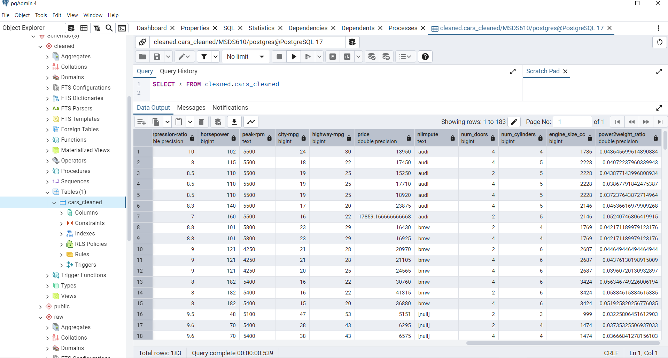
Screenshot of Cleaned Data

Slide 10
Star Schema Approach
Fact Table:
Fact_Car
Symboling
normalized-losses
curb-weight
engine-size
Horsepower
peak-rpm
city-mpg
highway-mpg
Price
engine_size_cc
power2weight_ratio
Notes:
For data organization, I followed the Star Schema approach.
The Fact Table(Fact_car) is at the center, containing the main measurable values related to cars, such as:
Symboling, normalized-losses, curb-weight, engine-size, horsepower, peak-rpm, city-mpg, highway-mpg, price, engine_size_cc, and power2weight_ratio.
Fact tables store numerical values that can be used for aggregation and analysis.

Slide 11
Star Schema Approach
Dimension Tables:
Dim_Car_Make (make)
Dim_Fuel (fuel-type, fuel-system)
Dim_Engine (engine-type, num-of-cylinders, bore, stroke, compression-ratio)
Dim_Body (body-style, num-of-doors, num_doors)
Dim_Drive (drive-wheels, engine-location, wheel-base, length, width, height)
Notes:
Surrounding the fact table are the dimension tables, which provide descriptive information.
The key dimension tables in this schema are:
Dim_Car_Make – Stores car brands/makes.
Dim_Fuel – Contains details about fuel type and fuel system.
Dim_Engine – Includes attributes like engine type, number of cylinders, bore, stroke, and compression ratio.
Dim_Body – Describes the body style and number of doors.
Dim_Drive – Holds information on drive wheels, engine location, wheelbase, and overall car dimensions.
This structure helps in organizing the data efficiently for better querying and performance.

