Slide 1
Lending club case study
Finance Company
Chandan P

Slide 2
Problem Statement
To use real time data with loan application of various customer who has taken loan with the finance company, the Goal is to analyse this loan detail set and understand which customer are more likely to DEFAULT in the future and give the insight how and what aspect effect leads to the Finance loss by default customer.
The Data set contain detail of customer with three categories releated to loan.
Fully paid: Applicant has fully paid the loan (the principal and the interest rate)
Current: Applicant is in the process of paying the instalments, i.e. the tenure of the loan is not yet completed. These candidates are not labelled as 'defaulted'.
Charged-off: Applicant has not paid the instalments in due time for a long period of time, i.e. he/she has defaulted on the loan

Slide 3
Data Cleaning
(39717, 111)
Fixing row
Fixing columns
Standardizing values
Remove of invalid values
Filter data
We had 39717 rows and 111 columns before Data cleaning
After the cleaning we have 36440 rows and 27 columns

Slide 4
Univariate/bivariate Analysis

Slide 5
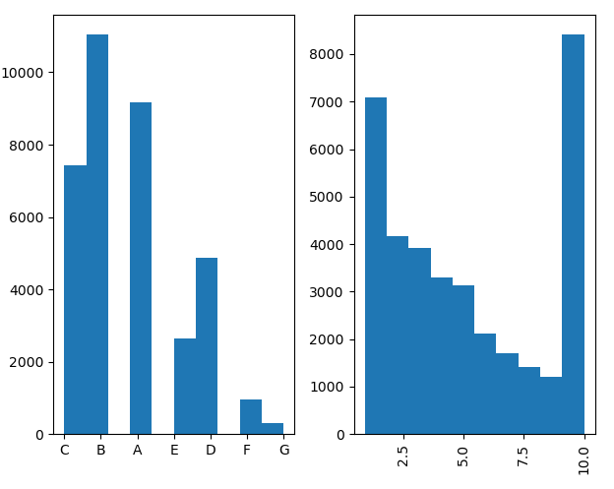
Analysis

Slide 6
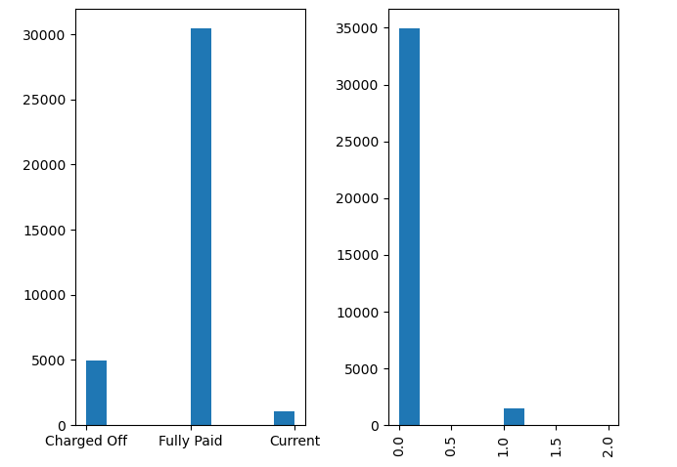
Analysis

Slide 7
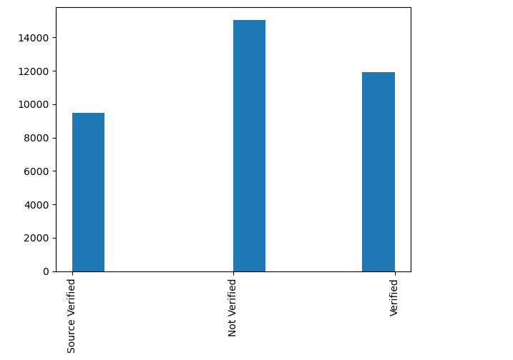
Analysis

Slide 8
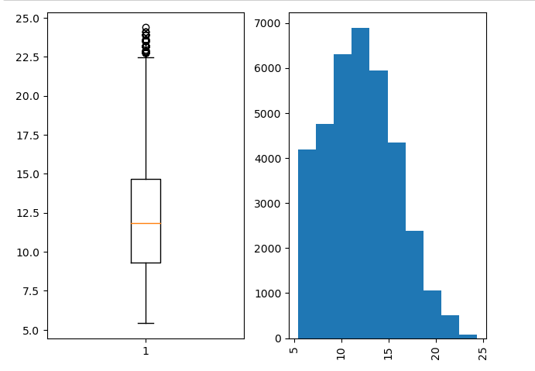
Analysis

Slide 9
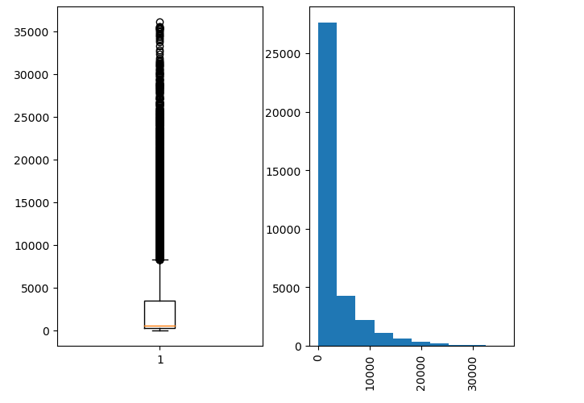
Analysis

Slide 10
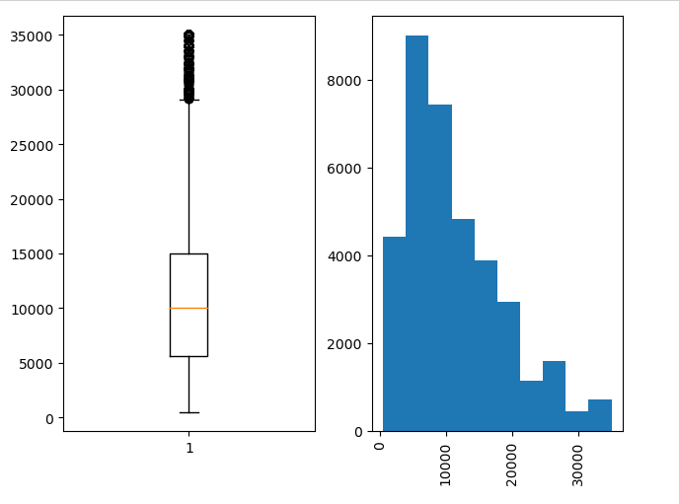
Analysis

Slide 11
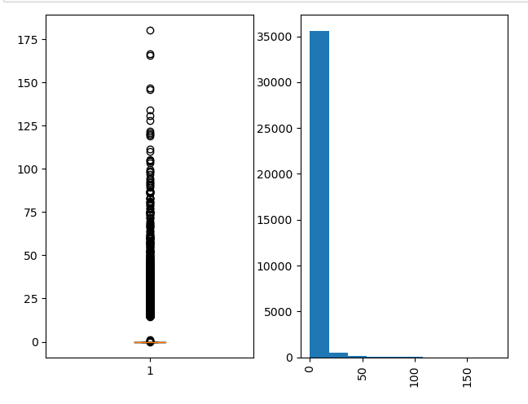
Analysis

Slide 12
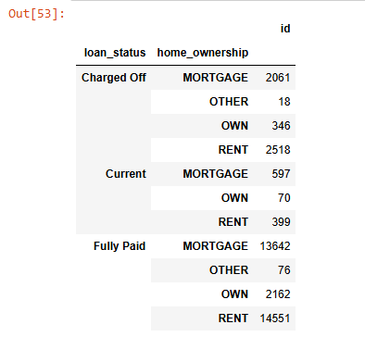
Analysis

Slide 13
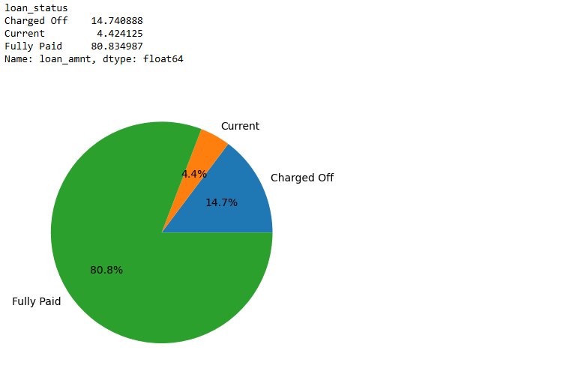
Analysis

Slide 14
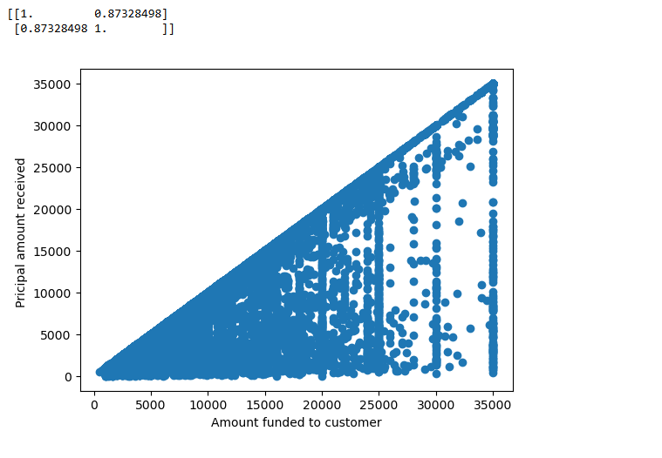
Analysis

Slide 15
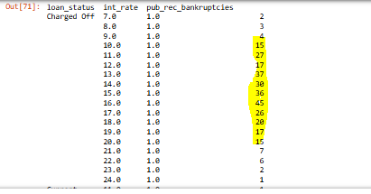
Analysis

Slide 16
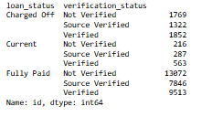
Analysis

Slide 17
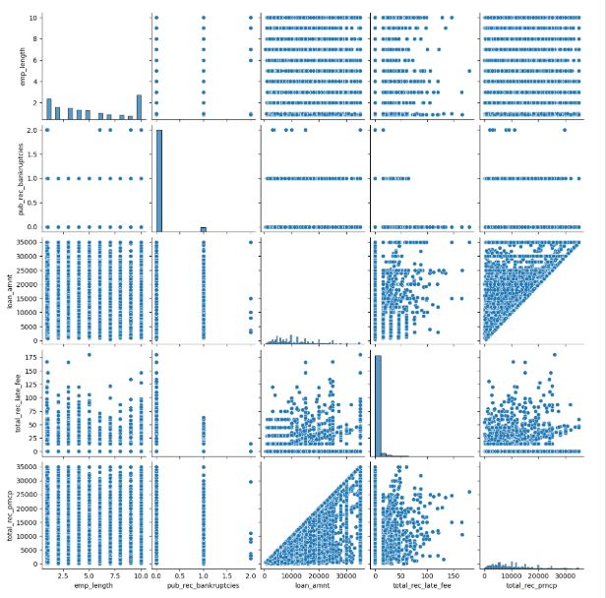
Analysis

Slide 18
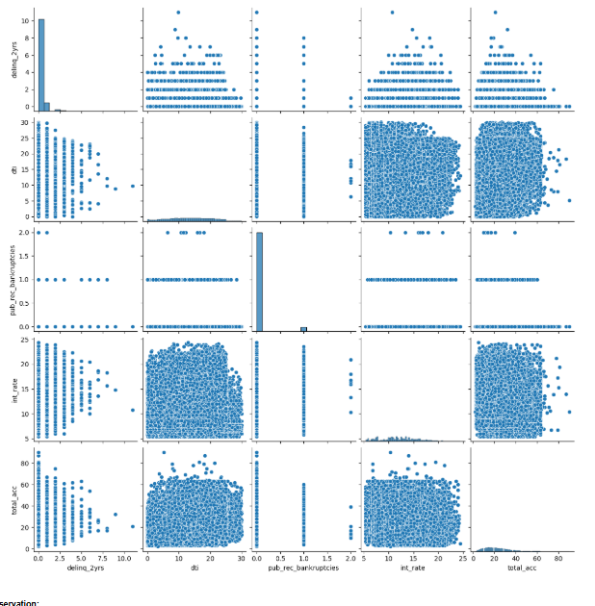
Analysis

Slide 19
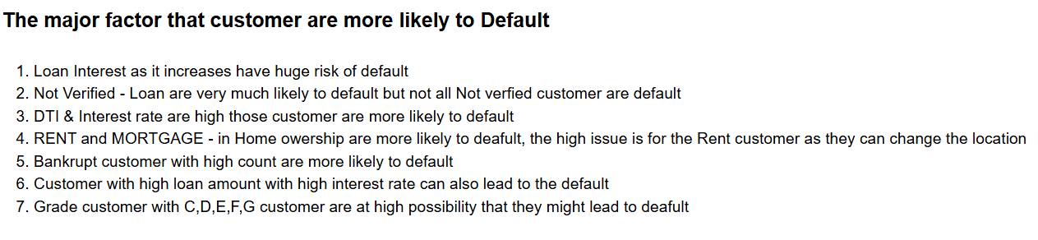
Conclusion

